Slide 1
Cash实验汇报
——汇报人：张中俊

Slide 2
实验策略
to evaluate the performance of our scheme, we implement Cash’s OXT scheme
The data set which we use in our experiment is derived from Wikipedia, each web page is treated as a separate document
use redis to storage keyword-filename pairs
use MySql to storage TSets
use Bloom filter to storage XSets（参考了Cash的做法）
Intel Xeon CPU E5-1603 2.8GHz x4
16GB RAM
Ubuntu 14.04 LTS

Slide 3
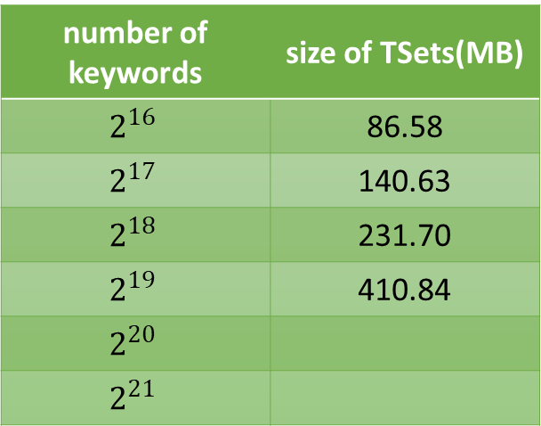
索引大小
we use Bloom filter to store XSet. Since the size of a Bloom Filter is determined by the max number of elements which will be insert to it, we only evaluate the size of TSet.
the size of Bloom Filter with 10,000,000 elements is 11.758 MB
number of keywords | size of TSets(MB)
$$2^{16}$$ | 86.58
$$2^{17}$$ | 140.63
$$2^{18}$$ | 231.70
$$2^{19}$$ | 410.84
$$2^{20}$$
$$2^{21}$$

Slide 4
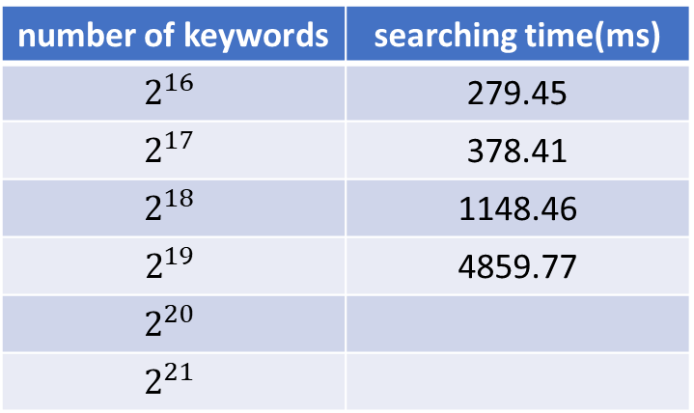
TSet实例化
randomly choose 3 keywords send to server to retrieve in encrypted database.
Note that the time below do not contain token generation time
number of keywords | searching time(ms)
$$2^{16}$$ | 279.45
$$2^{17}$$ | 378.41
$$2^{18}$$ | 1148.46
$$2^{19}$$ | 4859.77
$$2^{20}$$
$$2^{21}$$
备注：因为实验的工作站正在建立索引，所以这里的数据是我用我的笔记本仿真的，但是趋势应该是一致的

Slide 5
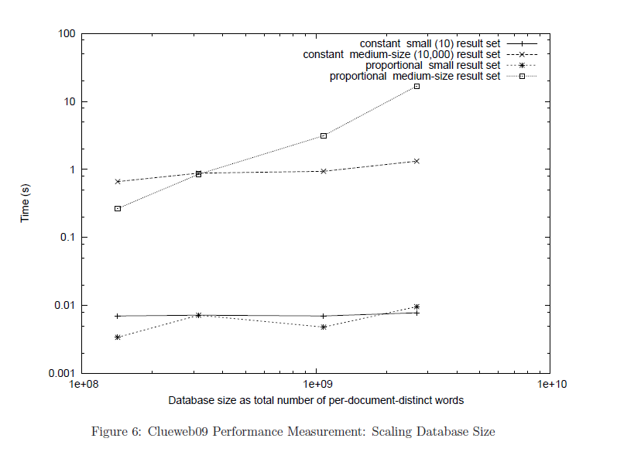
思考
搜索时间其实和w1包含的文件个数有关，选取查询的关键词时候是不是应该注意
Cash的实验中是通过控制结果集中文件名的个数来区分的，见下图：

