Slide 1
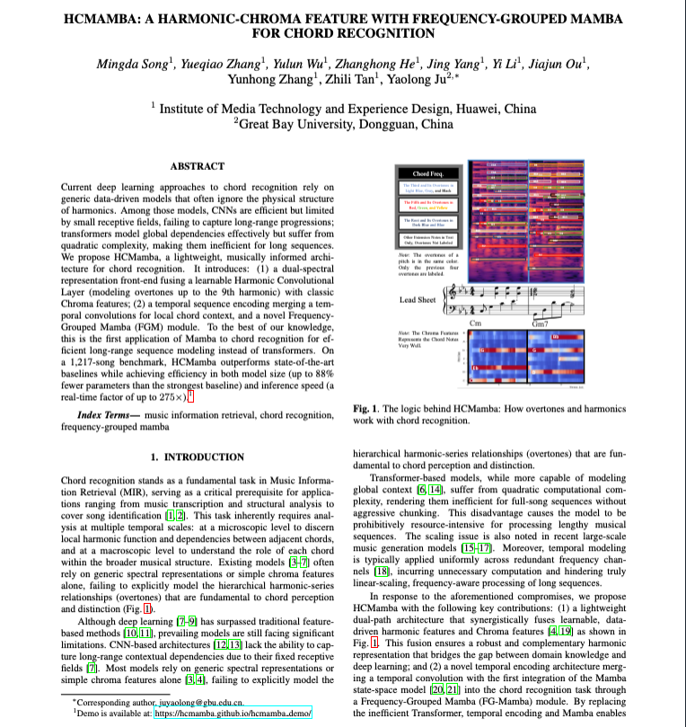
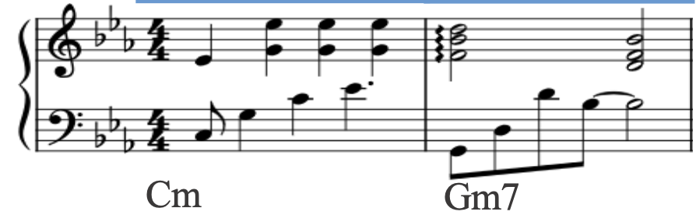
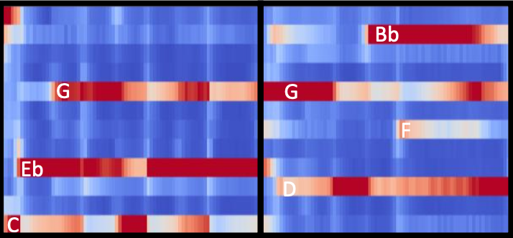

Slide 2
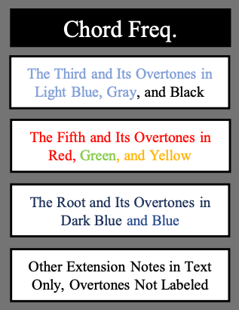
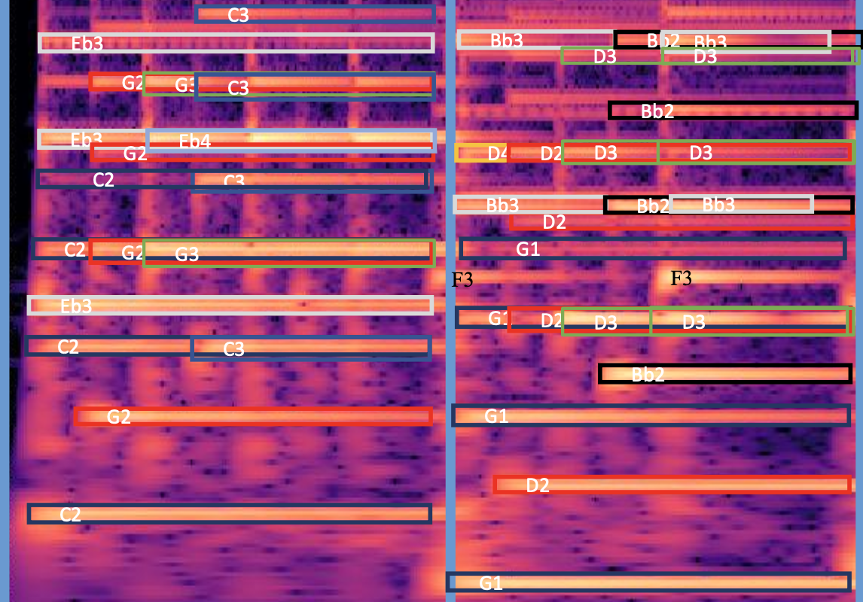
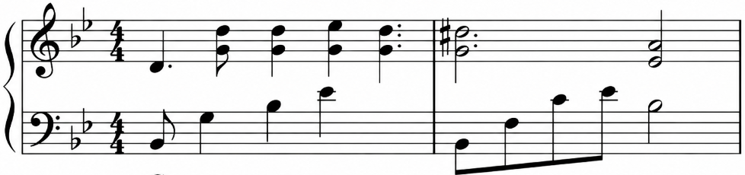
Note: Overtones of a pitch is in same color. Only previous four overtones are labelled.
Lead Sheet
Cm
Gm7
Chormagram
Note: Chroma Features Represents The Chord Notes Very Well.

Slide 3
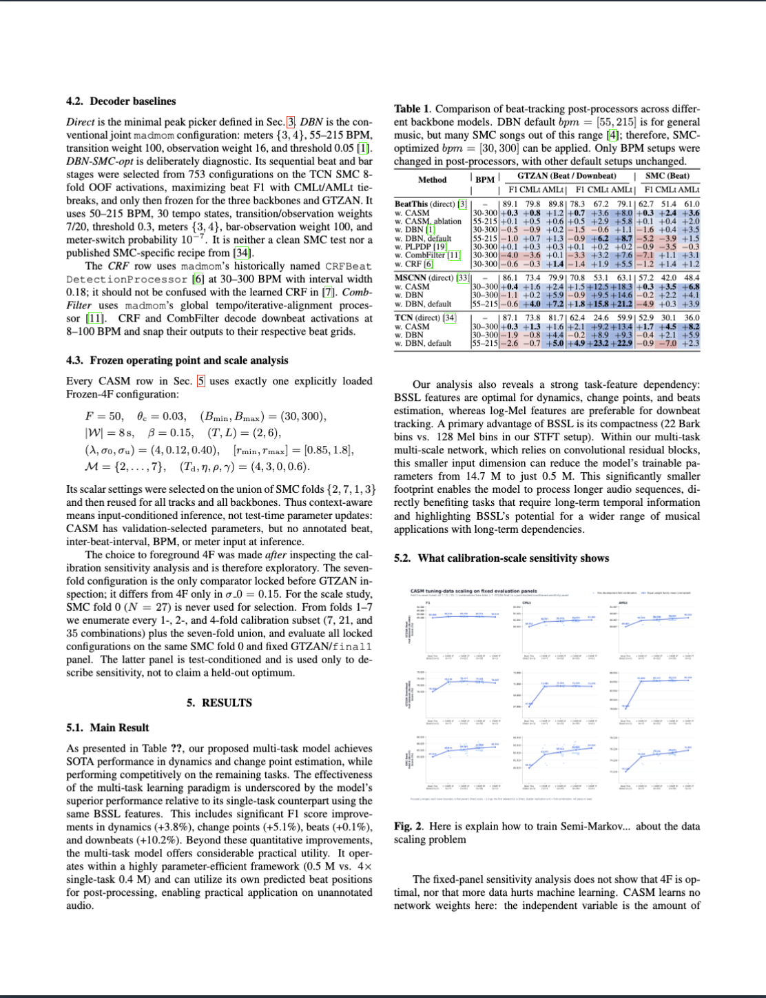
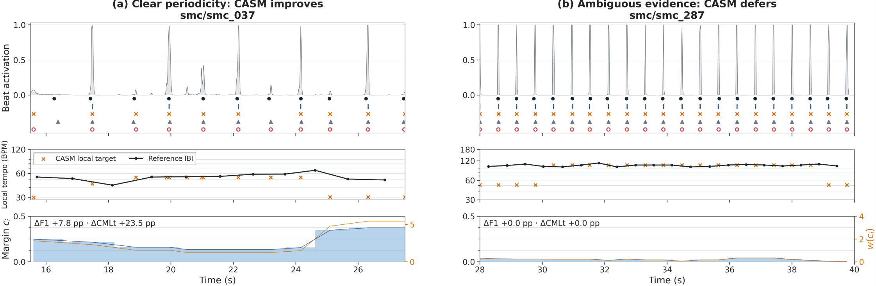
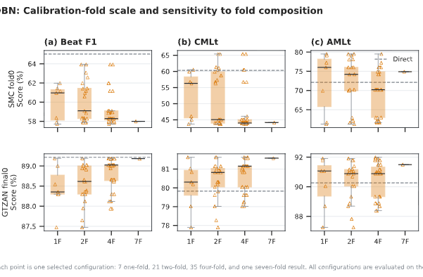
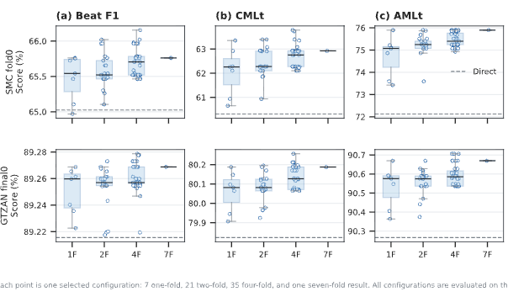

Slide 4
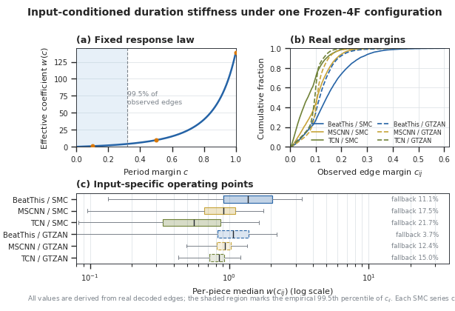
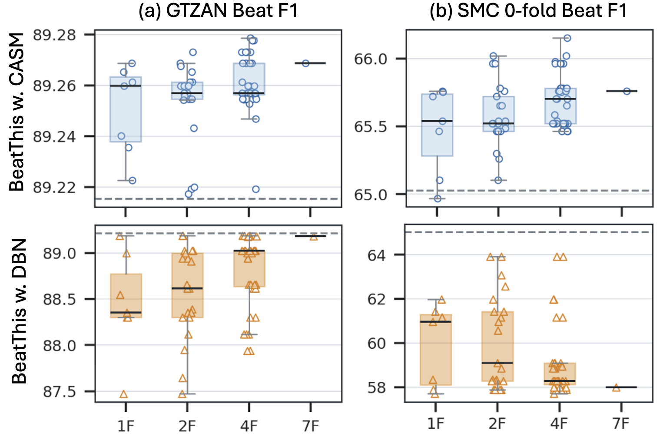

Slide 5
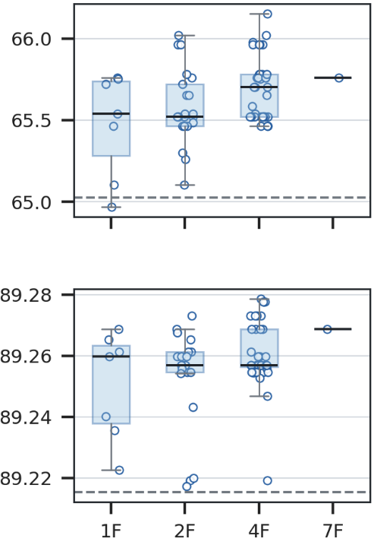
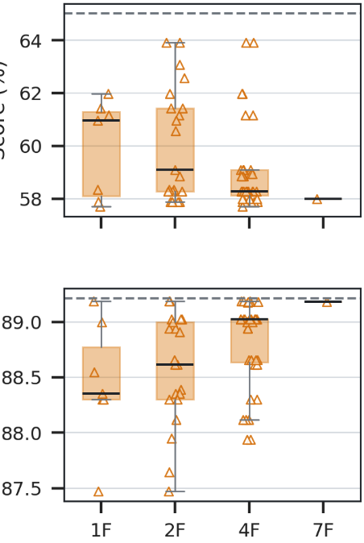
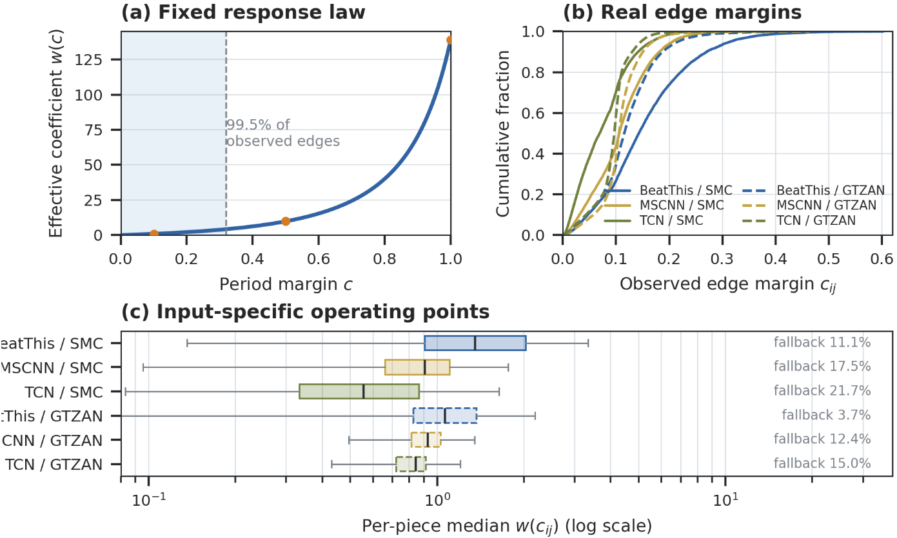
(a) GTZAN Beat F1
(b) SMC 0-fold Beat F1
BeatThis w. CASM
BeatThis (direct)
BeatThis w. DBN
BeatThis/S
MSCNN/S
TCN/S
BeatThis/G
MSCNN/G
TCN/G

Slide 6
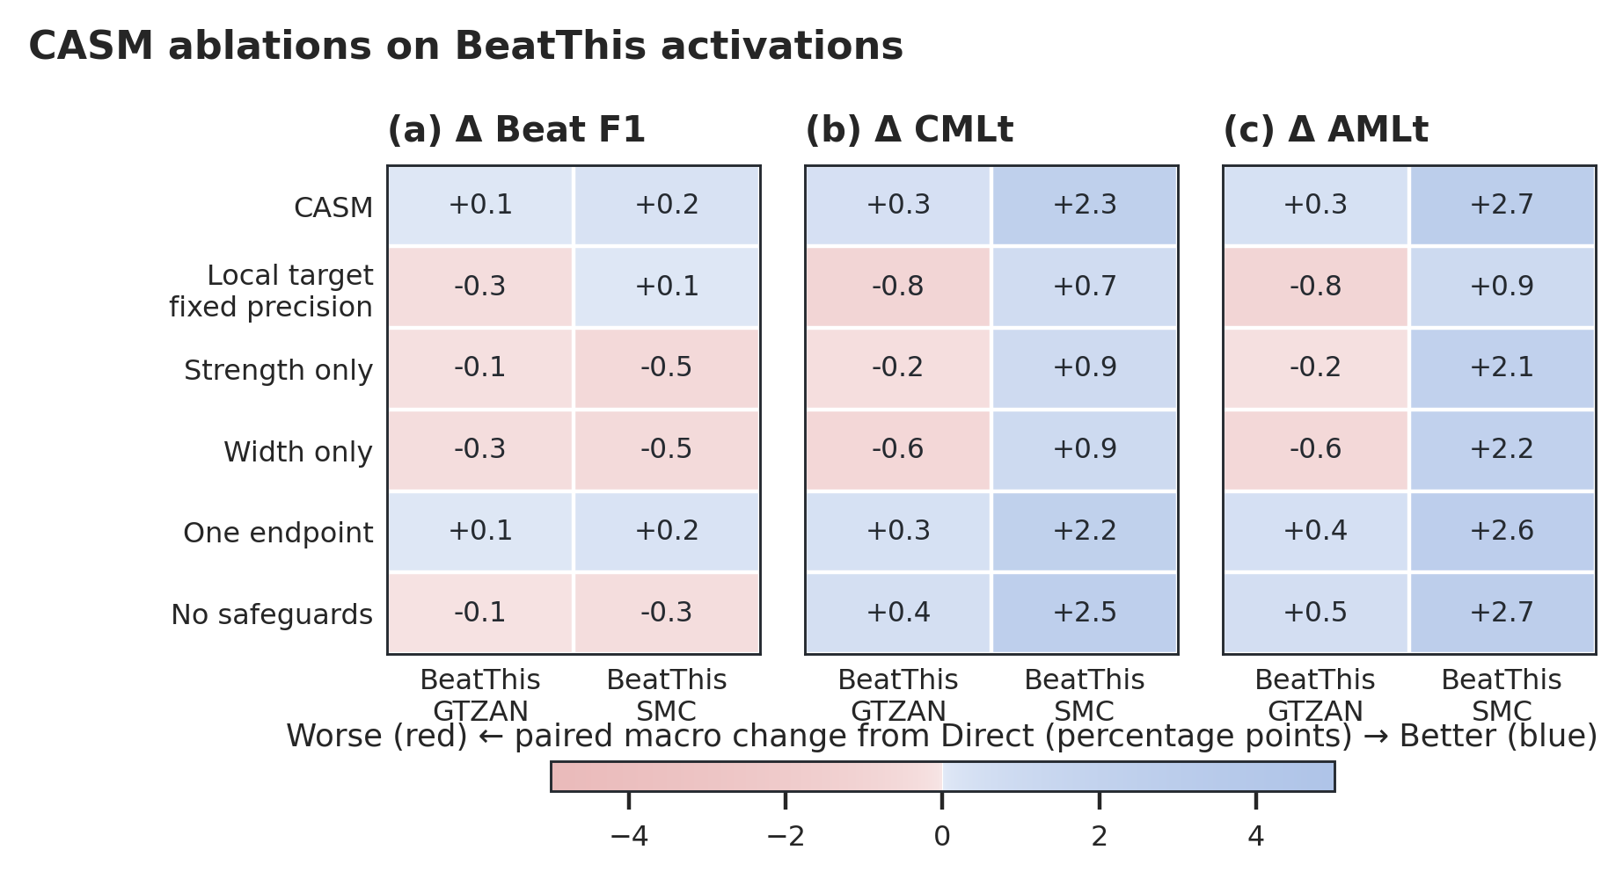
(a) GTZAN Beat F1
(b) SMC 0-fold Beat F1
BeatThis w. CASM
BeatThis (direct)
BeatThis w. DBN

