Slide 1
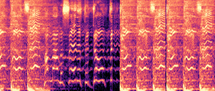
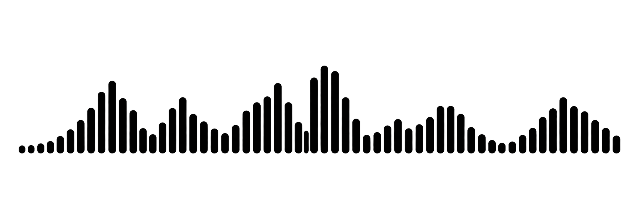
Audio (WAV)
log-Mel spectrogram
Backbone: choose one
BeatThis
MSCNN
TCN
params: 20.25M
params: 1.27M
params: 0.07M
22.05 kHz / 50 Hz
Beat / downbeat activations (50 Hz)
Post-processor: choose one
Beat / downbeat events
beat
Direct
CASM
DBN55–215
Peak-picking
30–300 BPM
55–215 BPM
beat
downbeat
DBN30–300
PLPDP
CRF
downbeat
30–300 BPM
30–300 BPM
30–300 BPM
Notes:
Version B: compact two-row pipeline. Source: /Users/hanyu/Downloads/p1.pptx and /Users/hanyu/Downloads/p1.jpg. Original spectrogram, waveform, activation paths and event positions reused. PLPDP and CRF added at the user's request. Their gray fill is intentional; no explanatory legend appears on the slide. Other processor boxes are white. Backbone parameter counts and frontend frequencies are transcribed from the supplied figure. No configuration total is claimed.

