Slide 1
Human-Human Interaction Experiment
Clustering
Zhanibek Rysbek

Slide 2
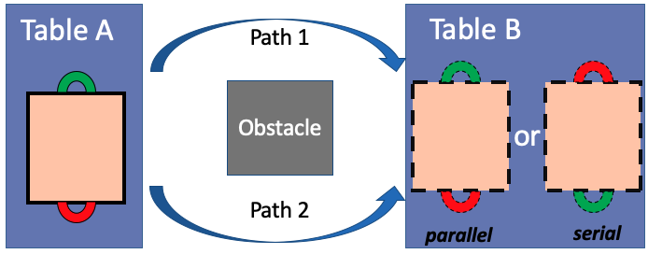
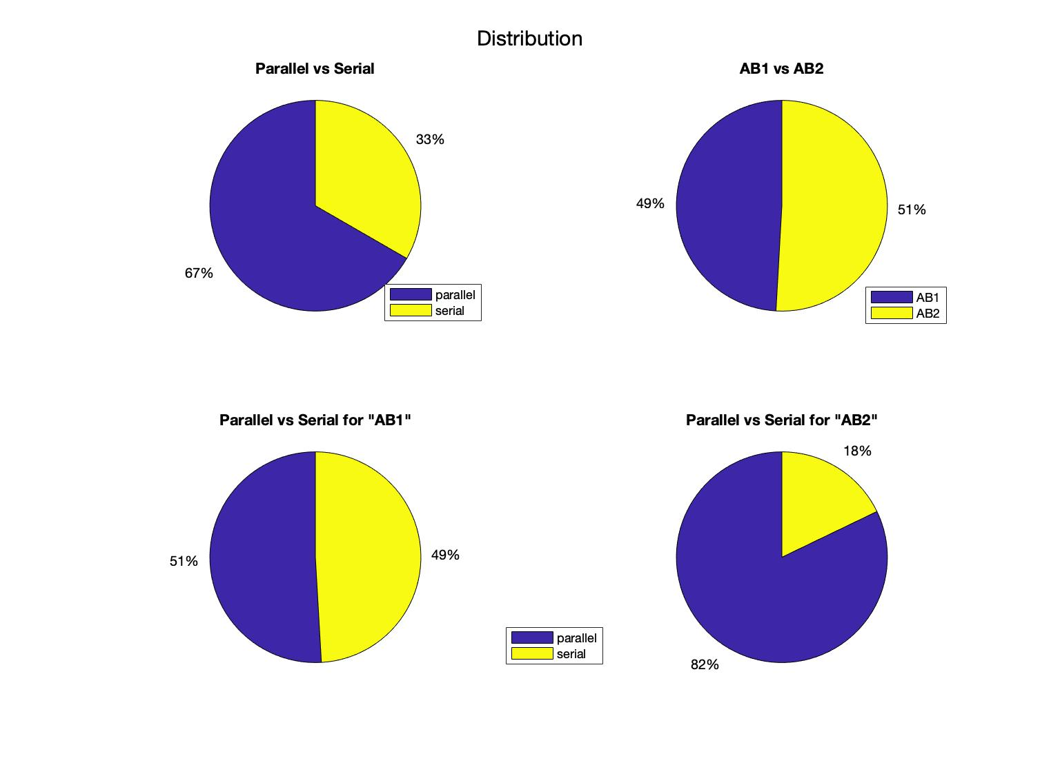
Data Description
Total number of Observations: 112
Average duration: 10 sec

Slide 3
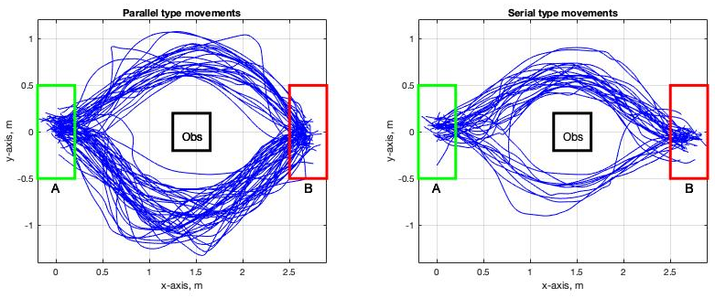
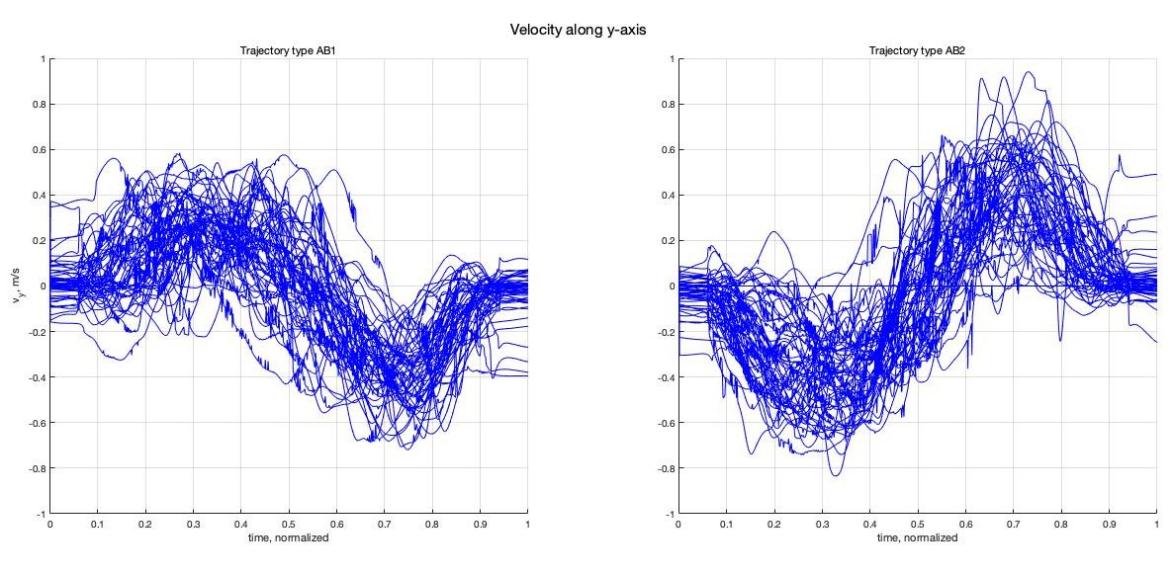
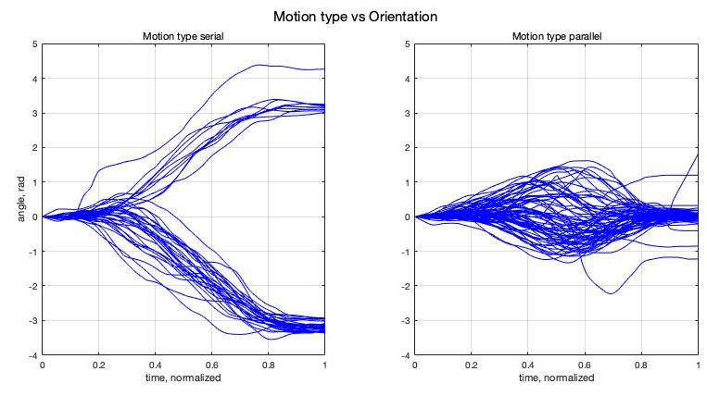

Slide 4
Sliding Window
Time is normalized between [0,1]
Window size: 0.5
Stride: 0.2
Divisions: 5
Features: [rft1(6) rft2(6) pose(7) twist(6) accel(3)]
Body Frame - except pose
Spatial Frame
Total Dimension: [5376, 140]

Slide 5
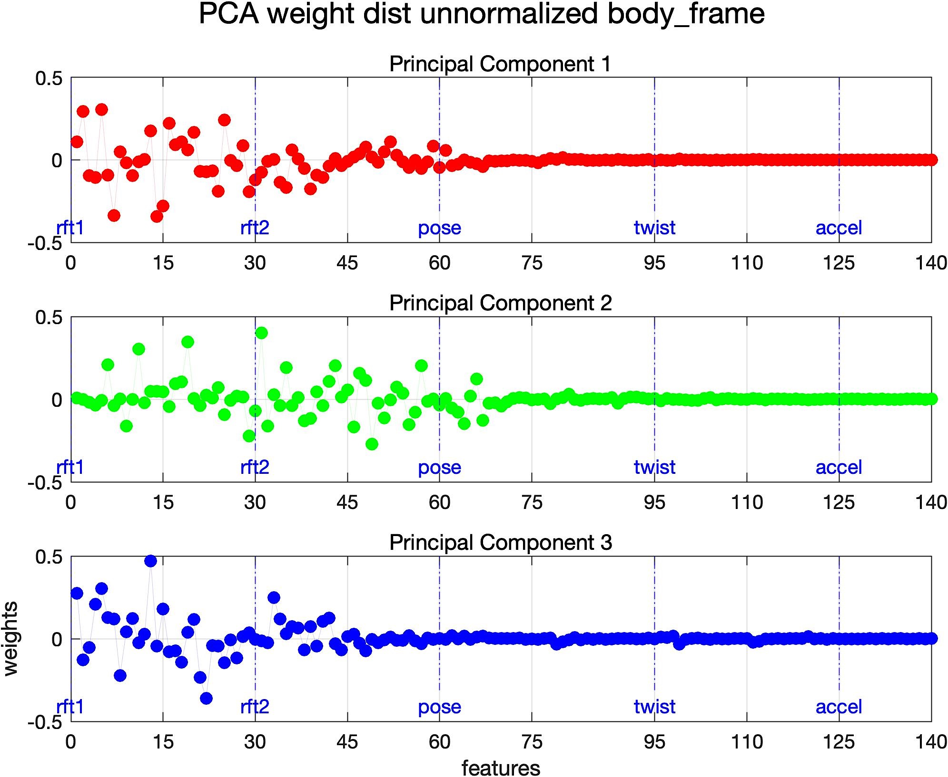
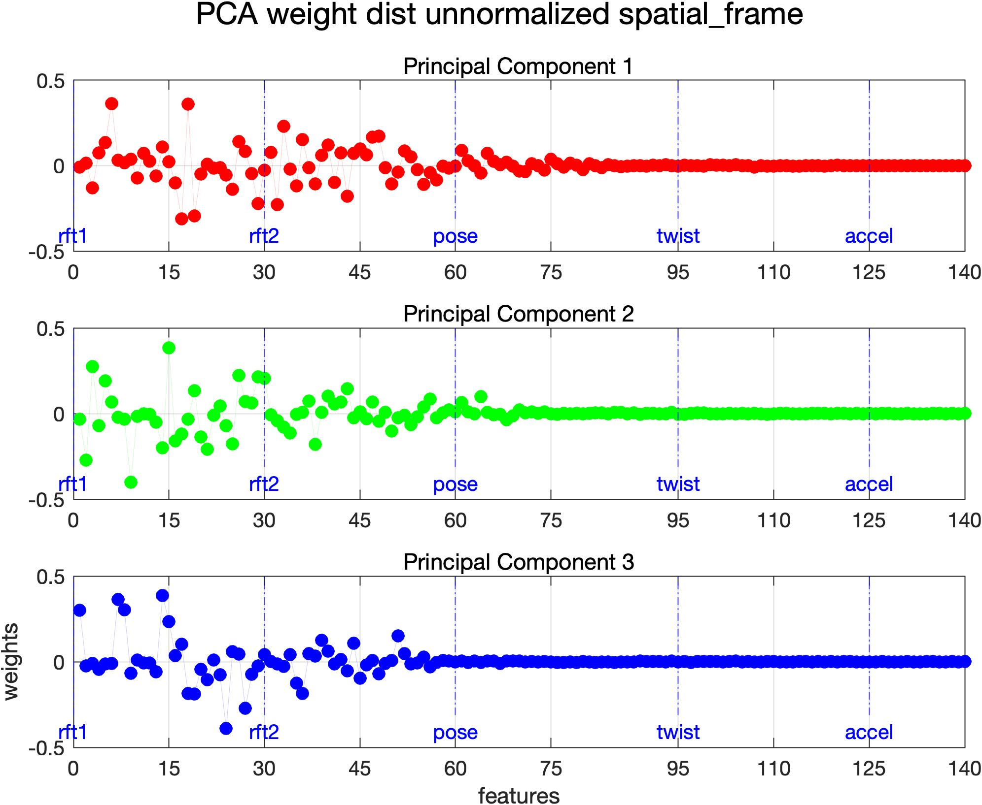
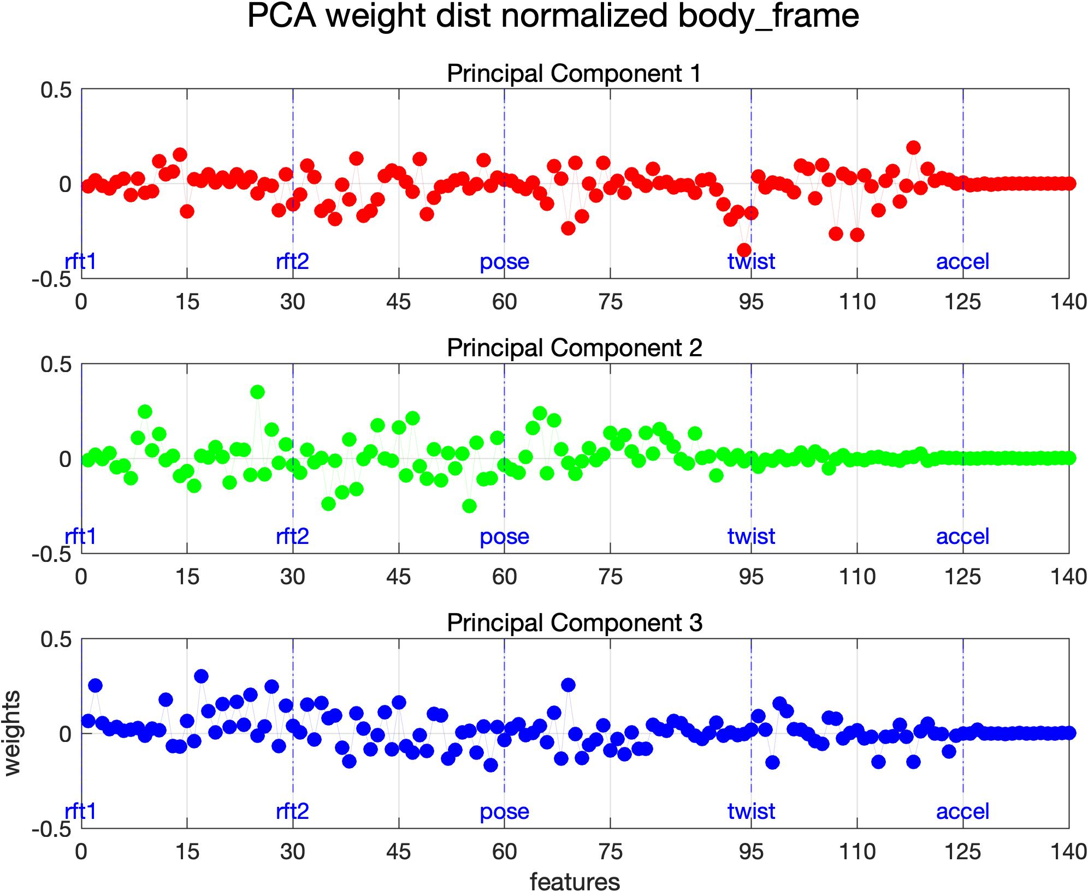
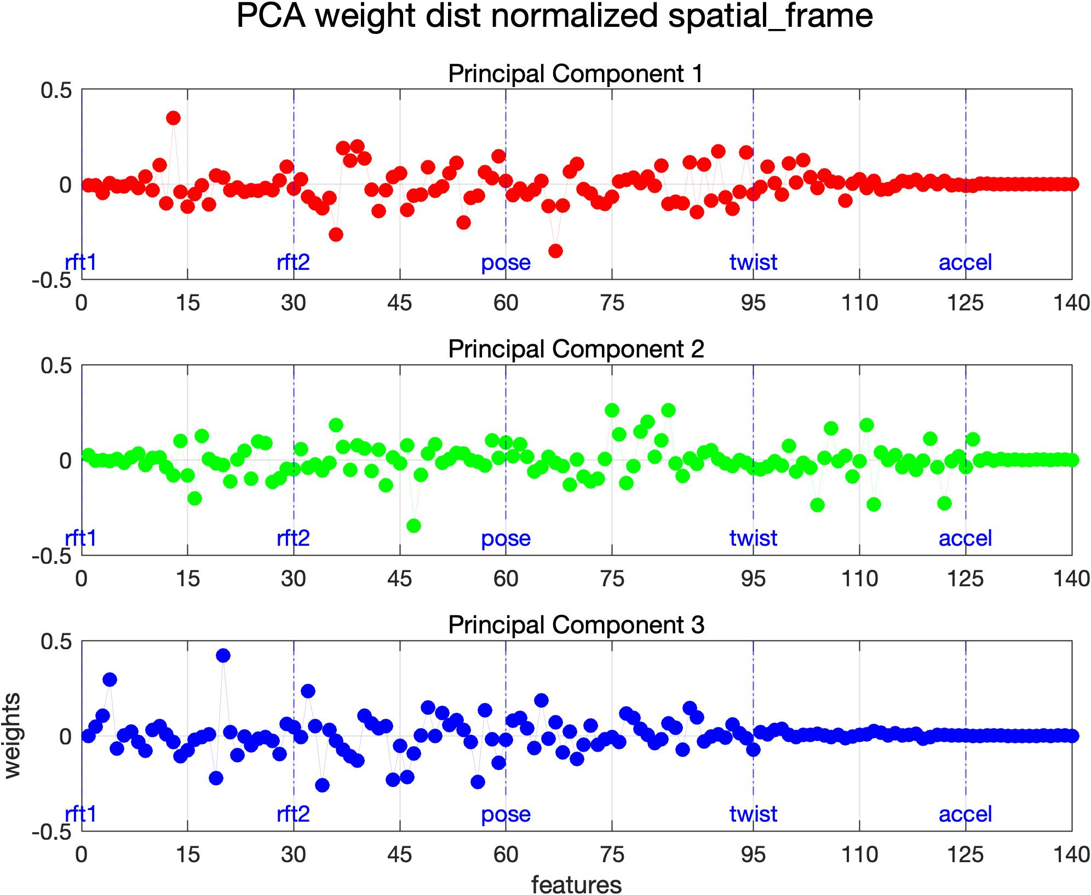
PCA - Weights
Body
Spatial

Slide 6
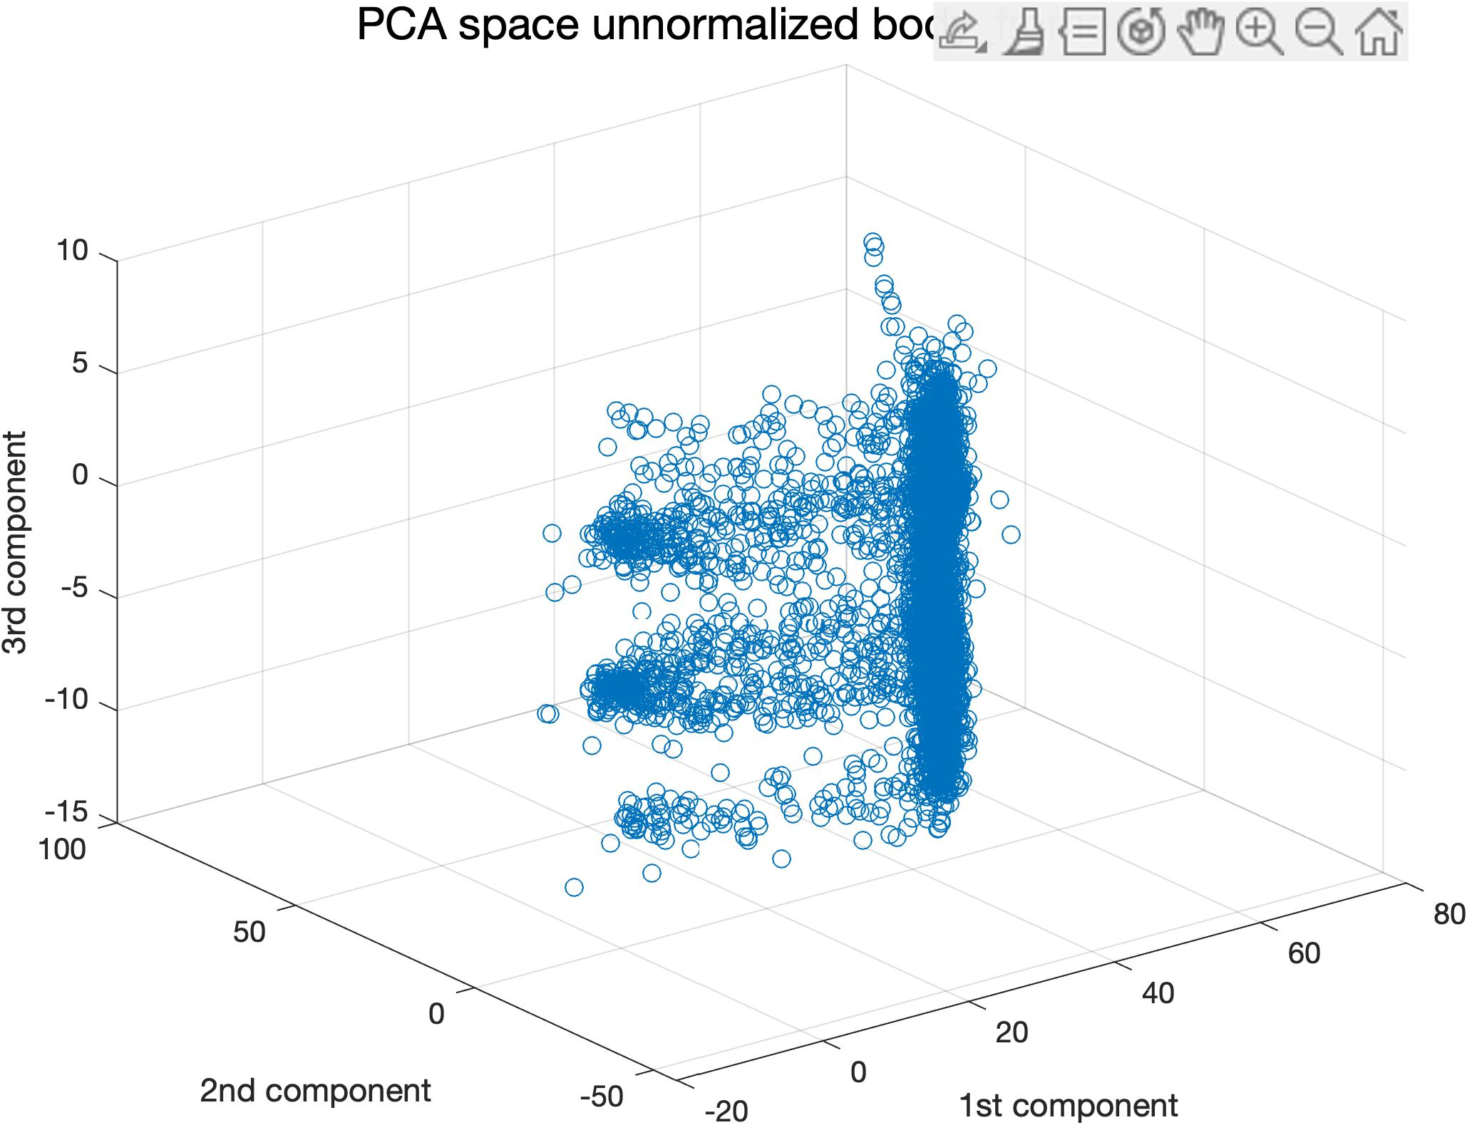
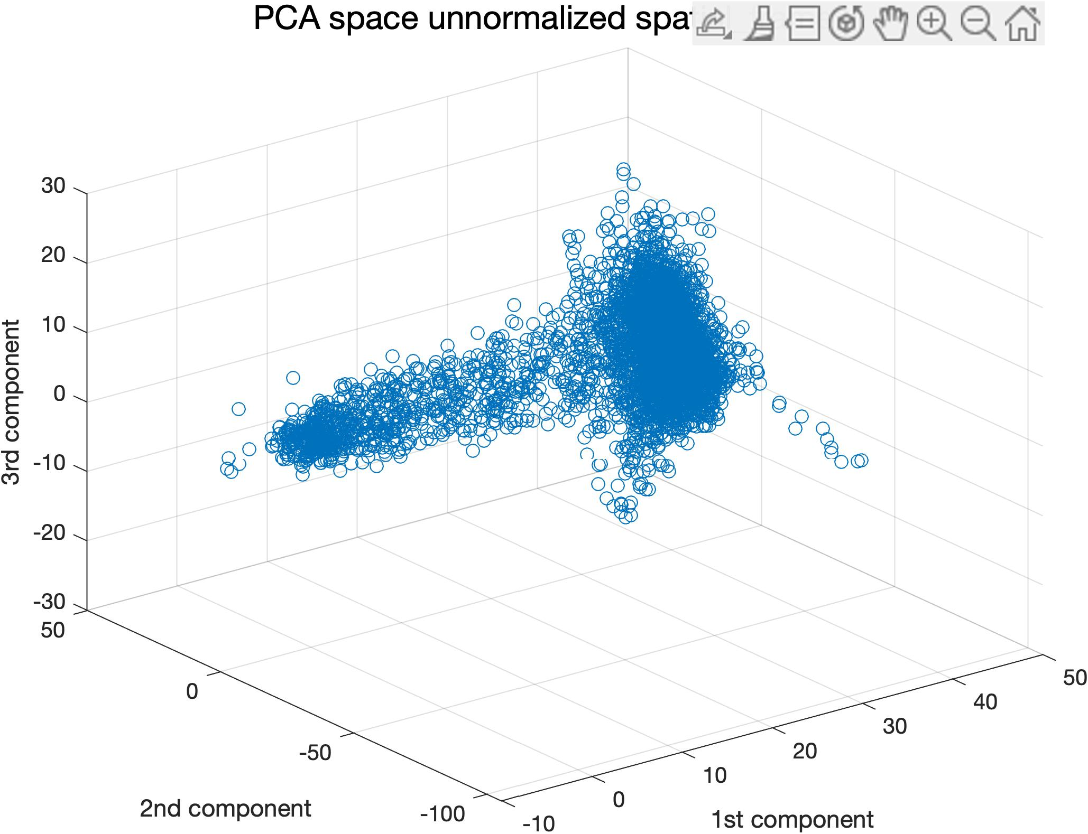

Slide 7
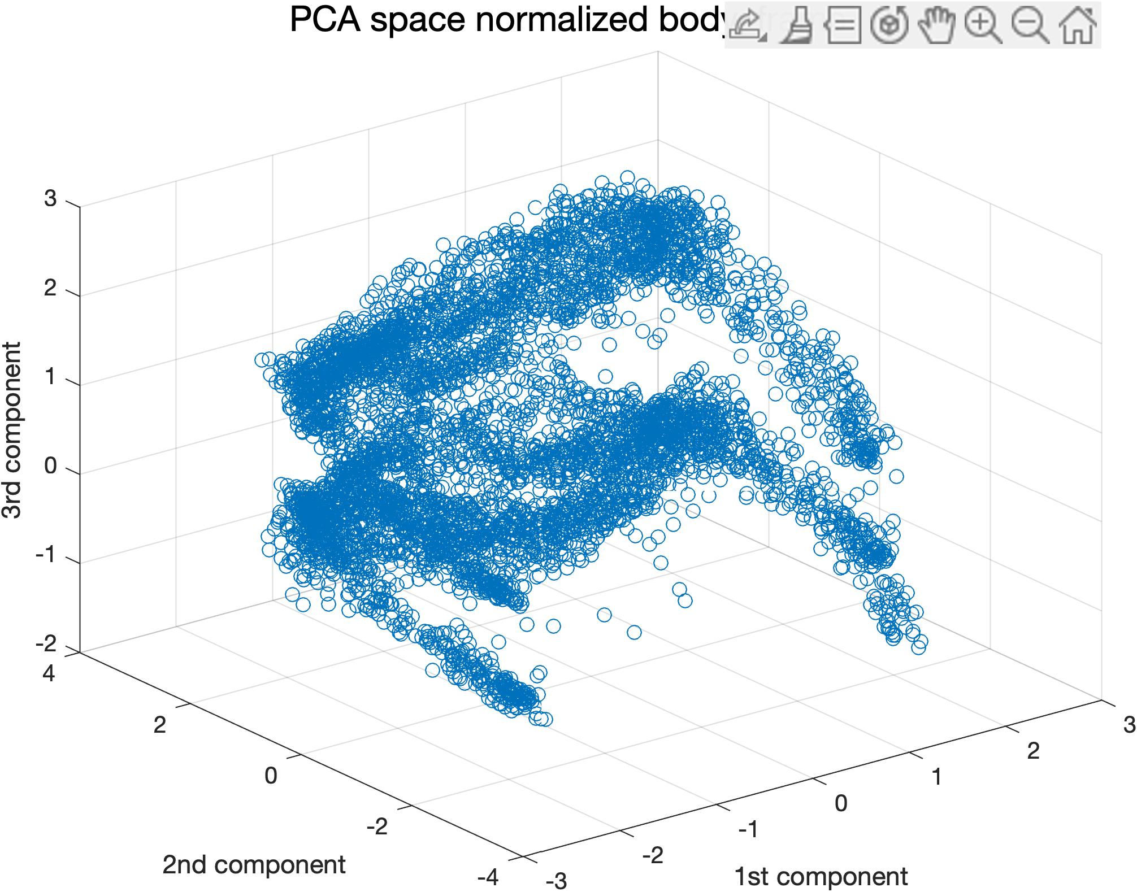
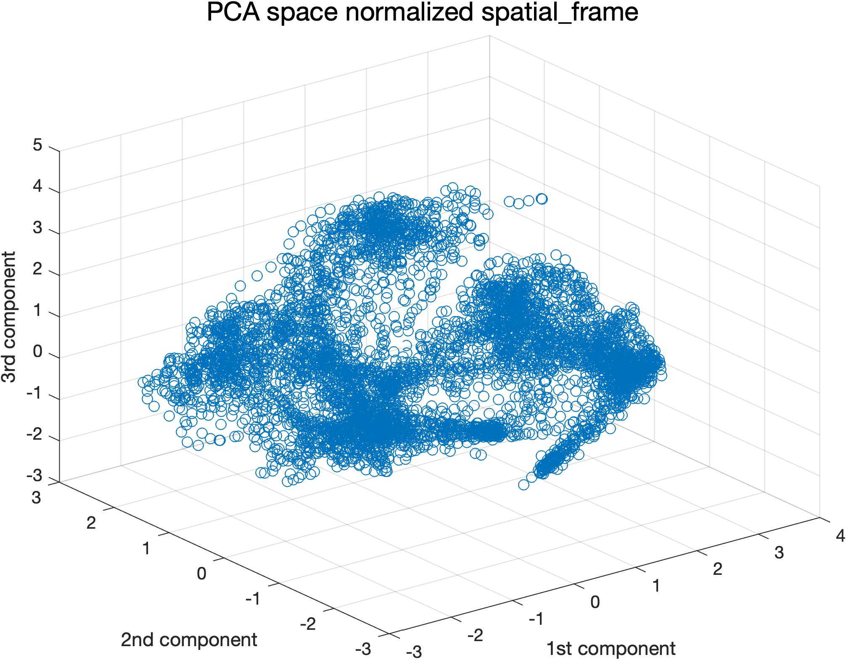

Slide 8
Kmeans

