Slide 1


LAWYER
PROFESSIONAL

Slide 2


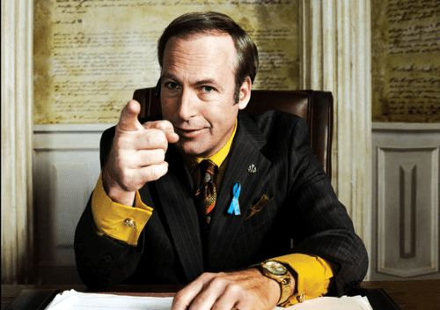
WELCOME TO OUR PRESENTATION
lawyer, one trained and licensed to prepare, manage, and either prosecute or defend a court action as an agent for another and who also gives advice on legal matters that may or may not require court action.

Slide 3
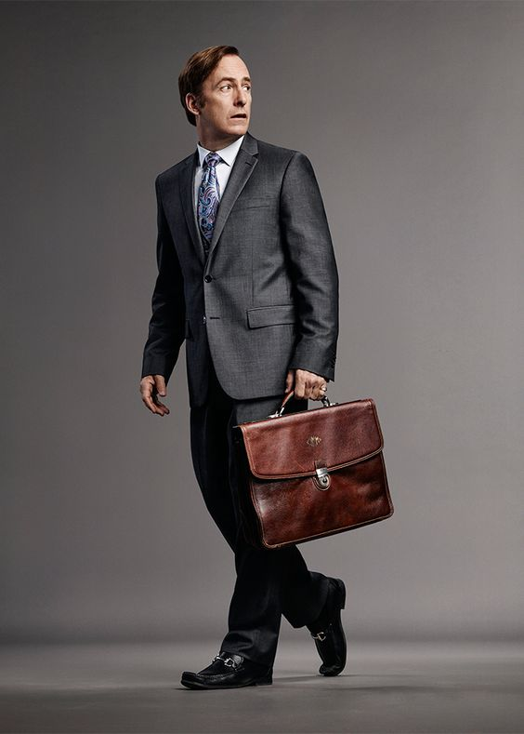
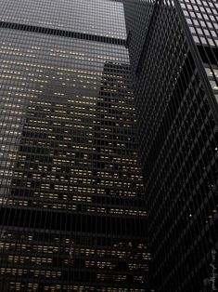
OUR VISION AND MISSION
We strive for a world where lawyers can practice law freely and independently to effectively fulfil their role in upholding the rule of law and the protection of human rights. Lawyers should be able to do their job without improper interference or fear of reprisal. Always and everywhere. Also, when that does not suit the government, the bar association, or the establishment.
Lawyers for Lawyers promotes and preserves the independence of the legal profession worldwide and defends the professional rights of lawyers to provide legal services safely and independently, without fear of reprisal. We safeguard the lawyers’ role in protecting the rule of law and human rights and ensuring effective justice for all by acting wherever lawyers are under threat.

Slide 4
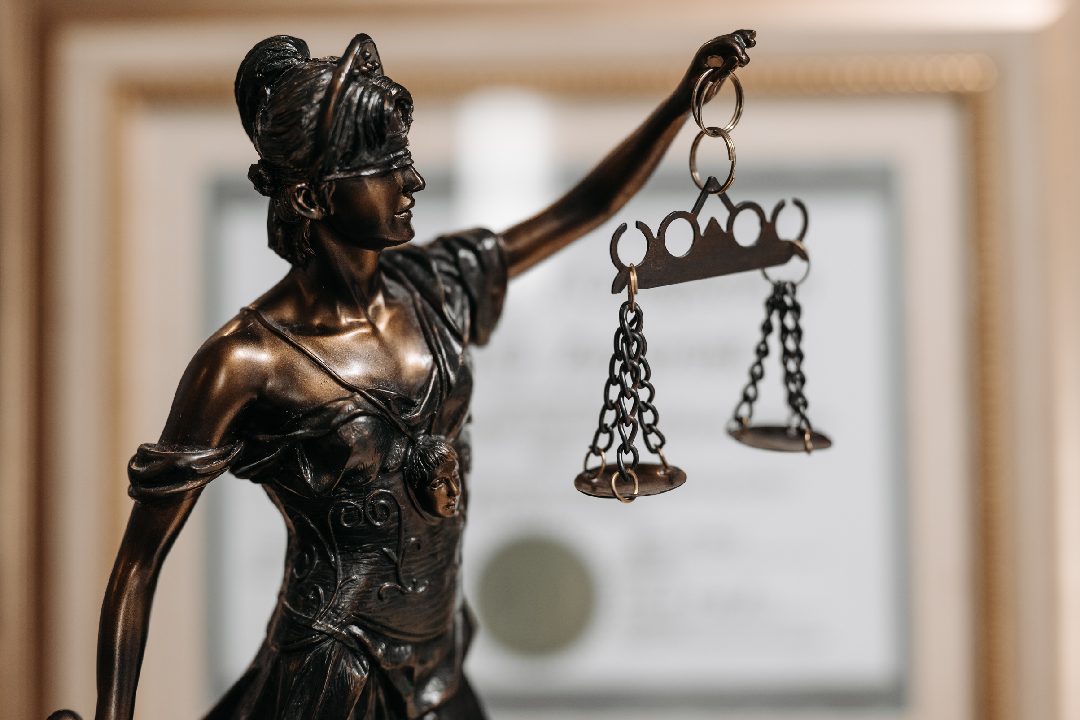
It is important to take care of the patient, to be followed by the patient, but it will happen at such a time that there is a lot of work and pain. For to come to the smallest detail, no one should practice any kind of work unless he derives some benefit from it. Do not be angry with the pain in the reprimand in the pleasure he wants to be a hair from the pain in the hope that there is no breeding.
ABOUT OUR AGENCY

Slide 5
REVIEWS
Good reviews: 90%
Bad reviews: 10%

Slide 6
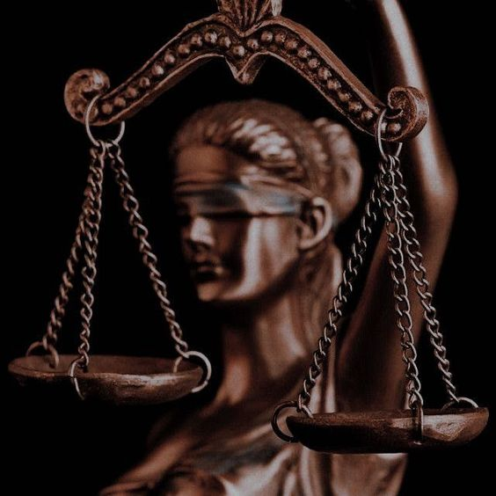

Click here to contact with us on telegram:
THANK YOU
We are on telegram: @birdenkelaw
WWW.BIRDENKELAW.COM
Click here to contact with us on telegram:

