Slide 1


Slide 2
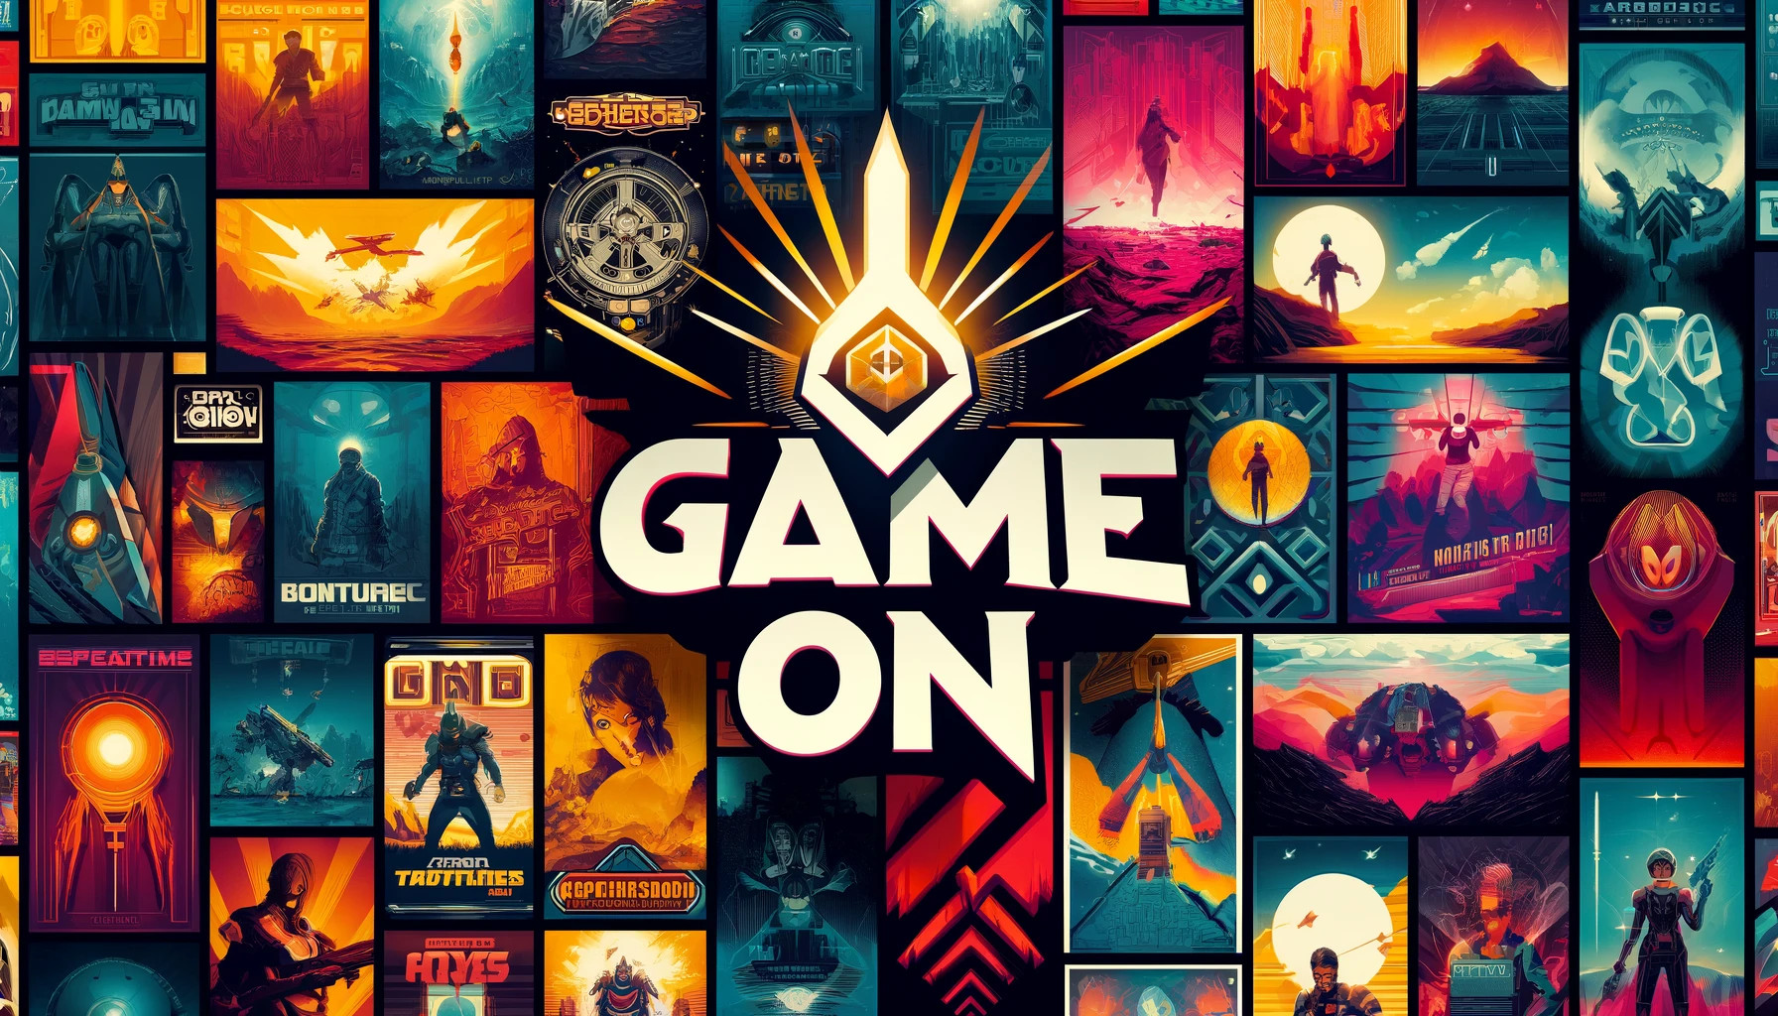
Game On: A Comprehensive Data Analysis of PC and Console Games

Slide 3
Project Description
The main goal of the project is to analyze and visualize trends in the video game industry. The project leverages datasets from Kaggle, including "Metacritic All Time Games Stats" and "Cleaned Global Video Game Sales Dataset"
The datasets provide extensive information on game releases, reviews, and sales, which are crucial for understanding market dynamics and consumer preferences.
Metacritic aggregates reviews from critics and users, offering a comprehensive view of a game's reception. This data, combined with sales figures from the global video game sales dataset, allows for an in-depth analysis of factors that influence a game's success.
To address gaps in the available data, web scraping was conducted on the Metacritic website, resulting in a detailed dataset with 14 columns and 27,224 rows. This dataset was cleaned and processed to ensure accuracy and usability.
Key analyses included:
WebCraping: To get the full dataset.
Games Analysis Over Time: Identified seasonal trends in game releases, analyzed genre trends and shifts in critical reception over time.
Sales Analysis: Compared regional and global sales trends, highlighting differences and significant events in the industry.
Machine Learning: Created classification models to determine which is better at predicting game categories based on their sales figures.

Slide 4
The project is designed to solve such problems in the video game industry as:
Understanding Market Trends: By analyzing game releases, reviews, and sales data over time, the project helps stakeholders understand market trends and shifts in consumer preferences. This is crucial for making informed decisions about game development, marketing, and release strategies.
Impact of External Factors: The analysis highlights the impact of significant external factors such as the COVID-19 pandemic, economic constraints, and technological transitions on game releases and sales. Understanding these impacts can help companies better prepare for and adapt to future challenges.
Seasonal Release Strategies: Identifying peak and low periods for game releases can help developers and publishers optimize their release schedules to maximize visibility and sales, especially around major shopping events like Black Friday and the holiday season.
Genre Trends and Player Preferences: The detailed analysis of genre trends over the years provides insights into changing player preferences. This information can guide developers in creating games that align with current trends and cater to the evolving tastes of gamers.
Regional Sales Insights: The comparison of sales data across different regions helps identify which markets are most lucrative for certain types of games. This can inform localization efforts and targeted marketing campaigns to boost sales in specific regions.
Predictive Modeling for Sales Success: The classification models developed in the project can assist developers and publishers in predicting the potential sales success of upcoming games based on their genre, platform, and publisher. This predictive capability can inform strategic decisions and reduce the risk associated with game development and release.

Slide 5
Stack
What did I use in my analysis?
Web Scraping
Data Cleaning
Exploratory Data Analysis
Power BI
Using Python in PyCharm
BeautifulSoup and requests for scraping data from the Metacritic website
Using pandas and numpy
Deleting duplicates and useless rows
Converting types of the data
Using matplotlib, plotly and seaborn
Power BI for creating interactive visualization and dashboards
Using scikit-learn for machine learning and predictive modeling

Slide 6
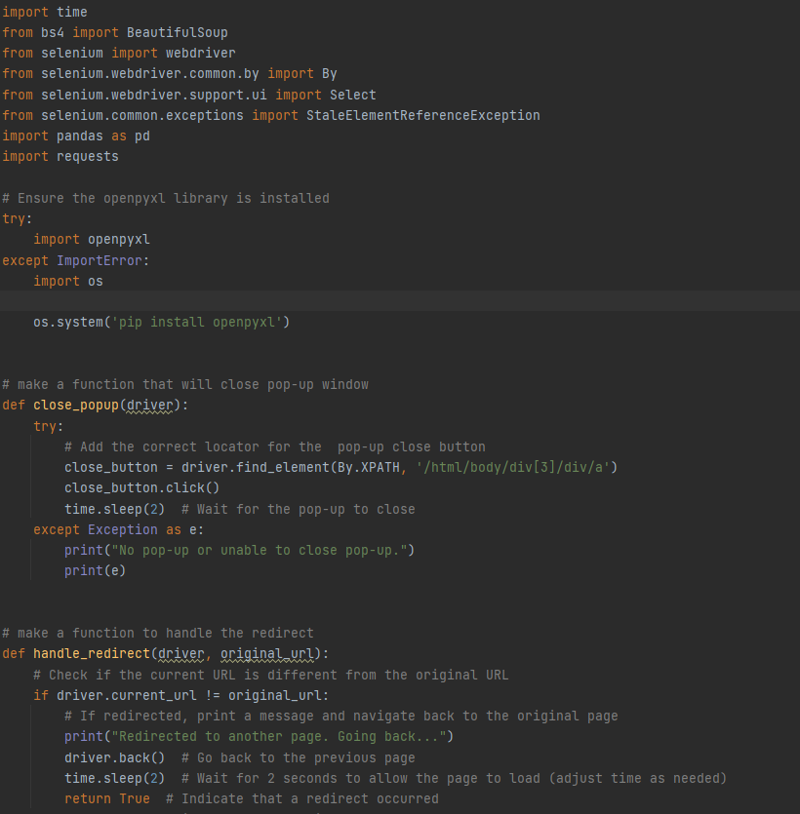
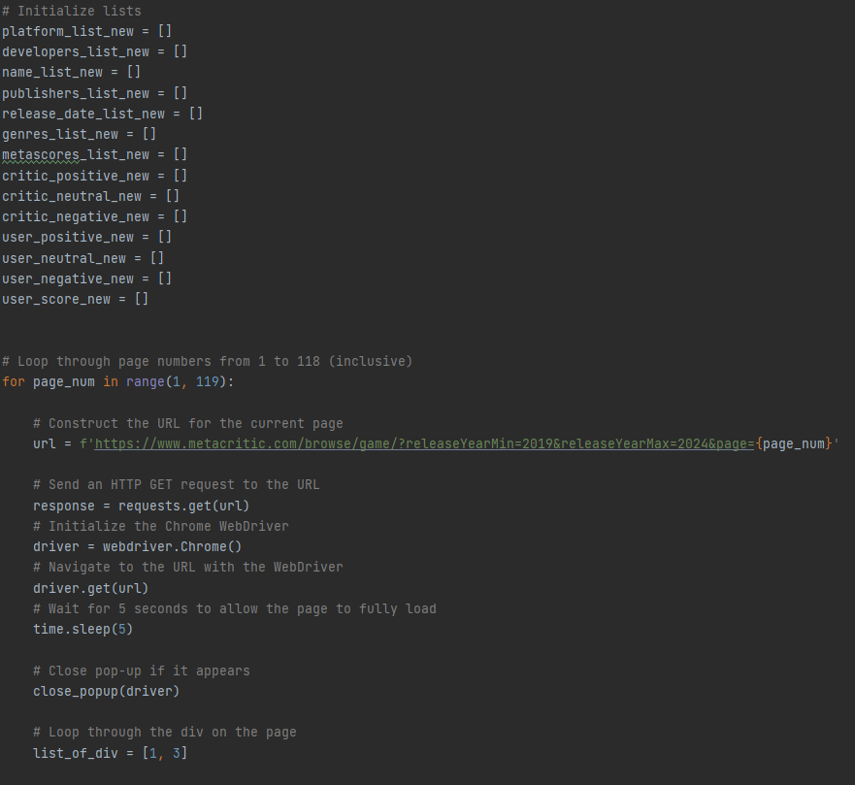
A little bit of code…

Slide 7
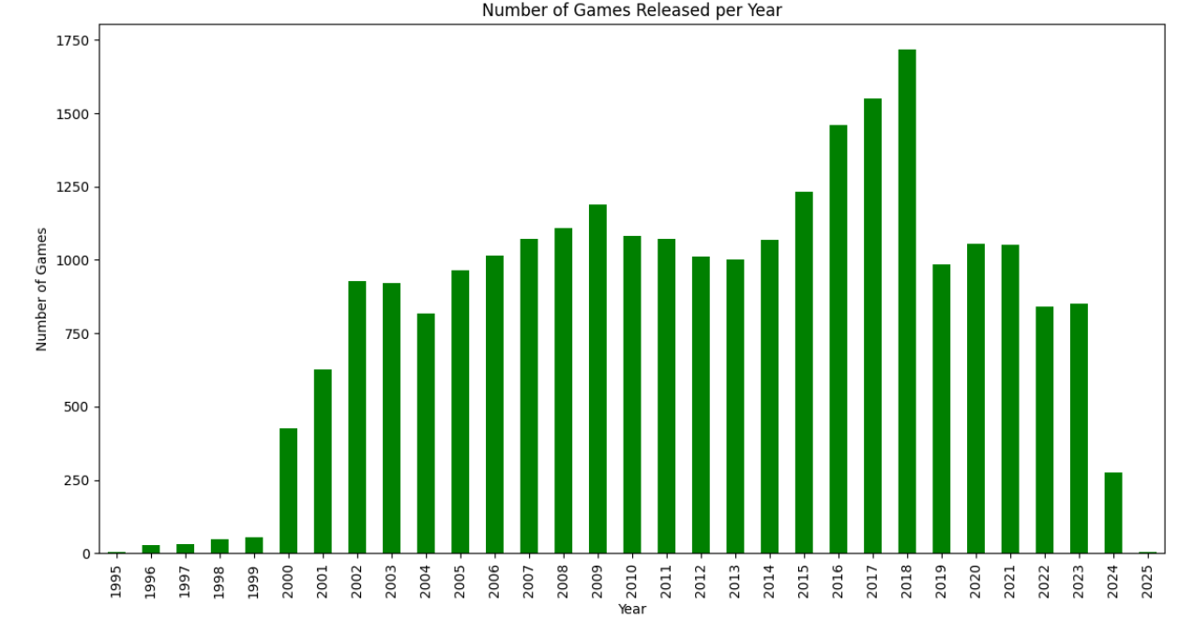
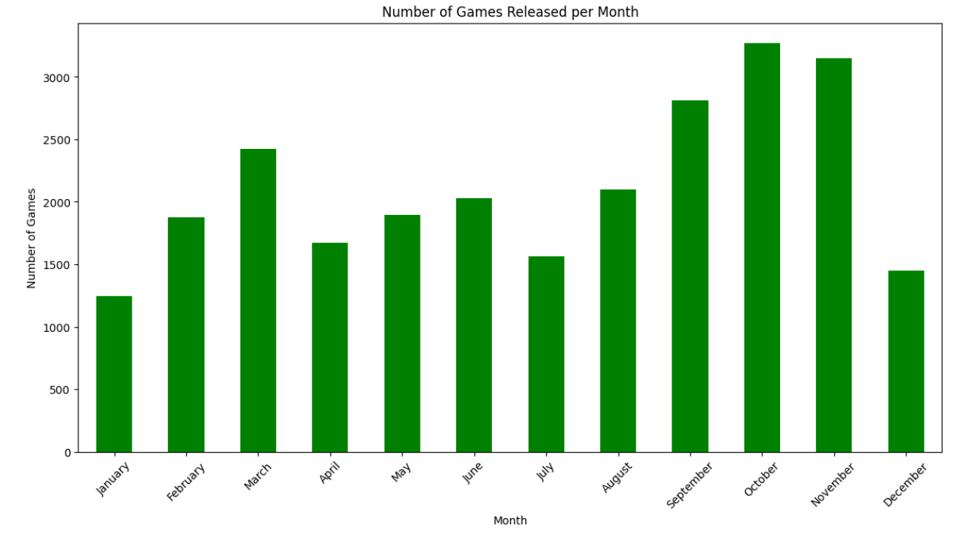
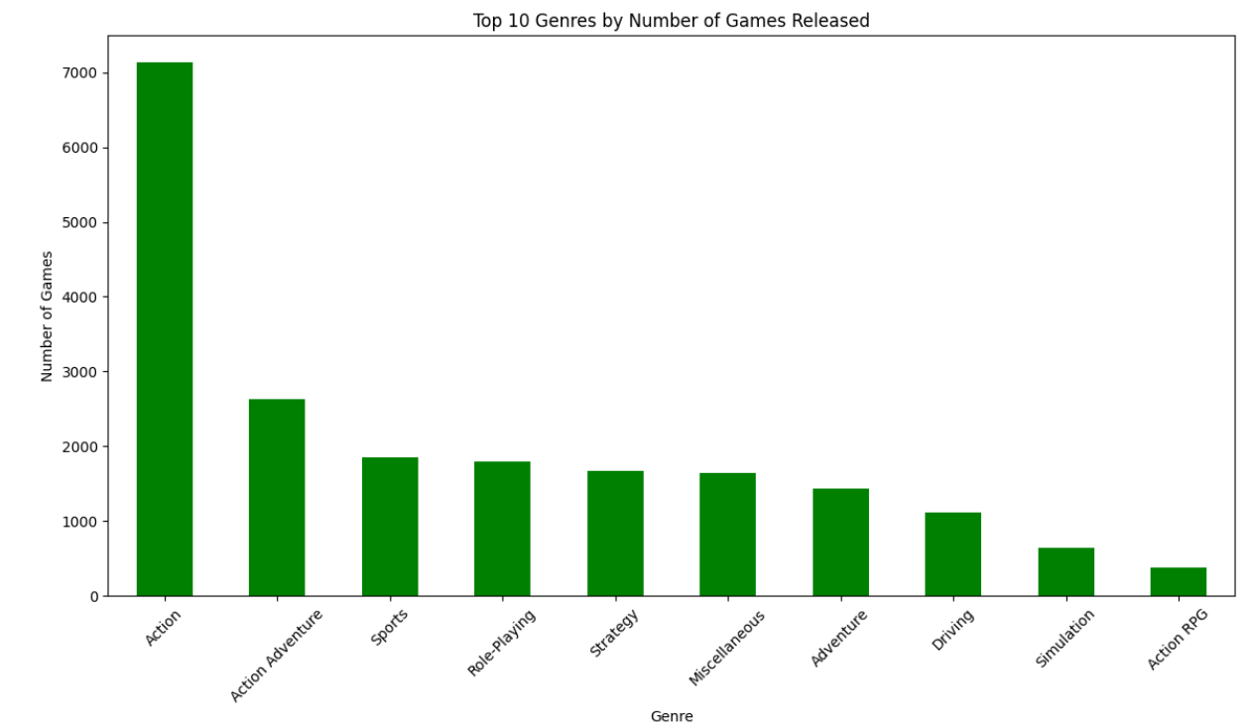
Let me share some insights from the analysis
2018 was the Top year of released games, but a decline is visible after that. We can suggest several reasons. The first is the impact of the COVID-19 pandemic, many game releases were postponed due to logistical challenges, production delays, and the need for additional development time. And the second reason is economic factors like market saturation and strategic releases. Studios, especially smaller ones, faced financial constraints that limited their ability to develop and release new titles and investors became more cautious.
There is a significant rise of releases in September, October, and November. The main suggestion that the cause of this is the Holidays.
Over the years, the game with the highest number of positive critic reviews is "Halo Infinite," and the game with the most positive user reviews is "Cyberpunk 2077."
The most popular genre for game releases is Action.
Ubisoft is the top of publisher, and Capcom is the top developer.

Slide 8
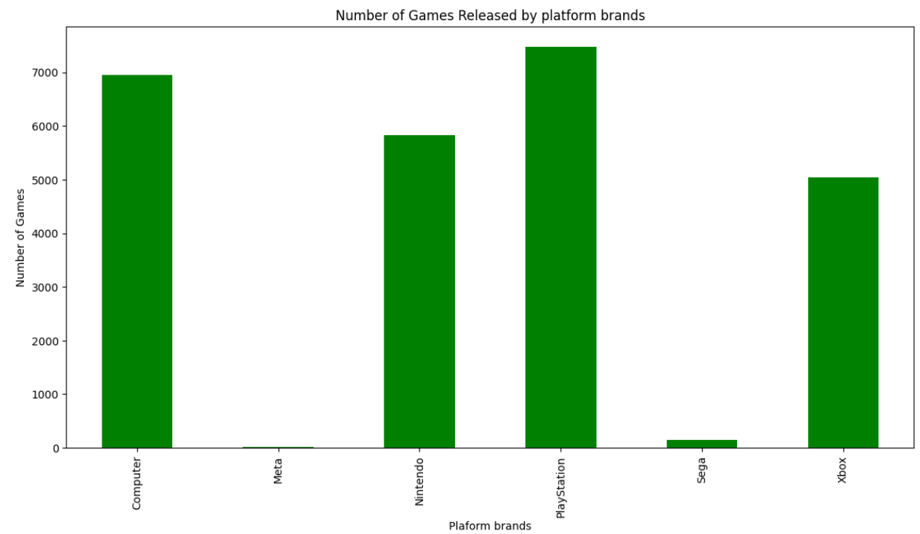
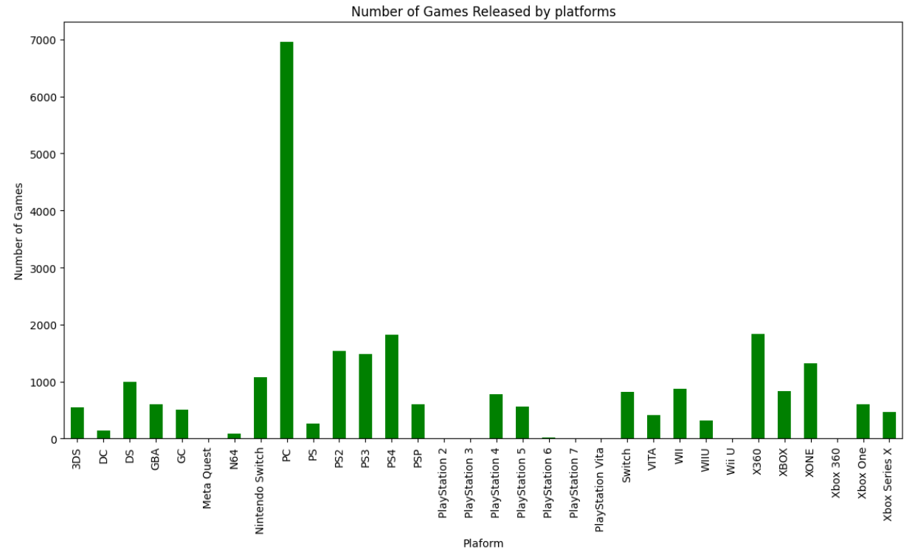
Most games are released for the PC
but
Without considering console versions, the PlayStation brand is the most popular for releases.

Slide 9
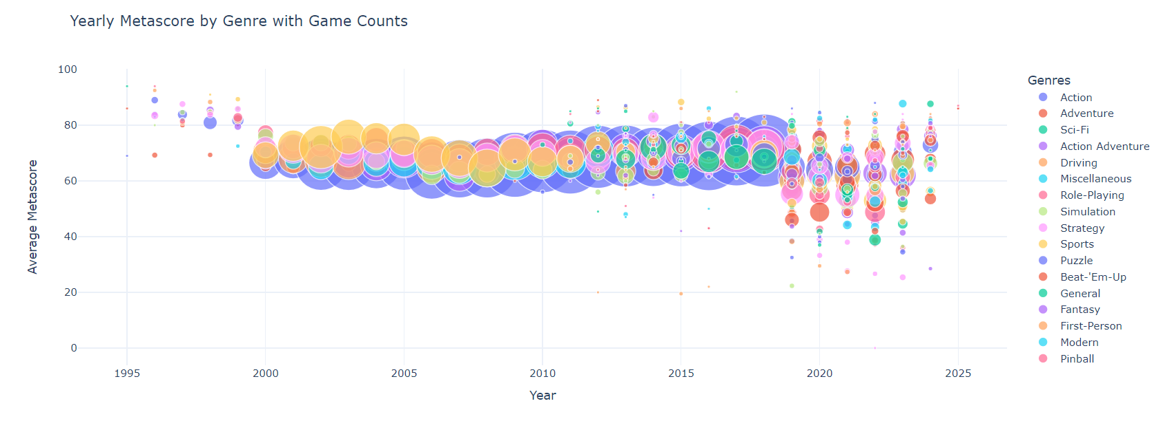
We can see a clear growth trend in action games from 2000 to 2018, but by 2019, other genres prevail, and action games decline. This shift could be due to changing player preferences. There has been a growing demand for games with rich narratives and storylines, leading to the rise of genres like role-playing games (RPGs) and adventure games. The increasing popularity of indie games, which often explore unique and diverse genres, has introduced players to new experiences beyond traditional action games.

Slide 10
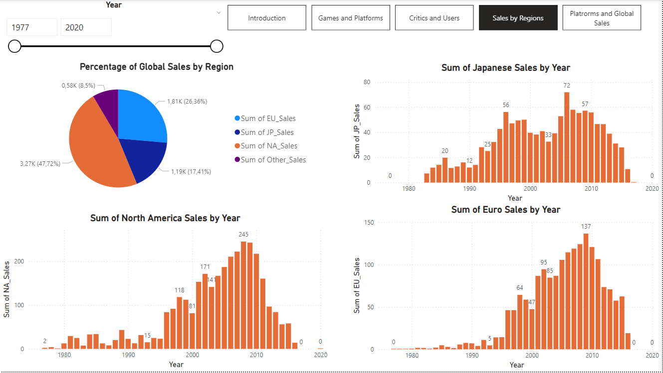

Slide 11
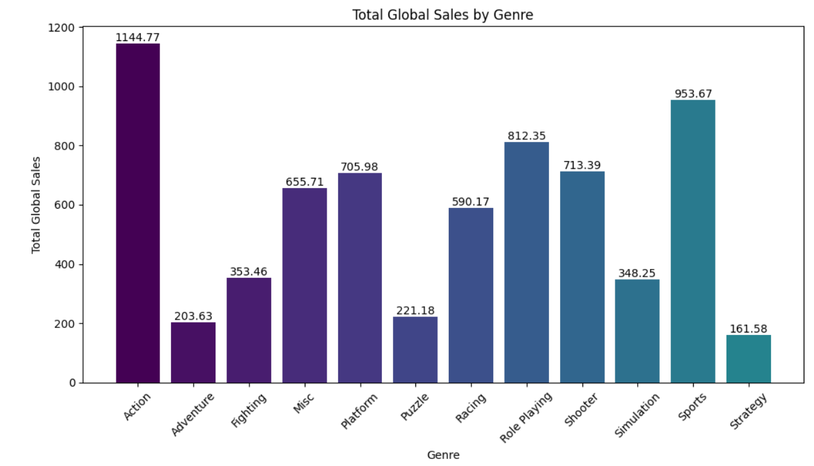
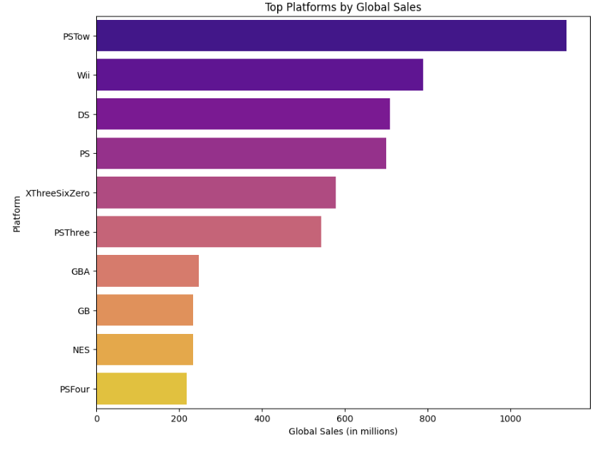
Best-Selling Game in North America:
Year: 2006, Name: Wii Sports, Sales: 41.49
Best-Selling Game in Japan:
Year: 1996, Name: Pokémon Red Pokémon Blue, Sales: 10.22
Best-Selling Game in Europe:
Year: 2006, Name: Wii Sports, Sales: 29.02
Best-Selling Game in Other Regions:
Year: 2004, Name: Grand Theft Auto San Andreas, Sales: 10.57

Slide 12
Links
Github link
https://github.com/zhanna-naumenko/Final-project-Game-On-
2-mn video link
https://www.loom.com/share/33e5a0b47a584eee9e911c777306c7ee
Portfolio link https://www.datascienceportfol.io/dashboard

Slide 13
Thank you!

