Slide 1
Data Analysis of Air Quality in Australia
Group 16 - GreenTech
Ran Jiang (ranj3)
Zhanna Sakayeva (zhannas3)
Mengjia Zeng (mengjia6)

Slide 2
Outline
Introduction
Related Work
Methods
ShinyApp
Results
Conclusion and Future Work

Slide 3
Introduction
Problems:
Trend analysis for PM2.5
Predictions and classification for PM2.5 to warn people
Importance:
PM2.5 may cause long-term health problems and short-term health effects

Slide 4
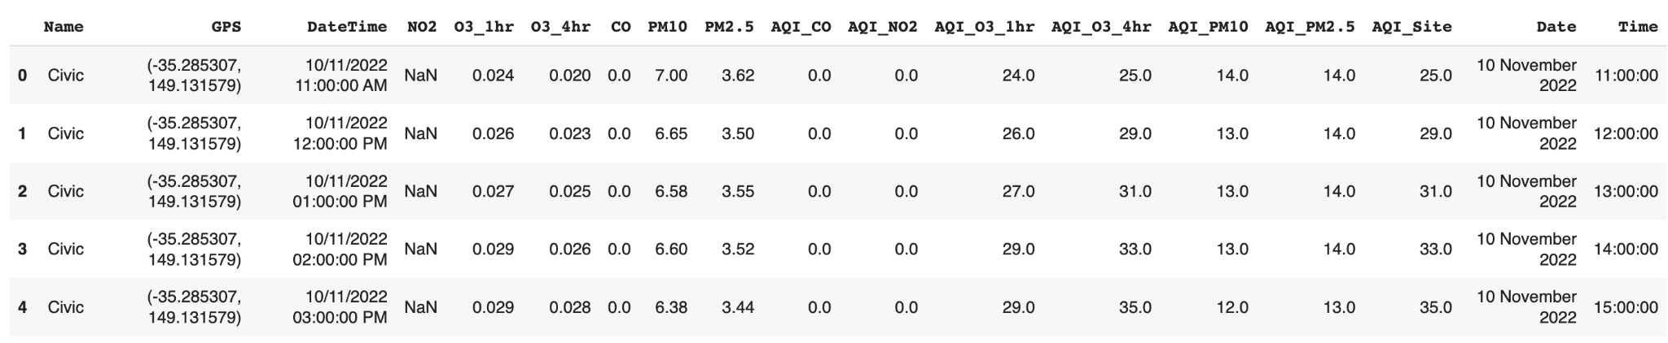
Introduction-Data
Input: AQI_O3_4hr, AQI_PM10
Output
AQI_PM2.5 for prediction
air quality levels for classification
Update frequency/ Source
ACT Government Open Data Portal Australia Government
From January 1, 2011 and updated hourly

Slide 5
Related Work
Prior Contributions:
Various machine-learning techniques, like Artificial Neural Networks, Random Forest Models, and Decision Tree models
Compare with the proposed model to find the balance between accuracy and suitability
Differences:
Trend analysis: trend of chemicals, as well as PM2.5 annually and air quality may even be different between weekdays and weekends.
Datasets

Slide 6
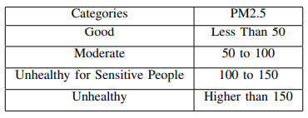
Methods
Multiple Linear Regression
Predictor variables:
AQI_O3_4hr and AQI_PM10
Response variable:
PM2.5
Train set: 75%
Test set: 25%
Classification
Decision Tree and Random Forest

Slide 7
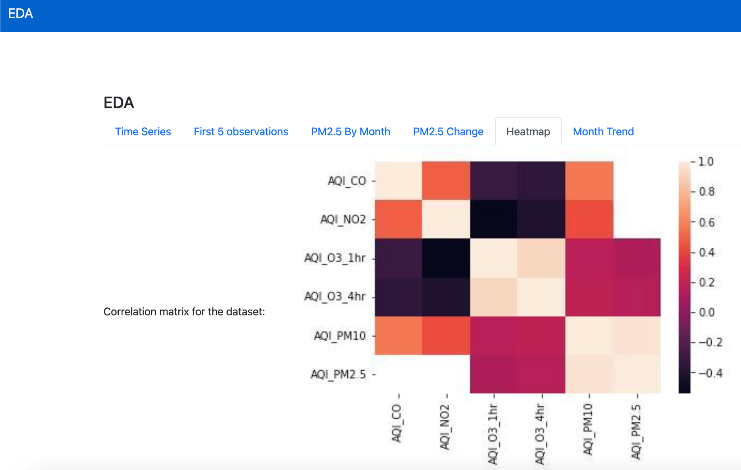
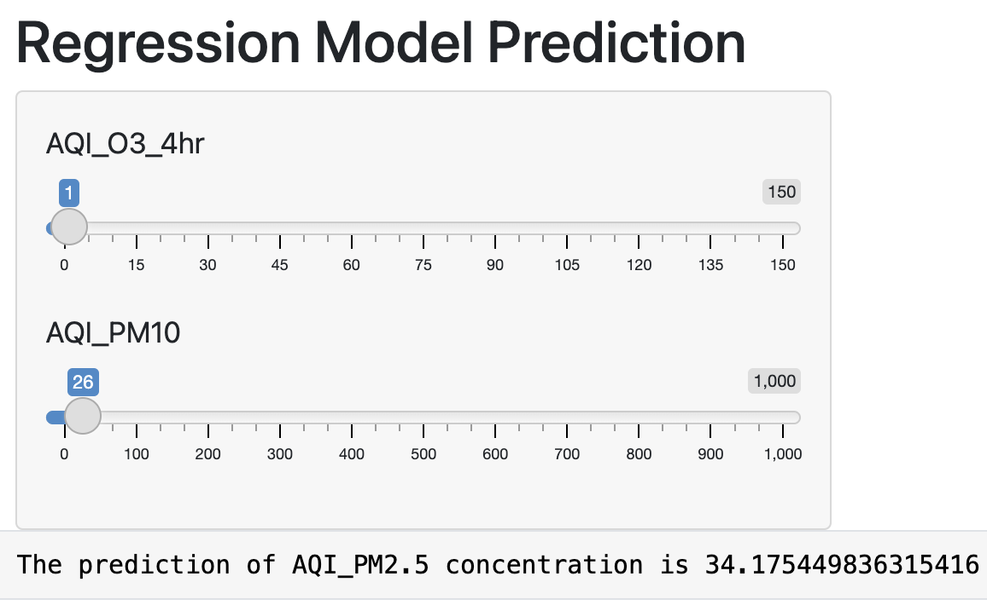
ShinyApp

Slide 8
Results
Model with AQI_O3_4hr and AQI_PM10 as the predictors. RMSE to be 29.513.
Offend assumption of homogeneity of variances
Classification - Decision Tree and Random Forest
Random Forest to be better with accuracy to be 0.995
Predicting Good better and Predicting Unhealthy the worst.

Slide 9
Conclusion and Future Work
The result suggested that the model with AQI_O3_4hr and AQI_PM10 should be the chosen one.
The random forest is believed to be better in predicting different levels of PM2.5, especially in predicting good categories.
This study could also try some different non-parametric models in the future, because the regression model offended the assumptions for homogeneity of variances. Also, this study could compare the models fitted by the Australia dataset with the other frequently used dataset, and see whether the models could also work well with other datasets.

Slide 10
Thanks for Listening！

