Slide 1
CIKM Competition 2014 Second Place Solution
Team: FAndy
Zhanpeng Fang, Jie Tang
Department of Computer Science
Tsinghua University

Slide 2
Task
Input: a sequence of query sessions
Example
Class1 Query1 –
Class1 Query1 Title1
Class2 Query2 –
Class2 Query2 Title2
Class2 Query2 Title3
Partially labeled
Output: the class label of test queries

Slide 3
Challenges
Encoding character
Only little prior knowledge can be used
Heterogeneous data
Query, title, session information
User search behavior
How to incorporate user search behavior to help the classification task?
Unlabeled data
How to utilize the large scale unlabeled data?

Slide 4
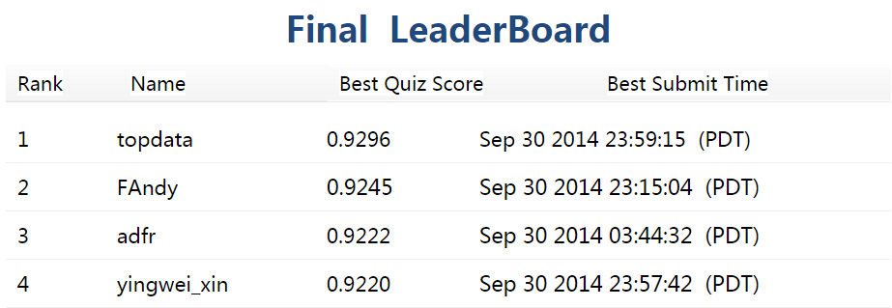
Result
0.9245(public score)/0.9245(private score)
2nd place winner
Achieve in 4 days, from Sep. 27th to Sep. 30th EST
2014/10/29

Slide 5
Our Approach
Feature extraction
Bag of words
User search behavior
Learning models
Logistic regression
Gradient boosted decision trees
Factorization machines
Ensemble

Slide 6
Feature Extraction – Bag of Words
Given a query Q
One gram, two grams, last gram of Q
0 -> 0.8452

Slide 7
Feature Extraction – Bag of Words
Given a query Q
One gram, two grams, last gram of Q
0 -> 0.8452
One gram, two grams of the clicked titles
0.8452 -> 0.9091, top 12 in the leaderboard!

Slide 8
Feature Extraction – Bag of Words
Given a query Q
One gram, two grams, last gram of Q
0 -> 0.8452
One gram, two grams of the clicked titles
0.8452 -> 0.9091, top 12 in the leaderboard!
More bag of words features?
Queries of same session?
Titles of same session?

Slide 9
Feature Extraction – Bag of Words
Given a query Q
One gram, two grams, last gram of Q
0 -> 0.8452
One gram, two grams of the clicked titles
0.8452 -> 0.9091, top 12 in the leaderboard!
More bag of words features?
Queries of same session?
Titles of same session?
Performance decreases, 0.9091 -> 0.89x
How to use the session information?

Slide 10
Feature Extraction – Search Behavior
Given a query Q
Macro features
#total search, average length of clicked titles, length of the query
0.9091 -> 0.9105

Slide 11
Feature Extraction – Search Behavior
Given a query Q
Macro features
#total search, average length of clicked titles, length of the query
0.9091 -> 0.9105
Session class features
For each potential class C, calculate:
#class C queries in the same session
#class C queries in the next/previous query
0.9105 -> 0.9145

Slide 12
Feature Extraction – Search Behavior
Same session’s queries can help but might contain noises

Slide 13
Feature Extraction – Search Behavior
Same session’s queries can help but might contain noises
Only use similar queries!
Same session’s queries feature
Bag of words feature for same session’s queries that are similar to the query Q
Use Jaccard to measure similarity between queries
0.9145 -> 0.9182, utilizing the large scale unlabeled data!

Slide 14
Feature Extraction – Search Behavior
Further add clicked titles of same session’s similar queries
Performance decrease, 0.9182 -> 0.9176

Slide 15
Feature Extraction – Feature List
1 gram, 2 grams of the query
1 gram, 2 grams of the clicked titles of the query
Marco statistics of the query
#specific class of queries in same session
1 gram, 2 grams of similar queries in same session

Slide 16
Learning Models
Logistic regression
Use the implementation of Liblinear
Factorization machine
Use the implementation of LibFM
Gradient boosted decision trees
Use the implementation of XGBoost
Method | Implementation | Score on leaderboard
Logistic Regression | Liblinear | 0.9182
Factorization Machine | LibFM | 0.9151
GBDT | XGBoost | 0.9225

Slide 17
Ensemble
Ensemble prediction results from different models by logistic regression
Ensemble can effectively improves the performance
Method | Implementation | Score on Validation
Logistic Regression | Liblinear | 0.9182
Factorization Machine | LibFM | 0.9151
GBDT | XGBoost | 0.9225
Ensemble | Liblinear | 0.9245

Slide 18
Summary
“Tricks” on how to win 2nd place
Use unlabeled data
Train multiple models
Ensemble different results

Slide 19
Thank you! Questions？

