Slide 1
Modelling Paying Behavior in Game Social Networks
Zhanpeng Fang⁺, Xinyu Zhou⁺, Jie Tang⁺, Wei Shao#, A.C.M. Fong*, Longjun Sun#, Ying Ding⁻, Ling Zhou⁺, and Jarder Luo⁺
⁺Tsinghua University
#Tencent Corporation
*Auckland University of Technology
⁻Indiana University
Notes:
Good afternoon, ladies and gentlemen. I am Zhanpeng Fang from Tsinghua University. The title of my talk is modeling paying behavior in game social networks. This is a joint work with Xinyu Zhou, Jie Tang, Ling Zhou, Jarder Luo from Tsinghua University, Wei Shao, Longjun Sun from Tencent corporation, A.C.M. Fong from Auckland university of technology and Ying Ding from Indiana University.

Slide 2


Billion Dollar Industry
Facebook^{[1]}
250 million monthly players
200 games with >1 million active players
12% revenue
Tencent^{[2]} (Market Cap: ~150B $)
>400 million players
50% revenue
[1] Facebook 2013 First Quarter Report
[2] Tencent 2013 Anual Report
Notes:
Online gaming is one of the largest industries on internet, generating tens of billions of dollars in revenue annually. According to Facebook’s first quarter report in 2013, it has 250 million monthly game players, and there are about 200 games on facebook with more than 1 million active players. About 12% of the company’s revenue is directly from games.
The situation is the same in China. Tencent is the second largest Internet company and also the largest game service provider in China. According to its 2013 annual report, it has more than 400 million gaming users. About 50% of the company’s revenue is from games.

Slide 3
Billion Dollar Industry
Facebook^{[1]}
250 million monthly players
200 games with >1 million active players
12% revenue
Tencent^{[2]} (Market Cap: ~150B $)
>400 million players
50% revenue
Not only keep players playing,
but also make them pay.
[1] Facebook 2013 First Quarter Report
[2] Tencent 2013 Anual Report
Notes:
One core problem in online games is to not only keep players playing but also make them pay. This is important for the sustainable development of the whole game industry.

Slide 4
What we do
Given users’ data in online games, predict:
Free users -> Paying users
Notes:
In this paper, what we do is that given users’ data in online games, predict which free users are going to be paying users.

Slide 5
What we do
Given users’ data in online games, predict:
Our goals:
Fundamental factors
Social effect
Predictive model
Free users -> Paying users
Notes:
To be more precisely, we have three goals in this work. The first goal is to study what the fundamental factors are that trigger free users to pay in online games. The second goal is to study how users’ paying behavior influence each other in the game social network. The third goal is to design a prediction model to identify those potential users who are likely to pay.

Slide 6

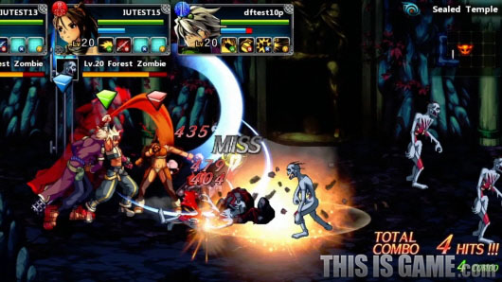
Two games: DNF
Dungeon & Fighter Online (DNF)
Fight enemies by individuals or groups
400+ million users
2nd largest online game in China.
Notes:
We study the problem in two large online games.
The first one is Dungeon and fighter online. This is a game that users can fight against a large number of enemies by individuals or by groups. The game has more than 400 million users, and it is the second largest online game in china.

Slide 7
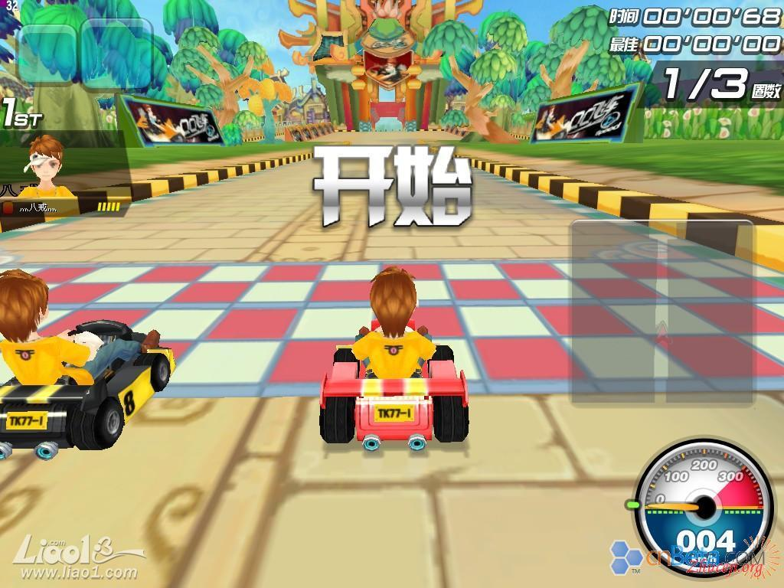

Two games: QQ Speed
QQ Speed
Car racing against other users
200+ million users
Notes:
The second game is QQ Speed. It is a racing game that users can take part in racing competitions to play against other users. The game is the largest racing game in china and has more than 200 million users.

Slide 8
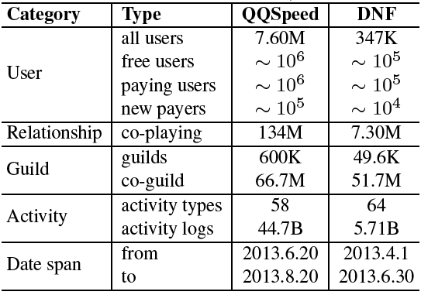
Datasets
Statistics of the datasets
Notes:
Here shows the statistics of the datasets.

Slide 9
Datasets
Statistics of the datasets
Notes:
The qq speed dataset has a two-month period. There are 44 billion activity logs from 7.6 million users. The dnf dataset has a three-month period. There are totally 5.7 billion activity logs from 347 thousand users.

Slide 10
Datasets
Statistics of the datasets
Date span of the data
Free users:
No $
Paying users:
$
New Payers:
No $
$
Notes:
In addition, the two datasets also contain the paying logs. Based on these logs, we classify the users into free users, paying users and new payers. For the users who never pay, we classify them as free users. For the users that paid before the start of the data’s date span, we classify them as paying users. For the remaining users who have no paying behavior before, but paid during the date span, we classify them as new payers.

Slide 11
Observation
How do demographic attributes affect users’ paying behavior?
How do social factors influence users’ paying behavior?
Notes:
We first conduct analysis on how different factors influence users’ paying behavior. In particular, we focus on how demographic attributes and social factors influence users’ paying behavior. Due to the time limit, I will only present the analysis results on social factors.

Slide 12
Observation – Social Effects
Social network construction
Co-playing network
Social relationship
Social influence
Strong/Weak tie
Status
Structural diversity
Notes:
Before studying social effects, We first construct a co-playing network. In the co-playing network, if two users have played together, we connect the two users by an edge. Then we analyze the correlations between users’ paying behavior and various social effects in this network. Particularly, we focus on social relationship and structural diversity. For social relationship, we study the theories of social influence, strong/weak tie and status.

Slide 13
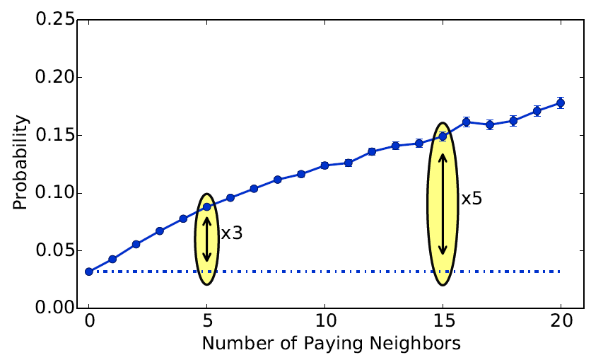
Social Relationship – Social Influence
Y: probability that a free user converts to a new payer
More paying neighbors
Higher conversion probability
Notes:
We first study social influence. We want to study whether users’ paying behavior will be influenced by their paying neighbors. So we calculate the conversion probability conditioned on the number of paying neighbors. In the figure, we can see that the conversion probability continues to increase when the user has more paying neighbors. For example, when a free user has 5 paying neighbors, the conversion probability increase to 3 times higher than that he has no paying neighbors. This suggests that user’s paying behavior will be influenced by their paying neighbors.

Slide 14
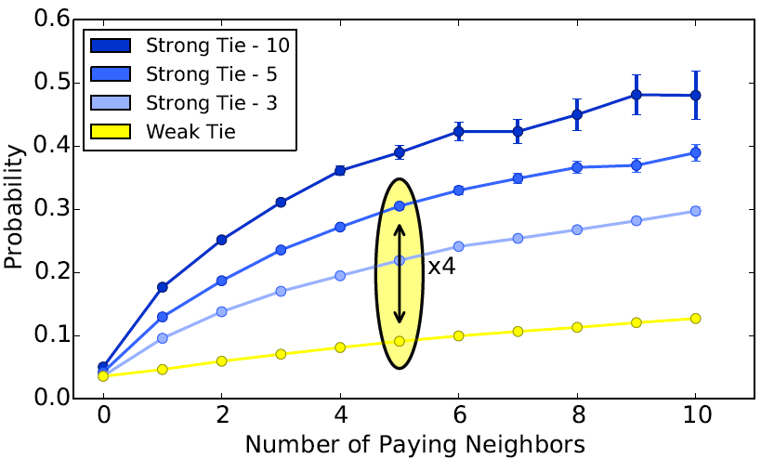
Social Relationship – Strong/Weak Tie
Y: probability that a free user converts to a new payer
Strong ties
Strong influence
Notes:
Then we further study whether strong tie and weak tie have different influence on users’ paying behavior. We classify the relationships into strong ties and weak ties by the number of times that two users played together in the game. We take 5 as a threshold. Then if two users played together for more than 5 times, we call the relationship as a strong tie, otherwise a weak tie. In the figure, we can see that strong ties indeed have strong influence on the paying behavior. Take 5 paying neighbors for example. If the relationship is strong tie, the conversion probability is 30%, almost 4 times higher than the case when the relationship is weak tie.

Slide 15
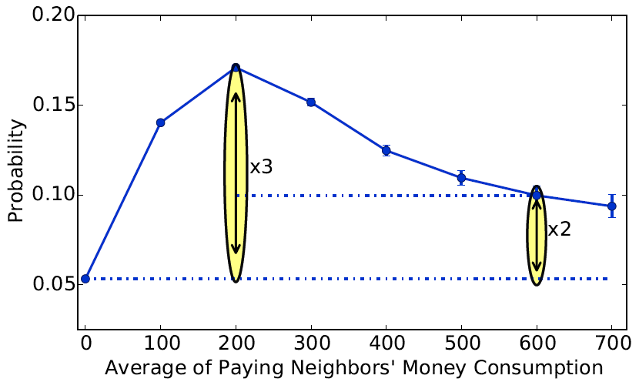
Social Relationship – User Status
Y: probability that a free user converts to a new payer
Neighbors’ money consumption increases
Conversion probability follows a unimodal shape
Notes:
Another interesting analysis is how the amount of money paid by the paying neighbors would influence the user’s paying behavior. We calculate the conversion probability conditioned on the average of paying neighbors’ money consumption in our dataset. We can see that when the paying neighbors pay more money, the conversion probability follows a unimodal shape. This is possibly because some users could receive more gift items from their “rich friends” than other users.

Slide 16
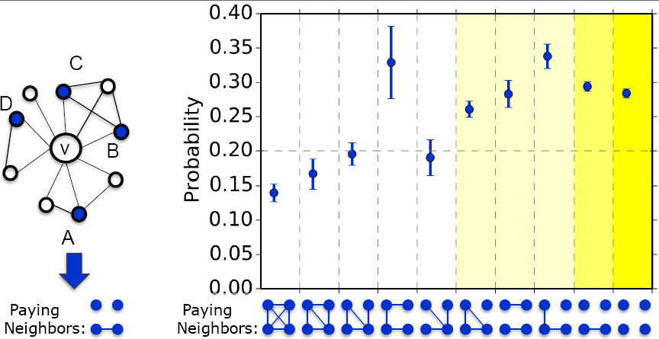
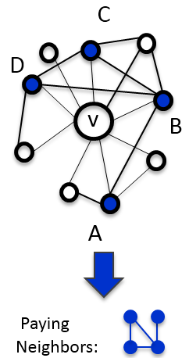
Structure Diversity
Different structures of a user’s neighbors have different effects on the user’s behavior^{[1]}
[1] Ugander, J., Backstrom, L., Marlow, C., & Kleinberg, J. Structural diversity in social contagion. In PNAS’12.
Notes:
Besides peer relationships, we also study how the structure of one’s neighbor influences his paying behavior. We use the idea of structural diversity, which suggests that different structures of a user’s neighbors have different effects on the user’s behavior. Take the figure on left hand side for an example. The centric node is the free user we are going to study. The surrounding nodes are neighbors where blue nodes indicating paying users. We can see that B and C are connected as a component; A and D are separated as two independent components. This structure can be abstracted as below.

Slide 17
Structure Diversity
Notes:
We show the conversion probability of different structure for 4 paying neighbors.

Slide 18
Structure Diversity
Notes:
. We can see that the conversion probability generally increases when the structure become more sparse, except the fourth case.

Slide 19
Structure Diversity
Notes:
For example, if all the neighbors do not know each other, which corresponds to the last case here, the conversion probability is almost twice higher than the situation when the four neighbors know each other, which corresponds to the first case here.

Slide 20
Extracted Features
User attributes features
Social effect features
In-game behavior features
#purchased items
sum of virtual money consumption
etc.
Notes:
Based on the analysis above, we extract features from user attributes and social network. In addition, we also extract features from users’ in-game behavior log, including number of purchased items, and so on, which can complement the features extracted from attributes and social network.

Slide 21
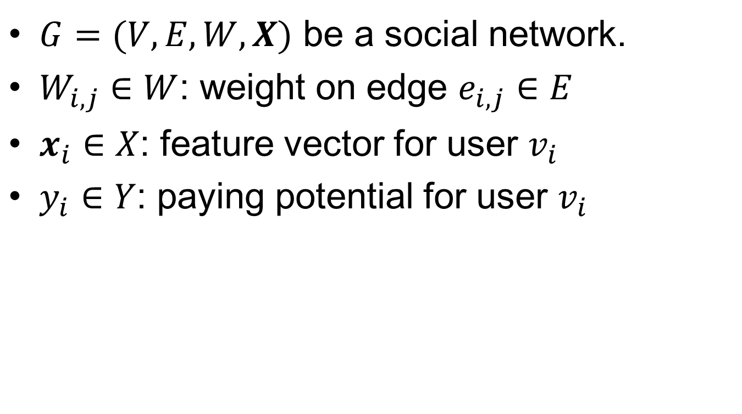
Model Framework - Notations
$G=(V,E,W,X)$ be a social network.
$W_{i,j}∈W$: weight on edge $e_{i,j}∈E$
$x_{i}∈X$: feature vector for user $v_{i}$
$y_{i}∈Y$: paying potential for user $v_{i}$
Input:
G = (V, E, W, X)
Output:
Y
Notes:
Next we introduce our model. To present the model precisely, we first introduce some notations. Let G=(V,E,W,X) be a social network. Wij represents weight on edge eij. Xi represent a feature vector for user vi. Yi represents the paying potential for user vi. Then the input of the model is the social network G, and the output of the model is the paying potential Y.

Slide 22
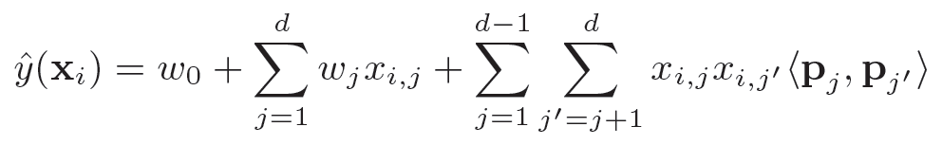

Factorization Machines
The prediction for feature vector $x_{i}$:
Model parameters:
Notes:
We first recall factorization machine, which is the basic of our model. Factorization machines have been proposed and successfully applied to various recommendation and prediction tasks.

Slide 23
Factorization Machines
The prediction for feature vector $x_{i}$:
Model parameters:
Notes:
For feature vector xi, the prediction is computed by this formula in the fm model, where d is the length of the feature vector, pj are k-dimensional latent vectors that capture the interactions between feature variables

Slide 24
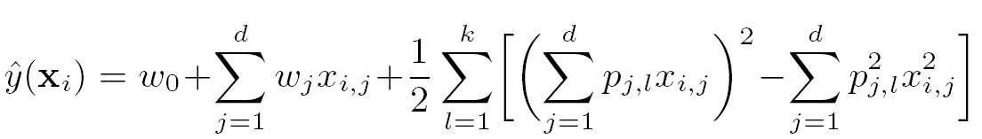

Factorization Machines
The prediction for feature vector $x_{i}$:
Model parameters:
It can be rewritten as:
Notes:
The formula can be rewritten as followed. So that we can calculate the prediction in O(dk) time.

Slide 25
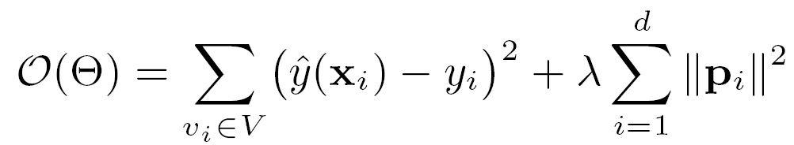
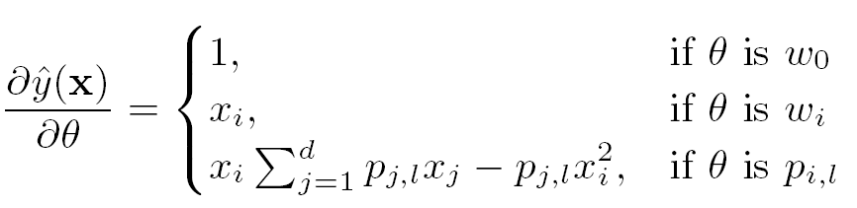
Factorization Machine (cont’)
Objective function:
Solve by Stochastic Gradient Descent (SGD)
Notes:
We could write down the objective function by using square loss as loss function and applying L-2 regularization on the latent vector parameters to avoid overfitting. The parameter can be learned efficiently by the gradient descent method, like stochastic gradient descent.

Slide 26
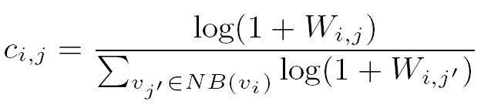
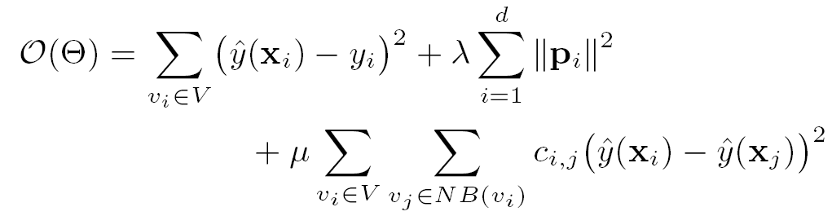
Local Consistent FM Model
Consistency degree between two nodes:
Incorporate the local consistency factor by a regularization term:
Notes:
Since the standard FM model cannot utilize the network information between users, we propose a Local Consistent FM (LCFM) model that incorporates the network information by local consistency. The general idea is that we assume neighborhood nodes in the network should be similar with each other, and the tendency depends on the strength of the relationship between them.

Slide 27
Local Consistent FM Model
Consistency degree between two nodes:
Incorporate the local consistency factor by a regularization term:
Notes:
Formally, based on the edge weight Wij, we define a consistency degree cij which equal to the normalized value of log Wij.

Slide 28
Local Consistent FM Model
Consistency degree between two nodes:
Incorporate the local consistency factor by a regularization term:
Notes:
Then we incorporate the local consistency factor by a regularization term, and rewrite the objective function as follows, where the third term in the objective function is the local consistency constraint.

Slide 29
Model Learning – Two-step approach
First step
Optimize the FM terms in training data by SGD.
.
Notes:
We use a two step approach to learn the model. In the first step, we directly optimize the factorization machine terms in training data, which is the same as learning traditional factorization machines.

Slide 30
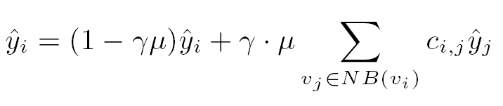

Model Learning – Two-step approach
First step
Optimize the FM terms in training data b SGD.
Second step
Optimize the local consistency terms by local propagation.
Where is a parameter to control the propagation rate.
Notes:
In the second step, we optimize the local consistency terms by a propagation strategy. For every yi, if vi has neighbors, we iteratively update yi by paying potential scores of its neighbors.

Slide 31


Time Complexity
Directly apply SGD:
Our approach:
Notes:
For the time complexity, if we directly use stochastic gradient descent to solve the new objective function, the time complexity is O(|E|Tkd), which is infeasible in most cases. By our approach, we can effectively reduce the time complexity.

Slide 32
Experimental Setup
Datasets
QQ Speed
Dungeon & Fighter Online (DNF)
Task
Predict new payers from free users
Training and test data
Split the datasets by time
Same time length for training and test
Notes:
For experiment, we use the two datasets QQ Speed and DNF. The task is to predict whether a free user will become a new payer. We split the datasets into training and test sets by time, and we have same time length for training and test set.

Slide 33
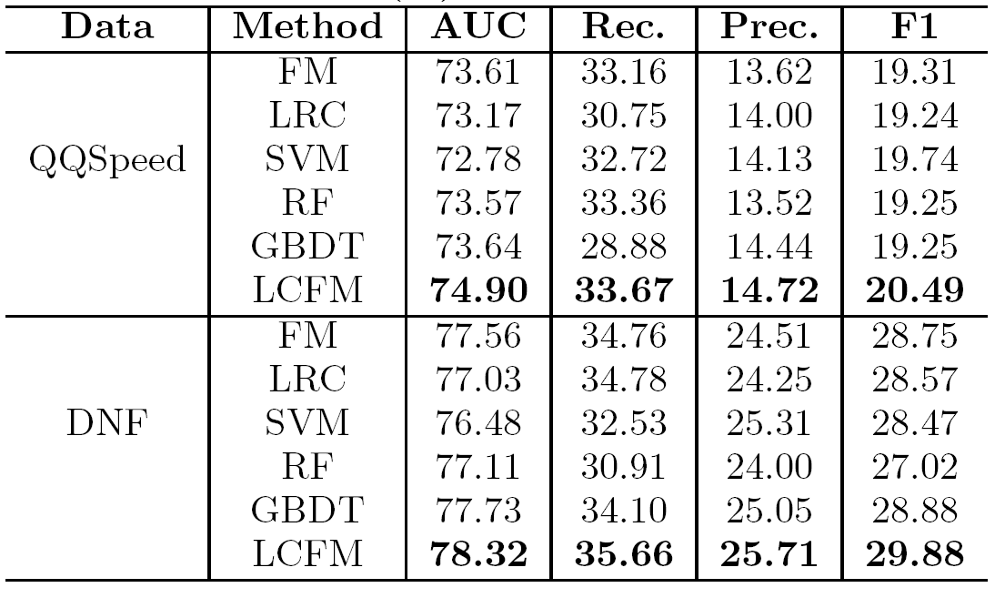
Results of Different Methods
Notes:
Here are the results of offline tests. We compare our local consistent factorization machine model with 5 baseline methods, which are factorization machines, logistic regression, support vector machine, random forest, and gradient boosted decision trees.

Slide 34
Results of Different Methods
Notes:
From the table, we can see that proposed model clearly outperforms all the baseline methods. The advantage of the LCFM model mainly lies in using the network information by the local consistency assumption, thus can better fit the data.

Slide 35
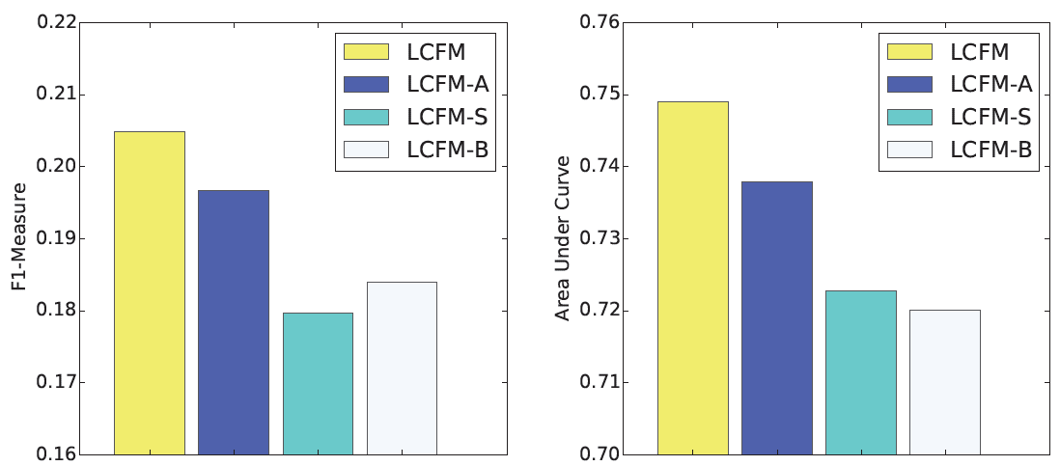
Feature Contribution
LCFM-A: stands for removing attribute features
LCFM-S: stands for removing social effect features
LCFM-B: stands for removing in-game behavior features
Notes:
We also study the contribution of different categories of features in LCFM model based on the QQ Speed dataset. In the figure, we can observe clear drop on the performance when ignoring each category of features. This indicates that our method works well by combining different categories of features and each category of features in our method contributes improvement in the performance.

Slide 36

Online Test
Test setting
Two groups: test group and control group.
Send messages to invite the users to attend a promotion activity.
Notes:
Besides offline tests, we also deployed the proposed method to the online games, and conducted two online tests in the game QQ Speed. For each online test, we use different methods to select a test group of users and a control group of users. Then we send messages to invite the selected users to a promotion activity. In the promotion activity, the user only needs to pay some amounts of money, then the user can participate a lottery draw to get items in QQ Speed.

Slide 37
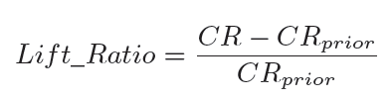
Online Test
Test setting
Two groups: test group and control group.
Send messages to invite the users to attend a promotion activity.
Evaluation metric:
where CR means the new payer convertion rate.
Prior strategy: suggests users mainly by their activities.
Notes:
We use a metric called lift_ratio to evaluate different methods. It calculates the relative improvement of conversion rate against the prior strategy used by the game company. The prior strategy of the game company suggest users mainly according to their activities.

Slide 38
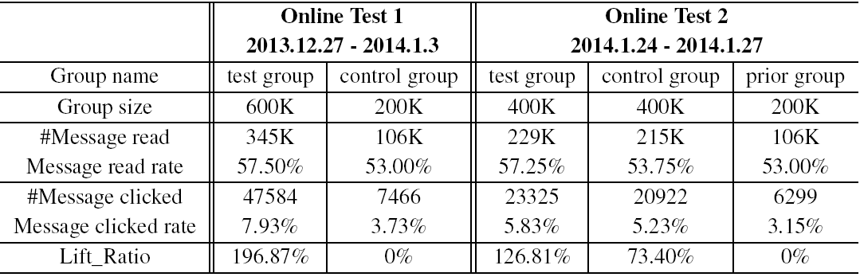
Online Test Results
Online test 1
Test the effectiveness of our approach in online scenario.
Test group: LCFM
Control group: Prior strategy
Notes:
In online test 1, we focus on validating the effectiveness of our approach in online scenario. We use the proposed method to select the test group users and use the prior strategy to select the control group users. We can see that our method significantly outperforms the baseline. Although the message read rates of the two methods are almost the same, our method brings almost 200% relative improvement in conversion rate compared to the prior selection method, which validates the effectiveness of our method in online scenario.

Slide 39
Online Test Results
Online test 2
Test the contribution of social factors in online scenario.
Test group: LCFM
Control group: LCFM – Social effect features
Notes:
In online test 2, we focus on testing the contribution of social factor in the online scenario. We use the proposed LCFM model to select the test group users, and used the LCFM model with removing the social effect features to select the control group users. From the results, we can see that the lift ratio in test group is 70% higher than that in the control group, which demonstrates that social factor plays an important role in modeling and predicting users’ paying behavior in online scenario.

Slide 40
Conclusion
Discovered strong social influence on users’ paying behavior in the game network.
Proposed a LCFM model that incorporates network information into FM model.
Confirmed the effectiveness of our approach by online test results.
Notes:
To conclude, in this paper, we found strong social influence on users’ paying behavior in the game network. Based on the discoveries, we proposed a local consistent factorization machines model that incorporates the network information into FM model. We deployed the model in online games and the online test results confirmed the effectiveness of the proposed model.

Slide 41
Thank you!

Slide 42
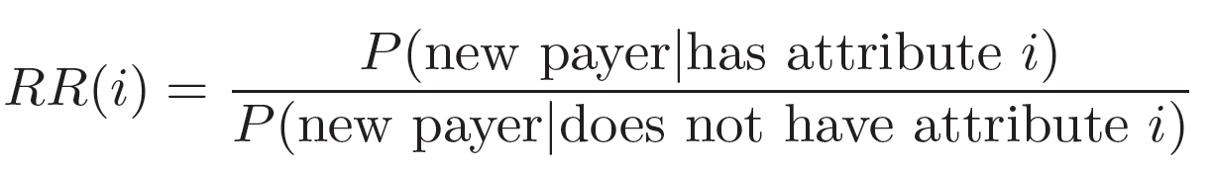
Observation - Demographics
Relative risk for attribute i:
RR(i) > 1: more likely to become paying users
RR(i) < 1: less likely to become paying users
Notes:
We use relative risk to study the correlation between user’s paying behavior and user’s attribute. For a specific attribute, if the relative risk is larger than 1, the users with this attribute are more likely to become paying users. If it is less than 1, the users with this attribute are less likely to become paying users.

Slide 43
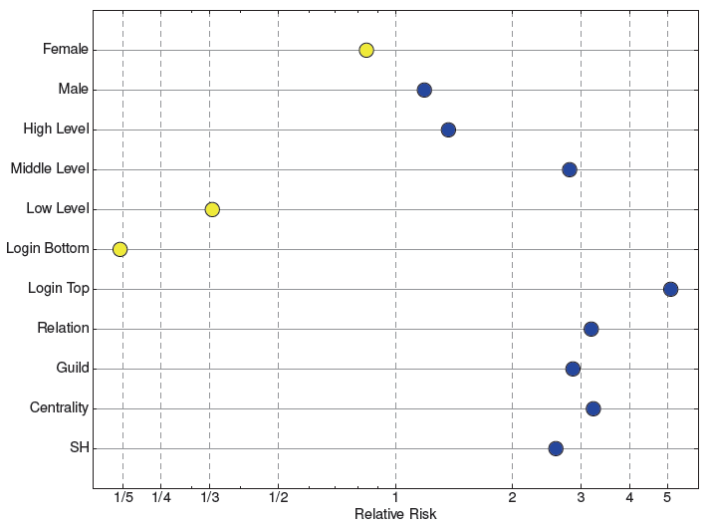
Observation - Demographics
Notes:
Here are the results for different attributes.

Slide 44
Observation - Demographics
Notes:
For gender, male users are easier to become new payer than female users.

Slide 45
Observation - Demographics
Notes:
For users’ level, we categorize users into three level groups: low, middle and high. The users in the middle level group are easier to become a new payer than the others.

Slide 46
Observation - Demographics
Notes:
For login frequency, we evenly divide the users into two groups, login bottom and login top to represent users who login less frequently and more frequently respectively. And the users that login in frequently are much more willing to pay than the users that login less frequently.

Slide 47
Observation - Demographics
Notes:
Moreover, the users that have relationship with others, or have joined guilds, or are centrality, or structural hole in the game network, are more likely to become new payers.

Slide 48
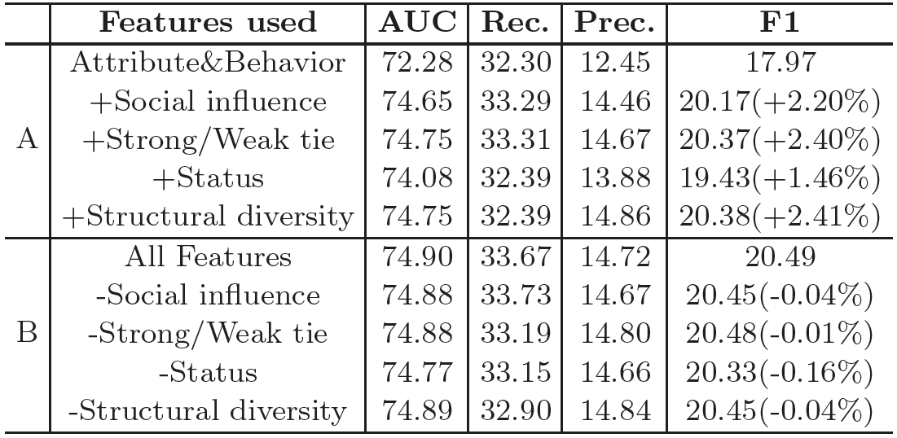
Social Effect Contribution

Slide 49
Social Effect Contribution

Slide 50
Online gaming is one of the largest industries on the Internet…
Facebook
250 million users play games monthly
200 games with more than 1 million active users
12% of the company’s revenue is from games
Tencent (Market Cap: ~150B $)
More than 400 million gaming users
50% of Tencent’s overall revenue is from online games
Not only keep players playing,
but also make them pay.
Notes:
In online game, one key problem is how to design strategies to keep players not just playing, but also paying. This is important for the sustainable development of the whole game industry

Slide 51
Online games are become more and more social…
Social activity has already become one of the most important elements in designing online games.
Statistics show that 80% of Zynga’s revenue comes from Facebook users.

Slide 52
What we do
Given users’ data in online games, predict:
Precisely, we aim to answer:
What are the fundamental factors that trigger free users to play?
How does users’ paying behavior influence each other in the game social network?
How to design a prediction model to recognize those potential users who are likely to pay?
Free users -> Paying users
Notes:
social activity has already become one of the most important elements in designing online games. How is users’ paying behavior influenced by friends and the social structure?
Design methods that can combine the user features and the social effects

Slide 53
Online games are become more and more social…
Statistics show that 80% of Zynga’s revenue comes from Facebook users.

Slide 54
Online games are become more and more social…
Statistics show that 80% of Zynga’s revenue comes from Facebook users.
How to model paying behavior in game social networks?

Slide 55
Online games are become more and more social…
Statistics show that 80% of Zynga’s revenue comes from Facebook users.
How to model paying behavior in game social networks?
Free users -> Paying users

Slide 56
Challenges
Sparsity
Only 3% of the users in Zynga have purchased credits in the game.
Social effect
How is users’ paying behavior influenced by friends and the social structure?
Predictive models
How to develop methods that can effectively identify potential paying users?

Slide 57
Related Work
Attribute analysis
Motivation for play [Yee CPB’06]
Gender swapping [Lou WWW’13]
Social Analysis
Interaction patterns [Ducheneaut CSCW’04]
Grouping patterns [Ducheneaut CHI’06]
Group stability [Patil WWW’13]
Types of interaction networks [Son PloS one 12]
Notes:
Online games have billions of users worldwide. Analyzing and mining the big data from online games becomes an important topic for understanding users’ behaviors.

Slide 58
Two games: QQ Speed
QQ Speed
A racing game that users can take part in competitions to play against other users.
200+ million users.
Users can race against other users by individuals or forma a group to race together.

Slide 59
Datasets
Statistics of the datasets

Slide 60
Datasets
Statistics of the datasets
No $
Free users:
Date span of data

Slide 61
Datasets
Statistics of the datasets
$
Paying users:
Date span of data

Slide 62
Datasets
Statistics of the datasets
No $
$
New Payers:
Date span of data

Slide 63
Social Relationship – Social Influence
Social influence: users tend to change their behavior so as to match to their friends’ behavior.
Examine the probability of a free user becoming a new payer, conditioned on the number of paying neighbors in the game network.
Notes:
The principle of social influence suggests that users tend to change their behavior so as to match to their friends’ behaviors.

Slide 64
Social Relationship – Strong/Weak Tie
Strong tie: connections with people who you are close to and associate regularly with.
Weak tie: more distant connections.
Classify the relationships into strong/weak ties by the number of times that two users played together in the game.
Notes:
We further study whether strong tie and weak tie have different influence on users’ paying behavior.

Slide 65
Social Relationship – User Status
User status: the total amount of money consumption in the two month period.
Examine the probability of a free user becoming a new payer, conditioned on the average of paying neighbors’ status.
Notes:
Another interesting analysis is how the total amount of money paid by the paying neighbors would influence the user’s paying behavior.

Slide 66
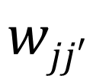
Factorization Machines
The prediction for feature vector $x_{i}$:
Model parameters:
MF
$$wjj′$$

Slide 67
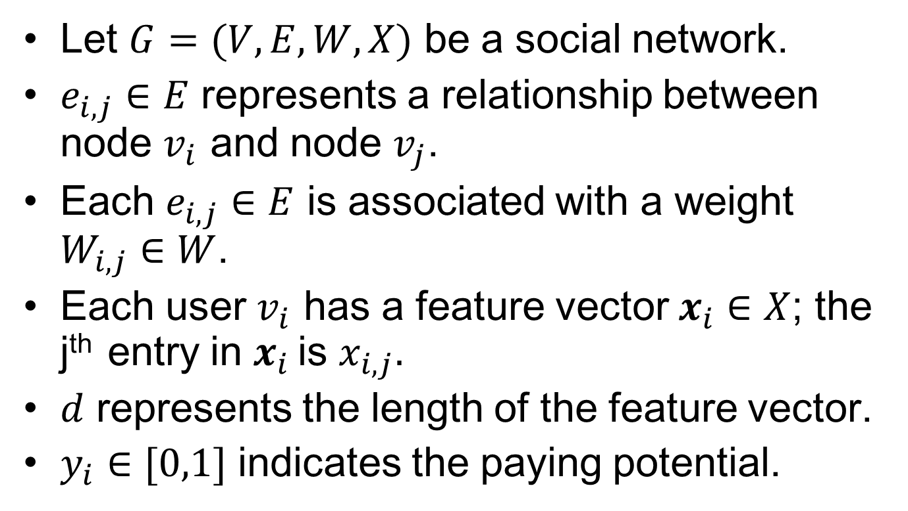
Model Framework - Notations
Let $G=(V,E,W,X)$ be a social network.
$e_{i,j}∈E$ represents a relationship between node $v_{i}$ and node $v_{j}$.
Each $e_{i,j}∈E$ is associated with a weight $W_{i,j}∈W$.
Each user $v_{i}$ has a feature vector $x_{i}∈X$; the j^{th} entry in $x_{i}$ is $x_{i,j}.$
$d$ represents the length of the feature vector.
$y_{i}∈[0,1]$ indicates the paying potential.

Slide 68
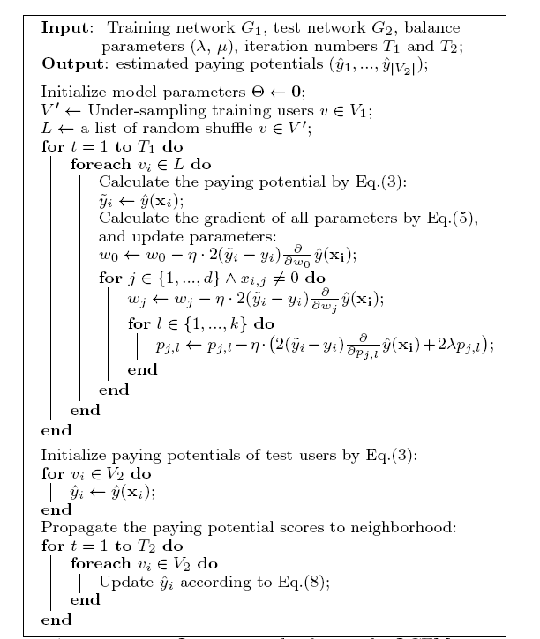

Slide 70
Online Test
Test setting
Two groups: test group and control group.
Send messages to invite the user to attend a promotion activity.

Slide 71
Experimental Setup
Prediction setting
Predict whether a free user will become a new payer
Split the datasets into training and test sets by time
Evaluation measures
Precision (Prec.)
Recall (Rec.)
F1-Measure (F1)
Area under Curve (AUC)

Slide 72
Datasets
Statistics of the datasets

Slide 73
Observation - Demographics

