Slide 1
Accurate Product Name Recognition from User Generated Content
Team: ISSSID
Sen Wu, Zhanpeng Fang, Jie Tang
Department of Computer Science
Tsinghua University
Notes:
Good afternoon, ladies and gentlemen. I am XXX. I am going to present the solution of the team “ISSSID” for the consumer products contest of ICDM 2012.

Slide 2
ISSSID Team
ISSSID
  “In Science, Self-Satisfaction Is Death”
Notes:
“XX”. our team name comes from this motto.

Slide 3
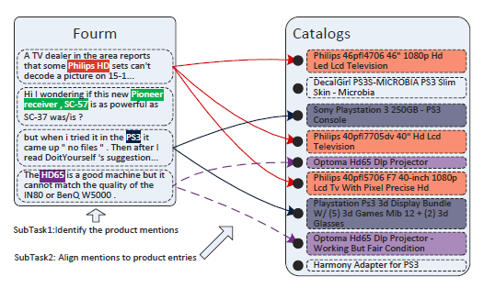
Task
Notes:
First of all, let me briefly introduce the contest’s problem.
The contest provides texts that contains product mentions and a products catalog.
The task of the competition can be divided into two subtasks. Subtask 1 is to find the product mentions in the text content. Subtask 2 is to align the found product mentions to product entries in the product catalog.

Slide 4
Challenges
Heterogeneous data
  Product name, category & price
Informal text
  from Forum
Product recognition subtasks
  Recognition & Alignment
Notes:
the problem has several unique challenges.
The first challenge is that the dataset contains heterogeneous data including product name, product category and product price. We need to find a method to utilize these heterogeneous information to enhance the performance.
The second challenge is that the text data are collected from forum. Most of the text are informal. The text contains much noise than standard text.
The third challenge is that the product recognition has two subtasks. First we need to find product mentions. Second we need to align each mention to products in the catalog. We need to have a high accuracy in both recognition and alignment to obtain a good performance in the contest.

Slide 5
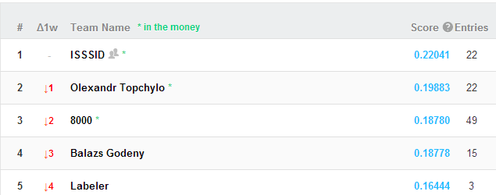
Result
0.30379(public score)/0.22041(private score)
1st place winner
Notes:
In this contest, we propose a hybrid approach. The approach achieves the best performance with an F-measure of 0.22041 on the private leaderboard.

Slide 6
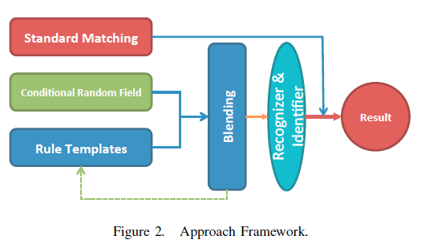
Framework
1
2
Forum Text
Notes:
This is the framework of our approach. It basically consists of two stages.
In the first stage, we apply three basic models: XXX1 , XXX2 and XXX3 to find product mentions. The three model utilize different aspects of the data.
SM directly uses the annotated information in the training data to find product mentions.
Rule templates uses rules to find product mentions.
CRF builds a machine learning model to find product mentions.
In the second stage, we use a blending model to combine the output of the three basic models. And finally, we use a method to align the products with each mention we find.

Slide 7
1st Basic Model: Standard Matching
Directly use the annotated information in the training data
Extract terms that are annotated as products in the train data
Find corresponding terms/symbols in the test data
Notes:
The first basic model is standard matching.
The easiest way to find product mentions is to use the annotated information in the training data. Based on this idea, we can simply extract those terms that are annotated as products in the training data, and then find their occurrences in the test data.
This model has an obvious drawback. It can only recognize a small proportion of product mentions. Only those that are annotated in the train data can be found. But it has high precision, which means that almost all the product mentions it finds are true positives.

Slide 8
2nd Basic Model: Rule Templates
Product mentions
  Identify product mentions by rules
Rules for recognition
  Special words
Rules for filter
  Semantic patterns
  General list
Notes:
The second basic model is rule templates. In this model, we find product mentions by a set of rules. There are two kinds of rules in this model. The first kind of rule is for recognition. By this kind of rules, we can find product mentions. The second kind of rules is for filter. By this kind of rules, we can filter some incorrect product mentions we find.

Slide 9
Rule Templates: Special Words
Products’ names: combination of specific characters
  Denon 3808CI receiver
  Marantz VP11S2
Special words
  One-gram non-standard words
  Appear no more than 20 times in the catalogs
Notes:
Next, I will introduce an important rule to find product mentions. A key observation is that many products’ names use the combination of specific characters. For example, like ‘3808CI’in the first example, and ‘VP11S2’ in the second example.
Based on the observation, we define special words. To be a special word, it need to satisfy two conditions. The first condition is that it’s a one-gram non-standard word, which means that it can not be found in a general dictionary. Because we want to limit the number of special words, so we set the second condition is that it should appear in the products catalog, but appear no more than 20 times.

Slide 10
Rule Templates: Special Words
Find special words in text
Identify the whole product mention
  Construct a name tokens set using products’ names which contains the special word
  Expand the special word on both sides if the neighbor tokens are in the set
  Four million special words found?
Notes:
To use special words for finding product mentions, we use the following method.
First, we find words that are special words in text.
Then we try to find product mention by the special word.
First we construct a name tokens set using all the products’ names that contain the special word. Then, we expand the special word in the text on both sides if the neighbor tokens are in the set. Then we get a product mention for a special word.
However, four million special words are found in the data. Do all of them works for finding product mentions?

Slide 11
Rule Templates: Special Words
Too many incorrect mentions
  ‘Goto page 1 , 2 , 3Next Page 1 of 3’
  ‘Replied by mohmony’
  ‘SIGN UP 25 MJanosh 490 Thu May 17’
  ‘all speakers to small and raise the crossovers up to 80hz’
How to filter the product mentions?
Notes:
In fact, there are many incorrect mentions are found by the special words rule. Here are some examples. Words marked as red are incorrect mentions found by the rule. These incorrect mentions make our performance even worse. How to filter the product mentions ? We find that many of these incorrect mentions have obvious patterns. Therefore, we can design some rules to filter these product mentions.

Slide 12
Rule Templates: Semantic Patterns
Most products follow a pron, prep or quantifier
  ‘my mac’, ‘the Xbox’, ‘one GTR’…
Preposition ‘for’ in product mentions
  ‘Seidio Innocase 360 for BlackBerry Curve 8900’
Words following ‘by’
  Usually represent a person rather than a product name
  ‘Posted by jbooker82’
Notes:
We design a series of rules for filter based on semantic patterns. We summarize three important patterns. The first pattern is that we find most product names follow a pronoun, preposition or quantifier, such as ‘my mac’, ‘the xbox’, ‘one GTR’ and so on.
The second pattern is that when a sentence mentions some products and contains preposition ‘for’ in it, the words before ‘for’ has a higher probability to be a product mention than those after ‘for’. For example ‘BlackBerry Curve 8900’ is not a mentioned product while ‘Seidio Innocase 360’ is a mentioned product.
The third pattern is that the words following ‘by’ usually represent a user name or an organization rather than a product name. For example we should ignore ‘jbooker82’ in this example.

Slide 13
Rule Templates: General List
Several categories of words are not helped for special words
  Stop words (e.g., his, her)
  Capitalized nouns (e.g., January, Monday)
  Common abbreviations (e.g., mins, kg )
Filter special words in the above categories
  ‘speakers to small and raise the crossovers up to 80hz’
  ‘Then the resulting M2TS is 23fps’
Notes:
Another important filter rule we use is to filter the special words again by some general lists.
We find that special words in some categories are not helped.
These categories are stop words, capitalized nouns and common abbreviations.
So, we filter special words in the above categories and reduce some incorrect mentions found by special words rule. Like the example here, they all filtered by the rule.

Slide 14
Rule Templates: Other Filter Rules
Length limitation: 2~15 characters per token
Filter product mentions beside particular words
  Views, replies, posts & pages
Mixture word contains both number and letters
Notes:
Besides filter rules dbased on semantic patterns and general list, here are some other filter rules we find useful.
First, it’s to set a length limitation for each token in the product mention.
Second, it’s to filter product mentions beside particular words, like ‘views’, ‘replies’, …
Third, it’s to only consider the mixture word that contains both number and letters as special words.
These filter rules significantly help us improve the performance of rule templates model.

Slide 15
3rd Basic Model: Conditional Random Field
“Mallet”
  A machine learning for language toolkit
Sequence tagging model
Three Categories
  ‘B’: beginning of a product mention
  ‘I’: inside a product mention
  ‘O’: outside a product mention
Notes:
The third basic model is conditional random field. We use “Mallet”to implement the CRF model. Our approach is similar to baseline 2 provided by the contest. It trains a sequence tagging model. The model classifies each token as one of the three categories ‘B’ ‘I’ and ‘O’indicating that token is the beginning, inside or outside of a product mention;

Slide 16
CRF: Features
Features | Example
TOKEN | Current token
FC | Upper-case/Lower-case of first character
CHARCNT | #characters
UCCNT | #upper-case characters
NUMCNT | #numeric characters
LCCNT | #lower-case characters
DSHCNT | #dash-characters
SLSHCNT | #slash-characters
PERIODCNT | #periods characters
GRWRDCNT | #matching grammatical words
BRNDWRDCNT | #matching English common words
ENWRDCNT | #matching brand words
P_TOKEN* | Previous token
P_PREP* | If the previous token is a preposition
PF* | Pattern feature
  CRF1: the same as baseline 2; CRF2: include additional features(*)
Notes:
In our final submission, we use two different CRF models. This table lists all the features used in the CRF models. The first CRF is the same as the baseline 2 provided by the contest. The second CRF is added three features compared to the first one. The three features are listed with star in the bottom of the table.

Slide 17
Blending Process
Filter the mentions that CRF recognizes by rule templates method
Filter conflicted mentions by following priority: SM > CRF > RT
Blend all the mentions together
Notes:
As all the models proposed so far focus on different aspects of the problem, blending all product mentions together may be helpful. Our blending process contains three steps.
The first step is to filter the mentions that CRF find by rule templates again. This can reduce the number of incorrect mentions found by CRF.
The second step is to filter the conflicted mentions. If two mentions are overlapped, we say that they are conflicted. Then we will first keep the mention found by SM, then keep the mentions found by CRF, and last keep the mentions found by RT.
Finally, we blend all the mentions together.

Slide 18
Product Alignment
Select the product items whose name contains the product mention
Utilize product category data
  Every product mention only belong to one category, CE or AU
  Conformity principle
Notes:
Next we try to align products in the product catalogs with each product mentions we find. Our product alignment method is quite straightforward. First, We select all the product items whose name contains the product mention. Then, we use the category information to enhance the performance. Intuitively, every product mention should only align to products that belong to one category, either CE or AU. So we need to determine which category the product mention belongs to. Here, we choose the category with more selected products as the category the product mention belongs to. Then, we only keep the product items in the chosen category as the aligned products.

Slide 19
Experiment
No. | Models | Public Leaderboard | Private Leaderboard
1 | Standard Matching | 0.14557 | 0.09005
2 | Rule Templates | 0.15844 | 0.11365
3 | CRF1 | 0.16328 | 0.15775
4 | CRF2 | 0.12168 | 0.14390
5 | 3 + 4 | 0.17375 | 0.17465
6 | 1 + 2 | 0.26525 | 0.17909
7 | 3 + 6 | 0.30656 | 0.20526
8 | 4 + 7 | 0.30379 | 0.22041(+0.02)
Performance of each model is limited
Combination can significantly improves the performance
Notes:
Following is the experiment result. From the table, we can see that while the performance of each individual model is limited, the combination can significantly improves the performance. Because each model use different aspects of the data.
another interesting point is that the performance between public and private leaderboard have huge difference. We think that this is because the size of training data is small, so it’s not easy to train a robust model.

Slide 20
Summary
“Tricks” on how to win the contest
  Rules + Statistics (+5%)
  Blending (+6.5%)
  Pruning (+1-5%)
Notes:
In summary, we find some tricks on how to win the contest.
The first trick is that we can use both rule based method and statistics based method to achieve a better performance. The rule based method can easily incorporate manual observed pattern to the solution, while the statistics method like machine learning algorithm can capture other information which is not easy to observe.
The second trick is that we can use the blending method to combine the advantages of different models to achieve a better performance.
The third trick is that we can use some pruning method to reduce the false positives. This technique is critical for the algorithms that do not have a high precision.

Slide 21
Thank you!
Questions？

Slide 22
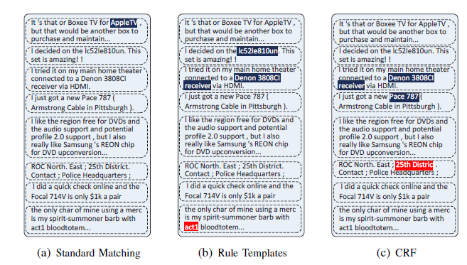
Case Study

Slide 23
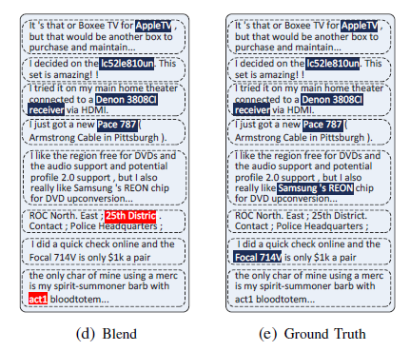
Case Study

