Slide 1
Testing combinatory effect of two mutations

Slide 2
Basic approach
Different modes:
The question asked: does the combinatory effect explain the phenotype variation with genotype
Recessive:
Additive:
Dominant:
Inhibitory:
REF HET VAR
REF HET VAR
REF HET VAR
REF HET VAR
REF
0 | 0 | 0
0 | 0 | 0
0 | 0 | 1
REF
0 | 0 | 0
0 | 1 | 2
0 | 2 | 4
REF
0 | 0 | 0
0 | 1 | 1
0 | 1 | 1
REF
0 | 1 | 2
1 | 0 | 0
2 | 0 | 0
HET
HET
HET
HET
VAR
VAR
VAR
VAR
Whether combinatory effect increases the prevalence of affected mice
Whether combinatory effect decreases the prevalence of affected mice

Slide 3

Program output
P value matrix of additive mode
Distribution of the genotype and phenotype of G3 mice
P value matrix of dominant mode
Heatmap summarizing analysis results
log
P value matrix of recessive mode

Slide 4
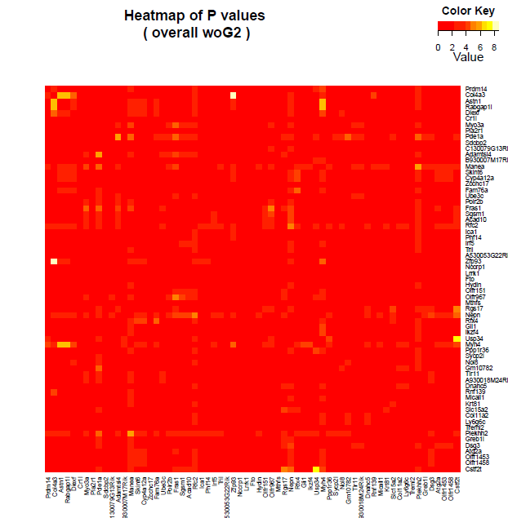
Heatmap

Slide 5
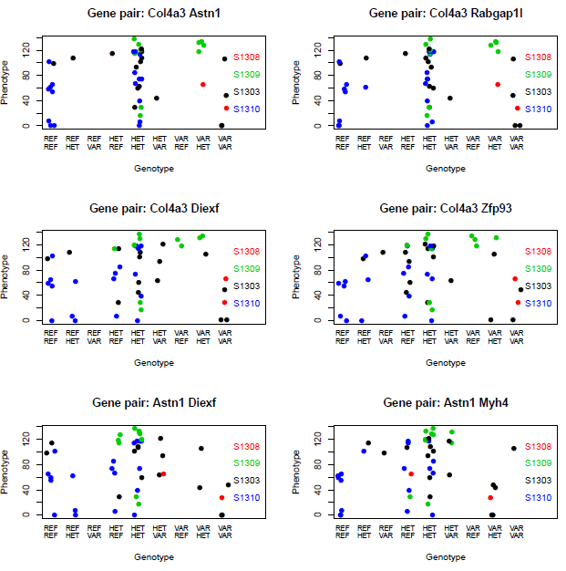
Distribution plot

