Slide 1
R package: LinkageAnalysis
Title: Identification of genotypes with significant association with phenotype and lethality
Version: 0.2
Platform: Linux, PC, Mac
Depends: R (>= 2.15.0), lme4

Slide 2
Functionality
single_link(main_file="Thames/Thames_QM_Report_Continuous.csv",G2_file="Thames/Thames_QM_Report_G2.csv", output="Thames/Continuous_mixed",silent=T,test="mixed",cutoff=c(10,90))
Finding phenotype-associated mutations
Generalized linear model (“fixed”)
Generalized linear fixed effect model (“mixed”)
Transmission disequilibrium test (TDT)
Finding lethality-causing mutations
Not complete yet
Various diagnostic plots

Slide 3
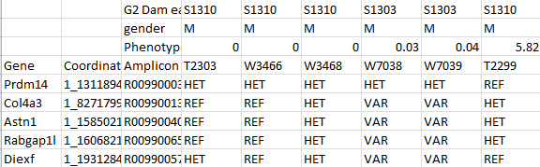
Input – main file
CSV file saved by excel
Names of columns and rows
Must be Gene, Coordination, Amplicon, G2 Dam eartag, gender, phenotype
Phenotype
Affected/Nonaffected or numerical values
Name of G2 mothers
Gender
F/M
G3 names
Amplicon
Genotype
REF, HET, VAR - recognized
FAILED, FALSE – treated as NA
Other symbols – treated as NA
Gene name
Gene position
chr_location

Slide 4
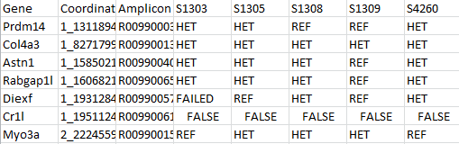
Input – G2 file (optional)
CSV file saved by excel
Names of columns
Must be Gene, Coordination, Amplicon
Name of G2 mothers
G2 mother Genotype
REF, HET, VAR - recognized
FAILED, FALSE – treated as NA
Other symbols – treated as NA
Amplicon
Gene name
Gene position
chr_location

Slide 5
Input – program parameters
Input files (two CSV files)
main_file="Thames/Thames_QM_Report_Continuous.csv“
G2_file="Thames/Thames_QM_Report_G2.csv“
Output folder (used to store output files)
output="Thames/Continuous_mixed“
Verbose (TRUE or FALSE)
silent=T
Algorithm (“mixed”: GLMER, “fixed”: GLM)
test="mixed“
Cutoff on phenotype scores (when supplying continuous phenotype scores, you can specify this vector to see how the scores can be divided into different modes. Not very useful yet)
cutoff=c(10,90)

Slide 6
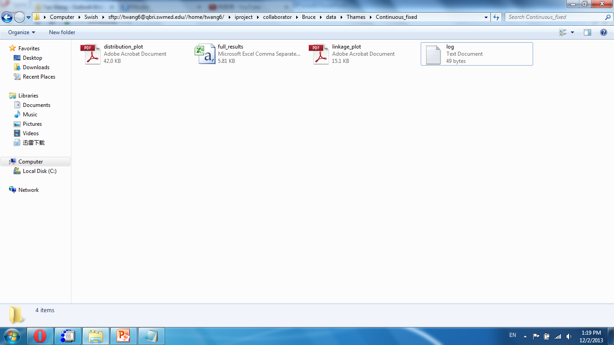
Output – output folder
Output folder

Slide 7
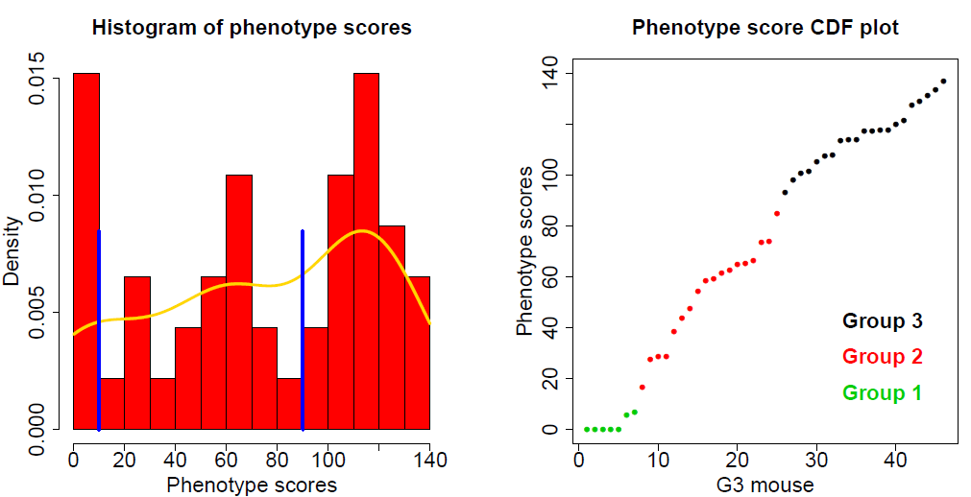
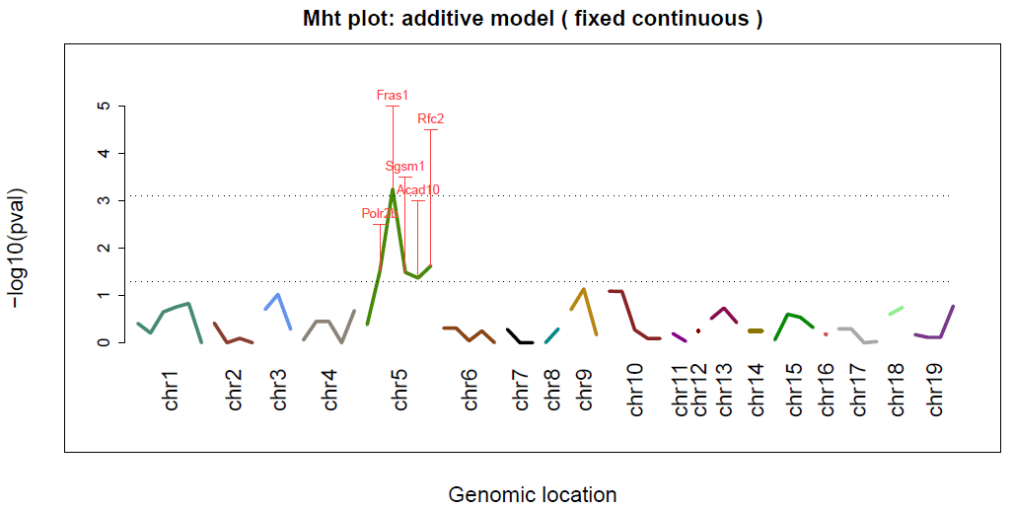
Output – linkage testing
One diagnostic plot
Additive
Recessive
Dominant
TDT

Slide 8
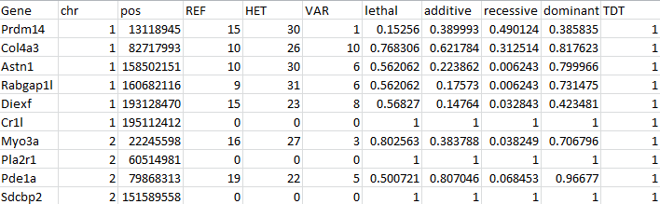
Output – detailed results
CSV file readable by Excel
Gene information
G3 mouse counts
Statistical test results

Slide 9
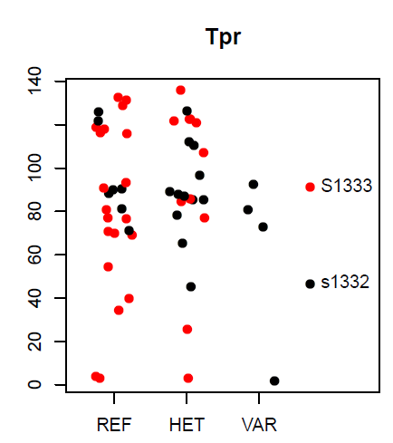
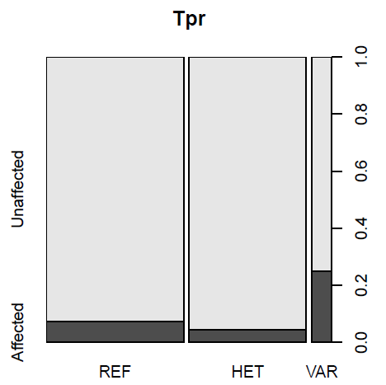
Output – distribution plots
Continuous phenotype scores
Binary phenotypes

Slide 10
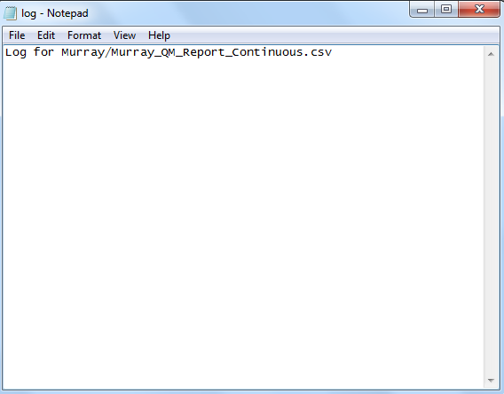
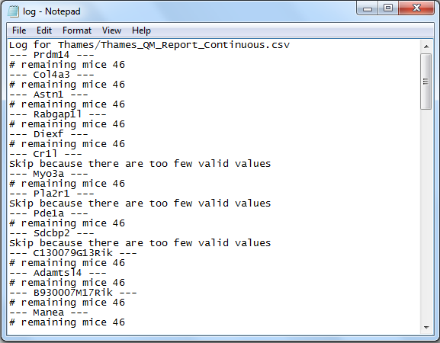
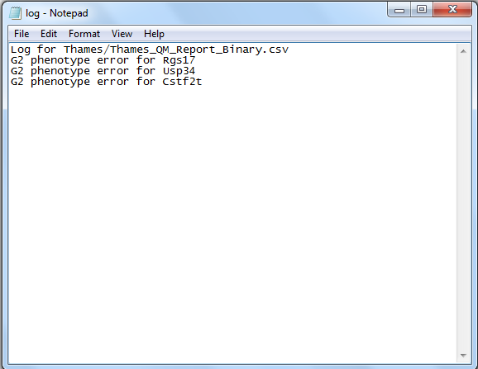
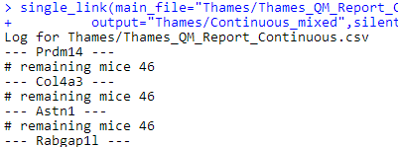
Output – log file
(1) In most cases, only one line
(2) If “silent=F”, verbose output
(3) In some cases, errors and warnings will be printed
(4) The same information is also printed to the R command line

Slide 11
Note
“? single_link” to view help documents
Example input files in LinkageAnalysis/extdata/ folder
Lme4 package stability problem. One older version that is stable at least on Linux is attached with the package.
Errors and warnings
Disconcordant G2 and G3 genotypes
Typos and unrecognized symbols

