Slide 1

Mining Association Rules in Large Databases
Knowledge Discovery in Databases
School of Software, Nanjing University

Slide 2

Mining Association Rules in Large Databases
Association rule mining
Mining single-dimensional Boolean association rules from transactional databases
Mining multilevel association rules from transactional databases
Mining multidimensional association rules from transactional databases and data warehouse
From association mining to correlation analysis
Summary

Slide 3

What Is Association Mining?
Association rule mining:
  Finding frequent patterns, associations, correlations, or causal structures among sets of items or objects in transaction databases, relational databases, and other information repositories.
Applications:
  Basket data analysis, cross-marketing, catalog design, loss-leader analysis, clustering, classification, etc.
Examples.
  Rule form: “Body → Ηead [support, confidence]”.
  buys(x, “diapers”) → buys(x, “beers”) [0.5%, 60%]
  major(x, “CS”) ^ takes(x, “DB”) → grade(x, “A”) [1%, 75%]

Slide 4
Association Rule: Basic Concepts
Given: (1) database of transactions, (2) each transaction is a list of items (purchased by a customer in a visit)
Find: all rules that correlate the presence of one set of items with that of another set of items
  E.g., 98% of people who purchase tires and auto accessories also get automotive services done
Applications
  Commodity arrangement
  Buying power analysis
  Other applications

Slide 5
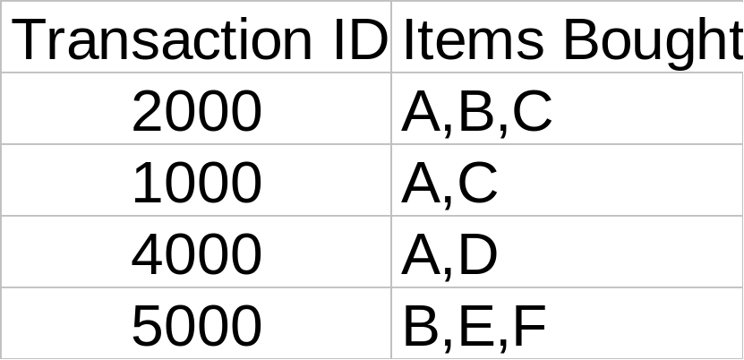
Rule Measures: Support and Confidence
Find all the rules X & Y ⇒ Z with minimum confidence and support
  support, s, probability that a transaction contains {X , Y , Z}
  confidence, c, conditional probability that a transaction having {X , Y} also contains Z
Customer
buys both
Customer
buys diaper
Customer
buys beer
Let minimum support 50%, and minimum confidence 50%, we have
  A ⇒ C (50%, 66.6%)
  C ⇒ A (50%, 100%)

Slide 6
Association Rule Mining: A Road Map
Boolean vs. quantitative associations (Based on the types of values handled)
  buys(x, “SQLServer”) ^ buys(x, “DMBook”) → buys(x, “DBMiner”) [0.2%, 60%]
  age(x, “30..39”) ^ income(x, “42..48K”) → buys(x, “PC”) [1%, 75%]
Single dimension vs. multiple dimensional associations (see ex. Above)
Single level vs. multiple-level analysis
  What brands of beers are associated with what brands of diapers?
Various extensions
  Correlation, causality analysis
    Association does not necessarily imply correlation or causality
  Maxpatterns and closed itemsets

Slide 7
Mining Association Rules in Large Databases
Association rule mining
Mining single-dimensional Boolean association rules from transactional databases
Mining multilevel association rules from transactional databases
Mining multidimensional association rules from transactional databases and data warehouse
From association mining to correlation analysis
Summary

Slide 8
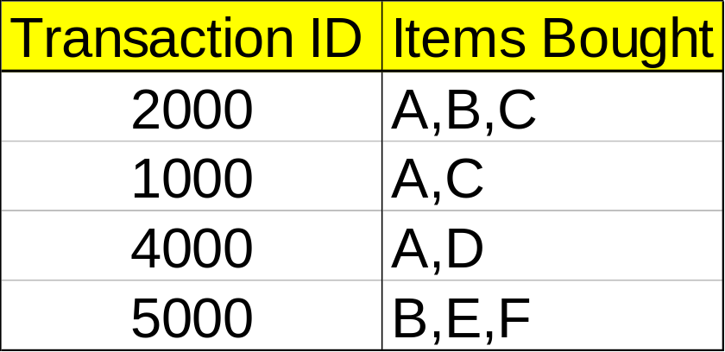
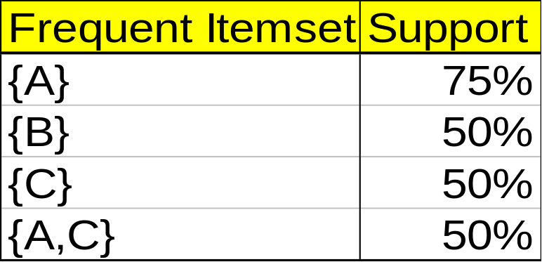
Mining Association Rules—An Example
Min. support 50%
Min. confidence 50%
For rule A ⇒ C:
  support = support({A and C}) = 50%
  confidence = support({A and C})/support({A}) = 66.6%
The Apriori principle:
  Any subset of a frequent itemset must be frequent

Slide 9
Mining Frequent Itemsets: the Key Step
Find the frequent itemsets: the sets of items that have minimum support
  A subset of a frequent itemset must also be a frequent itemset
    i.e., if {AB} is a frequent itemset, both {A} and {B} should be a frequent itemset
  Iteratively find frequent itemsets with cardinality from 1 to k (k-itemset)
Use the frequent itemsets to generate association rules.

Slide 10
The Apriori Algorithm
Join Step: C_{k} is generated by joining L_{k-1}with itself
Prune Step: Any (k-1)-itemset that is not frequent cannot be a subset of a frequent k-itemset
Pseudo-code:
    C_{k}: Candidate itemset of size k
    L_{k} : frequent itemset of size k
    L₁ = {frequent items};
    for (k = 1; L_{k} !=∅; k++) do begin
    C_{k+1} = candidates generated from L_{k};
    for each transaction t in database do
      increment the count of all candidates in C_{k+1} that are contained in t
    L_{k+1} = candidates in C_{k+1} with min_support
    end
    return ∪_{k} L_{k};

Slide 11




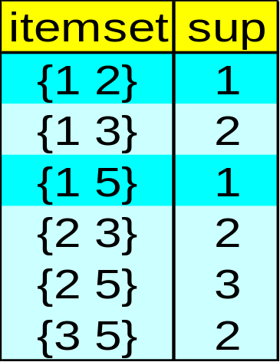

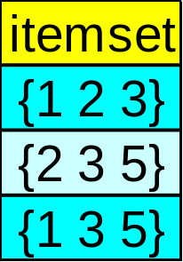

The Apriori Algorithm — Example
Database D
L₁
C₁
Scan D
C₂
C₂
L₂
Scan D
C₃
Scan D
L₃

Slide 12
How to Generate Candidates?
Suppose the items in L_{k-1} are listed in an order
Step 1: self-joining L_{k-1}
  insert into C_{k}
  select p.item₁, p.item₂,…, p.item_{k-1}, q.item_{k-1}
  from L_{k-1} p, L_{k-1} q
  where p.item₁=q.item₁,…, p.item_{k-2}=q.item_{k-2}, p.item_{k-1} < q.item_{k-1}
Step 2: pruning
  forall itemsets c in C_{k} do
    forall (k-1)-subsets s of c do
      if (s is not in L_{k-1}) then delete c from C_{k}

Slide 13
Example of Generating Candidates
L₃={abc, abd, acd, ace, bcd}
Self-joining: L₃*L₃
  abcd from abc and abd
  acde from acd and ace
Pruning:
  acde is removed because ade is not in L₃
C₄={abcd}

Slide 14
Methods to Improve Apriori’s Efficiency
Hash-based itemset counting: A k-itemset whose corresponding hashing bucket count is below the threshold cannot be frequent
Transaction reduction: A transaction that does not contain any frequent k-itemset is useless in subsequent scans
Partitioning: Any itemset that is potentially frequent in DB must be frequent in at least one of the partitions of DB
Sampling: mining on a subset of given data, lower support threshold + a method to determine the completeness
Dynamic itemset counting: add new candidate itemsets only when all of their subsets are estimated to be frequent

Slide 15
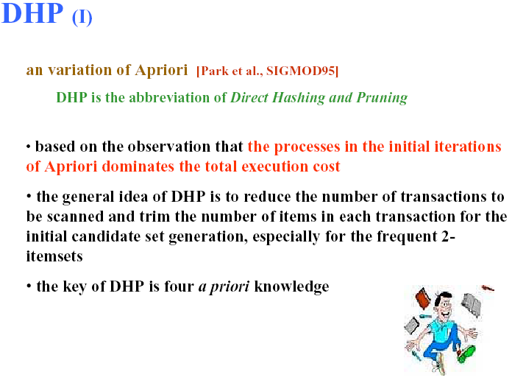

Slide 16
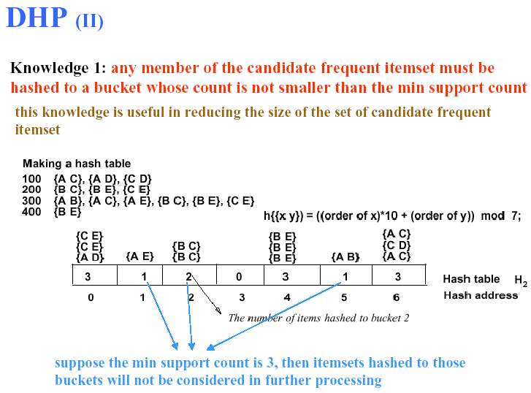

Slide 17
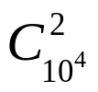
Is Apriori Fast Enough? — Performance Bottlenecks
The core of the Apriori algorithm:
  Use frequent (k – 1)-itemsets to generate candidate frequent k-itemsets
  Use database scan and pattern matching to collect counts for the candidate itemsets
The bottleneck of Apriori: candidate generation
  Huge candidate sets:
    10⁴ frequent 1-itemset will generate 10⁷ candidate 2-itemsets
    To discover a frequent pattern of size 100, e.g., {a₁, a₂, …, a₁₀₀}, one needs to generate 2¹⁰⁰ ≈ 10³⁰ candidates.
  Multiple scans of database:
    Needs (n +1 ) scans, n is the length of the longest pattern

Slide 18
Mining Frequent Patterns Without Candidate Generation
Compress a large database into a compact, Frequent-Pattern tree (FP-tree) structure
  highly condensed, but complete for frequent pattern mining
  avoid costly database scans
Develop an efficient, FP-tree-based frequent pattern mining method
  A divide-and-conquer methodology: decompose mining tasks into smaller ones
  Avoid candidate generation: sub-database test only!

Slide 19
Construct FP-tree from a Transaction DB
TID Items bought (ordered) frequent items
100 {f, a, c, d, g, i, m, p} {f, c, a, m, p}
200 {a, b, c, f, l, m, o} {f, c, a, b, m}
300 {b, f, h, j, o} {f, b}
400 {b, c, k, s, p} {c, b, p}
500 {a, f, c, e, l, p, m, n} {f, c, a, m, p}
min_support = 0.5
{}
Steps:
Scan DB once, find frequent 1-itemset (single item pattern)
Order frequent items in frequency descending order
Scan DB again, construct FP-tree
Header Table
Item frequency head
f 4
c 4
a 3
b 3
m 3
p 3
f:4
c:1
c:3
b:1
b:1
a:3
p:1
m:2
b:1
p:2
m:1

Slide 20
Benefits of the FP-tree Structure
Completeness:
  never breaks a long pattern of any transaction
  preserves complete information for frequent pattern mining
Other advantages:
  reduce irrelevant information—infrequent items are gone
  never be larger than the original database (if not count node-links and counts)
  much faster than Apriori

Slide 21
Mining Frequent Patterns Using FP-tree
General idea (divide-and-conquer)
  Recursively grow frequent pattern path using the FP-tree
Method
  For each item, construct its conditional pattern-base, and then its conditional FP-tree
  Repeat the process on each newly created conditional FP-tree
  Until the resulting FP-tree is empty, or it contains only one path (single path will generate all the combinations of its sub-paths, each of which is a frequent pattern)

Slide 22
Step 1: From FP-tree to Conditional Pattern Base
Starting at the frequent header table in the FP-tree
Traverse the FP-tree by following the link of each frequent item
Accumulate all of transformed prefix paths of that item to form a conditional pattern base
Header Table
Item frequency head
f 4
c 4
a 3
b 3
m 3
p 3
{}
Conditional pattern bases
item cond. pattern base
c f:3
a fc:3
b fca:1, f:1, c:1
m fca:2, fcab:1
p fcam:2, cb:1
f:4
c:1
c:3
b:1
b:1
a:3
p:1
m:2
b:1
p:2
m:1

Slide 23
Step 2: Construct Conditional FP-tree
For each pattern-base
  Accumulate the count for each item in the base
  Construct the FP-tree for the frequent items of the pattern base
m-conditional pattern base:
  fca:2, fcab:1
{}
Header Table
Item frequency head
f 4
c 4
a 3
b 3
m 3
p 3
f:4
c:1
All frequent patterns concerning m
m,
fm, cm, am,
fcm, fam, cam,
fcam
c:3
b:1
b:1
{}

a:3
p:1
f:3

m:2
b:1
c:3
p:2
m:1
a:3
m-conditional FP-tree

Slide 24
Mining Frequent Patterns by Creating Conditional Pattern-Bases
Item
Conditional pattern-base
Conditional FP-tree
p
{(fcam:2), (cb:1)}
{(c:3)}|p
m
{(fca:2), (fcab:1)}
{(f:3, c:3, a:3)}|m
b
{(fca:1), (f:1), (c:1)}
Empty
a
{(fc:3)}
{(f:3, c:3)}|a
c
{(f:3)}
{(f:3)}|c
f
Empty
Empty

Slide 25
Step 3: Recursively mine the conditional FP-tree
{}
{}
Cond. pattern base of “am”: (fc:3)
f:3
c:3
f:3
am-conditional FP-tree
c:3
{}
Cond. pattern base of “cm”: (f:3)
a:3
f:3
m-conditional FP-tree
cm-conditional FP-tree
{}
Cond. pattern base of “cam”: (f:3)
f:3
cam-conditional FP-tree

Slide 26
Single FP-tree Path Generation
Suppose an FP-tree T has a single path P
The complete set of frequent pattern of T can be generated by enumeration of all the combinations of the sub-paths of P
{}
All frequent patterns concerning m
m,
fm, cm, am,
fcm, fam, cam,
fcam
f:3

c:3
a:3
m-conditional FP-tree

Slide 27
Principles of Frequent Pattern Growth
Pattern growth property
  Let α be a frequent itemset in DB, B be α's conditional pattern base, and β be an itemset in B. Then α ∪ β is a frequent itemset in DB iff β is frequent in B.
“abcdef ” is a frequent pattern, if and only if
  “abcde ” is a frequent pattern, and
  “f ” is frequent in the set of transactions containing “abcde ”

Slide 28
Why Is Frequent Pattern Growth Fast?
Our performance study shows
  FP-growth is an order of magnitude faster than Apriori, and is also faster than tree-projection
Reasoning
  No candidate generation, no candidate test
  Use compact data structure
  Eliminate repeated database scan
  Basic operation is counting and FP-tree building

Slide 29

FP-growth vs. Apriori: Scalability With the Support Threshold
Data set T25I20D10K

Slide 30
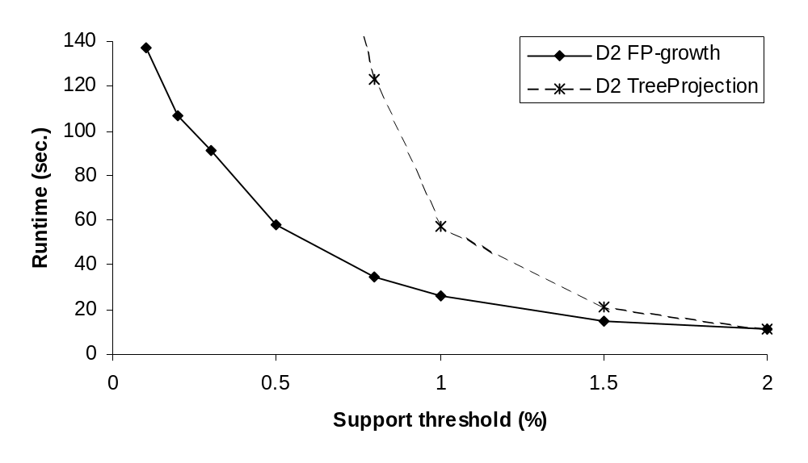
FP-growth vs. Tree-Projection: Scalability with Support Threshold
Data set T25I20D100K

Slide 31
Mining Association Rules in Large Databases
Association rule mining
Mining single-dimensional Boolean association rules from transactional databases
Mining multilevel association rules from transactional databases
Mining multidimensional association rules from transactional databases and data warehouse
From association mining to correlation analysis
Constraint-based association mining
Summary

Slide 32
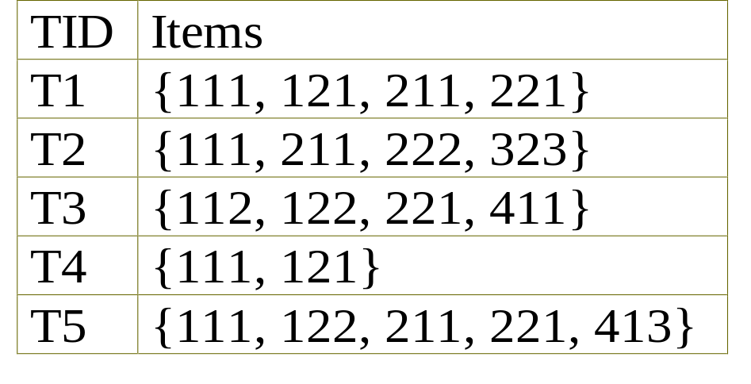
Multiple-Level Association Rules
Food
Items often form hierarchy.
Items at the lower level are expected to have lower support.
Rules regarding itemsets at
appropriate levels could be quite useful.
Transaction database can be encoded based on dimensions and levels
We can explore shared multi-level mining
milk
bread
Thin
Sweet
wheat
white
A brand
B brand

Slide 33
Mining Multi-Level Associations
A top_down, progressive deepening approach:
  First find high-level strong rules:
milk → bread [20%, 60%].
  Then find their lower-level “weaker” rules:
Sweet milk → wheat bread [6%, 50%].
Variations at mining multiple-level association rules.
  Level-crossed association rules:
Sweet milk → Wonder wheat bread
  Association rules with multiple, alternative hierarchies:
Sweet milk → Wonder bread

Slide 34
Multi-level Association: Uniform Support vs. Reduced Support
Uniform Support: the same minimum support for all levels
  + One minimum support threshold. No need to examine itemsets containing any item whose ancestors do not have minimum support.
  – Lower level items do not occur as frequently. If support threshold
    too high ⇒ miss low level associations
    too low ⇒ generate too many high level associations

Slide 35
Uniform Support
Multi-level mining with uniform support
Level 1
min_sup = 5%
Milk
[support = 10%]
Level 2
min_sup = 5%
Sweet Milk
[support = 6%]
Thin Milk
[support = 4%]
Back

Slide 36
Reduced Support
Multi-level mining with reduced support
Level 1
min_sup = 5%
Milk
[support = 10%]
Level 2
min_sup = 3%
2% Milk
[support = 6%]
Skim Milk
[support = 4%]
Back

Slide 37
Reduced Support: Searching Strategy(I)
Reduced Support: reduced minimum support at lower levels
  There are 4 search strategies:
    Level-by-level independent
    Level-cross filtering by k-itemset
    Level-cross filtering by single item
    Controlled level-cross filtering by single item
Level-by-level independent
  check all the nodes, not considering whether their parents are frequent

Slide 38
Reduced Support: Searching Strategy(II)
Level-cross filtering by k-itemset :
Level-cross filtering by single itemset :
Computer and printer[support=7%]
Min_support=5%
Laptop and
b/w printer[support=1%]
Desktop computer
and color printer[support=3%]
Min_support=2%
Computer[support=10%]
Min_support=12%
laptop[unchecked]
Desktop computer[unchecked]

Slide 39
Reduced Support: Searching Strategy(III)
Controlled level-cross filtering by single item
Min_support=12%
Computer[support=10%]
Level_passage_sup=8%
laptop[support=6%]
Desktop computer[support=4%]
Min_support=3%

Slide 40

Multi-level Association: Redundancy Filtering
Some rules may be redundant due to “ancestor” relationships between items.
Example
  milk ⇒ wheat bread [support = 8%, confidence = 70%]
  Sweet milk ⇒ wheat bread [support = 2%, confidence = 72%]
We say the first rule is an ancestor of the second rule.
A rule is redundant if its support is close to the “expected” value, based on the rule’s ancestor.

Slide 41
Mining Association Rules in Large Databases
Association rule mining
Mining single-dimensional Boolean association rules from transactional databases
Mining multilevel association rules from transactional databases
Mining multidimensional association rules from transactional databases and data warehouse
From association mining to correlation analysis
Constraint-based association mining
Summary

Slide 42
Multi-Dimensional Association: Concepts
Single-dimensional rules:
    buys(X, “milk”) ⇒ buys(X, “bread”)
Multi-dimensional rules: >2 dimensions or predicates
  Inter-dimension association rules (no repeated predicates)
    age(X,”19-25”) ∧ occupation(X,“student”) ⇒ buys(X,“coke”)
  hybrid-dimension association rules (repeated predicates)
    age(X,”19-25”) ∧ buys(X, “popcorn”) ⇒ buys(X, “coke”)
Categorical Attributes/Nominal Attributes
  finite number of possible values, no ordering among values
Quantitative Attributes
  numeric, implicit ordering among values

Slide 43
Techniques for Mining MD Associations
Search for frequent k-predicate set:
  Example: {age, occupation, buys} is a 3-predicate set.
  Techniques can be categorized by how age are treated.
1. Using static discretization of quantitative attributes
  Quantitative attributes are statically discretized by using predefined concept hierarchies.
2. Quantitative association rules
  Quantitative attributes are dynamically discretized into “bins”based on the distribution of the data.
3. *Distance-based association rules
  This is a dynamic discretization process that considers the distance between data points.

Slide 44
Static Discretization of Quantitative Attributes
Discretized prior to mining using concept hierarchy.
Numeric values are replaced by ranges.
In relational database, finding all frequent k-predicate sets will require k or k+1 table scans.
Data cube is well suited for mining.
The cells of an n-dimensional
  cuboid correspond to the
  predicate sets.
Mining from data cubes
can be much faster.
()
(age)
(income)
(buys)
(age, income)
(age,buys)
(income,buys)
(age,income,buys)

Slide 45

Quantitative Association Rules
Numeric attributes are dynamically discretized
  Such that the confidence or compactness of the rules mined is maximized.
2-D quantitative association rules: A_{quan1} ∧ A_{quan2} ⇒ A_{cat}
Cluster “adjacent”
  association rules
  to form general
  rules using a 2-D
  grid.
Example:
age(X,”34-35”) ∧ income(X,”30K - 50K”) ⇒ buys(X,”high resolution TV”)

Slide 46
Mining Association Rules in Large Databases
Association rule mining
Mining single-dimensional Boolean association rules from transactional databases
Mining multilevel association rules from transactional databases
Mining multidimensional association rules from transactional databases and data warehouse
From association mining to correlation analysis
Summary

Slide 47
Interestingness Measurements
Objective measures
  Two popular measurements:
  support; and
  confidence
Subjective measures (Silberschatz & Tuzhilin, KDD95)
  A rule (pattern) is interesting if
  it is unexpected (surprising to the user); and/or
  actionable (the user can do something with it)

Slide 48
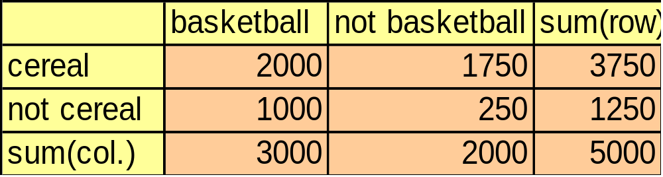
Criticism to Support and Confidence
Example 1: (Aggarwal & Yu, PODS98)
  Among 5000 students
    3000 play basketball
    3750 eat cereal
    2000 both play basket ball and eat cereal
  play basketball ⇒ eat cereal [40%, 66.7%] is misleading because the overall percentage of students eating cereal is 75% which is higher than 66.7%.
  not play basketball ⇒ eat cereal [35%, 87.5%]
  play basketball ⇒ not eat cereal [20%, 33.3%] is far more accurate, although with lower support and confidence

Slide 49
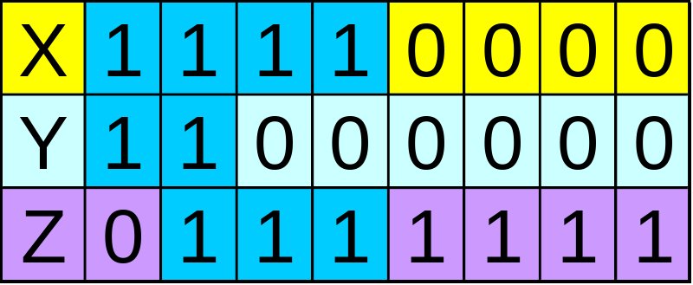
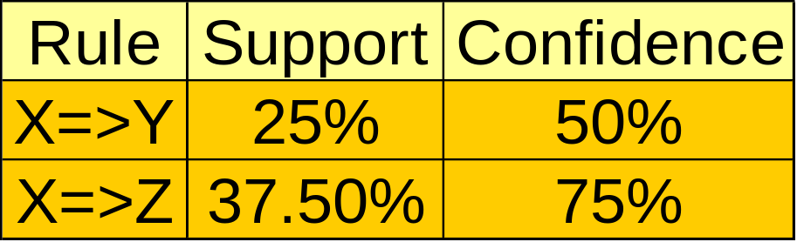
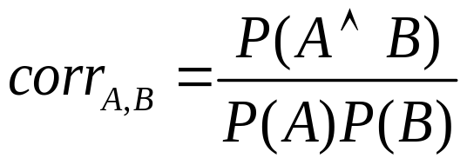
Criticism to Support and Confidence (Cont.)
Example 2:
  X and Y: positively correlated,
  X and Z, negatively related
  support and confidence of
  X=>Z dominates
We need a measure of dependent or correlated events

Slide 50
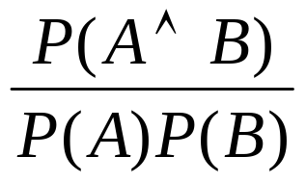
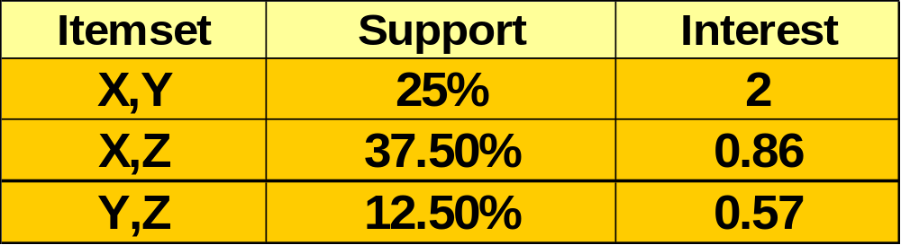
Other Interestingness Measures: Interest
Interest (correlation, lift)
  taking both P(A) and P(B) in consideration
  P(A^B)=P(B)*P(A), if A and B are independent events
  A and B negatively correlated, if the value is less than 1; otherwise A and B positively correlated

Slide 51
Mining Association Rules in Large Databases
Association rule mining
Mining single-dimensional Boolean association rules from transactional databases
Mining multilevel association rules from transactional databases
Mining multidimensional association rules from transactional databases and data warehouse
Summary

Slide 52
Summary
Association rule mining
  probably the most significant contribution from the database community in KDD
  A large number of papers have been published
Many interesting issues have been explored
An interesting research direction
  Association analysis in other types of data: spatial data, multimedia data, time series data, etc.

Slide 53
References
J. Han and M. Kamber. Data Mining: Concepts and Techniques. Morgan Kaufmann, 2000.(Including Materials)
R. Agarwal, C. Aggarwal, and V. V. V. Prasad. A tree projection algorithm for generation of frequent itemsets. In Journal of Parallel and Distributed Computing (Special Issue on High Performance Data Mining), 2000.
R. Agrawal, T. Imielinski, and A. Swami. Mining association rules between sets of items in large databases. SIGMOD'93, 207-216, Washington, D.C.
R. Agrawal and R. Srikant. Fast algorithms for mining association rules. VLDB'94 487-499, Santiago, Chile.
R. Agrawal and R. Srikant. Mining sequential patterns. ICDE'95, 3-14, Taipei, Taiwan.
R. J. Bayardo. Efficiently mining long patterns from databases. SIGMOD'98, 85-93, Seattle, Washington.
S. Brin, R. Motwani, and C. Silverstein. Beyond market basket: Generalizing association rules to correlations. SIGMOD'97, 265-276, Tucson, Arizona.
S. Brin, R. Motwani, J. D. Ullman, and S. Tsur. Dynamic itemset counting and implication rules for market basket analysis. SIGMOD'97, 255-264, Tucson, Arizona, May 1997.
K. Beyer and R. Ramakrishnan. Bottom-up computation of sparse and iceberg cubes. SIGMOD'99, 359-370, Philadelphia, PA, June 1999.

Slide 54
References (2)
G. Grahne, L. Lakshmanan, and X. Wang. Efficient mining of constrained correlated sets. ICDE'00, 512-521, San Diego, CA, Feb. 2000.
Y. Fu and J. Han. Meta-rule-guided mining of association rules in relational databases. KDOOD'95, 39-46, Singapore, Dec. 1995.
T. Fukuda, Y. Morimoto, S. Morishita, and T. Tokuyama. Data mining using two-dimensional optimized association rules: Scheme, algorithms, and visualization. SIGMOD'96, 13-23, Montreal, Canada.
E.-H. Han, G. Karypis, and V. Kumar. Scalable parallel data mining for association rules. SIGMOD'97, 277-288, Tucson, Arizona.
J. Han, G. Dong, and Y. Yin. Efficient mining of partial periodic patterns in time series database. ICDE'99, Sydney, Australia.
J. Han and Y. Fu. Discovery of multiple-level association rules from large databases. VLDB'95, 420-431, Zurich, Switzerland.
J. Han, J. Pei, and Y. Yin. Mining frequent patterns without candidate generation. SIGMOD'00, 1-12, Dallas, TX, May 2000.
T. Imielinski and H. Mannila. A database perspective on knowledge discovery. Communications of ACM, 39:58-64, 1996.
M. Kamber, J. Han, and J. Y. Chiang. Metarule-guided mining of multi-dimensional association rules using data cubes. KDD'97, 207-210, Newport Beach, California.
M. Klemettinen, H. Mannila, P. Ronkainen, H. Toivonen, and A.I. Verkamo. Finding interesting rules from large sets of discovered association rules. CIKM'94, 401-408, Gaithersburg, Maryland.

Slide 55
References (3)
F. Korn, A. Labrinidis, Y. Kotidis, and C. Faloutsos. Ratio rules: A new paradigm for fast, quantifiable data mining. VLDB'98, 582-593, New York, NY.
B. Lent, A. Swami, and J. Widom. Clustering association rules. ICDE'97, 220-231, Birmingham, England.
H. Lu, J. Han, and L. Feng. Stock movement and n-dimensional inter-transaction association rules. SIGMOD Workshop on Research Issues on Data Mining and Knowledge Discovery (DMKD'98), 12:1-12:7, Seattle, Washington.
H. Mannila, H. Toivonen, and A. I. Verkamo. Efficient algorithms for discovering association rules. KDD'94, 181-192, Seattle, WA, July 1994.
H. Mannila, H Toivonen, and A. I. Verkamo. Discovery of frequent episodes in event sequences. Data Mining and Knowledge Discovery, 1:259-289, 1997.
R. Meo, G. Psaila, and S. Ceri. A new SQL-like operator for mining association rules. VLDB'96, 122-133, Bombay, India.
R.J. Miller and Y. Yang. Association rules over interval data. SIGMOD'97, 452-461, Tucson, Arizona.
R. Ng, L. V. S. Lakshmanan, J. Han, and A. Pang. Exploratory mining and pruning optimizations of constrained associations rules. SIGMOD'98, 13-24, Seattle, Washington.
N. Pasquier, Y. Bastide, R. Taouil, and L. Lakhal. Discovering frequent closed itemsets for association rules. ICDT'99, 398-416, Jerusalem, Israel, Jan. 1999.

Slide 56
References (4)
J.S. Park, M.S. Chen, and P.S. Yu. An effective hash-based algorithm for mining association rules. SIGMOD'95, 175-186, San Jose, CA, May 1995.
J. Pei, J. Han, and R. Mao. CLOSET: An Efficient Algorithm for Mining Frequent Closed Itemsets. DMKD'00, Dallas, TX, 11-20, May 2000.
J. Pei and J. Han. Can We Push More Constraints into Frequent Pattern Mining? KDD'00. Boston, MA. Aug. 2000.
G. Piatetsky-Shapiro. Discovery, analysis, and presentation of strong rules. In G. Piatetsky-Shapiro and W. J. Frawley, editors, Knowledge Discovery in Databases, 229-238. AAAI/MIT Press, 1991.
B. Ozden, S. Ramaswamy, and A. Silberschatz. Cyclic association rules. ICDE'98, 412-421, Orlando, FL.
J.S. Park, M.S. Chen, and P.S. Yu. An effective hash-based algorithm for mining association rules. SIGMOD'95, 175-186, San Jose, CA.
S. Ramaswamy, S. Mahajan, and A. Silberschatz. On the discovery of interesting patterns in association rules. VLDB'98, 368-379, New York, NY..
S. Sarawagi, S. Thomas, and R. Agrawal. Integrating association rule mining with relational database systems: Alternatives and implications. SIGMOD'98, 343-354, Seattle, WA.
A. Savasere, E. Omiecinski, and S. Navathe. An efficient algorithm for mining association rules in large databases. VLDB'95, 432-443, Zurich, Switzerland.
A. Savasere, E. Omiecinski, and S. Navathe. Mining for strong negative associations in a large database of customer transactions. ICDE'98, 494-502, Orlando, FL, Feb. 1998.

Slide 57
References (5)
C. Silverstein, S. Brin, R. Motwani, and J. Ullman. Scalable techniques for mining causal structures. VLDB'98, 594-605, New York, NY.
R. Srikant and R. Agrawal. Mining generalized association rules. VLDB'95, 407-419, Zurich, Switzerland, Sept. 1995.
R. Srikant and R. Agrawal. Mining quantitative association rules in large relational tables. SIGMOD'96, 1-12, Montreal, Canada.
R. Srikant, Q. Vu, and R. Agrawal. Mining association rules with item constraints. KDD'97, 67-73, Newport Beach, California.
H. Toivonen. Sampling large databases for association rules. VLDB'96, 134-145, Bombay, India, Sept. 1996.
D. Tsur, J. D. Ullman, S. Abitboul, C. Clifton, R. Motwani, and S. Nestorov. Query flocks: A generalization of association-rule mining. SIGMOD'98, 1-12, Seattle, Washington.
K. Yoda, T. Fukuda, Y. Morimoto, S. Morishita, and T. Tokuyama. Computing optimized rectilinear regions for association rules. KDD'97, 96-103, Newport Beach, CA, Aug. 1997.
M. J. Zaki, S. Parthasarathy, M. Ogihara, and W. Li. Parallel algorithm for discovery of association rules. Data Mining and Knowledge Discovery, 1:343-374, 1997.
M. Zaki. Generating Non-Redundant Association Rules. KDD'00. Boston, MA. Aug. 2000.
O. R. Zaiane, J. Han, and H. Zhu. Mining Recurrent Items in Multimedia with Progressive Resolution Refinement. ICDE'00, 461-470, San Diego, CA, Feb. 2000.

Slide 58
Thank you !!!

