Slide 1
Advanced Artificial Intelligence
Project Practice: Car Logos Classification

Slide 2

Introduction
The car logos dataset was handpicked from loosely scraped websites and contains images, photos, drawings, sketches at various color schemes (black/white, RGB, CMYK, one-color), different angles and can sometimes contain some noise (other logotypes, background, etc.)
Datasets
About 20,778 50x50px RGB images depicting logotypes of 40 different car brands.

Slide 3
Experimental environment
Keras+TensorFlow
You can choose Jupyter notebook or Pycharm as IDE.

Slide 4
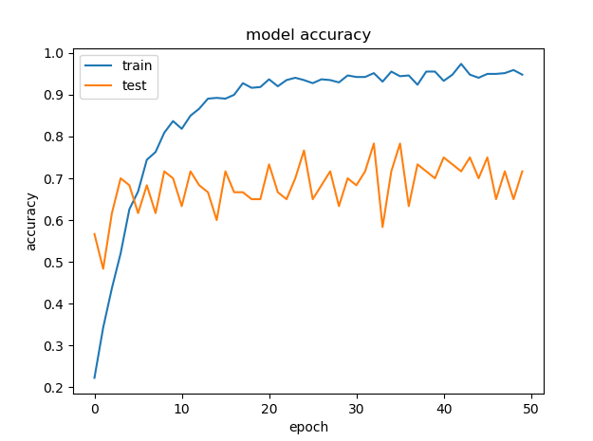
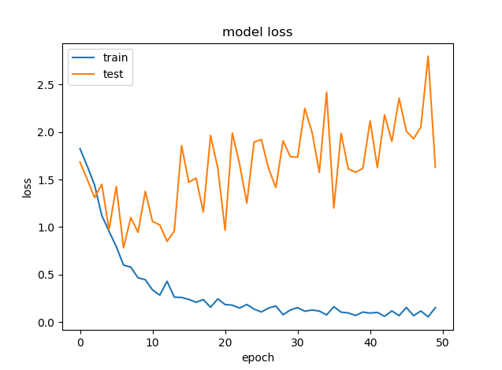
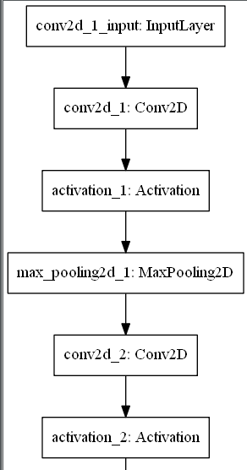
Submit
Trained network model files, including models (json format), model weights (h5 format).
model_architecture_studentId.json
model_weights_studentId.h5
Project
Experiment Report
Including：
The experimental result graph contains the curves of accuracy and loss. example:
Network model structure ，example：
Model identification accuracy
If the verification set is divided, the accuracy of the training set and the accuracy of the verification set need to be submitted.
If the verification set is not divided, only the accuracy rate on the training set needs to be submitted.

Slide 5
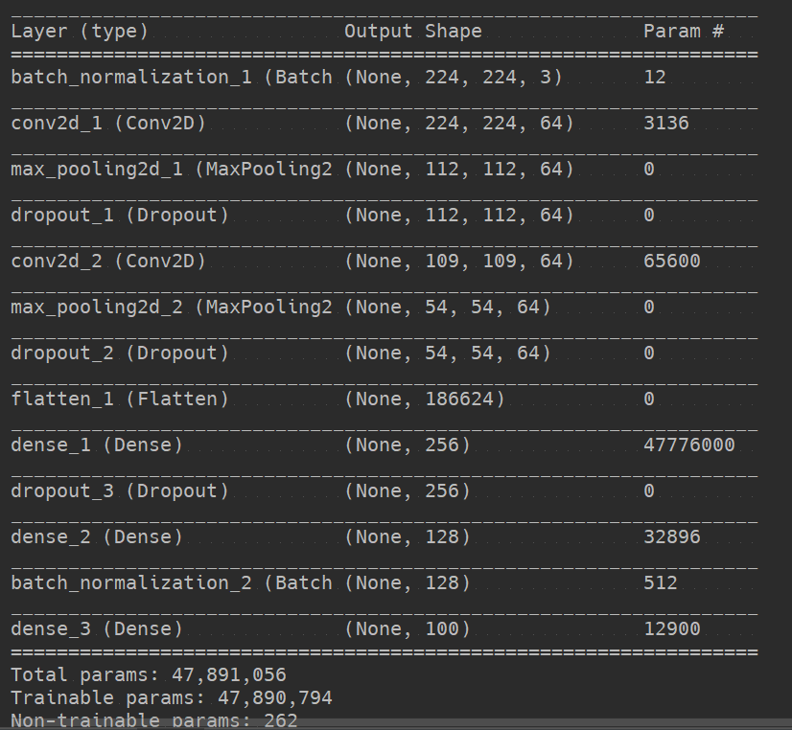
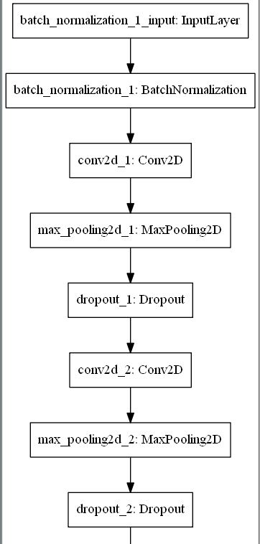
Reference
# Network model display model.summary() plot_model(model, to_file=‘your/project/path/model.png')

Slide 6
Reference
# Save the model structure as a json file
json_string = model.to_json() open(' your/project/path/model_architecture.json', 'w').write(json_string) # Save model parameters to h5 file model.save_weights(' your/project/path/model_weights.h5')

Slide 7
Note
This experiment is based on the recognition accuracy of the model on the test set and the experimental report.
No plagiarism.
I hope that you will try to design a new network model to solve the image recognition task and learn the way of tuning and some suppression methods of overfitting.
If the data processing method, the principle of model design, and the method of adjusting the parameters can be reflected in the experimental report, extra points will be considered.

Slide 8
Data
Link：https://pan.baidu.com/s/1k-h6VSPi71hgRcbzpR0iSA
Password：wm29
Submit
email：yukai_tech@163.com
way of naming：studentID+name+AAI

