Slide 1



Towards Practical Oblivious Join
Zhao Chang
Xidian University, China
Dong Xie
The Pennsylvania State University, USA
Sheng Wang
Alibaba Group, Singapore
Feifei Li
Alibaba Group, China
Notes:
Hi, my name is Zhao Chang. I come from Xidian University, China.
Let me introduce our paper Towards Practical Oblivious Join.
This work was done in collaboration with Dong Xie at the Penn State University, Sheng Wang and Feifei Li at Alibaba Group.

Slide 2
Outline
Background
Problem Formulation
Binary Join
Multiway Join
Experimental Evaluation
Notes:
Here is a brief outline of this talk.

Slide 3

Background
Security and Privacy Issues
Public cloud: data and IT infrastructure platform
Remote access brings security and privacy issues
David Fletcher. http://cloudtweaks.com/
Notes:
Today, many companies choose the cloud as their data and IT infrastructure platform.
However, the remote access brings security and privacy issues in public cloud.

Slide 4
Background
Strong Encryption is NOT Enough
Adversaries can still learn sensitive information by observing the data access patterns.
Example:
Given the database that stores spatial POIs in NYC, the most frequently accessed records are probably from Manhattan.
Notes:
Although data encryption is necessary to keep sensitive information secure and private in the cloud, adversaries can still learn sensitive information by observing the data access patterns.
For example, given the database that stores spatial places of interest from New York City, the most frequently accessed records are probably from Manhattan.

Slide 5
Background
ORAM (Oblivious RAM)
Goal: protect the data access patterns
Oblivious: its sequence of accessing (e.g. read/write) locations in the (server) storage is indistinguishable for any two inputs with the same length
8B
F5
37
1E
A9
B2
02
1C
Server
Read (i) / Write (i, data)
Client
Notes:
To protect the data access patterns, a general solution is to use ORAM, short for Oblivious RAM.
ORAM applies to the client-server model. The server keeps a sequence of encrypted blocks in the untrusted storage. At the client side, each ORAM operation is either a read operation, which reads block i from the server, or a write operation, which updates block i with some new block content.
Since all the blocks are encrypted and have the same length, all an adversary can see is the number of accessed blocks and the block accessing locations.
“Oblivious” means its sequence of accessing locations in the storage is indistinguishable for any two inputs with the same length.

Slide 6
Background
Path ORAM
The cloud storage is organized as a full binary tree.
Each node in the tree is a bucket of Z blocks (It suffices to set Z = 4).
Invariant: each block i must reside in the path to leaf “posMap[i]”.
leaf x
leaf r
N leaf nodes
(1 + log N) levels
block i
root
Server
Client
posMap
stash
Notes:
We choose the commonly-used Path ORAM scheme in our implementation.
In Path ORAM, the cloud storage is organized as a full binary tree, with N leaf nodes and (1+log N) levels. Each node in the tree is a bucket of Z blocks. It suffices to set Z equal to 4. Path ORAM maintains the invariant that at any time, each block i is always placed in some bucket along the path to the leaf node that block i is mapped to. The client tracks the mapping information using the position map.
When any block i is requested by the client, Path-ORAM protocol will access the path with the leaf node that b is mapped to (for example, leaf x), and block i will be re-mapped to another leaf node (for example, leaf r).
Note that ORAM scheme can be viewed as a black box in our method. We can introduce some novel ORAM schemes rather than Path ORAM to improve the performance.

Slide 7
Background
Limitations in ORAM:
1) support only read and write operations
2) lead to large overhead while answering complex queries
Oblivious Join
Objective: support complex queries (e.g., joins) obliviously
Complex Queries
Notes:
Although using ORAM can protect access patterns from the adversary, there are still some major limitations in performing database queries using ORAMs.
First, ORAM only supports read and write operations. Second, using ORAM leads to large overhead while answering complex queries.
In this work, our objective is to deal with the limitations above and support join queries using ORAMs.

Slide 8
Background
Previous Studies:
Oblivious Query Processing [ICDT 2014]
> not leading to practical implementation
Systems like Opaque [NSDI 2017] and ObliDB [PVLDB 2019]
> efficient for foreign key joins only
> general binary or multiway equi-joins: Cartesian product
Efficient Oblivious Database Joins [PVLDB 2020]
> restricted to binary equi-joins
Notes:
Some prior studies also focus on oblivious joins, but they do have some major limitations.
(1) Oblivious Query Processing does not lead to practical implementation.
(2) Systems like Opaque and ObliDB are only efficient for foreign key joins. However, they need to perform Cartesian product to support general binary or multiple equi-joins, which is too expensive.
(3) Efficient Oblivious Database Joins is restricted to binary equi-joins, but does not support multiway equi-joins.

Slide 9
Background
Our Contributions:
Propose two binary equi-join algorithms:
> sort-merge join > index nested-loop join
Support some types of band joins:
> index nested-loop join
Support acyclic multiway equi-joins:
> index nested-loop join
Notes:
Our major contributions are listed as follows.
First, we propose two oblivious algorithms for general binary equi-joins. One is oblivious sort-merge join. The other is oblivious index nested-loop join.
Then, we extend our index nested-loop join to support some types of oblivious band joins and oblivious multiway equi-joins.
All the algorithms achieve better query performance than the Cartesian product method.
Due to time limit, I will focus on binary and multiway equi-joins in this talk.

Slide 10
Overview
Overview
ORAM Data Structure
Server
Secure Data Storage
Untrusted
get
put
Trusted
Oblivious Join Operator
ORAM Protocol
Client
Metadata
ORAM Stash
Notes:
Here is an overview of our design.
In preprocessing, the client partitions records in the database into blocks, encrypts the data blocks, and builds an ORAM data structure over them. Some B-tree indices can be integrated into the ORAM. Then, the client uploads the ORAM data structure to the secure data storage in the server, and keeps the encryption keys, metadata, and ORAM stash at her side.
In online processing, the client issues join queries against the server. By using the oblivious join algorithm, the client reads and writes blocks to the server through the ORAM protocol and generates the query results. The details will be given in the following pages.

Slide 11
Binary Join
Strawman Solution
Primary-foreign key join
Table T₁
Table T₂
A | B
1 | 1
2 | 2
3 | 1
A | C
1 | 1
2 | 1
2 | 2
2 | 3
Notes:
Before introducing our method, we first present the primary-foreign key join algorithm in Opaque and ObliDB system as a strawman solution.
Given two input tables T1 and T2,

Slide 12
Binary Join
Strawman Solution
Primary-foreign key join
Table T₁
Table T₂
Single Sorted Table T
A | B
1 | 1
2 | 2
3 | 1
A | C
1 | 1
2 | 1
2 | 2
2 | 3
Table | A | B/C
T₁ | 1 | 1
T₂ | 1 | 1
T₁ | 2 | 2
T₂ | 2 | 1
T₂ | 2 | 2
T₂ | 2 | 3
T₁ | 3 | 1
Notes:
The strawman solution first puts tuples from both input tables into one single table T, and then obliviously sorts the new table T according to the join key A.

Slide 13
Binary Join
Strawman Solution
Primary-foreign key join
Table T₁
Table T₂
Single Sorted Table T
A | B
1 | 1
2 | 2
3 | 1
A | C
1 | 1
2 | 1
2 | 2
2 | 3
Table | A | B/C
T₁ | 1 | 1
T₂ | 1 | 1
T₁ | 2 | 2
T₂ | 2 | 1
T₂ | 2 | 2
T₂ | 2 | 3
T₁ | 3 | 1
Output
dummy record
T₁ (1, 1) T₂ (1, 1)
dummy record
T₁ (2, 2) T₂ (2, 1)
T₁ (2, 2) T₂ (2, 2)
T₁ (2, 2) T₂ (2, 3)
dummy record
Scan
Notes:
Finally, the algorithm performs a linear scan over the sorted table T. During the linear scan, it joins each primary key tuple with the corresponding foreign key tuples. After accessing each input tuple, we ensure to write out exactly one real or dummy join record.

Slide 14
Binary Join
Strawman Solution
Security issue in many-to-many join
Table T₁
Table T₂
A | B
1 | 1
2 | 1
2 | 2
3 | 1
A | C
1 | 1
2 | 1
2 | 2
2 | 3
Notes:
However, the strawman solution is unable to support many-to-many join obliviously, since it leaks some sensitive information, such as the join degree. For example, given these two input tables T1 and T2,

Slide 15
Binary Join
Strawman Solution
Security issue in many-to-many join
Table T₁
Table T₂
Single Sorted Table T
A | B
1 | 1
2 | 1
2 | 2
3 | 1
A | C
1 | 1
2 | 1
2 | 2
2 | 3
Table | A | B/C
T₁ | 1 | 1
T₂ | 1 | 1
T₁ | 2 | 1
T₁ | 2 | 2
T₂ | 2 | 1
T₂ | 2 | 2
T₂ | 2 | 3
T₁ | 3 | 1
Notes:
The strawman solution still puts tuples from both input tables into one single table T and obliviously sorts T based on the join key on column A.

Slide 16
Binary Join
Strawman Solution
Security issue in many-to-many join
Table T₁
Table T₂
Single Sorted Table T
A | B
1 | 1
2 | 1
2 | 2
3 | 1
A | C
1 | 1
2 | 1
2 | 2
2 | 3
Table | A | B/C
T₁ | 1 | 1
T₂ | 1 | 1
T₁ | 2 | 1
T₁ | 2 | 2
T₂ | 2 | 1
T₂ | 2 | 2
T₂ | 2 | 3
T₁ | 3 | 1
Output
dummy record
T₁ (1, 1) T₂ (1, 1)
dummy record
dummy record
T₁ (2, 1) (2, 2) T₂ (2, 1)
T₁ (2, 1) (2, 2) T₂ (2, 2)
T₁ (2, 1) (2, 2) T₂ (2, 3)
dummy record
Scan
Notes:
During the linear scan, the algorithm still joins the tuples from T1 and T2.
But when we access any tuple that belongs to table T2 with join key A equal to 2, we will find two join matches from table T1. Hence, we must write out two join records for each access.
That’s to say, the number of output records between two accesses over table T leaks the join degree.

Slide 17
Binary Join
Integrate B-Tree into ORAM
Table T₁
A | B
1 | 1
2 | 1
2 | 2
3 | 1
Table T₂
A | C
1 | 1
2 | 1
2 | 2
2 | 3
Notes:
Our goal is to address the security issue in the strawman solution and design new algorithms to ensure the obliviousness in many-to-many joins.
Suppose we still have the two input tables T1 and T2.

Slide 18
Binary Join
Integrate B-Tree into ORAM
Table T₁
B-Tree
A | B
1 | 1
2 | 1
2 | 2
3 | 1
encryption key
17
15
16
index
10
11
12
13
14
data
0
1
2
3
4
5
6
7
8
9
Table T₂
B-Tree
A | C
1 | 1
2 | 1
2 | 2
2 | 3
encryption key
17
15
16
index
10
11
12
13
14
data
0
1
2
3
4
5
6
7
8
9
Notes:
During preprocessing, we build B-tree indices over the input tables.

Slide 19
Binary Join
Integrate B-Tree into ORAM
Table T₁
= data/index block
posMap
B-Tree
= dummy block
A | B
1 | 1
2 | 1
2 | 2
3 | 1
encryption key
17
stash
= slot
Path-ORAM
15
16
index
10
11
12
13
14
data
0
1
2
3
4
5
6
7
8
9
Table T₂
= data/index block
posMap
B-Tree
= dummy block
stash
A | C
1 | 1
2 | 1
2 | 2
2 | 3
encryption key
17
= slot
Path-ORAM
15
16
index
10
11
12
13
14
data
0
1
2
3
4
5
6
7
8
9
Notes:
And integrate B-tree indices into ORAMs for each input table. Note that leaf level entries in each B-tree index are sorted based on the entry keys.
In online processing, we retrieve blocks through B-tree indices obliviously to perform the oblivious join algorithm.

Slide 20
Binary Join
Oblivious Sort-Merge Equi-Join
Table T₁
Table T₂
A | B
1 | 1
2 | 1
2 | 2
3 | 1
A | C
1 | 1
2 | 1
2 | 2
2 | 3
Notes:
Our first algorithm is an oblivious sort-merge join.

Slide 21
Binary Join
Oblivious Sort-Merge Equi-Join
Table T₁
Table T₂
Join Comparison
A | B
1 | 1
2 | 1
2 | 2
3 | 1
A | C
1 | 1
2 | 1
2 | 2
2 | 3
T₁ |  | T₂ |  | res | getNext()
A | B | A | C
1 | 1 | 1 | 1 | = 0
Notes:
In online join processing, we retrieve the tuple needed from each input table alternatively. A dummy tuple is retrieved as necessary to ensure the obliviousness.
In each step, if there is a match, we output the join record; otherwise, we output a dummy record.
In this example, at first, we retrieve the first tuple from each input table. Since there is a match, we output the join record.

Slide 22
Binary Join
Oblivious Sort-Merge Equi-Join
Table T₁
Table T₂
Join Comparison
A | B
1 | 1
2 | 1
2 | 2
3 | 1
A | C
1 | 1
2 | 1
2 | 2
2 | 3
T₁ |  | T₂ |  | res | getNext()
A | B | A | C
1 | 1 | 1 | 1 | = 0
 |  | 2 | 1 | < 0
Notes:
Then we retrieve the next tuple from table T2. To ensure the obliviousness, we also retrieve a dummy tuple from T1.
Note that all the real or dummy tuples are retrieved through ORAM protocol, and the adversary doesn’t know which tuples are being accessed by observing the data access patterns.
Here, since the two retrieved tuples cannot match, we output a dummy record. Since the comparison result is “less than”.

Slide 23
Binary Join
Oblivious Sort-Merge Equi-Join
Table T₁
Table T₂
Join Comparison
A | B
1 | 1
2 | 1
2 | 2
3 | 1
A | C
1 | 1
2 | 1
2 | 2
2 | 3
T₁ |  | T₂ |  | res | getNext()
A | B | A | C
1 | 1 | 1 | 1 | = 0
 |  | 2 | 1 | < 0 | T₁→(2, 1)
2 | 1 | 1 | 1 | > 0
Notes:
Then we retrieve the next tuple from T1 and let the cursor on T2 go back. It looks like the traditional sort-merge join.
But to ensure the obliviousness, we still retrieve a real tuple or dummy tuple from each input table alternatively in each step.
Here, since the new comparison result is “larger than”, we output a dummy record.

Slide 24
Binary Join
Oblivious Sort-Merge Equi-Join
Table T₁
Table T₂
Join Comparison
A | B
1 | 1
2 | 1
2 | 2
3 | 1
A | C
1 | 1
2 | 1
2 | 2
2 | 3
T₁ |  | T₂ |  | res | getNext()
A | B | A | C
1 | 1 | 1 | 1 | = 0
 |  | 2 | 1 | < 0 | T₁→(2, 1)
2 | 1 | 1 | 1 | > 0 | T₂→(2, 1)
2 | 1 | 2 | 1 | = 0
Notes:
Then we retrieve the next tuple from table T2, and also retrieve a dummy tuple from T1 to ensure the obliviousness.

Slide 25
Binary Join
Oblivious Sort-Merge Equi-Join
Table T₁
Table T₂
Join Comparison
A | B
1 | 1
2 | 1
2 | 2
3 | 1
A | C
1 | 1
2 | 1
2 | 2
2 | 3
T₁ |  | T₂ |  | res | getNext()
A | B | A | C
1 | 1 | 1 | 1 | = 0
 |  | 2 | 1 | < 0 | T₁→(2, 1)
2 | 1 | 1 | 1 | > 0 | T₂→(2, 1)
2 | 1 | 2 | 1 | = 0
 |  | 2 | 2
 |  | 2 | 3
 |  | ⊥ |  | < 0
Notes:
The algorithm goes in a similar way. To ensure the obliviousness, we still keep accessing T1 and T2 alternatively.
After three join matches, we reach the end of T2. In this step, we retrieve a dummy tuple from each input table to ensure the obliviousness, and logically let the comparison result be “less than”, and output a dummy record. Since the new comparison result is “less than”.

Slide 26
Binary Join
Oblivious Sort-Merge Equi-Join
Table T₁
Table T₂
Join Comparison
A | B
1 | 1
2 | 1
2 | 2
3 | 1
A | C
1 | 1
2 | 1
2 | 2
2 | 3
T₁ |  | T₂ |  | res | getNext()
A | B | A | C
1 | 1 | 1 | 1 | = 0
 |  | 2 | 1 | < 0 | T₁→(2, 1)
2 | 1 | 1 | 1 | > 0 | T₂→(2, 1)
2 | 1 | 2 | 1 | = 0
 |  | 2 | 2
 |  | 2 | 3
 |  | ⊥ |  | < 0 | T₁→(2, 2)
2 | 2 | 2 | 1 | = 0
Notes:
Then we retrieve the next tuple from T1, and the cursor in T2 goes back, as that in the traditional sort-merge join.
To ensure the obliviousness, we still keep retrieving a real tuple or dummy tuple from each input table alternatively in each step.

Slide 27
Binary Join
Oblivious Sort-Merge Equi-Join
Table T₁
Table T₂
Join Comparison
A | B
1 | 1
2 | 1
2 | 2
3 | 1
A | C
1 | 1
2 | 1
2 | 2
2 | 3
T₁ |  | T₂ |  | res | getNext()
A | B | A | C
1 | 1 | 1 | 1 | = 0
 |  | 2 | 1 | < 0 | T₁→(2, 1)
2 | 1 | 1 | 1 | > 0 | T₂→(2, 1)
2 | 1 | 2 | 1 | = 0
 |  | 2 | 2
 |  | 2 | 3
 |  | ⊥ |  | < 0 | T₁→(2, 2)
2 | 2 | 2 | 1 | = 0
T₁ |  | T₂ |  | res | getNext()
A | B | A | C
2 | 2 | 2 | 2 | = 0
 |  | 2 | 3
 |  | ⊥ |  | < 0 | T₁→(3, 1)
3 | 1 | 2 | 1 | > 0 | T₂→(2, 2)
 |  | 2 | 2 |  | T₂→(2, 3)
 |  | 2 | 3 |  | T₂→⊥
 |  | ⊥ |  | < 0 | T₁→⊥
⊥ |  | ⊥ |  | end
Notes:
The rest can be done in a similar way.

Slide 28
Binary Join
Oblivious Sort-Merge Equi-Join
Table T₁
Table T₂
Join Comparison
A | B
1 | 1
2 | 1
2 | 2
3 | 1
A | C
1 | 1
2 | 1
2 | 2
2 | 3
T₁ |  | T₂ |  | res | getNext()
A | B | A | C
1 | 1 | 1 | 1 | = 0
 |  | 2 | 1 | < 0 | T₁→(2, 1)
2 | 1 | 1 | 1 | > 0 | T₂→(2, 1)
2 | 1 | 2 | 1 | = 0
 |  | 2 | 2
 |  | 2 | 3
 |  | ⊥ |  | < 0 | T₁→(2, 2)
2 | 2 | 2 | 1 | = 0
T₁ |  | T₂ |  | res | getNext()
A | B | A | C
2 | 2 | 2 | 2 | = 0
 |  | 2 | 3
 |  | ⊥ |  | < 0 | T₁→(3, 1)
3 | 1 | 2 | 1 | > 0 | T₂→(2, 2)
 |  | 2 | 2 |  | T₂→(2, 3)
 |  | 2 | 3 |  | T₂→⊥
 |  | ⊥ |  | < 0 | T₁→⊥
⊥ |  | ⊥ |  | end
|T₁| = 4
|T₂| = 4
f = 16
Number of Tuple Retrievals:
f (|T₁|, |T₂|, |R_{real}|) = |T₁| + |T₂| + |R_{real}| + 1
|R_{real}| = 7
Notes:
In total, we get through sixteen steps and perform sixteen tuple retrievals from each input table.
Since we retrieve the real or dummy tuples through ORAM protocol, the adversary doesn’t know which tuples have been accessed and which tuples have not been accessed by observing the data access patterns. The adversary only knows the number of tuple retrievals from each input table is sixteen. But we can prove this number is equal to T1’s size, plus T2’s size, plus real join size, plus 1. Since this number only pertains to the input size and real join size, no additional information will be leaked to the adversary.
After that, we obliviously filter out the dummy records from the output and only keep the real join records.

Slide 29
Binary Join
Oblivious Index Nested-Loop Equi-Join
Table T₁
Table T₂
A | B
1 | 1
2 | 1
2 | 2
3 | 1
A | C
1 | 1
2 | 1
2 | 2
2 | 3
Notes:
Our second algorithm is an oblivious index nested-loop join.
Note that during preprocessing, we still integrate B-tree indices into Path ORAM for each input table.
In online processing, we retrieve the blocks through the B-tree indices obliviously to perform our algorithm.

Slide 30
Binary Join
Oblivious Index Nested-Loop Equi-Join
Table T₁
Table T₂
Join Comparison
A | B
1 | 1
2 | 1
2 | 2
3 | 1
A | C
1 | 1
2 | 1
2 | 2
2 | 3
T₁ |  | T₂ |  | match
A | B | A | C
1 | 1 | 1 | 1 | true
 |  | 2 | 1 | false
Notes:
The outer loop is to scan table T1. While accessing each tuple in T1, the inner loop keeps retrieving matched tuples from T2 one by one, until we meet the tuple that cannot match.
In this example, at first, we access the first tuple in T1 and retrieve matched tuples from T2.
To ensure the obliviousness, we add dummy retrievals from T1 as necessary and keep accessing T1 and T2 alternatively.
Here, the first tuple (1, 1) retrieved from T2 leads to a match. We output the join record. The next tuple (2, 1) cannot match. We output a dummy record.

Slide 31
Binary Join
Oblivious Index Nested-Loop Equi-Join
Table T₁
Table T₂
Join Comparison
T₁ |  | T₂ |  | match
A | B | A | C
2 | 1 | ⊥ |  | false
A | B
1 | 1
2 | 1
2 | 2
3 | 1
A | C
1 | 1
2 | 1
2 | 2
2 | 3
T₁ |  | T₂ |  | match
A | B | A | C
1 | 1 | 1 | 1 | true
 |  | 2 | 1 | false
2 | 1 | 2 | 1 | true
 |  | 2 | 2
 |  | 2 | 3
Notes:
Then we access the second tuple in T1 and retrieve matched tuples from T2 obliviously through the B-tree indices.
To ensure the obliviousness, we add dummy retrievals from T1 as necessary and keep accessing T1 and T2 alternatively.
After three join matches, we reach the end of T2. In this step, we retrieve a dummy tuple from each input table, and logically let the comparison result be “false”, and output a dummy record.

Slide 32
Binary Join
Oblivious Index Nested-Loop Equi-Join
Table T₁
Table T₂
Join Comparison
T₁ |  | T₂ |  | match
A | B | A | C
2 | 1 | ⊥ |  | false
2 | 2 | 2 | 1 | true
 |  | 2 | 2
 |  | 2 | 3
 |  | ⊥ |  | false
3 | 1 | ⊥ |  | false
A | B
1 | 1
2 | 1
2 | 2
3 | 1
A | C
1 | 1
2 | 1
2 | 2
2 | 3
T₁ |  | T₂ |  | match
A | B | A | C
1 | 1 | 1 | 1 | true
 |  | 2 | 1 | false
2 | 1 | 2 | 1 | true
 |  | 2 | 2
 |  | 2 | 3
Notes:
The rest can be done in a similar way.

Slide 33
Binary Join
Oblivious Index Nested-Loop Equi-Join
Table T₁
Table T₂
Join Comparison
T₁ |  | T₂ |  | match
A | B | A | C
2 | 1 | ⊥ |  | false
2 | 2 | 2 | 1 | true
 |  | 2 | 2
 |  | 2 | 3
 |  | ⊥ |  | false
3 | 1 | ⊥ |  | false
A | B
1 | 1
2 | 1
2 | 2
3 | 1
A | C
1 | 1
2 | 1
2 | 2
2 | 3
T₁ |  | T₂ |  | match
A | B | A | C
1 | 1 | 1 | 1 | true
 |  | 2 | 1 | false
2 | 1 | 2 | 1 | true
 |  | 2 | 2
 |  | 2 | 3
|T₁| = 4
|T₂| = 4
f = 11
Number of Tuple Retrievals:
f (|T₁|, |T₂|, |R_{real}|) = |T₁| + |R_{real}|
|R_{real}| = 7
Notes:
In total, we get through eleven steps and perform eleven tuple retrievals from each input table.
Since we retrieve the real or dummy tuples through ORAM protocol, the adversary doesn’t know which tuples have been accessed and which tuples have not been accessed by observing the data access patterns. The adversary only knows the number of tuple retrievals from each input table is eleven. But we can prove this number is equal to T1’s size, plus real join size. Since this number only pertains to the input size and real join size, no additional information will be leaked to the adversary.
After that, we obliviously filter out the dummy records from the output and only keep the real join records.

Slide 34
Binary Join
Oblivious Index Nested-Loop Band Join
Table T₁
Table T₂
A | B
1 | 1
2 | 1
2 | 2
3 | 1
A | C
1 | 1
2 | 1
2 | 2
2 | 3
T₁.A > T₂.A
Notes:
We extend our index-nested loop join to support some types of band join.

Slide 35
Binary Join
Oblivious Index Nested-Loop Band Join
Table T₁
Table T₂
Join Comparison
A | B
1 | 1
2 | 1
2 | 2
3 | 1
A | C
1 | 1
2 | 1
2 | 2
2 | 3
T₁ |  | T₂ |  | match
A | B | A | C
1 | 1 | 1 | 1 | false
T₁.A > T₂.A
Notes:
The join processing is similar to the index nested-loop equi-join. Suppose the join condition is T1’s value A larger than T2’s value A.
The outer loop is to scan table T1. While accessing each tuple in T1, the inner loop keeps retrieving matched tuples from T2 one by one, until we meet the tuple that cannot match.
In this example, at first, we access the first tuple in T1 and retrieve tuples from T2 that satisfy the join condition. But no tuple in T2 satisfies the condition. We output a dummy record.

Slide 36
Binary Join
Oblivious Index Nested-Loop Band Join
Table T₁
Table T₂
Join Comparison
A | B
1 | 1
2 | 1
2 | 2
3 | 1
A | C
1 | 1
2 | 1
2 | 2
2 | 3
T₁ |  | T₂ |  | match
A | B | A | C
1 | 1 | 1 | 1 | false
2 | 1 | 1 | 1 | true
 |  | 2 | 1 | false
T₁.A > T₂.A
Notes:
Then we access the second tuple in T1 and retrieve matched tuples from T2 obliviously through the B-tree indices.
To ensure the obliviousness, we add dummy retrievals from T1 as necessary and keep accessing T1 and T2 alternatively.
Here, the first tuple (1, 1) retrieved from T2 leads to a match. We output the join record. The next tuple (2, 1) cannot match. We output a dummy record.

Slide 37
Binary Join
Oblivious Index Nested-Loop Band Join
Table T₁
Table T₂
Join Comparison
A | B
1 | 1
2 | 1
2 | 2
3 | 1
A | C
1 | 1
2 | 1
2 | 2
2 | 3
T₁ |  | T₂ |  | match
A | B | A | C
1 | 1 | 1 | 1 | false
2 | 1 | 1 | 1 | true
 |  | 2 | 1 | false
2 | 2 | 1 | 1 | true
 |  | 2 | 1 | false
T₁ |  | T₂ |  | match
A | B | A | C
3 | 1 | 1 | 1 | true
 |  | 2 | 1
 |  | 2 | 2
 |  | 2 | 3
 |  | ⊥ |  | false
T₁.A > T₂.A
Notes:
The rest can be done in a similar way.

Slide 38
Binary Join
Oblivious Index Nested-Loop Band Join
Table T₁
Table T₂
Join Comparison
A | B
1 | 1
2 | 1
2 | 2
3 | 1
A | C
1 | 1
2 | 1
2 | 2
2 | 3
T₁ |  | T₂ |  | match
A | B | A | C
1 | 1 | 1 | 1 | false
2 | 1 | 1 | 1 | true
 |  | 2 | 1 | false
2 | 2 | 1 | 1 | true
 |  | 2 | 1 | false
T₁ |  | T₂ |  | match
A | B | A | C
3 | 1 | 1 | 1 | true
 |  | 2 | 1
 |  | 2 | 2
 |  | 2 | 3
 |  | ⊥ |  | false
|T₁| = 4
|T₂| = 4
f = 10
T₁.A > T₂.A
Number of Tuple Retrievals:
f (|T₁|, |T₂|, |R_{real}|) = |T₁| + |R_{real}|
|R_{real}| = 6
Notes:
In total, we get through ten steps and perform ten tuple retrievals from each input table.
Since we retrieve the real or dummy tuples through ORAM protocol, the adversary doesn’t know which tuples have been accessed and which tuples have not been accessed by observing the data access patterns. The adversary only knows the number of tuple retrievals from each input table is ten. But we can prove this number is equal to T1’s size, plus real join size. Since this number only pertains to the input size and real join size, no additional information will be leaked to the adversary.
After that, we obliviously filter out the dummy records from the output and only keep the real join records.

Slide 39
Multiway Join
Oblivious Index Nested-Loop Multiway Equi-Join
Acyclic join: each input table is arranged as a node in the join tree
Pre-order traversal: if table T_{i} is an ancestor of table T_{j}, then i < j
T_{p(i)}: parent table of T_{i}
T₁(A, B, C)
T₂(A, D, E)
T₅(B, I)
T₆(C, F)
T₃(D, G)
T₄(E, H)
T₇(F, J)
Notes:
Finally, we extend the index nested-loop join to support joins over multiple tables, while not leaking any intermediate table sizes. We focus on acyclic multiway equi-join. “Acyclic” means each input table can be arranged as a node in the join tree.
We number the input tables using the pre-order traversal of the join tree. It ensures that if table Ti is an ancestor of table Tj, then i is less than j. Especially, we denote the parent table of Ti in the join tree as Tp(i). This figure shows an example of the join tree.

Slide 40
Multiway Join
Oblivious Index Nested-Loop Multiway Equi-Join
Observation 1: tuple[p(i)] will make no contribution to the final join result, if no available tuples in T_{i} can match tuple[p(i)]
tuple[p(i)] can be safely disabled (will not be accessed)
Notes:
We make three observations in the join processing.
Our observation 1 is if no available tuples in table Ti can match tuple[p(i)] in the parent table Tp(i), tuple[p(i)] will make no contribution to the final join result. Therefore, tuple[p(i)] can be safely disabled and will not be accessed in processing the current query.

Slide 41
Multiway Join
Oblivious Index Nested-Loop Multiway Equi-Join
Observation 1: tuple[p(i)] will make no contribution to the final join result, if no available tuples in T_{i} can match tuple[p(i)]
tuple[p(i)] can be safely disabled (will not be accessed)
Table T₂
T₂(A, C)
A | C
1 | 1
2 | 1
2 | 2
2 | 3
Table T₃
Table T₄
C | D
1 | 4
2 | 1
2 | 3
D | E
1 | 2
2 | 3
3 | 1
T₃(C, D)
T₄(D, E)
Notes:
In this example, we join three tables T2, T3 and T4. Specifically, T3 is the parent table of T4 in the join tree.
Since no available tuples in T4 can match the first tuple (1, 4) in T3, it can be safely disabled and will not be accessed any more.

Slide 42
Multiway Join
Oblivious Index Nested-Loop Multiway Equi-Join
Observation 2: tuple[p(i)] can be disabled, if each tuple in T_{i} that matches tuple[p(i)] has been disabled
Notes:
Our observation 2 is if each tuple in table Ti that matches tuple[p(i)] has been disabled, tuple[p(i)] can also be disabled.

Slide 43
Multiway Join
Oblivious Index Nested-Loop Multiway Equi-Join
Observation 2: tuple[p(i)] can be disabled, if each tuple in T_{i} that matches tuple[p(i)] has been disabled
Table T₂
T₂(A, C)
A | C
1 | 1
2 | 1
2 | 2
2 | 3
Table T₃
Table T₄
C | D
1 | 4
2 | 1
2 | 3
D | E
1 | 2
2 | 3
3 | 1
T₃(C, D)
T₄(D, E)
Notes:
In this example, since tuple (1, 4) in table T3 has been disabled, no other tuples in T3 can match the first two tuples (1, 1) and (2, 1) in T2. Therefore, they can also be disabled.

Slide 44
Multiway Join
Oblivious Index Nested-Loop Multiway Equi-Join
Observation 3: if tuple[i] can match tuple[p(i)], but succeeding tuple in T_{i} has a different join key, then tuple[p(i)] will have no more matches
Notes:
Our observation 3 is if tuple[i] can match tuple[p(i)], but the succeeding tuple in table Ti has a different join key, then tuple[p(i)] will have no more matches in table Ti.

Slide 45
Multiway Join
Oblivious Index Nested-Loop Multiway Equi-Join
Observation 3: if tuple[i] can match tuple[p(i)], but succeeding tuple in T_{i} has a different join key, then tuple[p(i)] will have no more matches
Table T₂
T₂(A, C)
A | C
1 | 1
2 | 1
2 | 2
2 | 3
Table T₃
Table T₄
C | D
1 | 4
2 | 1
2 | 3
D | E
1 | 2
2 | 3
3 | 1
T₃(C, D)
T₄(D, E)
Notes:
In this example, tuple (1, 2) in table T4 can match tuple (2, 1) in parent table T3, but the succeeding tuple (2, 3) in Table T4 has a different join key, then tuple (2, 1) in parent table T3 will have no more matches in table T4.

Slide 46
Multiway Join
Oblivious Index Nested-Loop Multiway Equi-Join
Boolean tags in index entry:
1) “Disabled”: whether corresponding tuple(s) has been disabled
2) “Next”: whether has the same join key with succeeding entry
B-Tree
encryption key
17
15
16
PID
IsLeaf
Disabled
Next
# of Children
Children Keys
Children PIDs
index
10
11
12
13
14
data
0
1
2
3
4
5
6
7
8
9
Notes:
Based on the three observations, we add two Boolean tags in B-tree index entries.
The first tag is called “Disabled”, which indicates whether the corresponding tuple has been disabled. We can finish each disabling operation using one additional B-tree path access through the ORAM protocol. When we need to retrieve a new tuple, we just skip all the disabled entries.
The second tag is called “Next”, which indicates whether the current entry has the same join key with the succeeding entry. If not, there will be no more matches for this join key, and we will not retrieve the succeeding tuples.
After answering each join query, we simply go over all index blocks and reset these Boolean tags.

Slide 47
Multiway Join
Oblivious Index Nested-Loop Multiway Equi-Join
Table T₁
Table T₂
A | B
1 | 1
2 | 1
2 | 2
3 | 1
A | C
1 | 1
2 | 1
2 | 2
2 | 3
T₁(A, B)
T₂(A, C)
Table T₃
Table T₄
T₃(C, D)
C | D
1 | 4
2 | 1
2 | 3
D | E
1 | 2
2 | 3
3 | 1
T₄(D, E)
Notes:
This is an example of our multiway equi-join algorithm.
Note that during preprocessing, we still integrate B-tree indices into Path ORAM for each input table.
In online processing, we retrieve the blocks through the B-tree indices obliviously to perform our algorithm.

Slide 48
Multiway Join
Oblivious Index Nested-Loop Multiway Equi-Join
Table T₁
Table T₂
A | B
1 | 1
2 | 1
2 | 2
3 | 1
A | C
1 | 1
2 | 1
2 | 2
2 | 3
Join Comparison
T₁ |  | T₂ |  | T₃ |  | T₄ |  | match
A | B | A | C | C | D | D | E
1 | 1 | 1 | 1 | 1 | 4 | ⊥ |  | false
T₁(A, B)
T₂(A, C)
Table T₃
Table T₄
T₃(C, D)
C | D
1 | 4
2 | 1
2 | 3
D | E
1 | 2
2 | 3
3 | 1
T₄(D, E)
Notes:
The outer loop is to scan the root table T1. While accessing each tuple in T1, the inner loop retrieves tuples from each subsequent table to match the current tuple in its parent table.
To ensure the obliviousness, we add dummy retrievals as necessary and keep accessing each table in a round-robin way.
In this example, at first, we access the first tuple in T1 and retrieve the first matched tuples from T2 and T3. But we cannot find any matched tuple in T4. Hence, we output a dummy record.

Slide 49
Multiway Join
Oblivious Index Nested-Loop Multiway Equi-Join
Table T₁
Table T₂
A | B
1 | 1
2 | 1
2 | 2
3 | 1
A | C
1 | 1
2 | 1
2 | 2
2 | 3
Join Comparison
T₁ |  | T₂ |  | T₃ |  | T₄ |  | match
A | B | A | C | C | D | D | E
1 | 1 | 1 | 1 | 1 | 4 | ⊥ |  | false
⊥ |  | ⊥ |  | 1 | 4 | ⊥ |  | disable
T₁(A, B)
T₂(A, C)
Table T₃
Table T₄
T₃(C, D)
C | D
1 | 4
2 | 1
2 | 3
D | E
1 | 2
2 | 3
3 | 1
T₄(D, E)
Notes:
Since no available tuples in table T4 can match tuple (1, 4) in the parent table T3, based on Observation 1, we can disable tuple (1, 4) in T3.
We can finish this disabling operation using one additional B-tree path access in table T3 through the ORAM protocol.
To ensure the obliviousness, we add dummy retrievals from T1, T2 and T4, and output a dummy record.

Slide 50
Multiway Join
Oblivious Index Nested-Loop Multiway Equi-Join
Table T₁
Table T₂
A | B
1 | 1
2 | 1
2 | 2
3 | 1
A | C
1 | 1
2 | 1
2 | 2
2 | 3
Join Comparison
T₁ |  | T₂ |  | T₃ |  | T₄ |  | match
A | B | A | C | C | D | D | E
1 | 1 | 1 | 1 | 1 | 4 | ⊥ |  | false
⊥ |  | ⊥ |  | 1 | 4 | ⊥ |  | disable
⊥ |  | 1 | 1 | ⊥ |  | ⊥ |  | disable
T₁(A, B)
T₂(A, C)
Table T₃
Table T₄
T₃(C, D)
C | D
1 | 4
2 | 1
2 | 3
D | E
1 | 2
2 | 3
3 | 1
T₄(D, E)
Notes:
Since tuple (1, 4) in T3 has been disabled, no other tuples in T3 can match tuple (1, 1) in T2. Based on Observation 2, tuple (1, 1) in T2 can also be disabled.
By checking the “Next” tag, we know that the succeeding tuple in T2 has a different join key from tuple (1, 1). Based on Observation 3, tuple (1, 1) in root table T1 will have no more matches in child table T2.

Slide 51
Multiway Join
Oblivious Index Nested-Loop Multiway Equi-Join
Table T₁
Table T₂
A | B
1 | 1
2 | 1
2 | 2
3 | 1
A | C
1 | 1
2 | 1
2 | 2
2 | 3
Join Comparison
T₁ |  | T₂ |  | T₃ |  | T₄ |  | match
A | B | A | C | C | D | D | E
1 | 1 | 1 | 1 | 1 | 4 | ⊥ |  | false
⊥ |  | ⊥ |  | 1 | 4 | ⊥ |  | disable
⊥ |  | 1 | 1 | ⊥ |  | ⊥ |  | disable
2 | 1 | 2 | 1 | 2 | 1 | ⊥ |  | false
T₁(A, B)
T₂(A, C)
Table T₃
Table T₄
T₃(C, D)
C | D
1 | 4
2 | 1
2 | 3
D | E
1 | 2
2 | 3
3 | 1
T₄(D, E)
Notes:
Then, we access the next tuple (2, 1) in T1 and retrieve matched tuples from subsequent tables.

Slide 52
Multiway Join
Oblivious Index Nested-Loop Multiway Equi-Join
Table T₁
Table T₂
A | B
1 | 1
2 | 1
2 | 2
3 | 1
A | C
1 | 1
2 | 1
2 | 2
2 | 3
Join Comparison
T₁ |  | T₂ |  | T₃ |  | T₄ |  | match
A | B | A | C | C | D | D | E
2 | 1 | 2 | 2 | 2 | 3 | 3 | 1 | true
2 | 1 | 2 | 3 | ⊥ |  | ⊥ |  | false
⊥ |  | 2 | 3 | ⊥ |  | ⊥ |  | disable
2 | 2 | 2 | 2 | 2 | 1 | 1 | 2 | true
2 | 2 | 2 | 2 | 2 | 3 | 3 | 1 | true
3 | 1 | ⊥ |  | ⊥ |  | ⊥ |  | false
padding dummy operations
T₁ |  | T₂ |  | T₃ |  | T₄ |  | match
A | B | A | C | C | D | D | E
1 | 1 | 1 | 1 | 1 | 4 | ⊥ |  | false
⊥ |  | ⊥ |  | 1 | 4 | ⊥ |  | disable
⊥ |  | 1 | 1 | ⊥ |  | ⊥ |  | disable
2 | 1 | 2 | 1 | 2 | 1 | ⊥ |  | false
⊥ |  | 2 | 1 | ⊥ |  | ⊥ |  | disable
2 | 1 | 2 | 2 | 2 | 1 | 1 | 2 | true
Table T₃
Table T₄
C | D
1 | 4
2 | 1
2 | 3
D | E
1 | 2
2 | 3
3 | 1
Notes:
The rest can be done in a similar way.
Finally, we pad tuple retrievals and dummy record outputs to an upper bound to ensure the obliviousness.

Slide 53
Multiway Join
Oblivious Index Nested-Loop Multiway Equi-Join
Table T₁
Table T₂
A | B
1 | 1
2 | 1
2 | 2
3 | 1
A | C
1 | 1
2 | 1
2 | 2
2 | 3
Join Comparison
T₁ |  | T₂ |  | T₃ |  | T₄ |  | match
A | B | A | C | C | D | D | E
2 | 1 | 2 | 2 | 2 | 3 | 3 | 1 | true
2 | 1 | 2 | 3 | ⊥ |  | ⊥ |  | false
⊥ |  | 2 | 3 | ⊥ |  | ⊥ |  | disable
2 | 2 | 2 | 2 | 2 | 1 | 1 | 2 | true
2 | 2 | 2 | 2 | 2 | 3 | 3 | 1 | true
3 | 1 | ⊥ |  | ⊥ |  | ⊥ |  | false
padding dummy operations
T₁ |  | T₂ |  | T₃ |  | T₄ |  | match
A | B | A | C | C | D | D | E
1 | 1 | 1 | 1 | 1 | 4 | ⊥ |  | false
⊥ |  | ⊥ |  | 1 | 4 | ⊥ |  | disable
⊥ |  | 1 | 1 | ⊥ |  | ⊥ |  | disable
2 | 1 | 2 | 1 | 2 | 1 | ⊥ |  | false
⊥ |  | 2 | 1 | ⊥ |  | ⊥ |  | disable
2 | 1 | 2 | 2 | 2 | 1 | 1 | 2 | true
|T₁|
|T₂|
f
Table T₃
Table T₄
C | D
1 | 4
2 | 1
2 | 3
D | E
1 | 2
2 | 3
3 | 1
|T₃|
|T₄|
Number of Tuple Retrievals:
f (|T₁|, |T₂|, |R_{real}|) = |T₁| + 2(|T₂| + ··· + |T_{l}|) + |R_{real}|
Notes:
For a multiway join over \ell tables, we can prove the upper bound on the number of tuple retrievals is equal to T1’s size, plus two times of the total size from T2 to T\ell, plus real join result size.
Since we retrieve the real or dummy tuples through ORAM protocol, the adversary doesn’t know which tuples have been accessed and which tuples have not been accessed by observing the data access patterns. The adversary only knows the number of tuple retrievals from each input table. No additional information will be leaked from the processing.
After that, we obliviously filter out the dummy records from the output and only keep the real join records.
The last step is to go over all index blocks and reset these Boolean tags.

Slide 54
Experimental Evaluation
Experiment Setting
Server: Linux machine, 256 GB main memory, 2 TB hard disk, hosts a MongoDB instance as the outsourced storage.
Client: Linux PC, 18 GB main memory.
Bandwidth: 1 Gbps.
Notes:
Here is our experiment setting.
The cloud server is a Linux machine with 256 GB main memory and 2 TB hard disk.
It also hosts a MongoDB instance as the outsourced storage.
The client is a Linux PC with 18 GB main memory.
The bandwidth is 1 Gbps.

Slide 55
Experimental Evaluation
Experiment Setting
Server: Linux machine, 256 GB main memory, 2 TB hard disk, hosts a MongoDB instance as the outsourced storage.
Client: Linux PC, 18 GB main memory.
Bandwidth: 1 Gbps.
The server hosts a MongoDB instance as the outsourced storage, which supports insertion, deletion and update on blocks.
Notes:
The server hosts a MongoDB instance as the outsourced storage, which supports insertion, deletion and update on blocks.

Slide 56
Experimental Evaluation
Our Method
Baseline Methods
ObliDB (Cartesian product for general many-to-many joins)
ODBJ (restricted to binary equi-joins)
Raw Index (without any encryption or any ORAM protocol)
 | SepORAM | OneORAM
Sort-Merge Join | Sep SMJ | One SMJ
Index Nested-Loop Join | Sep INLJ | One INLJ
Index Nested-Loop Join with Index Caching | Sep INLJ+Cache | One INLJ+Cache
Notes:
We make the evaluation of different methods.
For our method, there are two different settings: SepORAM (stands for Separate ORAM) and OneORAM (stands for One Single ORAM). In SepORAM setting, for each input table, we build an ORAM data structure for data blocks and another smaller one for index blocks. In OneORAM setting, we put tuples in all input tables into one single ORAM. Each setting includes three algorithms: SMJ (short for Sort-Merge Join), INLJ (short for Index Nested-Loop Join), and INLJ+Cache (short for Index Nested-Loop Join with Index Caching). Index caching means the client caches the index blocks above B-tree leaf level indices.
We make the comparison with some baseline methods. The first one is ObliDB, which performs a Cartesian product for general many-to-many joins. The second one is ODBJ (short for Efficient Oblivious Database Joins), which is restricted to binary equi-joins. The last one is Raw Index. It builds standard B-tree indices over input tables, but doesn’t use any encryption or any ORAM protocol.

Slide 57
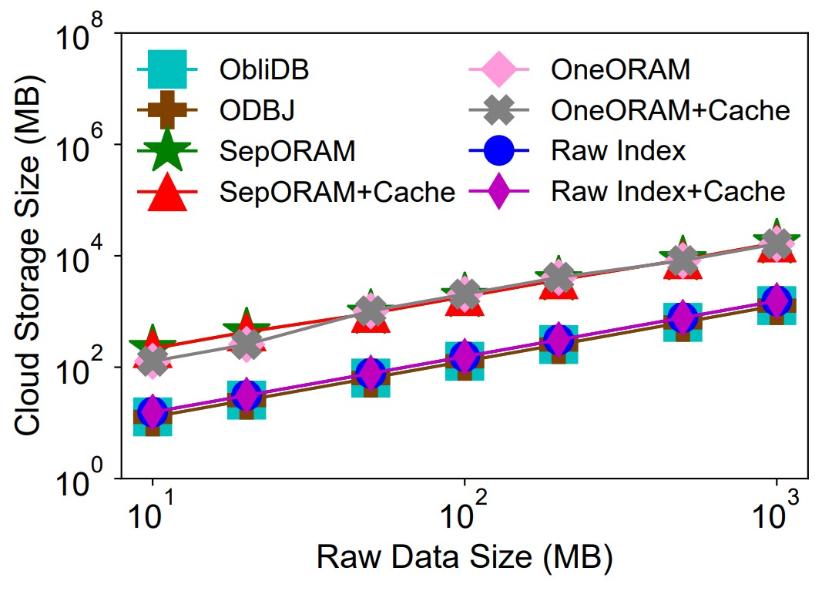
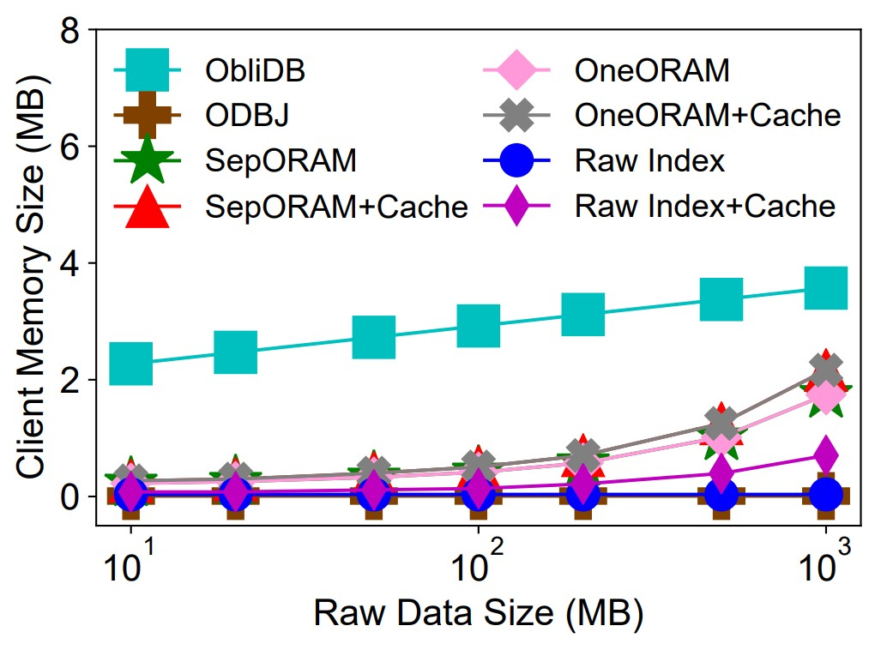
Experimental Evaluation
TPC-H Dataset
Figure 1: Cloud storage size.
Figure 2: Client memory size.
Notes:
We report the experimental results on TPC-H dataset, where the raw data size increases from 10 MB to 1 GB.
Figure 1 shows the cloud storage cost. ORAM based methods need roughly 10 times larger cloud storage cost than the other methods, due to building Path ORAM data structure.
Figure 2 shows the client memory size. ODBJ achieves the minimum cost, since the client always keeps a constant number of blocks. In Raw Index, the client also keeps a few more blocks along the B-tree paths and may cache some index blocks in “+Cache” mode. In ObliDB, we set the trusted memory size to the largest and make it finish as soon as possible. In our method, the client memory size grows roughly linearly with raw data size, since the client stores the position map in Path ORAM.

Slide 58
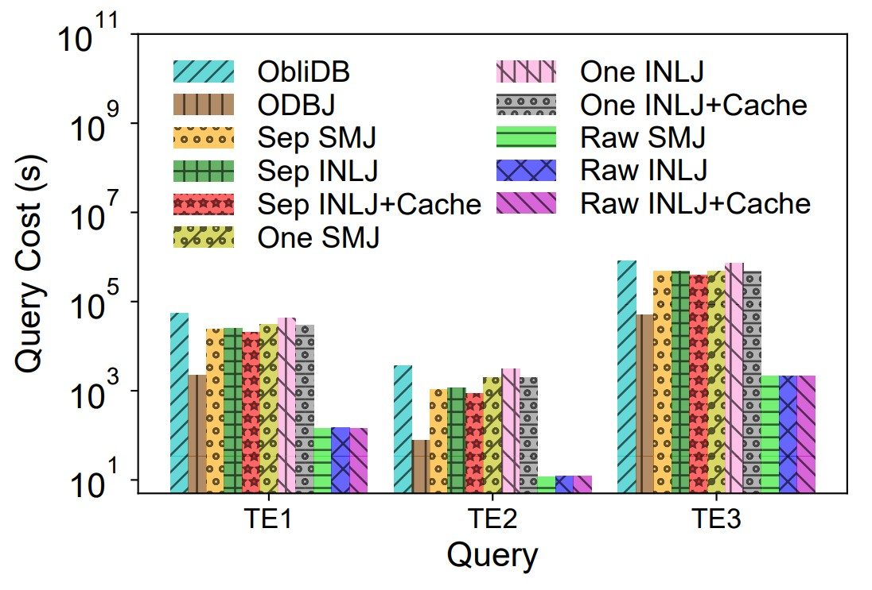
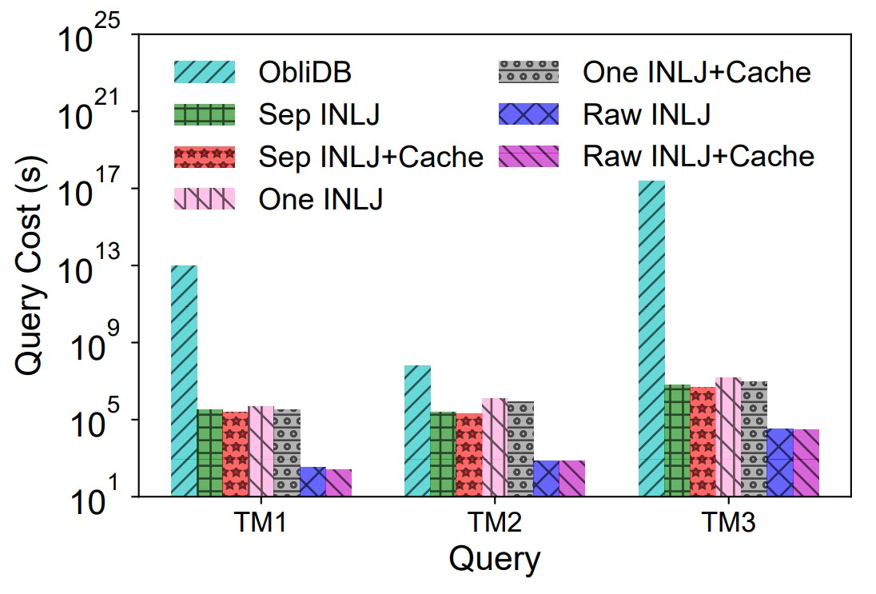
Experimental Evaluation
TPC-H Dataset
Figure 3: Query cost of binary equi-join.
Figure 4: Query cost of multiway equi-join.
Notes:
Figure 3 shows the query cost of binary equi-join. ObliDB has the worst query cost, due to the Cartesian product. Our SepORAM algorithms achieve 2 to 3 times better performance than ObliDB. In comparison with ODBJ, SepORAM algorithms bring 7X-15X larger blowup of query cost than ODBJ. Raw Index achieves the best query cost, since it doesn’t use any encryption or any ORAM protocol. SepORAM algorithms bring 90X-450X larger blowup of query cost than Raw Index. For our method, OneORAM algorithms have to access longer path through the single large ORAM and pay relatively larger cost than SepORAM algorithms. Last, the index caching brings 1.2X-1.6X speedup ratio in both settings.
Figure 4 shows the query cost of multiway equi-join. Our method achieves orders of magnitude speedup over ObliDB, since the join result size is far less than the Cartesian product size.

Slide 59

Thanks！
Do you have any questions?
Notes:
Thanks. Do you have any questions?

