Slide 1


Privacy Preserving Subgraph Matching on Large Graphs in Cloud
Zhao Chang*, Lei Zou†, Feifei Li*
*University of Utah, USA †Peking University, China
Notes:
Hi, my name is Zhao Chang. I come from University of Utah. Today, let me introduce our paper Privacy Preserving Subgraph Matching on Large Graphs in Cloud.

Slide 2
Outline
Background
K-Automorphism
Subgraph Matching
Experimental Results
Notes:
Here is a brief outline.

Slide 3
Background
Subgraph Matching on Large Graphs
Problem: subgraph matching
Solution: cloud computing
Data Privacy
Problem: untrusted cloud
Solution: anonymize the original data graph and query graphs
Notes:
The problem we need to solve is performing subgraph matching on large graphs. Public cloud can provide the service of subgraph matching. However, uploading the data graph and query graphs directly to the untrusted cloud would leak data privacy. Thus, our solution is to anonymize the data graph and query graphs before uploading them to the cloud.

Slide 4
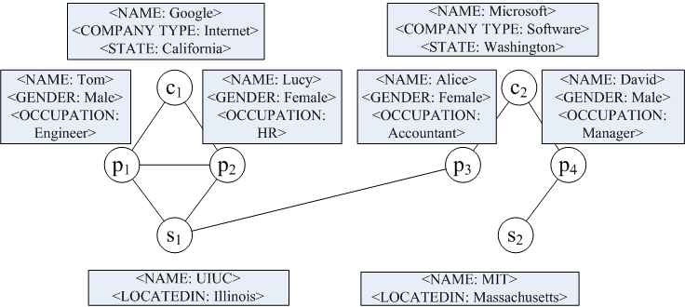
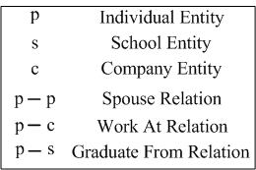
K-Automorphism
Original Graph G
Notes:
We use the k-automorphism privacy model to anonymize graphs, which was proposed in an existing work of VLDB 2009. Here is the original data graph G from a professional social network. Each node has node type and node attributes. P means the node is a person. S means the node is a school. C means the node is a company. The relations between p node and p node, p node and c node, p node and s node stand for spouse relation, work at relation and graduate from relation. For example, p1 and p2 are married couple who graduated from the same school UIUC and work at the same company Google.

Slide 5
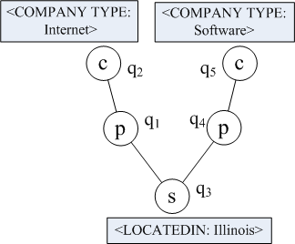
K-Automorphism
Original Graph G
Original Query Q
Notes:
Here is an original query graph Q. We should find matches of Q on G. For each match M, the vertex should have the same vertex type and contain vertex attributes of the corresponding vertex in Q.

Slide 6
K-Automorphism
Original Graph G
Original Query Q
Notes:
For example, here is a match of Q on G.

Slide 7
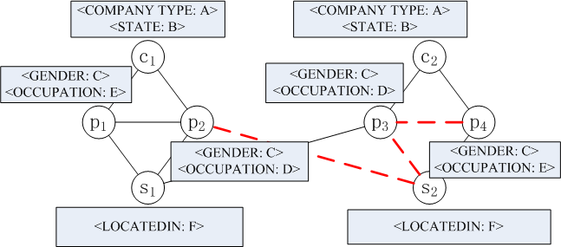
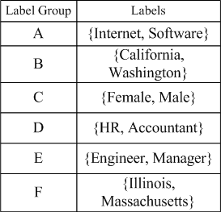
K-Automorphism
K-Automorphic Graph G^{k}
K = 2
Label Correspondence Table (LCT)
Notes:
To keep the data privacy, the client transforms the original data graph into a k-automorphic graph Gk. We need to protect both label privacy and structural privacy. For label privacy, we generate label groups by combining different labels to label groups using k-anonymity. The label correspondence table shows the relation between the label group and the corresponding labels. For structural privacy, the k-automorphic graph Gk can be divided into k identical partitions. Each vertex has at least k-1 other symmetric vertices.

Slide 8
K-Automorphism
K-Automorphic Graph G^{k}
K = 2
Original Query Q
Label Correspondence Table (LCT)
Notes:
For the query graph, the client uses the same label combination to generate the outsourced query Qo.

Slide 9
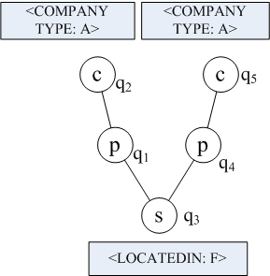
K-Automorphism
K-Automorphic Graph G^{k}
K = 2
Outsourced Query Qº
Label Correspondence Table (LCT)
Notes:
For the query graph, the client uses the same label combination to generate the outsourced query Qo.

Slide 10
K-Automorphism
Cloud
Client
G (Original Graph)
Notes:
However, if the client uploads the k-automorphic graph Gk to the cloud, it will need large cloud storage.

Slide 11
K-Automorphism
Cloud
G^{k} (K-Automorphic Graph)
Client
G (Original Graph)
Notes:
However, if the client uploads the k-automorphic graph Gk to the cloud, it will need large cloud storage.

Slide 12
K-Automorphism
Cloud
G^{k} (K-Automorphic Graph)
Client
G (Original Graph)
Q (Original Query)
Notes:
However, if the client uploads the k-automorphic graph Gk to the cloud, it will need large cloud storage.

Slide 13
K-Automorphism
Cloud
G^{k} (K-Automorphic Graph)
Qº (Anonymized Query)
Client
G (Original Graph)
Q (Original Query)
Notes:
However, if the client uploads the k-automorphic graph Gk to the cloud, it will need large cloud storage.

Slide 14
K-Automorphism
Cloud
G^{k} (K-Automorphic Graph)
Qº (Anonymized Query)
Client
G (Original Graph)
Q (Original Query)
Notes:
However, if the client uploads the k-automorphic graph Gk to the cloud, it will need large cloud storage.

Slide 15
K-Automorphism
Cloud
G^{k} (K-Automorphic Graph)
Qº (Anonymized Query)
Client
Notes:
However, if the client uploads the k-automorphic graph Gk to the cloud, it will need large cloud storage.

Slide 16
K-Automorphism
Cloud
R(Qº, G^{k})
We denote the matches of any query Q on any data graph G by R(Q, G).
Client
Notes:
However, if the client uploads the k-automorphic graph Gk to the cloud, it will need large cloud storage.

Slide 17
K-Automorphism
Cloud
R(Qº, G^{k})
Client
Notes:
However, if the client uploads the k-automorphic graph Gk to the cloud, it will need large cloud storage.

Slide 18
K-Automorphism
Cloud
R(Qº, G^{k})
Client
Notes:
However, if the client uploads the k-automorphic graph Gk to the cloud, it will need large cloud storage.

Slide 19
K-Automorphism
Cloud
R(Qº, G^{k})
Client
Hash Index
R(Q, G)
Notes:
However, if the client uploads the k-automorphic graph Gk to the cloud, it will need large cloud storage.

Slide 20
K-Automorphism
Cloud
Client
R(Q, G)
Notes:
However, if the client uploads the k-automorphic graph Gk to the cloud, it will need large cloud storage.

Slide 21
K-Automorphism
Optimization 1
Upload Gº rather than G^{k} to the cloud
Save cloud storage
Notes:
However, if the client uploads the k-automorphic graph Gk to the cloud, it will need large cloud storage.

Slide 22
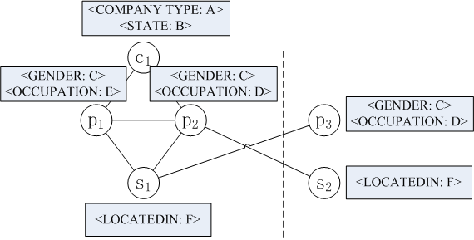
K-Automorphism
Optimization 1
Upload Gº rather than G^{k} to the cloud
Save cloud storage
Outsourced Graph Gº
K = 2
Notes:
Thus our Optimization 1 is to upload a small subset Go rather than Gk to the cloud. Go only includes the first block of Gk and their one-hop neighbors. It can largely save cloud storage.

Slide 23
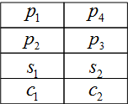
K-Automorphism
Optimization 1
Upload Gº rather than G^{k} to the cloud
Save cloud storage
Outsourced Graph Gº
K = 2
Outsourced Query Qº
Alignment Vertex Table (AVT)
Notes:
The client also needs to upload the outsourced query Qo and the alignment vertex table to the cloud.

Slide 24
Subgraph Matching
Star Matching
Outsourced Query Qº
Notes:
Then, the cloud performs the subgraph matching algorithm on the outsourced graph. Give an outsourced query Qo,

Slide 25
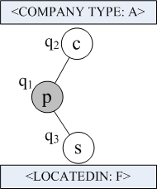
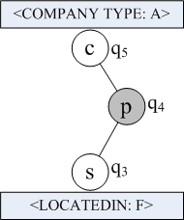
Subgraph Matching
Star Matching
Query Decomposition
Outsourced Query Qº
Star S₁
Star S₂
Notes:
the cloud first performs query decomposition. It divides the outsourced query Qo into several stars.

Slide 26
Subgraph Matching
Star Matching
Outsourced Graph Gº
Star Matching
Query Decomposition
Outsourced Query Qº
Star S₁
Star S₂
Notes:
Then the cloud performs star matching for each star query on the outsourced graph Go.

Slide 27
Subgraph Matching
Optimization 2
Estimate the search space of matching a star query
Better label generalization, better query decomposition
Save query time cost
Notes:
Since the cloud needs to perform star matching, our Optimization 2 is to estimate the search space of matching a star query. It gives us better label generalization and better query decomposition, which can save query time cost.

Slide 28
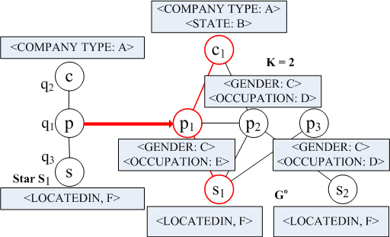
Subgraph Matching
Optimization 2
Estimate the search space of matching a star query
Better label generalization, better query decomposition
Save query time cost
Notes:
This example shows how we estimate the search space of matching a star query.

Slide 29
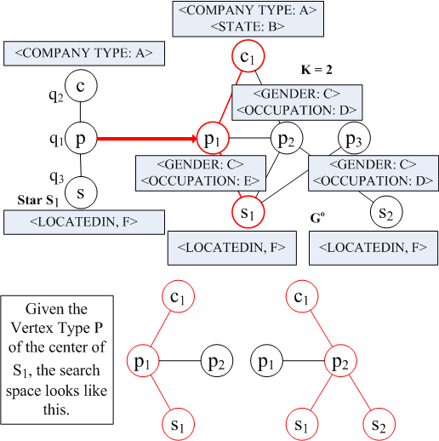
Subgraph Matching
Optimization 2
Estimate the search space of matching a star query
Better label generalization, better query decomposition
Save query time cost
Notes:
Given the vertex type P of the center of star S1, the search space looks like this.

Slide 30
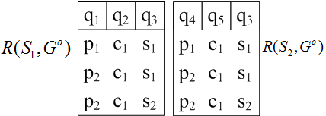
Subgraph Matching
Result Join
Notes:
After star matching, the cloud generates the matching results of each star on Go. Then the cloud needs to join these intermediate results R(S1, Go) and R(S2, Go).

Slide 31
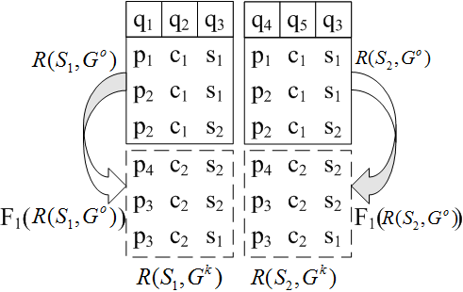
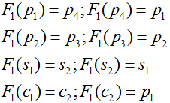
Subgraph Matching
Result Join
Alignment Vertex Table (AVT)
Automorphic Function F₁
Notes:
According to the alignment vertex table, the cloud can generate the matches of R(S1, Gk) and R(S2, Gk).

Slide 32
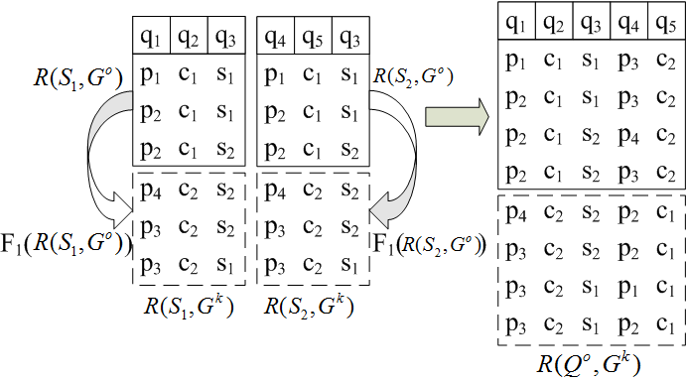
Subgraph Matching
Result Join
Alignment Vertex Table (AVT)
Automorphic Function F₁
Notes:
Then the cloud joins R(S1, Gk) and R(S2, Gk) and generates the matches of the outsourced query Qo on the whole k-automorphic graph Gk, denoted by R(Qo, Gk).

Slide 33
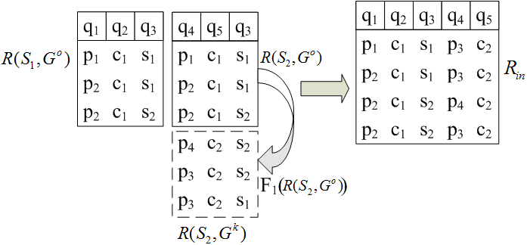
Subgraph Matching
Optimization 3
Generate R_{in} rather than all the results
Save query time cost and communication cost
Alignment Vertex Table (AVT)
Automorphic Function F₁
Notes:
However, according to the symmetry of the k-automorphic graph Gk, it’s not necessary for the cloud to generate R(Qo, Gk). In fact, joining R(S1, Go) and R(S2, Gk) is enough. We denote such result set by Rin. The size of Rin is only 1 over k of that of R(Qo, Gk).

Slide 34
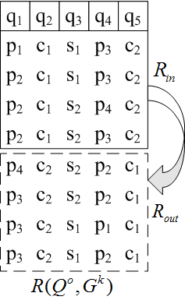
Subgraph Matching
Client Filtering
Generating Candidate Results
Notes:
The cloud just transmits Rin to the client side. Then, the client can recover R(Qo, Gk) by using the alignment vertex table.

Slide 35
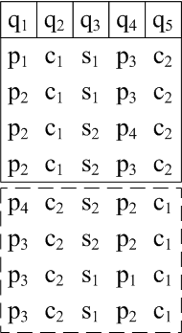

Subgraph Matching
Client Filtering
Generating Candidate Results
Filtering
Notes:
According to some hash index, the client filters out false positives and only keeps the real matches of the original query Q on the original data graph G.

Slide 36

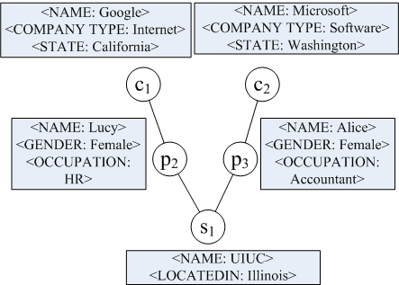
Subgraph Matching
Client Filtering
Original Query Q
Generating Candidate Results
Filtering
Matching Result
Notes:
After that, the client gains the final matching result.

Slide 37
Experimental Results
Original Data Graphs:
10⁵ – 10⁷ vertices, 10⁶ – 10⁸ edges
The ratio of # of vertices to # of different labels: around 10³
Original Query Graphs:
4 – 12 edges
Notes:
In the last part, I will show some of our experimental results. The original data graphs have ten to the five to ten to the seven vertices and ten to the six to ten to the eight edges. The ratio of the number of vertices to the number of different labels is around one thousand. The original query graphs have 4 to 12 edges.

Slide 38
Experimental Results
Methods:
EFF: applies all the three optimizations
Notes:
We compare the performance of four methods.

Slide 39
Experimental Results
Methods:
EFF: applies all the three optimizations
BAS: directly uploading the whole k-automorphic graph to the cloud

Slide 40
Experimental Results
Methods:
EFF: applies all the three optimizations
BAS: directly uploading the whole k-automorphic graph to the cloud
RAN: randomly combines labels into label groups

Slide 41
Experimental Results
Methods:
EFF: applies all the three optimizations
BAS: directly uploading the whole k-automorphic graph to the cloud
RAN: randomly combines labels into label groups
FSIM: combines labels with similar frequencies into the same label groups

Slide 42
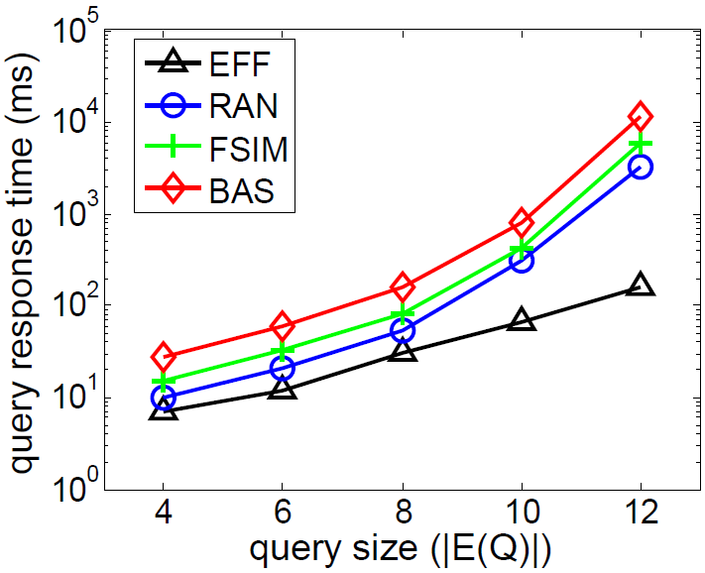
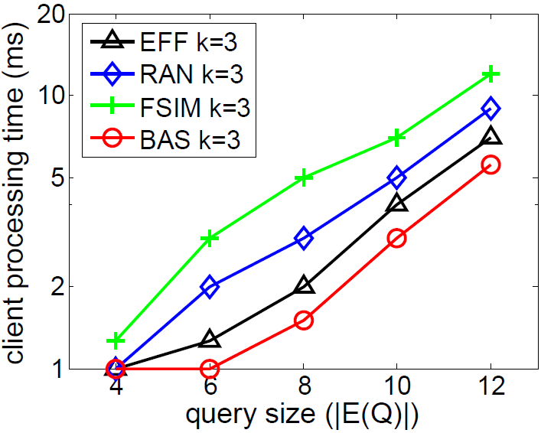
Experimental Results
Cloud processing time on DBpedia (K = 3)
Client processing time on DBpedia (K = 3)
Notes:
The two figures show the cloud processing time and the client processing time on DBpedia when k equals 3. EFF shows the best performance in terms of cloud processing time. Since BAS has already generated R(Qo, Gk) in the cloud, it has less time cost in the client processing than other methods.

Slide 43
Thanks!
Notes:
Thanks. Do you have any questions?

