Slide 1

Efficient Oblivious Query Processing for Range and kNN Queries
Zhao Chang, Dong Xie, Feifei Li, Jeff Phillips, Rajeev Balasubramonian
University of Utah
Notes:
Hi, my name is Zhao Chang. I come from University of Utah. Today, let me introduce our paper Efficient Oblivious Query Processing for Range and kNN Queries.

Slide 2
Outline
Background
Framework and Baseline
Integrate Indices into ORAM
Optimizations
Experimental Evaluation
Notes:
Here is a brief outline.

Slide 3

Background
Security and Privacy Issues in Public Cloud
Many companies choose the cloud as their data and IT infrastructure platform.
Remote access brings the issue of trust.
David Fletcher. http://cloudtweaks.com/
Notes:
Today, many companies choose the cloud as their data and IT infrastructure platform.
However, the remote access brings security and privacy issues in public cloud.

Slide 4
Background
Strong Encryption is NOT Enough
Adversaries can still learn sensitive information by observing the data access patterns.
Notes:
Although data encryption is necessary to keep sensitive information secure and private in cloud,
adversaries can still learn sensitive information by observing the data access patterns.

Slide 5
Background
Strong Encryption is NOT Enough
Adversaries can still learn sensitive information by observing the data access patterns.
Examples:
1. An attacker can identify as much as 80% of email search queries by observing the access pattern of an encrypted email repository alone.
[Islam et al. NDSS 2012]
Notes:
For example, Islam and his coauthors point out an attacker can identify as much as 80% of email search queries by observing the access pattern of an encrypted email repository alone.

Slide 6
Background
Strong Encryption is NOT Enough
Adversaries can still learn sensitive information by observing the data access patterns.
Examples:
2. Knowing that the database stores spatial POIs from NYC, the most frequently accessed records are probably from Manhattan.
Notes:
Another example is knowing that the database stores spatial places of interest from New York City, the most frequently accessed records are probably from Manhattan.

Slide 7
Background
Is there a way to protect the data access patterns?
Answer: Oblivious RAM (ORAM)
Notes:
Thus, our question is “Is there a way to protect the data access patterns?” The answer is using Oblivious RAM.

Slide 8
Background
What is ORAM?
Oblivious Random Access Machine [ORAM]
Notes:
ORAM is short for Oblivious Random Access Machine.

Slide 9
Background
What is ORAM?
Oblivious Random Access Machine [ORAM]
Oblivious: its sequence of accessing (e.g. read/write) locations in the (server) storage is indistinguishable for any two inputs with the same length.
Read (i)
Client
Server
Write (i, data)
Notes:
“Oblivious” means its sequence of accessing locations in the storage is indistinguishable for any two inputs with the same length.
ORAM applies to the client-server model.
Suppose the server keeps a sequence of blocks in the untrusted storage.
As for the client, each ORAM operation is either a read operation, which reads block i from the server, or a write operation, which updates block i with some new block content.

Slide 10
Background
Definition of ORAM
We use Oblivious RAM to simulate Original RAM.
Notes:
Then we can use an oblivious RAM to simulate the original RAM.

Slide 11
Background
Definition of ORAM
We use Oblivious RAM to simulate Original RAM.
For each possible input α (with the same length), given access pattern β, we have:
Pr(input α | access pattern β) = Pr(input α).
Notes:
For each possible input α with the same length, given access pattern β, we must have such a probability equation.

Slide 12
Background
Definition of ORAM
We use Oblivious RAM to simulate Original RAM.
For each possible input α (with the same length), given access pattern β, we have:
Pr(input α | access pattern β) = Pr(input α).
A list of Server Locations accessed in Oblivious RAM
A list of Read/Write Requests (needed) in Original RAM
Notes:
The input is a list of read or write requests needed in the original RAM, while the access pattern is a list of server locations accessed in the oblivious RAM.
The definition implies the probability of the original input α from the client, is independent of the access pattern β, which can be observed by the server.
That is to say, the server cannot gain any more information regarding the original input, just based on the observed access pattern.

Slide 13
Background
Trivial ORAMs
1: Store everything in client, without any calls to server.
> client storage = O(N).
Notes:
For ease of understanding, I will give some trivial ORAM examples.
The first one is to store everything in the client, without any calls to the server.
In this case, there is no access pattern in the server, but the client storage cost is O(N).

Slide 14
Background
Trivial ORAMs
1: Store everything in client, without any calls to server.
> client storage = O(N).
2: Store everything in server, but linearly scan everything for each operation.
> time cost = O(N), communication overhead = O(N).
Notes:
The second one is to store everything in the server, but the client needs to linearly scan everything for each ORAM operation.
In this case, each operation has the same access pattern.
But the time cost and communication overhead are both O(N).

Slide 15
Background
Trivial ORAMs
1: Store everything in client, without any calls to server.
> client storage = N.
2: Store everything in server, but linearly scan everything for each operation.
> time cost = O(N), communication overhead = O(N).
3: Assume the client accesses each block slot at most once.
> permute addresses using a PRP (pseudorandom permutation).
> optimal, but assumption does not hold in practice.
Notes:
The third one is to assume the client accesses each block slot at most once.
During the preprocessing, the client permutes addresses using a pseudorandom permutation.
For each online operation, the client retrieves only one block by leveraging the PRP function.
It’s optimal in theory, but the assumption is too strong and doesn’t hold in practice.

Slide 16
Background
Path-ORAM
[Stefanov et al. CCS 2013]
Advantages: good performance, simplicity
N leaf nodes
(1 + log N) levels
root
Server
Client
posMap
stash
Notes:
Next, I will introduce Path-ORAM, which is a commonly-used ORAM construction, due to its good performance and simplicity.

Slide 17
Background
Path-ORAM
The cloud storage is organized as a full binary tree.
Each node in the tree is a bucket of Z blocks (It suffices to set Z = 4).
N leaf nodes
(1 + log N) levels
root
Server
Client
posMap
stash
Notes:
In Path-ORAM, the cloud storage is organized as a full binary tree, with N leaf nodes and (1+log N) levels.
Each node in the tree is a bucket of Z blocks. It suffices to set Z equal to 4.

Slide 18
Background
Path-ORAM
Invariant: each block i must reside in path from root to leaf posMap[i]
The client uses a position map to track the mapping: block i leaf posMap[i] = x
leaf x
N leaf nodes
(1 + log N) levels
block i
root
Server
Client
posMap
stash
Notes:
Path-ORAM maintains such an invariant: each block i must reside in the path from the root node to the leaf node posMap[i].
The client uses a position map to track the mapping, from block i to the leaf node posMap[i] equal to x.

Slide 19
Background
Path-ORAM
Read Path: retrieve path x = posMap[i] and push all real blocks to stash
leaf x
N leaf nodes
(1 + log N) levels
root
Server
Client
block i
posMap
stash
Notes:
A Path-ORAM read/write operation needs three steps.
The first step is read path. The client retrieves path x equal to posMap[i] from the cloud and pushes all the real blocks along that path into her private stash.

Slide 20
Background
Path-ORAM
Read Path: retrieve path x = posMap[i] and push all real blocks to stash
Block i is (logically) assigned to a random leaf posMap[i] = r
leaf x
leaf r
N leaf nodes
(1 + log N) levels
root
Server
Client
block i
posMap
stash
Notes:
The second step is to logically assign block i to a random leaf node r and make posMap[i] equal to r.

Slide 21
Background
Path-ORAM
Read Path: retrieve path x = posMap[i] and push all real blocks to stash
Block i is (logically) assigned to a random leaf posMap[i] = r
Write Path: write blocks in stash back to path x (keep the invariant)
leaf x
leaf r
N leaf nodes
(1 + log N) levels
block i
root
Server
Client
posMap
stash
Notes:
The last step is write path. The client writes blocks in the stash back to the same path x.
During write path, the client still keeps the previous invariant.
For example, block i must reside in the path with the leaf node posMap[i] equal to r. In this example, block i is put into the crossing bucket of path x and path r.

Slide 22
Background
Limitations
Destroy the locality of references in databases
Notes:
Although one can protect client access patterns using ORAMs, there are still some major limitations while using ORAM to build an encrypted database.
First, using ORAM destroys the locality of references in databases due to hiding access patterns.

Slide 23
Background
Limitations
Destroy the locality of references in databases
Support only read and write operations
Notes:
Second, ORAM only supports read and write operations.

Slide 24
Background
Limitations
Destroy the locality of references in databases
Support only read and write operations
Hard to support concurrency in an efficient and scalable manner
Notes:
Lastly, it’s still hard to support concurrency in an efficient and scalable manner.

Slide 25
Framework and Baseline
Efficient Oblivious Query Processing for Range and kNN Queries
Propose a framework OQF to process range and kNN queries
Locality
Multiple Types of Queries
Notes:
In this work, we propose a framework OQF, which takes advantage of query locality information and supports multiple types of queries, such as range and kNN queries.

Slide 26
Framework and Baseline
Efficient Oblivious Query Processing for Range and kNN Queries
Propose a framework OQF to process range and kNN queries
Asynchronous, Query-level concurrency
Locality
Multiple Types of Queries
Concurrency
Notes:
Besides, OQF can also support asynchronous query processing and query-level concurrency.

Slide 27
Framework and Baseline
Efficient Oblivious Query Processing for Range and kNN Queries
Propose a framework OQF to process range and kNN queries
Asynchronous, Query-level concurrency
Objective: maximize the overall query throughput
Locality
Multiple Types of Queries
Concurrency
Notes:
Our objective is to maximize the overall query throughput.

Slide 28
Framework and Baseline
OQF Framework
Propose a framework OQF to process range and kNN queries
ORAM Data Structure
Cloud Storage
Secure Data Storage
Untrusted
get
put
Trusted
Oblivious Query Framework
ORAM Protocol
Coordinator
ORAM Stash
ORAM Cache
Results
Queries
Client
Client
Client
Client
Notes:
Here is our OQF framework. During preprocessing, the data owner partitions records in the database into blocks, encrypts these blocks, and builds an ORAM data structure over them. Then, she uploads the ORAM data structure to the untrusted cloud server, which stores them into a secure data storage. She shares the encryption keys and other metadata with the trusted coordinator. During online processing, clients issue queries against the cloud server through the coordinator. The coordinator performs an oblivious query algorithm, which follows the ORAM protocol, reads and writes blocks to the cloud to answer the queries, and returns query results to the clients. For our method, the coordinator also keeps an ORAM cache and stash in her private storage. The details will be given in the following pages.

Slide 29
Framework and Baseline
Baseline
Scan-based solution
Opaque method (without distributed setting) [Zheng et al. NSDI 2017]
Cloud
Untrusted
Trusted
Data Owner
data
3
4
5
6
7
8
9
0
1
2
Notes:
First, I will introduce a baseline method.
It’s a scan-based solution and actually the Opaque method without the distributed setting.
Suppose the data owner has a sequence of data blocks.

Slide 30
Framework and Baseline
Baseline
Cloud
Untrusted
Trusted
Data Owner
encryption key
data
3
4
5
6
7
8
9
0
1
2
Notes:
During preprocessing, the data owner encrypts these data blocks using an encryption key.

Slide 31
Framework and Baseline
Baseline
data
3
4
5
6
7
8
9
0
1
2
Cloud
Untrusted
Trusted
Data Owner
encryption key
Notes:
Then she directly uploads the encrypted blocks to the untrusted cloud.

Slide 32
Framework and Baseline
Baseline
data
3
4
5
6
7
8
9
0
1
2
Cloud
Untrusted
Trusted
Data Owner
Coordinator
Share
encryption key
encryption key
Notes:
and shares the encryption key with the trusted coordinator.

Slide 33
Framework and Baseline
Baseline
data
3
4
5
6
7
8
9
0
1
2
Cloud
Untrusted
Trusted
Clients
Coordinator
Range Query Q
encryption key
Result Set R = Φ
Notes:
During online processing, clients will issue queries against the cloud through the coordinator.
Take range query as an example.

Slide 34
Framework and Baseline
Baseline
data
3
4
5
6
7
8
9
0
1
2
Cloud
Untrusted
Trusted
Clients
Coordinator
Range Query Q
encryption key
Result Set R = Φ
Notes:
One client submits a range query Q and initializes the result set R as an empty set.

Slide 35
Framework and Baseline
Baseline
data
3
4
5
6
7
8
9
0
1
2
Scan-based solution
Cloud
Untrusted
Trusted
Clients
Coordinator
Range Query Q
encryption key
Result Set R = Φ
Notes:
The coordinator performs a scan-based algorithm.

Slide 36
Framework and Baseline
Baseline
data
3
4
5
6
7
8
9
0
1
2
Cloud
Untrusted
Trusted
Clients
Coordinator
Range Query Q
i
Decryption
encryption key
Result Set R
Notes:
For each operation, the coordinator retrieves data block i from the cloud and decrypts it.

Slide 37
Framework and Baseline
Baseline
data
3
4
5
6
7
8
9
0
1
2
Cloud
Untrusted
Trusted
Clients
Coordinator
Intersection R_{i}
Range Query Q
i
encryption key
R = R ∪ R_{i}
If R_{i} ≠ Φ
Result Set R
Notes:
Then the coordinator finds the records R_i from block i which reside in the query range.
If R_i is not empty, the coordinator transmits R_i to the client, and the client adds R_i into the result set R.

Slide 38
Framework and Baseline
Baseline
data
3
4
5
6
7
8
9
0
1
2
Cloud
Untrusted
Trusted
Clients
After scanning, R is the final result set.
Coordinator
encryption key
Result Set R
Notes:
After scanning, R will be the final result set.

Slide 39
Integrate Indices into ORAM
ORAM+B-Tree
Build an index over the data
Store all (index and data) blocks into ORAM
Cloud
Untrusted
Trusted
Data Owner
data
3
4
5
6
7
8
9
0
1
2
Notes:
A better solution is to build an index over the data blocks and store all the index and data blocks into ORAM.
Take ORAM+B-tree as an example.
Suppose the data owner has a sequence of data blocks.

Slide 40
Integrate Indices into ORAM
ORAM+B-Tree
Cloud
Untrusted
Trusted
Data Owner
B-Tree
17
15
16
PID
IsLeaf
# of Children
Children Keys
Children PIDs
index
10
11
12
13
14
data
3
4
5
6
7
8
9
0
1
2
Notes:
She builds a standard B-tree index over them.

Slide 41
Integrate Indices into ORAM
ORAM+B-Tree
Cloud
Untrusted
Trusted
encryption key
Data Owner
B-Tree
17
15
16
index
10
11
12
13
14
data
3
4
5
6
7
8
9
0
1
2
Notes:
and encrypts all the index and data blocks using the encryption key.

Slide 42
Integrate Indices into ORAM
ORAM+B-Tree
Cloud
Untrusted
Trusted
encryption key
Data Owner
B-Tree
17
15
16
index
10
11
12
13
14
data
3
4
5
6
7
8
9
0
1
2
Notes:
Then she stores all the index and data blocks into an ORAM data structure, for example, Path-ORAM.

Slide 43
Integrate Indices into ORAM
ORAM+B-Tree
Cloud
Untrusted
Trusted
encryption key
= data/index block
posMap
= dummy block
cache+stash
Data Owner
= slot
Path-ORAM
Notes:
In this example, each red-colored block stands for an index block or a data block, and each blue-colored block stands for a dummy block.

Slide 44
Integrate Indices into ORAM
ORAM+B-Tree
Cloud
Untrusted
Trusted
encryption key
= data/index block
posMap
= dummy block
cache+stash
Data Owner
= slot
Path-ORAM
Notes:
Then, the data owner uploads the Path-ORAM data structure to the untrusted cloud.

Slide 45
Integrate Indices into ORAM
ORAM+B-Tree
Path-ORAM
Cloud
Untrusted
Trusted
encryption key
= data/index block
posMap
= dummy block
cache+stash
Data Owner
= slot
Notes:
and only keeps some meta-data, such as the encryption key, the position map and the cache and stash in her private storage.

Slide 46
Integrate Indices into ORAM
ORAM+B-Tree
Path-ORAM
Cloud
Untrusted
Trusted
= data/index block
= dummy block
Data Owner
= slot
Coordinator
posMap
Share
posMap
cache+stash
cache+stash
encryption key
encryption key
Notes:
Lastly, the data owner shares the meta-data with the coordinator.

Slide 47
Integrate Indices into ORAM
Untrusted
ORAM+B-Tree
The online processing is the same as that over a standard B-tree.
Cloud
Path-ORAM
Trusted
= data/index block
= dummy block
Clients
= slot
Coordinator
B-Tree Query Q
posMap
Result Set R
cache+stash
encryption key
Notes:
The online processing is the same as that over a standard B-tree.

Slide 48
Integrate Indices into ORAM
Untrusted
ORAM+B-Tree
The online processing is the same as that over a standard B-tree.
The only difference is that the coordinator retrieves the index/data blocks through the ORAM protocol.
Cloud
Path-ORAM
Trusted
= data/index block
= dummy block
Clients
= slot
Coordinator
B-Tree Query Q
posMap
Result Set R
cache+stash
encryption key
Notes:
The only difference is the coordinator retrieves the index and data blocks through the ORAM protocol.

Slide 49
Integrate Indices into ORAM
Untrusted
ORAM+R-Tree
Cloud
Path-ORAM
Trusted
= data/index block
The similar construction and processing can be carried out for ORAM+R-Tree.
= dummy block
Clients
= slot
Coordinator
R-Tree Query Q
posMap
Result Set R
cache+stash
encryption key
Notes:
The similar construction and processing can be carried out for ORAM+R-tree.

Slide 50
Integrate Indices into ORAM
Oblivious B-Tree
Objective: eliminate the need of storing position map
Notes:
Another solution is to build an oblivious data structure to eliminate the need of storing the position map.

Slide 51
Integrate Indices into ORAM
Oblivious B-Tree
Objective: eliminate the need of storing position map
Observation: tree-like access patterns
B-Tree
17
15
16
10
11
12
13
14
0
1
2
3
4
5
6
7
8
9
Notes:
The observation is most query algorithms over tree-based indices have tree-like access patterns. Take B-tree as an example.

Slide 52
Integrate Indices into ORAM
Oblivious B-Tree
Objective: eliminate the need of storing position map
Observation: tree-like access patterns
B-Tree
17
15
16
10
11
12
13
14
0
1
2
3
4
5
6
7
8
9
Notes:
Each access pattern is from the root block.

Slide 53
Integrate Indices into ORAM
Oblivious B-Tree
Objective: eliminate the need of storing position map
Observation: tree-like access patterns
B-Tree
Notes:
to the leaf blocks.

Slide 54
Integrate Indices into ORAM
Oblivious B-Tree
Idea: pointer-based technique (extended from [Wang et al. CCS 2014])
B-Tree
Notes:
The idea is to leverage a pointer-based technique, which is extended from a paper in CCS 2014.

Slide 55
Integrate Indices into ORAM
Oblivious B-Tree
Parent blocks store their children position tags
B-Tree
PID
IsLeaf
PosTag
# of Children
Children Keys
Children PIDs
Children PosTags
Notes:
Particularly, parent blocks should also store their children position tags.

Slide 56
Integrate Indices into ORAM
Oblivious B-Tree
Parent blocks store their children position tags
The coordinator only keeps the position tag of the root
B-Tree
B-tree root posTag
PID
IsLeaf
PosTag
# of Children
Children Keys
Children PIDs
Children PosTags
Notes:
Then, the coordinator only needs to keep the position tag of the root block.

Slide 57
Integrate Indices into ORAM
Oblivious B-Tree
Cloud
Untrusted
Trusted
Data Owner
data
3
4
5
6
7
8
9
0
1
2
Notes:
Suppose the data owner still keeps a sequence of data blocks.

Slide 58
Integrate Indices into ORAM
Oblivious B-Tree
Cloud
Untrusted
Trusted
Data Owner
B-Tree
17
15
16
PID
IsLeaf
PosTag
# of Children
Children Keys
Children PIDs
Children PosTags
index
10
11
12
13
14
data
3
4
5
6
7
8
9
0
1
2
Notes:
She builds an oblivious B-tree index over them.

Slide 59
Integrate Indices into ORAM
Oblivious B-Tree
Cloud
Untrusted
Trusted
Data Owner
B-Tree
17
15
16
PID
IsLeaf
PosTag
# of Children
Children Keys
Children PIDs
Children PosTags
index
10
11
12
13
14
data
3
4
5
6
7
8
9
0
1
2
Notes:
Particularly, each index block stores its position tag and all the children position tags.

Slide 60
Integrate Indices into ORAM
Oblivious B-Tree
Cloud
Untrusted
Trusted
encryption key
Data Owner
B-Tree
17
15
16
index
10
11
12
13
14
data
3
4
5
6
7
8
9
0
1
2
Notes:
Then the data owner encrypts all the index and data blocks using the encryption key.

Slide 61
Integrate Indices into ORAM
Oblivious B-Tree
Cloud
Untrusted
Trusted
encryption key
Data Owner
B-Tree
17
15
16
index
10
11
12
13
14
data
3
4
5
6
7
8
9
0
1
2
Notes:
and stores them into a Path-ORAM data structure.

Slide 62
Integrate Indices into ORAM
Oblivious B-Tree
Cloud
Untrusted
Trusted
encryption key
= data/index block
B-tree root posTag
= dummy block
cache+stash
Data Owner
= slot
Path-ORAM

Slide 63
Integrate Indices into ORAM
Oblivious B-Tree
Cloud
Untrusted
Trusted
encryption key
= data/index block
B-tree root posTag
= dummy block
cache+stash
Data Owner
= slot
Path-ORAM
Notes:
Additionally, the data owner keeps the position tag of the B-tree root block.

Slide 64
Integrate Indices into ORAM
Oblivious B-Tree
Cloud
Untrusted
Trusted
encryption key
= data/index block
B-tree root posTag
= dummy block
cache+stash
Data Owner
= slot
Path-ORAM
Notes:
Then, the data owner uploads the Path-ORAM data structure to the cloud.

Slide 65
Integrate Indices into ORAM
Oblivious B-Tree
Path-ORAM
Cloud
Untrusted
Trusted
encryption key
= data/index block
B-tree root posTag
= dummy block
cache+stash
Data Owner
= slot
Notes:
and only keeps the meta-data.

Slide 66
Integrate Indices into ORAM
Oblivious B-Tree
Path-ORAM
Cloud
Untrusted
Trusted
= data/index block
= dummy block
Data Owner
= slot
Coordinator
B-tree root posTag
Share
B-tree root posTag
cache+stash
cache+stash
encryption key
encryption key
Notes:
Lastly, the data owner shares the meta-data with the coordinator.

Slide 67
Integrate Indices into ORAM
Untrusted
Oblivious B-Tree
Online processing: an additional cache needed
Cloud
Path-ORAM
Trusted
= data/index block
Logical B-Tree
= dummy block
Coordinator
= slot
Clients
root
child
B-tree root posTag
B-Tree Query Q
cache+stash
leaf
Result Set R
encryption key
an additional cache
Notes:
During online processing, the coordinator needs to keep an additional cache.

Slide 68
Integrate Indices into ORAM
Untrusted
Oblivious B-Tree
Online processing: an additional cache needed
Cloud
Path-ORAM
Trusted
= data/index block
Logical B-Tree
= dummy block
Take point query as an example.
Coordinator
= slot
Clients
root
child
B-tree root posTag
B-Tree Query Q
cache+stash
leaf
Result Set R
encryption key
an additional cache
Notes:
Take B-tree point query as an example.

Slide 69
Integrate Indices into ORAM
Untrusted
Oblivious B-Tree
1. Retrieve root using its ID and posTag stored in the coordinator.
Cloud
Path-ORAM
Trusted
= data/index block
Logical B-Tree
= dummy block
Coordinator
= slot
Clients
root
1. retrieve root
B-tree root posTag
child
B-tree root posTag
B-Tree Query Q
cache+stash
leaf
Result Set R
encryption key
an additional cache
Notes:
First, the coordinator retrieves the B-tree root block from the cloud, using its block ID and position tag stored in her private memory, and puts it into the additional cache.

Slide 70
Integrate Indices into ORAM
Untrusted
Oblivious B-Tree
2. Retrieve child using its ID and posTag stored in its parent.
Cloud
Path-ORAM
Trusted
= data/index block
Logical B-Tree
= dummy block
Coordinator
= slot
Clients
root
child
2. retrieve child
B-tree root posTag
B-Tree Query Q
cache+stash
leaf
Result Set R
encryption key
an additional cache
Notes:
Second, the coordinator retrieves a child block, using its block ID and position tag stored in its parent block, and puts it into the additional cache.
She repeats this step until reaching a leaf block.

Slide 71
Integrate Indices into ORAM
Untrusted
Oblivious B-Tree
3. Retrieve leaf using its ID and posTag stored in its parent.
The matched record will be found in leaf.
Cloud
Path-ORAM
Trusted
= data/index block
Logical B-Tree
= dummy block
Coordinator
= slot
Clients
root
child
B-tree root posTag
B-Tree Query Q
3. retrieve leaf
cache+stash
leaf
Result Set R
encryption key
an additional cache
Notes:
Third, the coordinator retrieves the leaf block, using its block ID and position tag stored in its parent block, and puts it into the additional cache.
The matched record will be found in the leaf block.

Slide 72
Integrate Indices into ORAM
Untrusted
Oblivious B-Tree
4. Write back the blocks along the path from bottom to top.
Cloud
Path-ORAM
Trusted
= data/index block
Logical B-Tree
= dummy block
Coordinator
= slot
Clients
root
child
4. write back the blocks along the path
B-tree root posTag
B-Tree Query Q
cache+stash
leaf
Result Set R
encryption key
an additional cache
Notes:
Lastly, the coordinator writes back the blocks along the B-tree path one by one from bottom to top.
Each block will be written to a Path-ORAM path with a random leaf node.

Slide 73
Integrate Indices into ORAM
Untrusted
Oblivious R-Tree
Cloud
Path-ORAM
Trusted
= data/index block
The similar construction and processing can be carried out for oblivious R-Tree.
= dummy block
Coordinator
= slot
Clients
R-tree root posTag
R-Tree Query Q
cache+stash
Result Set R
encryption key
Notes:
The similar construction and processing can be carried out for oblivious R-tree.

Slide 74
Optimizations
Optimizations
Objective: maximize the overall query throughput
Idea: process queries in batches
Notes:
Now, I will introduce some optimizations to improve the OQF framework.
Our objective is to maximize the overall query throughput.
The idea is to process queries in batches.

Slide 75
Optimizations
Optimizations
Method: keep an ORAM cache and leverage an ORAM caching strategy
> retrieve a block from cloud only when a cache miss happens
Assume there is a mapping from a query q to block IDs (to be accessed while processing q)
Notes:
Our method is to keep an ORAM cache and leverage an ORAM caching strategy in the coordinator.
The coordinator retrieves a block from the cloud only when a cache miss happens.
Here, we assume there is a mapping from a query q to block IDs to be accessed while processing q.
We will discuss how to design the mapping function in the next part.

Slide 76
Optimizations
Optimizations
Input: a query sequence of s query batches
s batches
batch 1
……
batch i
……
batch s
Notes:
In our setting, the input is a query sequence of s query batches.

Slide 77
Optimizations
Optimizations
Input: a query sequence of s query batches
Each batch contains g queries
s batches
batch 1
……
batch i
……
batch s
g queries
g queries
g queries
query sequence
…
……
…
……
…
Notes:
Each batch contains g queries.

Slide 78
Optimizations
Optimizations
Input: a query sequence of s query batches
Each batch contains g queries
Batch i needs to retrieve m_{i} blocks
s batches
batch 1
……
batch i
……
batch s
g queries
g queries
g queries
query sequence
…
……
…
……
…
block access sequence
…
…
……
…
m_{i} blocks
Notes:
Batch i needs to retrieve m_i blocks.

Slide 79
Optimizations
Optimizations
Query Locality: re-order queries by sorting or using space-filling curve
Constraint: re-order queries within a batch but not across batches
s batches
batch 1
……
batch i
……
batch s
g queries
g queries
g queries
query sequence
…
……
…
……
…
block access sequence
…
…
……
…
m_{i} blocks
Notes:
We leverage the query locality information, which means we reorder the kNN and range queries by sorting or using any space-filling curve.
The constraint is we only re-order queries within a batch but not across batches.

Slide 80
Bound the query latency by batch size g.
Optimizations
Optimizations
Query Locality: re-order queries by sorting or using space-filling curve
Constraint: re-order queries within a batch but not across batches
s batches
batch 1
……
batch i
……
batch s
g queries
g queries
g queries
query sequence
…
……
…
……
…
block access sequence
…
…
……
…
m_{i} blocks
Notes:
This will bound the query latency by tuning the batch size g.

Slide 81
Optimizations
Optimizations
Offline setting: the coordinator knows block IDs in all (future) batches
s batches
batch 1
……
batch i
……
batch s
g queries
g queries
g queries
query sequence
…
……
…
……
…
block access sequence
…
…
……
…
m_{i} blocks
Notes:
The offline setting is the coordinator knows the block IDs to be accessed in all future batches.

Slide 82
Optimizations
Optimizations
Offline setting: the coordinator knows block IDs in all (future) batches
Online setting: the coordinator knows only block IDs in current batch
s batches
batch 1
……
batch i
……
batch s
g queries
g queries
g queries
query sequence
…
……
…
……
…
block access sequence
…
…
……
…
m_{i} blocks
Notes:
The online setting is the coordinator only knows block IDs to be accessed in the current batch.

Slide 83
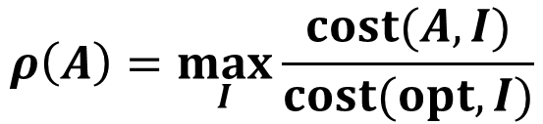
Optimizations
Optimizations
cost(A, I) ∝ number of blocks retrieved from cloud
(A: an online algorithm, I: an input query sequence)
Competitive ratio of A: (opt: offline optimal)
$$ρ\left(A\right)=\max_{I}{\frac{cost(A,I)}{cost(opt,I)}}$$
Notes:
We denote the cost of performing an online algorithm A over an input query sequence I as cost(A, I), which is proportional to the number of blocks retrieved from the cloud.
We also denote the competitive ratio of A as \rho(A). By definition, it’s equal to the maximum ratio of cost(A, I) to cost (opt, I), where opt is the offline optimal algorithm.

Slide 84
Optimizations
Assume each Path-ORAM operation leads to the same cost.
Optimizations
Offline Optimal: FIF
> Evict the block in cache that will not be accessed until Farthest In Future [Belady. 1966]
Notes:
Here, we assume each Path-ORAM operation retrieves and then writes a whole path to the cloud, which leads to the same cost.
Note that after query re-ordering, the query sequence is fixed.
In this case, the offline optimal algorithm is FIF, short for Farthest In Future.
It means when the cache is full and there is a cache miss, the coordinator will evict the block in the cache that will not be accessed until farthest in the future.

Slide 85
Optimizations
Optimizations
Offline Optimal: FIF
> Evict the block in cache that will not be accessed until Farthest In Future
cloud storage
Cloud
Coordinator
cache
cache hit: 0 cache miss: 0
batch 1
batch 2
batch 3
block access sequence
4
1
2
1
5
3
4
4
1
2
3
Notes:
Here is an example. Suppose the cache size is 3 and the query sequence contains 3 batches. The block access sequence is shown in the green data blocks.

Slide 86
Optimizations
Optimizations
Offline Optimal: FIF
> Evict the block in cache that will not be accessed until Farthest In Future
cloud storage
Cloud
Coordinator
cache
4
1
2
cache hit: 0 cache miss: 3
batch 1
batch 2
batch 3
block access sequence
4
1
2
1
5
3
4
4
1
2
3
Notes:
In batch 1, the coordinator retrieves blocks 4, 1, 2 from the cloud, which leads to 3 cache misses.

Slide 87
Optimizations
Optimizations
Offline Optimal: FIF
> Evict the block in cache that will not be accessed until Farthest In Future
cloud storage
Cloud
Coordinator
cache
4
1
2
cache hit: 1 cache miss: 3
batch 1
batch 2
batch 3
block access sequence
4
1
2
1
5
3
4
4
1
2
3
Notes:
In batch 2, the first block to be accessed is block 1, which leads to a cache hit.

Slide 88
Optimizations
Optimizations
Offline Optimal: FIF
> Evict the block in cache that will not be accessed until Farthest In Future
cloud storage
Cloud
Coordinator
cache
4
1
2
cache hit: 1 cache miss: 3
batch 1
batch 2
batch 3
block access sequence
4
1
2
1
5
3
4
4
1
2
3
Notes:
The next block to be accessed is block 5, which leads to a cache miss. The coordinator checks the block in her cache that will not be accessed until farthest in future, which is block 2.

Slide 89
Optimizations
Optimizations
Offline Optimal: FIF
> Evict the block in cache that will not be accessed until Farthest In Future
cloud storage
Cloud
Coordinator
cache
4
1
5
cache hit: 1 cache miss: 4
batch 1
batch 2
batch 3
block access sequence
4
1
2
1
5
3
4
4
1
2
3
Notes:
Then she evicts block 2 and retrieves block 5 from the cloud.

Slide 90
Optimizations
Optimizations
Offline Optimal: FIF
> Evict the block in cache that will not be accessed until Farthest In Future
cloud storage
Cloud
Coordinator
cache
2
1
3
cache hit: 5 cache miss: 6
batch 1
batch 2
batch 3
block access sequence
4
1
2
1
5
3
4
4
1
2
3
Notes:
The rest can be done in a similar way.

Slide 91
Optimizations
Optimizations
Offline Optimal: FIF
> Evict the block in cache that will not be accessed until Farthest In Future
cloud storage
cost(opt, I) = 6δ
Cloud
Coordinator
cache
2
1
3
cache hit: 5 cache miss: 6
batch 1
batch 2
batch 3
block access sequence
4
1
2
1
5
3
4
4
1
2
3
Notes:
In total, there are 5 cache hits and 6 cache misses. Thus, the cost of the offline optimal algorithm is 6\delta, where \delta is the cost of each Path-ORAM operation.

Slide 92
Optimizations
Optimizations
Online Algorithm: batch-FIF (LRU+FIF)
> First, evict the block that won’t be accessed within current batch (LRU)
> Second, evict the block that won’t be accessed until FIF within current batch
Notes:
Our online algorithm is batch-FIF, which is actually LRU+FIF.
When the cache is full and there is a cache miss, the coordinator first evicts the block that will not be accessed within the current batch using LRU caching strategy.
If such a block is not found, the coordinator will evict the block that will not be accessed until farthest in future within the current batch.

Slide 93
Optimizations
Optimizations
Online Algorithm: batch-FIF (LRU+FIF)
> First, evict the block that won’t be accessed within current batch (LRU)
> Second, evict the block that won’t be accessed until FIF within current batch
cloud storage
Cloud
Coordinator
cache
cache hit: 0 cache miss: 0
batch 1
batch 2
batch 3
block access sequence
4
1
2
1
5
3
4
4
1
2
3
Notes:
Still take the same example.

Slide 94
Optimizations
Optimizations
Online Algorithm: batch-FIF (LRU+FIF)
> First, evict the block that won’t be accessed within current batch (LRU)
> Second, evict the block that won’t be accessed until FIF within current batch
cloud storage
Cloud
Coordinator
cache
4
1
2
cache hit: 0 cache miss: 3
batch 1
batch 2
batch 3
block access sequence
4
1
2
1
5
3
4
4
1
2
3
Notes:
In batch 1, the coordinator retrieves blocks 4, 1, 2 from the cloud, which leads to 3 cache misses.

Slide 95
Optimizations
Optimizations
Online Algorithm: batch-FIF (LRU+FIF)
> First, evict the block that won’t be accessed within current batch (LRU)
> Second, evict the block that won’t be accessed until FIF within current batch
cloud storage
Cloud
Coordinator
cache
4
1
2
cache hit: 1 cache miss: 3
batch 1
batch 2
batch 3
block access sequence
4
1
2
1
5
3
4
4
1
2
3
Notes:
In batch 2, the first block to be accessed is block 1, which leads to a cache hit.

Slide 96
Optimizations
Optimizations
Online Algorithm: batch-FIF (LRU+FIF)
> First, evict the block that won’t be accessed within current batch (LRU)
> Second, evict the block that won’t be accessed until FIF within current batch
cloud storage
Cloud
Coordinator
cache
4
1
2
cache hit: 1 cache miss: 3
batch 1
batch 2
batch 3
block access sequence
4
1
2
1
5
3
4
4
1
2
3
Notes:
The next block to be accessed is block 5, which leads to a cache miss.
Since block 1 and block 2 will not be accessed within the current batch and block 2’s last access comes before block 1’s last access.

Slide 97
Optimizations
Optimizations
Online Algorithm: batch-FIF (LRU+FIF)
> First, evict the block that won’t be accessed within current batch (LRU)
> Second, evict the block that won’t be accessed until FIF within current batch
cloud storage
Cloud
Coordinator
cache
4
1
5
cache hit: 1 cache miss: 4
batch 1
batch 2
batch 3
block access sequence
4
1
2
1
5
3
4
4
1
2
3
Notes:
the coordinator evicts block 2 and retrieves block 5 from the cloud.

Slide 98
Optimizations
Optimizations
Online Algorithm: batch-FIF (LRU+FIF)
> First, evict the block that won’t be accessed within current batch (LRU)
> Second, evict the block that won’t be accessed until FIF within current batch
cloud storage
Cloud
Coordinator
cache
2
3
1
cache hit: 4 cache miss: 7
batch 1
batch 2
batch 3
block access sequence
4
1
2
1
5
3
4
4
1
2
3
Notes:
The rest can be done in a similar way.

Slide 99
Optimizations
Optimizations
Online Algorithm: batch-FIF (LRU+FIF)
> First, evict the block that won’t be accessed within current batch (LRU)
> Second, evict the block that won’t be accessed until FIF within current batch
cloud storage
cost(A, I) = 7δ
Cloud
Coordinator
cache
2
3
1
cache hit: 4 cache miss: 7
batch 1
batch 2
batch 3
block access sequence
4
1
2
1
5
3
4
4
1
2
3
Notes:
In total, there are 4 cache hits and 7 cache misses. Thus, the cost of our online algorithm is 7\delta, where \delta is the cost of each Path-ORAM operation.

Slide 100
Optimizations
Optimizations
Offline Optimal Algorithm: FIF
Online Algorithm: batch-FIF (LRU+FIF)
Notes:
In summary, the offline optimal algorithm is FIF, and our online algorithm is batch-FIF, which is actually LRU+FIF.

Slide 101
Optimizations
Optimizations
Offline Optimal Algorithm: FIF
Online Algorithm: batch-FIF (LRU+FIF)
Theorem:
A) If there are duplicate block
IDs within any batch, ρ ≤ τ.
B) Otherwise,
a) If τ ≤ m, ρ ≤ 2.
b) Otherwise, ρ ≤ τ.
ρ: competitive ratio
τ: cache size
m: minimum batch size
Notes:
We denote the competitive ratio as \rho, denote the cache size as \tau, and denote the minimum batch size as m. Then the theorem can bound the competitive ratio \rho.
In case A, if there are duplicate block IDs within any batch, \rho will be no larger than cache size \tau.
Otherwise, in case B, if cache size \tau is no larger than the minimum batch size m, \rho will be no larger than 2; otherwise, \rho will be no larger than cache size \tau.
Due to time limit, I omit the proof here.

Slide 102
Optimizations
Optimizations
Partial Path Retrieval + Batch Writing
Notes:
There are also some other optimizations. The first one is partial path retrieval and batch writing.

Slide 103
Optimizations
Optimizations
Partial Path Retrieval + Batch Writing
> Cache data blocks from retrieved paths
Notes:
In this optimization, the coordinator first caches all the data blocks from the retrieved paths.

Slide 104
Optimizations
Optimizations
Partial Path Retrieval + Batch Writing
> Cache data blocks from retrieved paths
> Retrieve only the partial path that is not kept in cache
Notes:
When she needs to retrieve a new block from the cloud, she only retrieves the partial path that is not kept in her cache.

Slide 105
Optimizations
Optimizations
Partial Path Retrieval + Batch Writing
> Cache data blocks from retrieved paths
> Retrieve only the partial path that is not kept in cache
> Write all paths back at once after every λ path retrievals
Notes:
Finally, she will write all the paths back to the cloud at once after every \lambda path retrievals.

Slide 106
Optimizations
Optimizations
Partial Path Retrieval + Batch Writing
> Cache data blocks from retrieved paths
> Retrieve only the partial path that is not kept in cache
> Write all paths back at once after every λ path retrievals
Path-ORAM
Cloud
0
1
2
3
4
5
6
7
Coordinator
cached path IDs
2
6
5
λ = 4
Notes:
Here is an example. Suppose \lambda is 4. The coordinator has already retrieved and cached Path 2, 6 and 5. Now, she needs to retrieve path 3.
According to our optimization, she only needs to retrieve the leaf bucket of Path 3, since all the remaining buckets have already been retrieved and cached, which are covered by the dotted blue lines.
We call this heuristics as partial path retrieval.

Slide 107
Optimizations
Optimizations
Partial Path Retrieval + Batch Writing
> Cache data blocks from retrieved paths
> Retrieve only the partial path that is not kept in cache
> Write all paths back at once after every λ path retrievals
Path-ORAM
Cloud
0
1
2
3
4
5
6
7
Coordinator
cached path IDs
2
6
5
3
λ = 4
Notes:
After retrieving \lambda paths,

Slide 108
Optimizations
Optimizations
Partial Path Retrieval + Batch Writing
> Cache data blocks from retrieved paths
> Retrieve only the partial path that is not kept in cache
> Write all paths back at once after every λ path retrievals
Path-ORAM
Write Back
Cloud
0
1
2
3
4
5
6
7
Coordinator
cached path IDs
λ = 4
Notes:
the coordinator writes all of them back to the cloud at once. We call this heuristics as batch writing.

Slide 109
Optimizations
R-Tree
Query to Block ID Mapping
0
1
2
index
3
4
5
6
7
8
9
data
10
11
12
13
14
15
16
17
18
19
20
21
22
23
Notes:
Lastly, we consider how to build the mapping function from a query to block IDs to be accessed. We take r-tree range query as an example.

Slide 110
Optimizations
R-Tree
Query to Block ID Mapping
Query Batch Q = {(q₁, q₂)}.
0
1
2
index
3
4
5
6
7
8
9
data
10
11
12
13
14
15
16
17
18
19
20
21
22
23
query batch
query sequence
q₁
q₂
0
1
4
5
6
13
14
15
17
0
1
2
5
6
7
14
16
17
18
block access sequence for caching strategy
Notes:
Suppose the query batch Q contains two r-tree range queries q1 and q2.
The results of query q1 reside in data blocks 13, 14, 15, and 17. The search space is highlighted in red.
The results of query q2 reside in data blocks 14, 16, 17, and 18. The search space is highlighted in blue.
The corresponding block access sequence is presented in the lower figure.

Slide 111
Optimizations
R-Tree
Query to Block ID Mapping
Cache 2nd level
Results of q₁ reside in
MBRs of blocks 4, 5, 6
Results of q₂ reside in
MBRs of blocks 5, 6, 7
0
Cached Level
1
2
index
3
4
5
6
7
8
9
data
10
11
12
13
14
15
16
17
18
19
20
21
22
23
query batch
query sequence
q₁
q₂
4
5
6
{12,13}
{14,15}
{16,17}
5
6
7
{14,15}
{16,17}
{18,19}
block access sequence for caching strategy
Notes:
Our method is to let the coordinator cache one specific level of the r-tree index in her storage.
Assume she caches the second level of the r-tree index, which contains the MBRs of the third level blocks.
Thus, she will know the results of q1 reside in the MBRs of blocks 4, 5, 6 and the results of q2 reside in the MBRs of blocks 5, 6, 7.
The updated block access sequence is presented in the lower figure.
A block ID set, for example, 12 and 13, means the coordinator may access one or more blocks in that set of blocks.

Slide 112
Optimizations
R-Tree
Query to Block ID Mapping
Farthest Reference:
(1) the exact block ID
(2) a set that covers
that block ID.
0
Cached Level
1
2
index
3
4
5
6
7
8
9
data
10
11
12
13
14
15
16
17
18
19
20
21
22
23
query batch
query sequence
q₁
q₂
4
5
6
{12,13}
{14,15}
{16,17}
5
6
7
{14,15}
{16,17}
{18,19}
block access sequence for caching strategy
Notes:
In our caching strategy, to find the farthest reference to a given block, we look for either the exact block ID or a set that covers that block ID.

Slide 113
Experimental Evaluation
Experiment Setting
Server: Linux machine, 256 GB main memory, 2 TB hard disk, hosts a MongoDB instance as the outsourced storage.
Coordinator: Linux PC, 18 GB main memory.
Bandwidth: 1 Gbps.
Notes:
Here is our experiment setting.
The cloud server is a Linux machine with 256 GB main memory and 2 TB hard disk.
It also hosts a MongoDB instance as the outsourced storage.
The coordinator is a Linux PC with 18 GB main memory.
The bandwidth is 1 Gbps.

Slide 114
Experimental Evaluation
Experiment Setting
Server: Linux machine, 256 GB main memory, 2 TB hard disk, hosts a MongoDB instance as the outsourced storage.
Coordinator: Linux PC, 18 GB main memory.
Bandwidth: 1 Gbps.
We implement a MongoDB connector class, which supports insertion, deletion and update operations on blocks inside the MongoDB engine.
Notes:
We implement a MongoDB connector class, which supports insertion, deletion and update operations on blocks inside the MongoDB engine.

Slide 115
Experimental Evaluation
Experiment Setting
Encryption Function: AES/CFB (Crypto++ Library).
Key Length: 128 bits
Size of Each Encrypted Block: 4 KB.
Notes:
We adopt AES/CFB method in Crypto++ library as our encryption function.
The key length is 128 bits.
We set the size of each encrypted block to 4 KB.

Slide 116
Experimental Evaluation
Different Methods
OQF+Optimization (our method)
Baseline (Opaque) (scan-based method)
Shared Scan (a single scan for each batch of queries)
ORAM+B/R-Tree (ORAM with a standard B/R-tree index)
Oblivious B/R-Tree (oblivious data structures)
Raw Index (without any encryption or any ORAM protocol) (a standard B/R-tree index + batch processing + LRU caching strategy)
Notes:
We make the evaluation of different methods.
OQF+Optimization is our method. Baseline (Opaque) is the Opaque method without the distributed setting. It’s a scan-based method.
Shared Scan is an improved approach over Baseline (Opaque). It answers each batch of queries together using one single scan operation.
ORAM+B-tree or R-tree integrates a standard B-tree or R-tree index into an ORAM, while oblivious B-tree or R-tree leverages oblivious data structures.
The last one is Raw Index, which doesn’t use any encryption or any ORAM protocol. It builds a standard B-tree or R-tree index over all data blocks and uses batch processing, just as our method. The caching strategy is a standard LRU.

Slide 117
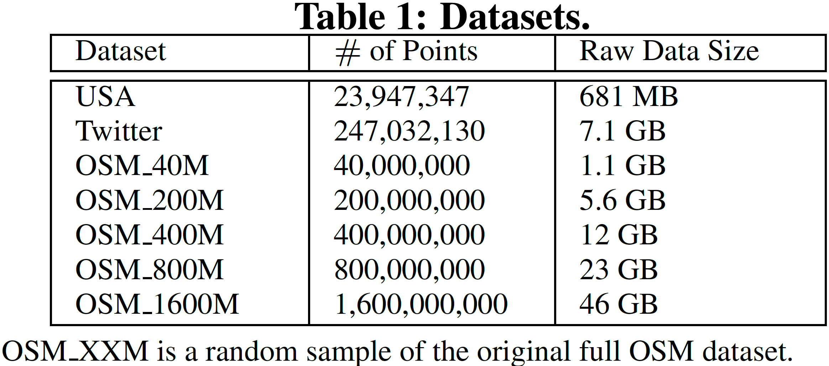
Experimental Evaluation
Notes:
We compare those methods on three datasets in our experiments. Statistics on the datasets are given in Table 1.

Slide 118
Experimental Evaluation
Default Values
Query Batch Size: 50.
Cache Size: 50 log N (N is number of blocks in the database).
Batch-Write Size: λ = 10.
Notes:
Here are some default parameter values.
By default, each query batch contains 50 queries in batch processing.
As for our method and Raw index method, the default cache size is 50 log N, where N is the number of blocks in the database.
For our batch writing optimization, the default batch write size \lambda is 10.

Slide 119
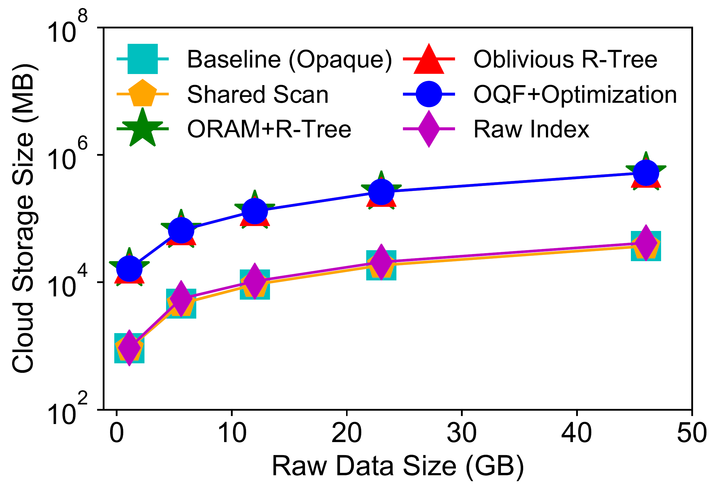
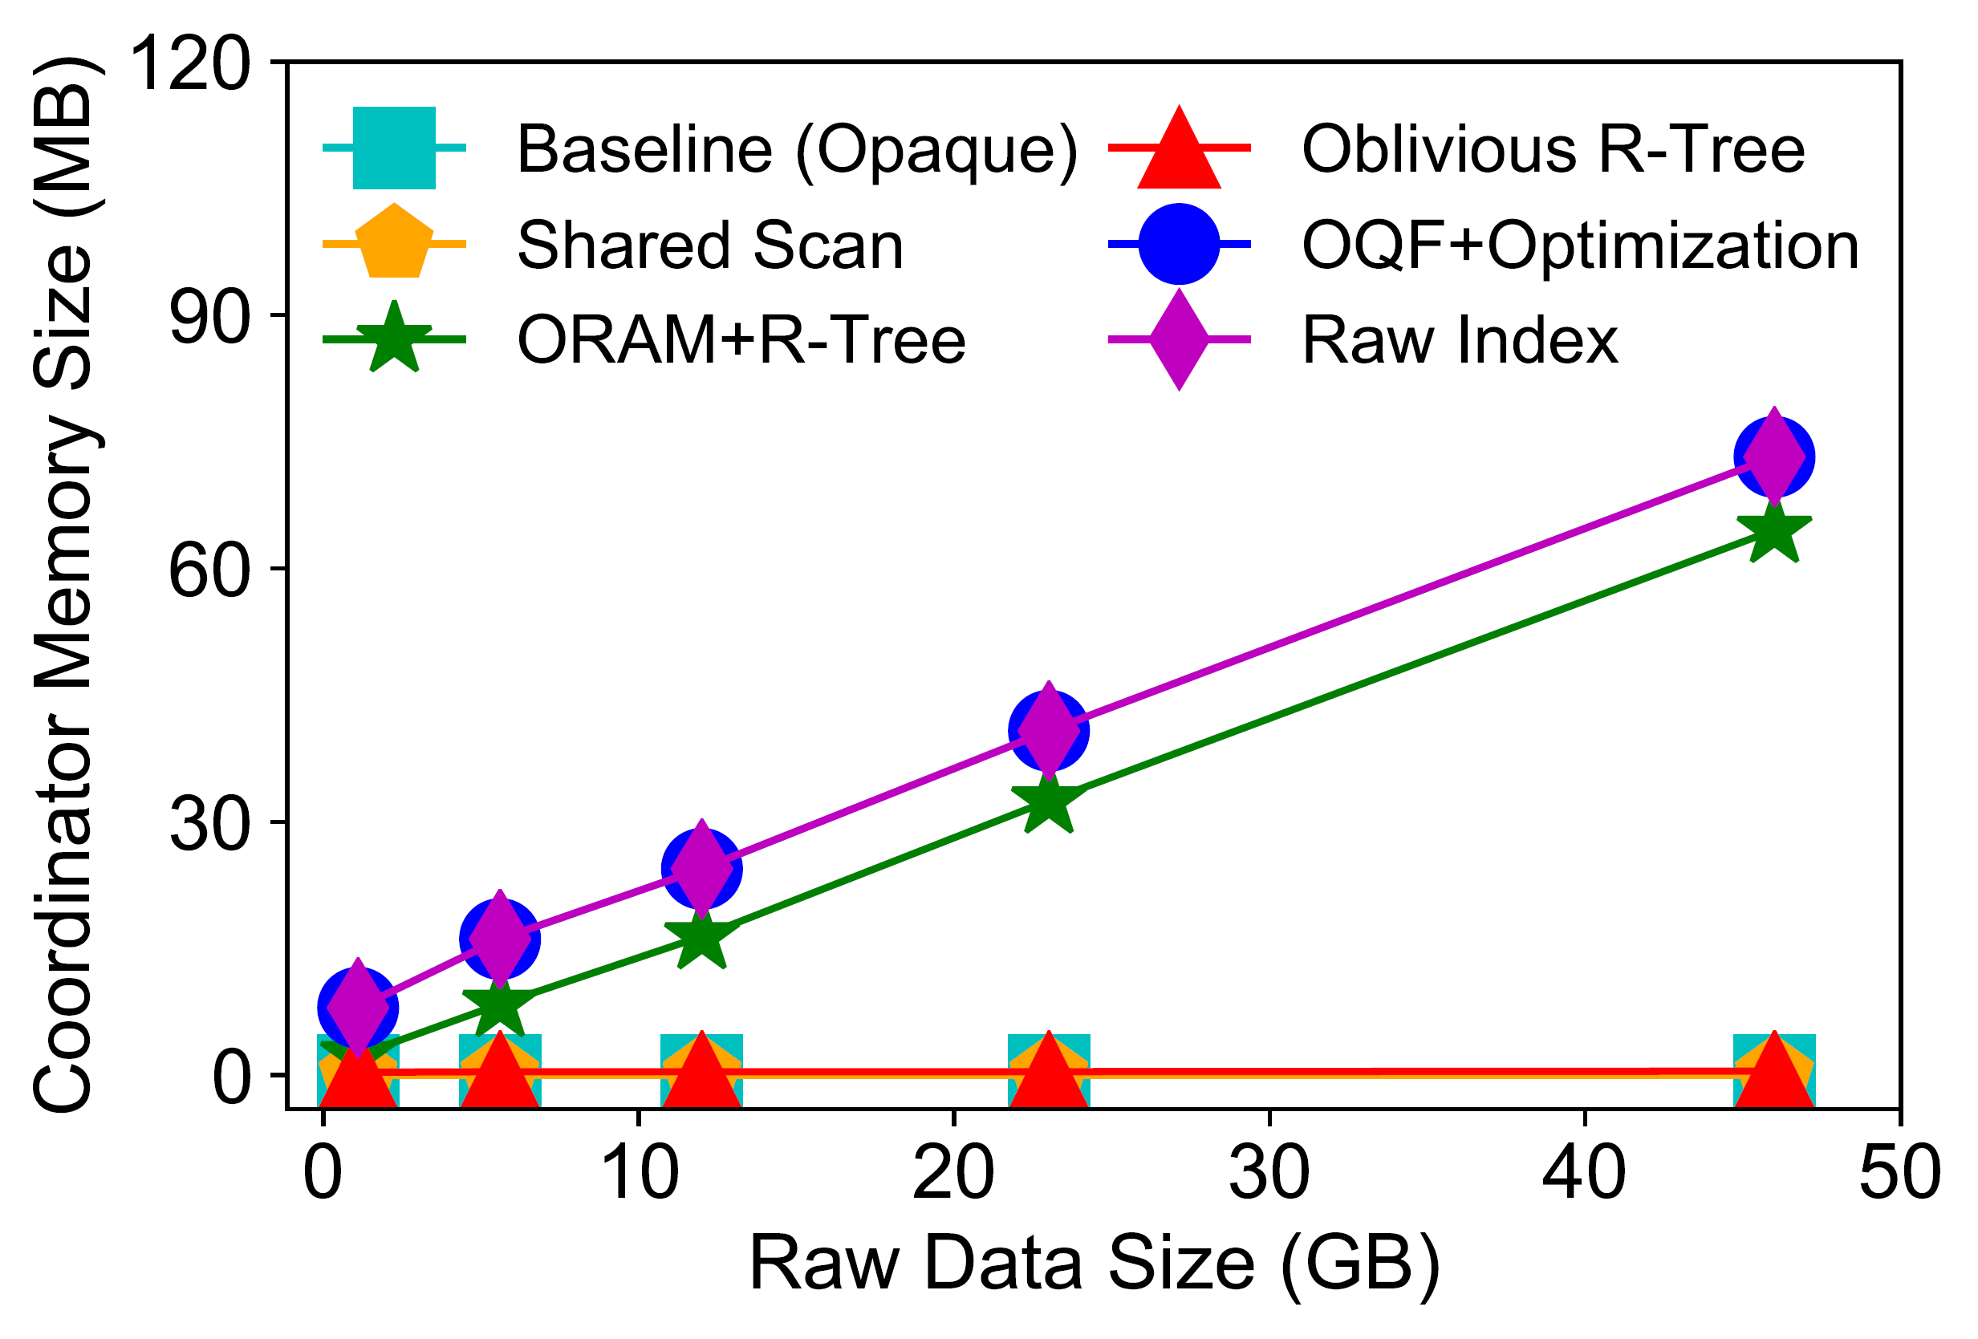
Experimental Evaluation
(a) cloud storage size.
(b) coordinator memory size.
Figure 1: Storage cost against raw data size.
Notes:
Due to time limit, here we mainly focus on scalability results about r-tree range queries, where the raw data size increases from 1.1 GB to 46 GB (1.6 billion two-dimensional points).
Figure 1(a) shows the cloud storage cost. The three Path ORAM based methods including ORAM+R-tree, Oblivious R-tree and our method need 8 to 16 times larger cloud storage cost than the other methods, due to building Path ORAM data structure.
Figure 1(b) shows the coordinator storage cost. Baseline (Opaque) and Shared Scan achieve the minimum cost, since they perform scan-based operations and only stores a constant number of blocks in the coordinator. For the other methods, Oblivious R-tree needs much less cost than ORAM+R-tree, since it integrates the position map information to the block content and doesn’t save it in the coordinator. ORAM+R-tree needs less cost than our method and Raw Index, since it doesn’t keep an additional cache in the coordinator.

Slide 120
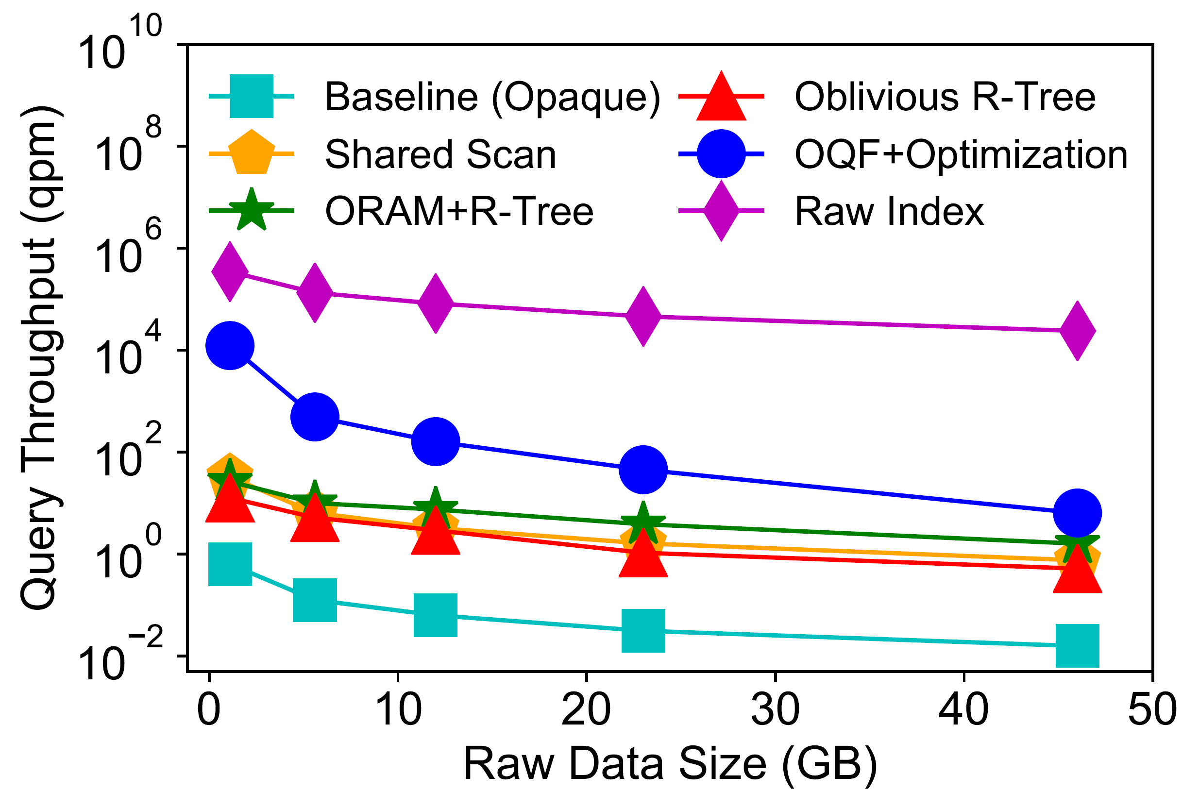
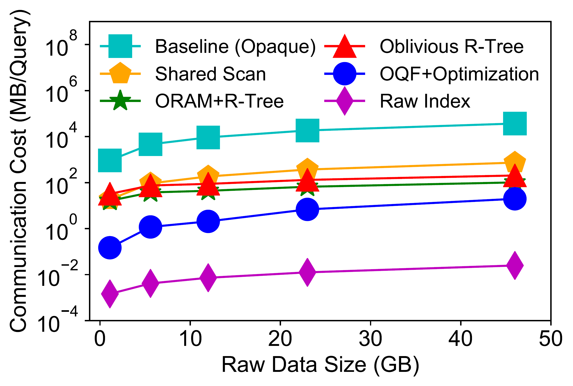
Experimental Evaluation
(a) query throughput.
(b) communication cost.
Figure 2: Performance of R-tree range query against raw data size.
Notes:
Figure 2(a) shows the query throughput for R-tree range query. The label on y-axis “qpm” is short for “queries per minute”.
Baseline (Opaque) has the minimum query throughput, since it uses scan-based operations. Raw Index has the largest query throughput, since it doesn’t use any encryption or any ORAM protocol. For the other methods, our method achieves 4 to 400 times larger query throughput than Shared Scan, ORAM+R-tree and Oblivious R-tree, since we introduce a series of optimizations including batch processing and ORAM caching.
Figure 2(b) shows the communication cost. It’s roughly inversely proportional to the query throughput for each method.

Slide 121
Thanks!
Notes:
Thanks. Do you have any questions?

