Slide 1
Oblivious RAM: A Dissection and Experimental Evaluation
Zhao Chang, Dong Xie, Feifei Li
University of Utah

Slide 2
Outline
Background
Preliminaries
ORAM Constructions
Experimental Results
Conclusion
Notes:
Here is a brief outline.

Slide 3

Background
Security and Privacy Issues in Public Cloud
Many companies choose the cloud as their data and IT infrastructure platform.
Remote access brings the issue of trust.
D.Fletcher. http://cloudtweaks.com/

Slide 4
Background
Strong Encryption is NOT Enough
Adversaries can still learn sensitive information by observing the data access patterns.

Slide 5
Background
Strong Encryption is NOT Enough
Adversaries can still learn sensitive information by observing the data access patterns.
Examples:
1. An attacker can identify as much as 80% of email search queries by observing the access pattern of an encrypted email repository alone.
[Islam et al. NDSS 2012]

Slide 6
Background
Strong Encryption is NOT Enough
Adversaries can still learn sensitive information by observing the data access patterns.
Examples:
2. If a sequence of queries q₁, q₂, q₃ is always followed by a stock-exchange action, the cloud can learn about the content of these queries, even if encrypted.
[Pinkas et al. CRYPTO 2010]

Slide 7
Background
Is there a way to hide the data access pattern but still use public cloud infrastructure?
Answer: Oblivious RAM (ORAM)

Slide 8
Background
What is ORAM?
Oblivious Random Access Machine [ORAM]

Slide 9
Background
What is ORAM?
Oblivious Random Access Machine [ORAM]
A machine is oblivious if its sequence of accessing (memory) locations is indistinguishable for any two inputs with the same length.

Slide 10
Background
What is ORAM?
Oblivious Random Access Machine [ORAM]
A machine is oblivious if its sequence of accessing (memory) locations is indistinguishable for any two inputs with the same length.
Read (i)
Client
Server
Write (i, data)

Slide 11
Background
What is ORAM?
Oblivious Random Access Machine [ORAM]
A machine is oblivious if its sequence of accessing (memory) locations is indistinguishable for any two inputs with the same length.
The server cannot gain any information from the access pattern of client’s Read/ Write requests.
Read (i)
Client
Server
Write (i, data)

Slide 12
Background
Definition of ORAM
We use oblivious RAM to simulate original RAM.

Slide 13
Background
Definition of ORAM
We use oblivious RAM to simulate original RAM.
For each possible input with the same length and each access pattern,
Pr(input α | access pattern β) = Pr(input α).

Slide 14
Background
Definition of ORAM
We use oblivious RAM to simulate original RAM.
For each possible input with the same length and each access pattern,
Pr(input α | access pattern β) = Pr(input α).
A list of server locations accessed in the oblivious RAM
A list of read / write requests really needed in the original RAM

Slide 15
Background
Trivial ORAMs
1: Store everything in the client, and simulate without any calls to server.
> client storage = N.

Slide 16
Background
Trivial ORAMs
1: Store everything in the client, and simulate without any calls to server.
> client storage = N.
2: Store everything in the server, but linearly scan everything for each operation.
> time cost = N, communication overhead = N.

Slide 17
Background
Trivial ORAMs
1: Store everything in the client, and simulate without any calls to server.
> client storage = N.
2: Store everything in the server, but linearly scan everything for each operation.
> time cost = N, communication overhead = N.
3: Assume the client accesses each block slot at most once.
> permute addresses using a PRP (pseudorandom permutation).
> optimal, but assumption does not hold in practice.

Slide 18
Preliminaries
Oblivious Sort
It sorts a set of items by accessing the items in a fixed, predefined order (i.e., hiding the access pattern).

Slide 19
Preliminaries
Oblivious Sort
Batcher Sorting Network [Batcher. 1968]
time cost = O(N log² N), small constant (around 0.5)

Slide 20
Preliminaries
Oblivious Sort
Batcher Sorting Network [Batcher. 1968]
time cost = O(N log² N), small constant (around 0.5)
AKS Sorting Network [Ajtai et al. STOC 1983]
time cost = O(N log N), large constant (6,100)

Slide 21
Preliminaries
Oblivious Sort
Batcher Sorting Network [Batcher. 1968]
time cost = O(N log² N), small constant (around 0.5)
AKS Sorting Network [Ajtai et al. STOC 1983]
time cost = O(N log N), large constant (6,100)
Randomized Shell Sort Algorithm [Goodrich. SODA 2010]
time cost = O(N log N), fail with a small probability

Slide 22
Preliminaries
Oblivious Sort
Batcher Sorting Network [Batcher. 1968]
time cost = O(N log² N), small constant (around 0.5)
Our Choice

Slide 23
Preliminaries
Batcher Sort
A type of merge sort
A type of oblivious sort

Slide 24
Preliminaries
Batcher Sort
A type of merge sort
A type of oblivious sort
Batcher Sort for N = 4

Slide 25
Preliminaries
Batcher Sort
A type of merge sort
A type of oblivious sort
3
2
4
1
Batcher Sort for N = 4

Slide 26
Preliminaries
Batcher Sort
A type of merge sort
A type of oblivious sort
3
2
4
1
Batcher Sort for N = 4

Slide 27
Preliminaries
Batcher Sort
A type of merge sort
A type of oblivious sort
3
2
4
1
Batcher Sort for N = 4

Slide 28
Preliminaries
Batcher Sort
A type of merge sort
A type of oblivious sort
3
2
4
1
Batcher Sort for N = 4

Slide 29
Preliminaries
Batcher Sort
A type of merge sort
A type of oblivious sort
3
1
2
2
4
3
1
4
Batcher Sort for N = 4

Slide 30
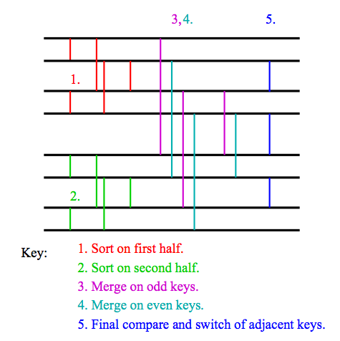
Preliminaries
Batcher Sort
N = 8
Time Complexity = O(N log² N)

Slide 31
Preliminaries
Oblivious Hash
It hashes a set of items into an array of hash buckets, while hiding the information regarding the hash function (i.e., which bucket each item is hashed into).

Slide 32
Preliminaries
Oblivious Hash
It hashes a set of items into an array of hash buckets, while hiding the information regarding the hash function (i.e., which bucket each item is hashed into).
Implemented based on oblivious sort
[Ostrovsky. STOC 1990]

Slide 33
Preliminaries
Oblivious Storage
It can be viewed as a collection of key-value pairs.

Slide 34
Preliminaries
Oblivious Storage
It can be viewed as a collection of key-value pairs.
It supports the following basic operations:
> getValue(k), putValue(k, v), getRange(k1, k2), delRange(k1, k2).
[Boneh et al. MIT CS Technical Report 2011]

Slide 35
Preliminaries
Oblivious Storage
It can be viewed as a collection of key-value pairs.
It supports the following basic operations:
> getValue(k), putValue(k, v), getRange(k1, k2), delRange(k1, k2).
It relaxes the size of client memory from O(1) in the original ORAM definition to a sub-linear scale (w.r.t. N).

Slide 36
ORAM Constructions
Basic Square Root ORAM
[Goldreich. STOC 1987]
It is the first ORAM proposed in the literature.

Slide 37

ORAM Constructions
Basic Square Root ORAM
Cloud Storage:
> Original locations
> Dummy locations
> Shelter locations
Original Locations
Dummy Locations
Shelter Locations
Server
N+2 blocks = N original blocks + dummy blocks+ shelter blocks

Slide 38
ORAM Constructions
Basic Square Root ORAM
Cloud Storage:
> Original locations (initialized to real data blocks).
> Dummy locations (initialized to dummy blocks).
> Shelter locations (initialized to dummy blocks).
Original Locations
Dummy Locations
Shelter Locations
Server
N+2 blocks = N original blocks + dummy blocks+ shelter blocks

Slide 39
ORAM Constructions
Basic Square Root ORAM
Cloud Storage:
> Original locations (initialized to real data blocks).
> Dummy locations (initialized to dummy blocks).
> Shelter locations (initialized to dummy blocks).
Client Storage: O(1)
Original Locations
Dummy Locations
Shelter Locations
Server
N+2 blocks = N original blocks + dummy blocks+ shelter blocks

Slide 40
ORAM Constructions
Basic Square Root ORAM
Original Locations
Dummy Locations
Shelter Locations
Server
oblivious sort over original locations and dummy locations

Slide 41
ORAM Constructions
Basic Square Root ORAM
Found in shelter?
Scan the shelter
Not found!
Original Locations
Dummy Locations
Shelter Locations
Server
① retrieve the real data block
Client
② get/update the block in client
Dummy counter: j

Slide 42
ORAM Constructions
Basic Square Root ORAM
Found in shelter?
Scan the shelter
Not found!
Original Locations
Dummy Locations
Shelter Locations
Server
③ write a dummy block back
④ append the updated data block to the shelter
Client
Dummy counter: j

Slide 43
ORAM Constructions
Basic Square Root ORAM
Found in shelter?
Scan the shelter
Found!
Original Locations
Dummy Locations
Shelter Locations
Server
① retrieve the real data block during scan
② get/update the block in client
Client
③ ++j, retrieve the dummy block originally in the j-th dummy location

Slide 44
ORAM Constructions
Basic Square Root ORAM
Found in shelter?
Scan the shelter
Found!
Original Locations
Dummy Locations
Shelter Locations
Server
④ write a dummy block back
⑤ write the updated data block to the same location
Client
Dummy counter: j

Slide 45
ORAM Constructions
Basic Square Root ORAM
After operations
Original Locations
Dummy Locations
Shelter Locations
Server
oblivious sort over all locations

Slide 46
ORAM Constructions
Interleave Buffer Shuffle SR-ORAM
[Xie et al. ICDE 2016]
Aim: reduce the expensive shuffling cost of Basic Square Root ORAM.

Slide 47
ORAM Constructions
Interleave Buffer Shuffle SR-ORAM
[Xie et al. ICDE 2016]
Aim: reduce the expensive shuffling cost of Basic Square Root ORAM.
Key Point: use O( ) rather than O(1) client storage.

Slide 48
ORAM Constructions
Interleave Buffer Shuffle SR-ORAM
Block
(h_{r}(k), En_{sk}(k, v))
Dummy Block
Server
ID -1, …, -
N+ blocks = N original blocks + dummy blocks
Client
Dummy counter: j
blocks

Slide 49
ORAM Constructions
Interleave Buffer Shuffle SR-ORAM
Found in cache?
get(k) /put(k, v)
Not found!
Server
① get(h_{r}(k))
② append returned block to cache
Client
③ get/update the block in cache

Slide 50
ORAM Constructions
Interleave Buffer Shuffle SR-ORAM
Found in cache?
get(k) /put(k, v)
Found!
Server
② ++j, get(h_{r}(- j))
③ append returned block to cache
Client
① get/update the block in cache

Slide 51
ORAM Constructions
Interleave Buffer Shuffle SR-ORAM
Cache is full!
④ Do an Interleave Buffer Shuffle over all blocks in the server
Server
② put blocks back to server
③ Clear cache
Client
① Block request from client

Slide 52
ORAM Constructions
Interleave Buffer Shuffle SR-ORAM
Interleave Buffer Shuffle (IBS): a kind of oblivious shuffle that requires private memory.
Padding. Insert padding blocks to extend sequence length to a square number T².
1
2
3
4
5
6
7
8
9
10
11
12
13
14
Padding
1
2
3
4
5
6
7
8
9
10
11
12
13
14
15
16

Slide 53
ORAM Constructions
Interleave Buffer Shuffle SR-ORAM
Permuting. Generate a uniform random permutation of T² items.
1
2
3
4
5
6
7
8
9
10
11
12
13
14
15
16
Local Shuffle
2
4
3
1
8
5
7
6
9
12
10
11
15
13
16
14
Interleaving
2
8
9
15
4
5
12
13
3
7
10
16
1
6
11
14
Local Shuffle
15
2
9
8
5
4
13
12
10
7
16
3
6
14
1
11

Slide 54
ORAM Constructions
Interleave Buffer Shuffle SR-ORAM
De-padding. Remove all padding items to get the final result.
15
2
9
8
5
4
13
12
10
7
16
3
6
14
1
11
De-padding
2
9
8
5
4
13
12
10
7
3
6
14
1
11
2
9
8
5
4
13
12
10
7
3
6
14
1
11

Slide 55
ORAM Constructions
Basic Hierarchical ORAM
[Goldreich et al. JACM 1996]
Aim: reduce the expensive cost of shuffling in Basic Square Root ORAM.

Slide 56
ORAM Constructions
Basic Hierarchical ORAM
[Goldreich et al. JACM 1996]
Aim: reduce the expensive cost of shuffling in Basic Square Root ORAM.
Main Ideas:
> Use hierarchy of buffers (hash tables) of different sizes
> Shuffle these buffers with frequency inversely proportional to their sizes

Slide 57
ORAM Constructions
Basic Hierarchical ORAM
Level
PRP Keys
1
K1
2
K2
3
= data
K3
4
K4

Slide 58
ORAM Constructions
Basic Hierarchical ORAM
Server Storage
log N levels for N items
Level i contains 2^{i} buckets
Each bucket contains log N slots
Each slot contains one block (encrypted or dummy)
Level
PRP Keys
1
K1
2
K2
3
= data
K3
4
K4

Slide 59
ORAM Constructions
Basic Hierarchical ORAM
Client Storage
PRP key Ki for each level
Server Storage
log N levels for N items
Level i contains 2^{i} buckets
Each bucket contains log N slots
Each slot contains one block (encrypted or dummy)
Level
PRP Keys
1
K1
2
K2
3
= data
K3
4
K4

Slide 60
ORAM Constructions
Basic Hierarchical ORAM
1. Read a Slot
Level
PRP Keys
1
K1
2
K2
3
= data
K3
4
K4

Slide 61
ORAM Constructions
Basic Hierarchical ORAM
1. Read a Slot
2. Read Another Slot
> Level 1 is shuffled after 2¹ = 2 operations
Level
PRP Keys
1
K1
2
K2
3
= data
K3
4
K4

Slide 62
ORAM Constructions
Basic Hierarchical ORAM
1. Read a Slot
2. Read Another Slot
> Level 1 is shuffled after 2¹ = 2 operations
3. Two More Reads
Level
PRP Keys
> Level 1 is shuffled after 2² = 4 operations
1
> Level 2 is shuffled after 2² = 4 operations
K1
2
K2
3
= data
K3
4
K4

Slide 63
ORAM Constructions
Basic Hierarchical ORAM
Data gets moved to Level 1 after accessing
Then data gets shuffled to lower levels
Level
PRP Keys
1
K1
2
K2
3
= data
K3
4
K4

Slide 64
ORAM Constructions
Basic Hierarchical ORAM
Invariant: ≤ 2^{i} data slots used in level i
(i.e. ≤ 1 per bucket on average)
Level
PRP Keys
1
K1
2
K2
3
= data
K3
4
K4

Slide 65
ORAM Constructions
TP-ORAM
i.e., Towards Practical Oblivious RAM
[Stefanov et al. NDSS 2012]
Aim: reduce the expensive cost of shuffling in Basic Hierarchical ORAM.

Slide 66
ORAM Constructions
TP-ORAM
i.e., Towards Practical Oblivious RAM
[Stefanov et al. NDSS 2012]
Aim: reduce the expensive cost of shuffling in Basic Hierarchical ORAM.
Main Ideas:
> improve hierarchical ORAM by using larger client storage and partitioning
> each partition is viewed as an ORAM blackbox hiding the access patterns within that partition

Slide 67
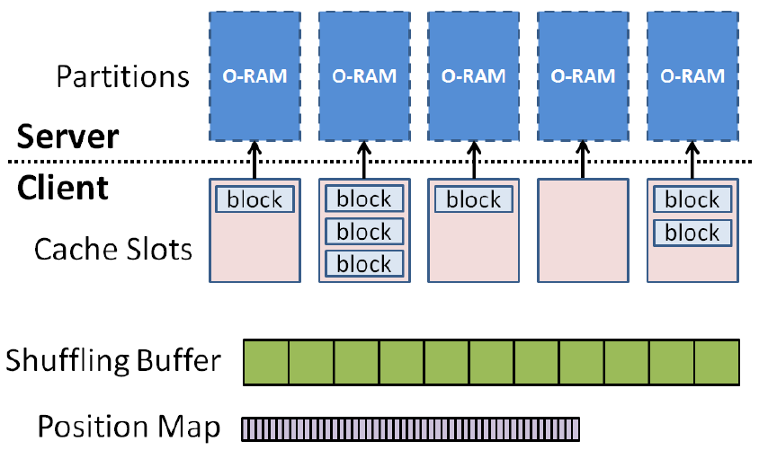
ORAM Constructions
TP-ORAM
The Partitioning Framework

Slide 68
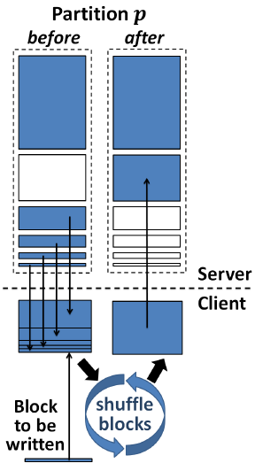
ORAM Constructions
TP-ORAM
Partition p
ReadPartition
accesses the position that the block should be hashed into for each level.
WritePartition
leads to the shuffling of consecutively filled levels into the first empty level.
Server
Client
real data blocks
dummy blocks
storage

Slide 69
ORAM Constructions
BB-ORAM
i.e., Basic Binary-Tree ORAM
[Shi et al. ASIACRYPT 2011]
Aim: remove any shuffling operations.

Slide 70
ORAM Constructions
BB-ORAM
i.e., Basic Binary-Tree ORAM
[Shi et al. ASIACRYPT 2011]
Aim: remove any shuffling operations.
Main Ideas:
> access blocks in the cloud along paths
> evict blocks from top to down after each access
(O(log^{c} N) cost vs. O(N^{c}) cost of shuffling blocks after several accesses)

Slide 71
ORAM Constructions
BB-ORAM
The cloud storage is treated as a binary tree over data buckets.

Slide 72
ORAM Constructions
BB-ORAM
The cloud storage is treated as a binary tree over data buckets.
Each data block is placed in some node along the path from the root to a specific leaf node (0 through N-1).

Slide 73
ORAM Constructions
BB-ORAM
The cloud storage is treated as a binary tree over data buckets.
Each data block is placed in some node along the path from the root to a specific leaf node (0 through N-1).
The client uses a position map to keep track of the index of the leaf.

Slide 74
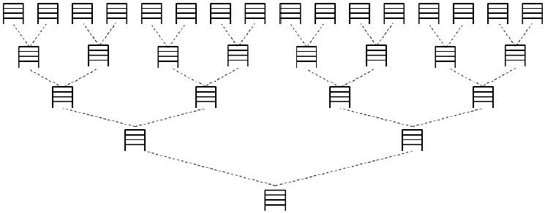
ORAM Constructions
BB-ORAM
Server-side storage hierarchy
Each bucket can hold up to O(log N) data blocks.

Slide 75
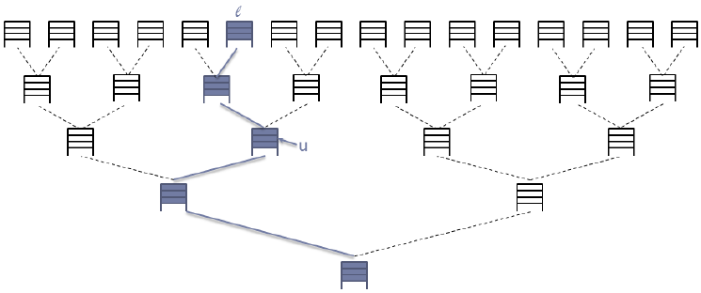
ORAM Constructions
BB-ORAM
Searching for a data block
A block is associated with a leaf node.
Every time a block is accessed, it will be assigned to a fresh random leaf node.

Slide 76
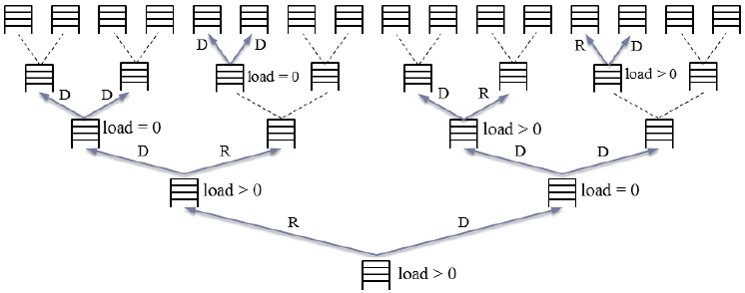
ORAM Constructions
BB-ORAM
Background evictions with eviction rate E = 2
Upon every data access operation, for each depth in the hierarchy, E buckets are chosen randomly for eviction.

Slide 77
ORAM Constructions
Path-ORAM
[Stefanov et al. CCS 2013]
Aim: reduce the cost of background eviction in Basic Binary-Tree ORAM.

Slide 78
ORAM Constructions
Path-ORAM
[Stefanov et al. CCS 2013]
Aim: reduce the cost of background eviction in Basic Binary-Tree ORAM.
Main Ideas:
> utilize larger client storage
> write blocks back along the same path (rather than evict blocks from top to down)

Slide 79
ORAM Constructions
Path-ORAM
Path-ORAM is an optimized binary-tree ORAM.

Slide 80
ORAM Constructions
Path-ORAM
Path-ORAM is an optimized binary-tree ORAM.
The main difference is each bucket contains Z blocks rather than O(log N) blocks (It suffices to set Z = 4).

Slide 81
ORAM Constructions
Path-ORAM
Path-ORAM is an optimized binary-tree ORAM.
The main difference is each bucket contains Z blocks rather than O(log N) blocks (It suffices to set Z = 4).
The client keeps a stash (i.e., a buffer to cache accessed data blocks at the client side).

Slide 82
ORAM Constructions
Path-ORAM
Access a data block
A block is associated with a leaf node.
Every time a block is accessed, it will be assigned to a fresh random leaf node.

Slide 83
ORAM Constructions
Path-ORAM
Write data blocks back along the same path
Upon every data access operation, write the cached data blocks (that can be written back) to the same path.

Slide 84
ORAM Constructions
Recursive ORAMs
TP-ORAM, BB-ORAM, Path-ORAM
To reduce client storage, we can recursively apply an ORAM to build the position map.
Client Storage: O(1)
Lead to higher computation and communication overheads.

Slide 85
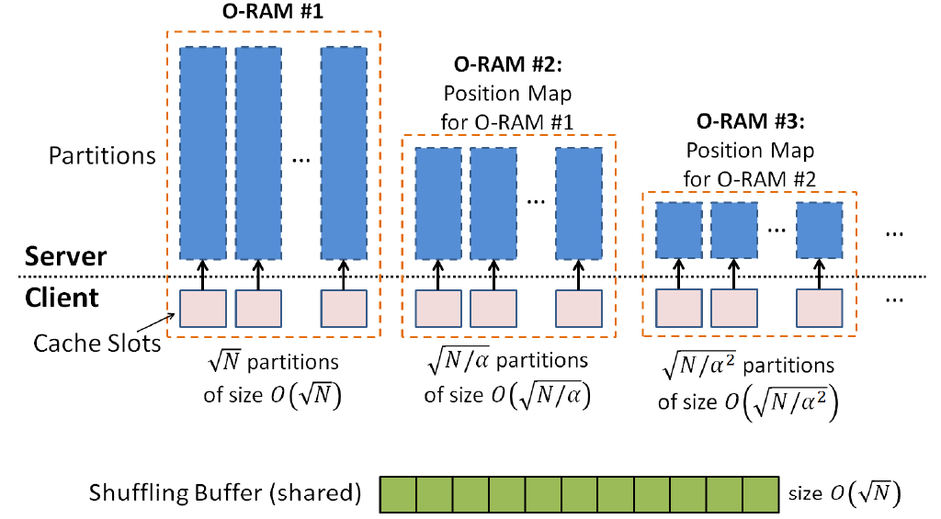
ORAM Constructions
Recursive ORAMs
An Example of Recursive TP-ORAM

Slide 86
Experimental Results
Setup
Server: a Linux machine with 95 GB main memory, 1 TB hard disk and 24 CPU cores, which hosts a MongoDB instance as the outsourced database.

Slide 87
Experimental Results
Setup
Server: a Linux machine with 95 GB main memory, 1 TB hard disk and 24 CPU cores, which hosts a MongoDB instance as the outsourced database.
Client: a Linux PC with 6 GB main memory and 8 CPU cores.

Slide 88
Experimental Results
Setup
Server: a Linux machine with 95 GB main memory, 1 TB hard disk and 24 CPU cores, which hosts a MongoDB instance as the outsourced database.
Client: a Linux PC with 6 GB main memory and 8 CPU cores.
Network: 1 Gbps LAN.

Slide 89
Experimental Results
Setup
Server: a Linux machine with 95 GB main memory, 1 TB hard disk and 24 CPU cores, which hosts a MongoDB instance as the outsourced database.
Client: a Linux PC with 6 GB main memory and 8 CPU cores.
Network: 1 Gbps LAN.
We implement a MongoDB connector class, which supports insertion, deletion and update operations on data blocks inside the MongoDB engine.

Slide 90
Experimental Results
Setup
Hash Function: SHA-256 (Crypto++ Library).
Encryption/Decryption Function: AES/CFB (Crypto++ Library).

Slide 91
Experimental Results
Setup
Hash Function: SHA-256 (Crypto++ Library).
Encryption/Decryption Function: AES/CFB (Crypto++ Library).
Real Data Blocks: 2¹⁰ – 2²⁴ blocks (4 MB – 64 GB).
Size of Each Encrypted Block: 4 KB.

Slide 92
Experimental Results
Different ORAM Constructions
Basic-SR (Basic Square Root ORAM)
IBS-SR (Interleave Buffer Shuffle Square Root ORAM)

Slide 93
Experimental Results
Different ORAM Constructions
Basic-SR (Basic Square Root ORAM)
IBS-SR (Interleave Buffer Shuffle Square Root ORAM)
Basic-HR (Basic Hierarchical ORAM)
TP-ORAM (Partition Based Hierarchical ORAM)

Slide 94
Experimental Results
Different ORAM Constructions
Basic-SR (Basic Square Root ORAM)
IBS-SR (Interleave Buffer Shuffle Square Root ORAM)
Basic-HR (Basic Hierarchical ORAM)
TP-ORAM (Partition Based Hierarchical ORAM)
BB-ORAM (Basic Binary-Tree ORAM)
Path-ORAM (Optimized Binary-Tree ORAM)

Slide 95
Experimental Results
Different ORAM Constructions
Basic-SR (Basic Square Root ORAM)
IBS-SR (Interleave Buffer Shuffle Square Root ORAM)
Basic-HR (Basic Hierarchical ORAM)
TP-ORAM (Partition Based Hierarchical ORAM)
BB-ORAM (Basic Binary-Tree ORAM)
Path-ORAM (Optimized Binary-Tree ORAM)
Recursive ORAMs vs. Non-Recursive ORAMs

Slide 96
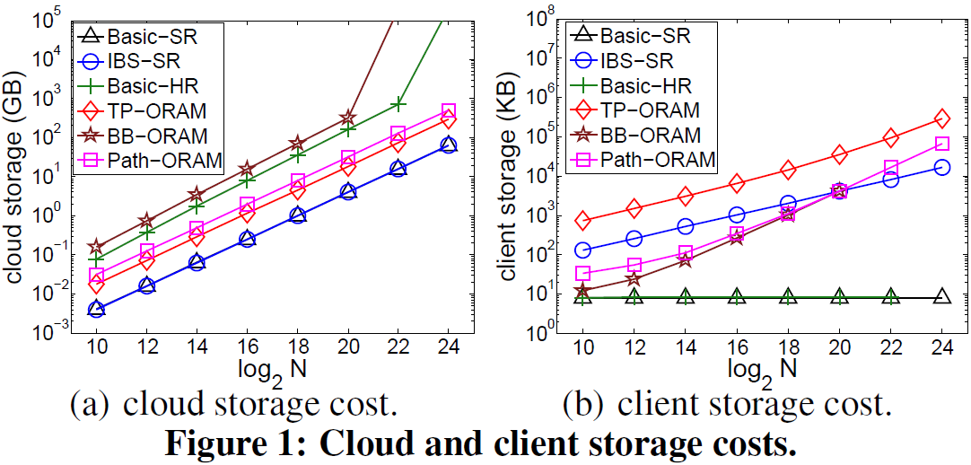
Experimental Results

Slide 97
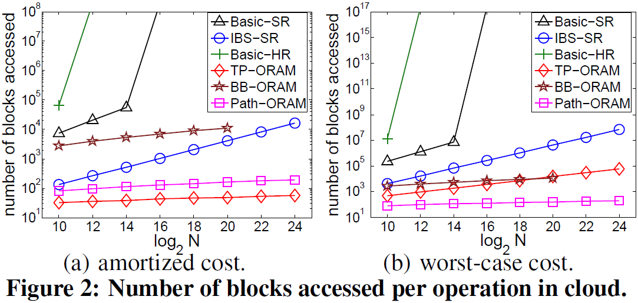
Experimental Results

Slide 98
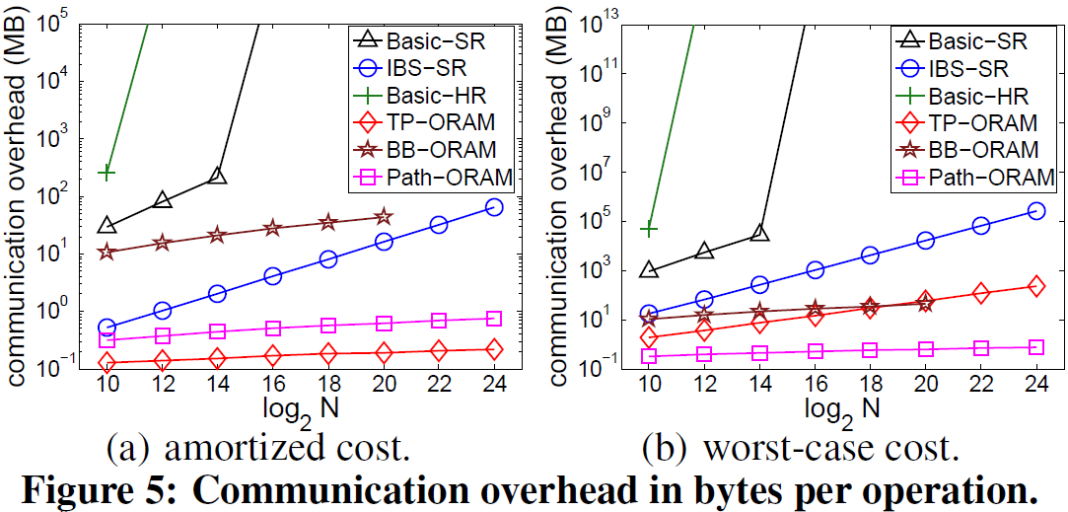
Experimental Results

Slide 99
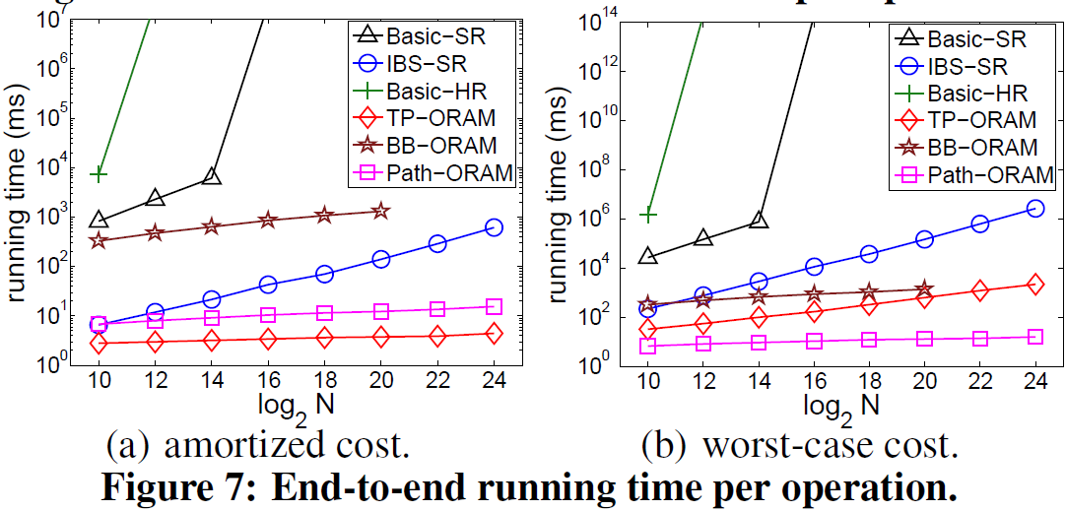
Experimental Results

Slide 100
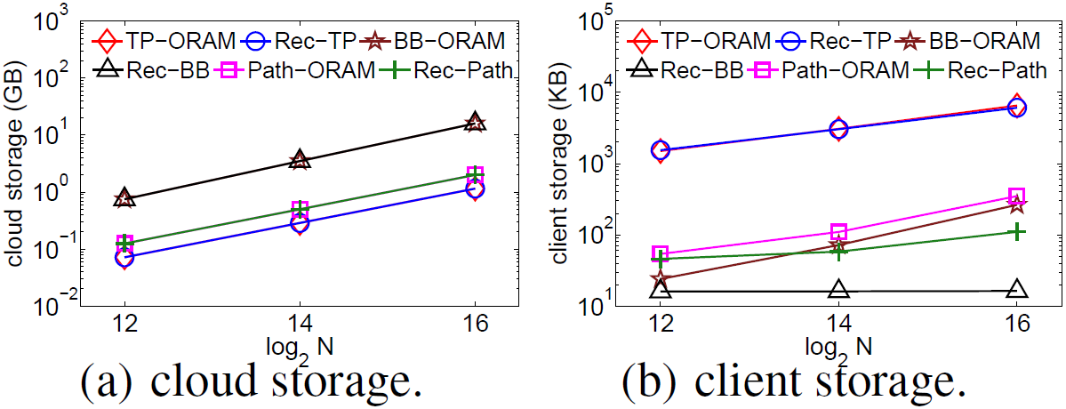
Experimental Results
Figure 8: Recursive ORAMs vs. non-recursive ORAMs, amortized cost used for (c), (d), and (e).

Slide 101
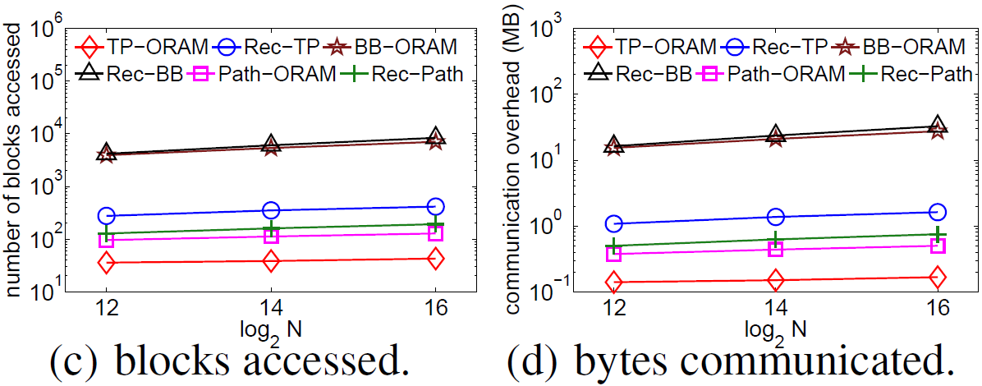
Experimental Results
Figure 8: Recursive ORAMs vs. non-recursive ORAMs, amortized cost used for (c), (d), and (e).

Slide 102
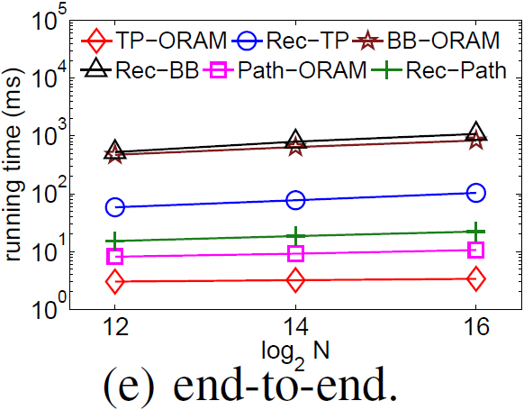
Experimental Results
Figure 8: Recursive ORAMs vs. non-recursive ORAMs, amortized cost used for (c), (d), and (e).

Slide 103
Conclusion
TP-ORAM and Path-ORAM have the best overall performance.

Slide 104
Conclusion
TP-ORAM and Path-ORAM have the best overall performance.
IBS-SR has acceptable performance, and achieves smaller cloud storage overhead than the two above.

Slide 105
Conclusion
TP-ORAM and Path-ORAM have the best overall performance.
IBS-SR has acceptable performance, and achieves smaller cloud storage overhead than the two above.
Basic-SR, Basic-HR and (recursive) BB-ORAM can be useful when database is small and client space is extremely tight.

Slide 106
Conclusion
For most ORAMs, there is a trade-off between the query cost and the client storage overhead that users may explore.

Slide 107
Conclusion
For most ORAMs, there is a trade-off between the query cost and the client storage overhead that users may explore.
Limitations:
> destroy the locality of references in datatabases

Slide 108
Conclusion
For most ORAMs, there is a trade-off between the query cost and the client storage overhead that users may explore.
Limitations:
> destroy the locality of references in datatabases
> only support read and write operations

Slide 109
Conclusion
For most ORAMs, there is a trade-off between the query cost and the client storage overhead that users may explore.
Limitations:
> destroy the locality of references in datatabases
> only support read and write operations
> lead to large overhead while answering complex queries

Slide 110
Conclusion
For most ORAMs, there is a trade-off between the query cost and the client storage overhead that users may explore.
Limitations:
> destroy the locality of references in datatabases
> only support read and write operations
> lead to large overhead while answering complex queries
> support concurrency in an efficient and scalable manner

Slide 111
Thanks!
Notes:
Thanks. Do you have any questions?

Slide 112
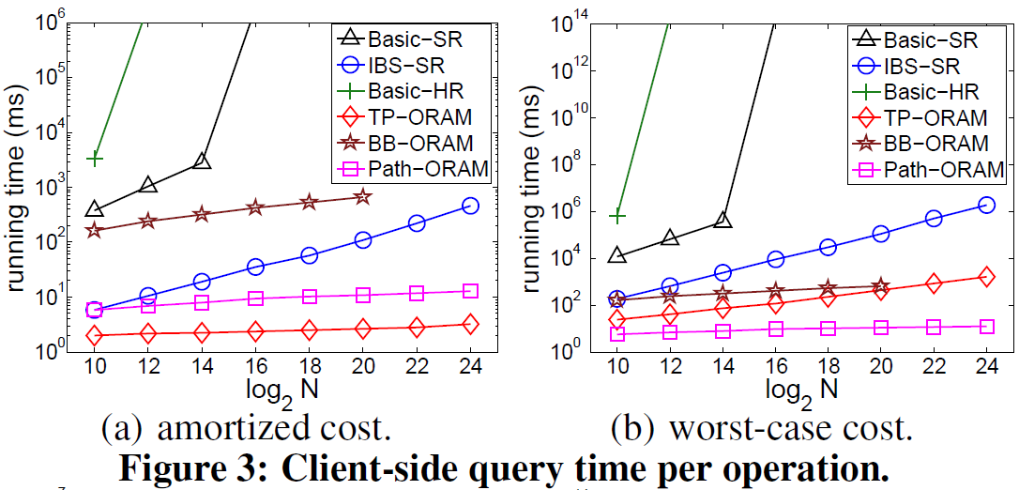
Experimental Results

Slide 113
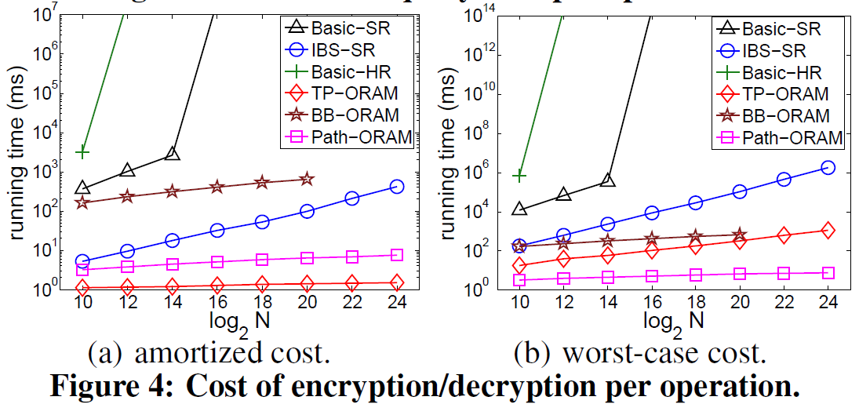
Experimental Results

Slide 114
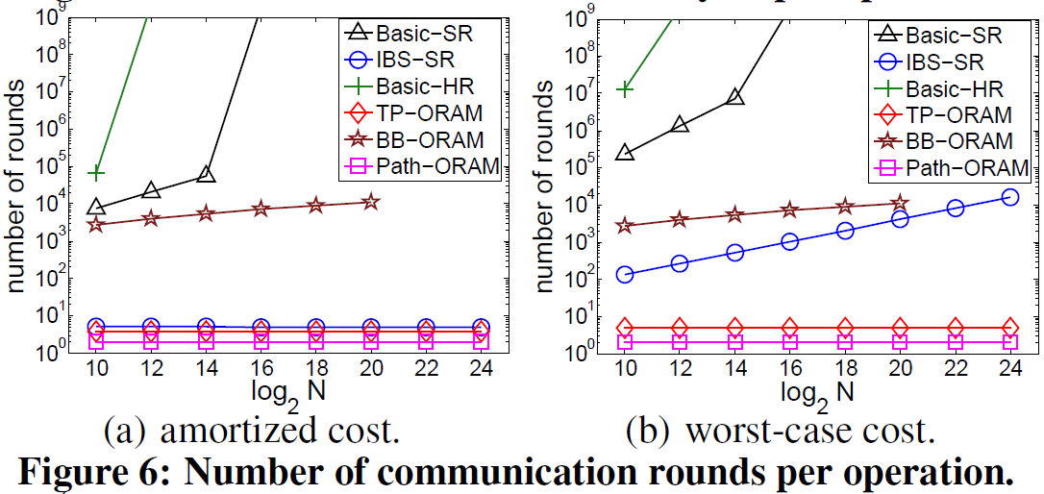
Experimental Results

Slide 115
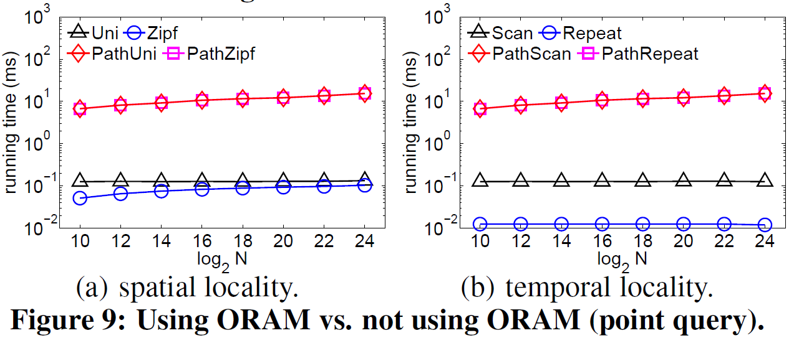
Experimental Results

Slide 116
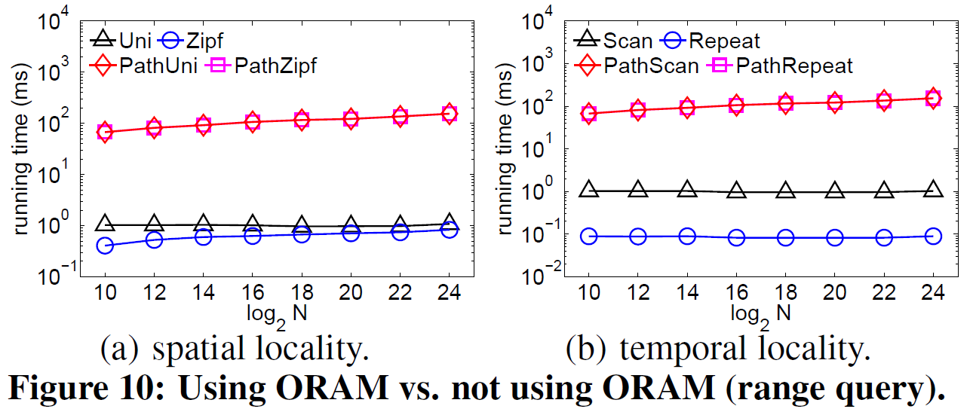
Experimental Results

Slide 117
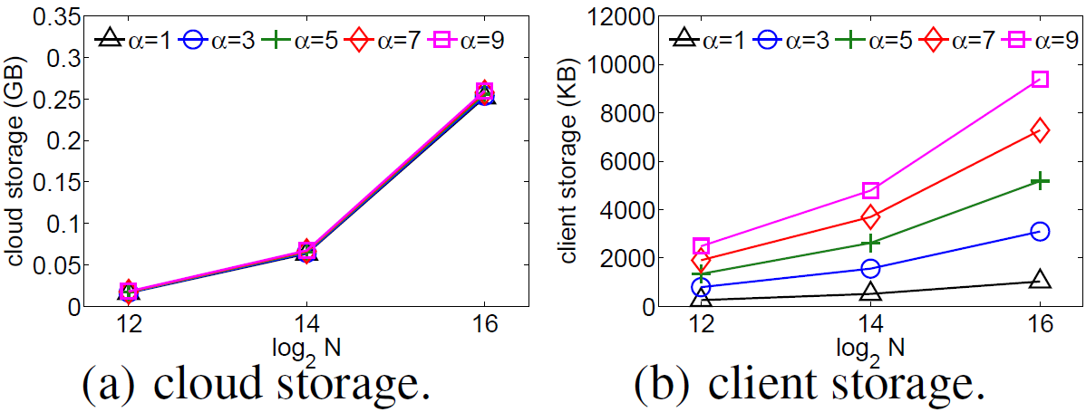

Experimental Results
Figure 11: Effect of α in IBS-SR: client uses O(α ) memory, amortized cost used for (c), (d), and (e).

Slide 118
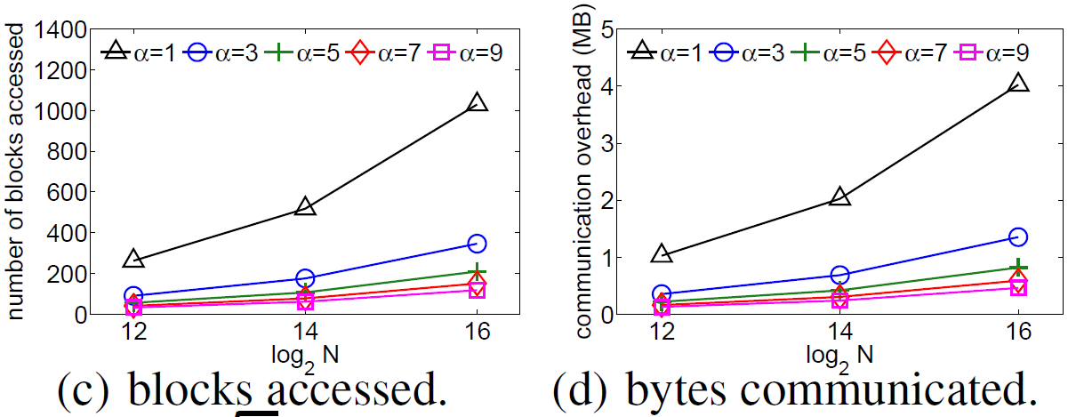
Experimental Results
Figure 11: Effect of α in IBS-SR: client uses O(α ) memory, amortized cost used for (c), (d), and (e).

Slide 119
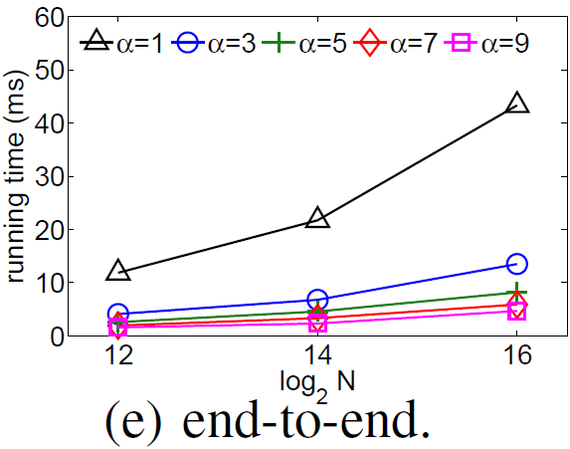
Experimental Results
Figure 11: Effect of α in IBS-SR: client uses O(α ) memory, amortized cost used for (c), (d), and (e).

Slide 120
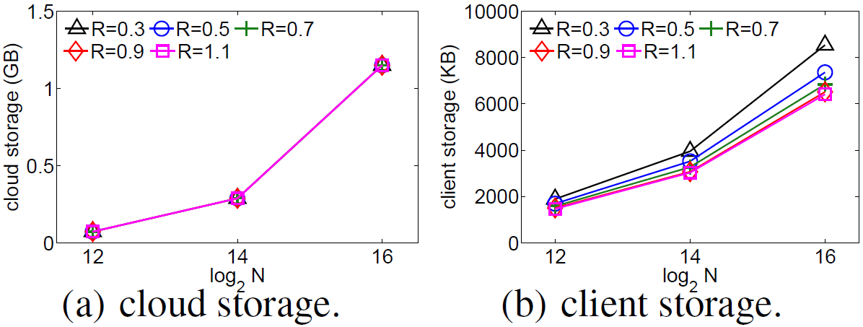
Experimental Results
Figure 12: Effect of R in TP-ORAM: background eviction rate, amortized cost used for (c), (d), and (e).

Slide 121
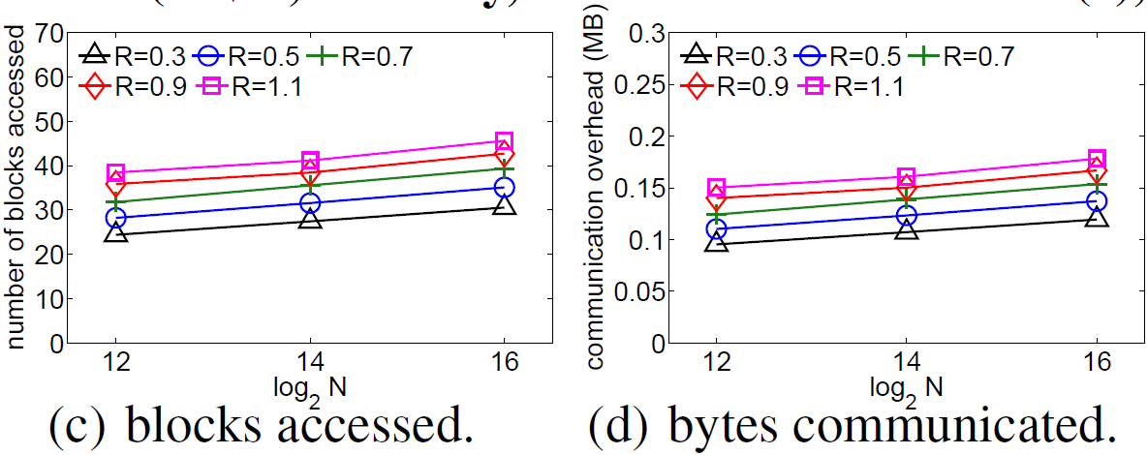
Experimental Results
Figure 12: Effect of R in TP-ORAM: background eviction rate, amortized cost used for (c), (d), and (e).

Slide 122
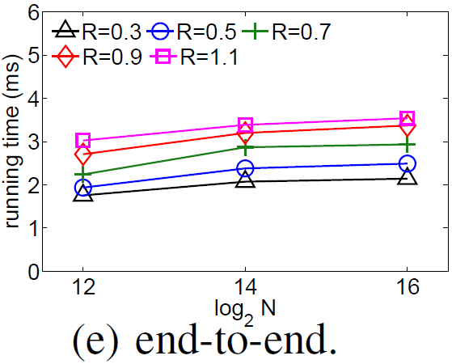
Experimental Results
Figure 12: Effect of R in TP-ORAM: background eviction rate, amortized cost used for (c), (d), and (e).

Slide 123
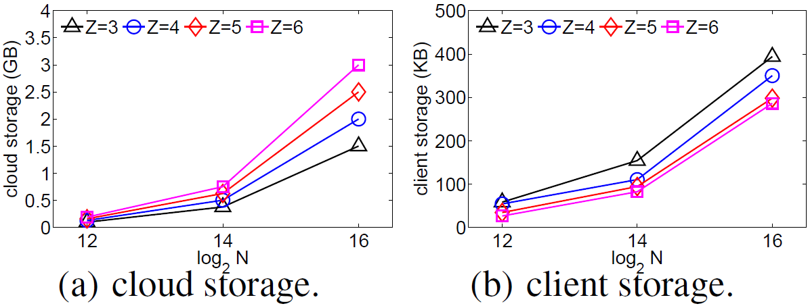
Experimental Results
Figure 13: Effect of Z in Path-ORAM: number of blocks in each bucket, amortized cost used for (c), (d), and (e).

Slide 124
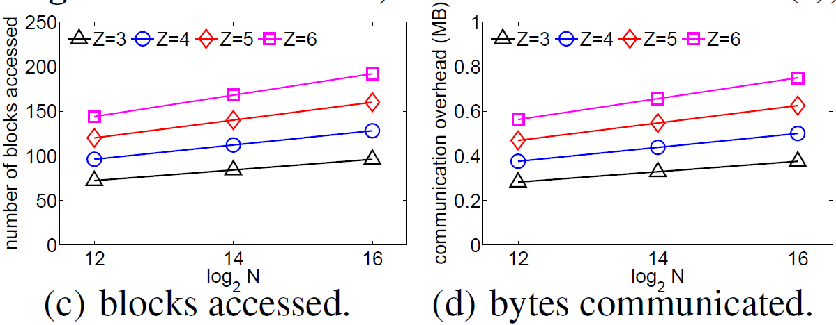
Experimental Results
Figure 13: Effect of Z in Path-ORAM: number of blocks in each bucket, amortized cost used for (c), (d), and (e).

Slide 125
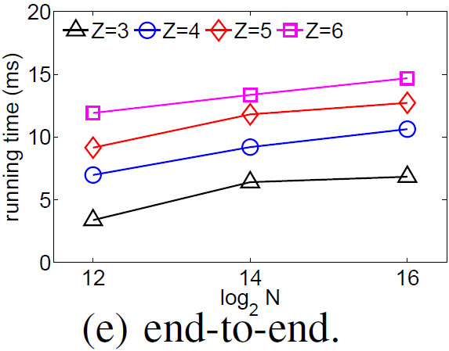
Experimental Results
Figure 13: Effect of Z in Path-ORAM: number of blocks in each bucket, amortized cost used for (c), (d), and (e).

