Slide 1

Oblivious RAM: A Dissection and Experimental Evaluation
Zhao Chang, Dong Xie, Feifei Li

Slide 2

Introduction
A lot of “big” data
Rise of cloud computing
Pay-as-you-go model for
public clouds
Outsourced data storage
Security concerns behind outsourcing data to public clouds

Slide 3
Introduction
Possible solutions?
Use “trusted” public cloud services (Google is not evil)
Use private cloud infrastructure (Walmart uses OpenStack)
Use encryption, however…

Slide 4
Introduction
Only hiding the content is not enough
E.g. In an online health application, when the user selects a health condition from a list, the server would send back an updated web page with information on that illness. By learning the size of the page or file access pattern for each health condition, they could determine which conditions a user had without seeing any data (even if encrypted).
Is there a way to hide how we access our data but still use public cloud infrastructure?
Answer: Oblivious RAM

Slide 5
Introduction
Lots of literatures have been published since 1987.
Challenge: choose and use ORAM in applications
Theoretical interest vs. Practical usage
Have not been thoroughly compared
Lack of open sourced implementation

Slide 6
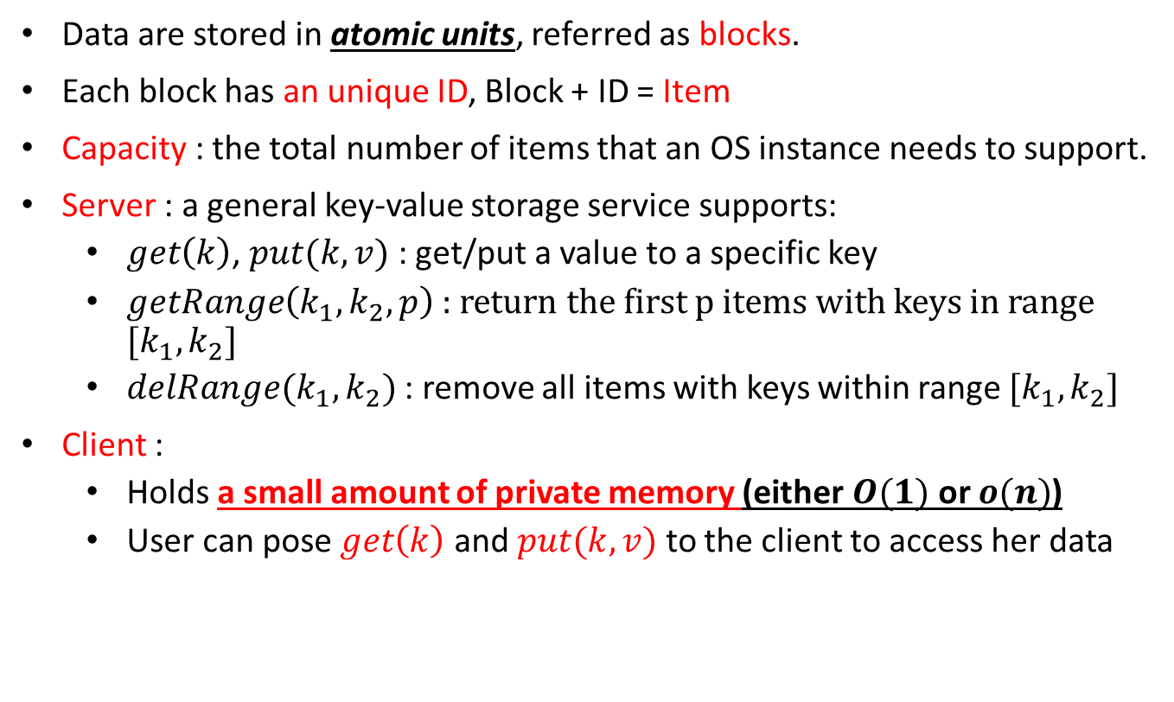
Oblivious RAM: Model
Data are stored in atomic units, referred as blocks.
Each block has an unique ID, Block + ID = Item
Capacity : the total number of items that an OS instance needs to support.
Server : a general key-value storage service supports:
$get\left(k\right)$, $put(k, v)$: get/put a value to a specific key
$getRange\left(k_{1}, k_{2}, p\right)$ : return the first p items with keys in range $[k_{1}, k_{2}]$
$delRange(k_{1}, k_{2})$ : remove all items with keys within range $[k_{1}, k_{2}]$
Client :
Holds a small amount of private memory (either $O(1)$ or $o(n)$)
User can pose $get\left(k\right)$ and $put(k, v)$ to the client to access her data

Slide 7
Oblivious RAM: Threat Model
Objective: hide both data content and access pattern
Any two access patterns of the same length are computational indistinguishable by anyone other than the client.
Adversary: cloud server
The server is “curious but not malicious”
Curious: wish to learn sensitive info of the client
Not malicious: will honestly do that it is supposed to do

Slide 8




Square-Root Construction
Item
$$(h_{r}\left(k\right), En_{sk}(k, v))$$
Dummy Item
ID →$−1,…,−\sqrt{N}$
Server
$N+\sqrt{N}$ items = $N$ original items + $\sqrt{N}$ dummy items
Client
Dummy counter: $j$
$\sqrt{N}$ items

Slide 9



Square-Root Construction (cont’d)
Found in cache?
$$get(k)/put(k,v)$$
Not found!
Server
$$① get(h_{r}(k))$$
② append returned item to cache
Client
③$get/update$ item in cache

Slide 10



Square-Root Construction (cont’d)
Found in cache?
$$get(k)/put(k,v)$$
Found!
Server
② ++$j,get(h_{r}(−j))$
③ Append returned item to cache
Client
①$get/update$ item in cache

Slide 11
Square-Root Construction (cont’d)
Cache is full!
④ Do an oblivious shuffle over all server items
Server
② put items back to server
③ Clear cache
Client
① Block request from clients
Possible options for oblivious shuffle:
K. E. Batcher. Sorting networks and their applications. In AFIPS Spring Joint Computing Conference, pages 370–314, 1968
D. Xie, G. Li, B. Yao, X. Wei, X. Xiao, Y. Gao, and M. Guo. Practical private shortest path computation based on oblivious storage. In ICDE, 2016.

Slide 12
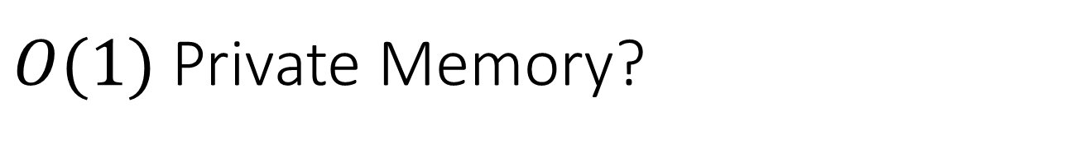
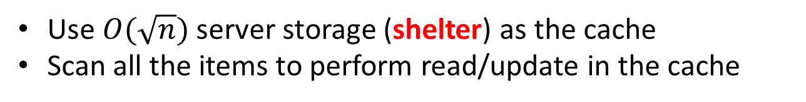
$O(1)$Private Memory?
Use $O(\sqrt{n})$ server storage (shelter) as the cache
Scan all the items to perform read/update in the cache
Server
Client
O(1) Square Root Construction:
O. Goldreich. Towards a theory of software protection and simulation by oblivious RAMs. In STOC, pages 182–194, 1987

Slide 13
Hierarchical ORAM Construction
Use Hierarchy of Buffers (hash tables) of different sizes
Server: log N “levels” for N items. Level i contains 2^{i} buckets. Each bucket contains log N slots.
Client: PRP key Ki for each level.
1
PRP Keys
K1
2
K2
3
= data
K3
4
K4
O. Goldreich and R. Ostrovsky. Software protection and simulation on oblivious RAMs. Journal of the ACM, 43(3), 1996.

Slide 14
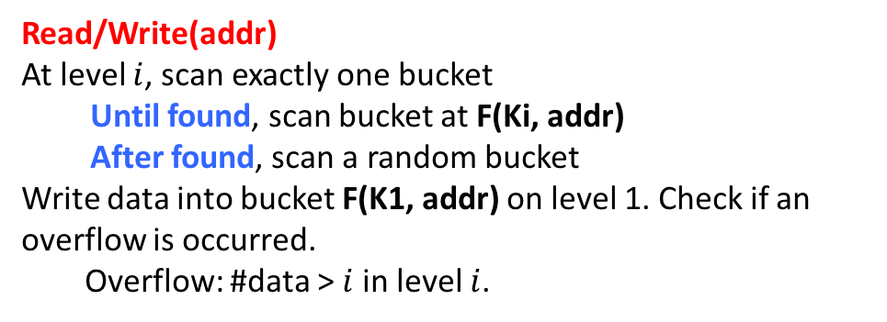
Hierarchical ORAM Construction (cont’d)
Read/Write(addr)
At level $i$, scan exactly one bucket
Until found, scan bucket at F(Ki, addr)
After found, scan a random bucket
Write data into bucket F(K1, addr) on level 1. Check if an overflow is occurred.
Overflow: #data > $i$ in level $i$.
PRP Keys
1
K1
2
K2
3
= data
K3
4
K4
O. Goldreich and R. Ostrovsky. Software protection and simulation on oblivious RAMs. Journal of the ACM, 43(3), 1996.

Slide 15
Hierarchical ORAM Construction (cont’d)
When level i overflows: pick new PRP key for levels i and i+1, then shuffle data in levels i and i+1 together into level i+1 using new key
Algorithm: Oblivious hashing*
Aim: Hash keys into buckets. The advisory cannot get information about the load factor of each bucket and the mapping between keys and buckets.
Shuffle buffers with frequency inversely proportional to their sizes
Level i is shuffled after every 2^{i} ops.
*: Ostrovsky, Rafail. "Efficient computation on oblivious RAMs." Proceedings of the twenty-second annual ACM symposium on Theory of computing. ACM, 1990.

Slide 16
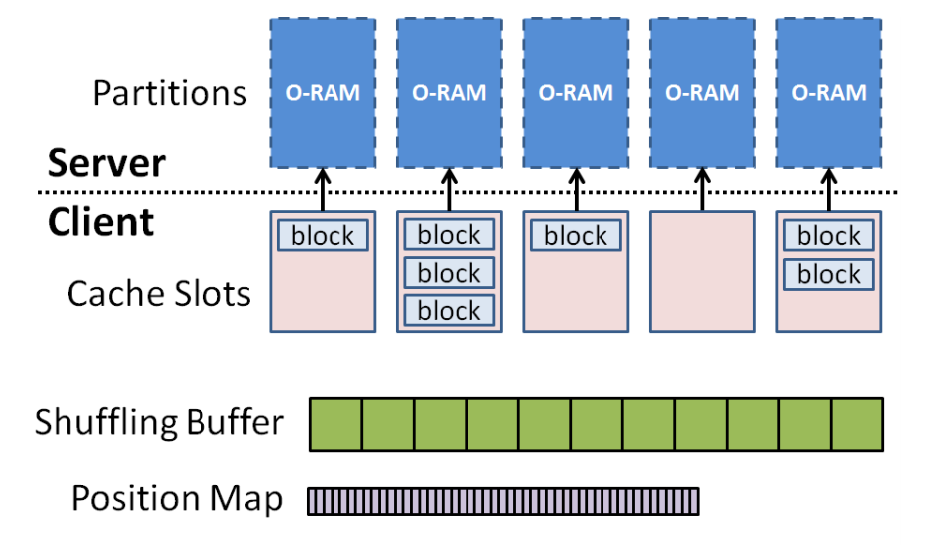
Partition ORAM
Subdivide the O-RAM into much smaller partitions
the operations performed on the partitions can be handled much more efficiently.
Each partition is a full functional ORAM scheme
Stefanov, Emil, Elaine Shi, and Dawn Song. "Towards practical oblivious RAM.” arXiv preprint arXiv:1106.3652 (2011).

Slide 17
Partition ORAM (cont’d)
Position map to track which partition each item resides in
Cache read/updated blocks in a random partition’s cache slot
Evict items in cache slots periodically to its ORAM partition
Stefanov, Emil, Elaine Shi, and Dawn Song. "Towards practical oblivious RAM.” arXiv preprint arXiv:1106.3652 (2011).

Slide 18



Tree-Based ORAM
Organize data blocks on the server as a full binary tree ($\log{N}$ levels, $N$ leaf nodes).
Each node in the tree is a bucket of $Z$ items
Each item is assigned to a random leaf node of the tree.
There is a position map to track which leaf node is assigned to a data item.
$N$ leaf nodes
$\log{N}$ levels
Server
Client
posMap
stash

Slide 19

Tree-Based ORAM (cont’d)
Basic invariant: Item $i$ must resides in the path starting from the tree root to leaf node $posMap[i]$.
Retrieve the whole path that may contain the item and push all items on the path in client’s private stash
Try to put items in the stash back to the tree while keep the basic invariant
$N$ leaf nodes
$\log{N}$ levels
Server
Client
posMap
stash

Slide 20
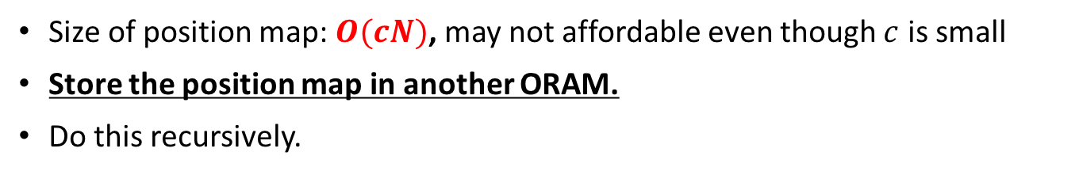
Recursion
Size of position map: $O(cN)$, may not affordable even though $c$ is small
Store the position map in another ORAM.
Do this recursively.
O-RAM #1
O-RAM #2: Position Map for O-RAM #1
O-RAM #3: Position Map for O-RAM #2
…
Server
Client
…

Slide 21
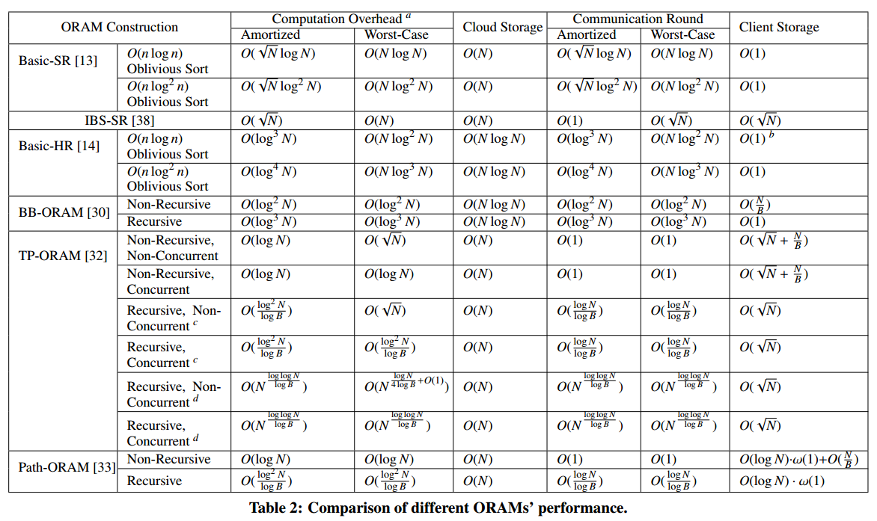
Theoretical Comparison

Slide 22
Performance Evaluation
Two machines: client and server
Client: 6GB main memory
Server: 95GB main memory and 1TB hard disk
Connected by 1Gbps Ethernet
Storage engine: MongoDB on the server
AES encryption + SHA2 hash provided by CryptoPP
Implement different ORAM schemes in a unified testbed.

Slide 23
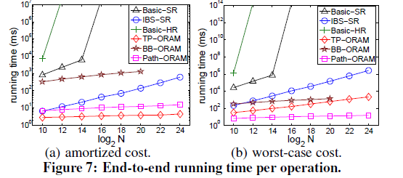
End-to-end running time

Slide 24
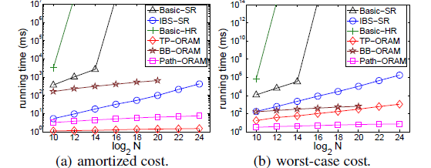
Cost of encryption/decryption

Slide 25
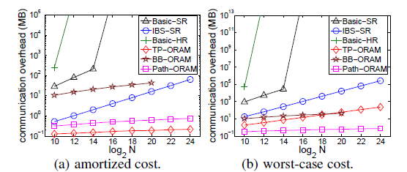
Communication overhead in bytes

Slide 26
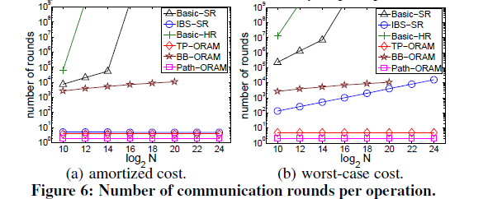
Number of communication rounds

Slide 27
Conclusion
Made a comprehensive survey on different ORAM constructions and principles.
Implement different ORAM schemes in a unified testbed, and optimize them with respect to efficiency, scalability, and communication cost.
Perform extensive experiments on large data to compare the performance of various ORAM constructions.
Report insights gained from the experimental results, which exposes the strength and weakness of different existing ORAMs, and provides guidelines on selecting a suitable construction under different scenarios
Our testbed is now open sourced at: https://github.com/InitialDLab/SEAL-ORAM

Slide 28
Thanks for your attention!

