Slide 1


Privacy Preserving Subgraph Matching on Large Graphs in Cloud
Zhao Chang*, Lei Zou†, Feifei Li*
*University of Utah, USA †Peking University, China

Slide 2
Outline
Background
K-Automorphism
Subgraph Matching
Experimental Results
Notes:
Here is a brief outline.

Slide 3
Background
Subgraph Matching on Large Graphs
Problem: high computational complexity
Solution: cloud computing
Data Privacy
Problem: untrusted cloud
Solution: construct a k-automorphic graph and anonymize query graphs

Slide 4
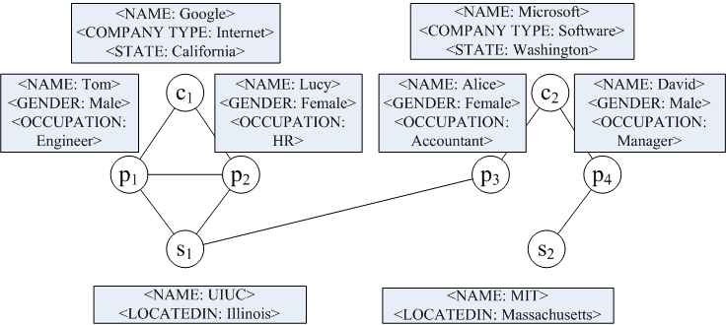
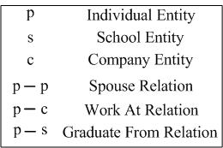
Background
Privacy Concerns
Original Graph G

Slide 5
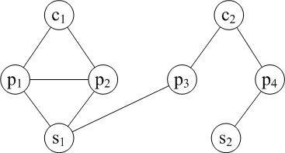
Background
Privacy Concerns
Naïve Anonymized Graph G’
Original Graph G

Slide 6
Background
Privacy Concerns
I know Tom and his wife graduated from the same university and work at the same company…
Naïve Anonymized Graph G’
Original Graph G

Slide 7
Background
Privacy Concerns
I know Tom and his wife graduated from the same university and work at the same company…
Naïve Anonymized Graph G’
Original Graph G

Slide 8
K-Automorphism
Original Graph G

Slide 9
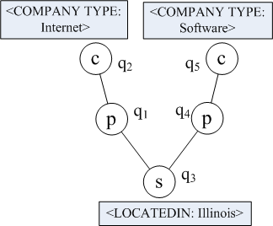
K-Automorphism
Original Graph G
Original Query Q

Slide 10
K-Automorphism
Original Graph G
Original Query Q

Slide 11
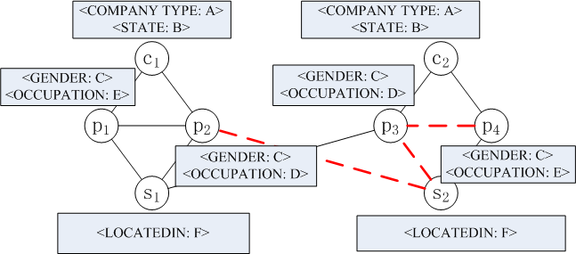
K-Automorphism
K-Automorphic Graph G^{k}
K = 2

Slide 12
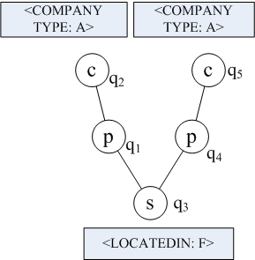
K-Automorphism
K-Automorphic Graph G^{k}
K = 2
Outsourced Query Qº

Slide 13
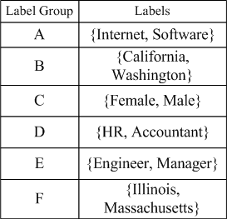
K-Automorphism
K-Automorphic Graph G^{k}
K = 2
Outsourced Query Qº
Label Correspondence Table (LCT)

Slide 14
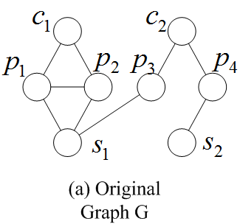
K-Automorphism

Slide 15
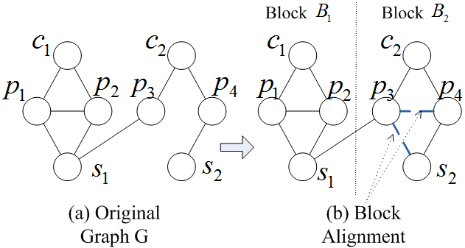
K-Automorphism

Slide 16
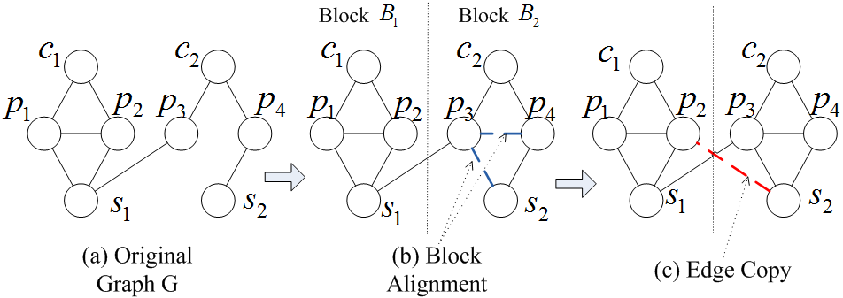
K-Automorphism

Slide 17
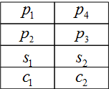
K-Automorphism
Alignment Vertex Table (AVT)

Slide 18
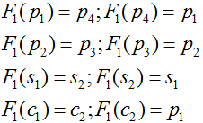
K-Automorphism
Alignment Vertex Table (AVT)
Automorphic Function F₁

Slide 19
K-Automorphism
Details of Block Alignment
1
7
One More Example
2
3
5
6
8
9
4
10
Notes:
19

Slide 20
K-Automorphism
Details of Block Alignment
1
7
One More Example
2
3
5
6
8
9
Graph Partition
4
10
Notes:
20

Slide 21
K-Automorphism
Details of Block Alignment
1
7
One More Example
2
3
5
6
8
9
Graph Partition
4
10
1
7
2
3
5
6
8
9
4
10
Notes:
21

Slide 22
K-Automorphism
Details of Block Alignment
1
7
One More Example
2
3
5
6
8
9
Graph Partition
4
10
1
7
2
3
5
6
8
9
4
10
Notes:
22

Slide 23
K-Automorphism
Details of Block Alignment
1
7
One More Example
2
3
5
6
8
9
Graph Partition
4
10
Graph Alignment
1
7
2
3
5
6
8
9
4
10
Notes:
23

Slide 24
K-Automorphism
Details of Block Alignment
1
7
One More Example
2
3
5
6
8
9
Graph Partition
4
10
Graph Alignment
1
7
Alignment Vertex Table (AVT)
1 | 7
2 | 9
3 | 8
4 | 10
5 | 6
2
3
5
6
8
9
4
10
Notes:
24

Slide 25
K-Automorphism
Details of Block Alignment
1
7
Alignment Vertex Table (AVT)
1 | 7
2 | 9
3 | 8
4 | 10
5 | 6
2
3
5
6
8
9
4
10

Slide 26
K-Automorphism
Details of Block Alignment
1
7
Alignment Vertex Table (AVT)
1 | 7
2 | 9
3 | 8
4 | 10
5 | 6
2
3
5
6
8
9
4
10
Finding the optimal block alignment is an NP-hard problem (even in the case of no attributes).

Slide 27
K-Automorphism
Heuristic Block Alignment
More complicated while considering attributes…
1
a
7
a
b
2
3
5
b
d
6
8
9
c
c
c
c
4
10
d
Notes:
27

Slide 28
K-Automorphism
Heuristic Block Alignment
More complicated while considering attributes…
The largest same degree with same label
1
a
7
a
b
2
3
5
b
d
6
8
9
c
c
c
c
4
10
d
Notes:
28

Slide 29
K-Automorphism
Heuristic Block Alignment
More complicated while considering attributes…
1
a
7
a
b
2
3
5
b
d
6
8
9
c
c
c
c
4
10
d
BF-search
Notes:
29

Slide 30
K-Automorphism
Heuristic Block Alignment
More complicated while considering attributes…
1
a
7
a
b
2
3
5
b
d
6
8
9
c
c
c
c
4
10
d
Pair-up vertices with the same label and / or the same (or similar) degrees
Notes:
30

Slide 31
K-Automorphism
Heuristic Block Alignment
More complicated while considering attributes…
1
a
7
a
b
2
3
5
b
d
6
8
9
c
c
c
c
4
10
d
Notes:
31

Slide 32
K-Automorphism
Heuristic Block Alignment
More complicated while considering attributes…
1
a
7
a
b
2
3
5
b
d
6
8
9
c
c
c
c
4
10
d
Notes:
32

Slide 33
K-Automorphism
Heuristic Block Alignment
More complicated while considering attributes…
1
a
7
a
b
2
3
5
b
d
6
8
9
c
Alignment Vertex Table (AVT)
c
c
1 | 7
2 | 6
3 | 9
4 | 8
5 | 10
c
4
10
d
Notes:
33

Slide 34
K-Automorphism
Heuristic Block Alignment
More complicated while considering attributes…
1
a
7
a
b
2
3
5
b
d
6
8
9
c
Alignment Vertex Table (AVT)
c
c
1 | 7
2 | 6
3 | 9
4 | 8
5 | 10
c
4
10
d
Notes:
34

Slide 35
K-Automorphism
Heuristic Block Alignment
More complicated while considering attributes…
1
a
7
a
b
2
3
5
b
d
6
8
9
c
Alignment Vertex Table (AVT)
c
c
1 | 7
2 | 6
3 | 9
4 | 8
5 | 10
c
4
10
d
Notes:
35

Slide 36
K-Automorphism
Heuristic Block Alignment
More complicated while considering attributes…
1
a
7
a
b
2
3
5
b
d
6
8
9
c
Alignment Vertex Table (AVT)
c
c
1 | 7
2 | 6
3 | 9
4 | 8
5 | 10
c
4
10
d
Notes:
36

Slide 37
K-Automorphism
Optimization 1
Upload Gº rather than G^{k} to the cloud
Save cloud storage

Slide 38
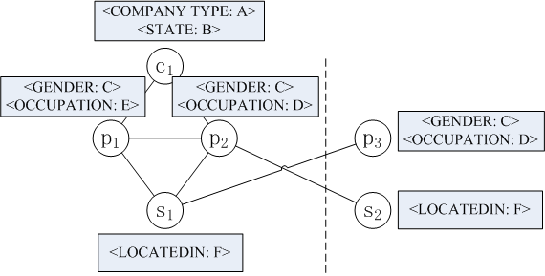
K-Automorphism
Optimization 1
Upload Gº rather than G^{k} to the cloud
Save cloud storage
Outsourced Graph Gº
K = 2

Slide 39
K-Automorphism
Optimization 1
Upload Gº rather than G^{k} to the cloud
Save cloud storage
Outsourced Graph Gº
K = 2
Outsourced Query Qº
Alignment Vertex Table (AVT)

Slide 40
Subgraph Matching
Star Matching
Outsourced Query Qº

Slide 41
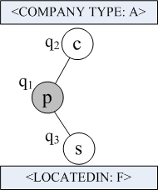
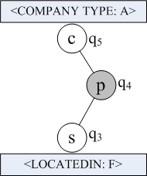
Subgraph Matching
Star Matching
Query Decomposition
Outsourced Query Qº
Star S₁
Star S₂

Slide 42
Subgraph Matching
Star Matching
Outsourced Graph Gº
Star Matching
Query Decomposition
Outsourced Query Qº
Star S₁
Star S₂

Slide 43
Subgraph Matching
Star Matching
Outsourced Graph Gº
Let |R(S_{i})| denote the number of matches of a star S_{i} on Gº.
Star Matching
Query Decomposition
Outsourced Query Qº
Star S₁
Star S₂

Slide 44
Subgraph Matching
Query Decomposition
Query Decomposition
Outsourced Query Qº
Star S₁
Star S₂

Slide 45
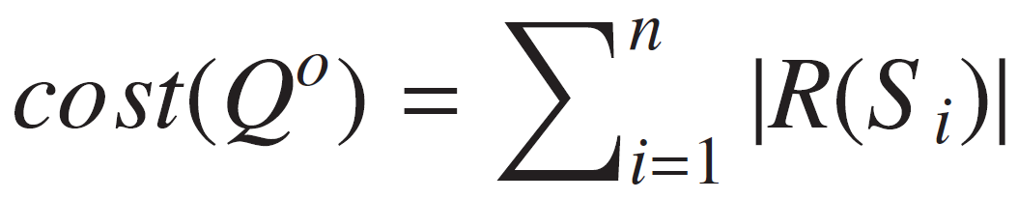
Subgraph Matching
Query Decomposition
Given a set of stars {S₁, S₂, …, S_{n}}, we define the cost of the query decomposition is:
Query Decomposition
Outsourced Query Qº
Star S₁
Star S₂

Slide 46
Subgraph Matching
Query Decomposition
Given a set of stars {S₁, S₂, …, S_{n}}, we define the cost of the query decomposition is:
Suppose each |R(S_{i})| has been given.
Finding the query decomposition with the minimum cost is an NP-hard problem.

Slide 47
Subgraph Matching
Query Decomposition
Given a set of stars {S₁, S₂, …, S_{n}}, we define the cost of the query decomposition is:
Solution: formulate it as an integer linear programming (ILP) problem and use an available ILP tool to solve it.

Slide 48
Subgraph Matching
Optimization 2
Estimate the search space of matching a star query (|R(S_{i})|)
Better label generalization, better query decomposition
Save query time cost

Slide 49
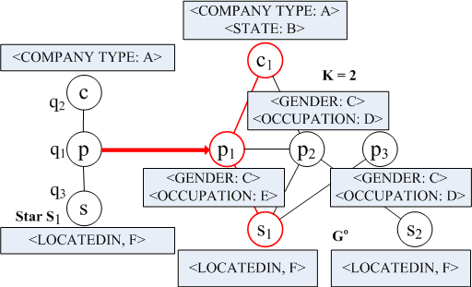
Subgraph Matching
Optimization 2
Estimate the search space of matching a star query (|R(S_{i})|)
Better label generalization, better query decomposition
Save query time cost

Slide 50
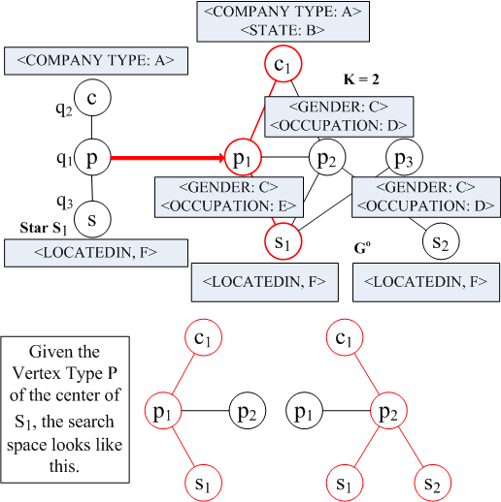
Subgraph Matching
Optimization 2
Estimate the search space of matching a star query (|R(S_{i})|)
Better label generalization, better query decomposition
Save query time cost

Slide 51
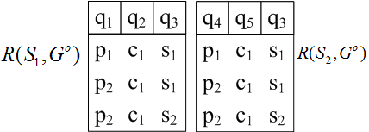
Subgraph Matching
Result Join

Slide 52
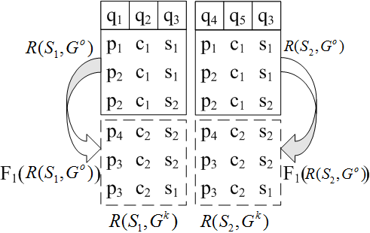
Subgraph Matching
Result Join
Alignment Vertex Table (AVT)
Automorphic Function F₁

Slide 53
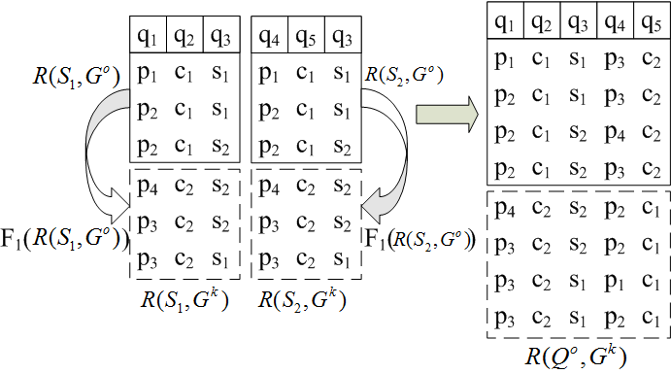
Subgraph Matching
Result Join
Alignment Vertex Table (AVT)
Automorphic Function F₁

Slide 54
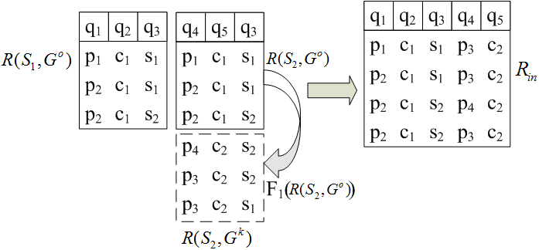
Subgraph Matching
Optimization 3
Generate R_{in} rather than all the results
Save query time cost and communication cost
Alignment Vertex Table (AVT)
Automorphic Function F₁

Slide 55
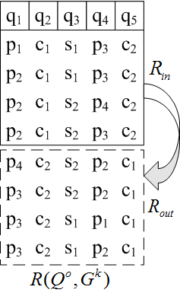
Subgraph Matching
Client Filtering
Generating Candidate Results

Slide 56
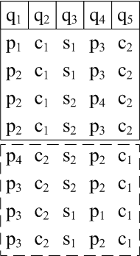

Subgraph Matching
Client Filtering
Generating Candidate Results
Filtering

Slide 57

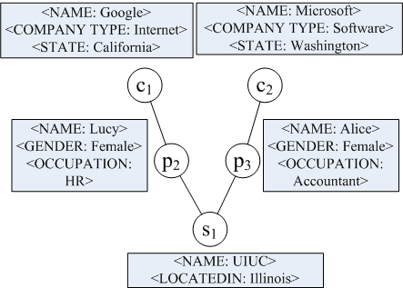
Subgraph Matching
Client Filtering
Original Query Q
Generating Candidate Results
Filtering
Matching Result

Slide 58
Experimental Results
Setup:
Server: a Windows server with 64 GB main memory and four CPU cores.
Client: a Windows PC with 8 GB main memory and Intel Core 2 Duo CPU

Slide 59
Experimental Results
Setup:
Server: a Windows server with 64 GB main memory and four CPU cores.
Client: a Windows PC with 8 GB main memory and Intel Core 2 Duo CPU
Original Data Graphs:
10⁵ – 10⁷ vertices, 10⁶ – 10⁸ edges
The ratio of # of vertices to # of different labels: around 10³
Original Query Graphs:
4 – 12 edges

Slide 60
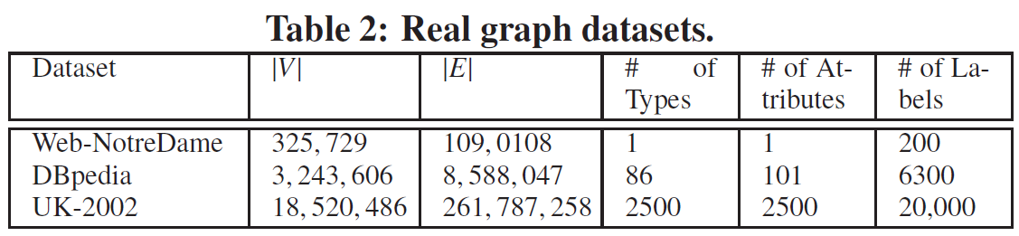
Experimental Results

Slide 61
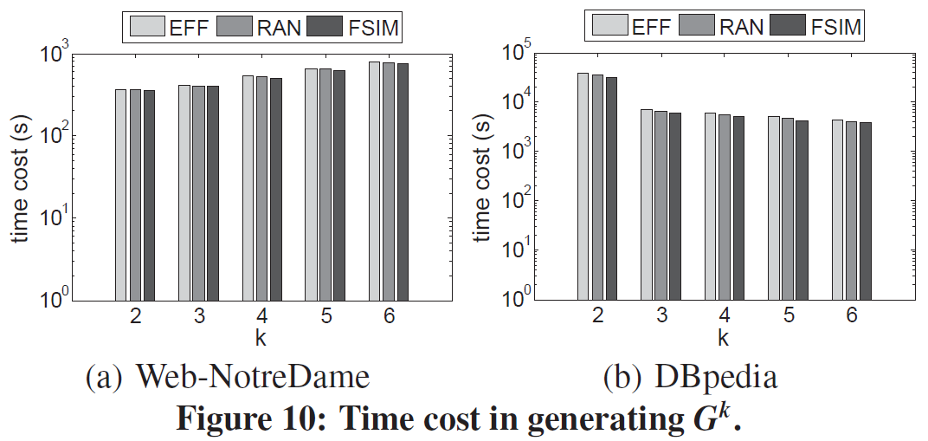
Experimental Results

Slide 62
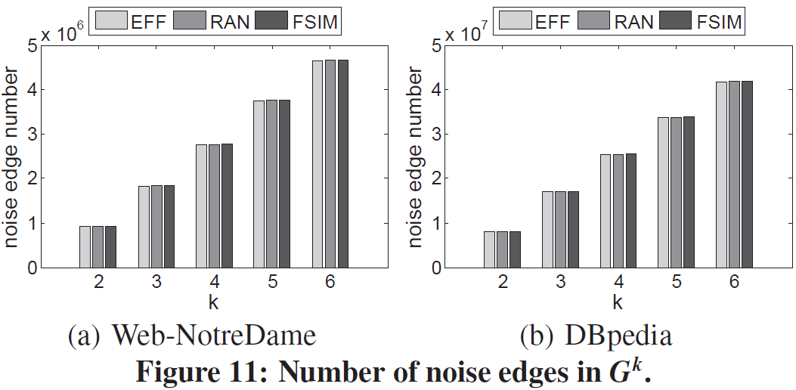
Experimental Results

Slide 63
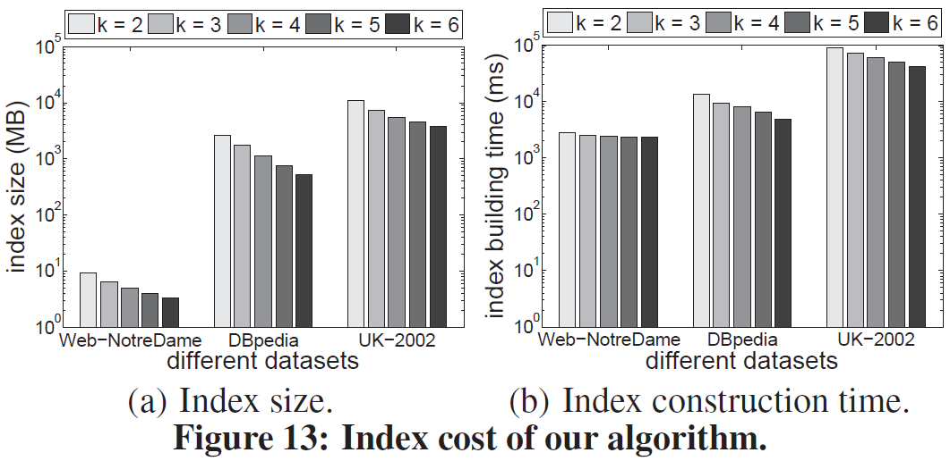
Experimental Results

Slide 64
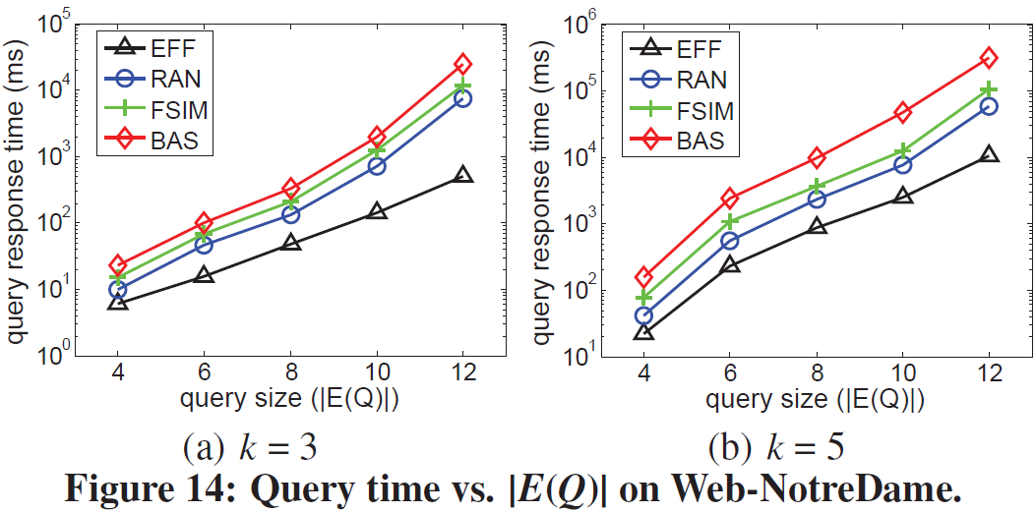
Experimental Results

Slide 65
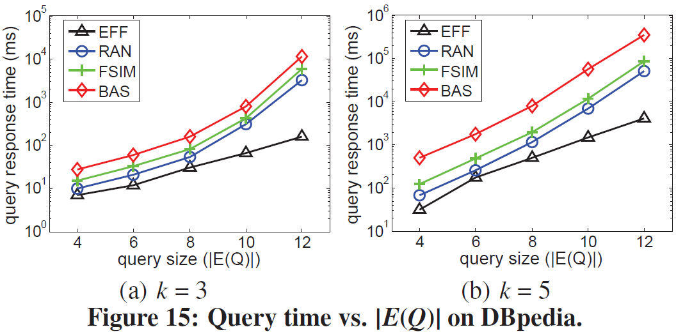
Experimental Results

Slide 66
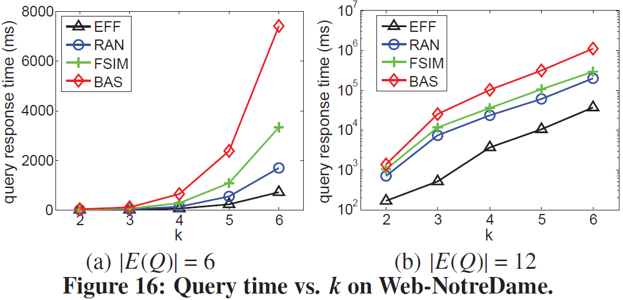
Experimental Results

Slide 67
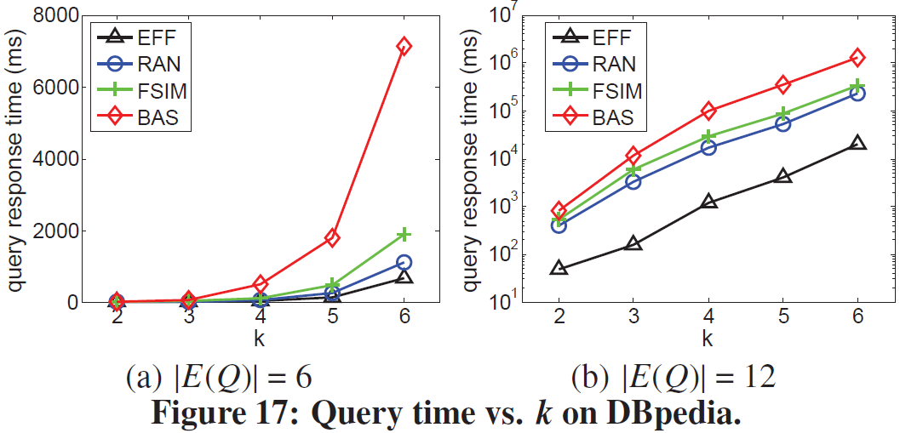
Experimental Results

Slide 68
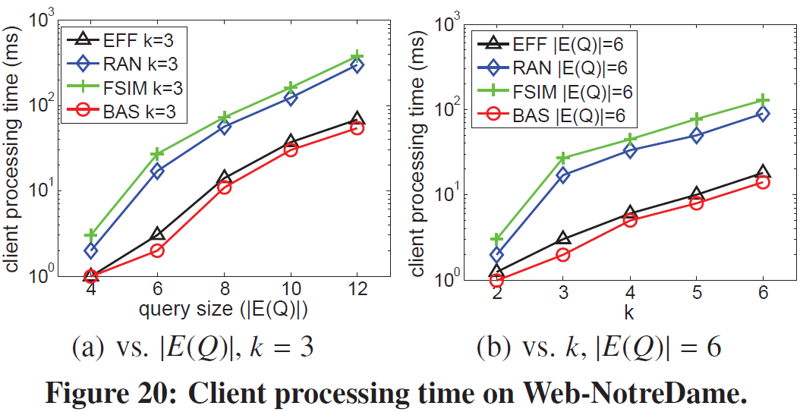
Experimental Results

Slide 69
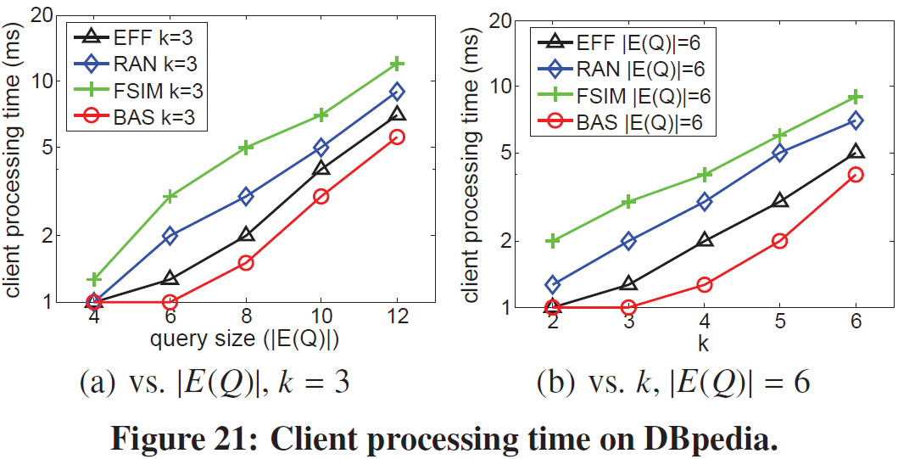
Experimental Results

Slide 70
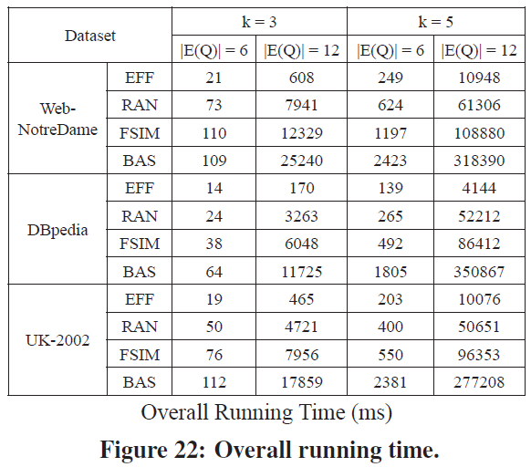
Experimental Results

Slide 71
Conclusions
1. Present an efficient framework

Slide 72
Conclusions
1. Present an efficient framework
2. Protect both structural and label privacy

Slide 73
Conclusions
1. Present an efficient framework
2. Protect both structural and label privacy
3. Explore a number of optimization techniques and leverage an effective cost model

Slide 74
Conclusions
1. Present an efficient framework
2. Protect both structural and label privacy
3. Explore a number of optimization techniques and leverage an effective cost model
4. Perform extensive experiments on large real graphs

Slide 75
Thanks!

