Slide 1
Text Mining World War I
Letters
Ada Mainetti, Harry Zhao, Kevin Warnakulasuriya

Slide 2
01
Introduction

Slide 3
BACKGROUND
availability of existing dataset(s)
intended mostly as exploration of the data
providing some historical (h)in(d)sight
bottom-up, firsthand perspective of the war
testing how well text mining techniques applies to historical data and forms of writing
RQ: How can we use computational methods to learn about the lived experiences of World War I from transcribed letters?

Slide 4
DATASETS
55 letters
367 letters
Kaggle (National Archive)
"My Dearest" Archive
contains 19 French letters
contains metadata file with years, authors, comments
manually input National Archive letters into dataset
obtained through web scraping with Beautiful Soup
transcribed correspondences from a single family, with most letters between 1917-18

Slide 5
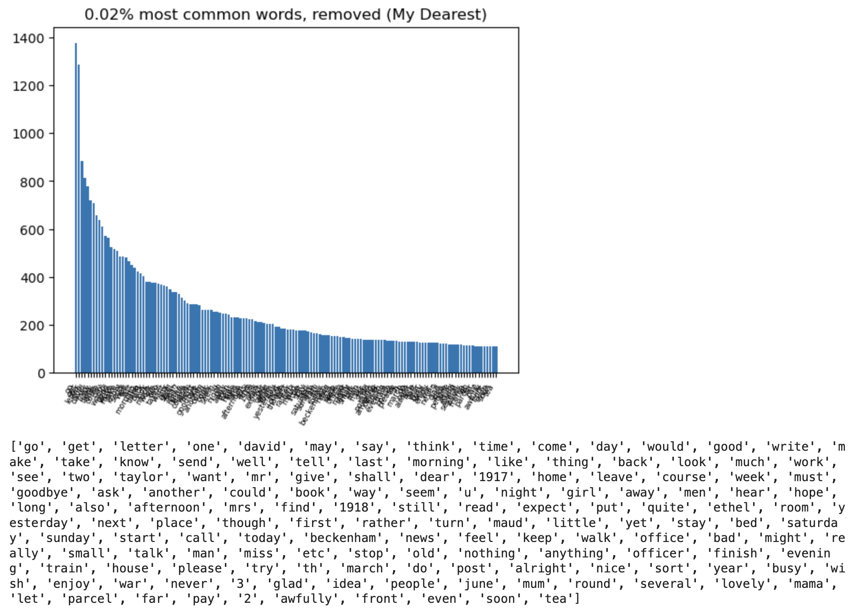
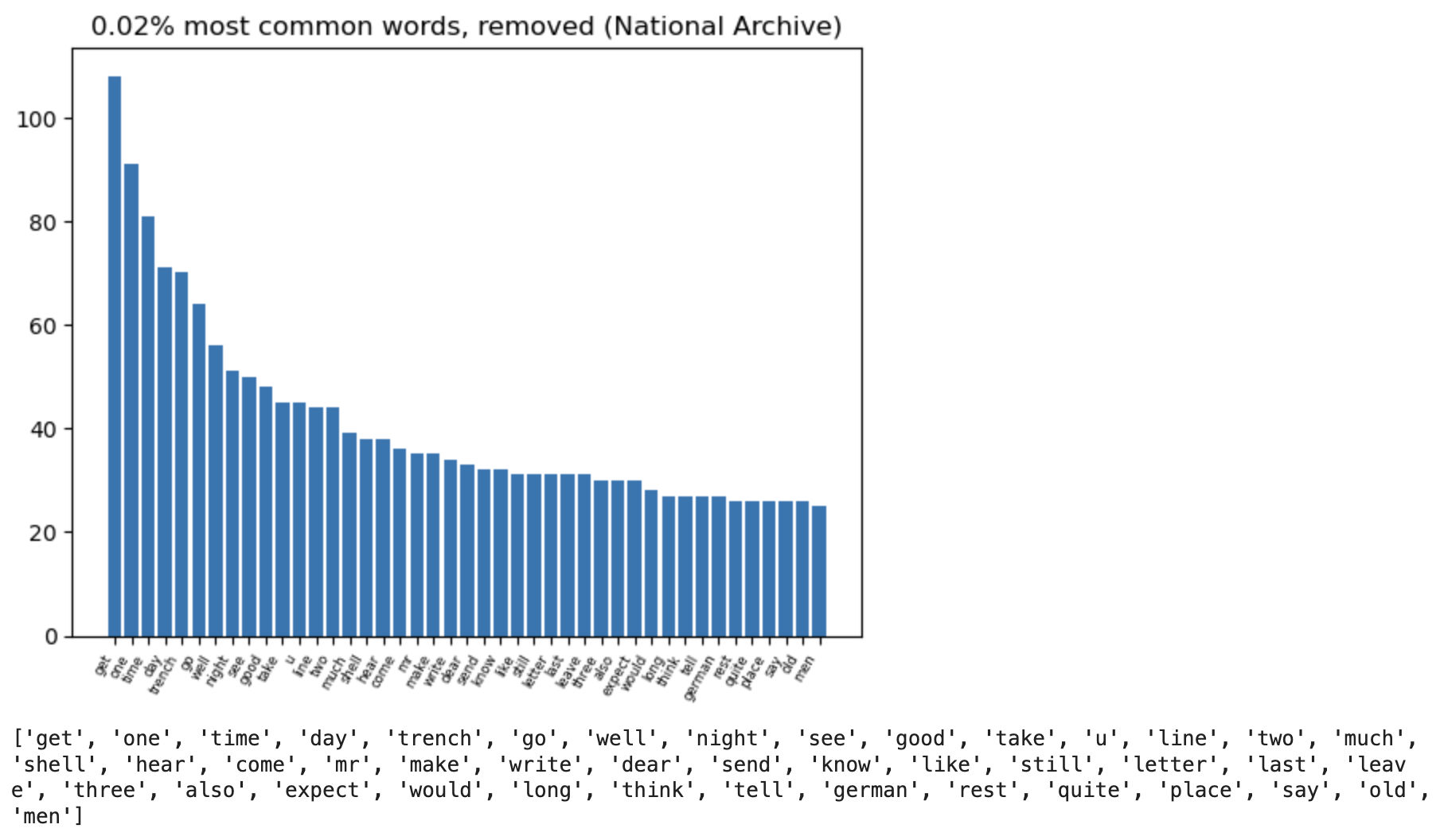
Preprocessing Steps
1. Tokenisation
3. Stopword Removal
2. Lemmatisation
NLTK tokeniser
NLTK set of stopwords
also remove top 0.02% of most frequent words
topic modelling and sentiment analysis
stopwords, frequent names, time phrases, and basic terms related to war or letter-writing
PoS tagging
WordNet lemmatiser

Slide 6
General Stats
2

Slide 7
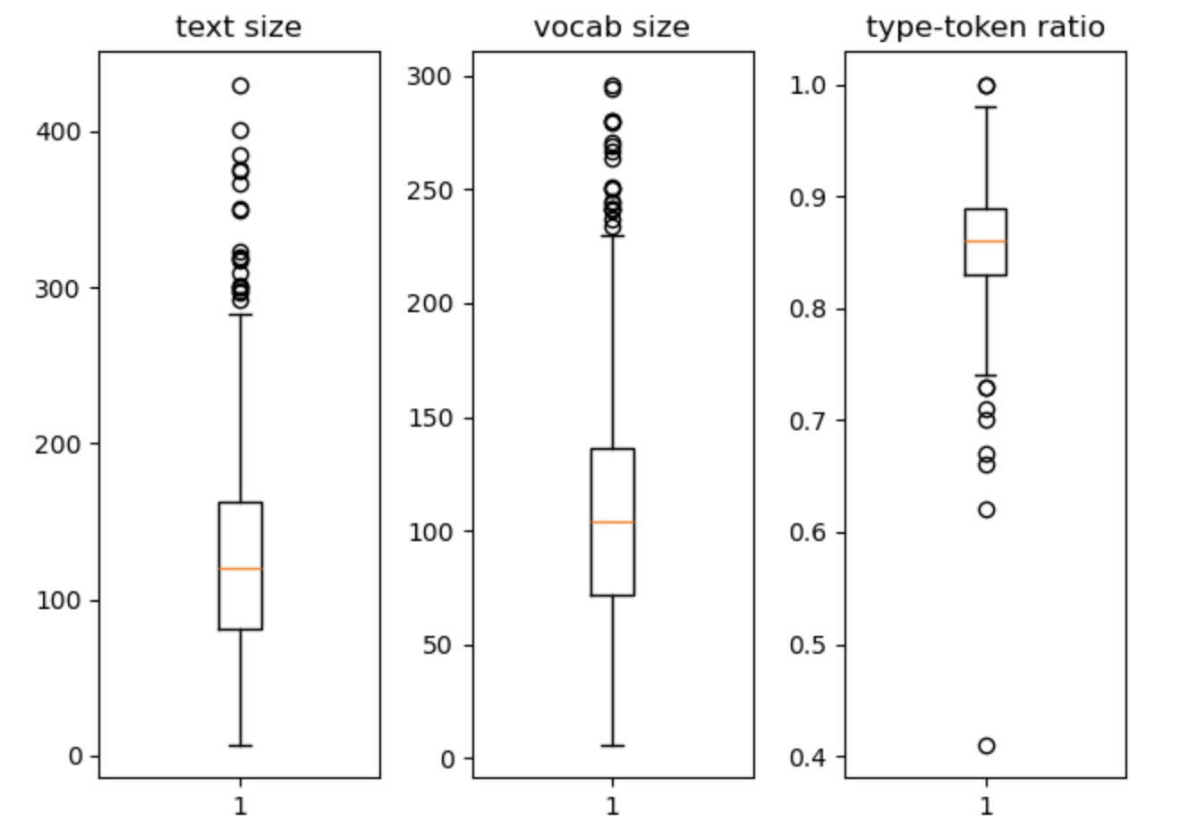
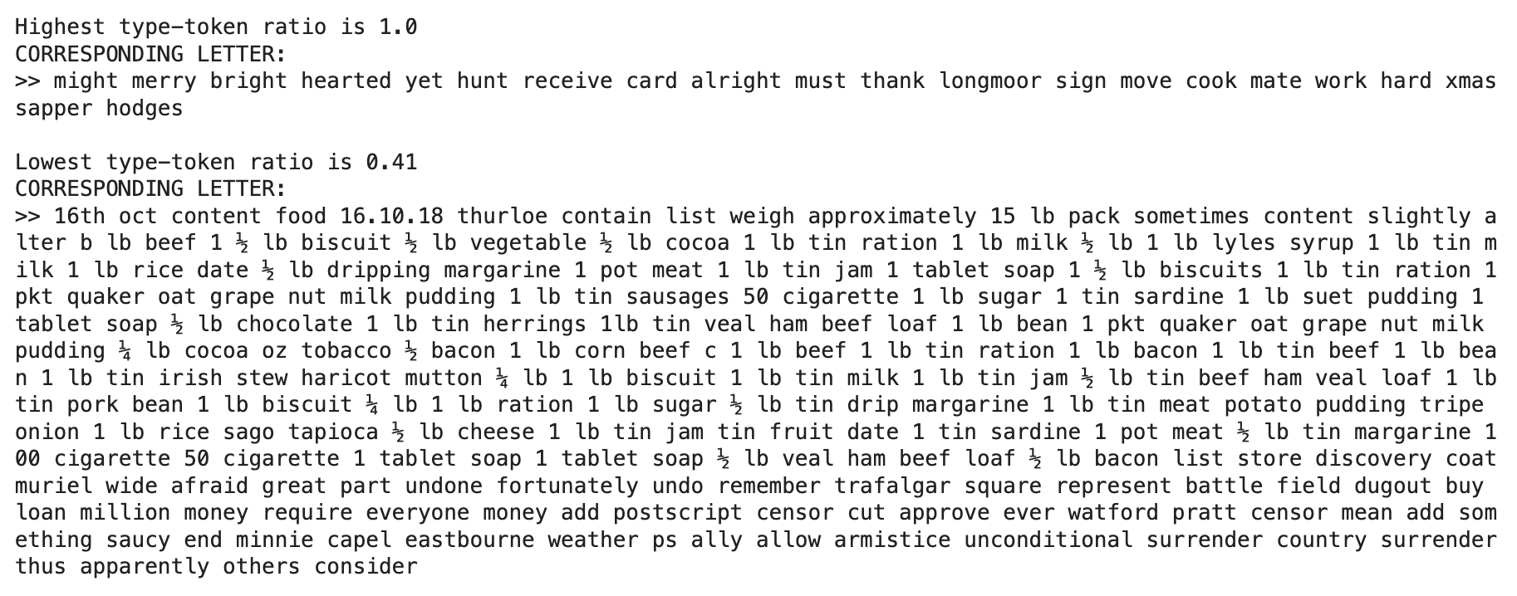
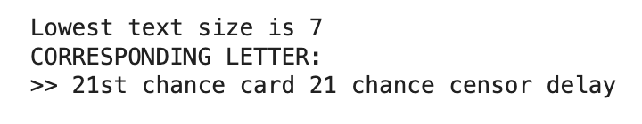
letters generally around 100 words long, and same vocabulary size
relatively high type-token ratio, suggests high diversity in word choice and topic

Slide 8
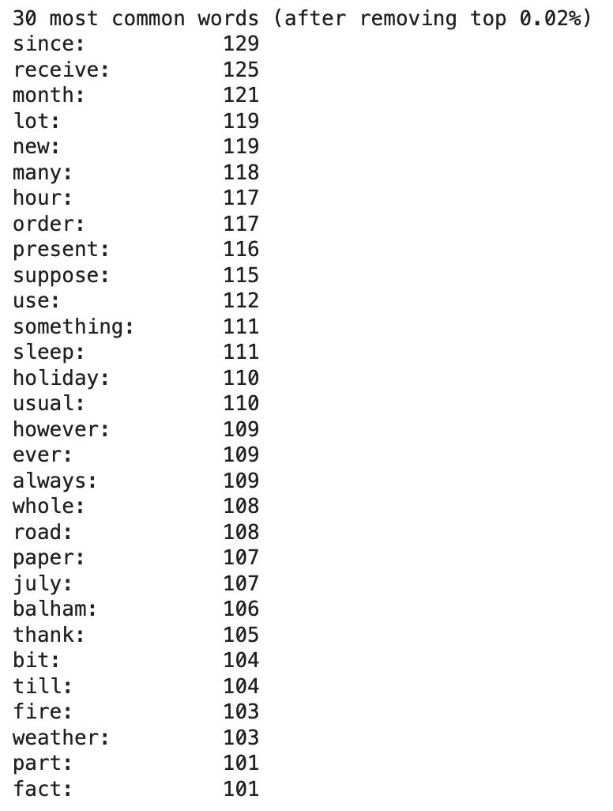
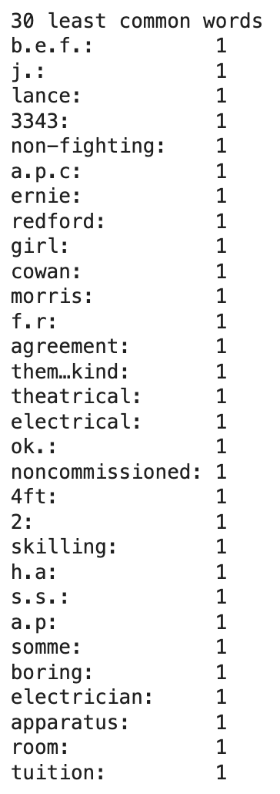
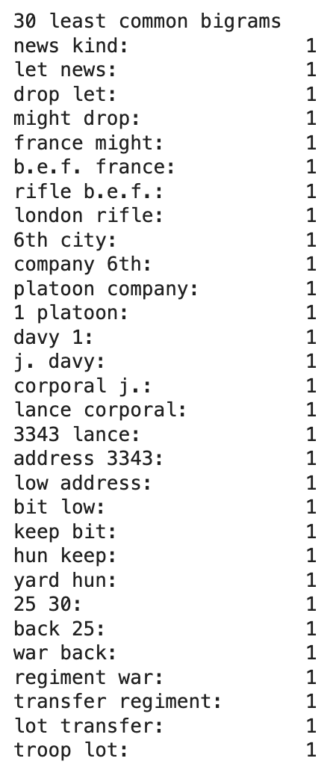
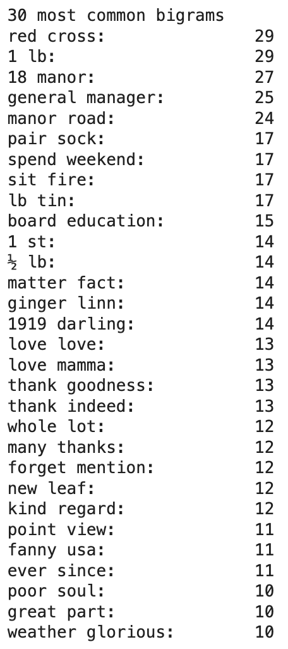
common words are not very informative
mostly about resources, health, mundane aspects of life, gratitude - not a lot of sentiment
least common words are usually proper names or war-related events and jargon

Slide 9
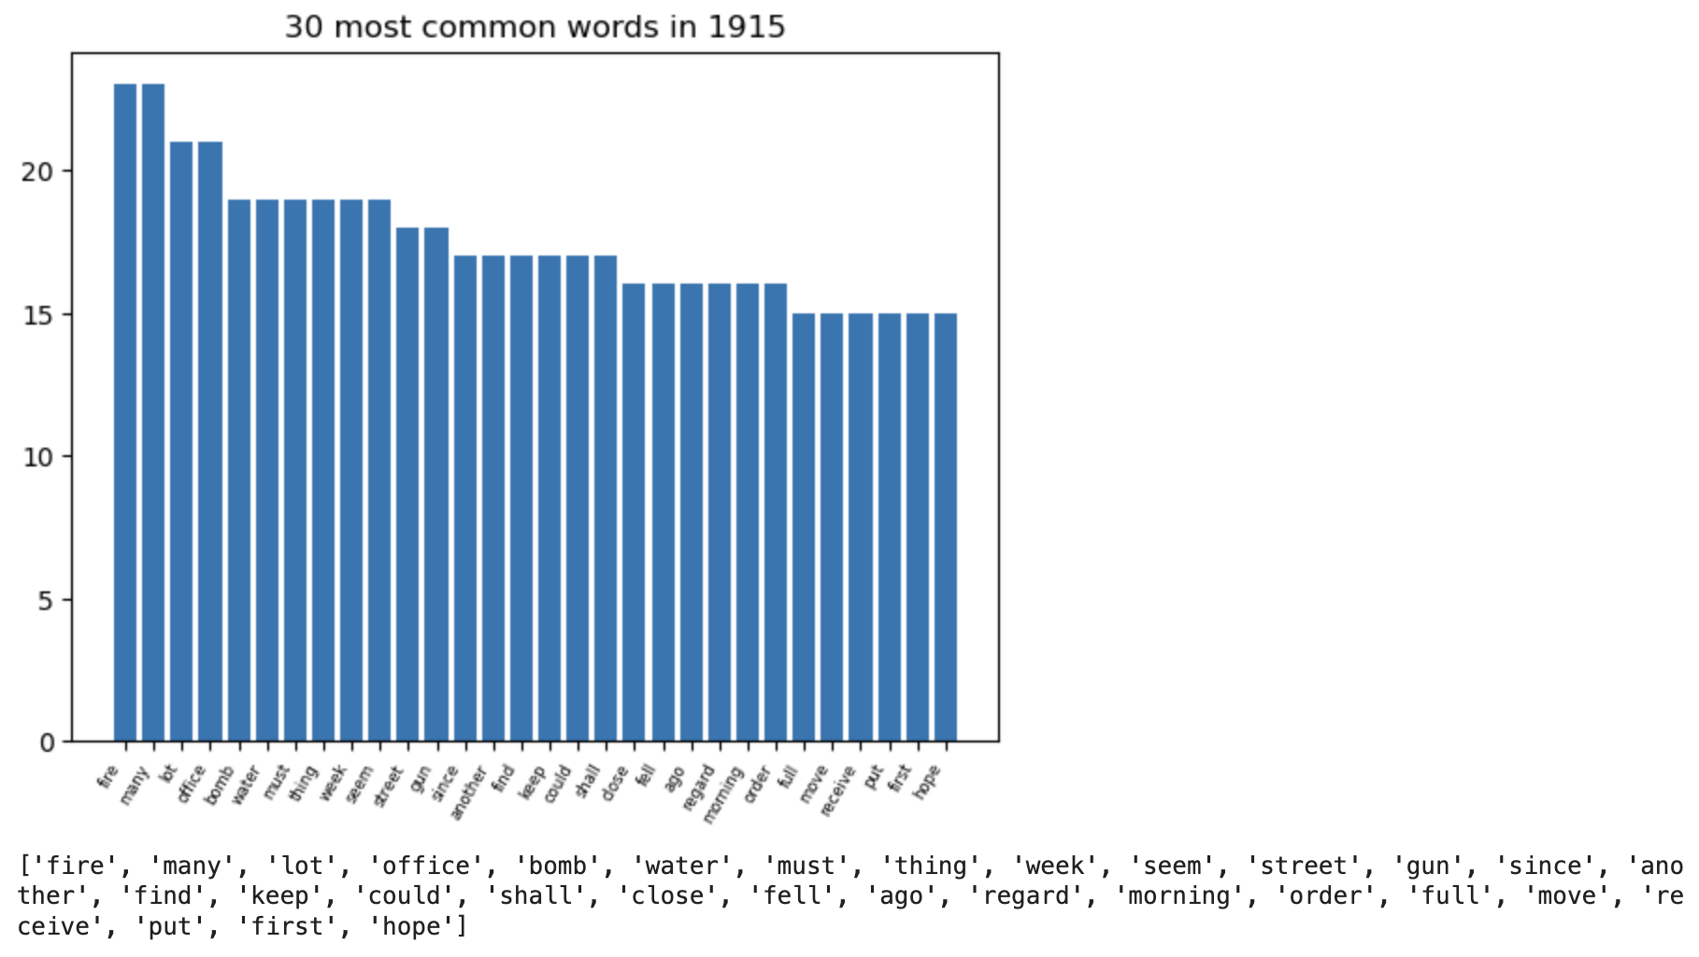
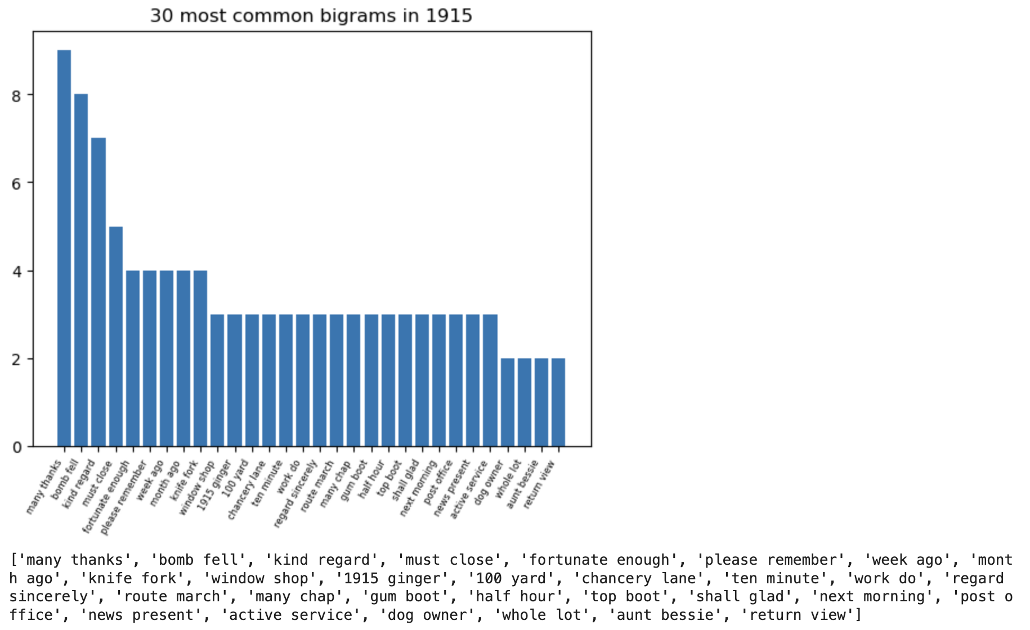
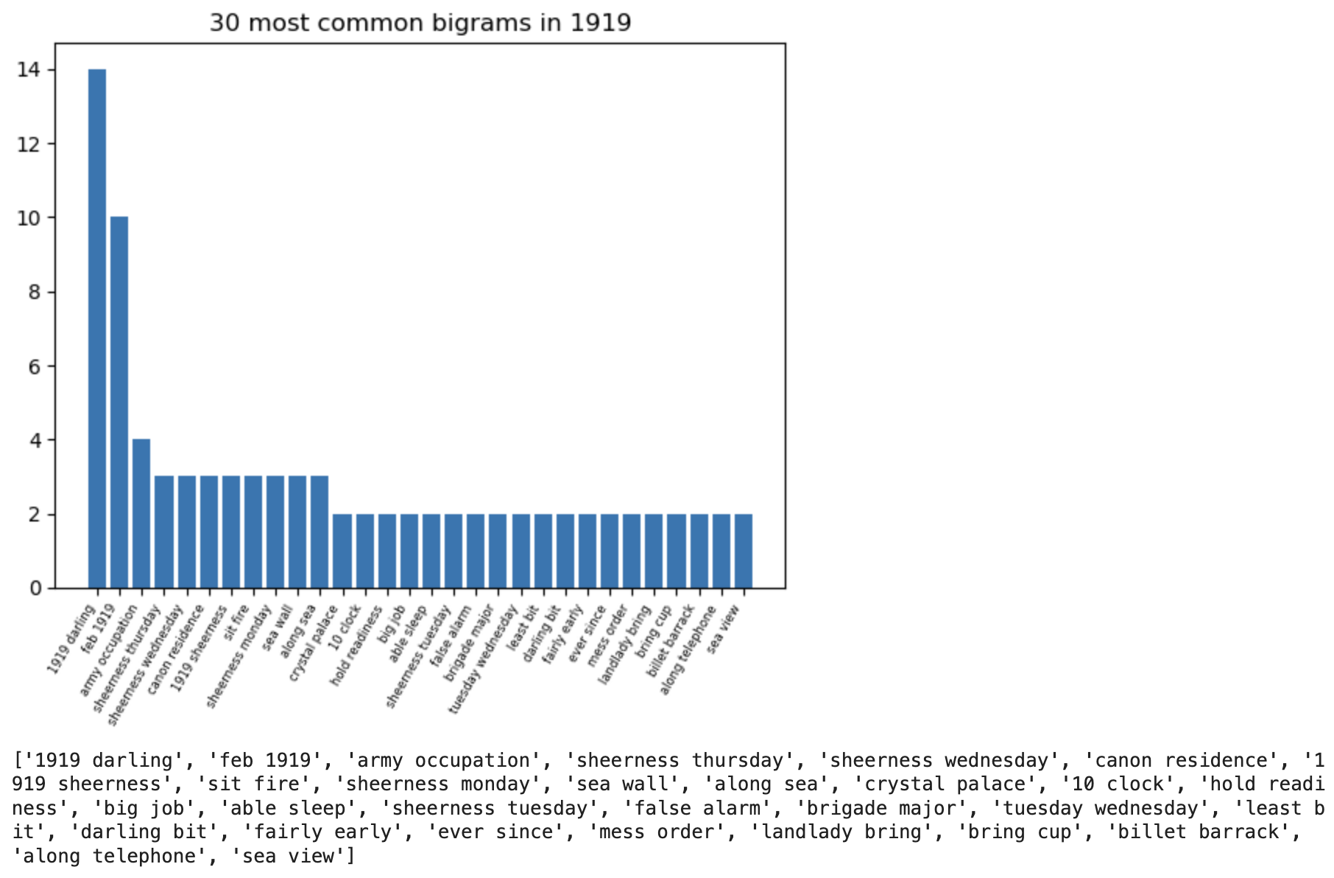
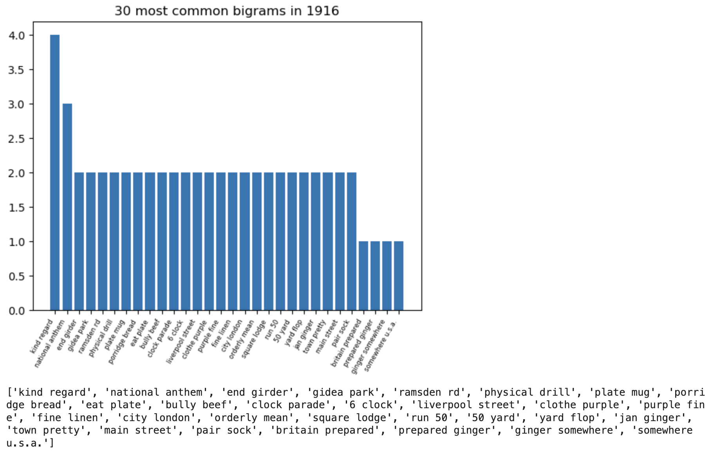
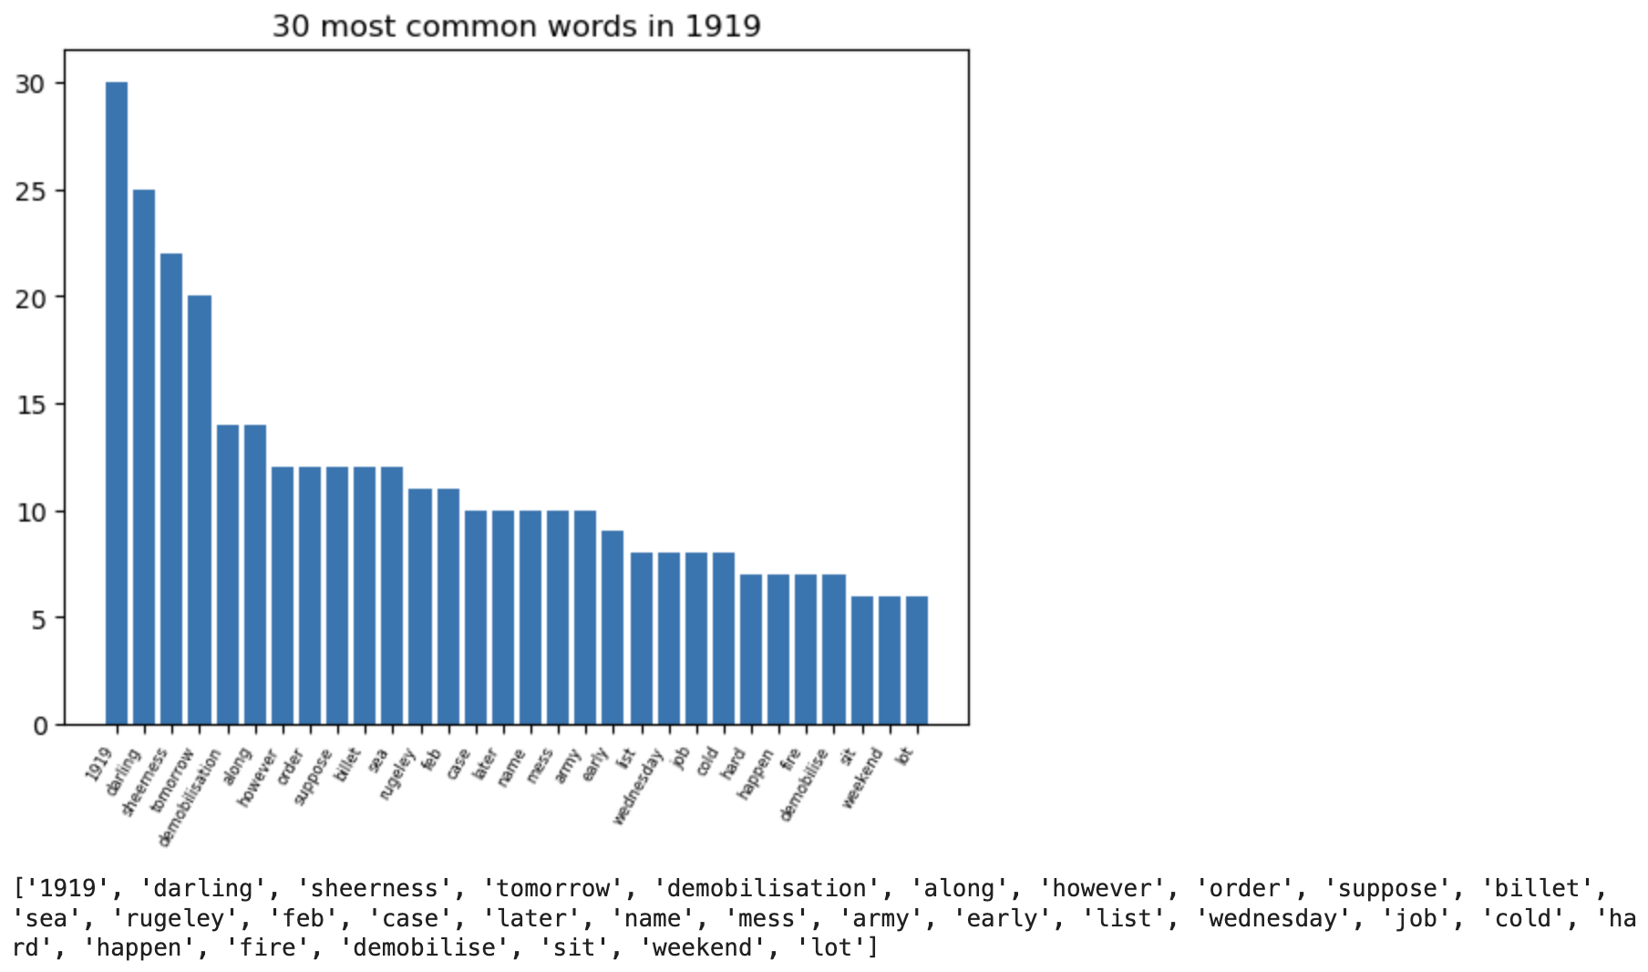
1915: destruction
1916: training and ceremonies
1919: demobilisation

Slide 10
03
Topic Modelling

Slide 11
Topic Modelling: Approach
We used LDA, which is one of the most popular forms of doing Topic Modelling.
Model Quality evaluated using Coherence Scores
First Model with Basic Preprocessed Data gave a Coherence Score of 0.38
To improve the score the following was done:
Preprocessing: removing some very common words, adding bigrams and trigrams
Running a search for the optimal number of topics
Tweaking model hyperparameters like chunksize and passes
Tweaking preprocessing parameters
The final model has a coherence score of 0.51, with 9 topics
Notes:
Topic Modelling is a form of unsupervised learning that aims to find topic clusters in a series of texts. Coherence score= show how well a topic is 'supported' by a text set (0.4 is bad, 0.6 is good,a anything higher is like. Suspicosuly good)
Tried removing all words that arent adjectives or nouns but this made the model worse so discarded it

Slide 12
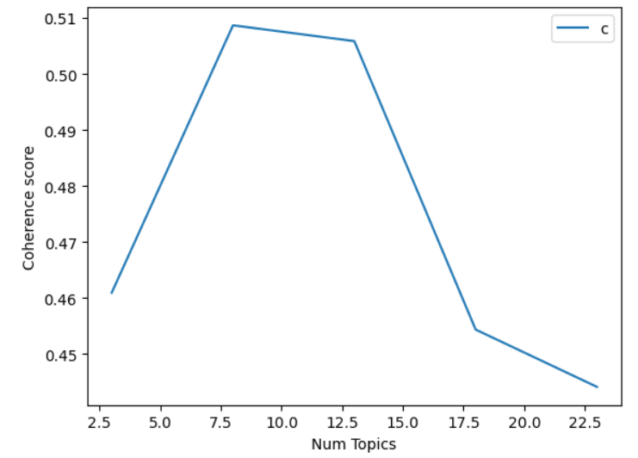
Topic Modelling: Topic Search
Coherence score for models with varying number of topics, graphed
Notes:
Topic Modelling is a form of unsupervised learning that aims to find topic clusters in a series of texts. Coherence score= show how well a topic is 'supported' by a text set (0.4 is bad, 0.6 is good,a anything higher is like. Suspicosuly good)
Tried removing all words that arent adjectives or nouns but this made the model worse so discarded it

Slide 13
Topic Modelling: Topic Examples
Topic (Food and Food Rations)
lb, tin, 1, soap, bacon, biscuit, ration, jam, ½, beef, meat, milk, oat, sugar, oz, tea, pack, pudding, porridge, stew
Topic (Life and Movement at the Front)
whole, order, pretty, road, fire, however, platoon, something, along, always, mile, number, except, although, company, play, many, side, water, happen
Topic (Urban Destruction)
street, bomb, port, damage, full, window, building, fell, door, burst, deaf, lately, daily, light, knock, cough, open, small, shop, carter
Topic (Mundane Life, Weather and Errands)
balham, till, weekend, cold, monday, weather, tea, holiday, late, guess, believe, wait, early, ought, dinner, spend, wonder, reach, return, buy
Notes:
Top 20 words fro some topics here are some generic ords like although something but i tried removing things tha twerent nouns or adjeitvies and it made it worse so. Topics, we dont know how people feel about them

Slide 14
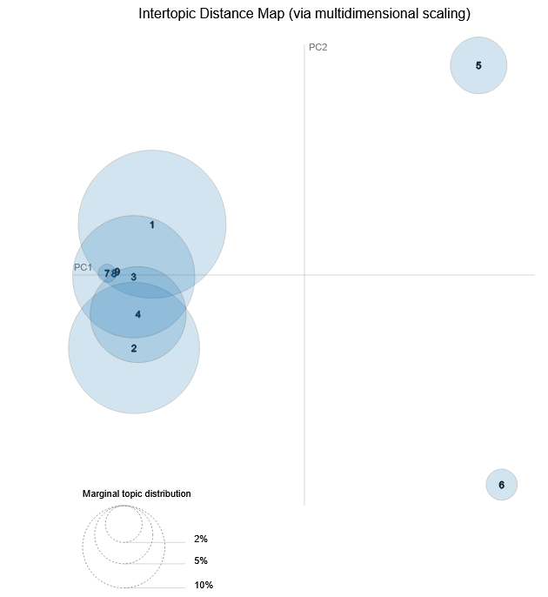
Topic Modelling: Topic Distribution
Notes:
Top 20 words fro some topics here are some generic ords like although something but i tried removing things tha twerent nouns or adjeitvies and it made it worse so. Topics, we dont know how people feel about them

Slide 15
04
Sentiment Analysis

Slide 16
Sentiment Analysis: The Model
Bert Multi-Classification Sentiment Analysis Model (pretrained from Kaggle)
Able to predict up to 27 emotions:
Admiration
Amusement
Anger
Annoyance
Approval
Caring
Confusion
Curiosity
Desire
Disappointment
Disapproval
Disgust
Embarrassment
Excitement
Fear
Gratitude
Grief
Joy
Love
Nervousness
Optimism
Pride
Realization
Relief
Remorse
Sadness
Surprise
Neutral
Notes:
Model trained on the GoEmotions dataset. Manually annotated dataset, by Google, of 58,000 English Reddit comments, labeled with 27 emotion categories or neutral.
Wrote some test “letters” with clear intended sentiments to check how the model performed.

Slide 17
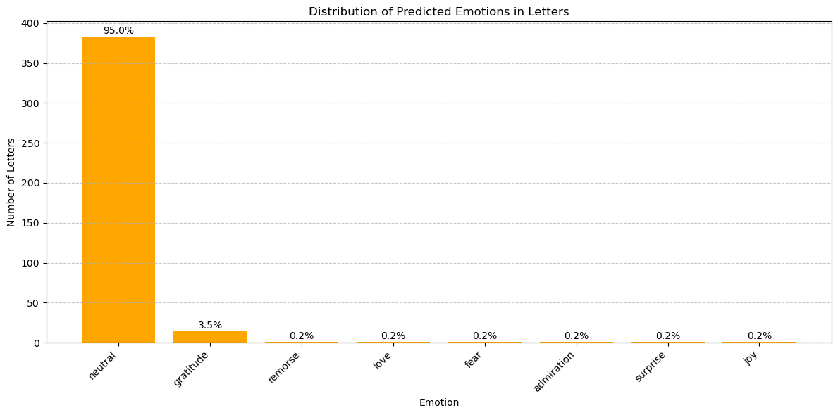
Sentiment Analysis: Initial Results
Notes:
95% of emotions predicted are classified as “neutral”
Make predictions based on segments of a letter rather than the whole letter

Slide 18
Sentiment Analysis: Initial Results
Example of letter classified as “neutral”
"15th May 1917 In a few months it will be my turn for leave [May’s copy of David’s letter] David to May 15th May 1917 I have got the morning free so shall be able to catch the post. People here are still going on leave. They go at the rate of about two a fortnight, so in the course of a few months it will work down to my turn, that is if all leave isn’t stopped again. I got up this morning thinking I was going on to the rly, as usual, but it was found that two of us were not actually required so I am having the morning off and going down to relieve the others this afternoon. According to the present plan we not only march back, to our old village, but we do all sorts of attacks and other training on the way, and then when we get there we are to do a whole lot of night operations. We are going to enjoy ourselves, Later: I have wandered out of camp and am now lying on a hillside having lovely daydream. I have been thinking of the time at Rottingdean, but this sort of thing only makes our longing for home worse. Goodby"
Notes:
Model trained on the GoEmotions dataset. Manually annotated dataset, by Google, of 58,000 English Reddit comments, labeled with 27 emotion categories or neutral.

Slide 19
Conclusion
Research Question: Understanding the lived experiences of WW1 through written correspondence
To get a feel for what people talked about, how they felt about it, what the format and structure of their correspondence was.
Methods:
General Statistics and Analysis
Topic Modelling
Sentiment Analysis
Reflection:
Limited data size due to poor availability of transcribed letters
Larger focus on qualitative analysis
Extract final weighting of letters from the sentiment model
Notes:
95% of emotions predicted are classified as “neutral”
Make predictions based on segments of a letter rather than the whole letter

Slide 20
Thank you for your attention

