Slide 1
High-Accuracy Atomic
Calculation for Plasma Opacity
Lianshui Zhao

Slide 2
Opacity
Atomic processes:
bound-bound and bound-free
Ionization threshold
h𝝂
h𝝂
* Pradhan, A.K. and Nahar, S. (2011) Atomic Astrophysics and Spectroscopy. New York: Cambridge University Press

Slide 3
Opacity
Atomic processes: bound-bound and bound-free
Inverse bremsstrahlung processes: free-free
h𝝂
e⁻⁻
e⁻⁻
+Ze
+Ze
* Pradhan, A.K. and Nahar, S. (2011) Atomic Astrophysics and Spectroscopy. New York: Cambridge University Press

Slide 4
Opacity
Atomic processes: bound-bound and bound-free
Inverse bremsstrahlung processes: free-free
Scattering processes:
Thomson scattering and Rayleigh scattering
h𝝂
e⁻⁻
h𝝂
e⁻⁻
+Ze
* Pradhan, A.K. and Nahar, S. (2011) Atomic Astrophysics and Spectroscopy. New York: Cambridge University Press

Slide 5
Background — Solar Abundance Problem
Standard Solar Model
Physical principles
Conservation of mass, momentum and energy
Equation of energy transport
Boundary conditions
Radius, luminosity, temperature and pressure
Input microphysics
Equation of state tables
Rosseland mean opacity tables
Nuclear reaction rates
Element abundances
Solar age
Etc.
It is so accurate that it predicted the defect in particle physics theory about neutrinos in the last century.
* Bahcall, J.N., and Pinsonneault, M.H. 1995, Rev. Mod. Phys., 67, 781
* Ahmad, Q.R., Allen, R.C. et al. 2002, Phys. Rev. Lett., 89, 011301

Slide 6
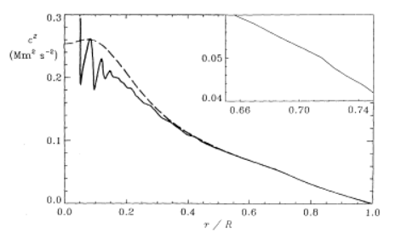
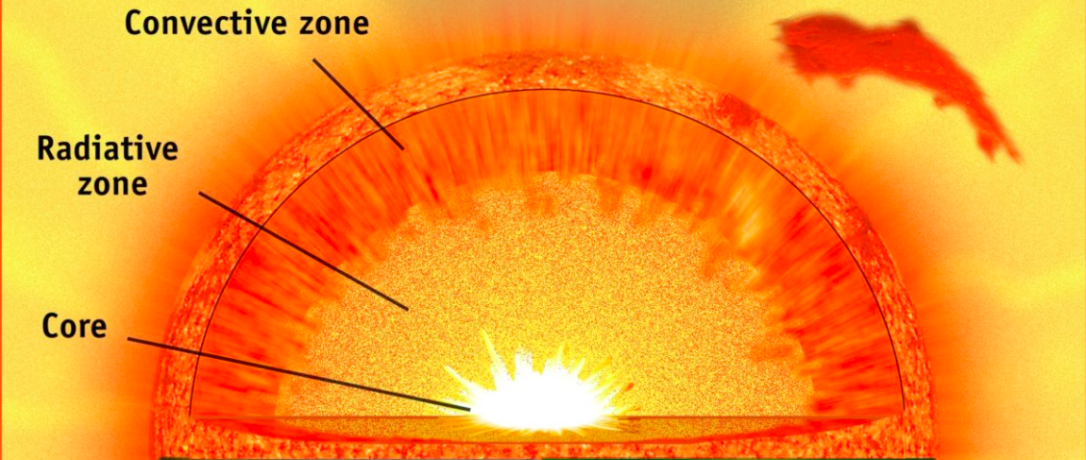
Background — Solar Abundance Problem
Helioseismology
Solar oscillations (standing acoustic waves) with 5-min period in Doppler velocity
Fluid dynamics equations with oscillating pressure perturbation
Solar convection zone boundary: [0.713±0.003(0.001)] R⦿
C_{s}² ∝ T_{e}
* Christensen-Dalsgaard, Gough, D.O., and Thompson, M.J. 1991, Astrophys. J., 378, 413

Slide 7
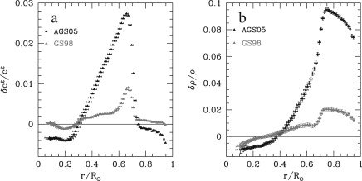
Background — Solar Abundance Problem
Hydrostatic 1D model: GS98
Standard solar model and helioseismology analysis agree with each other
Realistic 3D non-LTE radiative-hydrodynamical model: AGS05 (metals are reduced)
Sound speed distribution
Density distribution
Solar convection zone boundary: 0.726 R⦿
Etc.
Require 10%-20% increment of opacity near the convection zone boundary
* Basu, S., and Antia, H.M. 2008, Phys. Rep., 457, 217

Slide 8
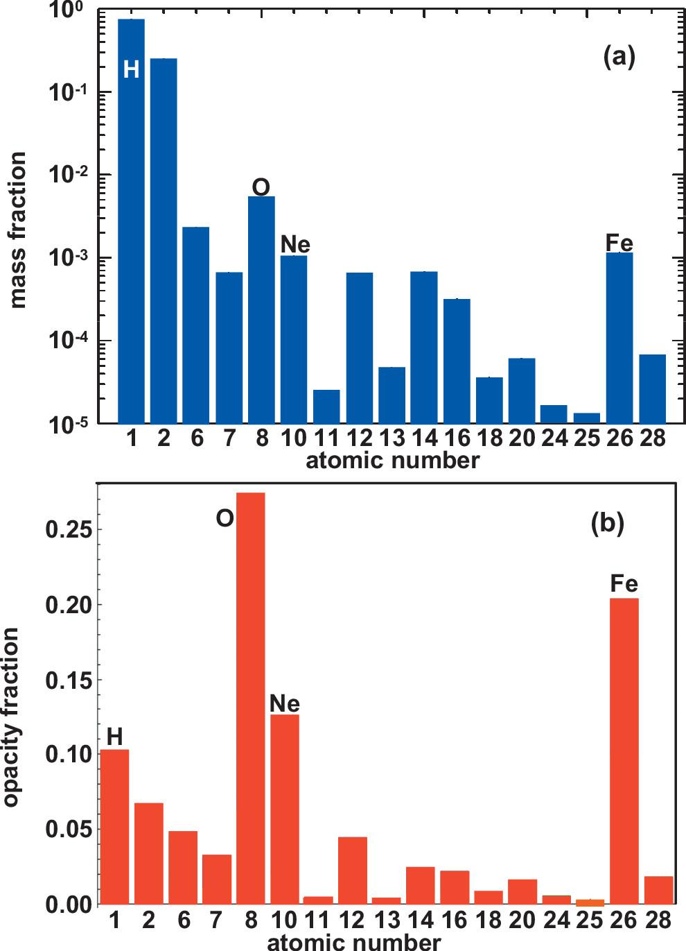
Background — Iron Opacity Z Measurement
OPAS
At T_{e} = 2.1x10⁶K, N_{e} = 9x10²²cm⁻³, which element to perform the measurement on?
OPAS
* Bailey, J.E., Rochau, G.A., et al. 2009, Phys. Plasmas, 16, 058101

Slide 9
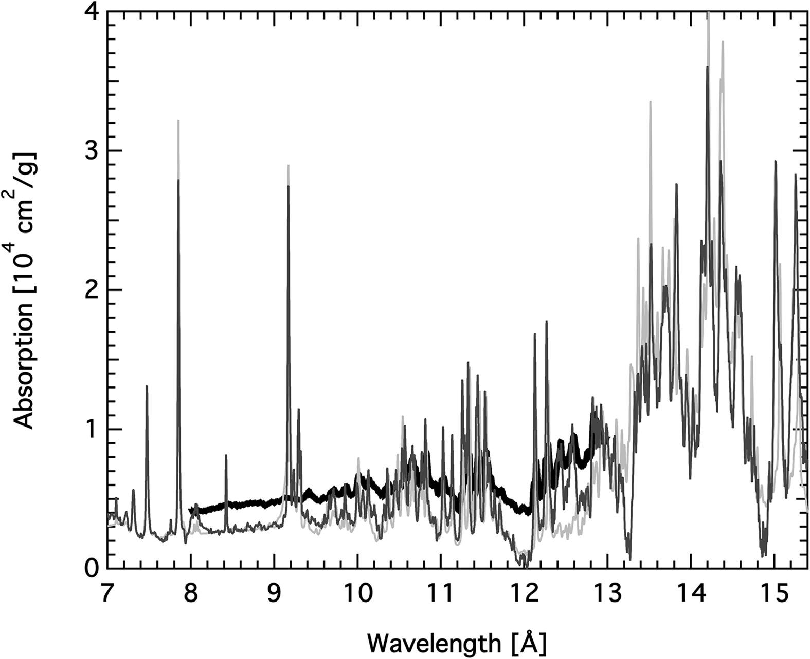
Background — Iron Opacity Z Measurement
Thin: T_{e} = 1.8x10⁶K,
N_{e} = 6.9x10²¹cm⁻³
Thick: T_{e} = 2.11x10⁶K,
N_{e} = 3.1x10²²cm⁻³
* Iglesias, C. 2015, HEDP, 15, 4

Slide 10
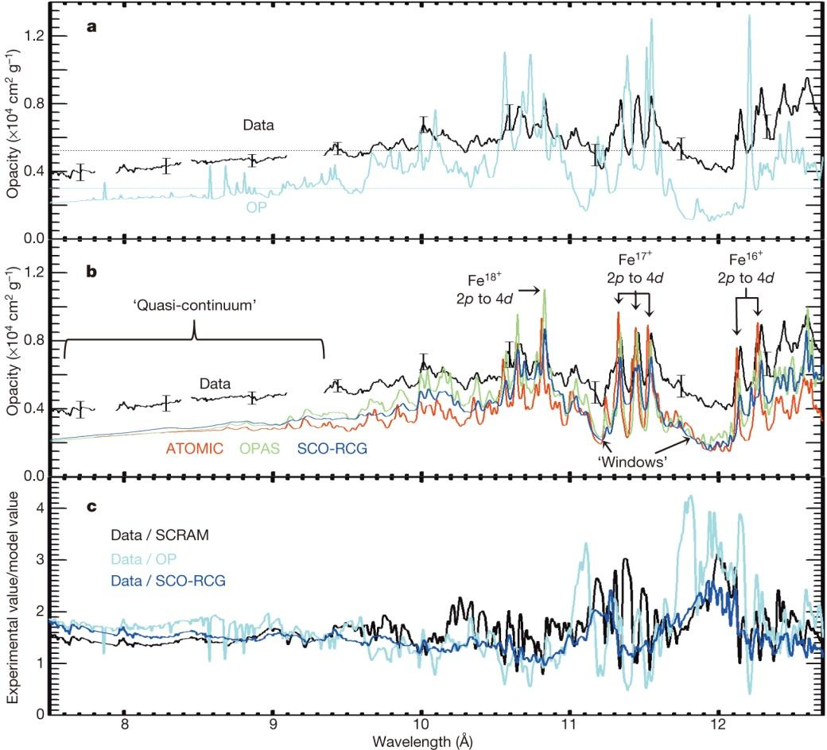
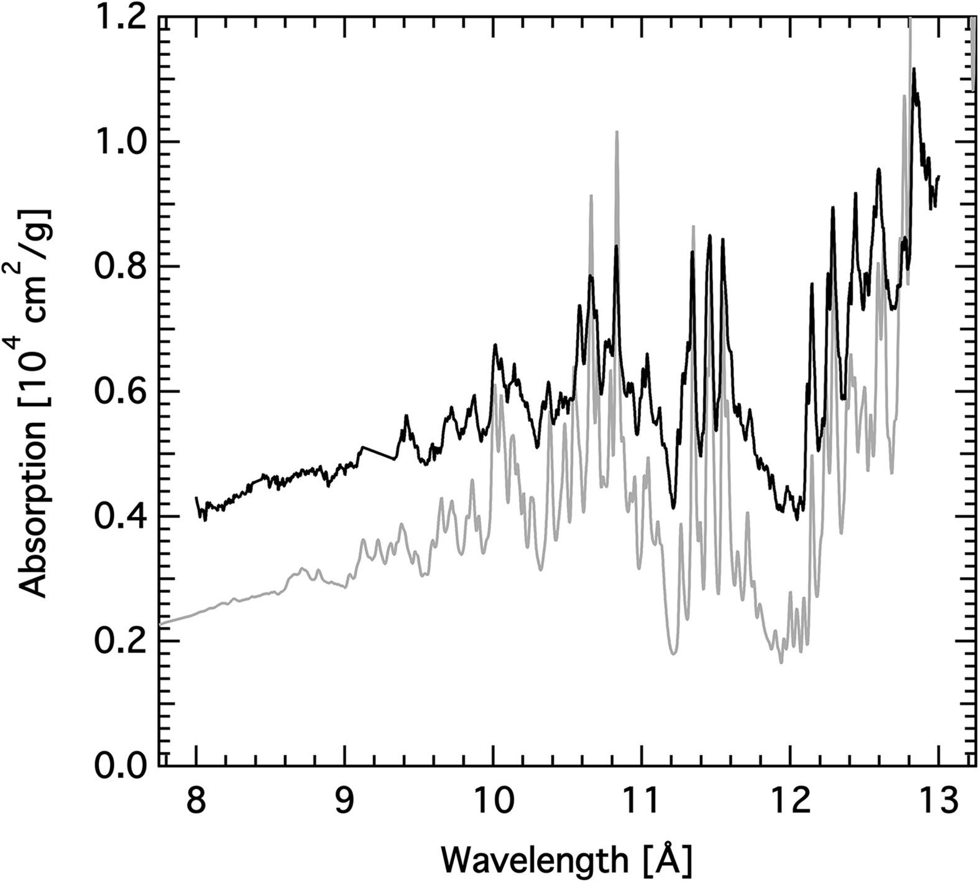
Background — Iron Opacity Z Measurement
TOPAZ
* Bailey, J., Nagayama, T., Loisel, G. P., et al. 2015, Nature, 517, 56
* Iglesias, C. 2015, HEDP, 15, 4

Slide 11
My research project
With the downward revision of solar metallicity, solar models require an increment of 10%-20% in theoretical Rosseland mean opacity
Z measurement of iron opacity reveals underestimated theoretical opacity values
Recalculate the atomic data of iron ions (Fe XVII, Fe XVIII, etc.)
High accuracy
Utilizing the state-of-the-art atomic code packages
Including more complete atomic transitions
Expecting a higher increment of opacity

Slide 12




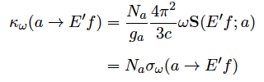
Atomic Calculation
— Bound-Bound & Bound-Free
Bound-Bound
Bound-Free

Slide 13







Atomic Calculation
— R-Matrix & Distorted Wave
Integro-differential equation

Slide 14



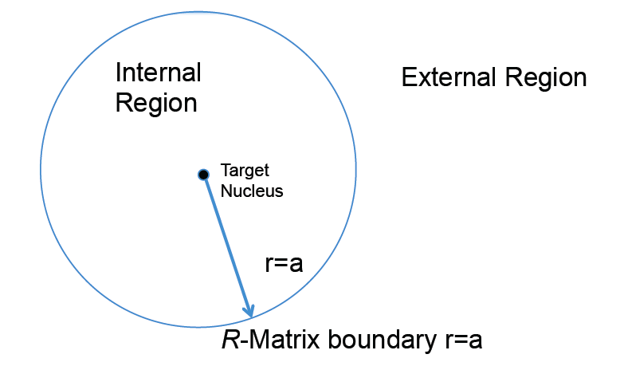
Atomic Calculation
— R-Matrix & Distorted Wave
R-Matrix Approach
Inner region: expand on a set of basis
Outer region: neglect exchange and correlation terms
Match at the R-Matrix boundary

Slide 15

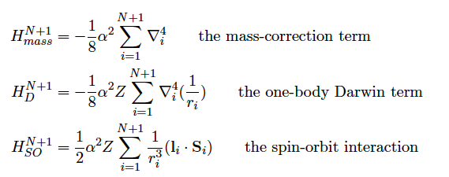
Atomic Calculation
— R-Matrix & Distorted Wave
Breit-Pauli R-Matrix

Slide 16


Atomic Calculation
— R-Matrix & Distorted Wave
Non-relativistic Distorted Wave
Neglect coupling, exchange and correlation potentials

Slide 17


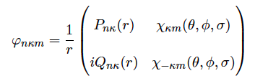

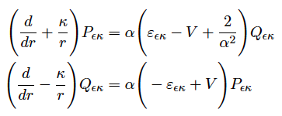
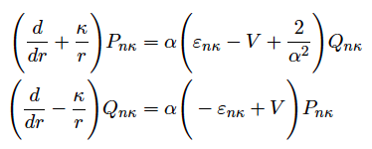
Atomic Calculation
— R-Matrix & Distorted Wave
Fully Relativistic Distorted Wave
Bound state:
Continuum state:

Slide 18
Atomic Calculation
— My Work
Carried out the large-scale BPRM calculation on Fe XVII & Fe XVIII
Werner Eissner, Sultana Nahar, Anil Pradhan, OSC, Arjuna, Unity, Jiaxin Wu, Keng Yuan Meng, Max Westphal, Xiankun Li, Yonas Getachew and Zhefu Yu
Complemented BPRM calculation with RDW (FAC)
Ming Feng Gu

Slide 19
Atomic Calculation
— My Work
N e⁻
(N+1) e⁻
E
0

Slide 20
Atomic Calculation
— My Work
N e⁻
(N+1) e⁻
E
Bound-Bound
0

Slide 21
Atomic Calculation
— My Work
N e⁻
(N+1) e⁻
E
Bound-Bound
Bound-Free
Direct Photoionization
0

Slide 22
Atomic Calculation
— My Work
N e⁻
(N+1) e⁻
E
Bound-Bound
Bound-Free
Direct Photoionization
Photoexcitation-Autoionization
0
(RDW does not treat autoionization process)

Slide 23
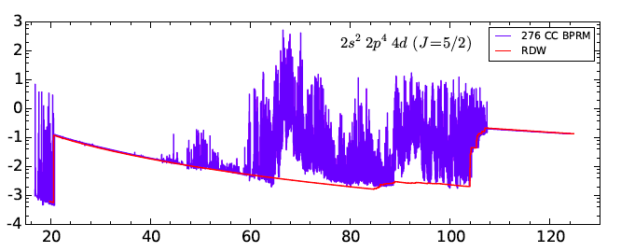

Atomic Calculation
— My Work
Resonances
Rydberg
Photo-Excitation-of-Core (PEC)

Slide 24
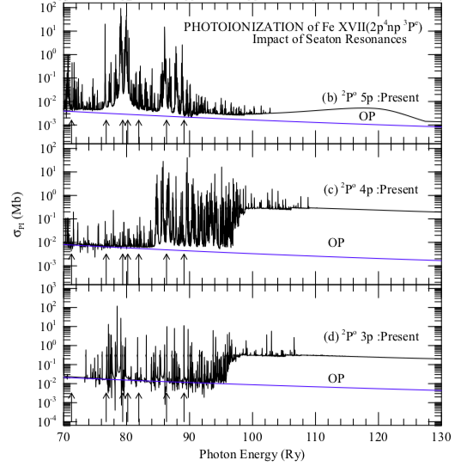
Atomic Calculation
— My Work
PEC-L Edge
* Nahar, S. N., & Pradhan, A. K. 2016a, Phys. Rev. Lett., 116, 235003

Slide 25
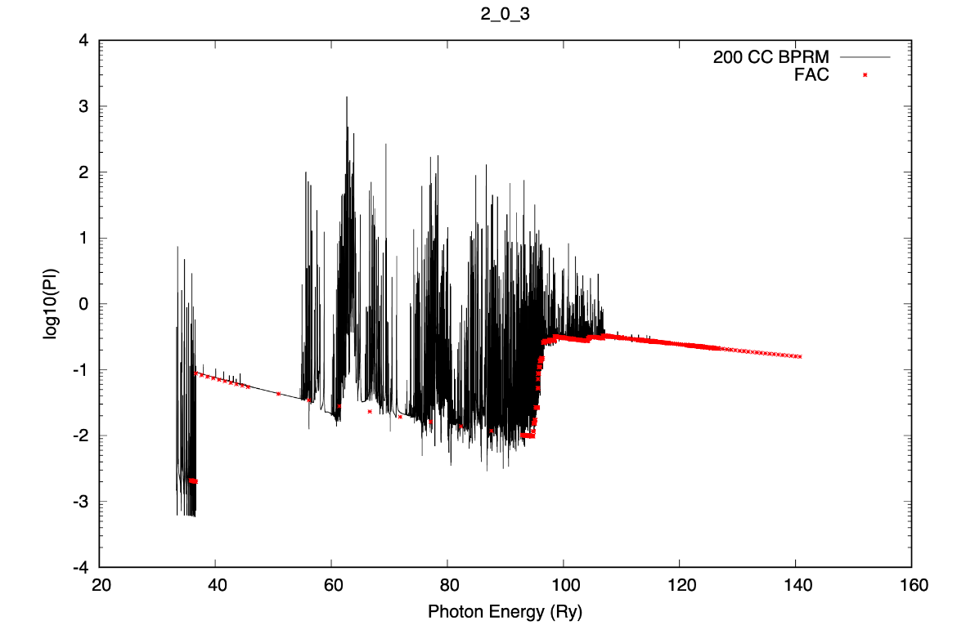
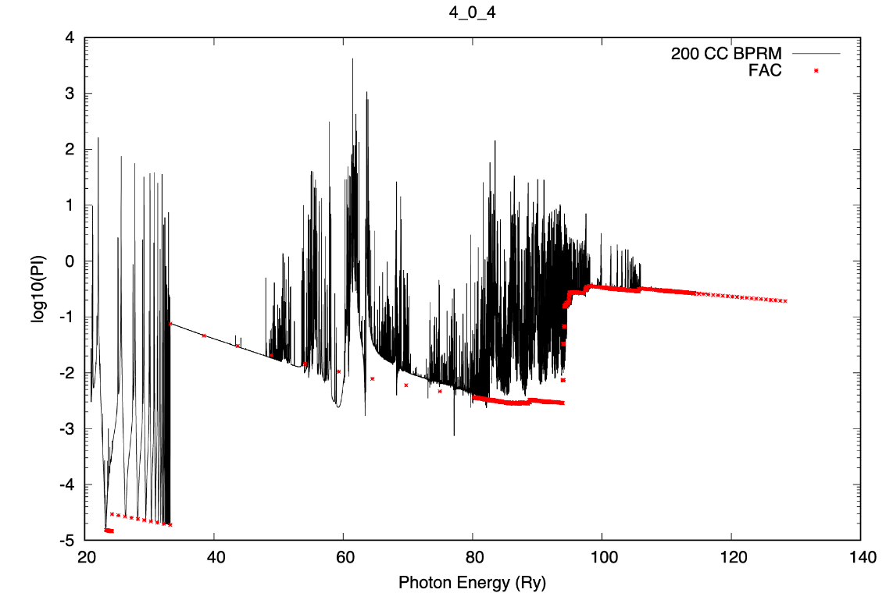
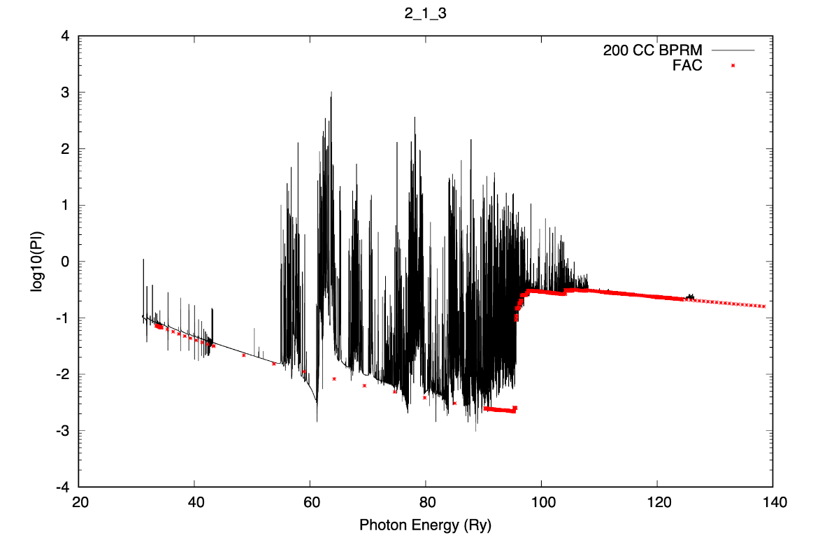
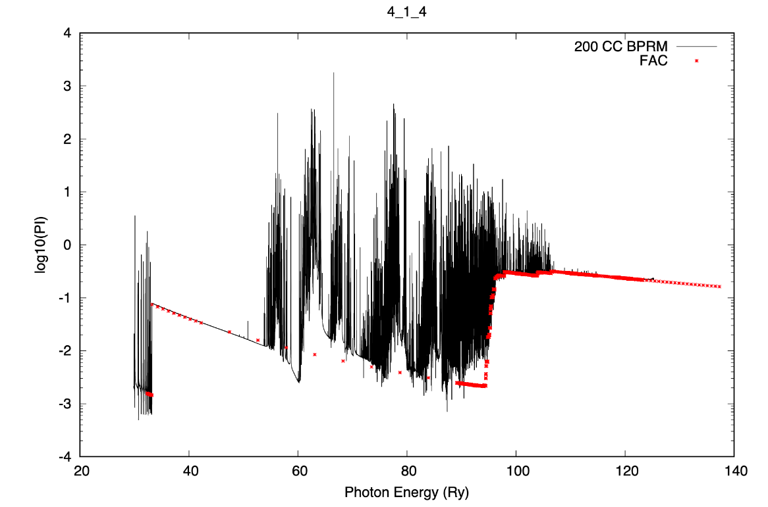
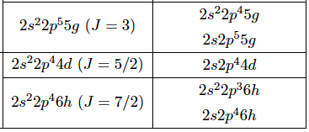
Atomic Calculation
— My Work
PEC-L Edge
The outermost electron acts like a spectator while one electron in the L-shell is ionized.

Slide 26
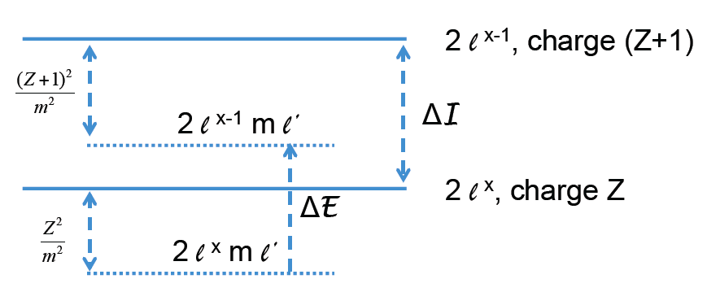
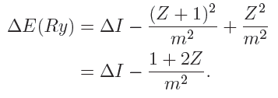
Atomic Calculation
— My Work
PEC-L Edge
PEC-L-Edge starts around the same photon energy
Fe XVII: 100 Ry
Fe XVIII: 106 Ry
Fe XIX: 114 Ry
Z = 17, 18, 19 for Fe XVII, Fe XVIII & Fe XIX

Slide 27
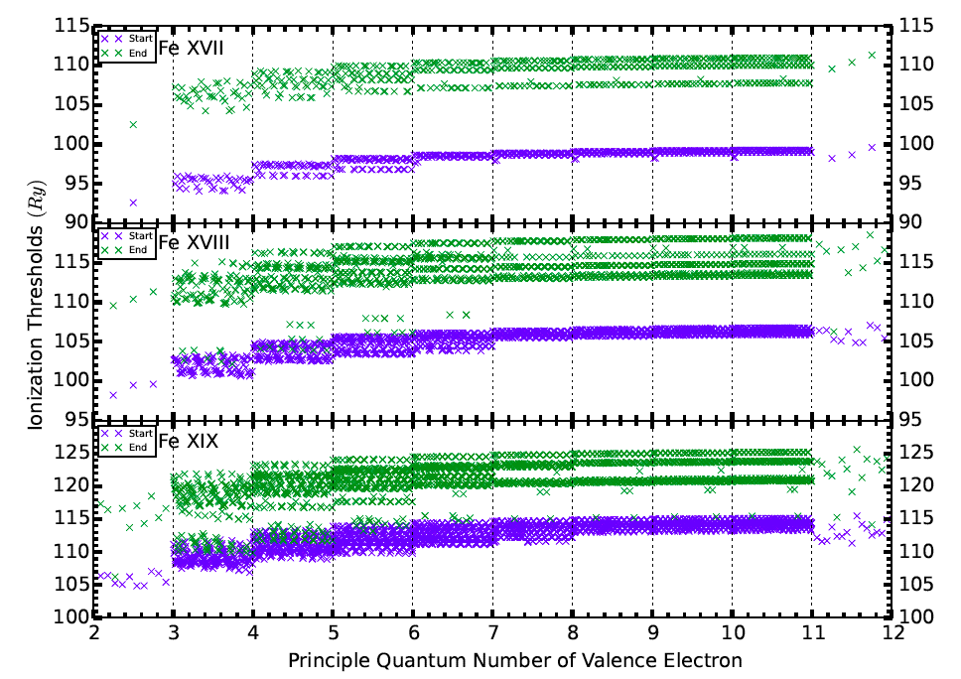
Atomic Calculation
— My Work
PEC-L Edge
PEC-L-Edge starts around the same photon energy
Fe XVII: 100 Ry
Fe XVIII: 106 Ry
Fe XIX: 114 Ry

Slide 28
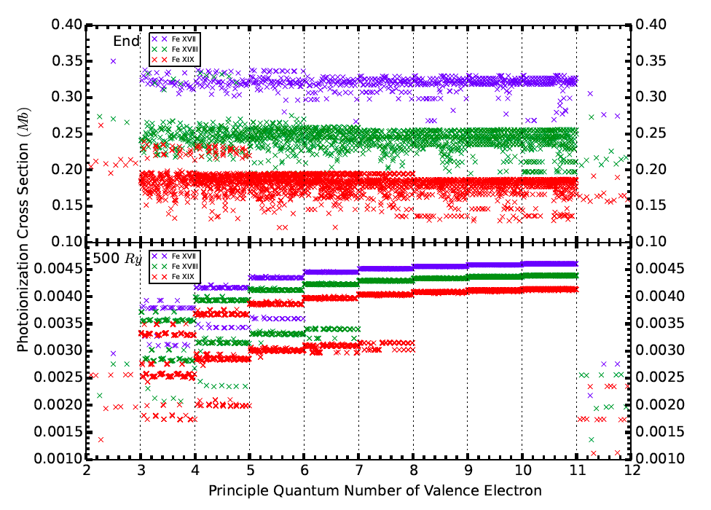
Atomic Calculation
— My Work
PEC-L Edge
The photoionization cross section is large and varies little from level to level.

Slide 29
Atomic Calculation
— My Work
PEC-L Edge

Slide 30
Atomic Calculation
— My Work
N e⁻ (n=10)
(N+1) e⁻
E
0
𝝂 ~ 10

Slide 31

Atomic Calculation
— My Work
N e⁻ (n=10)
(N+1) e⁻
E
Fe XVII
Fe XVIII
0
𝝂 ~ 10

Slide 32
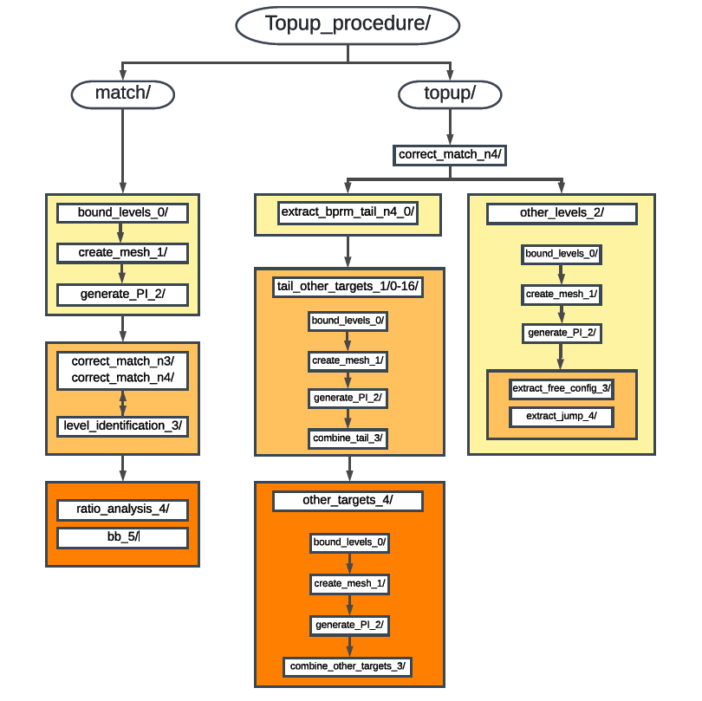
Atomic Calculation
— My Work

Slide 33
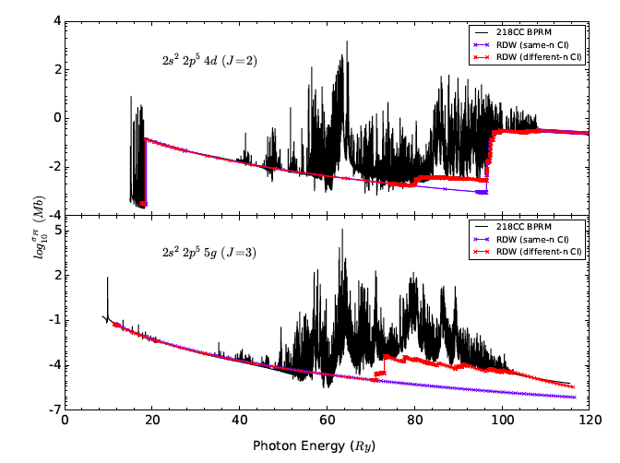
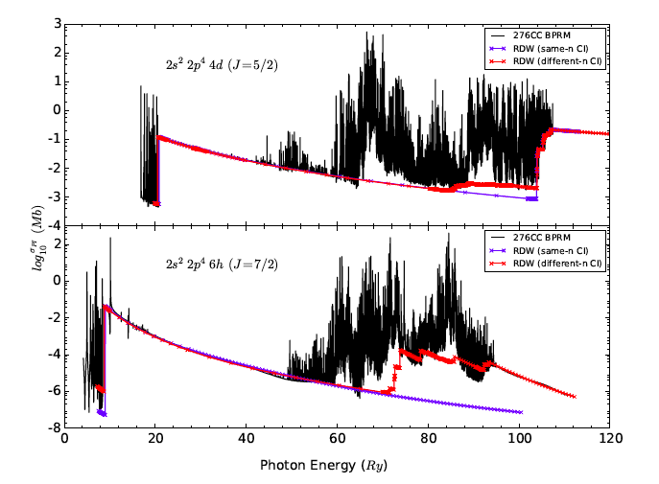
Atomic Calculation
— My Work
Match
Symmetry
Energy in ascending order
Compare the direct photoionization cross section

Slide 34
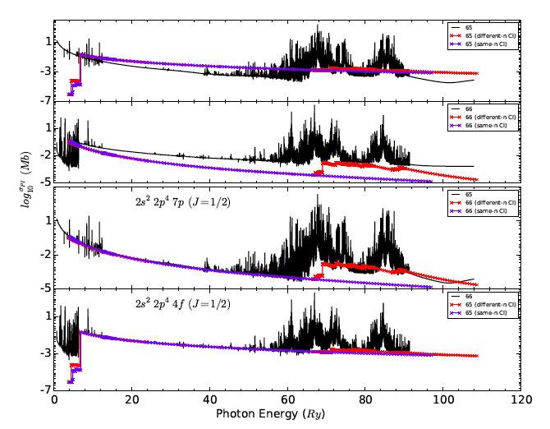
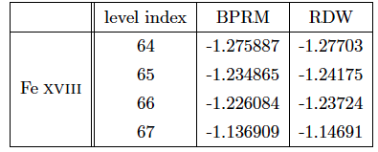
Atomic Calculation
— My Work
Match
Symmetry
Energy in ascending order
Compare the direct photoionization cross section

Slide 35
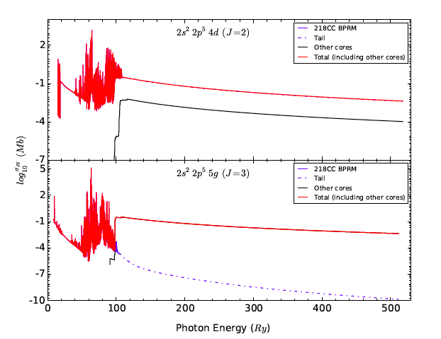
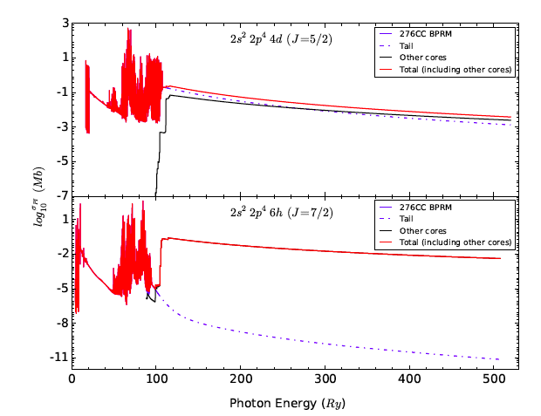
Atomic Calculation
— My Work
Topup — Bound - Free
Bound levels in BPRM
Tail
Other core configurations

Slide 36
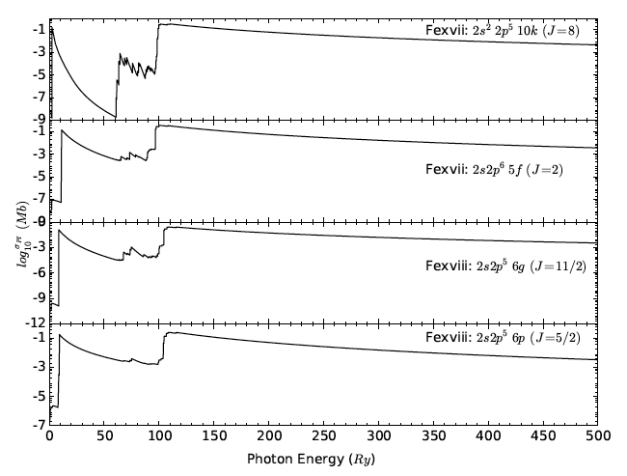
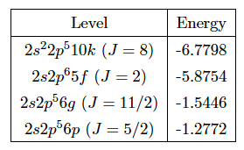
Atomic Calculation
— My Work
Topup — Bound - Free
Other levels

Slide 37
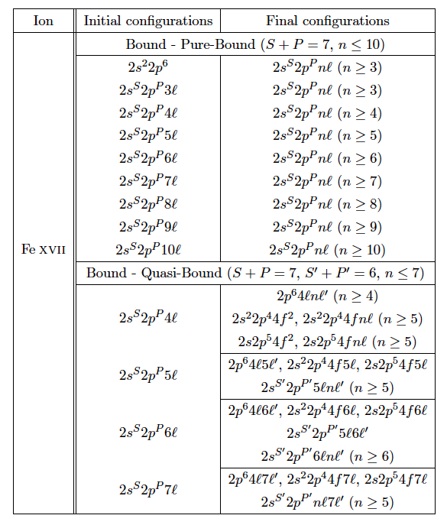
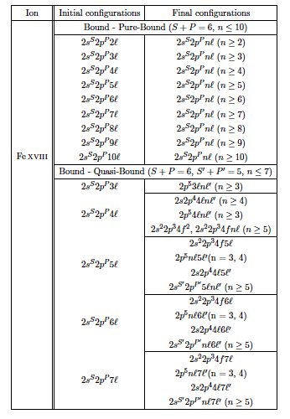
Atomic Calculation
— My Work
Topup — Bound - Bound
Bound - Pure-Bound
Bound - Quasi-Bound

Slide 38
Q & A

