Slide 1
Improving Polling Accuracy in US Presidential Elections
A machine learning approach to developing likely voter models

Slide 2
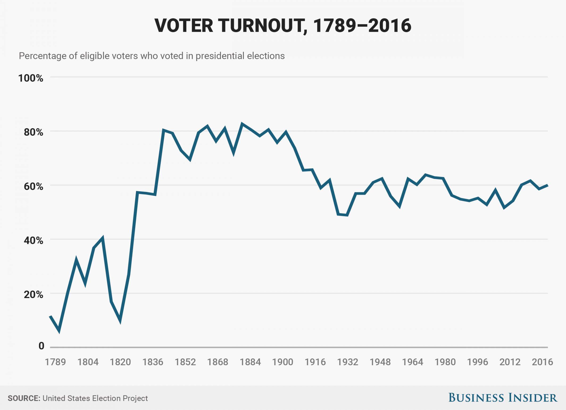
Why do we care?
For the past two decades, less than 60% of eligible voters participated in presidential elections
Difficulty of determining who will vote is a primary factor in polling inaccuracy

Slide 3
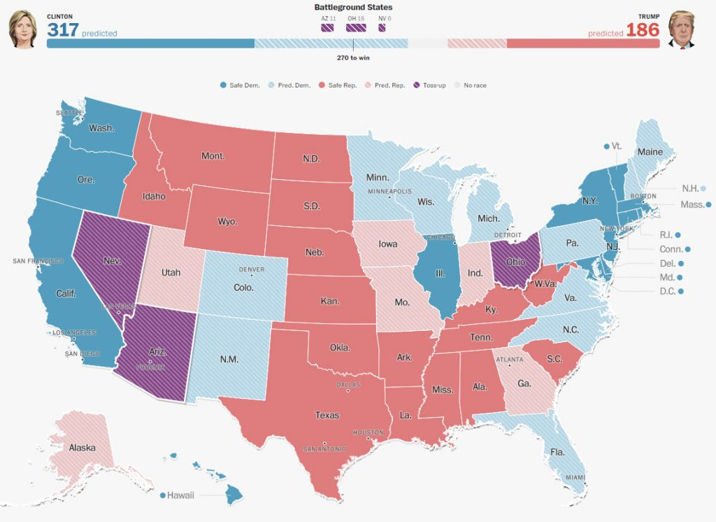
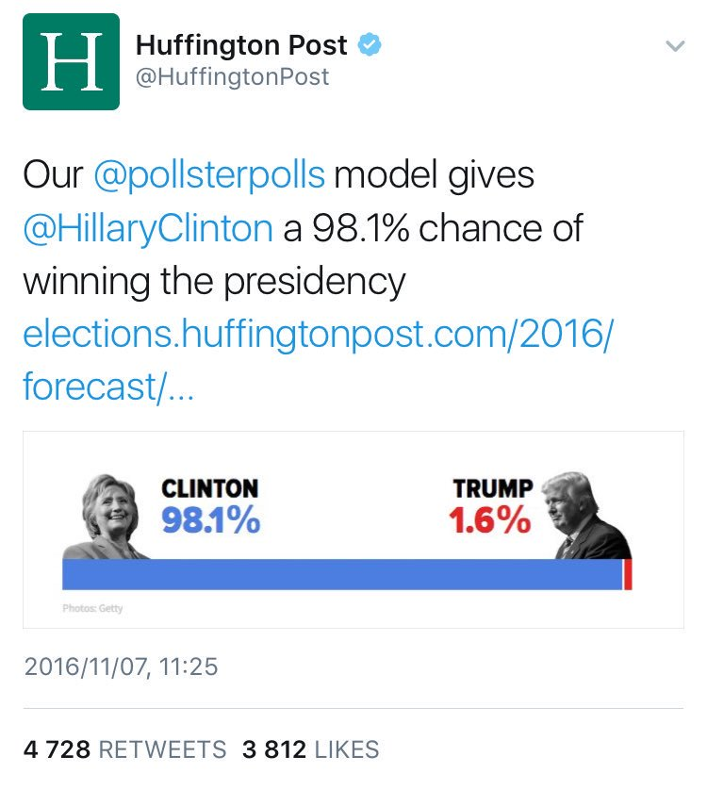
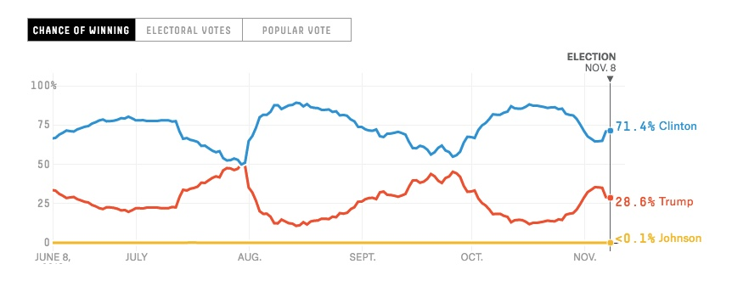
Garbage In, Garbage Out

Slide 4
American National Election Studies
ANES is a research organization specializing in time series studies of voting, public opinion, and political participation
Cumulative time series data
50000+ respondents, 900+ features
Each respondent interviewed prior to election as well as after
All pre and post-election interviews from 1948 to 2012

Slide 5
For This Project
Two goals:
Find best classification model for separating voters from non-voters
Determine change in polling error
Interested in recent elections
Data from 2000 to 2012
9,374 respondents and 263 features

Slide 6
Project Flow

Slide 7
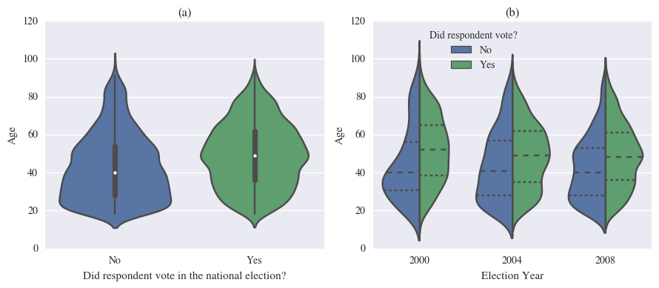
Non-Voters Skew Younger

Slide 8
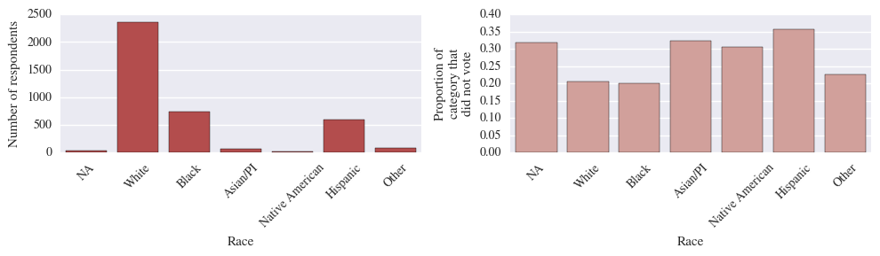
Non-Voter Proportions by Ethnicity
Whites and blacks have highest vote participation rates
Hispanics have the lowest despite being third largest racial group

Slide 9
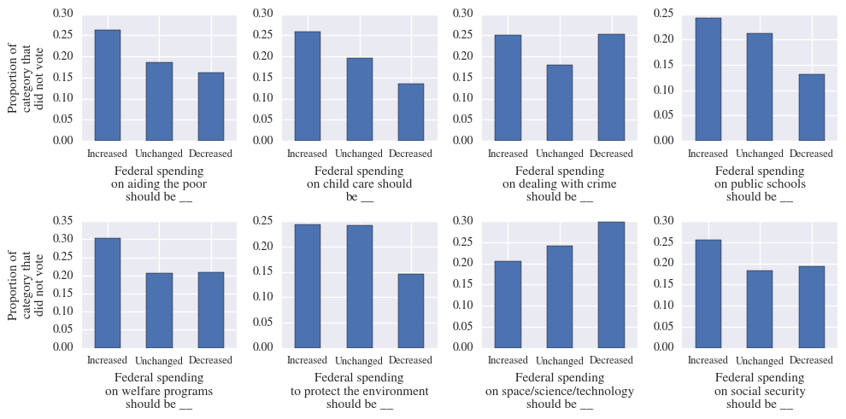
Non-voting hurts Democratic policies

Slide 10
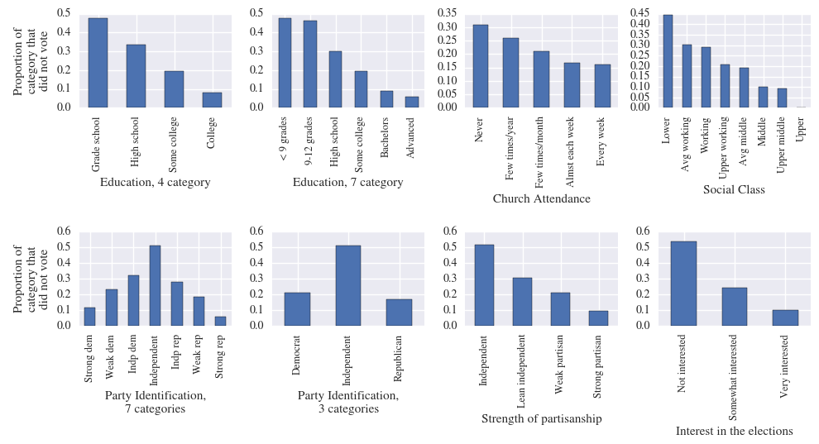
More Patterns

Slide 11
Non-Voters and Political Knowledge
ANES time series survey includes a battery of questions testing political knowledge
Do wrong or “don’t know” responses indicate a greater likelihood of being a non-voter?

Slide 12
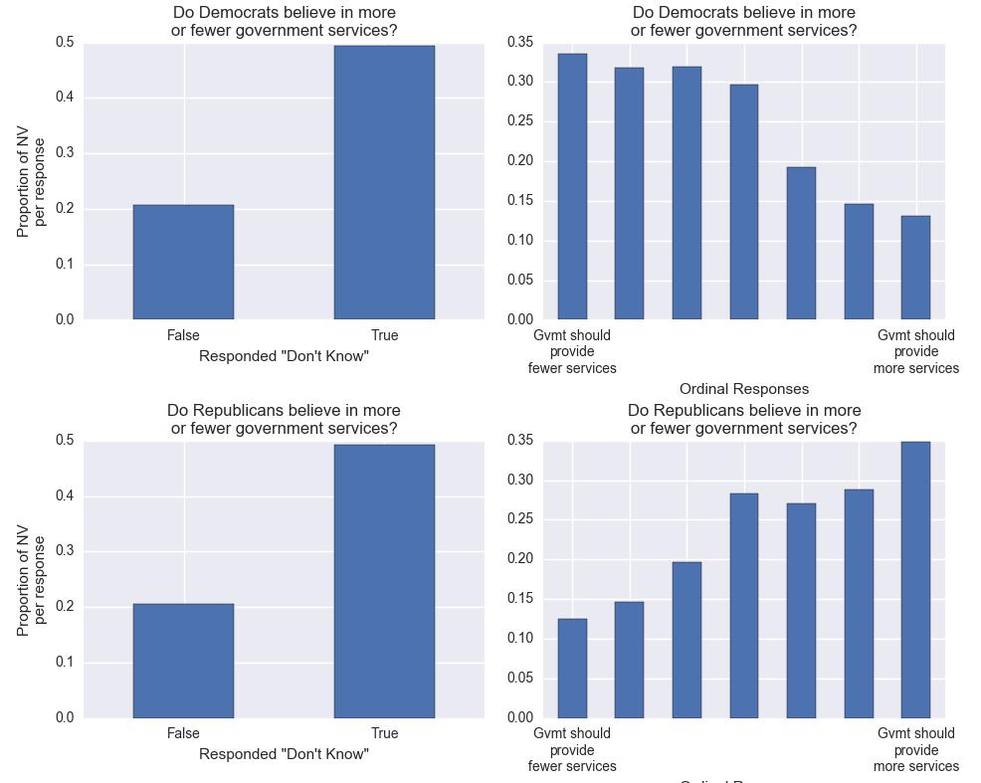
Example

Slide 13
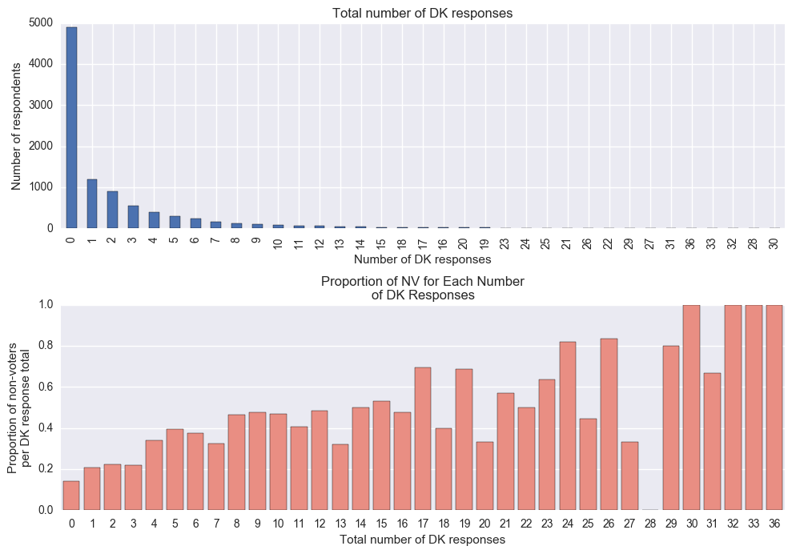
More “Don’t Know” Responses = Probably a Non-Voter

Slide 14
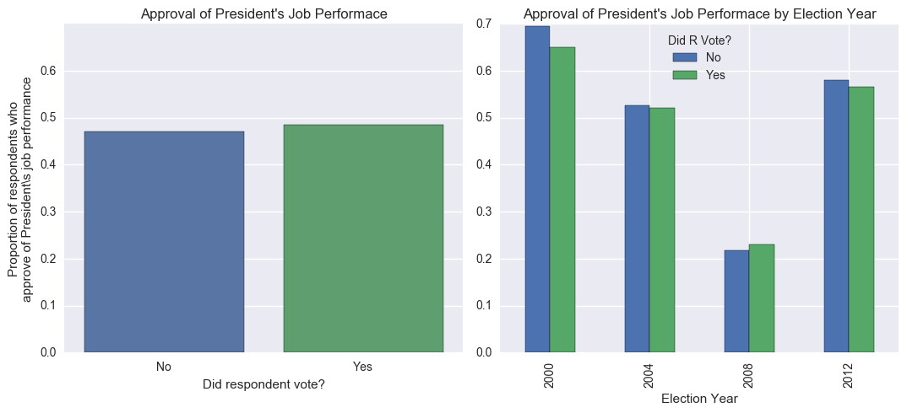
President’s Job Performance Equal Across Voters and Non-Voters

Slide 15
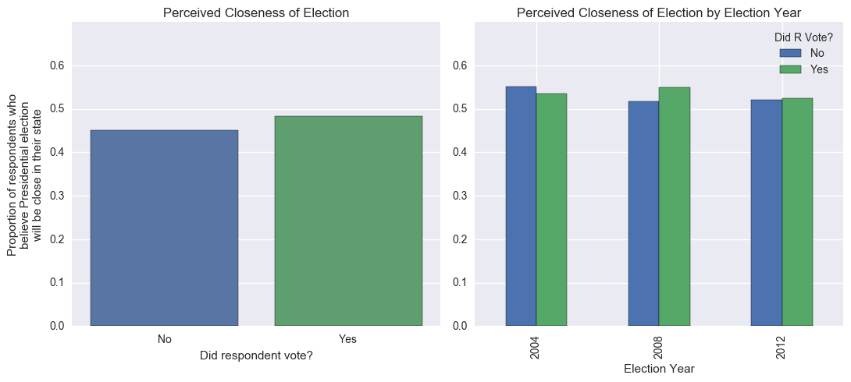
Closeness of Elections Do Not Matter

Slide 16
Non-Voters Are
Younger | More apathetic | More Hispanic | More pro-government | More culturally conservative
Less educated | Less religious | Less engaged | Less partisan | Less wealthy

Slide 17
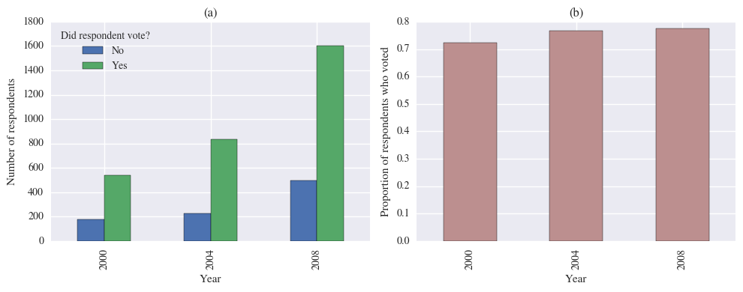
Problem: Unbalanced Data
Solution: evaluate models using F1-score rather than accuracy

Slide 18
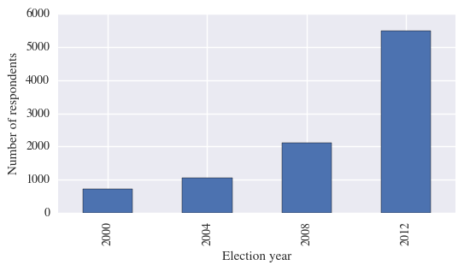
Problem: Unbalanced Data
Varying amounts of data available for training on different target years
Solution: automate feature selection with recursive feature elimination

Slide 19
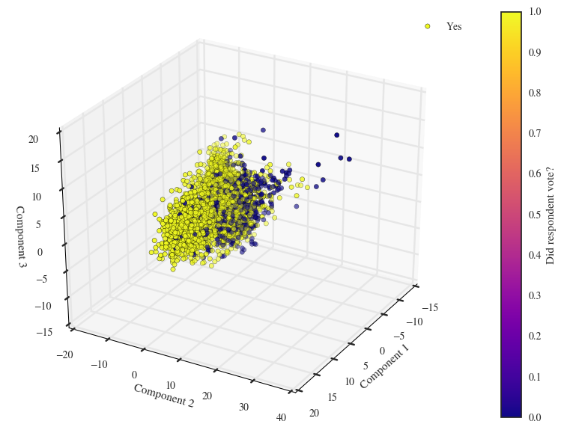
Mixed Signals
Principal component analysis

Slide 20
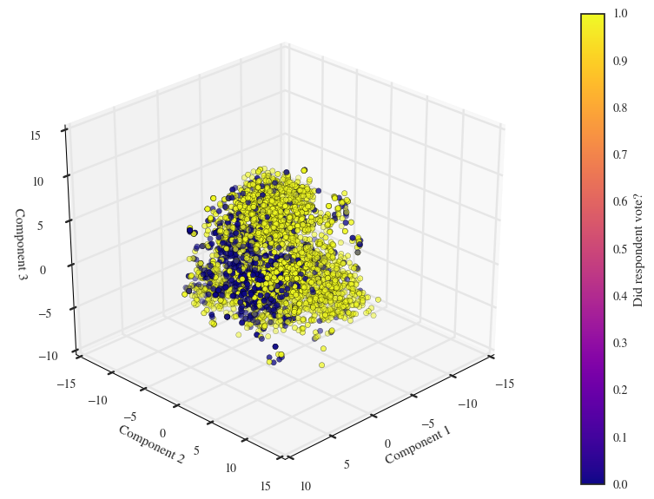
Mixed Signals
t-Distributed Stochastic Neighbor Embedding

Slide 21
Training and Testing Models
 | Target year of test set
 | 2004 |  |  | 2008 |  |  | 2012
 | F1 | Prec. | Rec. | F1 | Prec. | Rec. | F1 | Prec. | Rec.
Logistic Regression | 0.612 | 0.604 | 0.620 | 0.614 | 0.531 | 0.727 | 0.595 | 0.606 | 0.585
Adaptive Boosting | 0.611 | 0.694 | 0.546 | 0.617 | 0.522 | 0.699 | 0.584 | 0.532 | 0.565
Bernoulli Naïve Bayes | 0.636 | 0.647 | 0.624 | 0.618 | 0.525 | 0.749 | 0.538 | 0.655 | 0.456
Support Vector Machine | 0.659 | 0.703 | 0.620 | 0.618 | 0.518 | 0.764 | 0.542 | 0.448 | 0.687
Cross-validated training scores between 0.7 to 0.75
No individual model appears to consistently outperform all others

Slide 22
Soft Voting Classifier
 | Target year
 | 2004 | 2008 | 2012
Training F1 | 0.726 | 0.765 | 0.784
Test F1 | 0.619 | 0.647 | 0.611
Leverages the strength of each individual model
Outputs prediction based on weighted averages of each model’s classification probability
Improves test F1-score for 2008 and 2012

Slide 23
Problem: Social Desirability Bias
Self-reported vote participation is un-reliable
Many respondents claimed to have voted despite not voting

Slide 24
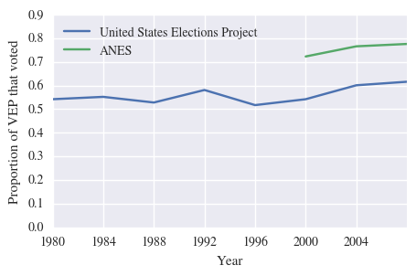
Problem: Social Desirability Bias
Ground truth is unreliable
Solution: require recall above threshold

Slide 25
Dealing with Unreliable Respondents
Rig models to aggressively identify non-voters
False positives preferred to false negatives
After training a model, find lowest classification threshold that gives recall > 0.8
Adjust threshold on test set classification

Slide 26
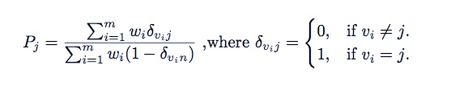

Calculating Polling Results
Without non-voter filter:
With non-voter filter:
Where P_{j} is the proportion of voting respondents who supported candidate j, w_{i} and v_{i} in {n, 1, 2, 3} are the sampling weights and vote intentions of the i^{th} respondent, n in v denotes the intention of the respondent not to vote, and z_{i} in {0,1} denotes the prediction as to whether the i^{th} respondent voted.

Slide 27
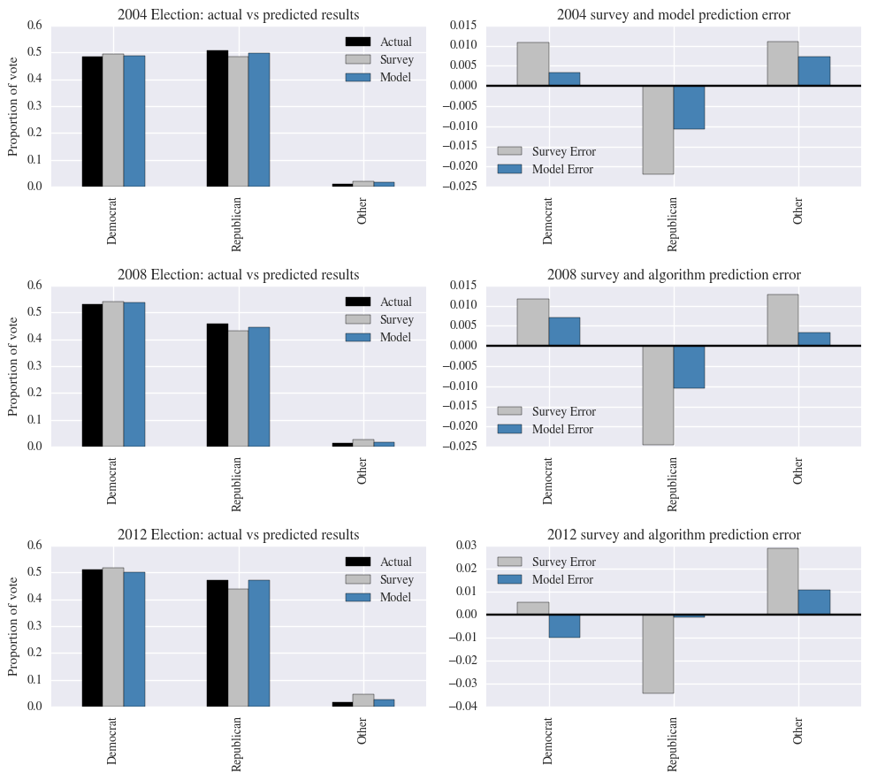

Slide 28
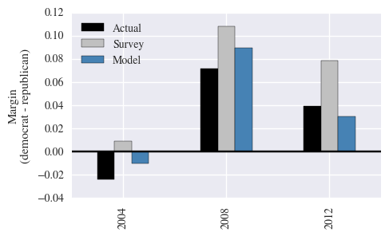
Using a Filter Improves Predicted Margins

Slide 29
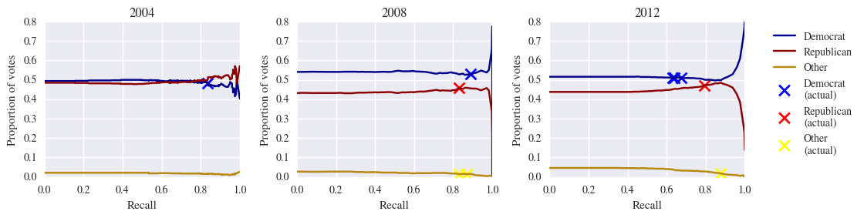
Recall Analysis
A recall of 0 is equivalent to not using the non-voting filter
0.8 appears to be a good recall requirement, but other values within 0.6-0.9 would also adjust polls in correct direction

Slide 30
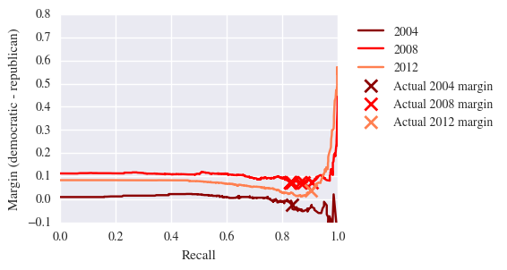
Recall Analysis
Vote margin predictions are also robust against different recall requirements

Slide 31
Conclusion
A soft voting classifier appears to perform best for classifying voters and non-voters from a survey
Using soft voting classifiers to serve as a non-voting filter improves the accuracy of national polls
Machine learning may be a viable model for developing likely voter models

Slide 32
Further Study
Compare performance of machine-learning based models against current heuristic models (i.e. Perry-Gallup Index)
Apply the same technique to recently released 2016 ANES data
Explore whether this method works on data for which ground truth is reliable (i.e. extending data with state voter registries)
Perform similar studies for state and local level polling

Slide 33
A Detour: Partisanship in America
How divided are we?

Slide 34
Thermometer features
ANES surveys contain a set of “thermometer” questions
Measure negative/positive sentiment
Response is an integer value
0 = negative sentiment
100 = positive sentiment
Remaining analyses incorporates sampling weights for population inference

Slide 35
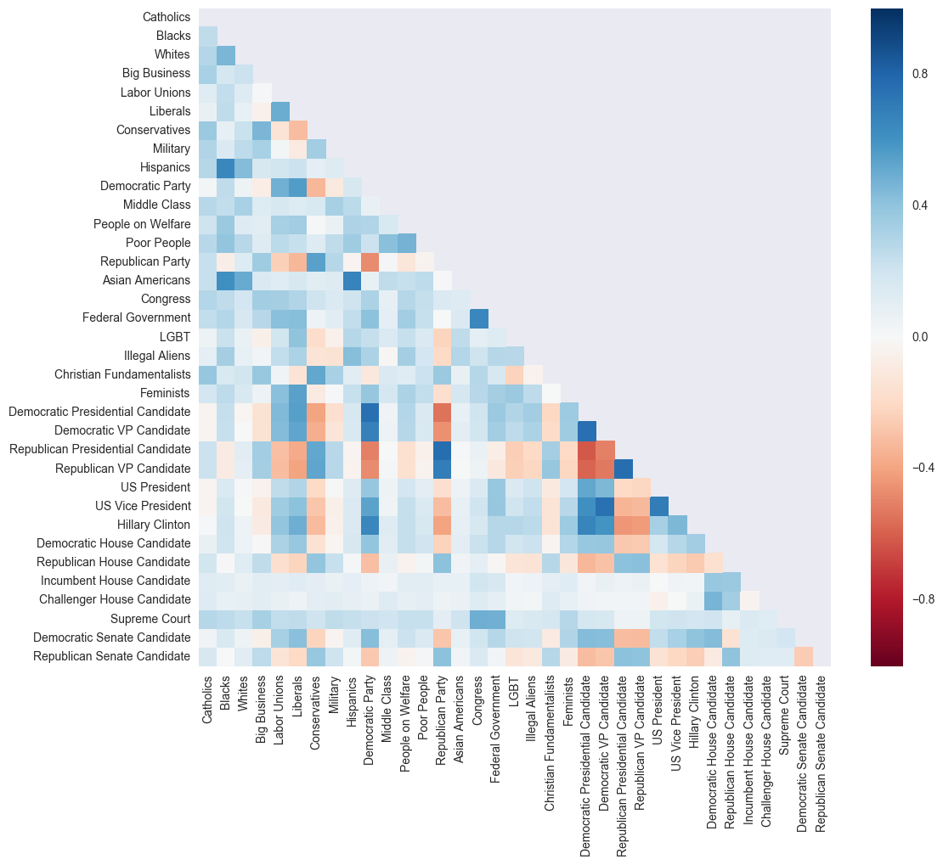
Correlation Matrix

Slide 36
Identity vs. Ideology
Thermometer Pair | Correlation Coefficient
Democratic vs. Republican Presidential Candidate | -0.61752
Democratic vs. Republican VP Candidate | -0.530565
Democratic vs. Republican Party | -0.469287
Liberals vs. Conservatives | -0.306816
Democratic vs. Republican Senate Candidate | -0.254292
LGBT vs. Christian Fundamentalists | -0.230465
Democratic vs. Republican House Candidate | -0.159287
Big Business vs. Labor Unions | 0.015196
Expected anti-correlated pairs only moderately correlated at best
Correlation weaker for parties and weaker still for ideology
Down ballot races far less divisive
Temporary polarization
Politics is tribalism, not ideology

