Slide 1
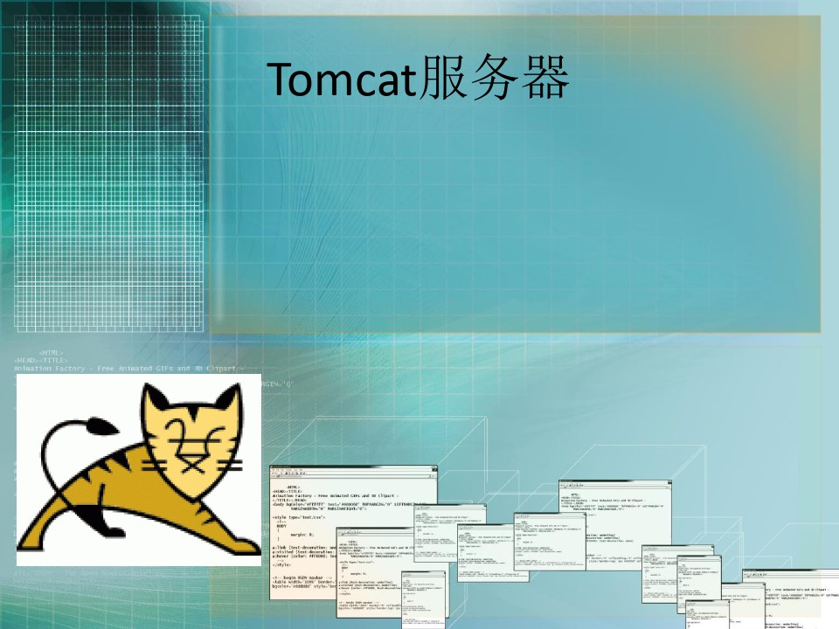

Slide 2


Slide 3
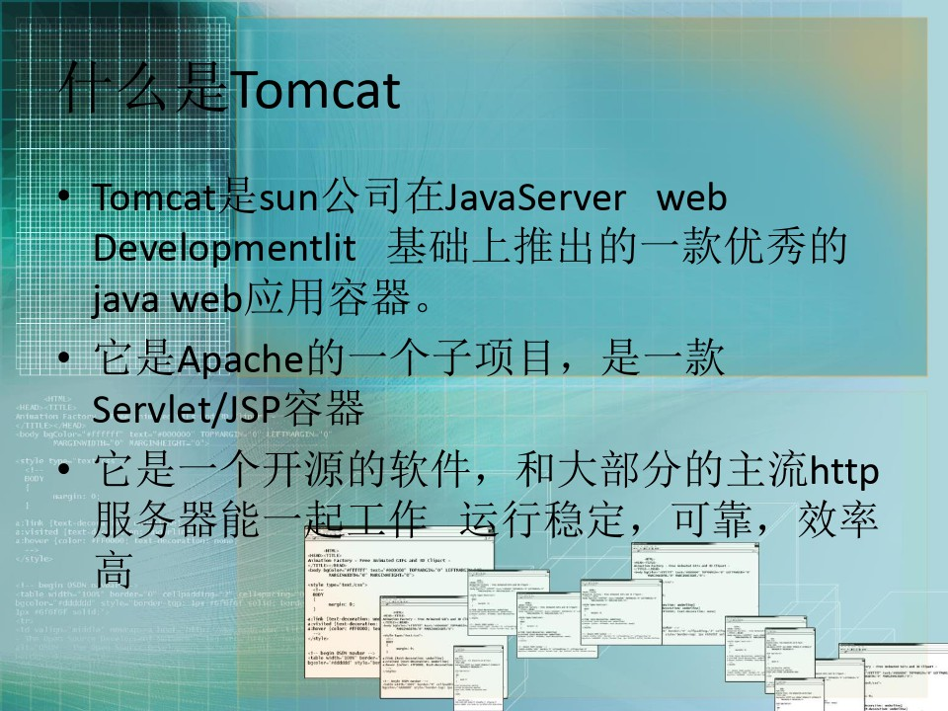

Slide 5
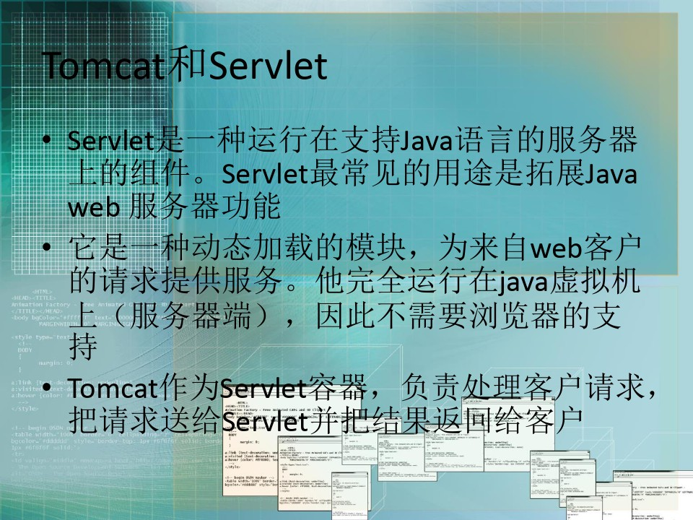

Slide 6
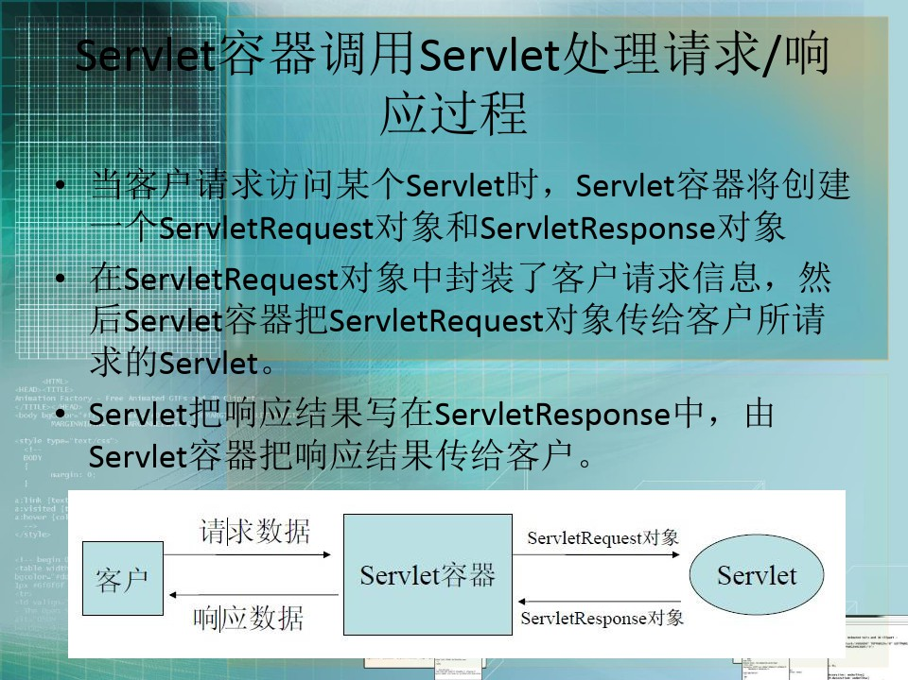

Slide 7
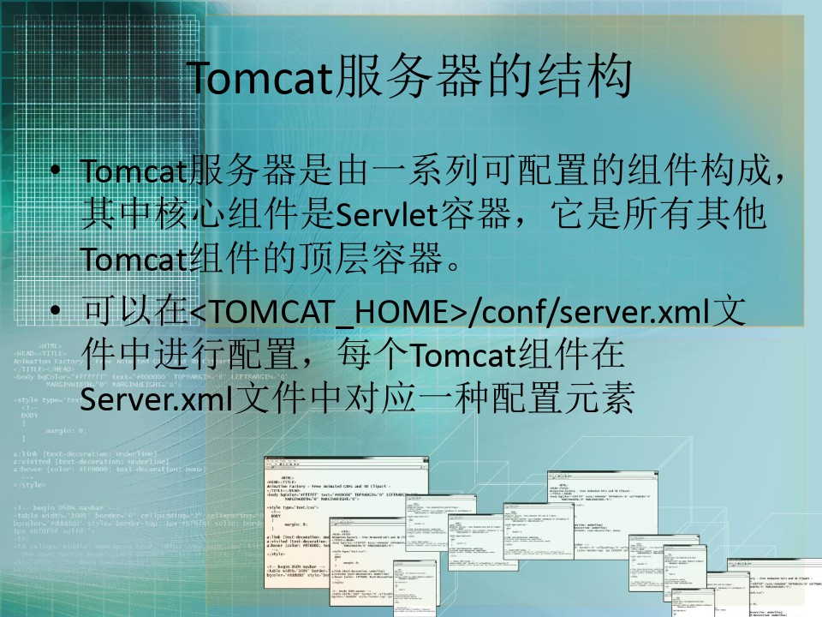

Slide 8
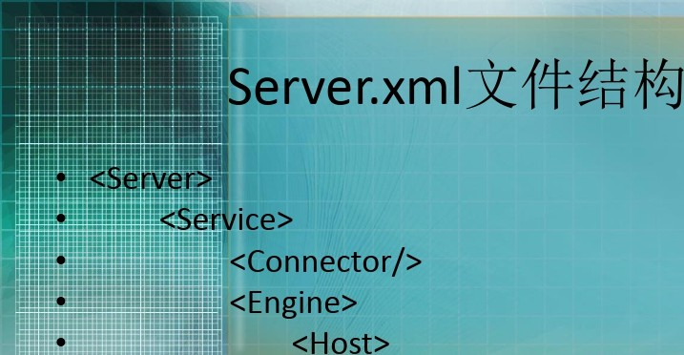


•
•
•
<Context></Context>
</Host>
</Engine>

Slide 9
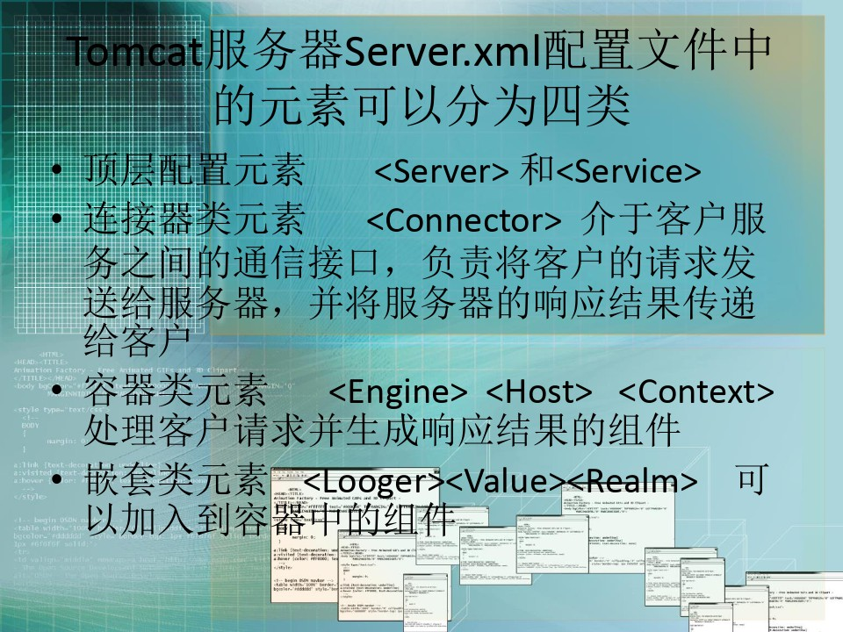

Slide 10
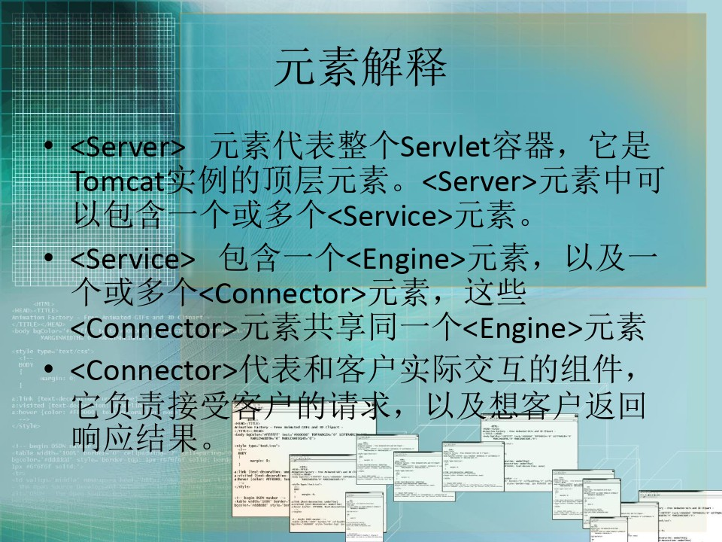

Slide 11
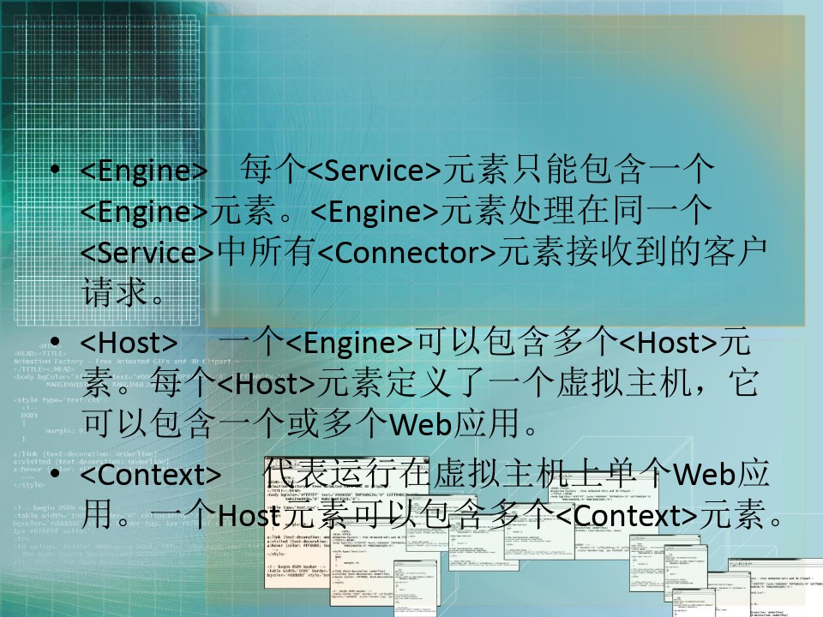

Slide 12
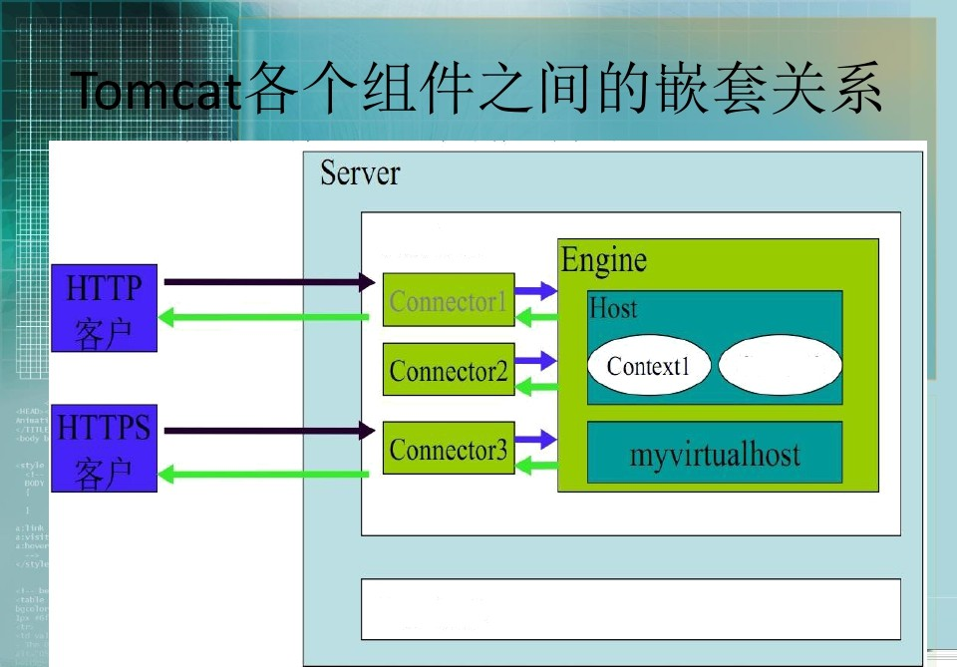



Service l
ŃC11CCŽ

Slide 13
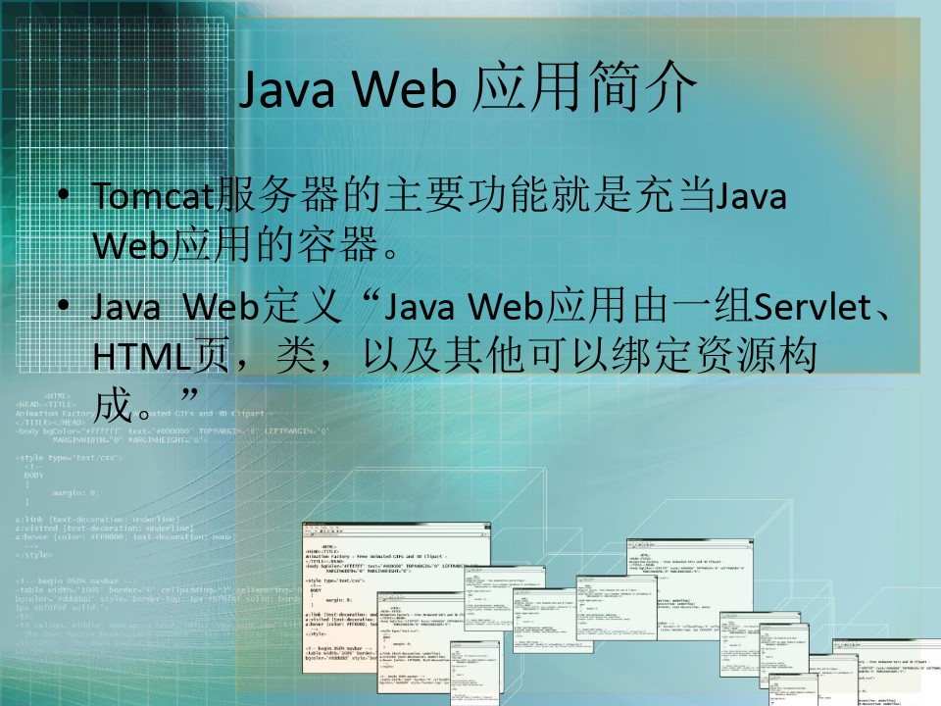

Slide 14
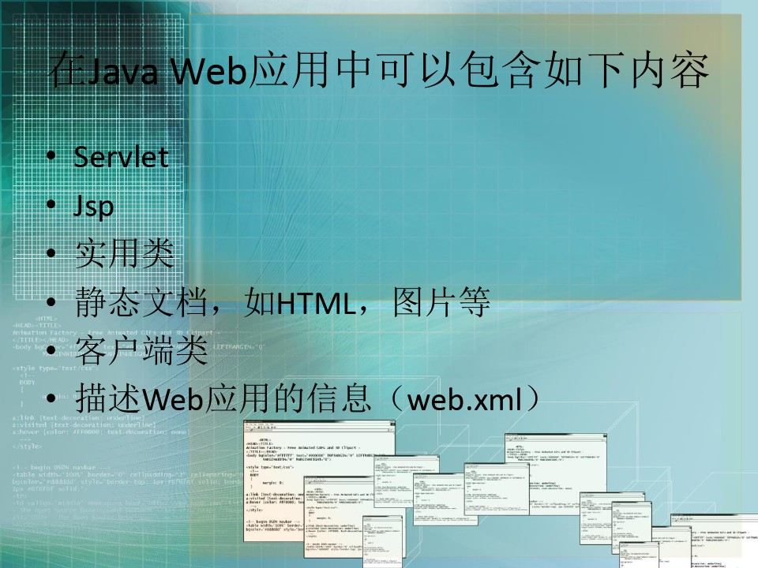

Slide 15
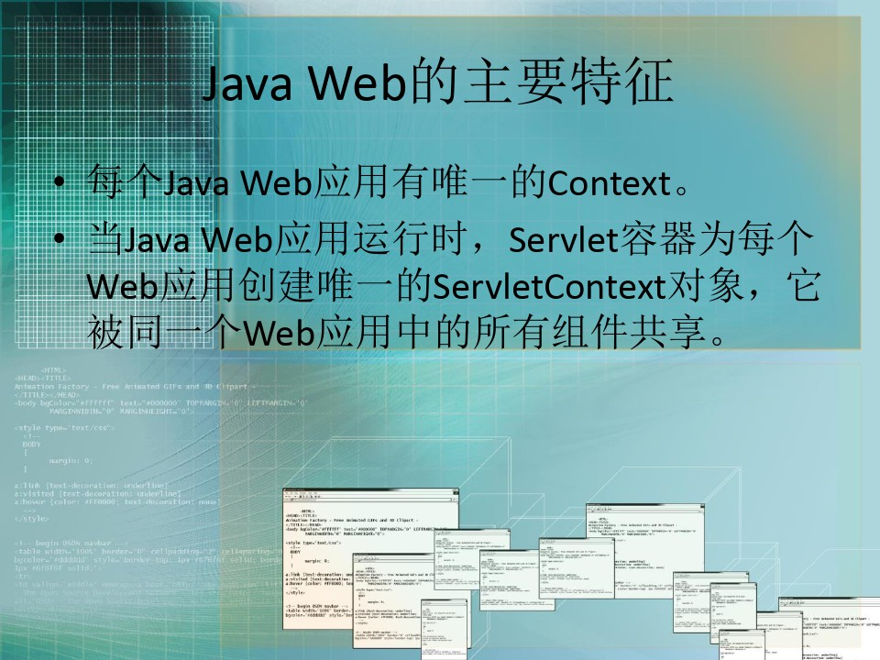

Slide 16
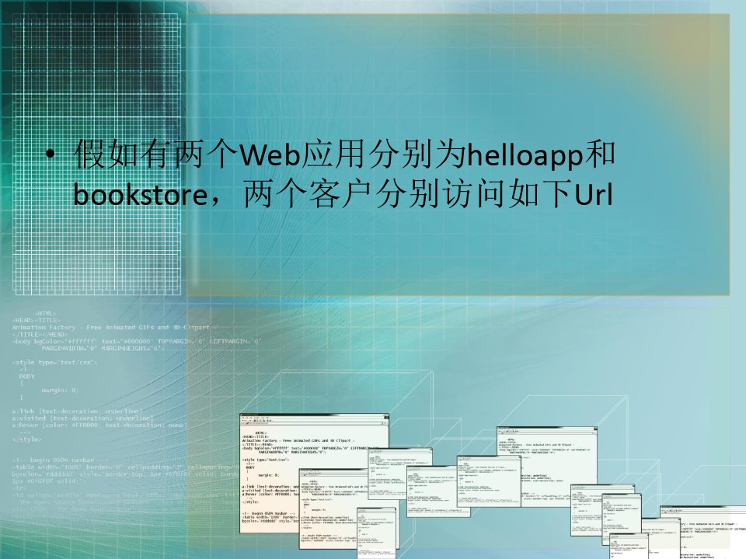

Slide 17
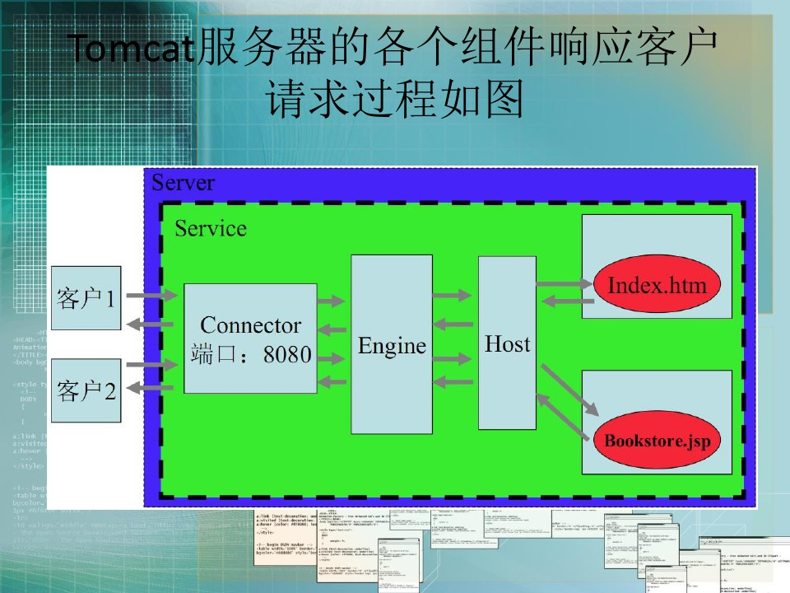

Slide 18
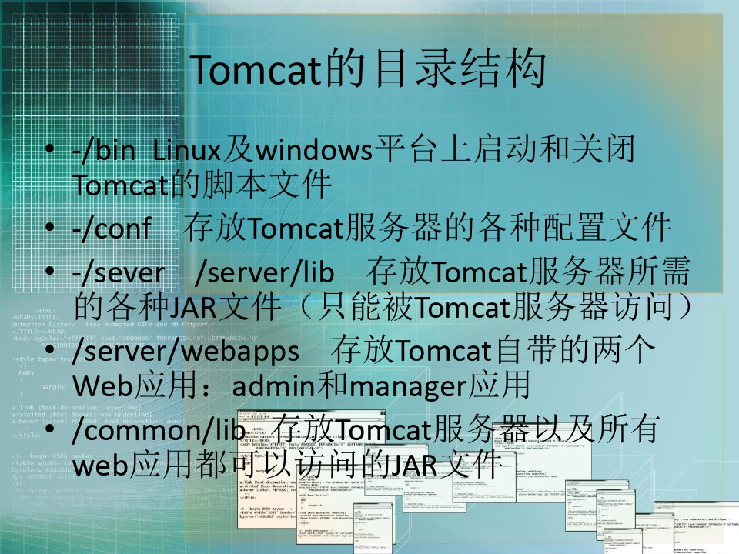

Slide 19
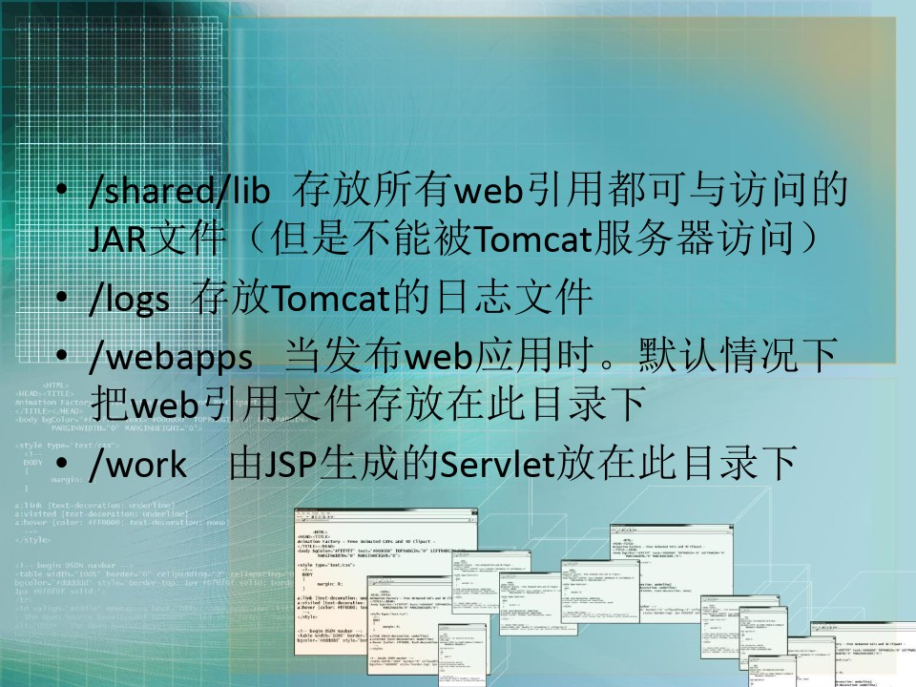

Slide 20
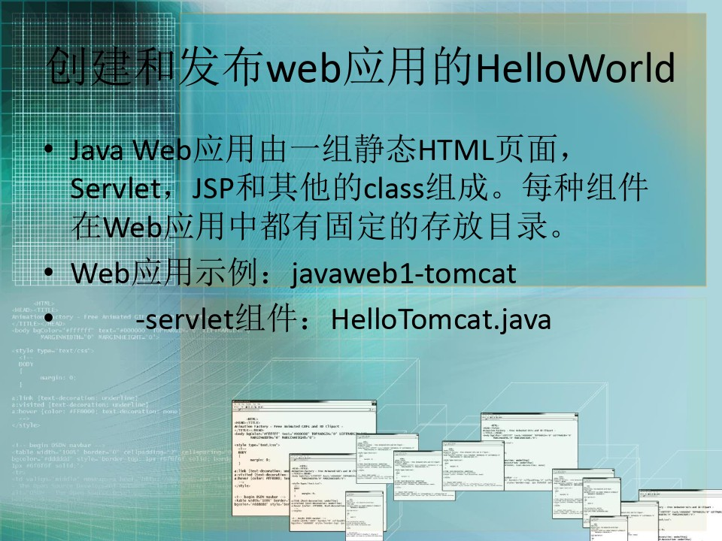

Slide 21
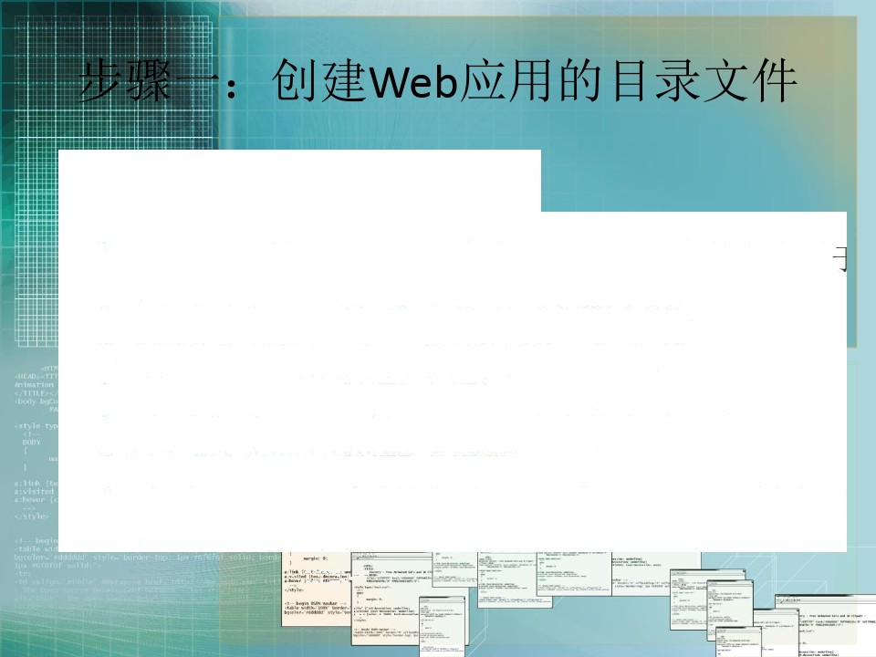
— /javaweb1-tomcat:
«TOMCAT H0ME>/webapps ü f tjb‘y üÄt1.
Web @ IiJ@ Ej Üt, /Ji??ß’jJsp1üHTMLÄ{'t $5J'/y§
/javaweb1-tomcat/WEB-INF( E| 2‘<if*J1):
  1’?ü/tWeb/Y@ ü'JÄ/f/Gi1xf'?web.xml
/javaweb1-tomcat/WEB-INF/classes:
  J'?fi/tD@cIass tf'1=, Servlet% t{']=Ak fiJtYLli E| o‹ T
/javaweb1-tomcat/WEB-INF/lib:
  ??//éWeb/‹'a@/??tüBJ&T?JARQf^t o éJ§ü. ‹?\?d“ B Üt T, ”öIiüJ'?fi§JDBCSX?$féJy›I1äJAR?tf't.

Slide 22
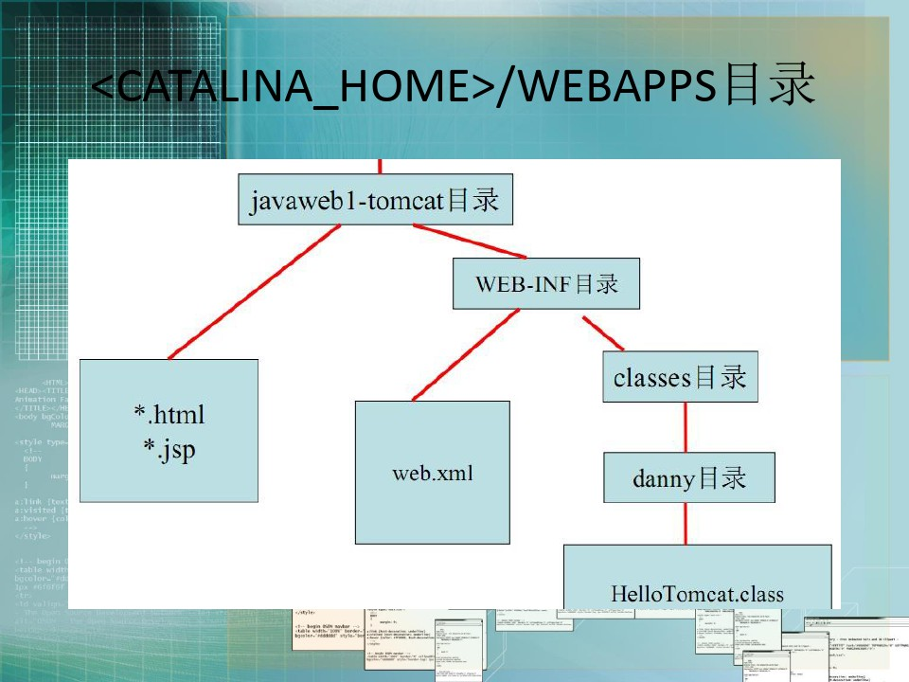

Slide 23
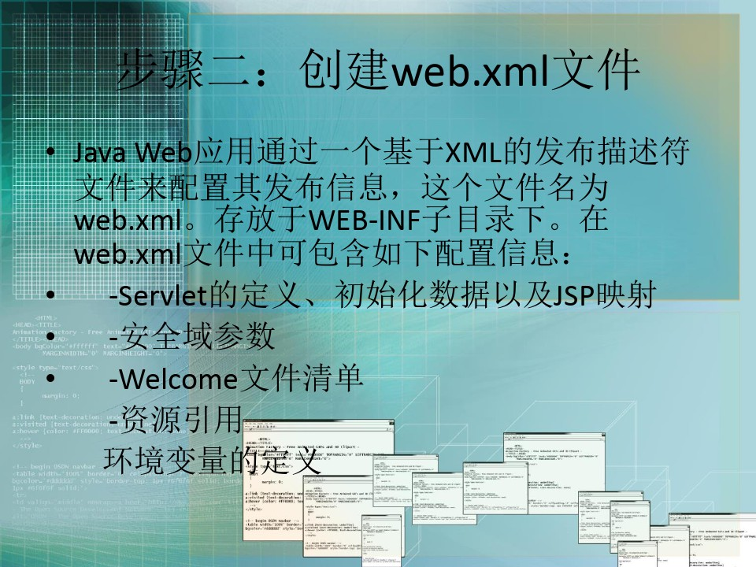

Slide 24

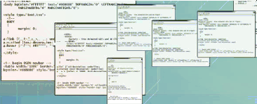

.. <!00CTYPE web-app PUBLIC
i <?xml version= encoding="IS0-8859-1"?>
'-//Sun Microsystems, mc.//DTD Web Application
2.3//EN'
'http://java.sun.com/j2ee/dtds/web-app 2 3.dtd'>
</web-app>

Slide 25
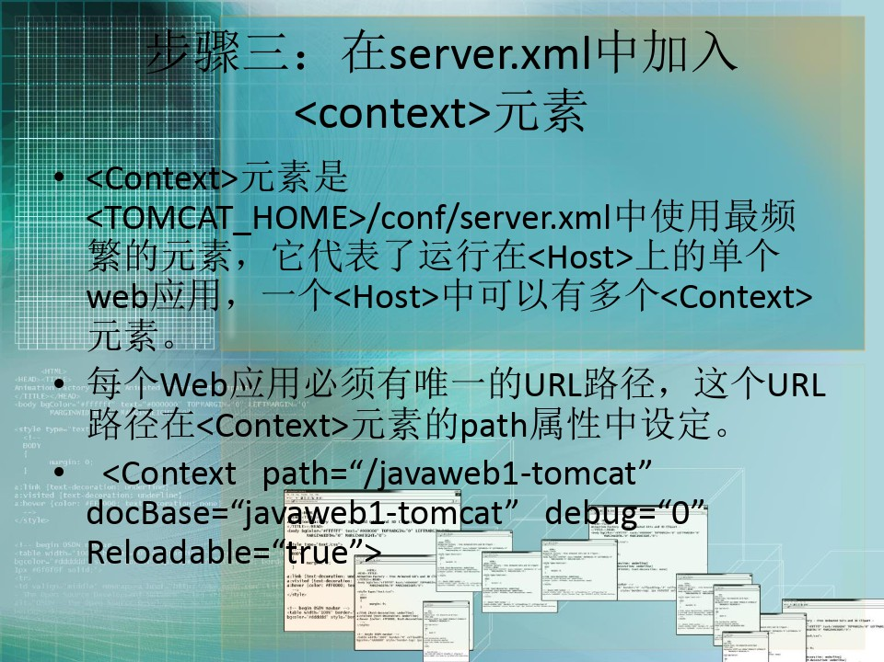

Slide 26
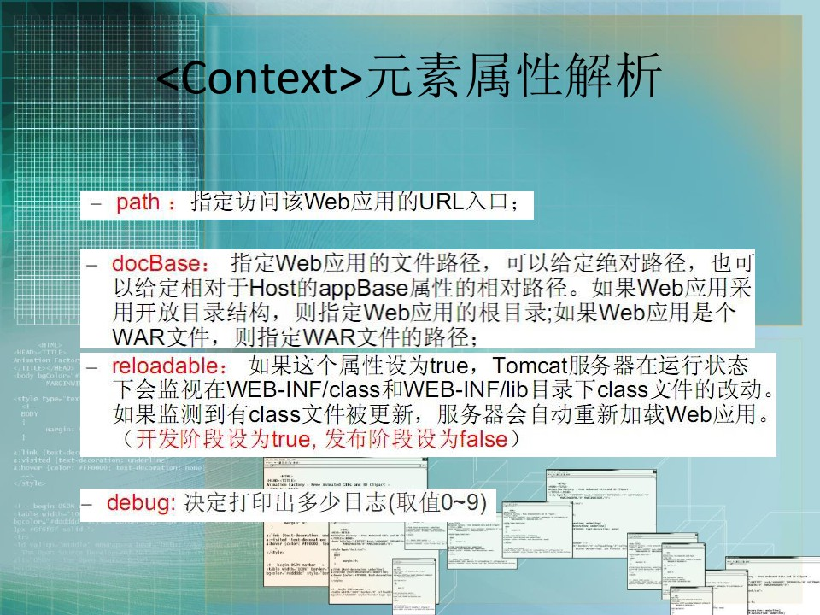

Slide 27
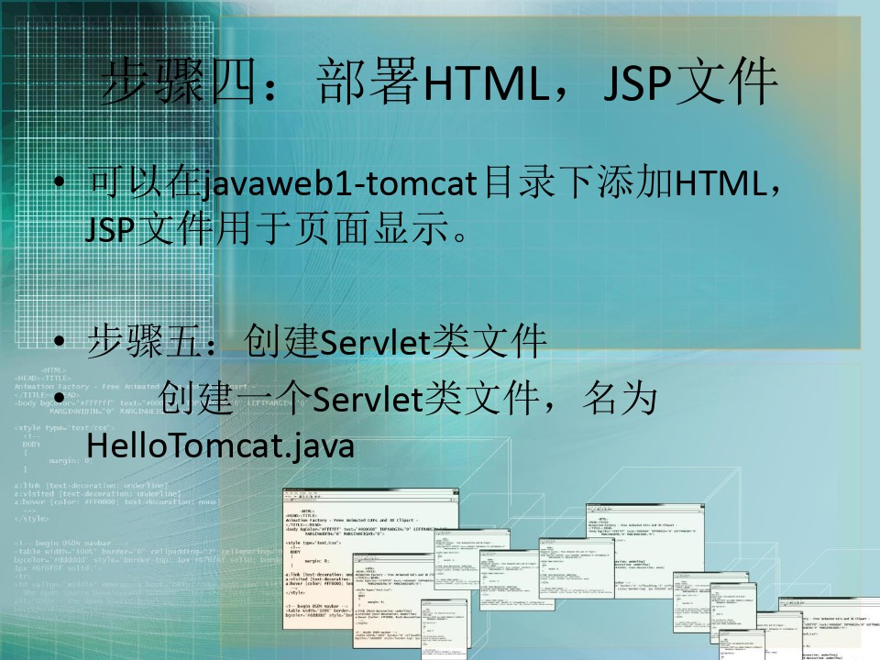

Slide 28
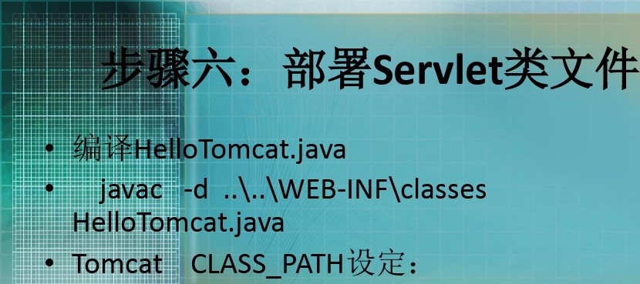

CATHLINE HOME=TomcatZ‹: § @ /§
CATHLINE BASE=Tomcatyc@ @ III
classpath=;.JAVA HOME^{O}o ib/dt.jar;^{O}o#AVA HOM

Slide 29
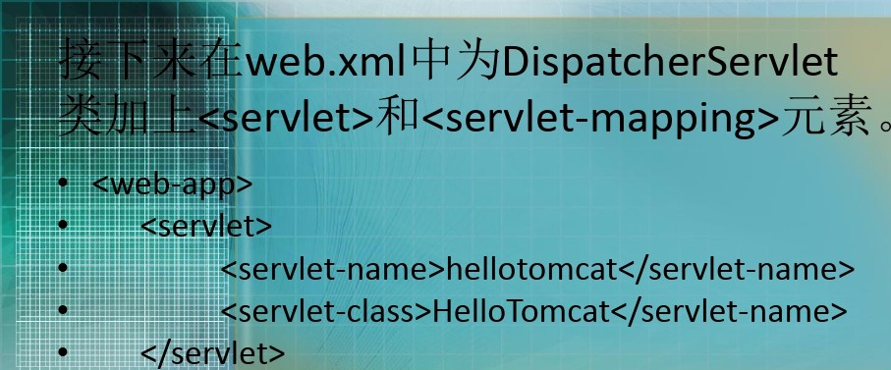

<servlet-mapping>
<servlet-name>heIIotomcat</servlet-name>
<urI-pattern>heIIotomcat</url-pattern>
(

Slide 30
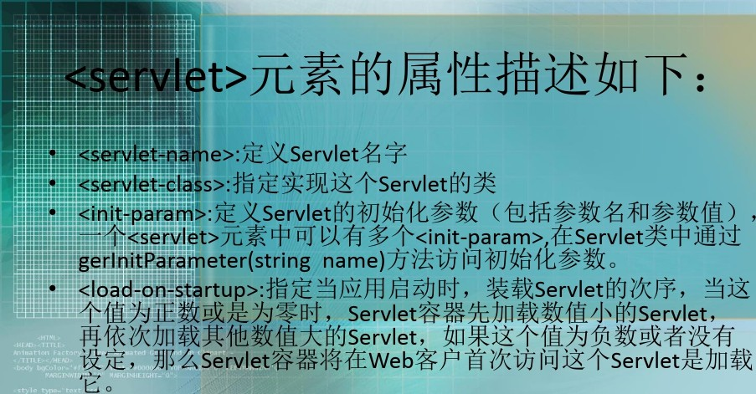
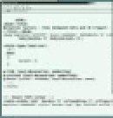





HelloTomcat
load-on-startup
’t/›
// web/*/@ @

Slide 31
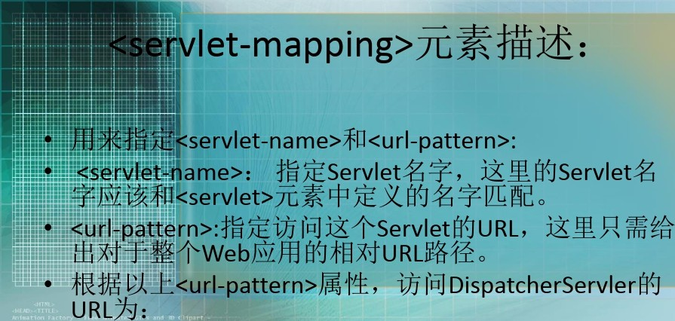
<servlet-mappin >t
T@@T @
@ServIet
@Mù @
*ioìfi I% @URL net

Slide 32
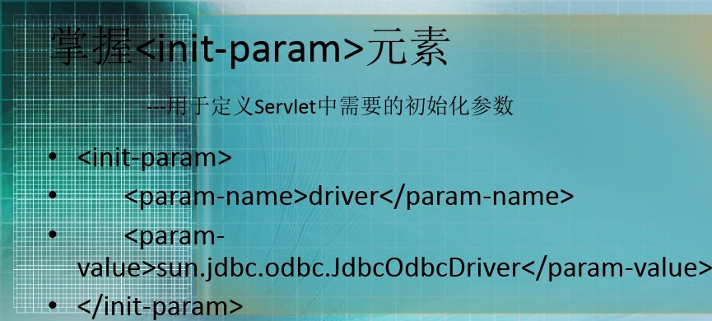
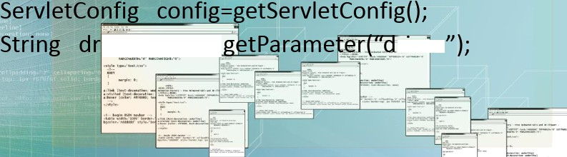
Public void init() throws ServletExptïon{
iver-co,nfïg.
river

Slide 33
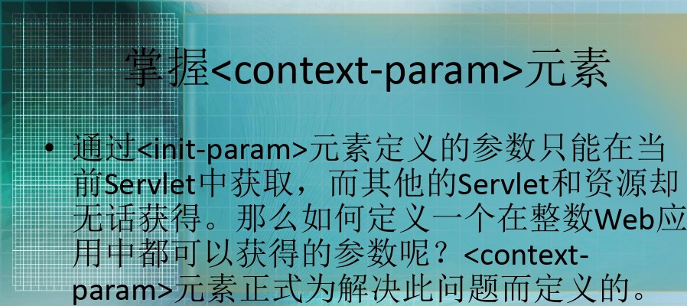

public String getlnitParameter(String
name);
•
numer
»”tèrJIaœes

Slide 34

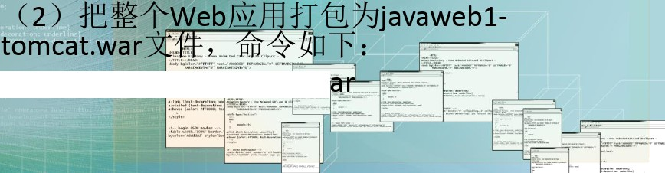
•
<CATALINE H0ME>/webapps/javaweb1- tomcat
Jar cvfjavawțb1-teœeat.w

Slide 35


the f ound at i on of sue ces s l ie s i n good habi I s

