Slide 1
Ad Insertion (with Media Analytics)
Anand Bodas, Antony Vance, Deepa Suresh
Inputs from: Kevin Cone, Surbhi Madan, Xintian Wu, Tao Tao Q, Brahmila Kamalakar, Peng Tu
v1.3
17th Dec 2018

Slide 2





UseCase: Content Analysis for Ad insertion
1
Centralized Ads
Capture/
Production
Storage and Distribution
Consumption
2
Traditional edge
Ad insertion, combining
Localized Ads
VOD
cDVR
Primary distribution
Secondary distribution
Local Headend/CO
Master encoding
Traditional TV Delivery
(Perf/TCO)
Detect Black Frames
Logo/Object detection
Tracking (Object/Logo)
Media Production
Data Center
IP EDGE
JUST-IN-TIME PKG, Ad insertion, streaming
National
Data Center
Regional
Data Center
Content Delivery Network
Production
(Video Quality)
Distribution
(Video Quality)
IP Delivery
(NFV and Perf/TCO)
Face/Person recognition
Image recognition
Scene transition analysis
Action recognition
Speech Recognition
Sentiment Classification
Same flows applicable for Ad insertion with live streams, with latency constraints

Slide 3
Ad Insertion
Target Customers
Telcos, LibertyGlobal, Charter (Live, Linear)
Not Google, not Netflix, not UGC !
Media Analytics enhanced Ad Insertion
78% customers prefer personalized ads – will skip Ad Blockers !
OTT cases
Server Side Ad Insertion (SSAI) vs CSAI
Material arrives as a single stream from a single source
HLS/DASH streaming
Out of Scope
Ad Blockers

Slide 4

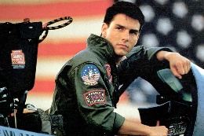


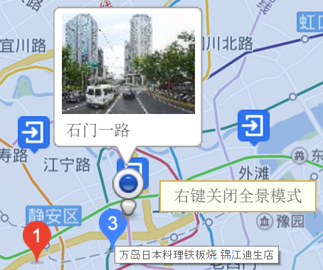

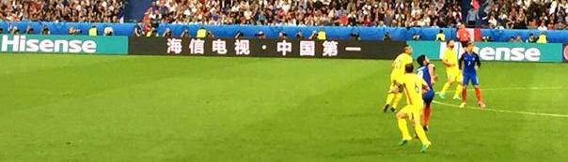





Localized Ad insertion
1
Ongoing CTC PoC
Face recognition
Central
Data Center
Media analytics on video stream on logo, faces, objects
Detecting on Ad time slot
Adding new local Ad into original video
Replace the Ad slot with local relevant Ads
Video Recommend
User profile Video Ad
2
vCDN
vCDN
Logo/car/object recognition
Regional
Data Center
Shopping Guide
vCDN
vCDN
Add-on Ad
Local stores
vCDN
vCDN
3
CDN Edge
Phase 1: Face recognition for video recommendation
Phase 2: Logo/Car/Object recognition for Add-on Ad
Phase 3: Implant Video Ad
Notes:
Camera Calibration needed for Phase 3.
Player tracking tech in football and cricket.

Slide 5
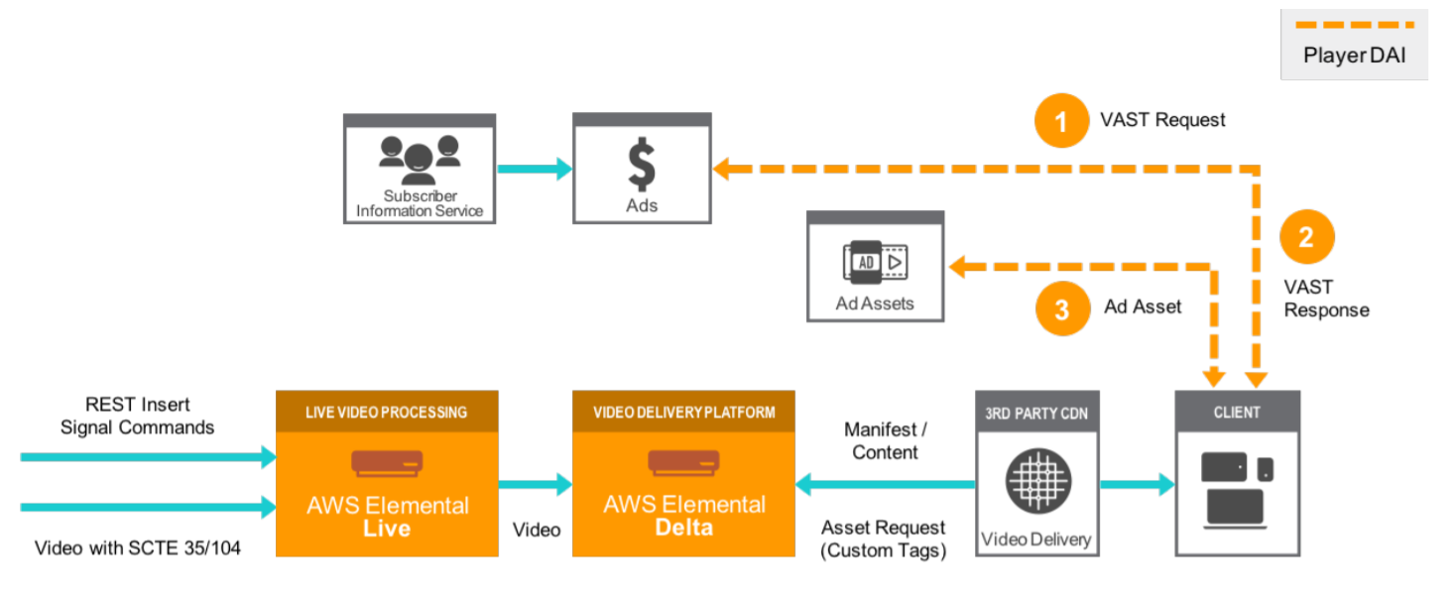
CSAI
Quality Issues
Format of content
ABR & HLS
Change in BW
Delays in switching
Impact on Quality !
Simple Ad Blockers !
Client makes call to ADS
Great Revenue Attribution
Also gets spoofed by some Ad Servers
Notes:
Ad Blocking => Changes based on IP switch and also on changes in Video Quality

Slide 6
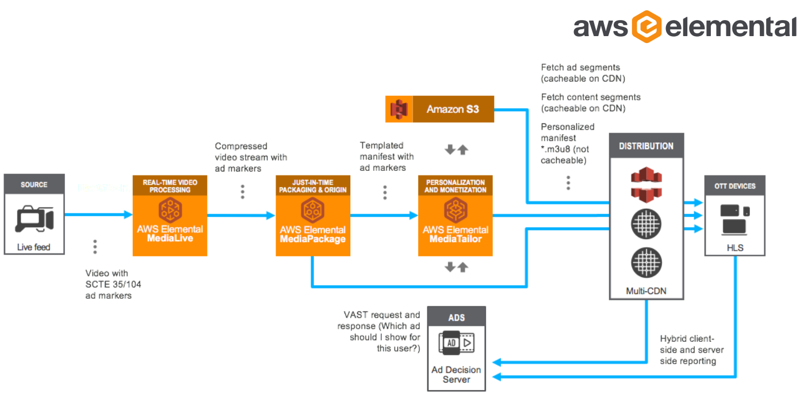
Server Side Ad Insertion
https://www.elemental.com/applications/what-server-side-ad-insertion-ssai
Notes:
1. A player sends a request for live or video-on-demand (VOD) HLS content from the content distribution network (CDN). The CDN is configured to use ad insertion services as the origin for manifests, rather than the content origin. Each request includes parameters from the player about the viewer, so manifests are unique for that request.
2. The ad insertion service pulls the fully formed template manifest from the content origin server. This manifest includes ad markers so that the ad insertion service knows where to perform an ad insertion or ad replacement.
3. When an ad marker is seen, the ad insertion service sends a request to the ad decision server (ADS), including the player parameters from the content request and the duration of the ad break.
4. The ADS provides a VAST or VMAP response that includes the ads to be played back, based on viewer information gathered from the parameters that the ad insertion service passed through, current ad campaigns, and ad tracking URLs to report ad playback to.
5. The ad insertion service manipulates the manifest to include the URLs for the appropriate ads from the VAST or VMAP response.
6. The ad insertion service provides the fully customized manifest to the requesting player via the CDN (the CDN cannot cache this response as it is unique to the player).
7. As playback progresses, either the ad insertion service or the video player reports how much of an ad is played. Using server-side reporting, the service sends ad viewing reports to the ad tracking URL directly, with no input required from you.
8. As the player requests ad segments throughout content playback, if the ad is not already transcoded in a format that matches the video content, the ad insertion service transcodes the ad at the time of the ad segment request. If an ad is not already transcoded, the service doesn't present it for playback at the first request.
Linear TV and People buying slots;
Will drive trials first
OTT will ramp faster
This will happen in the TV world as well;

Slide 7
Hybrid Approach
Use SSAI features for avoiding Ad Blocking
Use CSAI features for Ad Tracking / Reporting / Interactivity
Needs integration into players for different device/SW variations
Content with VPAID needs CSAI, choose approach based on available Ads
Hybrid Approach is proposed by some companies

Slide 8
Demo Setup – VOD
Phase 1: Ingesting and Analytics
Ingest Streams to create HLS segments
Ingest Ads to create HLS segments
Analytics to create Metadata DB
Phase 2: Dynamic Ad Insertion and Streaming
VAST request creation
VAST response
Manifest manipulation
HLS enabled client app
Phase 3: Enable CDN
Application Server
Egress Web Server
Ad Server
(Content and ADS)
Client App

Slide 9
Analytics
Metadata | Description
Image Class | Image Classification Analytic; Includes Start time, duration and confidence; Applies of Video
Logo | Logo Detection Analytic; Includes Start time, duration size and confidence; Applies on Video
Sentiment | Sentiment Classification Analytic; Includes Start time, duration and confidence; Applies on Video, Audio and Text
Emotion | Emotion Classification Analytic; Includes Start time, duration and confidence; Applies on Video, Audio and Text
Face | Face Detection and Recognition Analytic; Includes Start time, duration and confidence; Applies on Video
Action | Action Recognition Analytic; Includes Start time, duration and confidence; Applies on Video
Place | Place Detection Analytic; Includes Start time, duration and confidence; Applies on Video
Models to be selected based on Content chosen
Notes:
Use Intel Ads, differentiate between processor Ad and others.
Could get content from studios, like Sony; Identify 3-4 movies that have right content and then get approval;
Determine copyright of pictures is an issue for training ; Try to get pre-trained models; Use video from China?; Train from the copyright content itself;
Sample and Demo are 2 different cases; Get recommendation from ICV team, they own algos;

Slide 10
Ad Servers
VAST Compliant Video Ad Server vendors
AdZerk
Ooyala
SpotX
Epom
Revise (Not VAST Compliant)
Candidate partners for launch
Will be evaluated as second step

Slide 11
Models
Models from OpenVino are legally vetted
Face Detection
Emotion Recognition (Image based)
https://software.intel.com/en-us/openvino-toolkit/documentation/pretrained-models
Intel Paid Video Analytics
https://wiki.ith.intel.com/display/PaidAnalytics/IOTG+Paid+Video+Analytics+Wiki+Home
Only for Demo, not OpenVC Sample
Face Detection and Recognition
Face Database, can be trained easily for new faces
Celebrity faces could be trained from content itself
Code available for evaluation
Can run in OpenVino
Option for Demo
Train an Object Detection model for detecting Logos
Train Celebrity Face Recognition model
Reuse Emotion Recognition model from OpenVino models

Slide 12
VOD Pipeline
Transcode Pipeline
HLS Content in Origin Servers
High Quality / Mezzanine
Ingest
Decode
Different formats
Scaling / De-interlacing
Encode
Multiple encodes for multiple formats
ABR stacks
Manifest file update for HLS/DASH. Content cached on CDNs
.ts
.m3u8
High Quality / Mezzanine
Analytics Pipeline
Metadata
Server
CDN
Ingest
Decode
Different formats
Pre-Processing / Scaling
Content Analytics
.ts
.ts
Ad and Content Segments Cached
Same Transcode pipeline for Content and Ads
Analytics Pipeline for Content (could also be used for Ads)
Optimization is to use output from decode from Transcode pipeline as input to pre-processing for Analytics Pipeline
Must have for Live Streaming case
Image classification
Logo/Object detection & classification
Tracking (Object/Logo)
Sentiment Classification
Speech Recognition
Face/Person recognition
Action recognition
Scene transition analysis
Detect Black Frames

Slide 13
Serving/Playback
ADS gets metadata from DB
ADS gets Ad list from Ad Server
App and Origin servers can be separate for scaling
Client player can send Ad reports in Hybrid model
VOD
Content
Application/Origin Server
CDN Server
Transcode Pipe
Analytics Pipe
1
HLS
7
Server Application
(split into micro services)
Content and Ads
3
Client Player
2
1
Metadata
8
User
Database
.ts files
9
VAST Request with
Metadata URL
Selected Ads sent
for transcoding
VAST Response
with selected Ad
Metadata
Creates HLS and Metadata of VOD Content
Responds to incoming client requests, spawns off containers per connection
Manifest parsing to detect Ad Markers in Content
VAST requests to ADS with metadata info link
VAST response parsing (Ads selected by ADS)
Request transcoding of select Ads (Transcode Pipeline)
Manifest manipulation, create personalized manifest
Respond with personalized manifest to client
Send beacons to Ad Server for tracking
6
4
5
High Quality
Ads
Ad Server
Ad Decision Server

Slide 14
Metadata Handling
Analytics
App Server
Egress Web Server
Metadata can grow very large in size
3 per frame, with bounding box, approx. 12 bytes
Assuming 10 mins between Ad Breaks, metadata > ~200KB
Unique per stream, not per user
Ad Server can fetch from Metadata server (url)
Eg. http://www.metadatasrv.com?streamed={id1}&startframe={num1}&endframe={num2}
Request includes url for metadata server
Metadata
Server
ADS
Metadata

Slide 15
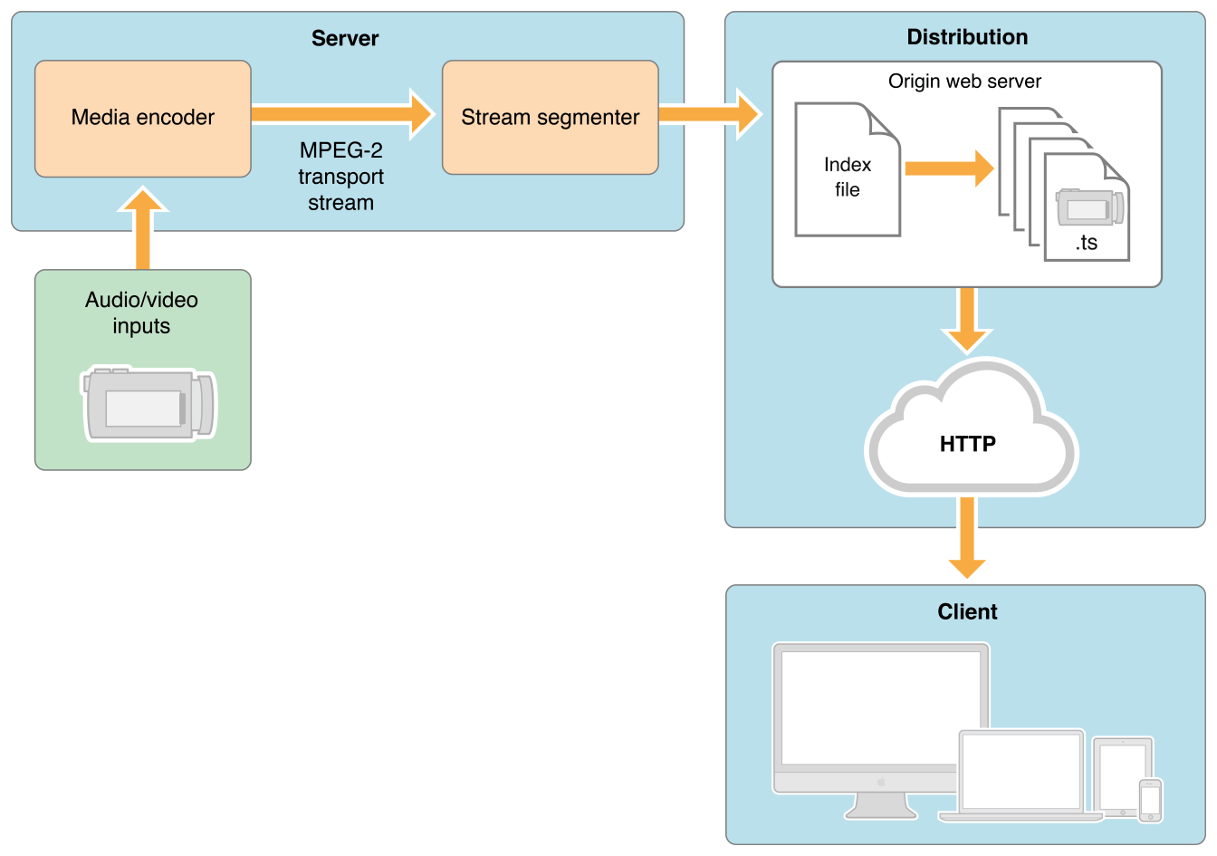
Streaming
Server
HDFS
Analytics

Slide 16
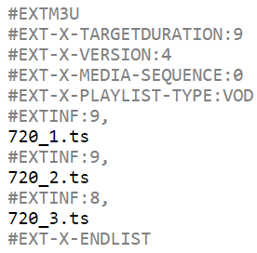
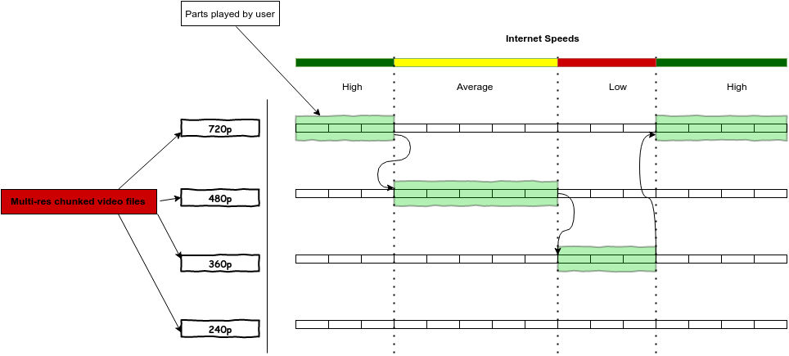
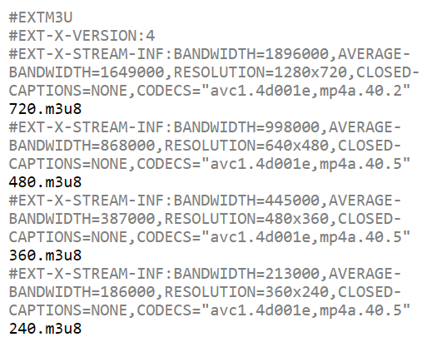
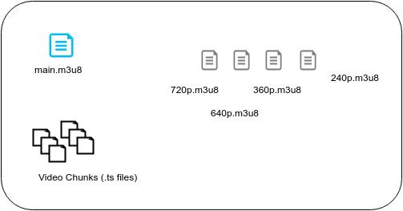
HLS
720p.m3u8
main.m3u8

Slide 17
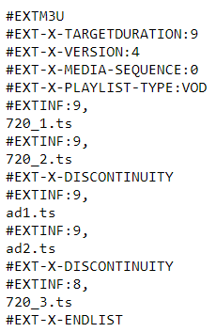
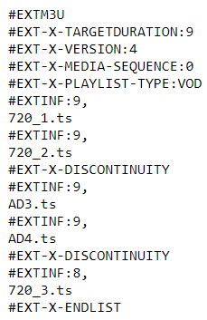
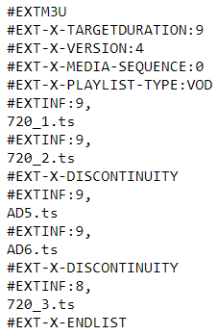
Ad Insertion – manifest manipulation
Personalized
Ads
Ads inserted in stream, done for each of the resolutions/bitrates of HLS

Slide 18
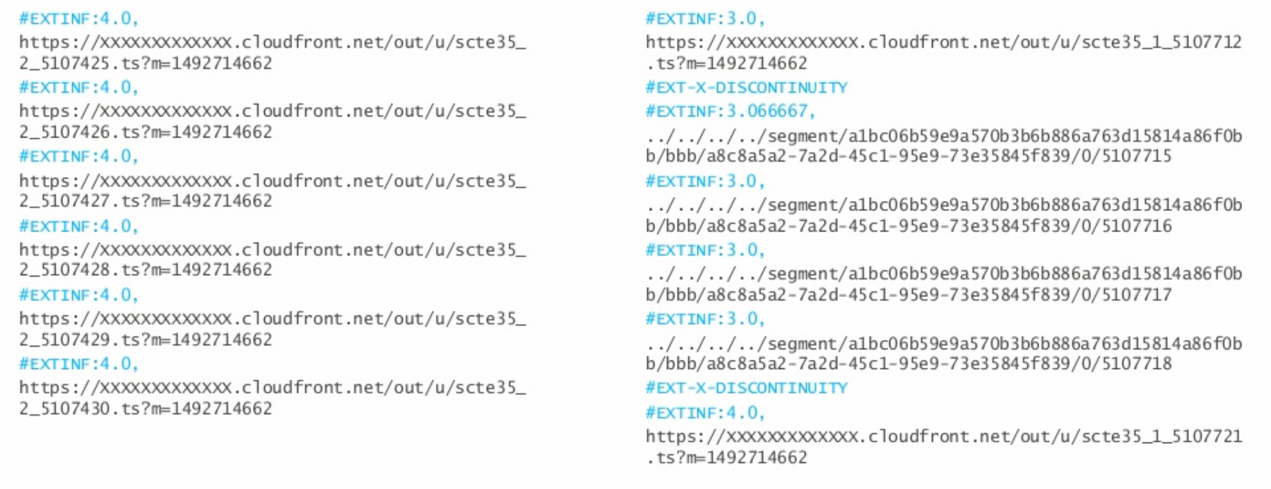
Manifests with Ads

Slide 19
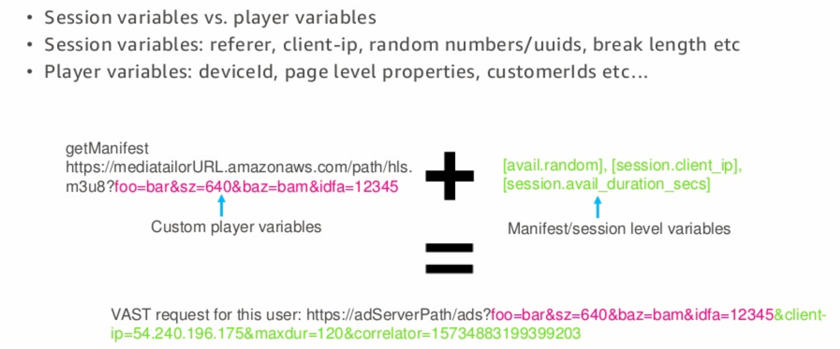
Targeting/Personalization Example

Slide 20
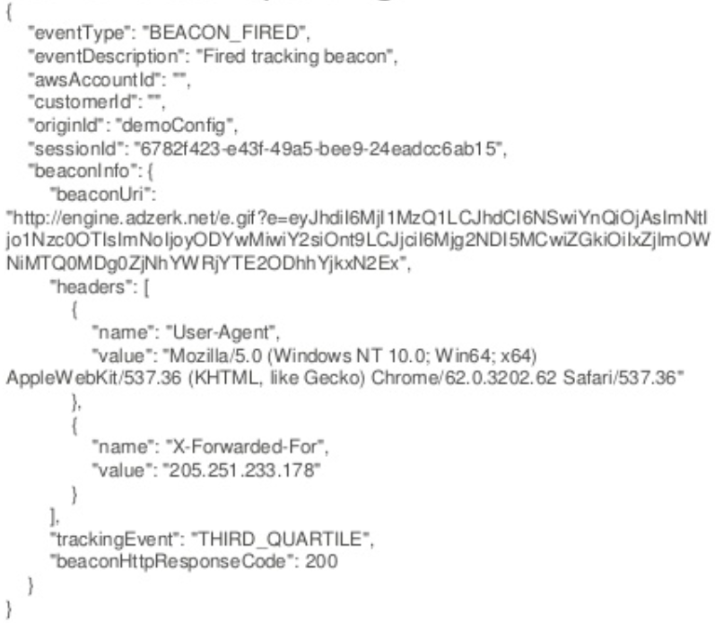
Server Side Reporting
FreeWheel Beacon examples
cn=slotImpression: This is a beacon Freewheel fires when it sees that there is an ad slot available in the CPB for an ad.
cn=defaultImpression: This is the beacon Freewheel fires when an ad view is fired. You have an impression beacon for each ad unit rendered.
cn=firstQuartile: This is the beacon fired for 25%
cn=midPoint:This is the beacon fired for 50%
cn=thirdQuartile: This is the beacon fired for 75%
cn=complete: This is the beacon fired for 100%
cn=adEnd: This is the beacon Freewheel fires when the ad event is completed.
cn=slotEnd: This is the beacon Freewheel fires when the slot is over and no more ads will serve in that ad break.
cn=videoView: This is the beacon Freewheel fires when the content begins.

Slide 21
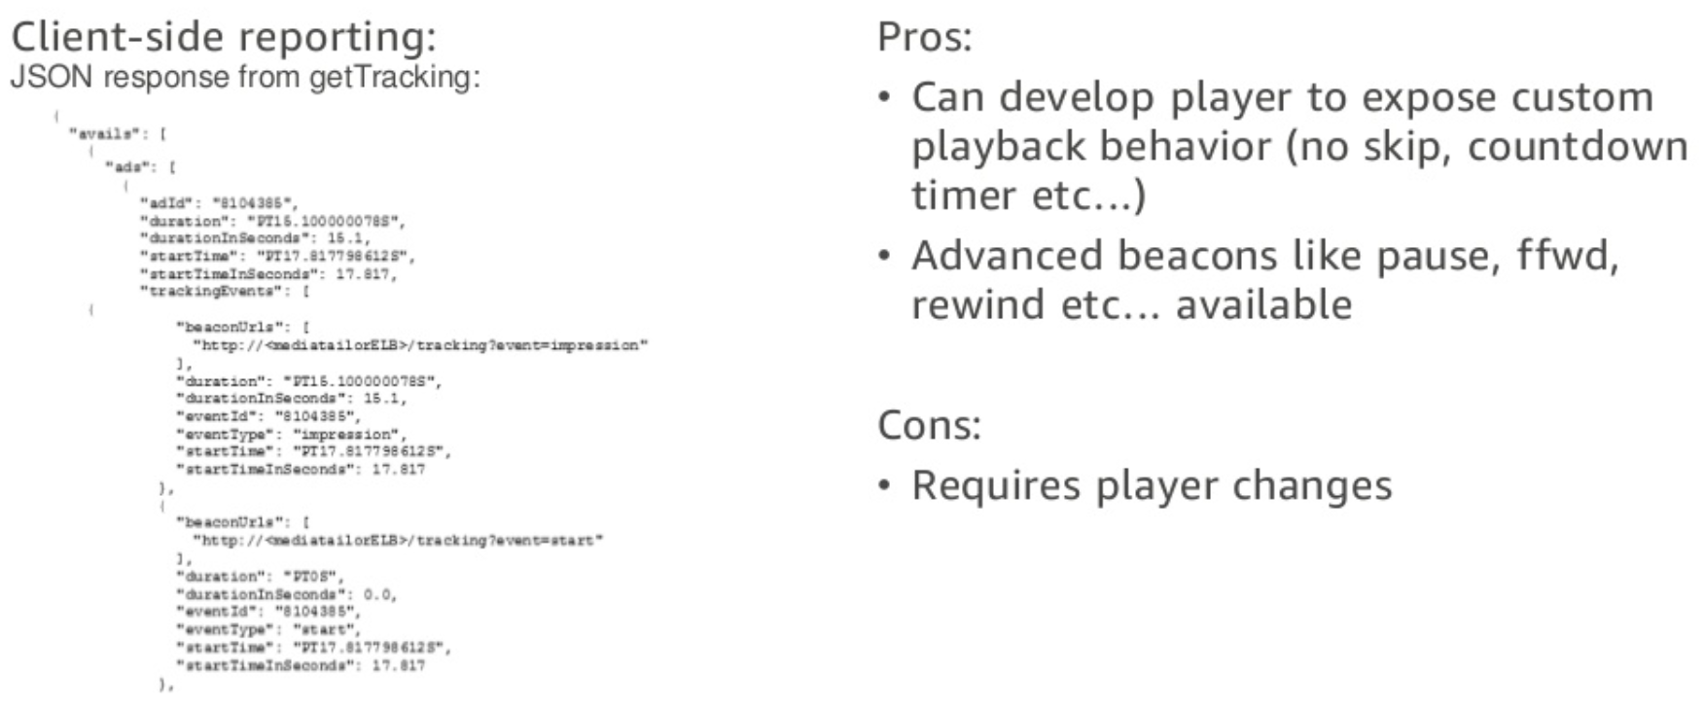
Client Side Reporting

Slide 22
Backup

Slide 23
Server Side Ad Insertion
Central
Data Center
Less personalized ads
Common across users
Diff across localities
Common DL models across users
MA in origin servers
Less Compute, more efficient
Lighter scaling
vCDN
More Personalized Ads
per user, per stream
Individual DL models per user / user group
MA in edge servers
More Compute, less efficient
Heavier scaling
vCDN
Regional
Data Center
Ad Decision Server
Ad Servers
vCDN
vCDN
vCDN
vCDN
Generalization
Personalization
CDN Edge
Content Caching
Ad Caching
Ad Insertion
Notes:
Windows of the Ads are fixed; fixed slots, too many constraints for live; finite number of groups, not too much personalization; Bamtech? (for playstation view)
Live needs to sync;
Personalization has limits
Edge should be complementary to previous analytics; Can be based on feedback for users etc.
In OTT or live
Dead time kills the experience;
Can work for VoD experiences;
Broadcasters need to have fallback on why it happened;
Paranoia in live stream to prevent going fully automated
Metadata archived

Slide 24
Manifest Example
#EXTM3U
#EXT-X-VERSION:3
#EXT-X-TARGETDURATION:4
#EXT-X-MEDIA-SEQUENCE:6719391
#EXTINF:4.000,
scte35_3_6719391.ts?m=1492714662
#EXTINF:3.533,scte35_3_6719392.ts?m=1492714662
#EXT-OATCLS-SCTE35:/DAlAAALkmP0AP/wFAXwAlXbf+//4dg/yP4AQItwAAEBAQAAhT3BsQ==
#EXT-X-CUE-OUT:47.000#EXTINF:0.467,scte35_3_6719393.ts?m=1492714662
#EXT-X-CUE-OUT-CONT:ElapsedTime=0.453,Duration=47.000,SCTE35=/DAlAAALkmP0AP/wFAXwAlXbf+//4dg/yP4AQItwAAEBAQAAhT3BsQ==
#EXTINF:4.000,scte35_3_6719394.ts?m=1492714662
#EXT-X-CUE-OUT-CONT:ElapsedTime=4.453,Duration=47.000,SCTE35=/DAlAAALkmP0AP/wFAXwAlXbf+//4dg/yP4AQItwAAEBAQAAhT3BsQ==
#EXTINF:4.000,scte35_3_6719395.ts?m=1492714662
#EXT-X-CUE-OUT-CONT:ElapsedTime=8.453,Duration=47.000,SCTE35=/DAlAAALkmP0AP/wFAXwAlXbf+//4dg/yP4AQItwAAEBAQAAhT3BsQ==
#EXTINF:4.000,scte35_3_6719396.ts?m=1492714662
#EXT-X-CUE-OUT-CONT:ElapsedTime=12.453,Duration=47.000,SCTE35=/DAlAAALkmP0AP/wFAXwAlXbf+//4dg/yP4AQItwAAEBAQAAhT3BsQ==
#EXTINF:4.000,scte35_3_6719397.ts?m=1492714662#EXT-X-CUE-OUT-CONT:ElapsedTime=16.453,Duration=47.000,SCTE35=/DAlAAALkmP0AP/wFAXwAlXbf+//4dg/yP4AQItwAAEBAQAAhT3BsQ==#EXTINF:4.000,scte35_3_6719398.ts?m=1492714662#EXT-X-CUE-OUT-CONT:ElapsedTime=20.453,Duration=47.000,SCTE35=/DAlAAALkmP0AP/wFAXwAlXbf+//4dg/yP4AQItwAAEBAQAAhT3BsQ==#EXTINF:4.000,scte35_3_6719399.ts?m=1492714662#EXT-X-CUE-OUT-CONT:ElapsedTime=24.453,Duration=47.000,SCTE35=/DAlAAALkmP0AP/wFAXwAlXbf+//4dg/yP4AQItwAAEBAQAAhT3BsQ==#EXTINF:4.000,scte35_3_6719400.ts?m=1492714662#EXT-X-CUE-OUT-CONT:ElapsedTime=28.453,Duration=47.000,SCTE35=/DAlAAALkmP0AP/wFAXwAlXbf+//4dg/yP4AQItwAAEBAQAAhT3BsQ==#EXTINF:4.000,scte35_3_6719401.ts?m=1492714662#EXT-X-CUE-OUT-CONT:ElapsedTime=32.453,Duration=47.000,SCTE35=/DAlAAALkmP0AP/wFAXwAlXbf+//4dg/yP4AQItwAAEBAQAAhT3BsQ==#EXTINF:4.000,scte35_3_6719402.ts?m=1492714662#EXT-X-CUE-OUT-CONT:ElapsedTime=36.453,Duration=47.000,SCTE35=/DAlAAALkmP0AP/wFAXwAlXbf+//4dg/yP4AQItwAAEBAQAAhT3BsQ==#EXTINF:4.000,scte35_3_6719403.ts?m=1492714662#EXT-X-CUE-OUT-CONT:ElapsedTime=40.453,Duration=47.000,SCTE35=/DAlAAALkmP0AP/wFAXwAlXbf+//4dg/yP4AQItwAAEBAQAAhT3BsQ==#EXTINF:4.000,scte35_3_6719404.ts?m=1492714662#EXT-X-CUE-OUT-CONT:ElapsedTime=44.453,Duration=47.000,SCTE35=/DAlAAALkmP0AP/wFAXwAlXbf+//4dg/yP4AQItwAAEBAQAAhT3BsQ==#EXTINF:2.533,scte35_3_6719405.ts?m=1492714662#EXT-X-CUE-IN#EXTINF:1.467,scte35_3_6719406.ts?m=1492714662 Document Conventions

Slide 25
Transcode + Analytics
Centralized Ad Insertion – VOD – Offline
Ingest
Live Stream from Network
Decode
Different formats
Scaling/Deinterlacing
Encode
Multiple encodes for multiple formats
Multiple channels
Append Metadata as SEI / Separate Manifest
Manifest file update for HLS/DASH. Content cached on CDNs
Pre-processing / scaling
Content Analytics
Select Ad / Synthesis
Video + Audio
Ad Server
Metadata
URL
VAST
Response
Image classification
Logo/Object detection & classification
Tracking (Object/Logo)
Ad Decision Server
Sentiment Classification
Speech Recognition
Face/Person recognition
Metadata
Database
(HDFS)
Action recognition
Scene transition analysis
Detect Black Frames

Slide 26
Content based Ad Insertion for VOD
Transcode + Analytics
Ingest
VOD Stream
Decode
Different formats
Scaling/ De-interlacing
Encode
Multiple encodes for multiple formats
ABR stacks
Manifest file update for HLS/DASH. Content cached on CDNs
Pre-processing / scaling
Video + Audio
Playback App
Request Personal Ad
Request Ad Transcode
Manifest Manipulation
HLS Content on CDN
Mezzanine/High Quality
Content
Content Analytics
Ad Content on CDN
Mezzanine/High
Quality Ads
Request Playback
Send Player/User info
Metadata
URL
VAST
Response
Image classification
Logo/Object detection & classification
Tracking (Object/Logo)
Sentiment Classification
Speech Recognition
Face/Person recognition
Action recognition
Scene transition analysis
Detect Black Frames
Ad Server
Client Device
Ad Decision Server
Metadata
Metadata
Database
(HDFS)
Transcode Flow
Analytics Flow
Ad Tracking/Reporting Info
Player Flow

Slide 27
Transcode + Analytics
Centralized Ad Insertion – Live – Real Time
Ingest
Live Stream from Network
Decode
Different formats
Scaling/Deinterlacing
Encode
Multiple encodes for multiple formats
Multiple channels
Append Metadata as SEI / Separate Manifest
Manifest file update for HLS/DASH. Content cached on CDNs
Pre-processing / scaling
Content Analytics
Select Ad / Synthesis
Video + Audio
Ad Server
Metadata
URL
VAST
Response
Image classification
Logo/Object detection & classification
Tracking (Object/Logo)
Metadata
Ad Decision Server
Sentiment Classification
Speech Recognition
Face/Person recognition
Metadata
Database
(HDFS)
Action recognition
Scene transition analysis
Detect Black Frames

Slide 28
Opens
Streams (Content)
Ads
DL Analytics Models
Metadata DB
VAST compliant Ad Server
Manifest manipulation
CDN for caching
Notes:
Peng on Metadata (BMW work and Elastic search)

