Slide 1
A brief introduction to counterfactual explanation
Presenter: Chenyuan Zhao

Slide 2

Counterfactual thinking example
Counterfactual example:
A “What if…?” question
the closest possible world(s)
“I could have won the gold medal if I run 0.01s faster”
“I could have obtained the scholarship if my GPA is 0.5 better.”
“My salary could be higher if I have a master degree.”

Slide 3
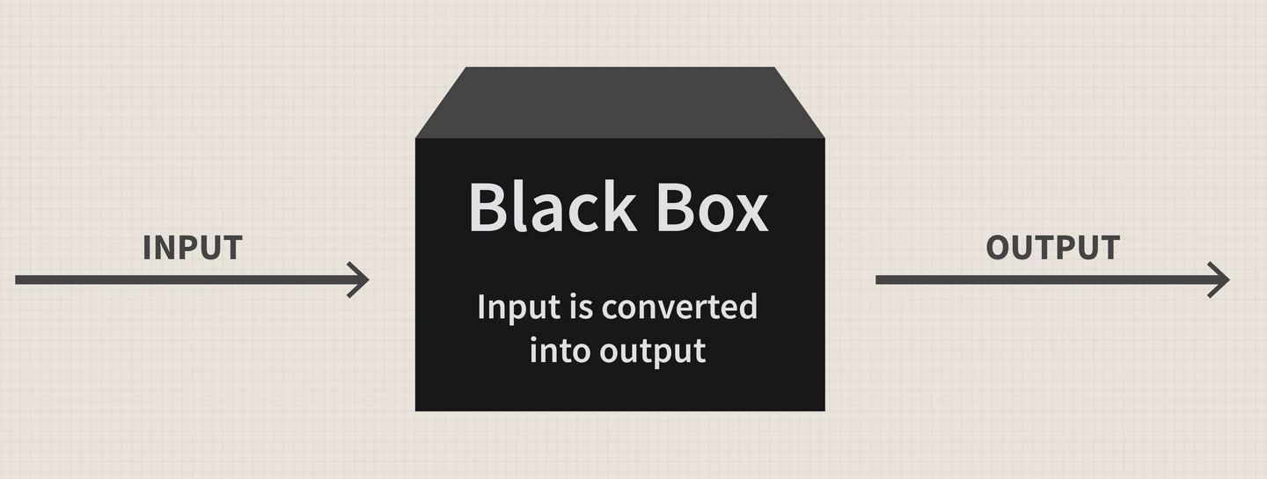

Counterfactual explanation: Features
Explainability:
How the internal nodes work and their significance in the model
Interpretability:
What effect does external variables pose on the result
Model agnostic
Local
Example-based

Slide 4
Three aims of an explanation: For lay audience
Understand a decision
Obtain guidance for future actions
Contest an unfair decision
Example 1 - “You could obtain the loan if your credit score is 30 higher.”
Reason for loan rejection: too low credit score
Recommended future action: improve the credit score
Example 2 - “You could obtain the loan if you change your race to...”
Reason for loan rejection: race
Contesting the decision: judgement based on race is unfair

Slide 5
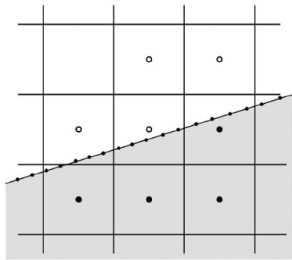
Checklist for generating a counterfactual example
Proximity: similar to the original data input
Validity: has a different prediction result
Sparsity: change as few entries as possible
Proximity
Validity
Sparsity

Slide 6
Popular datasets: social sensitive regions
Dataset name | Prediction | Criterion
Adult-Income | classify whether an individual’s income could be over $50,000 | education level, occupation, race, age, gender
LendingClub | decide loan approval based on predicting whether an individual will pay back the loan | annual income, number of opened credit accounts, credit history…
German-Credit | determine good or bad credit risk
COMPAS | decide bail based on predicting whether an individual will commit crime again. | prior count of offenses, degree of crime race, age, gender
MNIST | digital numbers | handwritten numbers

Slide 7
Popular techniques – gradient based method
具体步骤

Slide 8
Popular techniques – data evolution

Slide 9
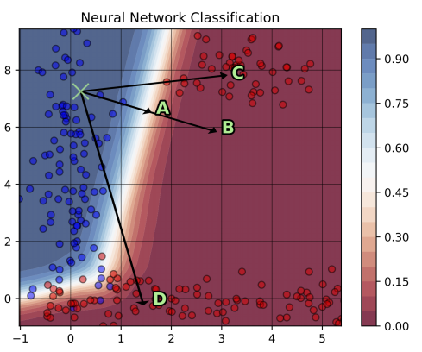
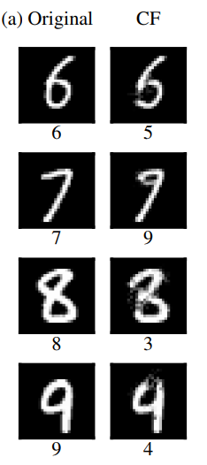
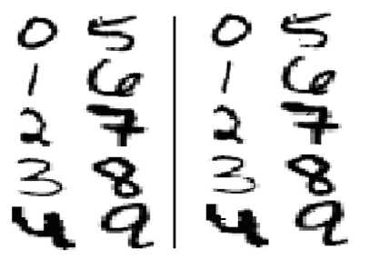
Shortage – Adversarial Example
Original – Counterfactual examples?
Good examples
Adversarial examples!

Slide 10
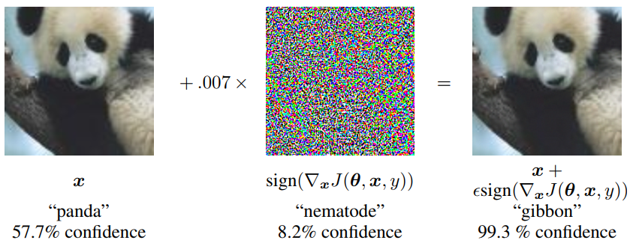
Continue.. Adversarial examples

Slide 11
Solution with adversarial example

Slide 12
Remaining challenge: actionability

Slide 13
Solution: causal graph

