Slide 1
A brief introduction to counterfactual explanation
Presenter: Chenyuan Zhao

Slide 2

Counterfactual thinking example
Counterfactual example:
A “What if…?” question
the closest possible world(s)
“I could have won the gold medal if I run 0.01s faster”
“I could have obtained the scholarship if my GPA is 0.5 better.”
“My salary could be higher if I have a master degree.”

Slide 3
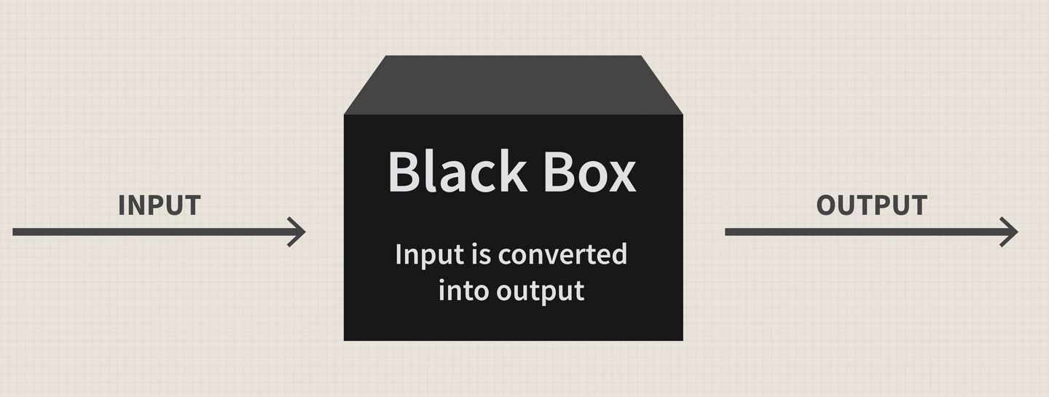

Counterfactual explanation: Features
Explainability:
How the internal nodes work and their significance in the model
Interpretability:
What effect does external variables pose on the result
Model agnostic
Local
Example-based

Slide 4
Three aims of an explanation: For lay audience
Understand a decision
Obtain guidance for future actions
Contest an unfair decision
Example 1 - “You could obtain the loan if your credit score is 30 higher.”
Reason for loan rejection: too low credit score
Recommended future action: improve the credit score
Example 2 - “You could obtain the loan if you change your race to...”
Reason for loan rejection: race
Contesting the decision: judgement based on race is unfair

Slide 5
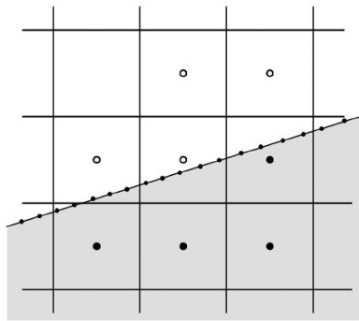
Checklist for generating a counterfactual example
Proximity: similar to the original data input
Validity: has a different prediction result
Sparsity: change as few entries as possible
Proximity
Validity
Sparsity

Slide 6
Popular technique – gradient based method
$$c={argmax}_{c} loss\left(y,f\left(c\right)\right)+d(x,c)$$
counterfactual example (CF)
original prediction
new prediction
distance between CF and original input
Use L1 or L0 norm to ensure sparsity
Predict an output
Calculate the loss/error of the output
Update the prediction system

Slide 7
Popular datasets: social sensitive regions
Dataset name | Prediction | Criterion
Adult-Income | classify whether an individual’s income could be over $50,000 | education level, occupation, race, age, gender…
LendingClub | decide loan approval based on predicting whether an individual will pay back the loan | annual income, number of opened credit accounts, credit history…
German-Credit | determine good or bad credit risk | credit history, credit amount, savings, employment length, age…
COMPAS | decide bail based on predicting whether an individual will commit crime again. | prior count of offenses, degree of crime race, age, gender…
MNIST | digital numbers | handwritten numbers

Slide 8
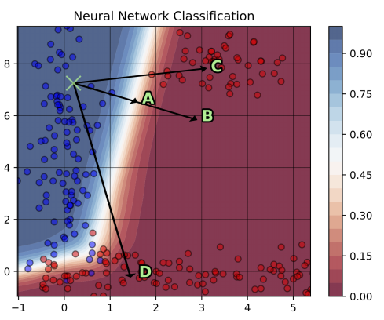
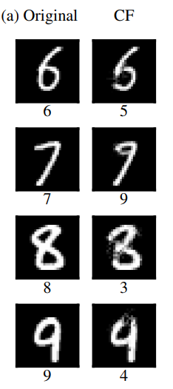
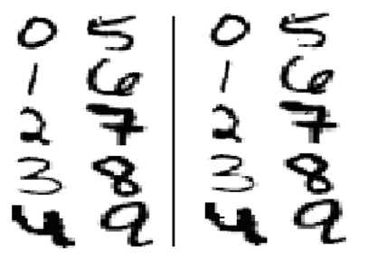
Shortage – Adversarial Example
Original – Counterfactual examples?
Good examples
Adversarial examples!

Slide 9
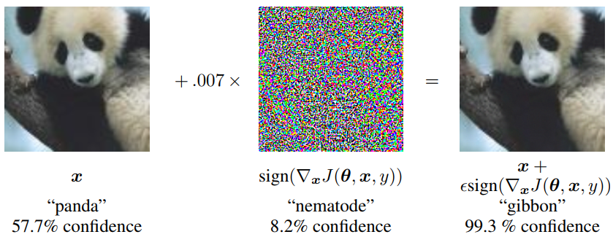
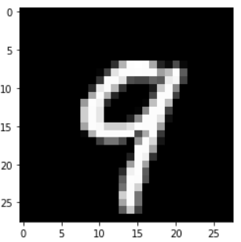
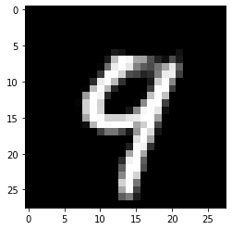
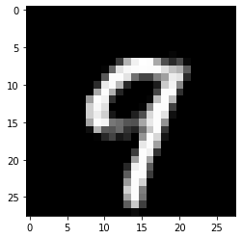

Continue.. Adversarial examples
Adversarial examples… | Counterfactual examples…
hide the changes | highlight the changes
“fool” the model | give plausible advices
are almost identical to the original input | are similar, but not identical to original input
take advantage of the model weak point | avoid the model weak point
↙9
4
9↘
7
panda
↓
gibbon
?
=
gibbon
4
7

Slide 10
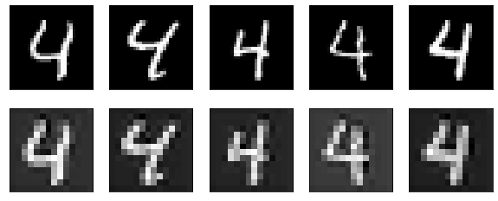
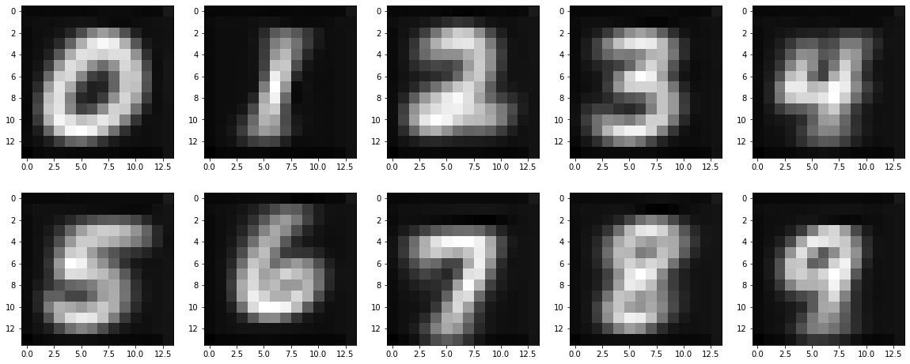
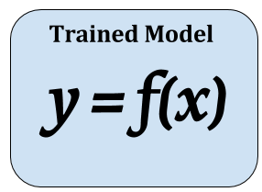
Solution to the adversarial pitfall: prototype guidance
Origin
(28x28)
Encoded
(14x14)
Input
proximate, sparse
proximate
CF result
prototypes (14x14)
Training
Fitting
Different label

Slide 11
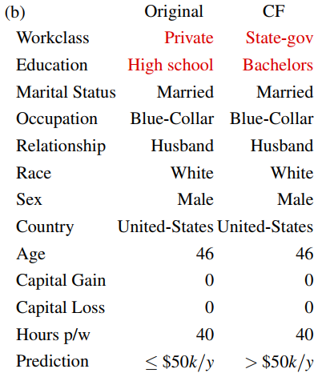
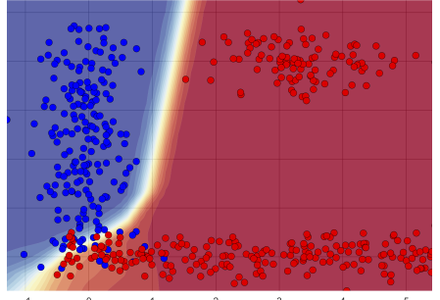
Remaining challenge: actionability
Example 2 - “You will receive the loan if you decrease your age by three and change the education level to master.”
Example 1
Age
30
23
Plausible CF may not be actionable CF!
Irreversible variables, e.g. age
Unchangeable variables, e.g. gender, race
Understand the decision–
“What could have been done in the past.”
Understand & act –
“What to do in the future.”
High school Bachelor Master Doctor
Education level

Slide 12
Solution to lack of actionability: causal graph
Offer extra causality information to the model.

Slide 13
Summary of counterfactual explanation
is similar to natural think way, easy to interpret.
does not include internal model nodes in the explanation, also lay audience can understand.
offers the explanation but also the suggested action.
prones to generate adversarial examples.
lacks actionability. Causality graphs are not always available in real life.

Slide 14
Backup slides

