Slide 1


Slide 2







Slide 4
Record, save, and share anything you like on the web inside your browser

Slide 6



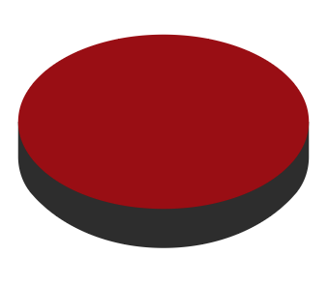

Upload
Copy GIF url and share
navigate to url
Do stuff
Start recording
Stop recording
Download
Process

Slide 7
Upload
Copy GIF url and share
navigate to url
Do stuff
Start recording
Stop recording
Download
Process
navigate to url
Start recording
Do stuff
Stop recording
Process image sequence
Convert to GIF
Upload to Gfycat and get GIF url

