Slide 1


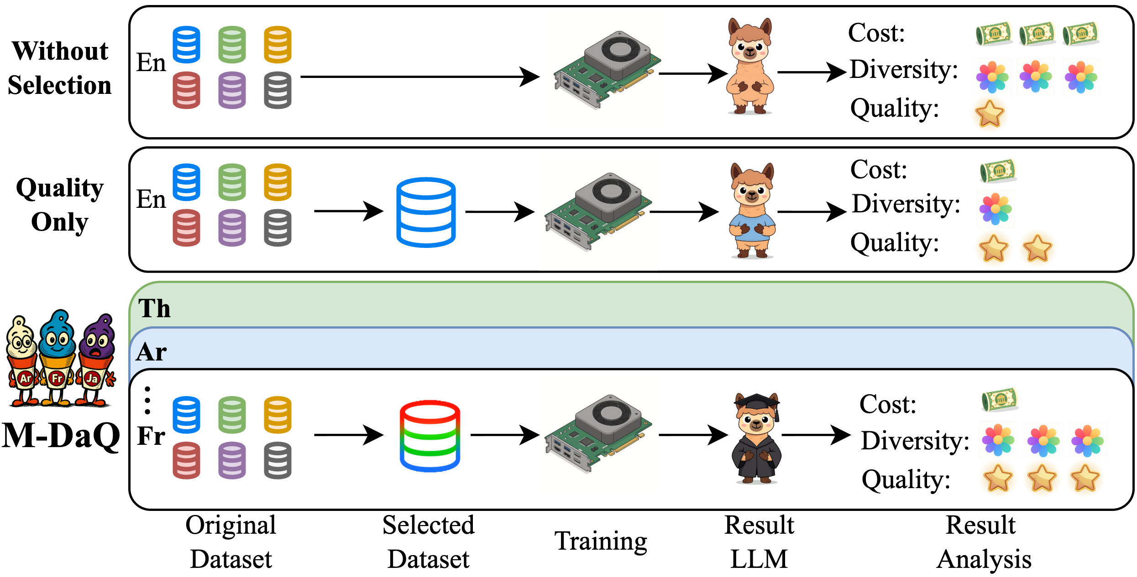
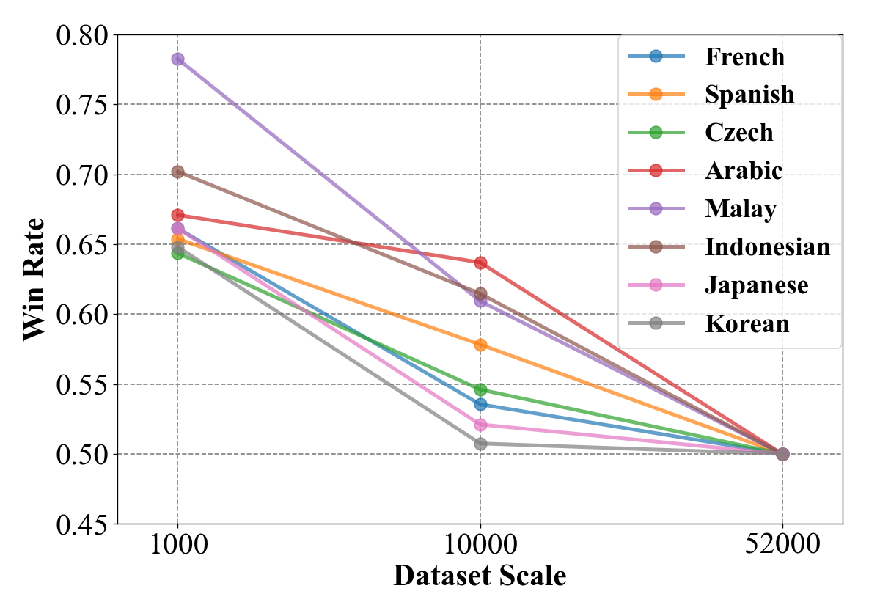
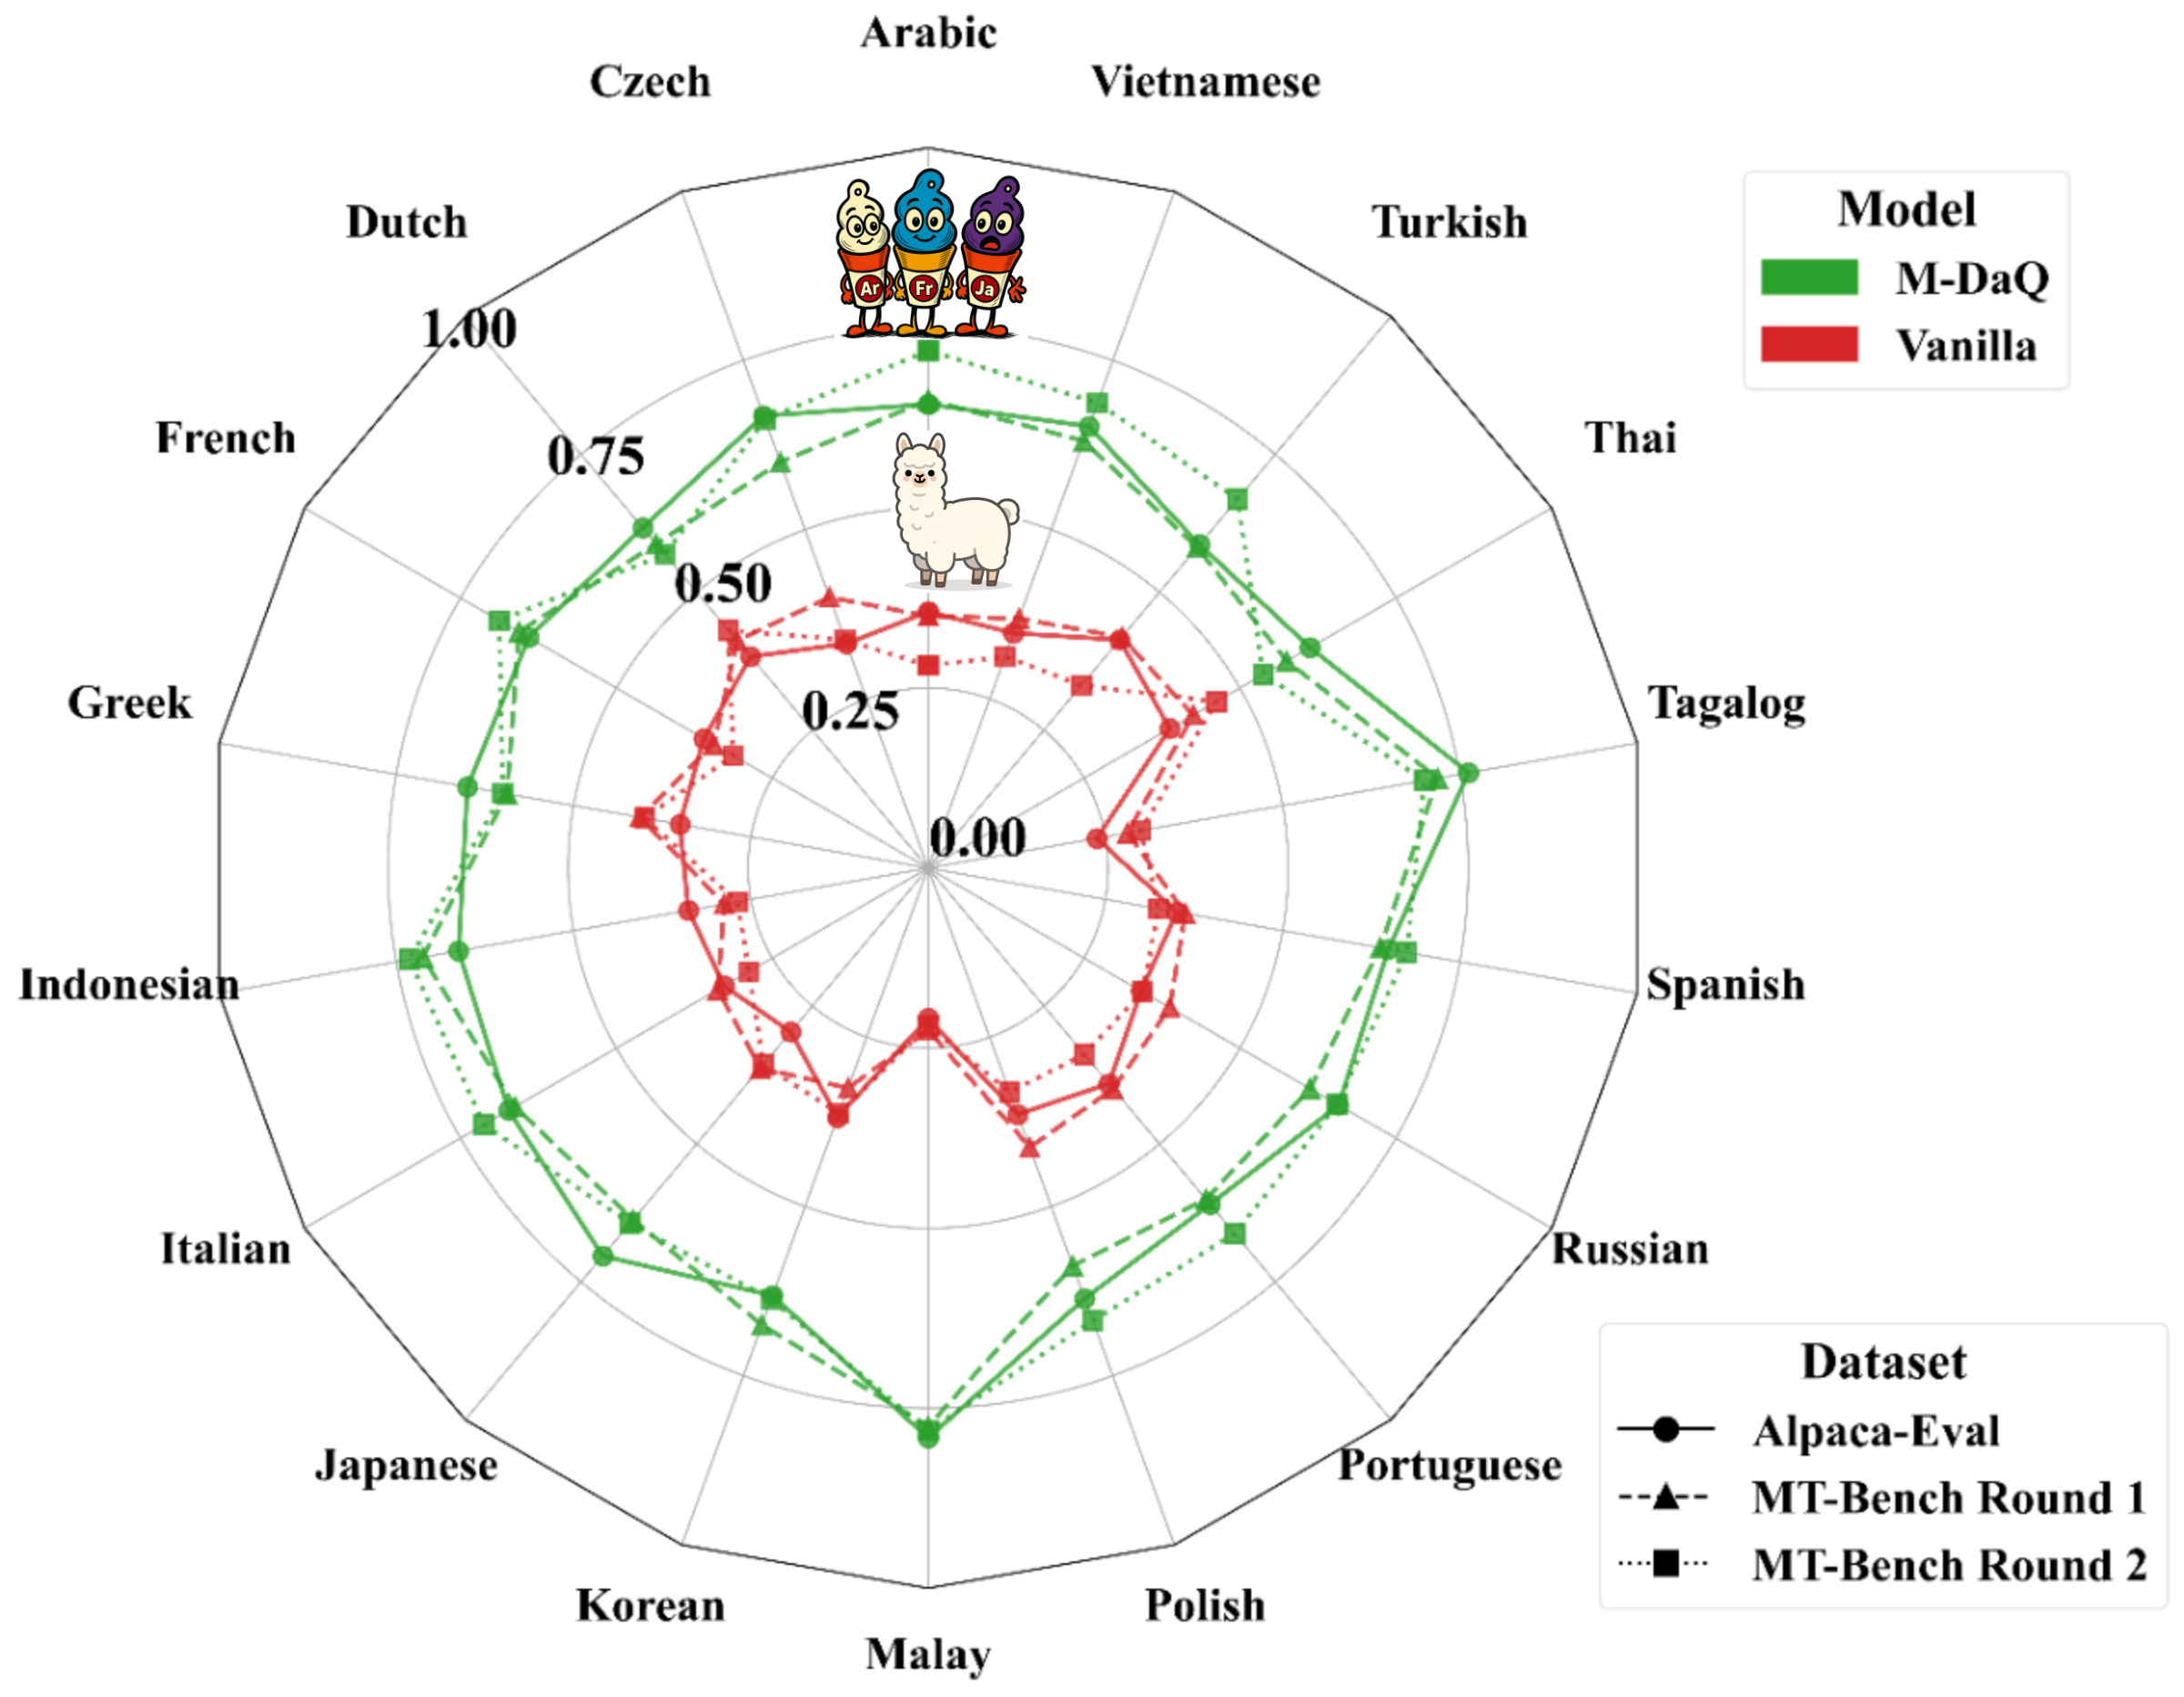
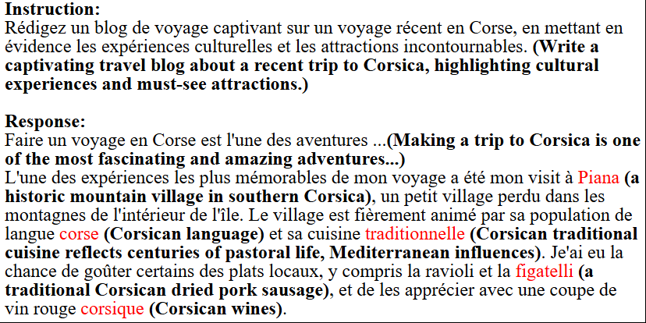
M-DaQ: Retrieving Samples with Multilingual Diversity and Quality for Instruction Fine-Tuning Datasets
Chunguang Zhao¹ · Yilun Liu¹ · Pufan Zeng² · Yuanchang Luo¹ · Shimin Tao¹ · Minggui He¹ · Weibin Meng¹ · Song Xu² · Chen Liu¹ · Hongxia Ma¹ · Li Zhang¹ · Boxing Chen¹ · Daimeng Wei¹
¹ Huawei Technologies Ltd. ² University of Science and Technology of China
SIGIR 2026 · Melbourne, Australia · July 20–24
1 MOTIVATION
3 KEY RESULTS
4 SAH IN MULTILINGUAL SETTINGS
• Multilingual IFT data is scarce, skewed toward English, and lacks systematic curation
• Llama-3 IFT dataset: only 3.01% multilingual samples
• No language-agnostic quality scoring for multilingual data
• Data diversity studied only in English settings
• Superficial Alignment Hypothesis (SAH) unverified in multilingual contexts
LLM-as-Judge: Avg Win Rate (M-DaQ vs Vanilla)
Alpaca-Eval: 60.2% | MT-Bench R1: 62.6% | MT-Bench R2: 62.9%
First systematic investigation of the Superficial Alignment Hypothesis across languages.
Three Challenges Addressed:
Cross-lingual win rates across 18 languages (Alpaca-Eval + MT-Bench)
C1
No extensible quality scoring for multilingual IFT
→ QSM with triplet loss
Win rate vs IFT dataset scale (1K–52K), 8 languages
C2
Diversity selection limited to English
→ DAS inspired by MMR
Key Findings:
• ✅ Diminishing returns: 1K curated > 52K unfiltered
• — SAH holds multilingually
• 10K → −10.1% avg win rate vs 1K baseline
• 52K → −6.2% avg win rate vs 1K baseline
• ⚠️ Language-dependent sensitivity:
• Arabic shows flatter curve than French
• (lower pretraining readiness)
• 💡 A few thousand high-quality samples suffice
• for effective multilingual alignment
C3
SAH unverified in multilingual settings
→ 1K→52K study, 8 languages
2 METHOD: M-DaQ FRAMEWORK
Stage 1: Quality Scoring Model (QSM)
• Fine-tuned on ~2.3K expert-revised samples × 18 languages (from MIDB)
• Triplet loss: instruction → positive (expert-revised) vs negative (original/MT)
• Language-agnostic quality signal from embedding space
Key Observations:
• Consistent improvement across all 18 languages
• Gains MORE pronounced in low-resource languages (Tagalog, Malay)
• M-DaQ effectively mitigates linguistic imbalance and data scarcity
Stage 2: Diversity-Aware Selection (DAS)
• MMR-inspired: Quality ≈ Relevance, Diversity ≈ Novelty
• Two-stage pipeline reduces O(n²) → O(n log n)
• Stage A: Select top-n by QSM score (quality subset)
• Stage B: Greedily augment from uncovered clusters (diversity subset)
• Ratio n_quality : n_diversity = 6:1 (empirically tuned)
Human Evaluation (6 Langs, 900 Samples, 58 Person-Hours):
5 CONCLUSION
Language | Alpaca-Eval | MT-Bench R1 | MT-Bench R2
Japanese | 86% | 84% | 80%
Korean | 94% | 94% | 94%
Russian | 70% | 86% | 84%
Portuguese | 80% | 78% | 84%
Greek | 58% | 76% | 82%
French | 80% | 92% | 88%
Average | 78.0% | 85.0% | 85.3%
• M-DaQ = QSM (quality) + DAS (diversity):
• compact, high-fidelity multilingual IFT subsets
• 60%+ avg win rate across 18 languages
• on Alpaca-Eval & MT-Bench
• Human eval confirms gains in cultural relevance,
• contextual appropriateness, instruction-following
• First empirical validation of SAH
• in multilingual settings
• Code released: github.com/zhaocorey/M-DaQ
Cultural Localization Example:
Figure: M-DaQ two-stage pipeline (QSM + DAS)
📎 Code & Resources
GitHub: github.com/zhaocorey/M-DaQ
📄 Paper
DOI: 10.1145/3805712.3809946
arXiv: 2509.15549
📧 Contact
zhaochunguang6@huawei.com
+86-15501192353
French travel query about Corsica → M-DaQ references Piana, figatelli, local cultural conventions
SIGIR 2026 · Melbourne, VIC, Australia · July 20–24, 2026

