Slide 1

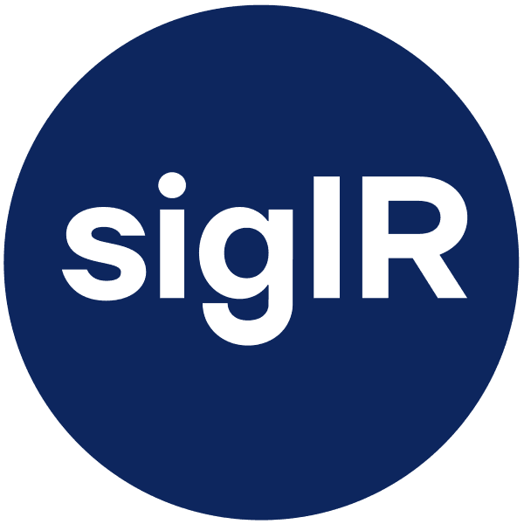

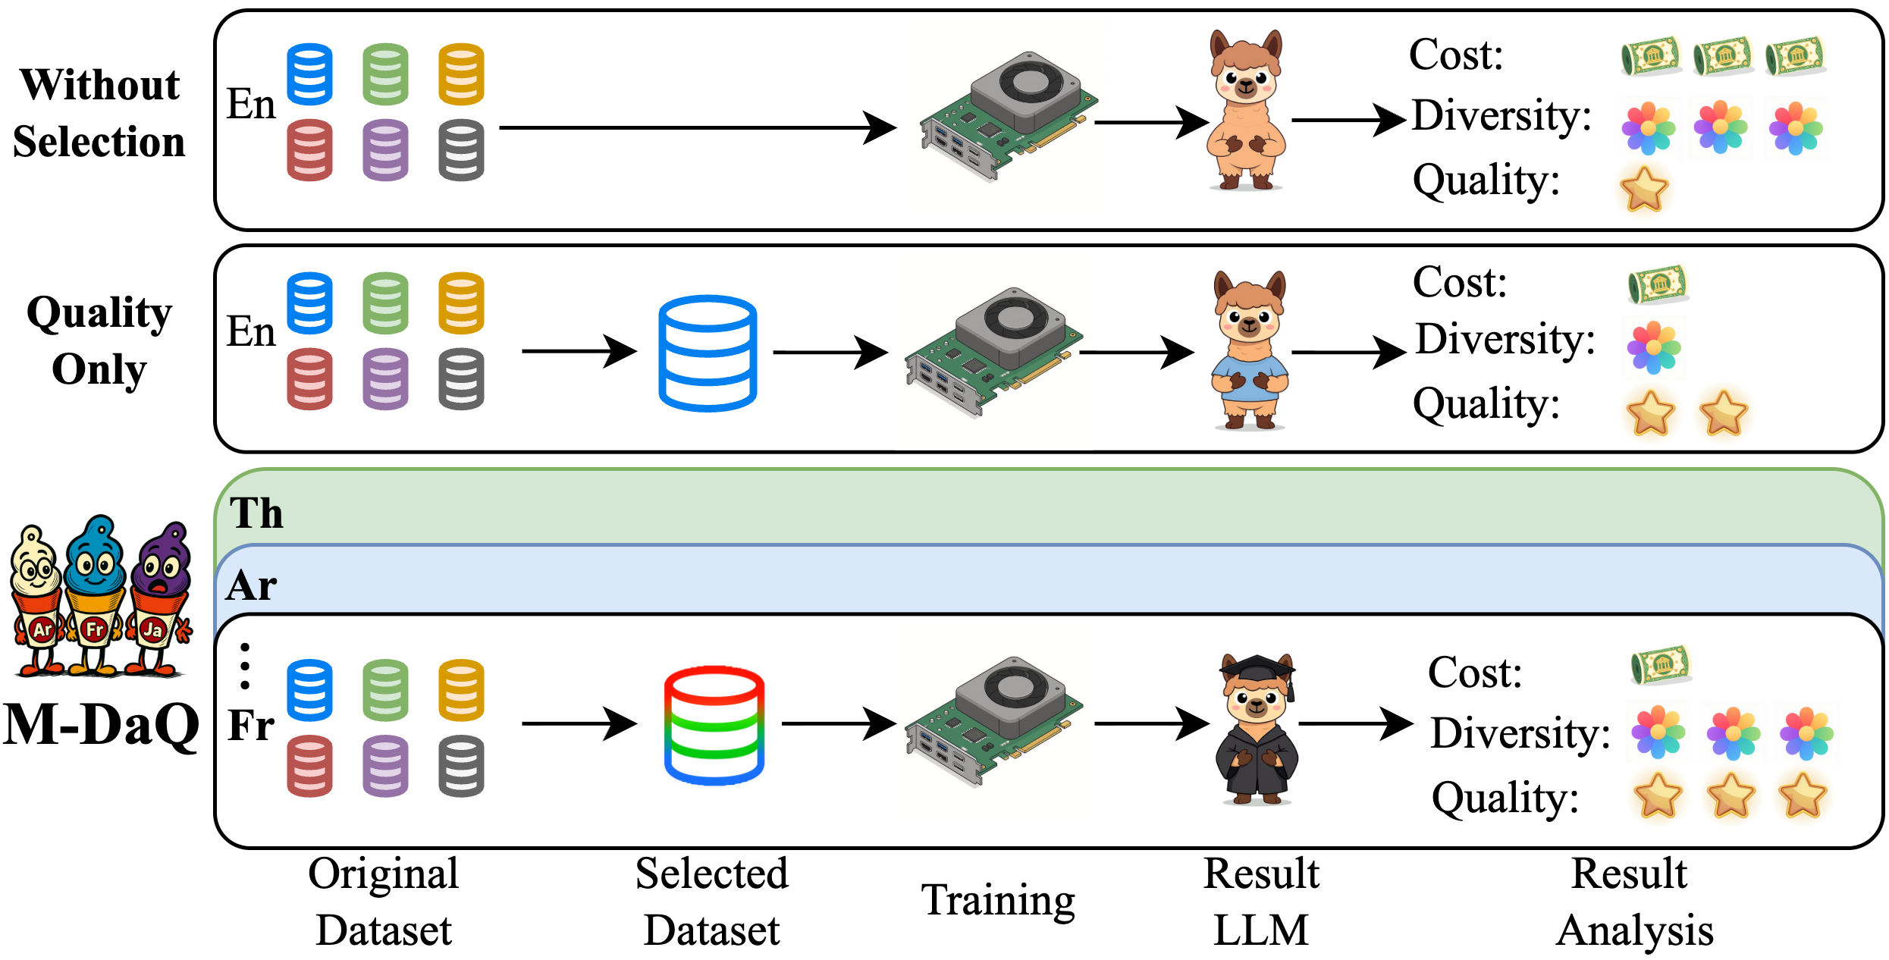
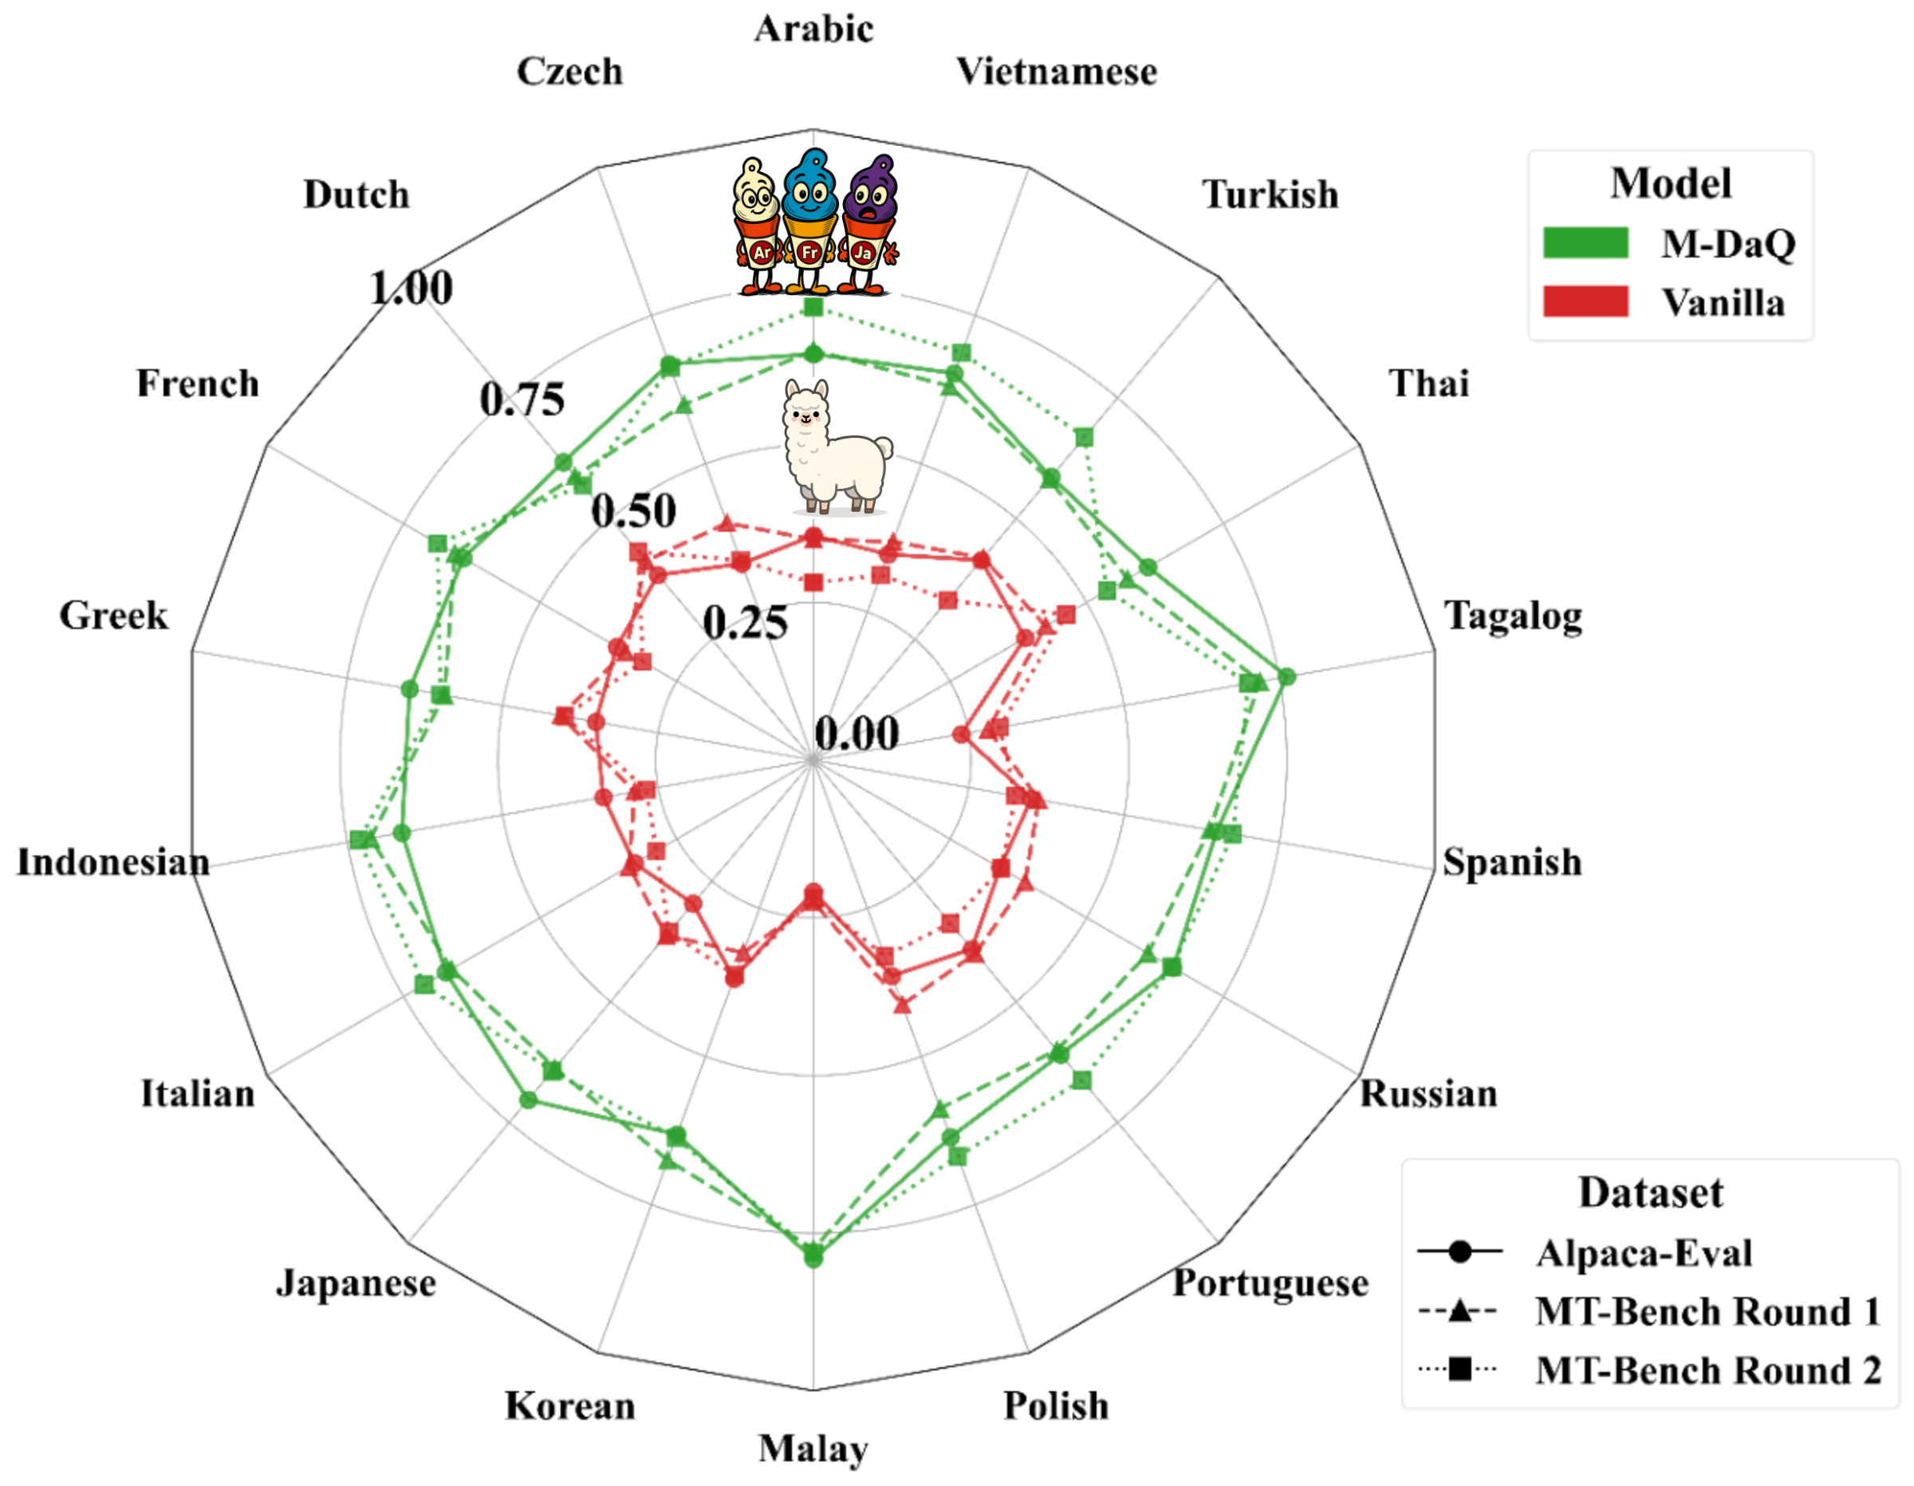
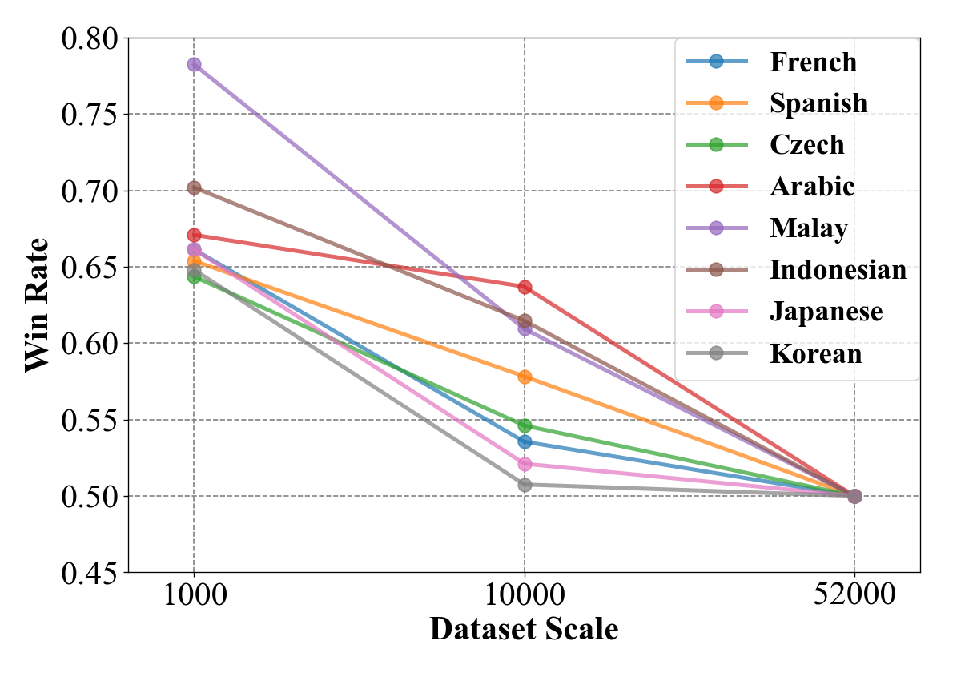
M-DaQ: Retrieving Samples with Multilingual Diversity and Quality for Instruction Fine-Tuning Datasets
Chunguang Zhao¹ · Yilun Liu¹ · Pufan Zeng² · Yuanchang Luo¹ · Shimin Tao¹ · Minggui He¹ · Weibin Meng¹ · Song Xu² · Chen Liu¹ · Hongxia Ma¹ · Li Zhang¹ · Boxing Chen¹ · Daimeng Wei¹
¹ Huawei Technologies Ltd. ² USTC | SIGIR 2026 · Melbourne · July 20–24
1 MOTIVATION
3 KEY RESULTS
• Multilingual IFT data is scarce, skewed toward English, lacks systematic curation
• Llama-3 IFT dataset: only 3.01% multilingual samples
• No language-agnostic quality scoring for multilingual data
• Data diversity studied only in English settings
• Superficial Alignment Hypothesis (SAH) unverified in multilingual contexts
LLM-as-Judge: Avg Win Rate (M-DaQ vs Vanilla)
Alpaca-Eval: 60.2% · MT-Bench R1: 62.6% · MT-Bench R2: 62.9%
Three Challenges Addressed:
C1
No extensible quality scoring for multilingual IFT
→ QSM with triplet loss
C2
Diversity selection limited to English
→ DAS inspired by MMR
C3
SAH unverified in multilingual settings
→ 1K→52K study, 8 langs
2 METHOD: M-DaQ FRAMEWORK
Cross-lingual win rates across 18 languages (Alpaca-Eval + MT-Bench)
Stage 1: Quality Scoring Model (QSM)
• Consistent improvement across all 18 languages
• Gains MORE pronounced in low-resource languages (Tagalog, Malay)
• M-DaQ mitigates linguistic imbalance and data scarcity
• Fine-tuned on ~2.3K expert-revised samples × 18 languages (from MIDB)
• Triplet loss: instruction → positive (expert-revised) vs negative (original/MT)
• Language-agnostic quality signal from embedding space
4 HUMAN EVALUATION
Stage 2: Diversity-Aware Selection (DAS)
6 Languages · 900 Samples · 58 Person-Hours
• MMR-inspired: Quality ≈ Relevance, Diversity ≈ Novelty
• Two-stage pipeline reduces O(n²) → O(n log n)
• Stage A: Select top-n by QSM score (quality subset)
• Stage B: Greedily augment from uncovered clusters (diversity subset)
• Ratio n_quality : n_diversity = 6:1 (empirically tuned)
Language | Alpaca-Eval | MT-Bench R1 | MT-Bench R2
Japanese | 86% | 84% | 80%
Korean | 94% | 94% | 94%
Russian | 70% | 86% | 84%
Portuguese | 80% | 78% | 84%
Greek | 58% | 76% | 82%
French | 80% | 92% | 88%
Average | 78.0% | 85.0% | 85.3%
5 SAH IN MULTILINGUAL SETTINGS
First systematic investigation of SAH across languages.
Win rate vs IFT dataset scale (1K–52K), 8 languages
• ✅ Diminishing returns: 1K curated > 52K unfiltered — SAH holds
• 10K → −10.1% avg win rate; 52K → −6.2% vs 1K baseline
• ⚠️ Language-dependent: Arabic flatter than French
• 💡 A few thousand high-quality samples suffice for multilingual alignment
6 CONCLUSION
Figure: M-DaQ two-stage pipeline (QSM + DAS)
• M-DaQ = QSM + DAS: compact, high-fidelity multilingual IFT subsets
• 60%+ avg win rate across 18 languages on Alpaca-Eval & MT-Bench
• Human eval confirms cultural relevance & instruction-following gains
• First empirical validation of SAH in multilingual settings
• Code: github.com/zhaocorey/M-DaQ
📎 Code & Resources
github.com/zhaocorey/M-DaQ
📄 Paper
DOI: 10.1145/3805712.3809946 | arXiv: 2509.15549
📧 Contact
zhaochunguang6@huawei.com | +86-15501192353
SIGIR 2026 · Melbourne, VIC, Australia · July 20–24, 2026

