Slide 1



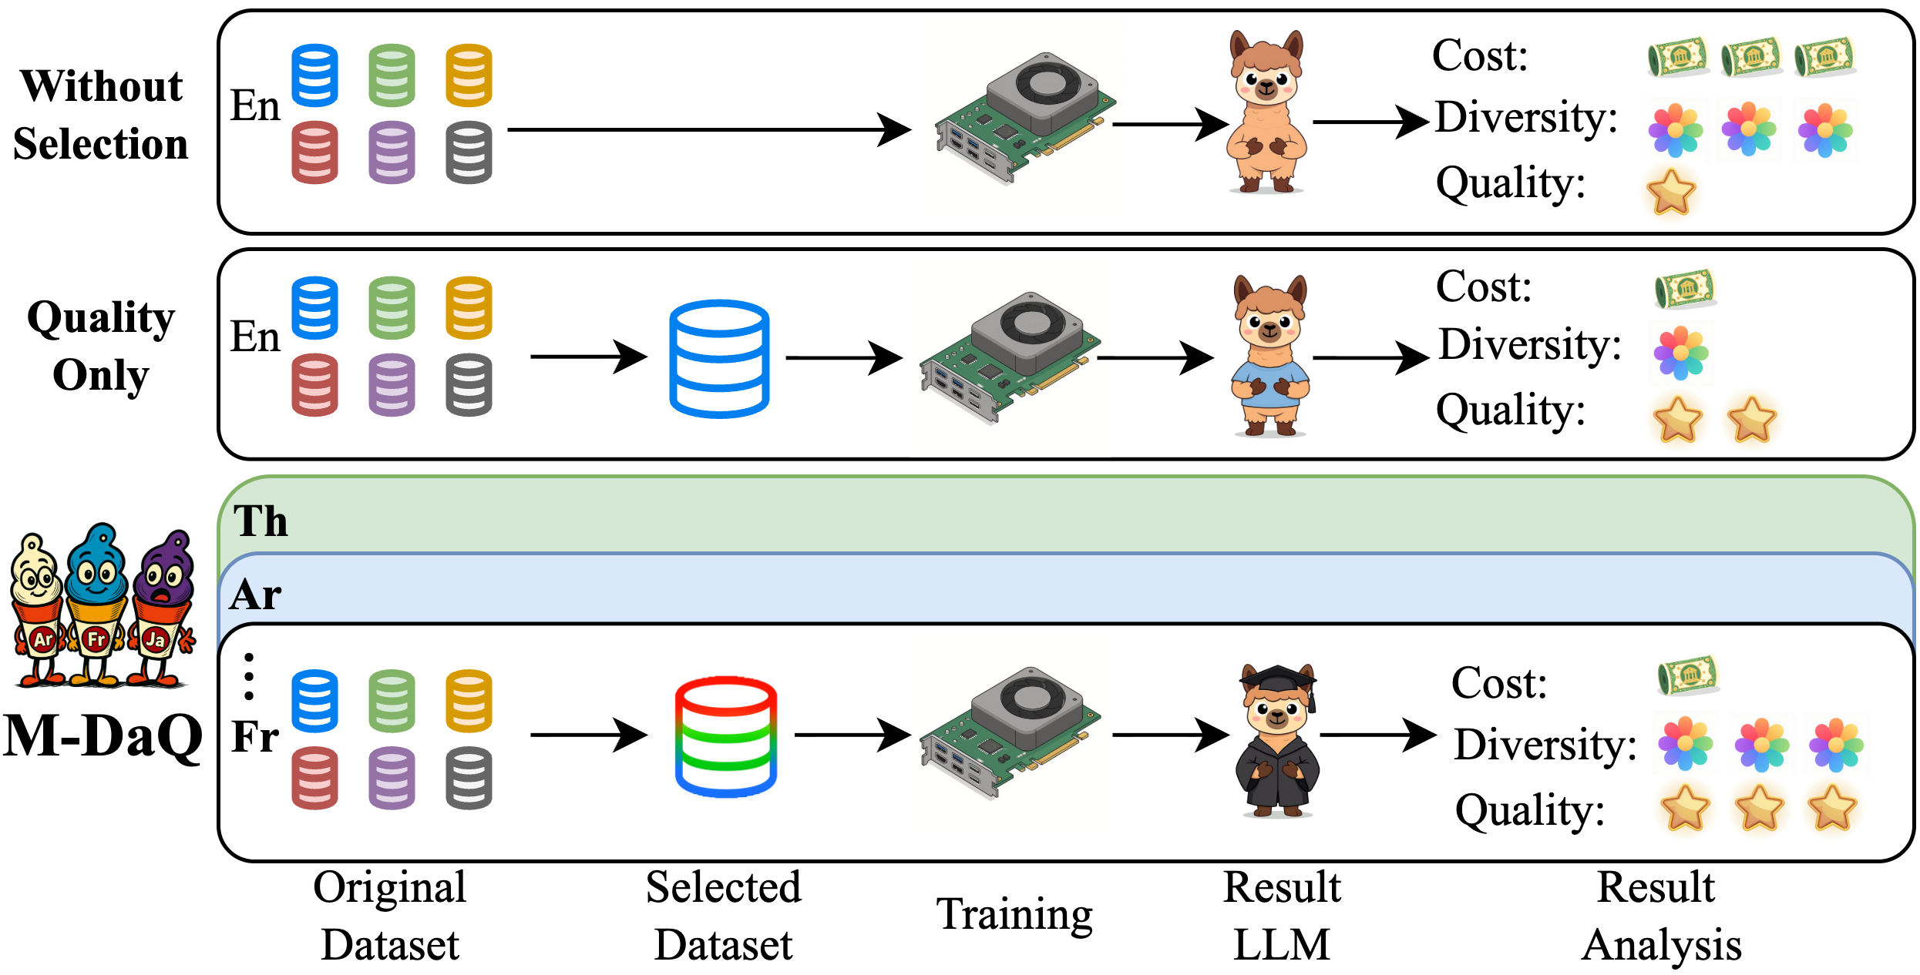
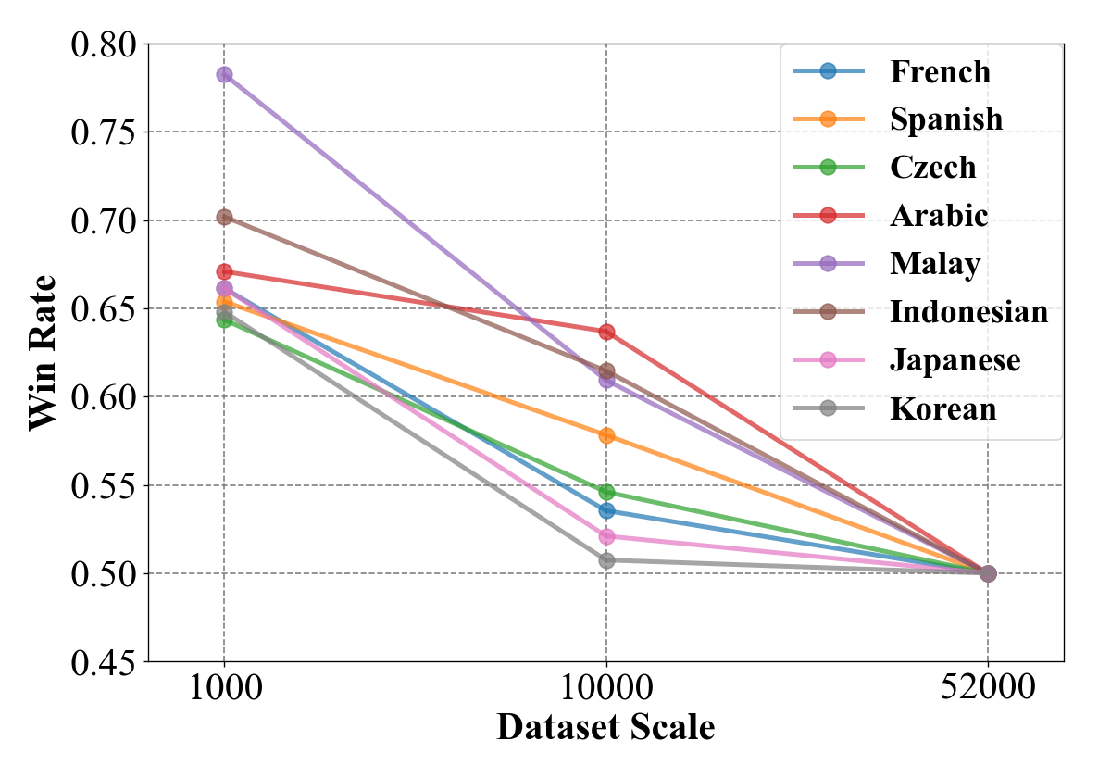
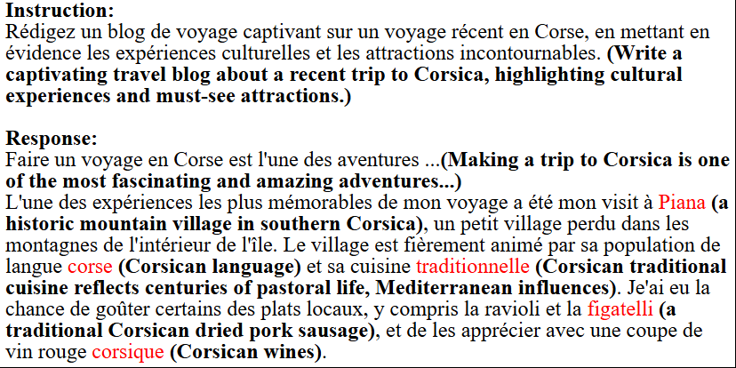
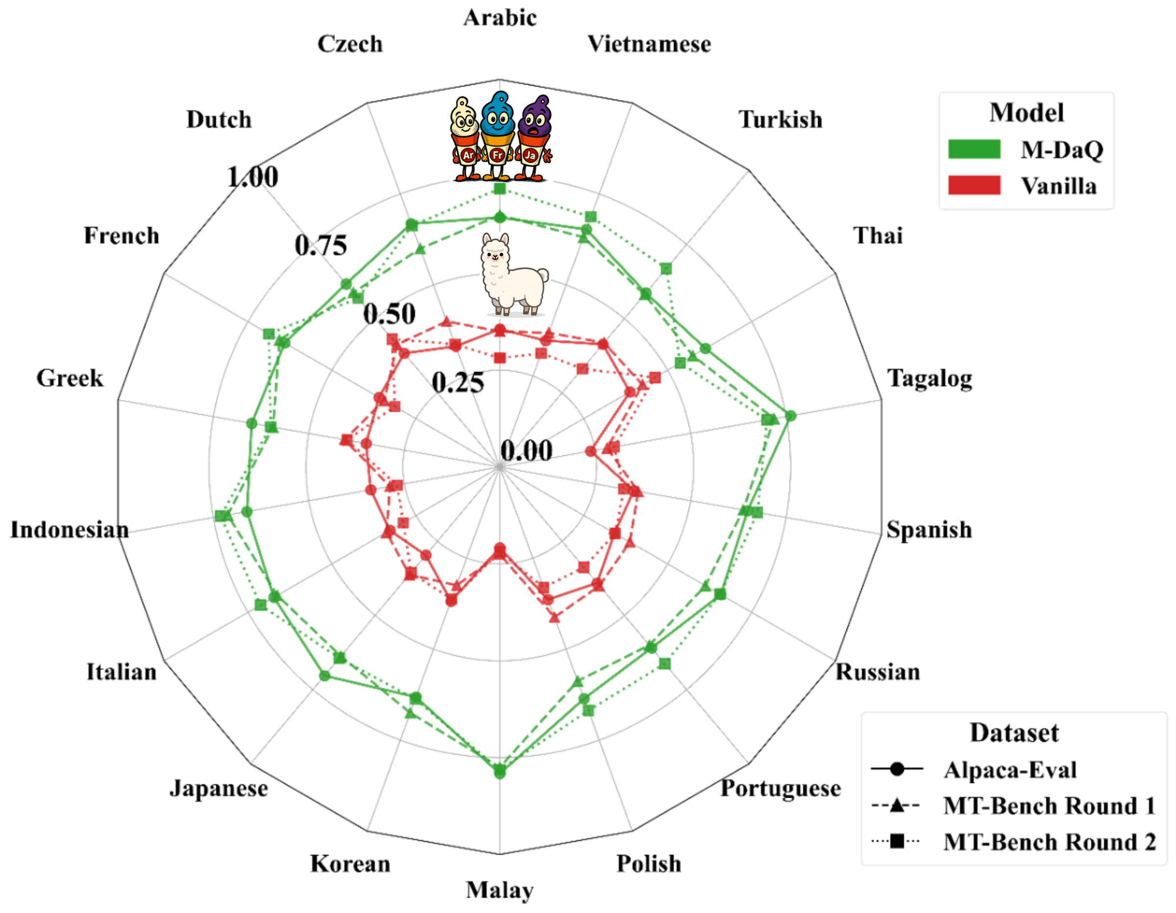
M-DaQ: Retrieving Samples with Multilingual Diversity
and Quality for Instruction Fine-Tuning Datasets
Chunguang Zhao¹ · Yilun Liu¹ · Pufan Zeng² · Yuanchang Luo¹ · Shimin Tao¹ · Minggui He¹ · Weibin Meng¹ · Song Xu² · Chen Liu¹ · Hongxia Ma¹ · Li Zhang¹ · Boxing Chen¹ · Daimeng Wei¹
¹ Huawei Technologies Ltd. ² University of Science and Technology of China
Motivation
Method: M-DaQ Framework
Key Results
• Multilingual IFT data is scarce & skewed toward English
• Llama-3 IFT: only 3.01% multilingual samples
• No language-agnostic quality scoring method
• SAH unverified in multilingual contexts
LLM-as-Judge: M-DaQ vs. Vanilla
Benchmark
Win Rate
Alpaca-Eval
60.2%
MT-Bench R1
62.6%
Challenge
M-DaQ Solution
MT-Bench R2
62.9%
No multilingual quality scoring
QSM (triplet loss)
Stage 1: Quality Scoring Model (QSM)
Human Eval (6 Langs, 58 Person-Hours)
Diversity limited to English
DAS (MMR-inspired)
Language
AE
MT-R1
MT-R2
SAH unverified multilingually
1K→52K, 8 langs
• Fine-tuned on ~2.3K expert-revised samples × 18 languages
• Triplet loss: instruction → positive vs. negative embedding
• Language-agnostic quality signal from embedding space
Japanese
86%
84%
80%
Experimental Setup
Korean
94%
94%
94%
Russian
70%
86%
84%
• Base model: Llama-3-8B
• IFT data: Alpaca-52K × 18 languages
• Training: 3 epochs, lr 5×10⁻⁵
• Judges: LLM-as-Judge + 7 native experts
• Benchmarks: Alpaca-Eval + MT-Bench
Stage 2: Diversity-Aware Selection (DAS)
Portuguese
80%
78%
84%
Greek
58%
76%
82%
• MMR-inspired: Quality ≈ Relevance, Diversity ≈ Novelty
• Select top-n by QSM → greedily augment from clusters
• Ratio n_quality : n_diversity = 6:1 (tuned)
• Complexity: O(n²) → O(n log n)
French
80%
92%
88%
Average
78.0%
85.0%
85.3%
Cultural Localization
SAH Validation
Cross-Lingual Results (18 Languages)
M-DaQ incorporates local knowledge (Piana, figatelli)
vs. generic baseline responses
• 1K curated > 52K unfiltered — SAH holds!
• Diminishing returns beyond quality threshold
• Language-dependent sensitivity observed
Conclusion
Avg. Win Rate: Alpaca-Eval 60.2% | MT-Bench R1 62.6% | R2 62.9%
Gains more pronounced in low-resource languages (Tagalog, Malay)
• QSM + DAS → compact, high-fidelity multilingual IFT
• 60%+ avg. win rate across 18 languages
• Human eval: cultural relevance & instruction-following
• First SAH validation in multilingual settings
• Few thousand quality samples > 52K unfiltered
📎 github.com/zhaocorey/M-DaQ
📎 arXiv:2509.15549
📧 liuyilun3@huawei.com
SIGIR 2026 · Melbourne, VIC, Australia · July 20–24, 2026

