Slide 1
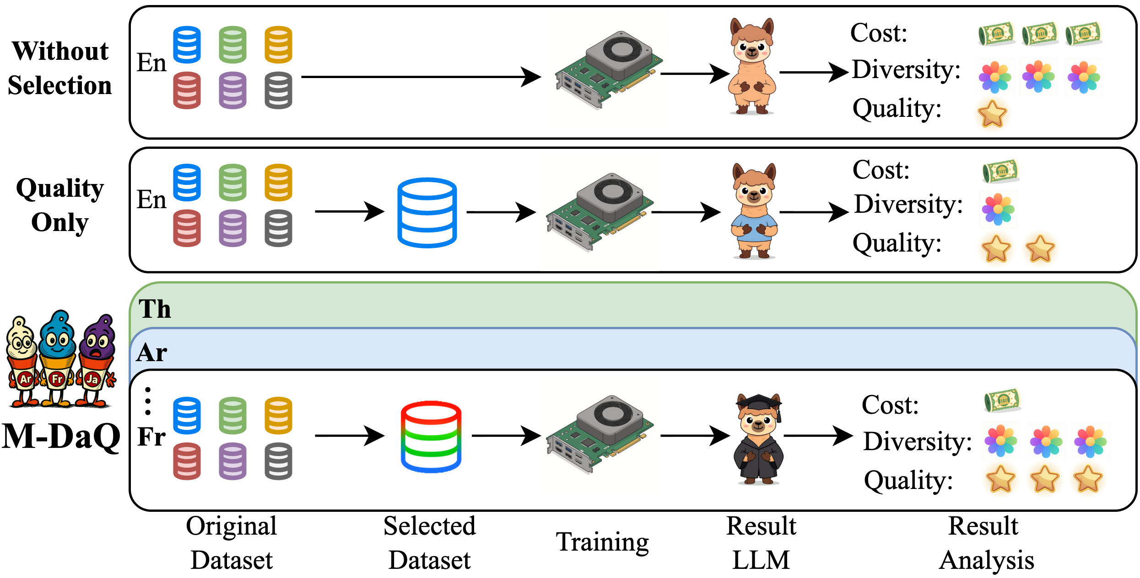
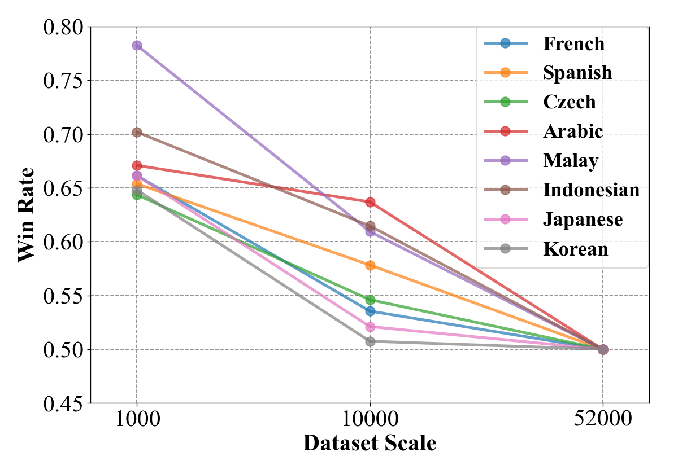
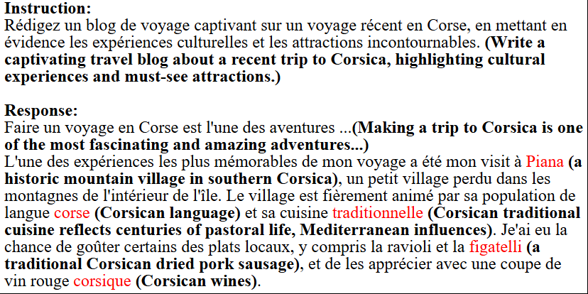
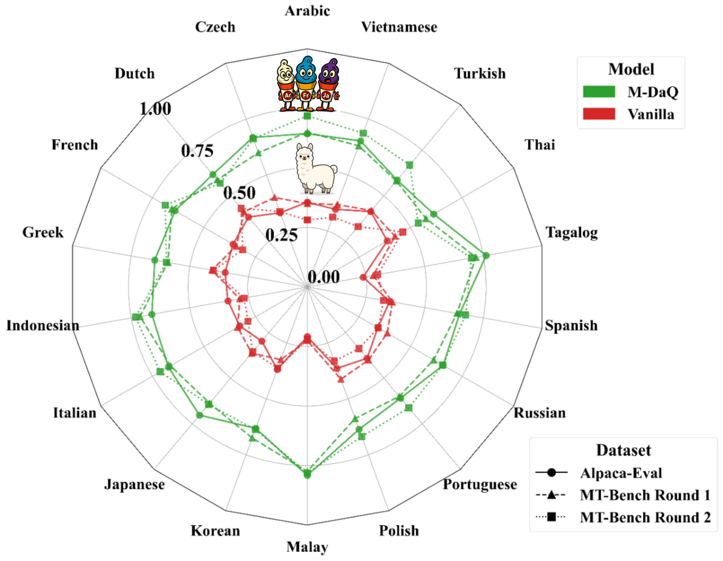
M-DaQ: Retrieving Samples with Multilingual Diversity and Quality for Instruction Fine-Tuning Datasets
Chunguang Zhao¹ · Yilun Liu¹ · Pufan Zeng² · Yuanchang Luo¹ · Shimin Tao¹ · Minggui He¹ · Weibin Meng¹ · Song Xu² · Chen Liu¹ · Hongxia Ma¹ · Li Zhang¹ · Boxing Chen¹ · Daimeng Wei¹
¹ Huawei Technologies Ltd. ² University of Science and Technology of China | SIGIR 2026 | github.com/zhaocorey/M-DaQ
1 MOTIVATION
3 KEY RESULTS
4 SAH IN MULTILINGUAL SETTINGS
• Multilingual IFT data is scarce, skewed toward English, and lacks systematic curation
• Llama-3 IFT dataset: only 3.01% multilingual samples
• No language-agnostic quality scoring method for multilingual data
• Data diversity studied only in English settings
• Superficial Alignment Hypothesis (SAH) unverified in multilingual contexts
LLM-as-Judge: Avg Win Rate (M-DaQ vs Vanilla)
First systematic investigation of the Superficial Alignment Hypothesis across languages.
Alpaca-Eval: 60.2% | MT-Bench R1: 62.6% | MT-Bench R2: 62.9%
Three Challenges Addressed:
C1
No extensible quality scoring → QSM with triplet loss
C2
Diversity selection English-only → DAS inspired by MMR
C3
SAH unverified multilingually → 1K→52K scale study, 8 langs
Figure: Win rate vs IFT dataset scale (1K–52K), 8 languages
2 METHOD
Key Findings:
Stage 1: Quality Scoring Model (QSM)
Figure: Cross-lingual win rates across 18 languages (Alpaca-Eval + MT-Bench)
• ✅ Diminishing returns: 1K curated > 52K unfiltered — SAH holds
• 10K: −10.1% avg win rate vs 1K baseline
• 52K: −6.2% avg win rate vs 1K baseline
• ⚠️ Language-dependent sensitivity:
• Arabic shows flatter curve than French
• (lower cross-lingual pretraining readiness)
• 💡 A few thousand high-quality samples suffice for effective multilingual alignment
• Fine-tuned on ~2.3K expert-revised samples × 18 languages
• Triplet loss: instruction → positive (expert) vs negative (original/MT)
• Language-agnostic quality signal from embedding space
Key Observations:
• Consistent improvement across all 18 languages
• Gains MORE pronounced in low-resource languages (Tagalog, Malay)
• M-DaQ effectively mitigates linguistic imbalance and data scarcity
Stage 2: Diversity-Aware Selection (DAS)
5 CULTURAL LOCALIZATION
• MMR-inspired: Quality ≈ Relevance, Diversity ≈ Novelty
• Two-stage pipeline: O(n²) → O(n log n)
• Stage 1: Select top-n by QSM score (quality)
• Stage 2: Greedily augment from uncovered clusters (diversity)
• Ratio n_quality : n_diversity = 6:1 (empirically tuned)
Human Evaluation (6 Langs, 900 Samples, 58 Person-Hours):
Language Alpaca-Eval MT-Bench R1 MT-Bench R2
Japanese 86% 84% 80%
Korean 94% 94% 94%
Russian 70% 86% 84%
Portuguese 80% 78% 84%
Greek 58% 76% 82%
French 80% 92% 88%
Average 78.0% 85.0% 85.3%
Example: French travel query about Corsica → M-DaQ references Piana, figatelli, local conventions
6 CONCLUSION
Figure: M-DaQ two-stage pipeline (QSM + DAS)
• M-DaQ = QSM (quality) + DAS (diversity): compact, high-fidelity multilingual IFT subsets
• 60%+ avg win rate across 18 languages on Alpaca-Eval & MT-Bench
• Human eval confirms gains in cultural relevance, contextual appropriateness, instruction-following
• First empirical validation of SAH in multilingual settings
• Code: github.com/zhaocorey/M-DaQ
📎 Code: github.com/zhaocorey/M-DaQ
📄 Paper: arXiv:2509.15549
📧 Contact: liuyilun3@huawei.com
SIGIR 2026 · Melbourne, VIC, Australia · July 20–24, 2026

