Slide 1















1
Yanfeng Ouyang

Slide 2







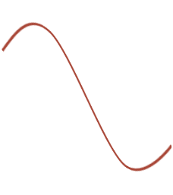
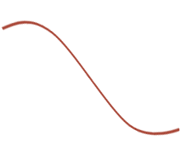


















Slide 3
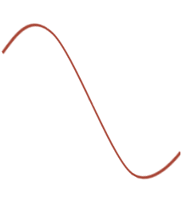
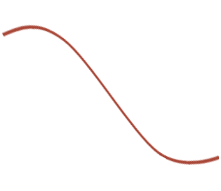

Slide 4

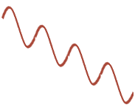
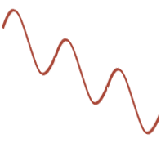
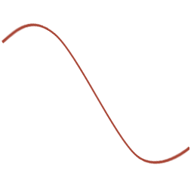
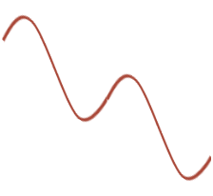










Slide 5
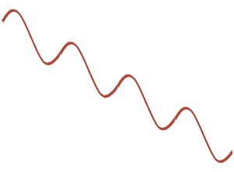
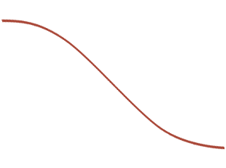
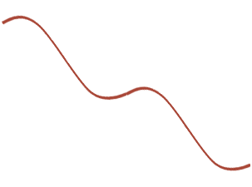
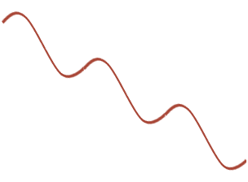













Slide 6





Slide 7


Slide 8















Yanfeng Ouyang

Slide 9
Decentralized Systems
System-level instability
  disturbances amplified across system
  compromise system performance
Can we achieve centralized performance with decentralized control?
  stabilize
  optimize
Yanfeng Ouyang
Notes:
In many transportation systems the individual elements behave autonomously with their local information… because it is often difficult and costly to establish full centralized control. Decentralization increases the chance for localized disturbances to be amplified as they propagate across the system. We call this amplification system-level instability, and it compromises overall system performance.
Therefore, a goal of my work has been finding decentralized control schemes that stabilize and optimize such systems. Now, I am going to explain these ideas with supply chains. In this field, instability is very prevalent.
Examples include freeways, elevator systems, and supply chains.

Slide 10
Outline
Basics
  Background
  The bullwhip effect
Deterministic chain stability
  System formulation
  Analytical results
Stochastic chain stability
  System formulation
  Analytical results
Toward optimality
  Decentralized negotiations
  Advance order commitment
Yanfeng Ouyang
Notes:
Okay. Now let’s get back to our supply chains. First we will analyze a deterministic inhomogeneous chain.

Slide 11
Goal
Establish a system-control framework
  Generalize past work on deterministic and homogeneous system (Daganzo, 2001, 2003a, b; Dejonckheere et al., 2003a, b)
  Further understand the bullwhip effect
Develop analytical methods to examine the existence of the bullwhip effect
Yanfeng Ouyang
Notes:
Again, our goal for this part is to establish a system-control framework that generalizes past work on deterministic and homogeneous system. Specifically we aim to develop analytical methods to examine the existence of the bullwhip effect for general ordering policies

Slide 12
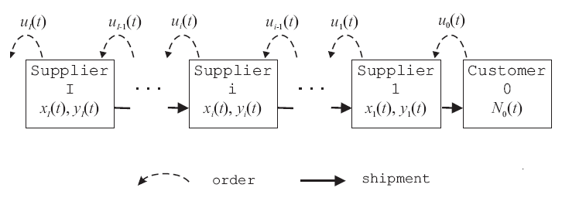
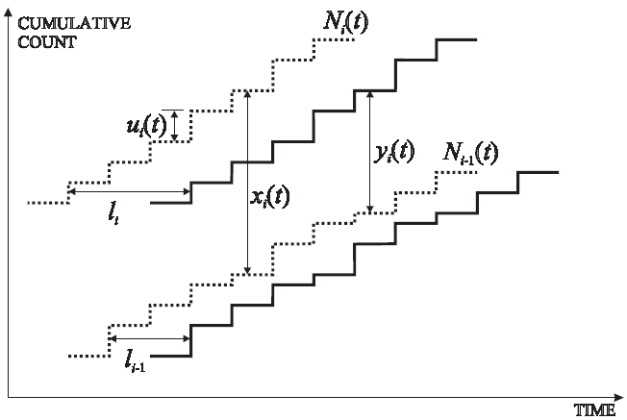
Supply Chain Representation
Definitions
N_{i}(t) = cumulative orders placed by supplier i by period t
u_{i}(t) = order placed by supplier i in period t
y_{i}(t) = in-stock inventory
x_{i}(t) = inventory position
l_{i} = lead time
Notes:
We use the following chart to represent a supply chain, where the suppliers are indexed consecutively.
If we plot over time the cumulative orders placed by each supplier, then the solid curve shifted to the right represents cumulative shipment arrivals. This type of cumulative curves is widely used in traffic analysis and queuing systems.
At any time, the vertical separation between the arrival curve and this order curve will be the in-stock inventory of supplier i. And the separation between the N curves is called inventory position. It is the in-stock inventory plus the products that have been ordered but haven’t arrived.

Slide 13
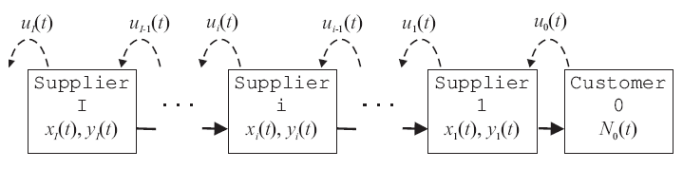
Assumptions
Decentralized decision-making
Rational ordering decisions
Linear ordering policy
Deterministic system operations
Notes:
Before proceeding, let’s elaborate on some assumptions. First the suppliers make independent ordering decisions based on private information. Such information include their own inventory records and the history of orders received from their immediate neighbors. Also we assume the suppliers are rational, so they use ordering policies that tend to stabilize their own conditions. For now we assume that the ordering policy is linear, and the operations in the supply chain is deterministic.

Slide 14

System Dynamics
Inventory dynamics:
Ordering policy:
P: shift operator; i.e. P^{k}x(t) = x(t–k), ∀ integer k ≥ 0
A_{i}(·), B_{i}(·), C_{i}(·): polynomials with real coefficients;
γ_{i}: constant
Equilibriumstate:
Yanfeng Ouyang
Notes:
By conservation law, it is straightforward to derive the inventory evolution over time. For example, the separation here at (t+1) equals the separation at (t) plus the difference of the two u(t) jumps.
At each period, the suppliers will place orders based on some policy. As said, we assume that the ordering policy is linear with regard to all private information. Here P is a shift operator and A, B, C are polynomials of P. So A(P)x_i(t) is a linear combination of x_i(t), x_i(t-1), … and so on. The whole right hand side then is a most general combination of historical information on past inventory and orders received.
For the policy to be rational, there must exist a steady state such that when the demand is a constant u_inf, the steady inventories x_inf and y_inf satisfy this relationship.

Slide 15
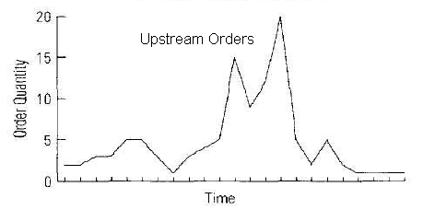
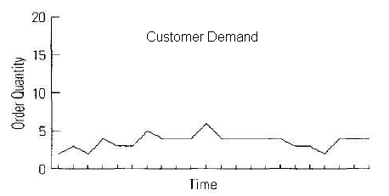
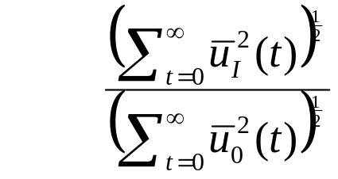
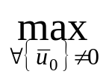

The Bullwhip Effect Metric
RMSE amplification
, where .
Worst-case (L₂ norm gain)
Yanfeng Ouyang
Notes:
Remember the bullwhip effect refers to the phenomenon that order variations increases along the chain. The sum of squared deviations from the nominal value measures sample variance. For any given demand sequence u0, the amplification of variance can be measured by the ratio. Since we have no control over customer demand, we calculate this amplification for all input demand, and use the largest one as our bullwhip effect metric.
Earlier researchers assumed a certain sequence u0(t) here. This greatly simplifies the problem, but largely compromises the generality of their results.

Slide 16
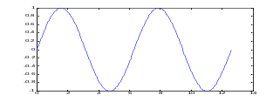
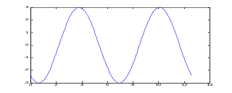
Frequency Response Analysis
Linear Supply Chain
(Arbitrary) Customer demand sequence
{u₀(t)}
Sinusoidal output components
Fourier Decomposition
Sinusoidal input components
Superposition
Upstream supplier order sequence
{u_{I}(t)}
?
Frequency preserves; the amplitude and phase angle changes according to the transfer function.
Notes:
Given an arbitrary input sequence, it is still hard to analyze the response of a linear system directly.
However, we can play a trick to simplify the problem. We can decompose the demand sequence into a set of sinusoidal components. Then feed each of them into a linear system, and the output would also be sinusoidal with the same frequency. Then by superposing the sinusoidal output components, we can obtain the upstream order sequence.
There are two advantages for doing this : One is that instead of checking all the possible customer demand sequences, we can focus on the whole spectrum of the sinusoidal components and make sure none of the frequencies on the spectrum gets amplified. The second advantage is that the complexity of analyzing a multiple-echelon chain is almost the same as that for a single-echelon chain.
Sinusoid [‘sai nә soid]

Slide 17
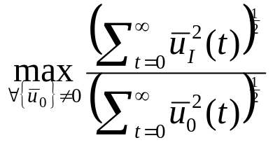
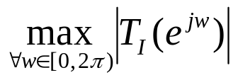
The Bullwhip Effect Metrics
Time domain
Worst-case RMSE amplification
(L₂ norm gain)
Frequency domain
The peak value on the Bode plot
(H∞ norm)
where T_{I} is the transfer function from customer demand to supplier I orders.
Yanfeng Ouyang
Notes:
Standard control theory will show that the time domain metric we just defined is exactly equivalent to the maximum norm of the transfer function across the frequency spectrum. This metric is much easier to deal with, but of course, we need to have to obtain the transfer function.

Slide 18
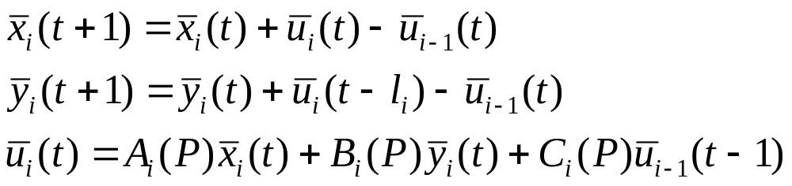
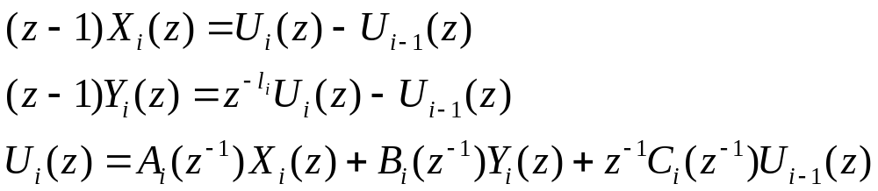
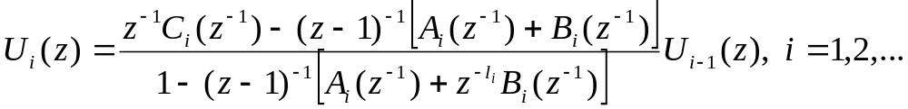
System Dynamics
For each variable, take its difference from the equilibrium-state value
∀ i, t > 0
In the frequency domain (z-transform):
Eliminating X_{i}(z) and Y_{i}(z),
Yanfeng Ouyang
Notes:
So we follow the standard and simple steps to derive the system dynamics in the frequency domain. Let’s don’t worry about the details. Here we collect the dynamics, the transform them into the frequency domain. Then simple algebra gives the relationship between orders received versus the orders placed at one supplier.

Slide 19
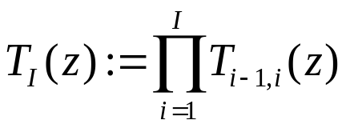
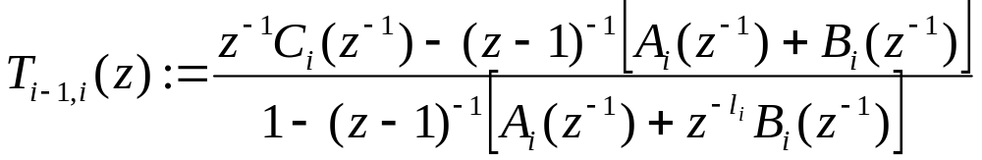
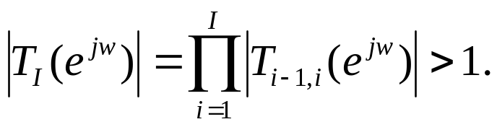
The Transfer Function
The transfer function from the customer demand to the upstream orders of supplier I is
where
To examine the bullwhip effect, check the H∞ norm:
whether ∃w ∈ [0, 2π), such that
Yanfeng Ouyang
Notes:
We can easily obtain the transfer function from the customer demand to upstream order. Then, to examine the bullwhip effect, we just need to check whether there exists a frequency w that makes the transfer function norm greater than 1.

Slide 20
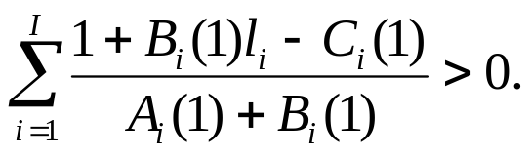
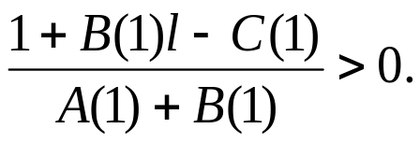
Deterministic Chain Results
Theorem 1 (Sufficient condition for instability)
Supplier I+1 in the deterministic (LTI) supply chain experiences the bullwhip effect if
Corollary 1 (Homogeneous chain)
When A_{i} = A, B_{i} = B, C_{i} = C, and l_{i} = l, ∀i, all upstream suppliers experience the bullwhip effect if
Yanfeng Ouyang
Notes:
For any policy, Theorem 1 provides a very simple analytical method to examine the existence of the bullwhip effect. Note that all the parameters in A B and C are known from the ordering policy. See how the difficult problem reduces to very simple conditions?
For a homogeneous chain, such that all the suppliers have the same ordering policy, and they face the same lead time, the condition is even simpler. The left hand side here turns out to be the sensitivity of equilibrium inventory to equilibrium order quantities. It is a key parameter to show how the supplier controls the inventory.
(My advisor was very excited by this result, as it is consistent with but generalizes his result from a totally different approach.)

Slide 21
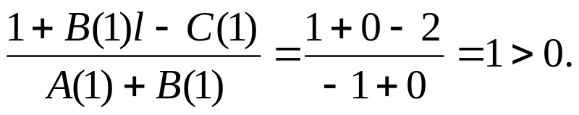
Example (Homogeneous Chain)
Order-up-to policy
  Variable “order-up-to level”: two-period moving-average demand forecasting
  Lead time l = 2
By Corollary 1:
The bullwhip effect exists for sure!
Yanfeng Ouyang
Notes:
(explain jargon – order-up-to policy) Now let me show you a simple example where suppliers all use an order-up-to policy with varying levels. Every period the supplier places an order so that his inventory position reaches a certain level that is determined by a moving average demand forecasting. Then we can write the polynomials and plug them into our condition. It satisfies the condition, and we are confident to state that there is going to be the bullwhip effect!

Slide 22
Outline
Basics
  Background
  The bullwhip effect
Deterministic chain stability
  System formulation
  Analytical results
Stochastic chain stability
  System formulation
  Analytical results
Toward optimality
  Decentralized negotiations
  Advance order commitment
Yanfeng Ouyang
Notes:
I have shown you some results for deterministic chains. Now I am going to talk about stochastic chains. Remember, in stochastic chains we additionally allow for operation uncertainties. This is important to address, since….

Slide 23
Motivation
Stochastic Environment
  Unreliable shipments, variable lead times, price fluctuations, etc.
  Randomness may affect system stability (bullwhip effect)
Develop analytical conditions to examine the existence of the bullwhip effect
Yanfeng Ouyang
Notes:
Very often the operations are also likely to be stochastic, and this stochasticity is likely to affect system stability. For example, the shipments may be unreliable and subject to damage.

Slide 24
System Dynamics
Return to the time-domain formulation
∀ i, t > 0
Simple algebra gives
Yanfeng Ouyang
Notes:
While dealing with a stochastic network, we can no longer use our model in the frequency domain because the dynamics is no longer linear. So we return to the time-domain formulation and derive a similar input-output relationship, where the order of one supplier is a linear combination of his/her own past orders, and the orders he received from downstream.
The formula can be illustrated in a time-space plane. The vertical axis is the supplier index, and the horizontal axis is time. As we said, the order here is depends on all the past orders here. The coefficients on these arrows can be determined from the formula.
By a standard state expansion technique, we are able to consolidate the relationship into this fashion, while the state now becomes a vector. The matrices R and S are determined from the previous formula, and they contain all the system parameters that may be stochastic. For a deterministic system, these two matrices will be the same over time. For a stochastic system, we will allow them to be random functions of time.

Slide 25
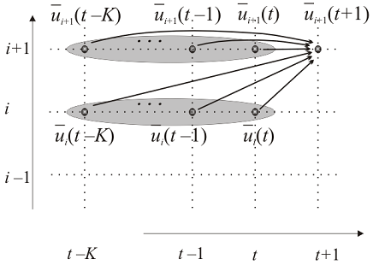
System Dynamics
Supplier index
Simple algebra gives
time
Yanfeng Ouyang

Slide 26
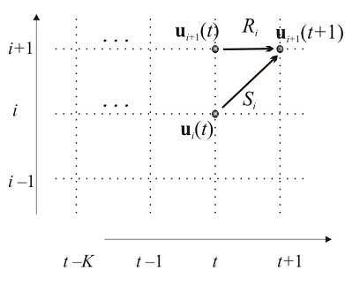

System Dynamics
Supplier index
Let , then

Slide 27
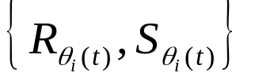
Markovian Jump Linear System (MJLS)
Allow stochastic model parameters
Consider
where matrix pair takes value from a finite set according to an exogenous Markov chain {θ_{i}(t)}.
θ_{i}(t) ∈ M_{i} = {1, 2, …, M_{i}}, with transition probability matrix
P_{i} = [p^{i}_{mn}]_{Mi× Mi}.
Yanfeng Ouyang
Notes:
Note that R and S contains all the system parameters. So any stochastic changes in the system specification can be accommodated in this formulation.

Slide 28
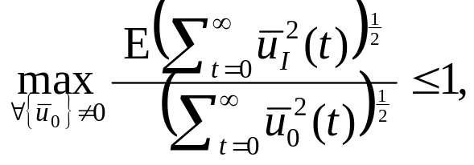
The Bullwhip Effect Metric
(Expected L₂ norm gain)
There is no bullwhip effect if
where the expectation is taken across Markov chain realizations.
Yanfeng Ouyang
Notes:
Then we an define the bullwhip effect metric similarly, except the expectation on the numerator because given u0. This is because for any realization of u0, the sequence of u1 now is a random process.

Slide 29
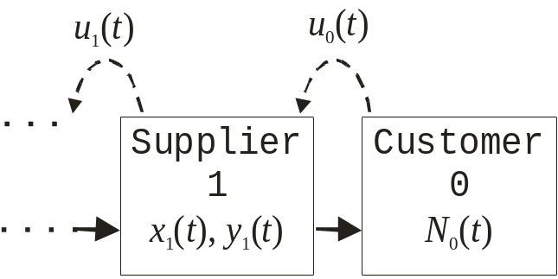



Simplifying Assumption
Homogeneous supply chain
  Only need to consider one supplier, i.e., i = 1
  Drop subscript i; e.g.,
  When , let
Yanfeng Ouyang
Notes:
There are a lot of control literature on MJLS that can be applied to our problem. Let me just show you the simplest example of a homogeneous chain where every supplier is now probabilistically identical. Here we only need to consider one supplier and we can drop the subscripts.

Slide 30
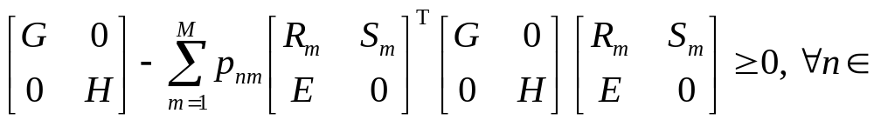
Stability Results
Theorem 2 (Sufficient condition for stability)
The bullwhip effect is avoided if there exists non-zero, positive semi-definite matrices G ≥ 0 and H := diag(h₀, h₁, …, h_{K}) ≥ 0 such that
where and E is the identity matrix.
M ,
Theorem 3 (Necessary condition for stability)
The condition in Theorem 2 is also necessary if:
  the system is “weakly controllable” (Ji and Chizeck, 1988)
  the transition probabilities satisfy p_{nm} ≡ p_{m}, ∀n∈M .
Yanfeng Ouyang
Notes:
With this set up, I was able to derive condition to examine the bullwhip effect. This theorem looks complicated but is actually very simple. The R and S’s and H, E are all known or available from data. We only need to search for a positive semi-definite matrix G that makes the left hand side positive semi-definite as well. This can be easily implemented in a math software.

Slide 31
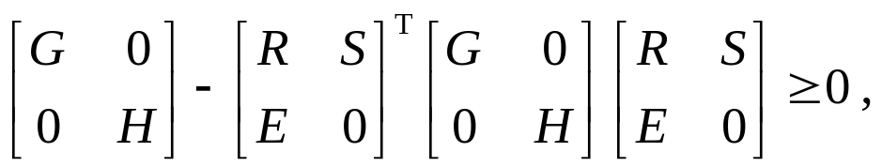
Stability Results
Corollary 2 (Deterministic chains)
The bullwhip effect is avoided in deterministic LTI chains if and only if there exists non-zero matrices G ≥ 0 and H := diag(h₀, h₁, …, h_{K}) ≥ 0 such that
where and E is the identity matrix.
Yanfeng Ouyang
Notes:
With this set up, I was able to derive condition to examine the bullwhip effect. This theorem looks complicated but is actually very simple. The R and S’s and H, E are all known or available from data. We only need to search for a positive semi-definite matrix G that makes the left hand side positive semi-definite as well. This can be easily implemented in a math software.

Slide 32
Example (Deterministic Chain)
A family of “order-based” policies with advance demand information
  where
Yanfeng Ouyang

Slide 33
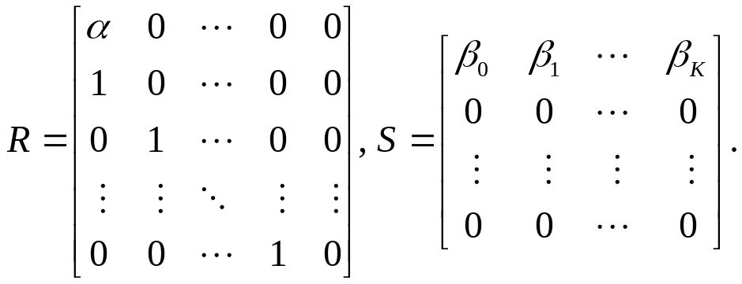
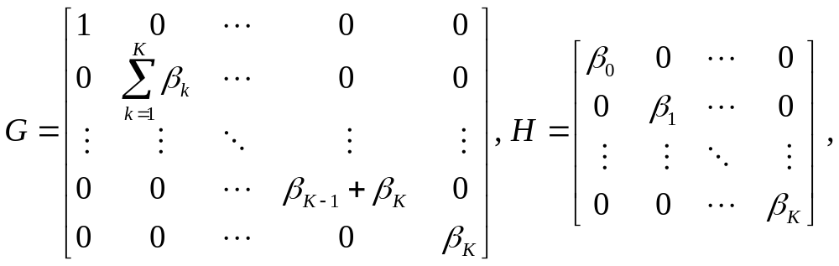
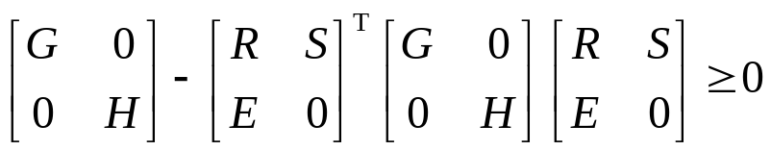
Note:
When G and H are as follows:
the stability condition in Corollary 2:
is satisfied. There is no bullwhip effect.

Slide 34
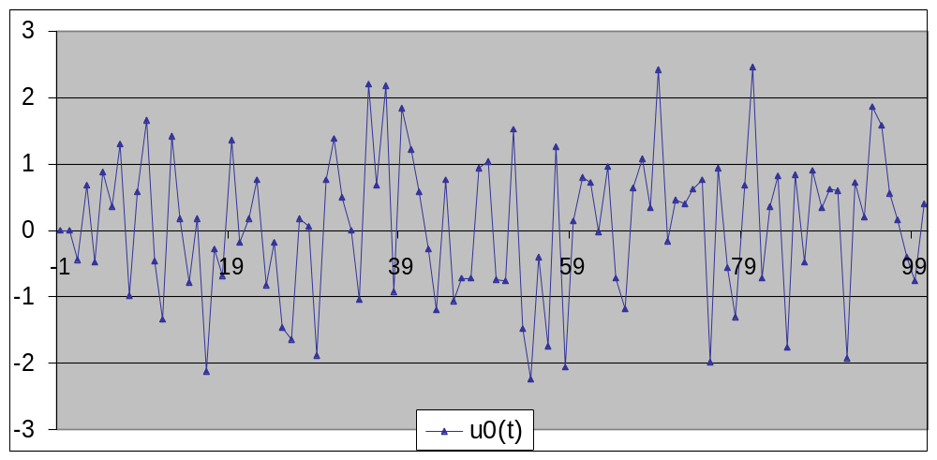
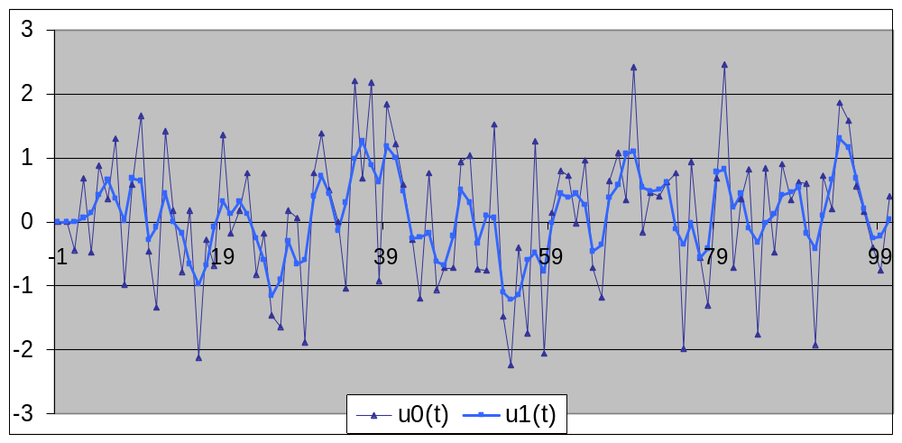
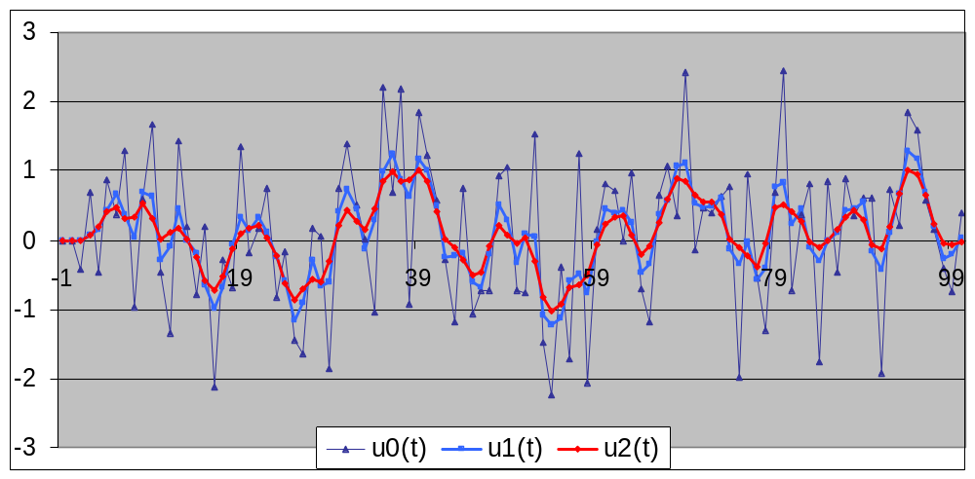

Simulation
~ i.i.d. Gaussian (0, 1), α = 0.4, β ₀ = β ₁ = 0.3 (K=1)

Slide 35
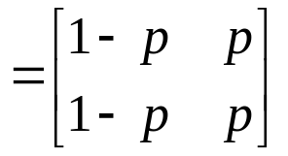

Example (Stochastic Chain)
Shipments lost with probability p
  Transition probability matrix (|M| = 2)
The order-up-to policy
  Safe mode
  Loss mode
P
Yanfeng Ouyang
Notes:
Now let me follow up with the earlier example. Assume that a shipment is subject to loss with an independent probability. The loss can be interpreted for example as real loss during shipping like if there is a war. Or, it can be fragile or perishable goods which may just get lost during shipment.
In this system, there are two effective system dynamics: one is when the shipment is safe, the other is when the shipment is lost.

Slide 36
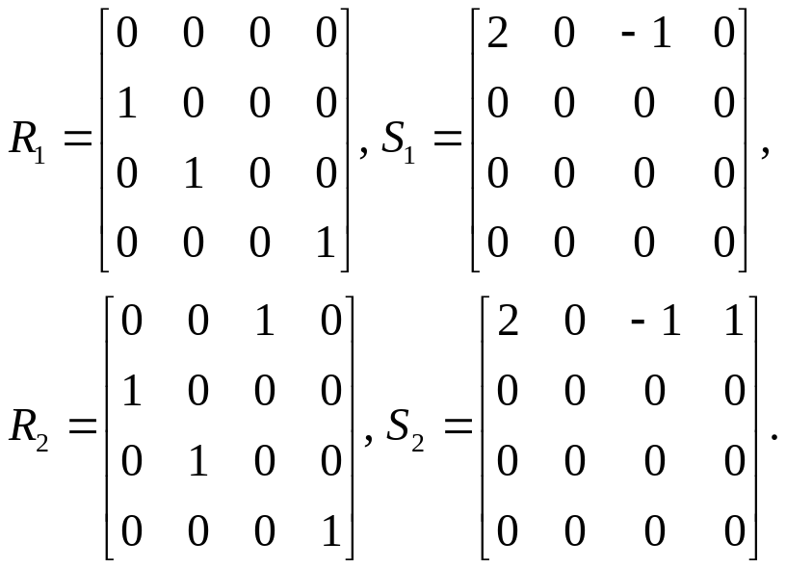
Example (Stochastic Chain)
Let
  Safe mode (m = 1)
  Loss mode (m = 2)
Result
  A numerical search reveals that matrices G and H satisfying Theorem 2 do not exist, ∀p∈[0,1]
  The bullwhip effect exists
Notes:
I can’t find a positive semi-definite matrix G that make the matrices positive semi-definite. Then we will have the bullwhip effect. To verify this, I did some simulations for this system.

Slide 37
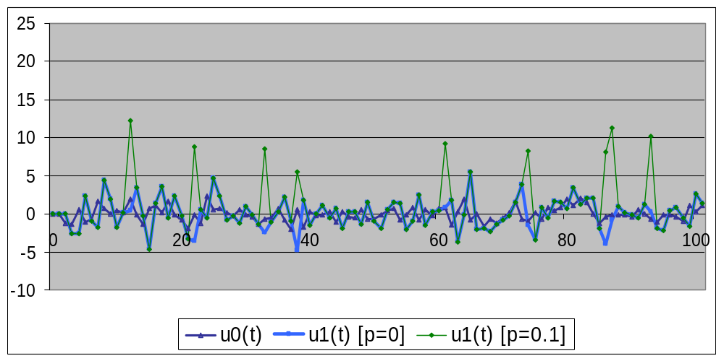
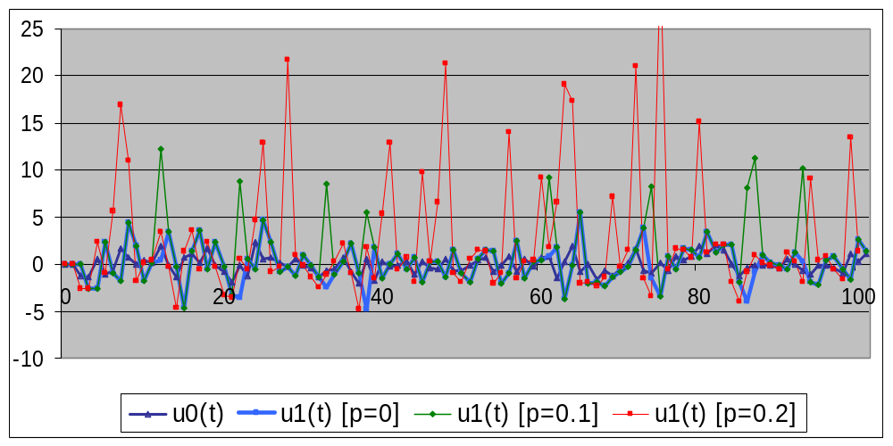
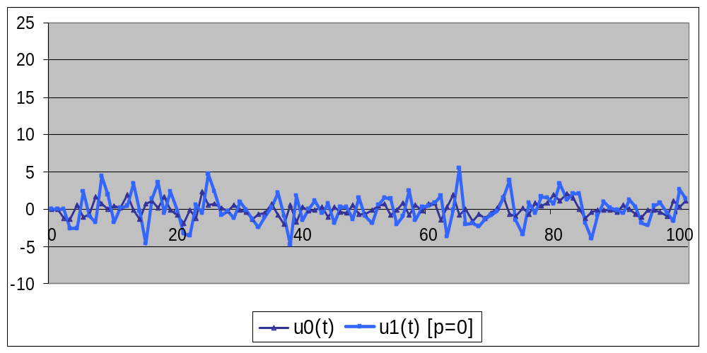


~ i.i.d. Gaussian (0, 1)
Plot under both deterministic condition (p = 0) and stochastic conditions (p = 0.1, p = 0.2)
Notes:
I generate the customer demand, and simulate the orders that would be placed by an upstream supplier.

Slide 38

Yanfeng Ouyang
Notes:
This chart then gives you some sense of the influence of operation stochasticity on the bullwhip effect.

Slide 39
Outline
Basics
  Background
  The bullwhip effect
Deterministic chain stability
  System formulation
  Analytical results
Stochastic chain stability
  System formulation
  Analytical results
Toward optimality
  Decentralized negotiations
  Advance order commitment
Yanfeng Ouyang
Notes:
Now, given any ordering policy, we have developed theorems to examine whether the supply chain would avoid the bullwhip effect. That lays foundation for us to develop control schemes to achieve system stability and optimality.

Slide 40

Achieving Stability / Optimality
Sharing information among suppliers (Lee et al., 2000; Simchi-Levi and Zhao, 2003; etc.)
Advance demand information (ADI) (Hariharan and Zipkin, 1995; Ouyang and Daganzo, 2005; etc.)
Yanfeng Ouyang
Notes:
One obvious way to achieve system stability and optimality would be to share information across the chain; but this is hard to implement because suppliers will be reluctant to lose independence. In the other systems, the difficulty would come from the construction of a central control and a communication framework.
Another way is to use a advanced demand information. Such that supplier place orders that will be due at a future time.

Slide 41


Advance Order Commitments
Downstream suppliers committing to advance orders …
  Reduces upstream order variations (introduces benefits)
  Increases own costs
Able to quantify benefits / costs for every supplier
Idealized optimum
  Coordination among suppliers
  Total benefits exceeds total costs for sufficiently long chains
Notes:
We can show that advance order commitment in effect reduces lead time. And Prof. Daganzo have proposed ordering policies that have been shown to reduce the bullwhip effect. We can show that this policy can drive the decentralized system toward near-optimum.

Slide 42
Decentralized Negotiations
Negotiations
  Neighboring suppliers negotiate discounts for advance order commitments and RMSE reductions
If suppliers are not greedy
  system reaches the same optimum as if there was a coordinating agent
If suppliers are greedy and impatient
  system may reach sub-optimum
Yanfeng Ouyang
Notes:
We can show that this policy can drive the decentralized system toward near-optimum.

Slide 43
Summary
System-control framework
  Supply chains
  The bullwhip effect
System-level stability
  Deterministic inhomogeneous chain
  Stochastic homogeneous chain
System-level optimality
  Advance order commitment
  Decentralized negotiations
Yanfeng Ouyang
Notes:
I think this is a good time to summarize my talk on my dissertation research. I have established a framework to address system-level stability and optimality problems under deterministic and stochastic conditions. I have developed analytical conditions that predicts system stability, and based on that proposed decentralized contracting scheme that would drive a decentralized system toward the performance of a centralized the system.
Looking into the future, I see a lot of research opportunities in extending my thesis work; especially, I plan to apply the perspective and techniques to other transportation systems.

Slide 44
Questions?
Thank you!

Slide 45
Back-up Slides

Slide 46

Bullwhip Effect Metrics
Time domain
Worst-case variance amplification
(L₂ norm)
Average-case variance amplification for white-noise input sequence
Variance amplification with certain demand process
Frequency domain
The peak value on the
Bode plot
(H∞ norm)
Noise-bandwidth
(H₂ norm)
Yanfeng Ouyang
Notes:
Specifically, for the bullwhip effect, we want to know the variances of both input and output signals. And we know that they both can be decomposed into pure sine waves. We also know that the variance of a pure sine wave is half of the square of its amplitude.
Then, the problem of bullwhip effect turns out to be the amplification of amplitudes. As we just mentioned, the input output relationship is determined by the transfer function. Especially for the bullwhip effect, we are particularly interested in the ratio of the amplitudes of those sinusoidal waves. This ratio will be different for different frequencies. If we plot the amplification ratio as a function of the input frequency, we get the Bode plot. …
We would use the peak value on the bode plot as the metric for the bullwhip effect. First, it is totally independent of the input. (worst case bound…) and it is appropriate for infinite and homogeneous supply chain. This is because the amplitude of each sine wave changes geometrically, and the one with the largest amplification ratio would eventually dominate the entire output.
Dojonkheere used a noise bandwidth metric, which is the area under the squared Bode curve. It is similar to a simple average of amplifications over all frequencies. This metric is physically meaningful only for the iid normal demand process. That it is not a good metric for long supply chains.
The variance metric is used in the statistical analyses and it is not right because it must be based on assumed signal compositions.

Slide 47

Bullwhip Effect Metrics
The “general replenishment rule” proposed by Dejonckheere (2003a)
Two sinusoidal input signals: sin(0.05πt) + 2 sin(0.88πt)
Amplification ratio: 1.464 and 0.282 through each stage; phase change: -0.1507 and -0.1515
Yanfeng Ouyang
Notes:
The rule proposed would eliminate the bullwhip effect with a small “average amplification”.
…
Two observations… (1) the proposed rule does not eliminate bullwhip effect as claimed, esp. in long chains; (2) the variance metric for the outputs at each stage equals 2.5, … We can see that the signal variance is first decreasing then increasing. If we use the variance metric based on the output of only one stage, we will get wrong results.

Slide 48




Theorem 1 Proof (Deterministic Chains)

Slide 49


Theorem 1 Proof (Deterministic Chains)
Back
Yanfeng Ouyang

Slide 50




System Dynamics
Supplier index
Let , then
where

Slide 51

Almost-surely stability (Mariton 1995)
above
Yanfeng Ouyang

Slide 52

Variance Amplification Bounds
Theorem 4 (Bounds for bullwhip effect metric)
The bullwhip effect metric (variance amplification) is bounded by μ (μ > 0), if there exists non-zero matrices G ≥ 0 and H := diag(h₀, h₁, …, h_{K}) ≥ 0 such that
where and E is the identity matrix.
M ,
Yanfeng Ouyang
Notes:
With this set up, I was able to derive condition to examine the bullwhip effect. This theorem looks complicated but is actually very simple. The R and S’s and H, E are all known or available from data. We only need to search for a positive semi-definite matrix G that makes the left hand side positive semi-definite as well. This can be easily implemented in a math software.

Slide 53




Theorem 2 Proof (Stochastic Chains)

Slide 54


Theorem 2 Proof (Stochastic Chains)
Yanfeng Ouyang

Slide 55
Outline
Basics
  Background
  The bullwhip effect
Deterministic inhomogeneous chain
  System formulation
  Analytical results
Stochastic homogeneous chain
  System formulation
  Analytical results
A decentralized contracting scheme
  Advance order commitment
Yanfeng Ouyang
Notes:
Now, given any ordering policy, we have developed theorems to examine whether the supply chain would avoid the bullwhip effect. That lays foundation for us to develop control schemes to achieve system stability and optimality.

Slide 56
Achieving System-level Stability
Sharing information among suppliers (Lee et al. 2000; Simchi-Levi and Zhao, 2003; etc.)
Advance demand information (Hariharan and Zipkin 1995; Ouyang and Daganzo, 2005; etc.)
Yanfeng Ouyang
Notes:
One obvious way to achieve system stability and optimality would be to share information across the chain; but this is hard to implement because suppliers will be reluctant to lose independence. In the other systems, the difficulty would come from the construction of a central control and a communication framework.
Another way is to use a advanced demand information. Such that supplier place orders that will be due at a future time.

Slide 57



Advance Order Commitments
Downstream suppliers placing advance orders …
  Reduces upstream order variations (introduces benefits)
  Increases own costs
Able to quantify benefits / costs for every supplier
Feasibility
  Total benefits exceeds total costs (an “imaginary broker” can profit)
Notes:
We can show that advance order commitment in effect reduces lead time. And Prof. Daganzo have proposed ordering policies that have been shown to reduce the bullwhip effect. We can show that this policy can drive the decentralized system toward near-optimum.

Slide 58
A Decentralized Option
Contracting
  Neighboring suppliers negotiate discounts for advance order commitments and variance reductions
  System reaches the same equilibrium as if there was a “broker”
No coordinating agent is necessary
Yanfeng Ouyang
Notes:
We can show that advance order commitment in effect reduces lead time. And Prof. Daganzo have proposed ordering policies that have been shown to reduce the bullwhip effect. We can show that this policy can drive the decentralized system toward near-optimum.

Slide 59
Extensions
Supply network
Nonlinear system
  ordering policy
  operation (e.g., load-dependent lead time)
Endogenous MJLS
Yanfeng Ouyang

Slide 60
Supply Networks
Supplier
J₁
Supplier
j
...
Supplier
i
Supplier
1
Customer
0
Supplier
J₂
Supplier
k
Shipments
Orders
G = (V ∪ W, E), V = {supplier node}, W = {customer node}, E={ordering arc};
Inventory x(t) ={x₁(t), x₂(t), …, x_{n}(t)}, orders u(t) = {u_{ij}(t): (i, j) ∈E};
lead time {l_{ij}}, shipment loss {ρ_{ij}}, ∀(i, j)∈E.
Yanfeng Ouyang

Slide 61


Supply Networks
System dynamics:
Inventory dynamics:
, i = 1, …, n, x(0) = 0;
Ordering policy:
, ∀(i, j)∈ E, i > 0
Yanfeng Ouyang

Slide 62



Supply Networks
Motion Equations:
, i = 1, …, n
, ∀(i, j)∈ E, i > 0
Transfer Function:
Yanfeng Ouyang

