Slide 1
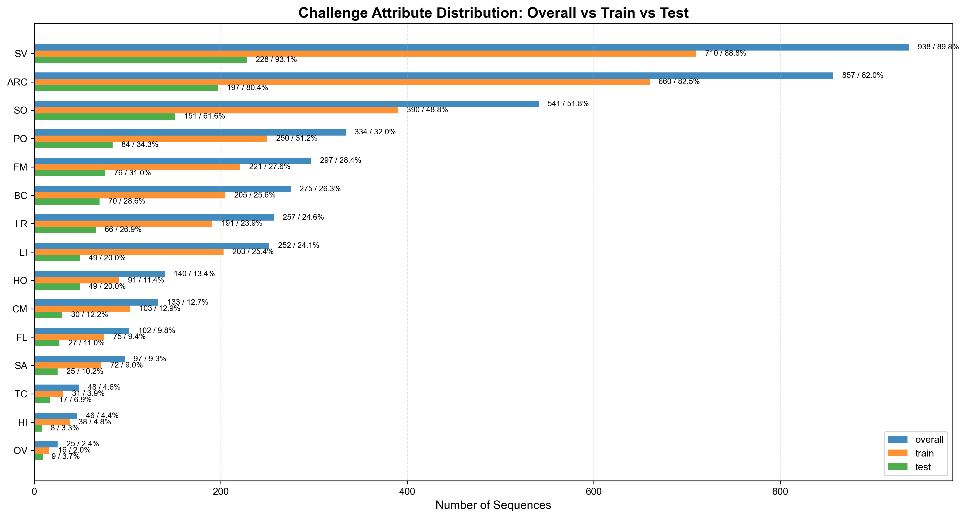
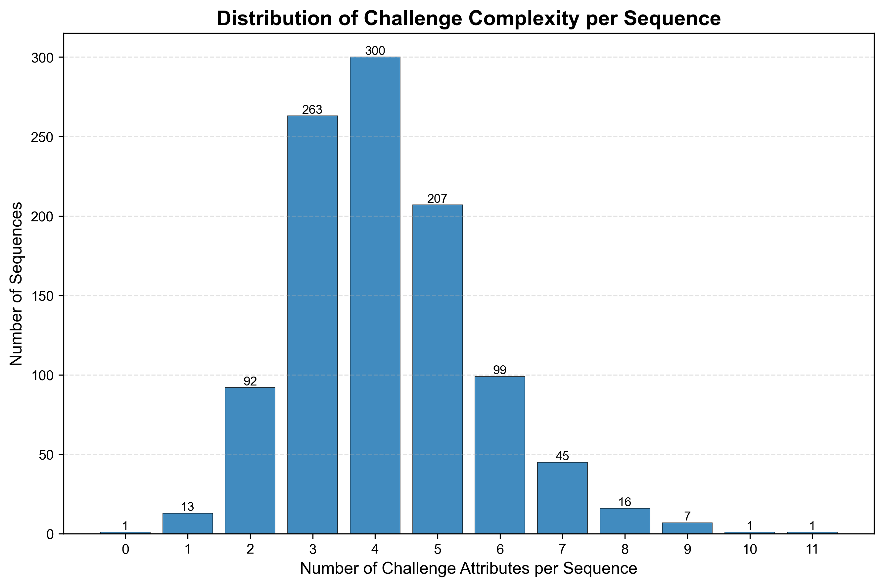
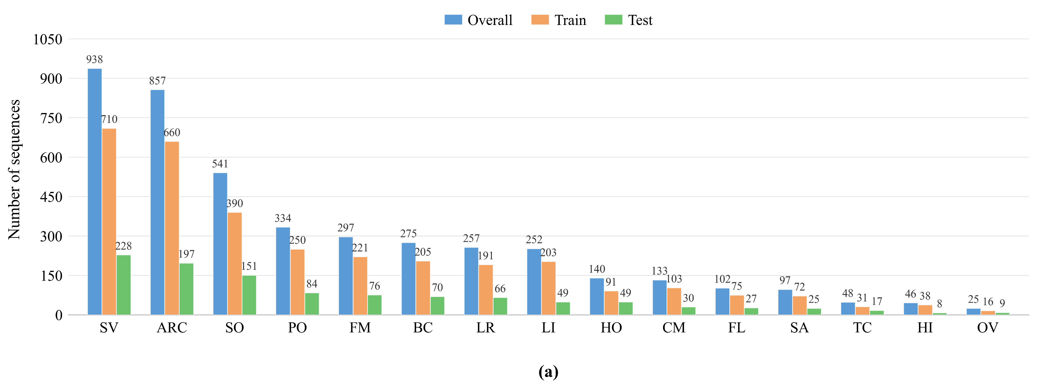

Slide 2
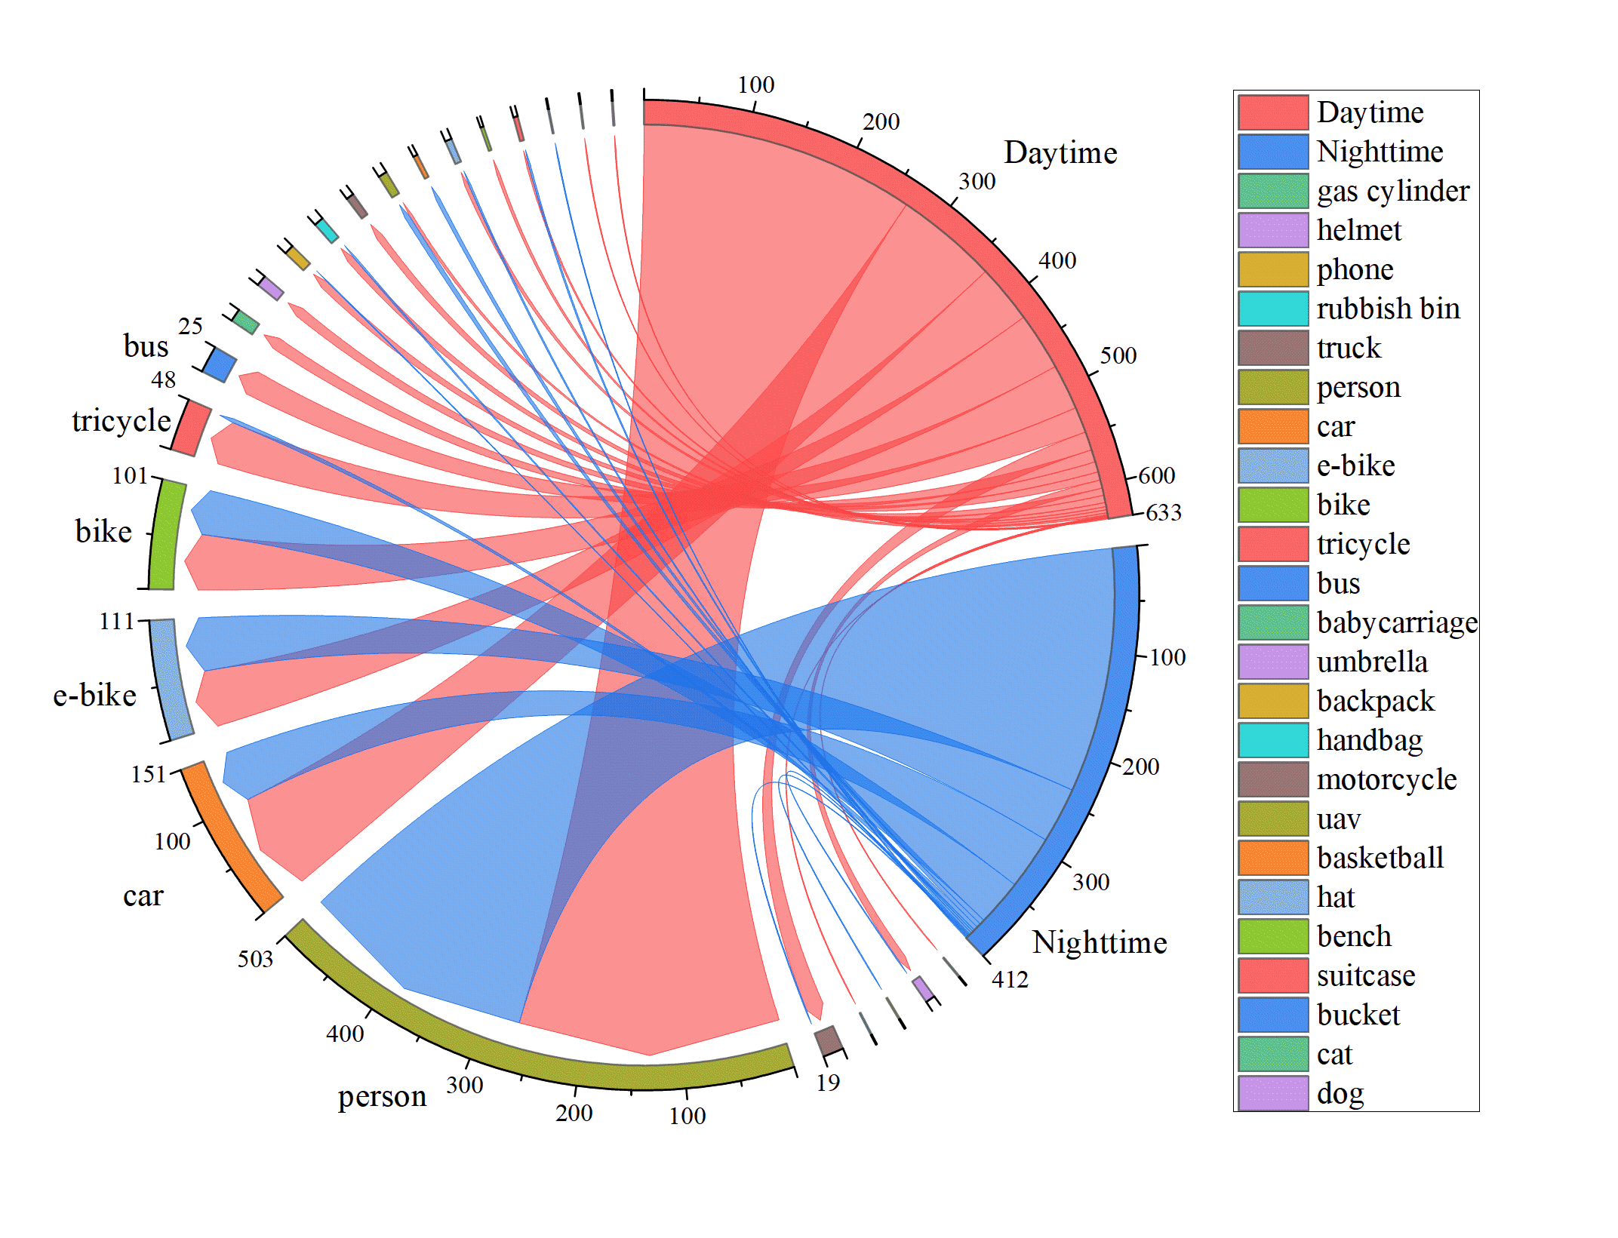
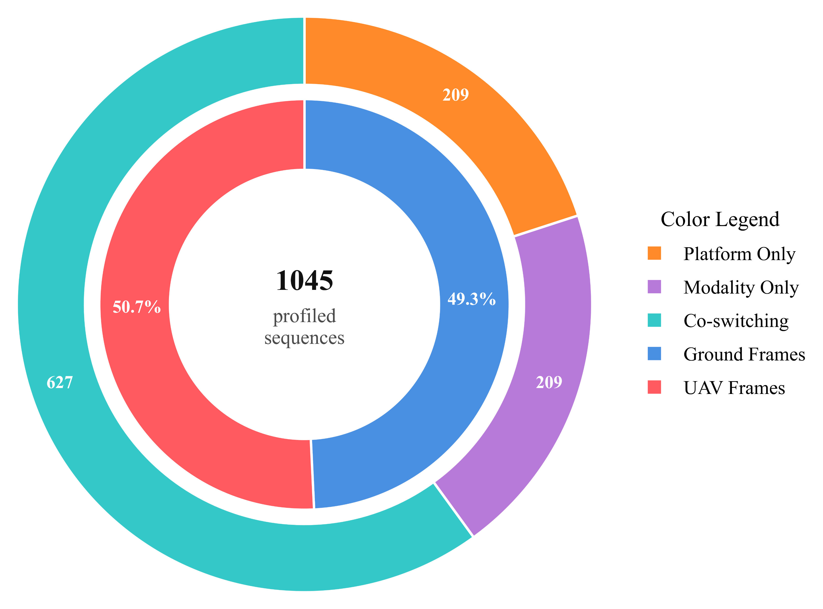
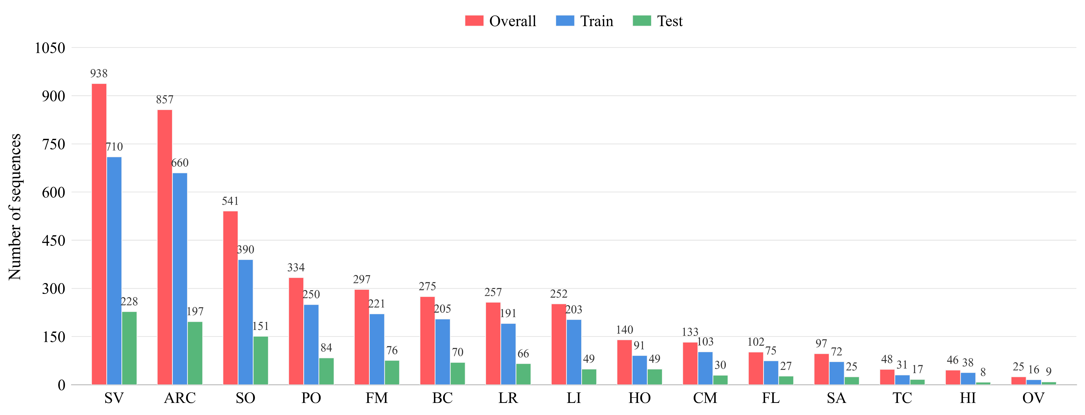
(a) Category Distribution across Daytime and Nighttime Scenarios
(b) Distribution of Modalities and Platforms in DRGBT1K
(c) Distribution of Challenge Attributes in DRGBT1K

Slide 3

(a) Category Distribution across Daytime and Nighttime Scenarios
(b) Category Distribution across Daytime and Nighttime Scenarios
(c) Category Distribution across Daytime and Nighttime Scenarios

Slide 4
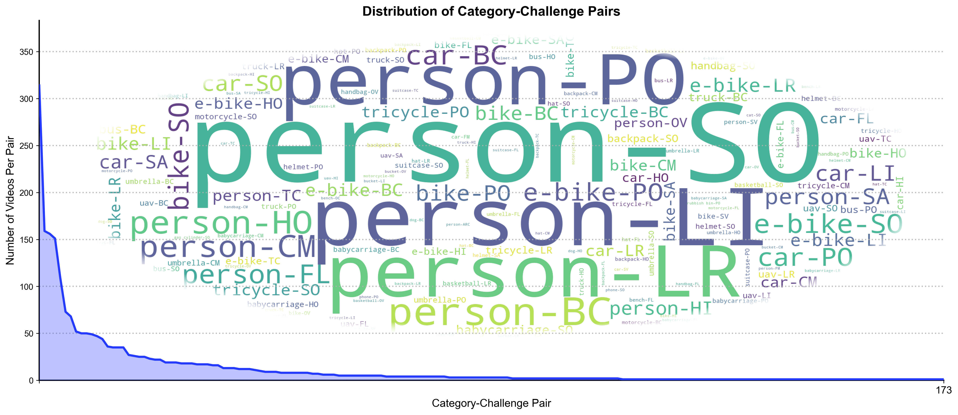

Slide 5
