Slide 1
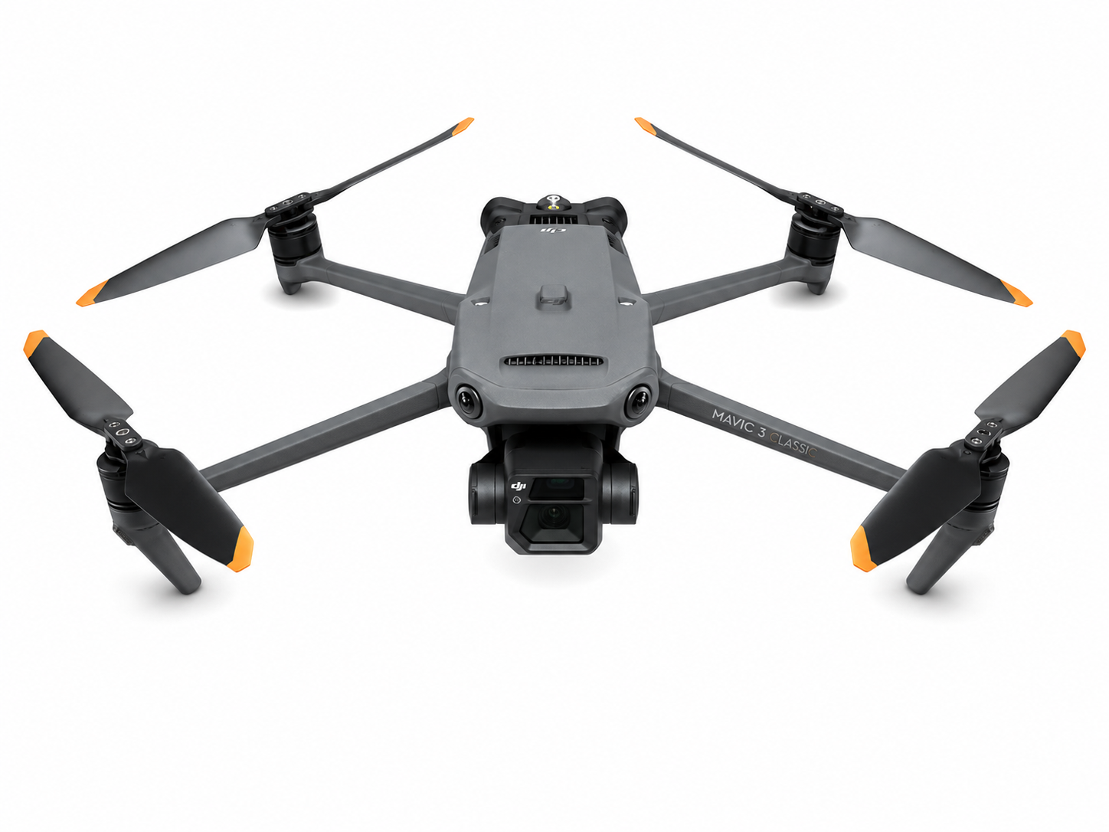
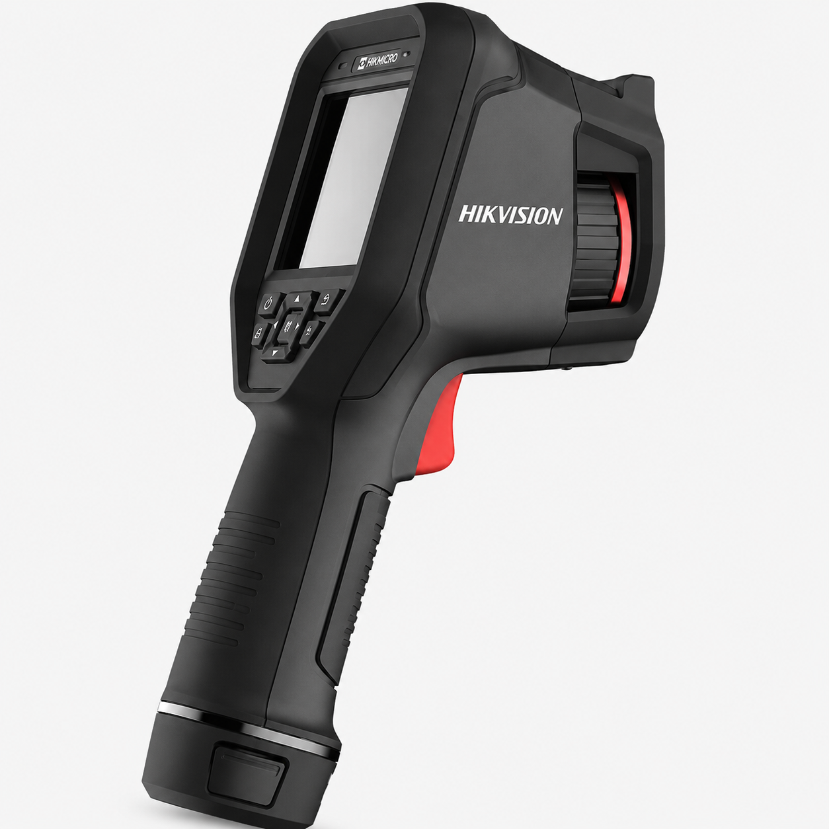
(a) DJI Mavic 3T
(b) Hikvision RGBT Camera

