Slide 1
Draw the context diagram (Digital dashboard)
壓力感測器
(測胎壓)
溫度感測器
(室內外溫度、油箱溫度)
速度感測器
3D影像感測器
(駕駛死角、智慧駕車)
運動感測器
(沒訊號用)
光學感測器
(自動調整螢幕亮度)
毫米波感測器
(接收衛星訊號、定位)
外接USB
(音樂、影片)
transcoder
選單
儀錶板A
儀表板B
地圖

Slide 2
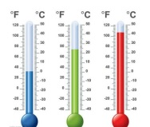
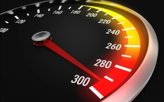


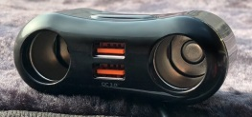
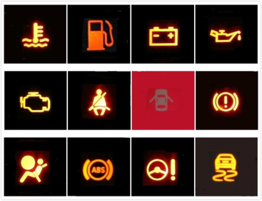
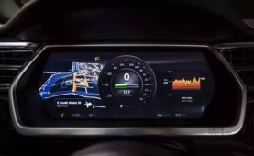
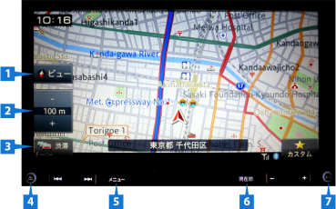
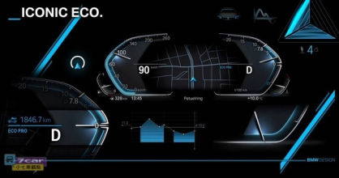
Development of a Prototype (Digital dashboard)

Slide 3


Model the requirements: Data flow diagram (Video transcoding)
Part of Source Video
Part of Transcoded Video
H
GOP
H
GOP
VM1
Transcoder
Input
壓力
溫度
速度
3D影像
運動
光學
毫米波
USB
Output
介面資訊
圖像
影像
聲音
H
GOP
H
GOP
VM2
Transcoder
Manager
Streaming
Server
H
GOP
GOP
GOP
H
GOP
GOP
GOP
Source Video
H
GOP
…..
H
GOP
VM n-1
Transcoder
H
GOP
H
GOP
H
GOP
H
GOP
VM n
Transcoder
H
GOP
Transocded Video
Transcoding Cloud

Slide 4
Model the requirements: State-transition diagrams (Cloud/ Virtual Machine Life-cycle OpenNebula )

Slide 5
User
On
Preset
Background
Menu
Music
Sensor
Maintenance
Style
GPS
Presure
Sensor
Radio
Sensor
Riversing
milage
Date
Speed
Caller ID
Text
Version
phone
Temperature
Surrounding
image
Car
door
Map
version
Aerodynamic
Design
Flameout
Racer
Mode
Self-Discharging
With Gear position
Player
Mode
To pass callange
Unlock
Style
Shot Down
Simple
Mode
Monochrome

Slide 6
ACTIVATE
ON
OFF
AT
IDLE
P
SHIFT GEAR
Cruise Control
N
D
R
AT
NEUTRAL
TOO SLOW
TOO FAST
DRIVE
accelerate
STEP ON GAS PADEL
DRIVE REVERSE
STEP ON BREAK
SLOW DOWN

