Slide 1
軟體程式開發實務與實作
2019 Fall
柯兆恩
張峻祥

Slide 2
Design Details
Description (each function module)
Flowchart (each function module)
Demo (interface)
Database (optional)

Slide 3
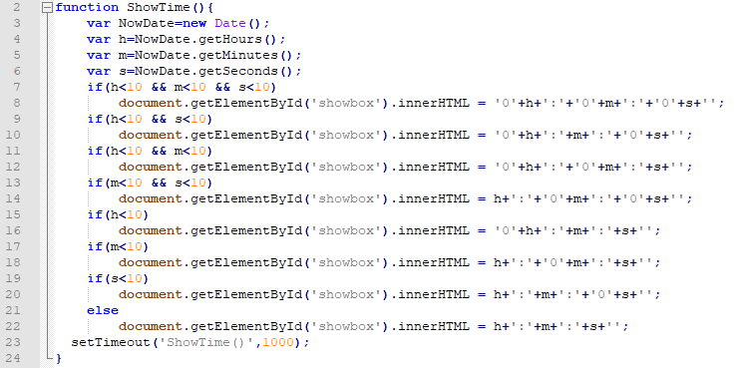
Description (SHOW_TIME)
由getHours、gedMinutes、getSeconds取得現在時間

Slide 4
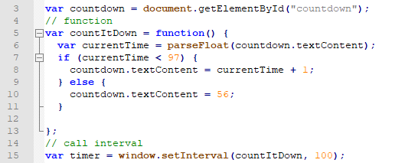
Description (Velocity)
計數器來顯示目前的時速

Slide 5
Flowchart (Show_time)
Start
Output h:m:s
Input current time(h、m、s)
NO
Output 0h:m:s or h:0m:s or h:m:0s
YES
Detemine if
h、m、s less then 10
End

Slide 6
Flowchart (Velocity)
Start
Countdown+1
Input countdown
YES
countdown=50
NO
If countdown<97
End
Output countdown

Slide 7
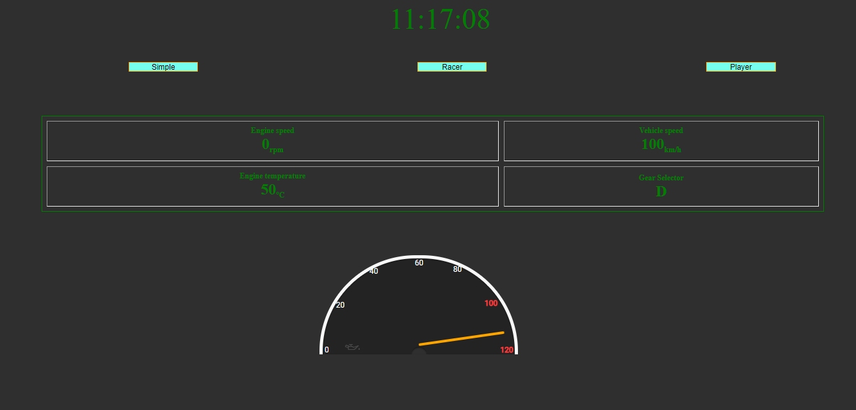
Demo (interface)

Slide 8
Exercise (Digital dashboard)
Q&A
Example: BENZ W213 原廠12.3吋數位儀表板
Software Specification
Product perspective
Design constraints

