Slide 1
軟體程式開發實務與實作
2019 Fall
李昌明
王騰毅

Slide 2
基礎程式介紹
考量現行智慧裝置的多樣性(除電腦，尚有平板裝置、智慧手機與手環等)，將以跨平台介面程式開發作為專案，並由業界講師介紹以階層樣式表(Cascading Style Sheets)作出可添加樣式的結構化文件，採用具備超文本標記的程式語言(HyperText Markup Language)，專案實作時需撰寫軟體開發文件，以呈現有效的版本控管，確保能解決專案開發所遇到的瓶頸。
APP (Android Studio)程式開發技術
GPS 定位APP 提供經緯度座標

Slide 3
跨平台介面的開發技術
數位儀表板 (Digital dashboard)
Adding a Google Map with a marker to your dashboard: HTML and CSS, and a little knowledge of JavaScript
Navigation
分組專案實作軟體開發時完成設計規範與版本控管
針對開發文件與報告，每組在專案開發時，會產出需求分析(Requirements analysis)、規格制定(Specification)、設計階段(Design)三階段的開發文件，並視狀況於專案書面報告完成實作階段(Implementation)的相關文件。至於整合階段(Integration)、維護階段(Maintenance)，和除役(Retirement)則保留由學生自行發揮。同時考量專業技術文書書寫能力的培養，提升專案文件的品質。

Slide 4
Requirements analysis
Draw the context diagram
Interfaces
Development of a Prototype
Visualize the proposed system/ Increase the understanding
Model the requirements
Graphical representations (functions, data entities, external entities,..)
Data flow diagram, entity-relationship diagram, data dictionaries, state-transition diagrams,…
Finalize the requirements
Correct and identify inconsistencies and ambiguities
Teamwork

Slide 5
Requirements analysis
Draw the context diagram
Interfaces
Development of a Prototype
Visualize the proposed system/ Increase the understanding
Model the requirements
Graphical representations (functions, data entities, external entities,..)
Data flow diagram, entity-relationship diagram, data dictionaries, state-transition diagrams,…
Finalize the requirements
Correct and identify inconsistencies and ambiguities
Teamwork

Slide 6
Draw the context diagram (Video transcoding)
Original Video
Video transcoder
Video
format1
…….
Video
formatN

Slide 7
Requirements analysis
Draw the context diagram
Interfaces
Development of a Prototype
Visualize the proposed system/ Increase the understanding
Model the requirements
Graphical representations (functions, data entities, external entities,..)
Data flow diagram, entity-relationship diagram, data dictionaries, state-transition diagrams,…
Finalize the requirements
Correct and identify inconsistencies and ambiguities
Teamwork

Slide 8
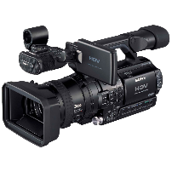
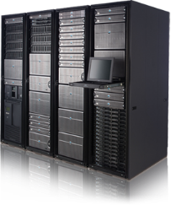

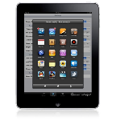
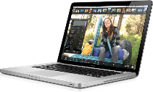

Development of a Prototype (Video transcoding)
…….

Slide 9
Development of a Prototype (Video transcoding)
…….

Slide 10
Requirements analysis
Draw the context diagram
Interfaces
Development of a Prototype
Visualize the proposed system/ Increase the understanding
Model the requirements
Graphical representations (functions, data entities, external entities,..)
Data flow diagram, entity-relationship diagram, data dictionaries, state-transition diagrams,…
Finalize the requirements
Correct and identify inconsistencies and ambiguities
Teamwork

Slide 11


Model the requirements: Data flow diagram (Video transcoding)
Part of Source Video
Part of Transcoded Video
H
GOP
H
GOP
VM1
Transcoder
Input
Output
H
GOP
H
GOP
VM2
Transcoder
Manager
Streaming
Server
H
GOP
GOP
GOP
H
GOP
GOP
GOP
Source Video
H
GOP
…..
H
GOP
VM n-1
Transcoder
H
GOP
H
GOP
H
GOP
H
GOP
VM n
Transcoder
H
GOP
Transocded Video
Transcoding Cloud

Slide 12
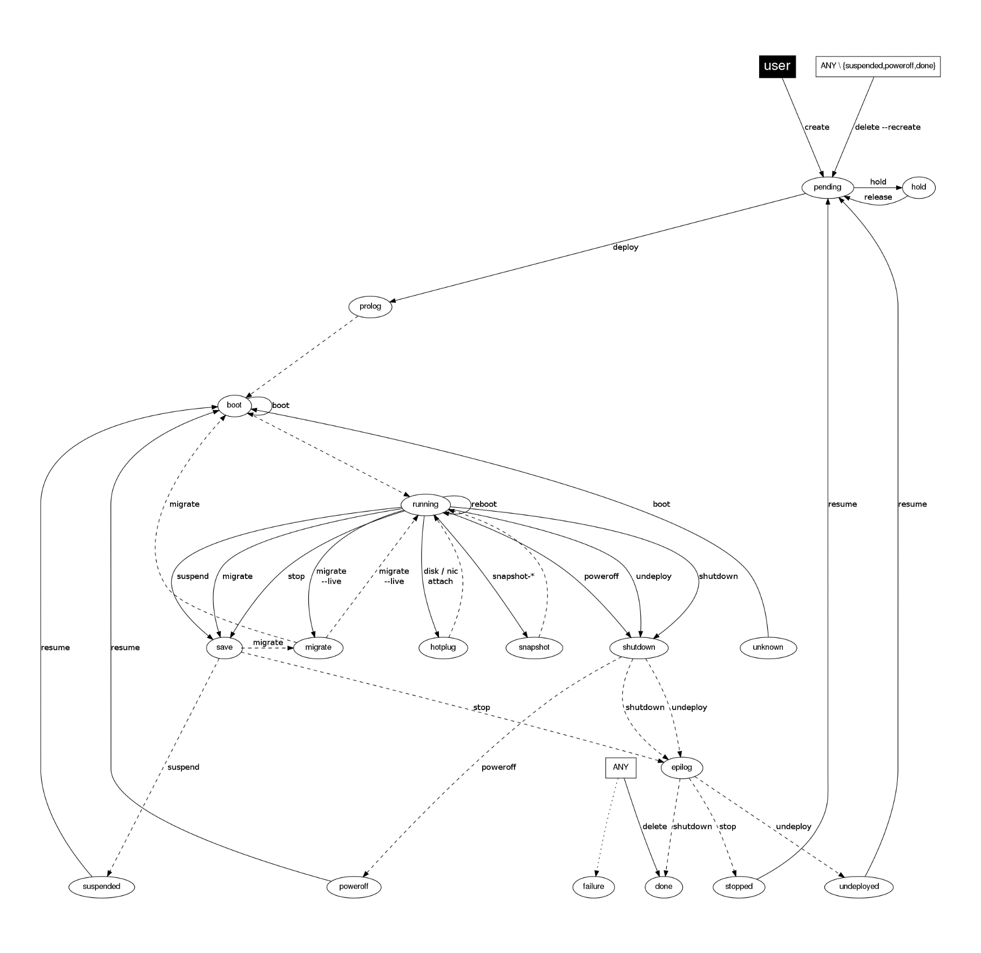
Model the requirements: State-transition diagrams (Cloud/ Virtual Machine Life-cycle OpenNebula )

Slide 13
Finalize the requirements
Correct and identify inconsistencies and ambiguities
Documentation
Teamwork

Slide 14
Exercise (Digital dashboard)
Q&A
Example: BENZ W213 原廠12.3吋數位儀表板
Requirements analysis
Context diagram
Prototype
Model the requirements
Finalize the requirements

Slide 15
Software Specification
Product perspective: system/user/hardware/software/communication interfaces, memory constraints.
Design constraints: operations, site adaptation requirements

Slide 16
Software Specification
Product perspective: system/user/hardware/software/communication interfaces, memory constraints.
Design constraints: operations, site adaptation requirements

Slide 17

Product perspective: System interface (Video transcoding)
OpenNebula
https://opennebula.org/
Data Center Virtualization Management
Cloud Management

Slide 18
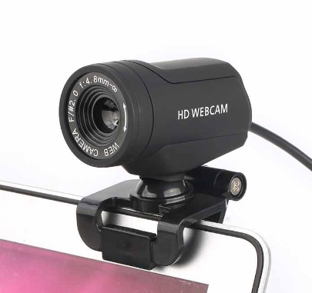
Product perspective: Hardware interface (Video transcoding)
Webcam, camera
CCD, CMOS,…
Mobile phone, PAD, laptop, desktop
LCD, LED

Slide 19
Product perspective: Software interface (Video transcoding)
Camera API/App
Video App, IE, Chrome, iTunes, media player

Slide 20
Software Specification
Product perspective: system/user/hardware/software/communication interfaces, memory constraints.
Design constraints: operations, site adaptation requirements

Slide 21
Design constraints: Operations (Video transcoding)
FFmpeg
Open source
https://www.ffmpeg.org/
multimedia framework: decode, encode, transcode, mux, demux, stream, filter and play pretty much anything

