Slide 1
Opinion Spam Detection
Team 5
Sijin Huang, Minzhi Qu, Guanchen Zhao

Slide 2
OUTLINE
Data Analysis
Preprocess & Feature Selection
Model Design
LR, LSTM & Bert
Model Comparison

Slide 3
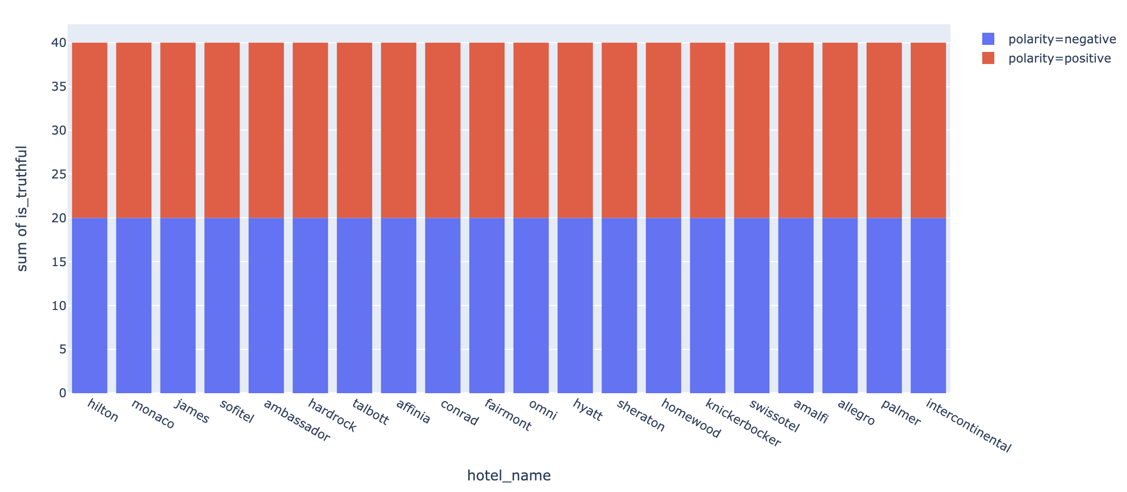
Data Analysis

Slide 4
Dataset Reorganization
text | is_truthful | polarity | hotel_name | source | fold | filename
The Millennium Hotel Knickerbocker sounds fine, | 0 | negative | knickerbocker | MTurk | 4 | d_knickerbocker_15.txt
After a one night stay at the Millennium Knickerbocker Hotel | 0 | negative | knickerbocker | MTurk | 4 | d_knickerbocker_2.txt
I was very unsatisfied with my stay at the Allegro. The front | 0 | negative | allegro | MTurk | 5 | d_allegro_3.txt
The Hilton Chicago is one of the best Hotels I have ever had the | 0 | positive | hilton | MTurk | 1 | d_hilton_19.txt
The InterContinental Chicago Hotel is one of the finest hotels I | 0 | positive | intercontinental | MTurk | 5 | d_intercontinental_6.txt
Me, My sister and my best friend all went to stay here in the | 1 | negative | james | Web | 1 | t_james_14.txt
Let me start by saying we are seasoned travelers who take 5-6 | 1 | negative | ambassador | Web | 2 | t_ambassador_7.txt
We loved this hotel and would definitely come back. Initially we | 1 | positive | monaco | TripAdvisor | 1 | t_monaco_9.txt
My husband and I decided to take a trip to Chicago at the last | 1 | positive | conrad | TripAdvisor | 3 | t_conrad_14.txt

Slide 5
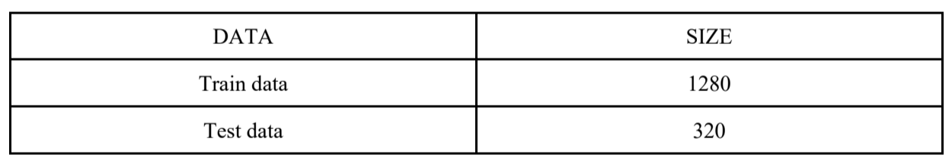
Dataset Division
We leveraged sk-learn’s built-in train_test_split method to split training set and validation set as 80% and 20% respectively.

Slide 6
Preprocess
I've stayed at other hotels in Chicago
Data Cleaning
[‘sta’, ‘oth’, ‘hotel’, ‘Chicago’]
TextStemmer:
Tokenize,
Remove number and punctuation,
Remove stopwords,
Stem words

Slide 7
Preprocess
I've stayed at other hotels in Chicago
Data Cleaning
[‘stay’, ‘other’, ‘hotel’, ‘Chicago’]
TextLemmatizer:
Tokenize,
Remove numbers and punctuation,
Remove stopwords,
Lemmatize words

Slide 8
Feature Selection
[‘stay’, ‘other’, ‘hotel’, ‘Chicago’]
most frequent words:
(benchmark)
stay room recommend Chicago
[ 1 0 0 1]
TextVectorizer:
Calculate the most frequent words
Construct feature vectors

Slide 9
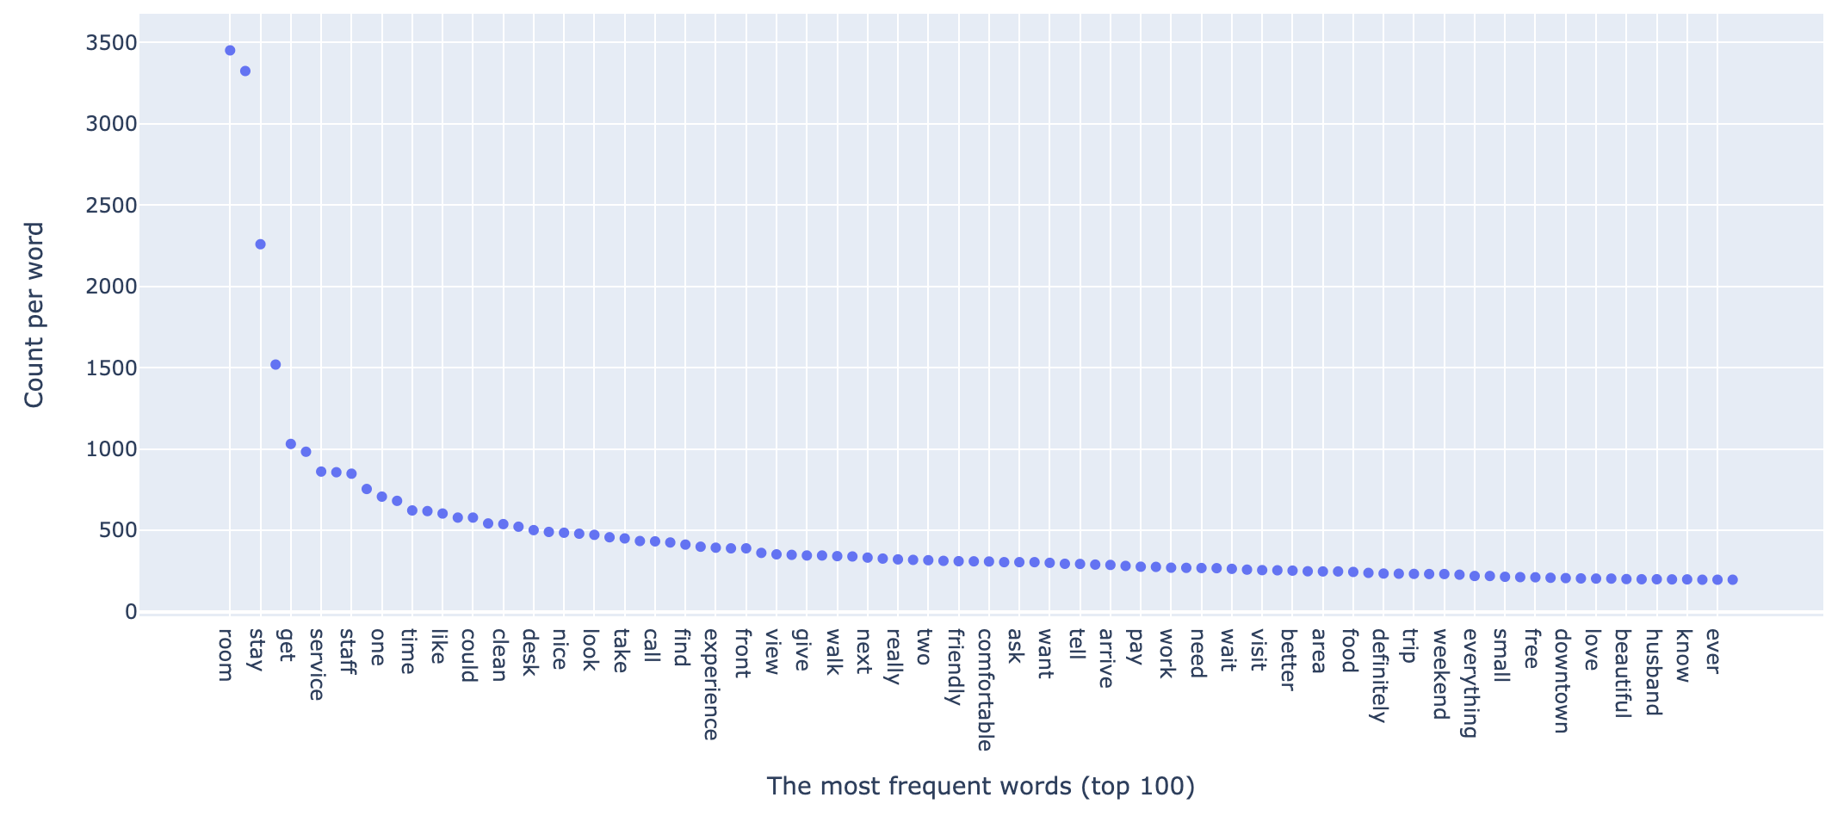
Feature Selection

Slide 10
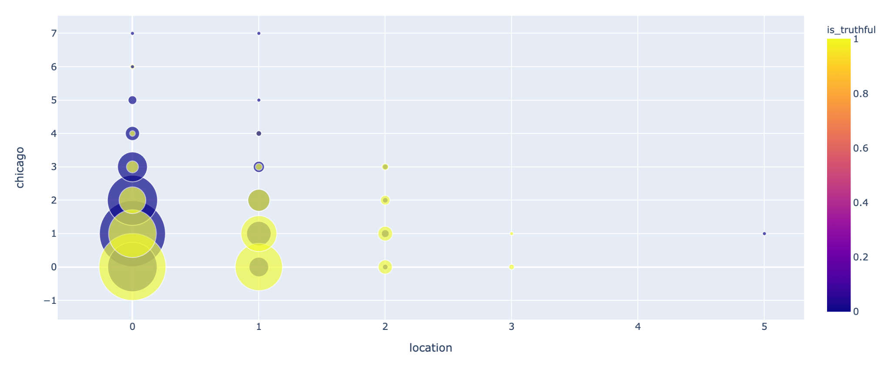
Feature Selection

Slide 11
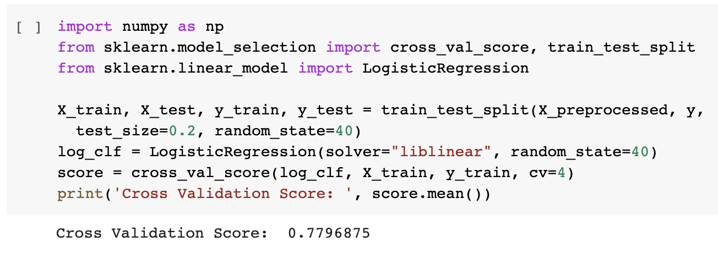
Logistic Regression

Slide 12
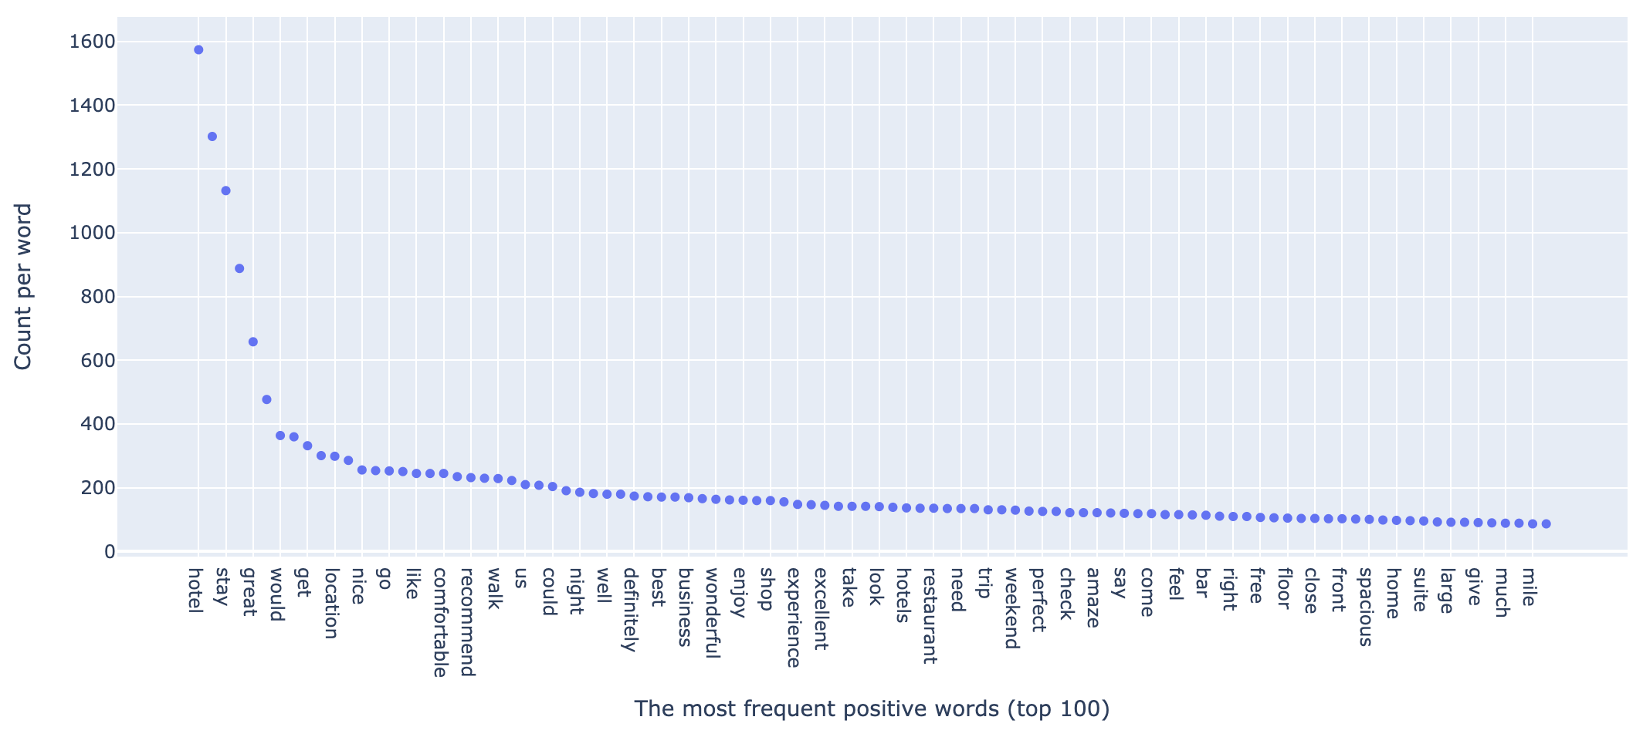
Logistic Regression
Positive Words
[‘like’, ‘well’, ‘amaze’, ‘large’]
Sentiment Analysis

Slide 13
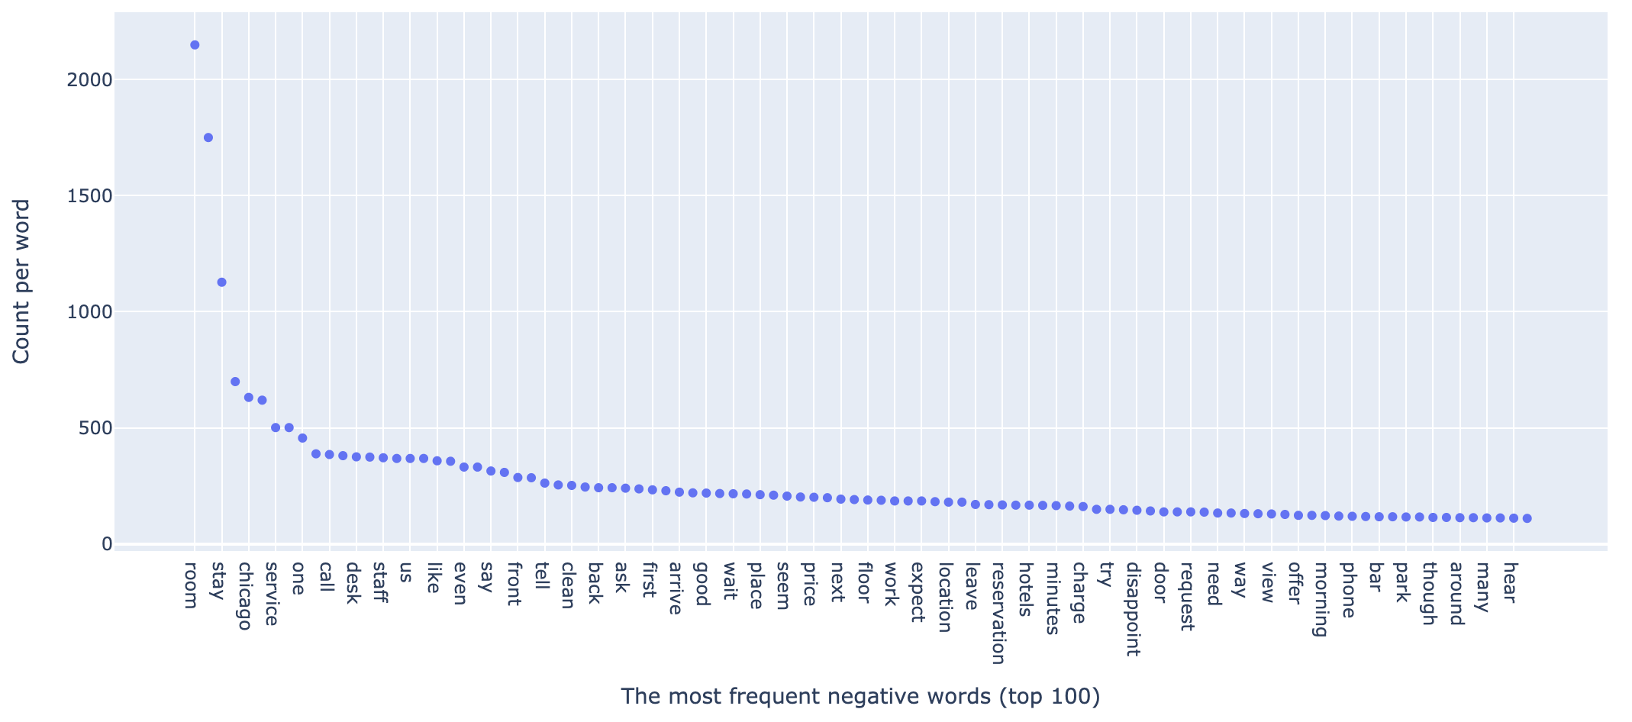
Logistic Regression
Negative Words
[‘disappoint’, ‘small’, ‘dry’, ‘smoke’]
Sentiment Analysis

Slide 14
Logistic Regression
Sentiment Analysis
Positive Reviews:
Negative Reviews:
[‘like’, ‘well’, ‘amaze’, ‘large’]
[‘disappoint’, ‘small’, ‘dry’, ‘smoke’]
[‘room service’, ‘recommend hotel’,
‘staff friendly’, ‘highly recommend’]
[‘hard rock’, ‘customer service’,
‘front desk’, ‘even tough’]
[‘within walking distance’,
‘staff friendly helpful’,
‘would definitely recommend’]
[‘front desk staff’,
‘would definitely recommend’
‘hard rock hotel’,]

Slide 15
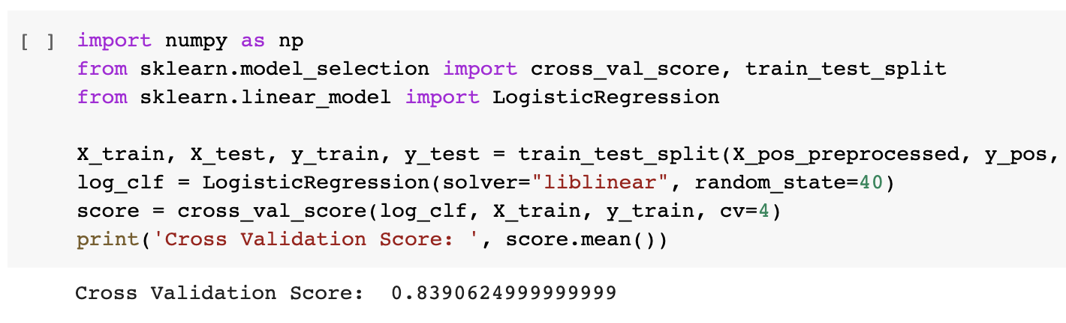
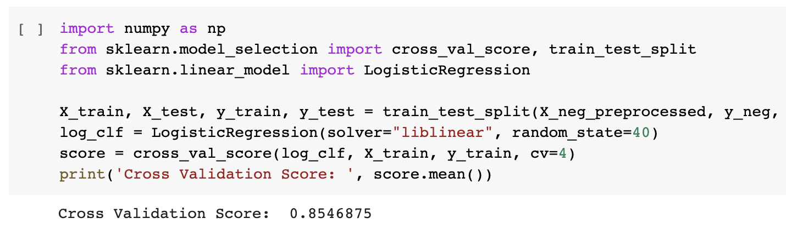
Logistic Regression
Sentiment Analysis

Slide 16
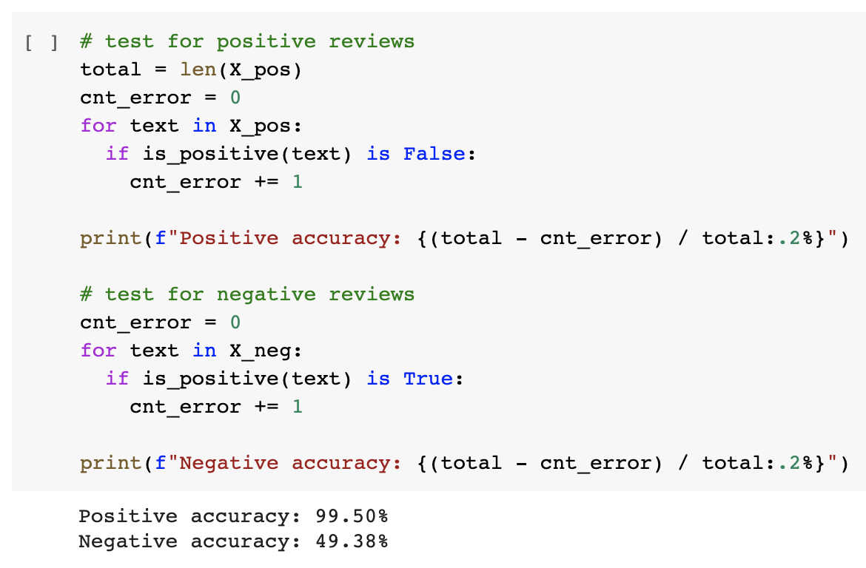
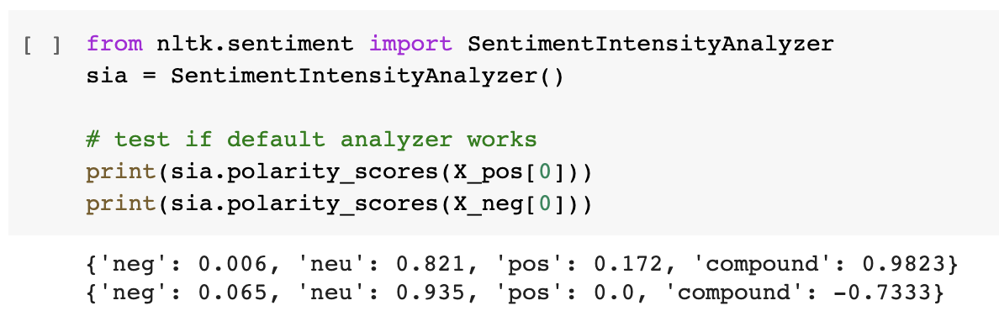
Sentiment Classifier
NLTK sentiment classifier:
{negative index, neutral index,
positive index, compound}

Slide 17
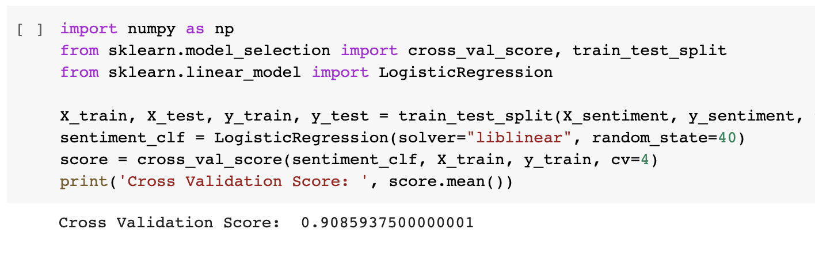
Sentiment Classifier
Classifier =
{negative index, positive index,
negative word count, positive word count}

Slide 18
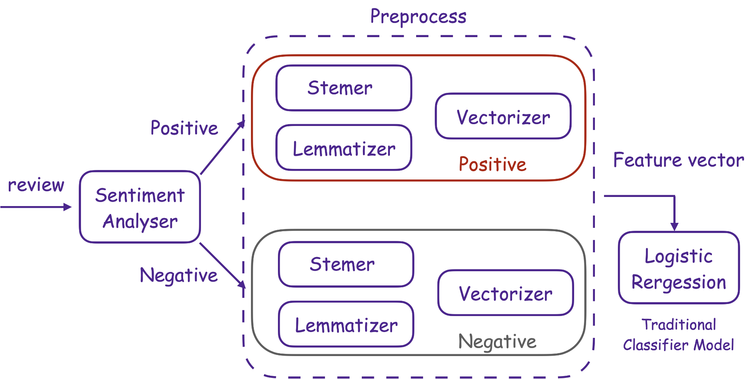
Logistic Regression

Slide 19
LSTM
Long Short Term Memory networks – usually just called “LSTMs” – are a special kind of RNN, capable of learning long-term dependencies.
Long short term memory networks is widely used in the field of natural language processing, such as text generation and machine translation.

Slide 20
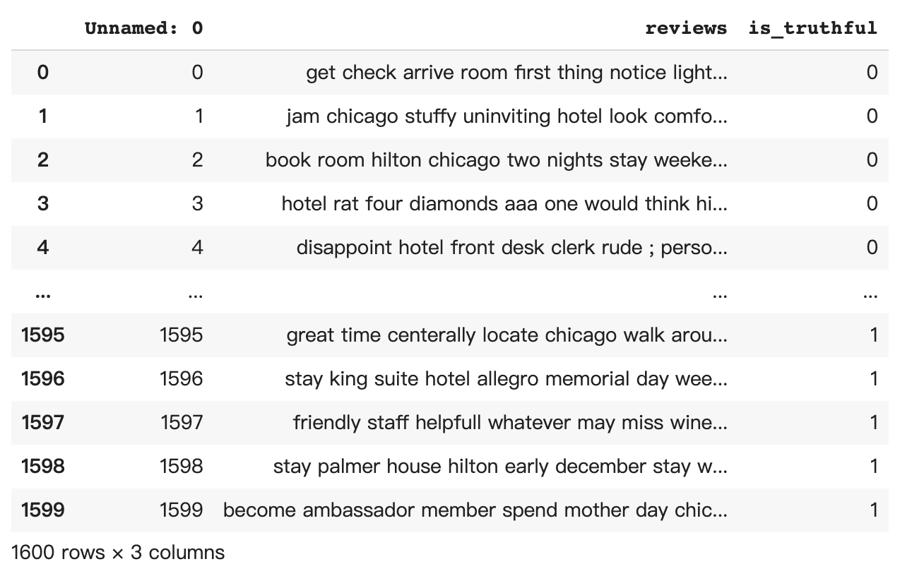
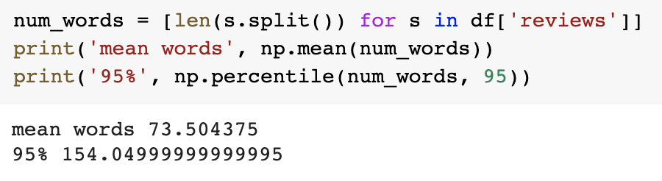
Prepare the data
Data set: review text after preprocessing
Longest Length: 154

Slide 21
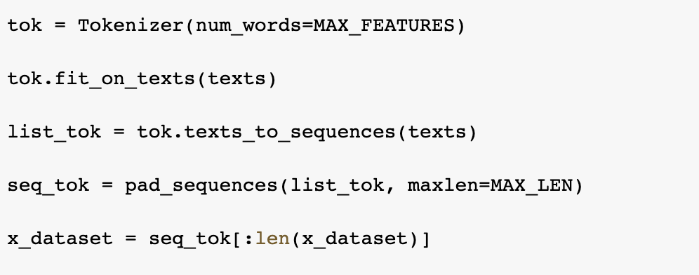
Prepare the data
Tokenizer: quantize text, or to convert text into a sequence
texts_to_sequences: Convert text to sequence
pad_sequences: convert the sequence into a new sequence of the same length after filling.

Slide 22
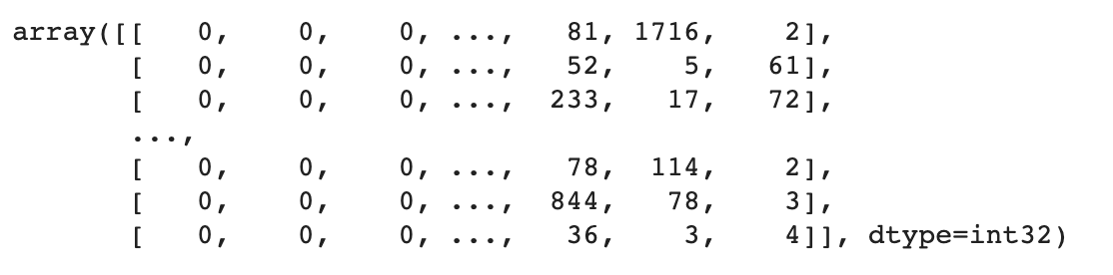
Prepare the data

Slide 23
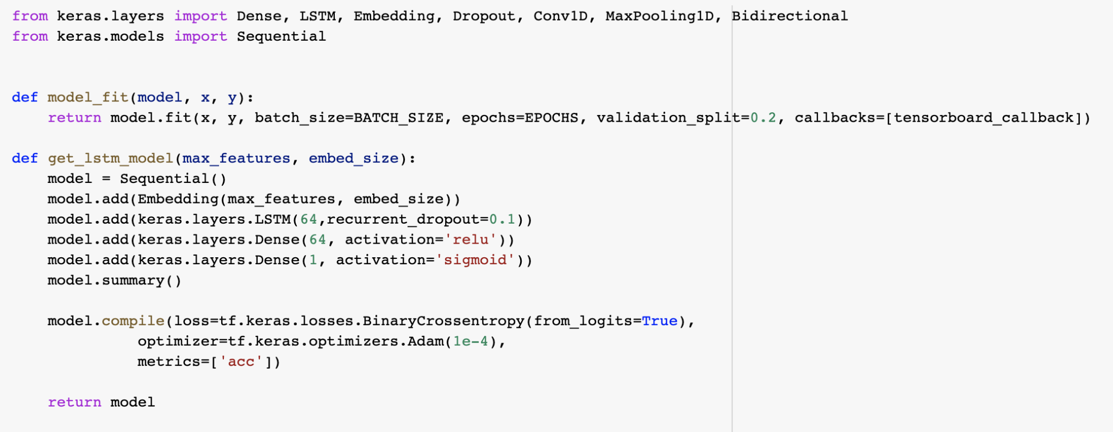
Model
BATCH_SIZE=20
EPOCHS = 10
MAX_LEN = 154

Slide 24
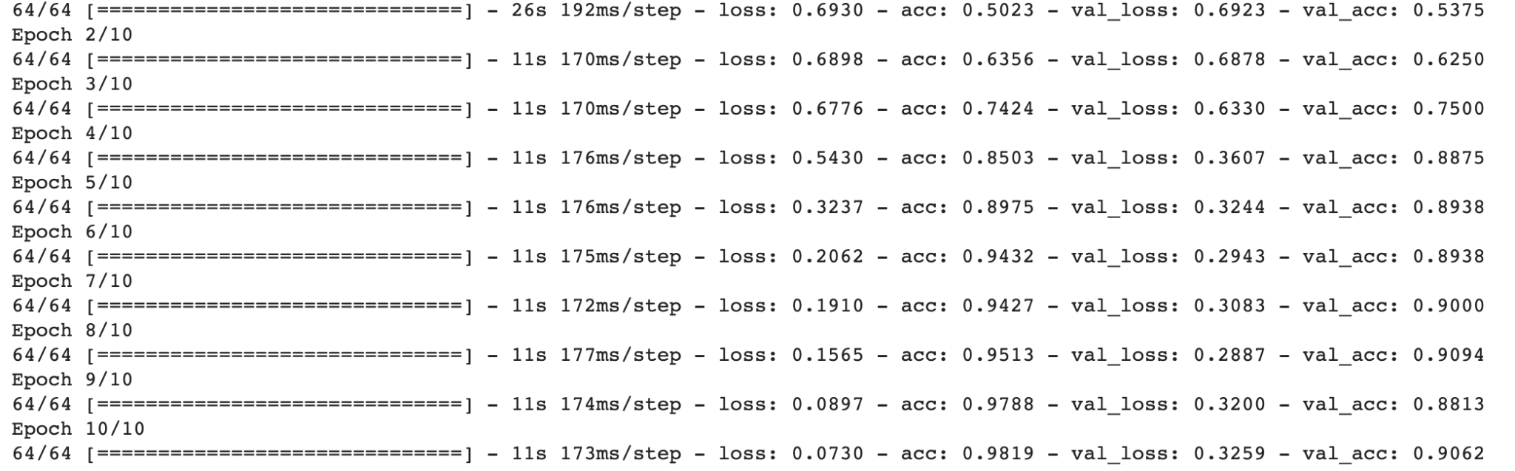
Output

Slide 25
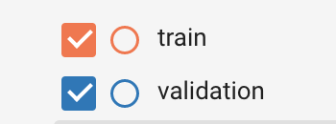
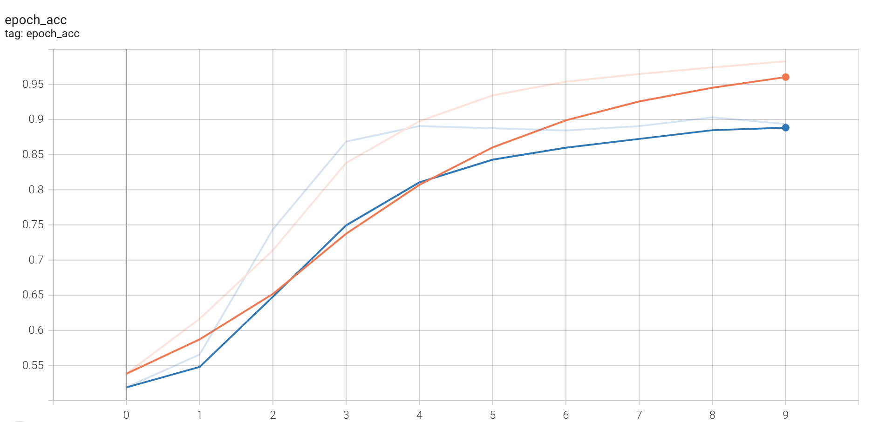
Accuracy
The accuracy rate is gradually rising, and finally close to 88%.

Slide 26
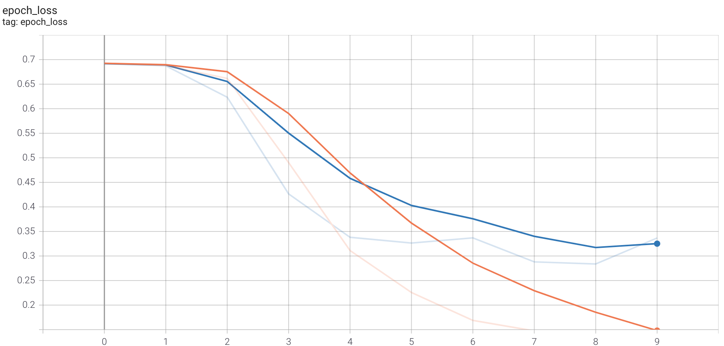
Loss

Slide 27
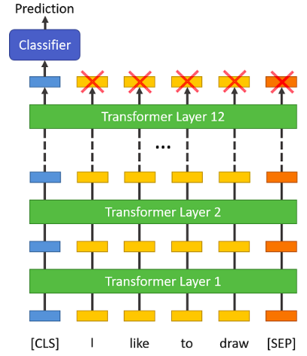
BERT
BERT is a transformers model pretrained on a large corpus in a self-supervised fashion.
Bert learns an inner representation that can then be used to extract features useful for downstream tasks.
We fine tune the pretrained model on OpSpam dataset to learn classification features.

Slide 28
BERT
softmax
Dense(2)
Dropout
Dense(256)
Tokenize the text using the same process as pretraining, adding [CLS] and [SEP] to the sentence.
The output embedding of 1st item could represent the semantic meaning of the whole sentence, which could be used for classification.
We stack two FC layers with dropout and BN as the classifier. Cross entropy loss is used for training.

Slide 29
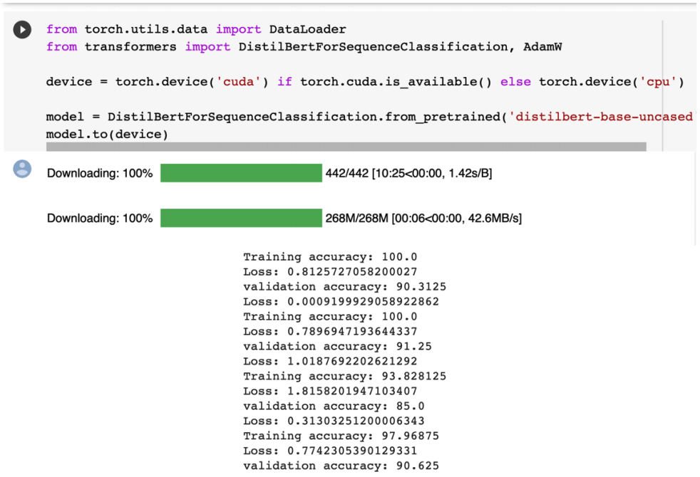
BERT
lr = 1e-5, 10 epochs
Took 17 min for training
Training set acc = 99.77%
Validation set acc = 91.56%

Slide 30
Model Performance Comparison
> LR model has the best interpretability, and achieves an acceptable accuracy with the shortest training time. It also shows the effectiveness of lexical features for spam detection.
> LSTM and Bert can achieve good results without heavy human designed features, shows the capability of neural networks to capture semantic information.
> Bert has a slightly better performance than LSTM, proves that with more parameters and pretrained linguistic knowledge, Bert has better semantic meaning capture capability. But its training time is the longest.
Model | Training Acc | Val Acc | Training Time
LR | 90.31% | 84.68% | 0.1min
LSTM | 95.58% | 88.28% | 2.5min
BERT | 99.77% | 91.56% | 17min

Slide 31
Comparison with related research
Kennedy et al. reported several non-neural and neural models performance on OpSpam dataset.
Our results demonstrate a match to the reported performance.
Model | Performance(Paper) | Performance(Ours)
LR | 85.6% | 84.68%
LSTM | 87.6% | 88.28%
Bert | 89.1% | 91.56%
Notes:
Kennedy, Stefan, et al. "Fact or factitious? Contextualized opinion spam detection." arXiv preprint arXiv:2010.15296 (2020).

Slide 32
Individual Contribution
Minzhi Qu:
Raw data analysis
data cleaning
sentiment analysis
feature extraction
Sijin Huang:
Data reorganizing
data analysis
Bert Model establishment and training
Guanchen Zhao:
Data analysis
Potential Models Planning
LSTM Model training
Notes:
Kennedy, Stefan, et al. "Fact or factitious? Contextualized opinion spam detection." arXiv preprint arXiv:2010.15296 (2020).

