Slide 1

Bonanza A Museum Inventory Management System
Group 3 : Guanchen Zhao, Huicong Jiang
December 10, 2021

Slide 2
Outline
Overview
Feature
Deployment
Architectural Design
Restful and Soap
UML Designs
Service Composition Scenarios
Challenges
Prototype/Demo

Slide 3
Overview
objective
Managing collections through this system will greatly improve the efficiency of the museum and make it easier for tourists to visit.
target audience
- Museum custodian
- Tourist

Slide 4
Feature
Front-end and back-end separation architecture
Frond-end: React
Back-end: Spring-Boot
Authentication
After the user logs in, the authentication token will be returned to the user, which is required to be carried in the header of subsequent requests.
Redis
We have access to the Redis to provide us with the caching service.

Slide 5
Feature
Https
use the domain and the certificate service provided by aws.
Soap and Restful
We combine restful service with soap service. The framework is spring boot and spring WS.
Data encryption
We use md5 + salt to encrypt sensitive information, such as passwords.

Slide 6
Feature
Single page application
There is only one html file in the entire application, and the transformation of web content depends entirely on the change of the front-end DOM tree.

Slide 7
Deployment
Back-end
AWS Elastic Beanstalk and AWS EC2.
Front-end
AWS Amplify and Google App Engine.
Database
RDS on Google Cloud Platform and RDS on AWS.
Redis
AWS EC2.

Slide 8
Architectural Design
Module
Login: contains login, register and logout.
User: contains add, update, delete and page list with search.
Inventory: contains add, update, delete and page list with search.
Subscribe: contains add, update, cancel and page list with search.
Appointment: contains add, update, cancel and page list with search.

Slide 9
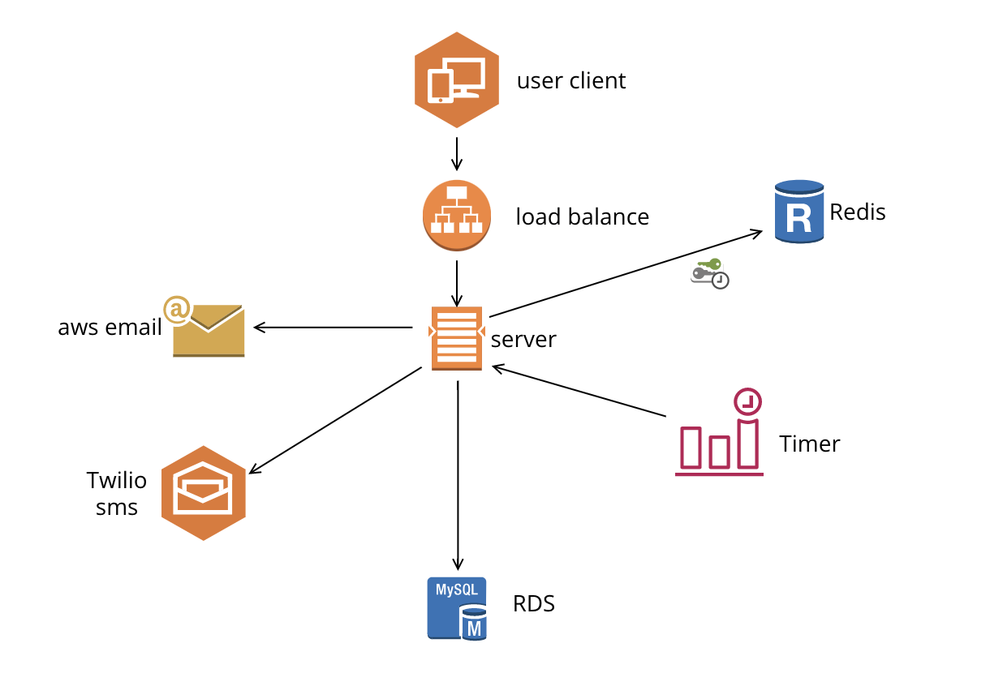
Architectural Design
Service Architecture

Slide 10
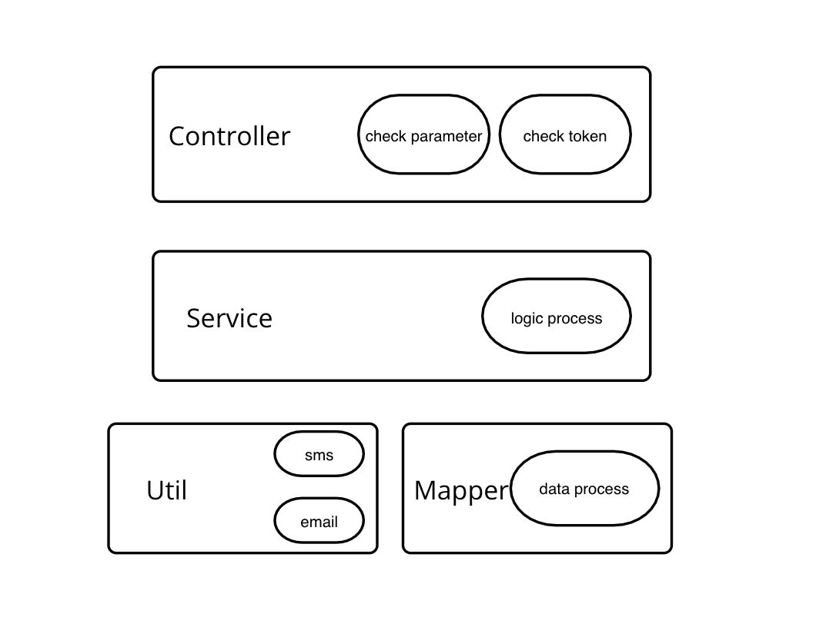
Architectural Design
Code Architecture

Slide 11
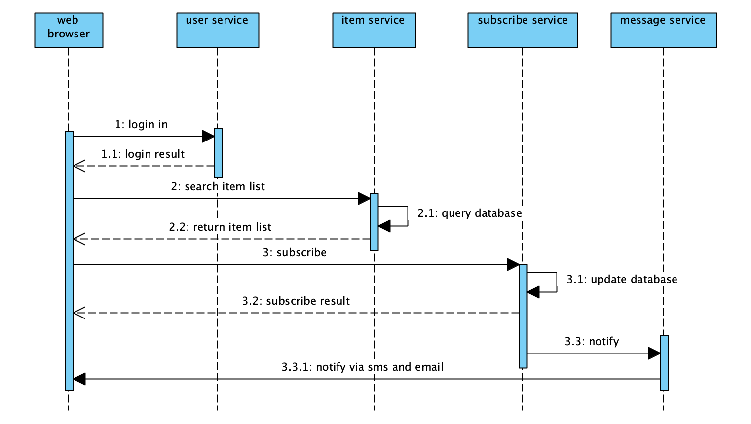
UML Designs
Sequence Diagram

Slide 12
Challenges
Cross-Origin Resource Sharing (CORS)
Common problems in front-end and back-end separation projects
add (Access-Control-Allow-Origin: *)
Https
Message：This request has been blocked; the content must be served over HTTPS.
Use Load balance and certificate service provided by aws.
Combine soap with restful
Using spring ws

Slide 13
Future work
Microservice structure
Several service
More service
AWS Pinpoint and SNS
Application notice
Mobile app

Slide 14
Demo
Demo Time！

