Slide 1
To Do:
Known variables vs disease score (& trajectories)
Time to outcome/event vs disease score
Disease score (1st visit) vs re-calculated disease score (2nd imaging visit) for known variables

Slide 2
Variable Vs Hyper Score

Slide 3
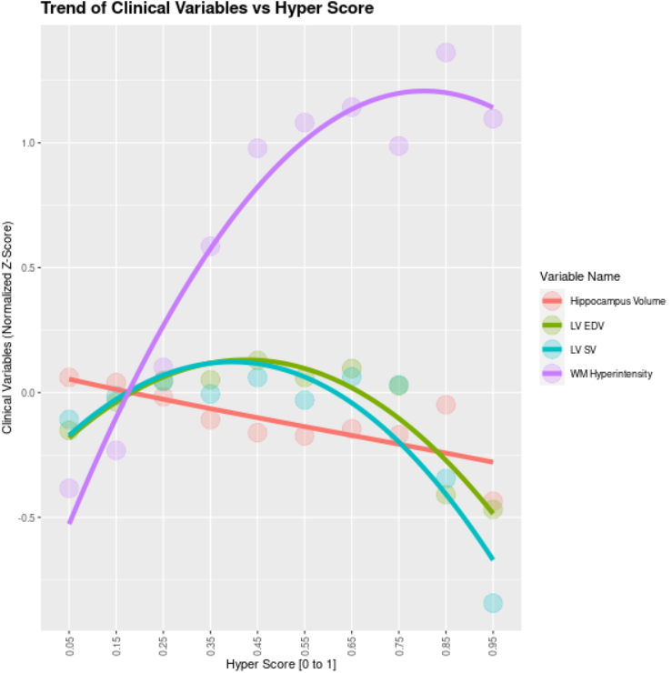
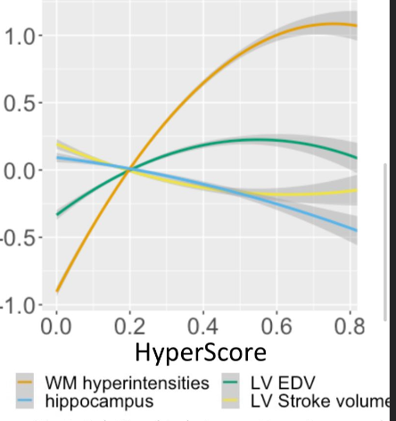
Split Hyper Score into Intervals and Plot Means of Variables per Interval

Slide 4
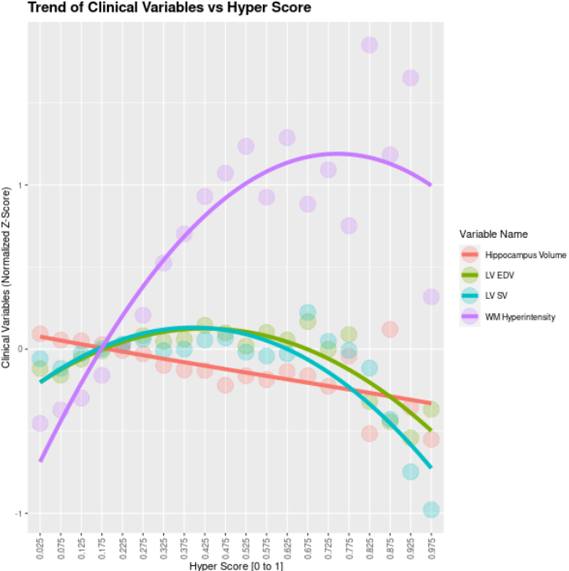

Slide 5
Variable Vs Hyper Score Per Trajectory

Slide 6
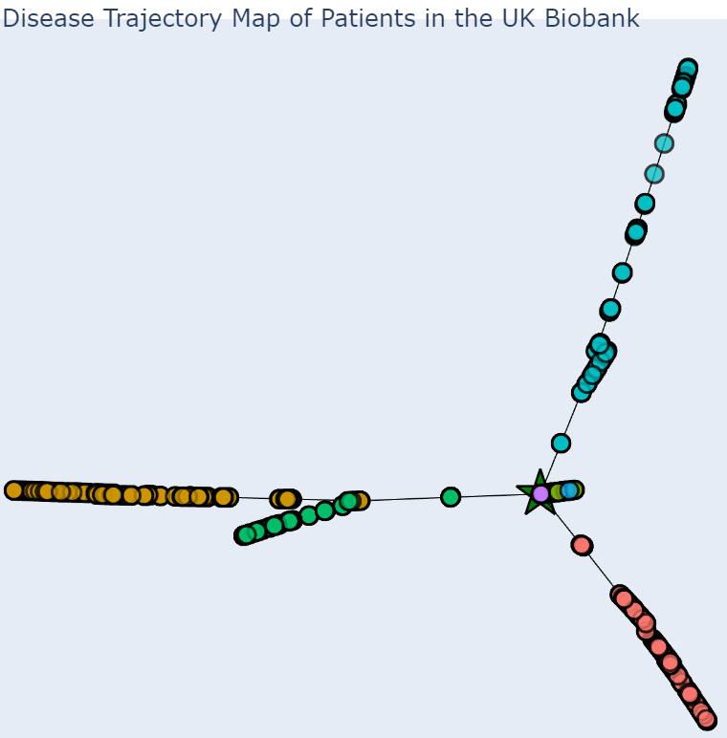
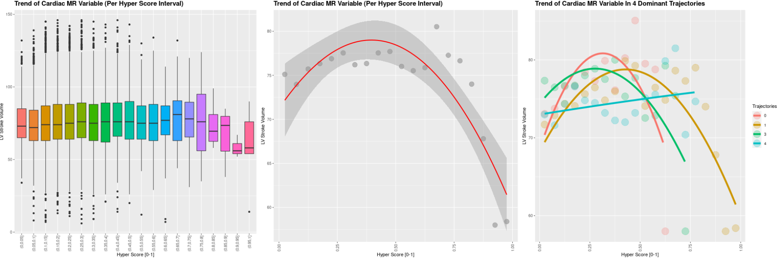
LV Stroke Volume

Slide 7
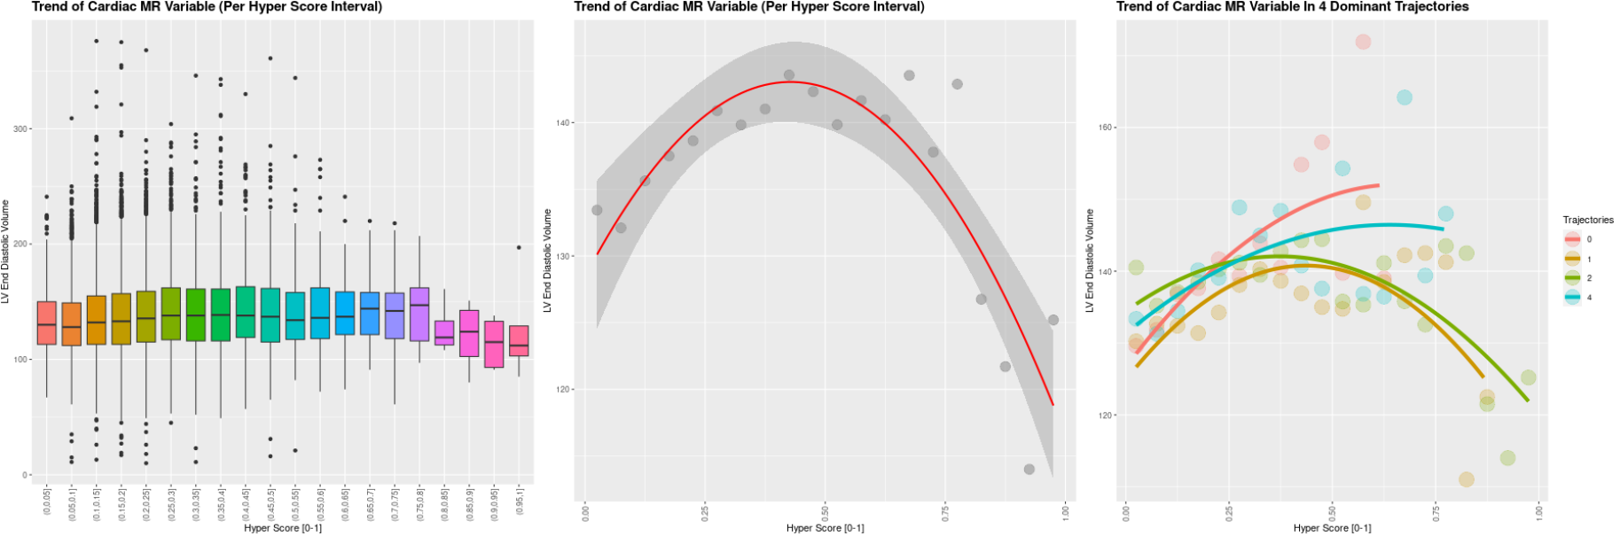
LV End Diastolic Volume

Slide 8
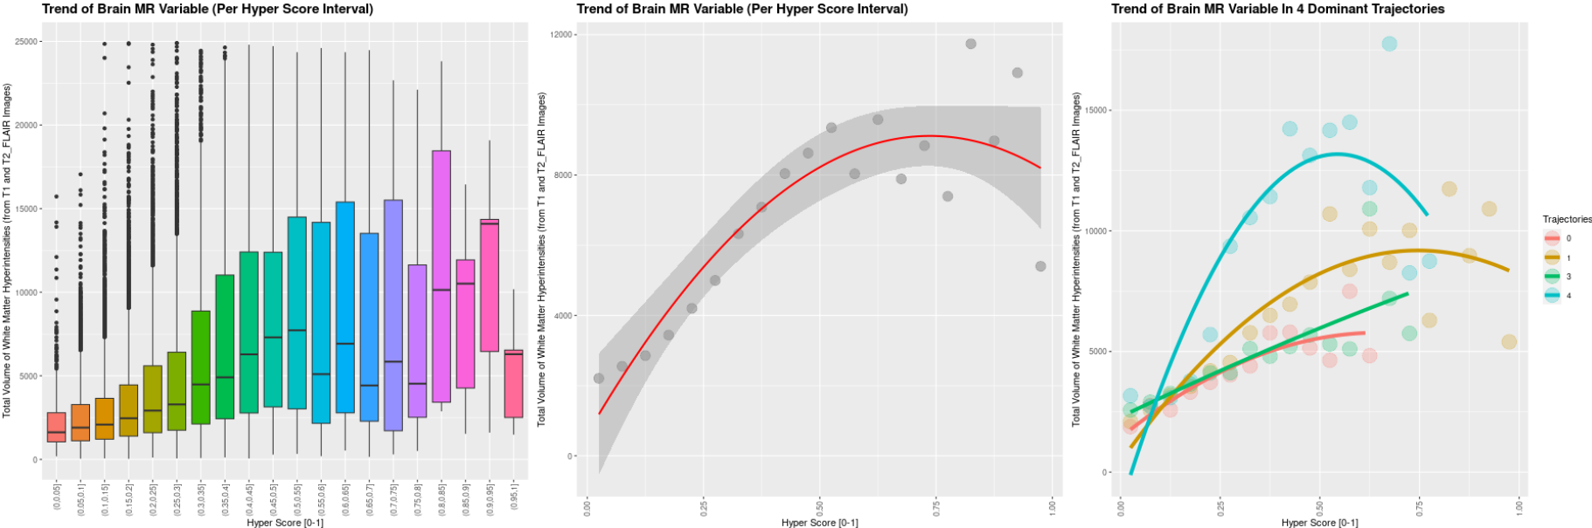
White Matter Hyperintensities

Slide 9
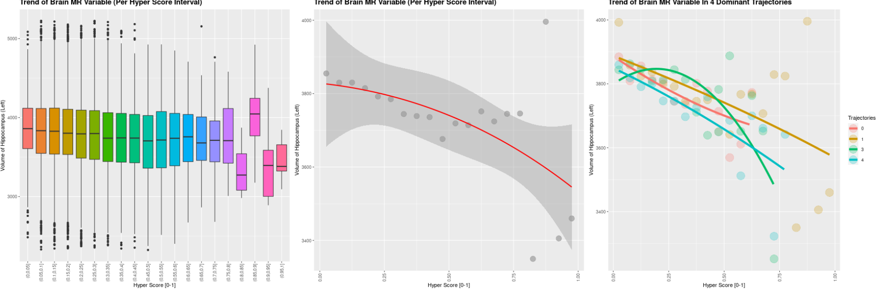
Volume of Hippocampus

Slide 10
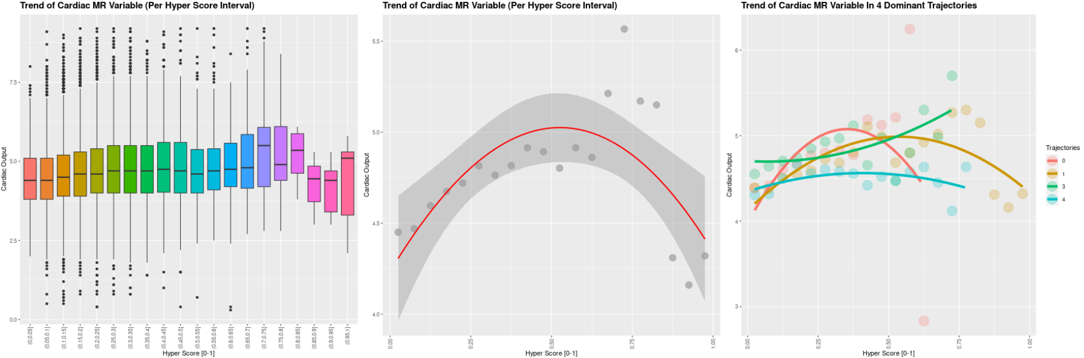
Cardiac Output

Slide 11
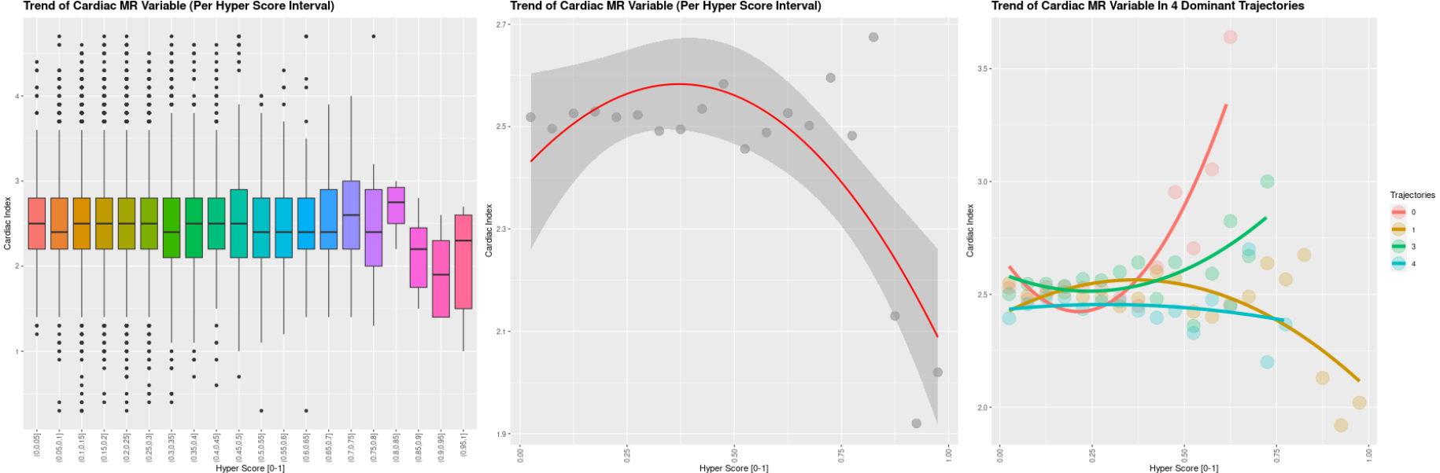
Cardiac Index

Slide 12
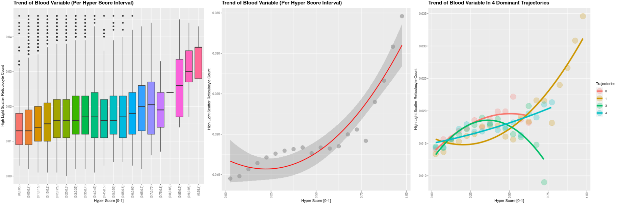
High Light Scatter Reticulocyte

Slide 13
Outcome vs Hyper Score

Slide 14
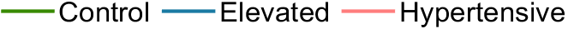
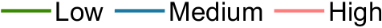
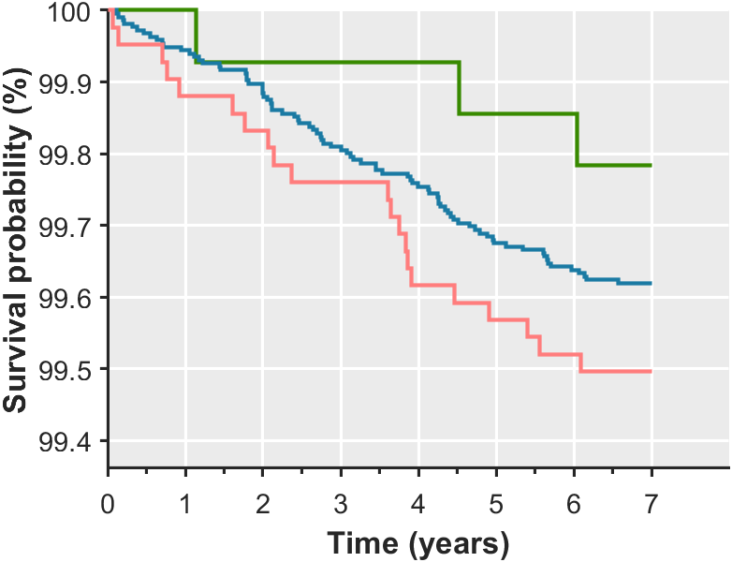
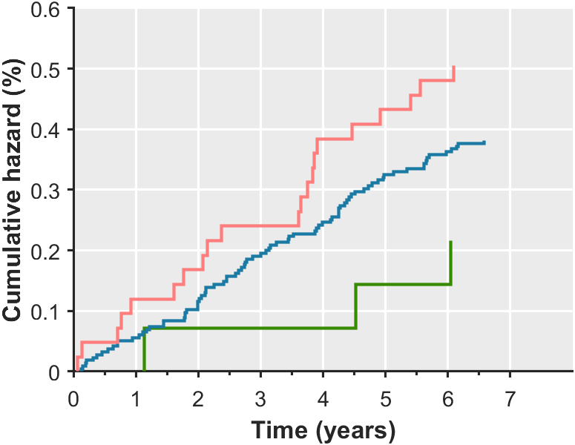
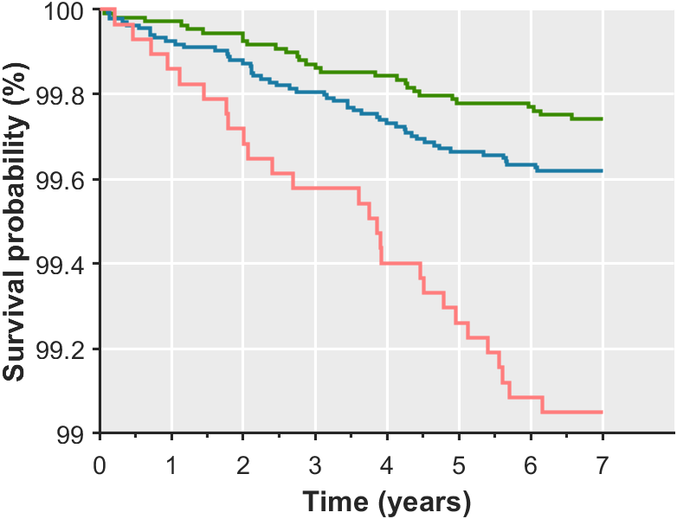
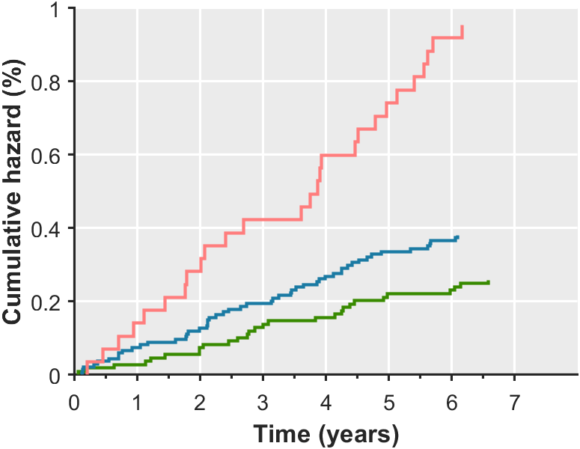
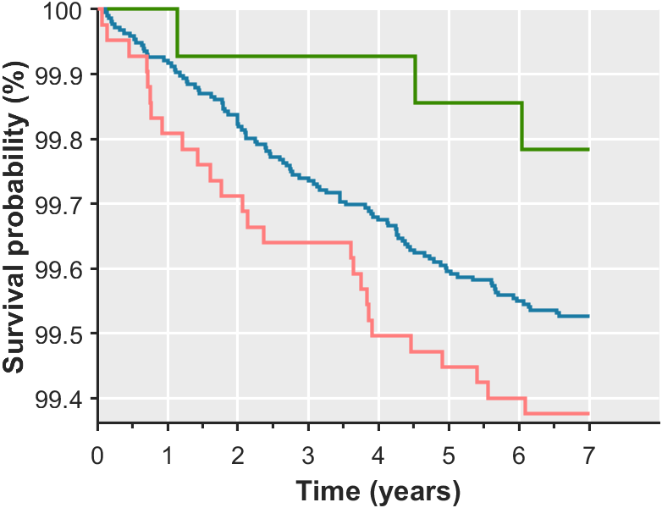
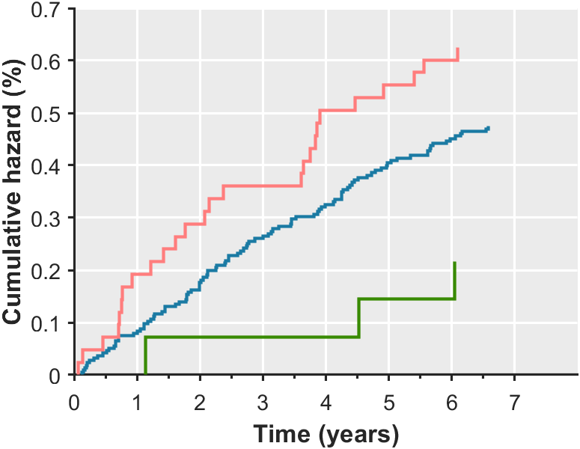
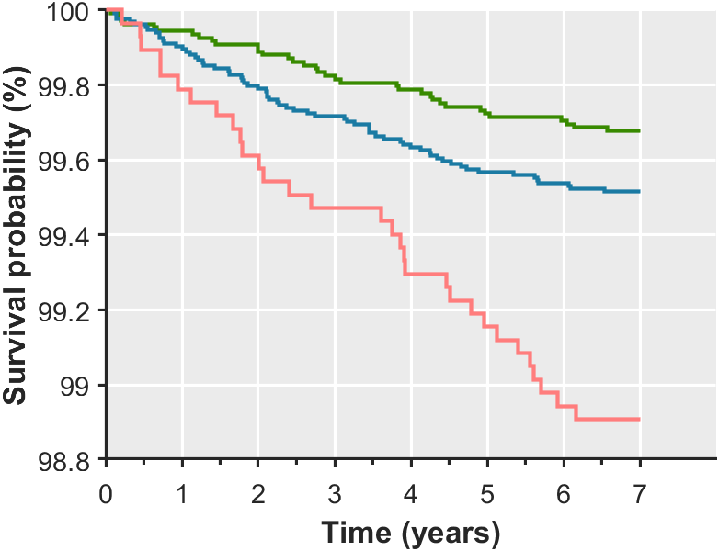
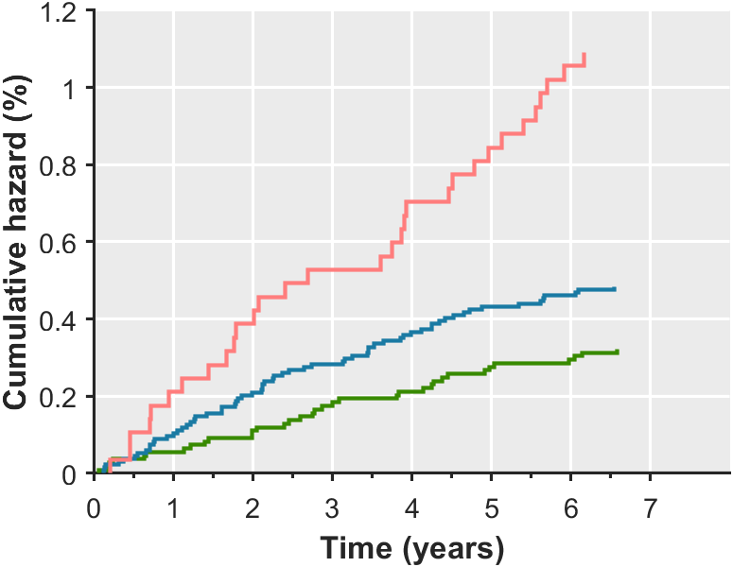
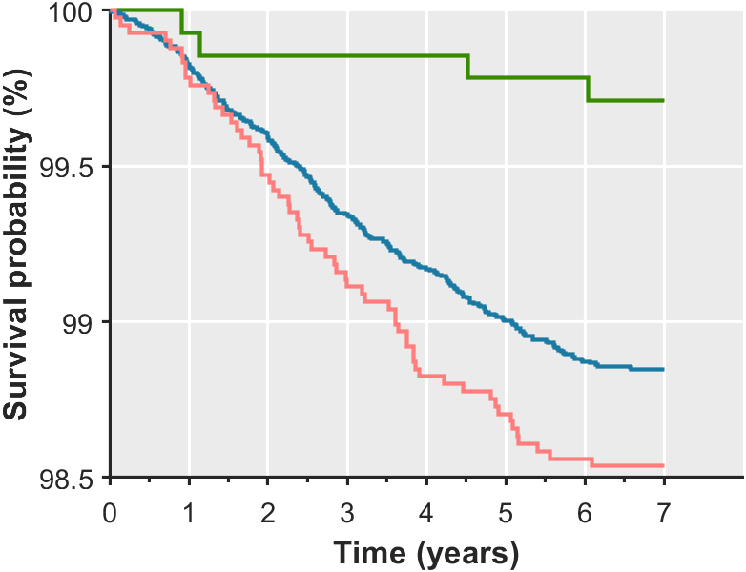
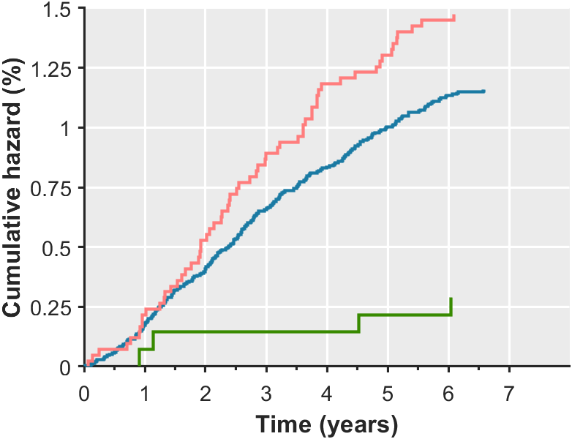
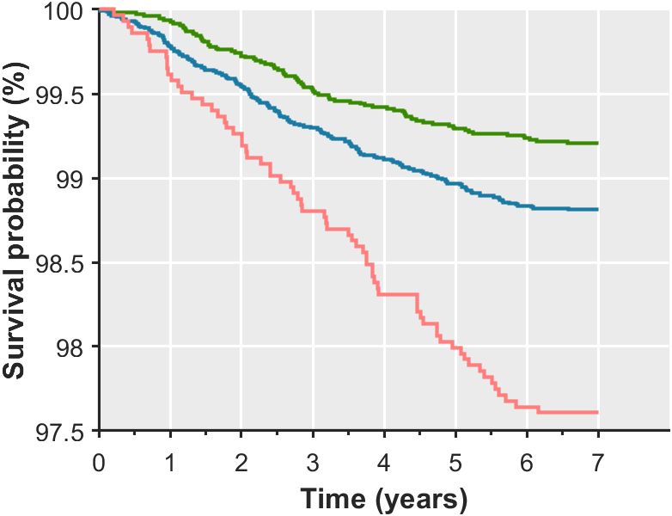
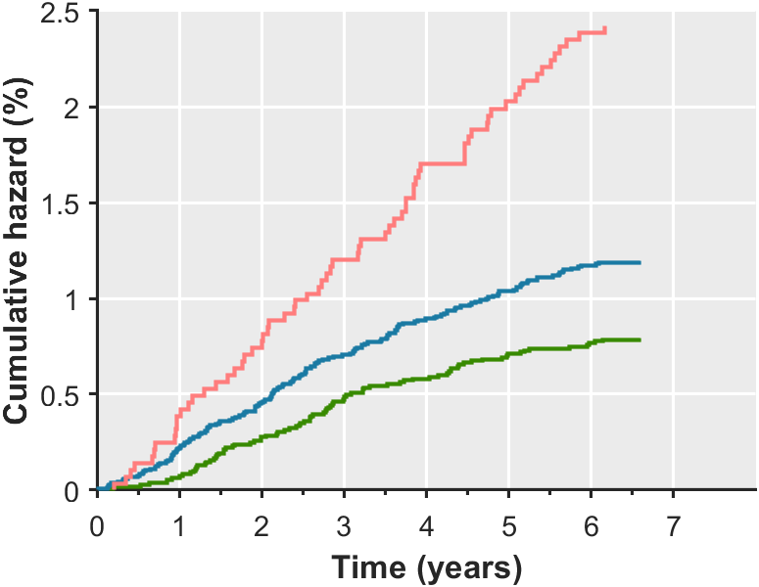
Categorised based on blood pressure
Categorised based on hyperscore
a
HR: 2.331
[0.925-5.874]
p: 0.097
HR: 3.693
[1.924-7.090]
p: 0.330
HR: 1.76
[0.722-4.294]
p: 0.068
p: <0.001
p: 0.249
p: <0.001
HR: 1.475
[0.946-2.298]
Overall p: 0.286, χ²: 2.505
Overall p: <0.001, χ²: 27.793
b
a. Circulatory diseases deaths
b. Circulatory diseases deaths + events
c. All-cause deaths
HR: 2.889
[1.246-6.695]
p: 0.049
HR: 3.393
[1.871-6.154]
p: 0.170
HR: 2.191
[0.982-4.886]
p: <0.001
HR: 1.504
[1.014-2.231]
p: 0.068
p: <0.001
Overall p: 0.150, χ²: 3.807
p: 0.207
Overall p: <0.001, χ²: 27.656
c
HR: 5.100
[2.910-8.937]
p: 0.021
HR: 3.048
[2.062-4.504]
p: 0.003
HR: 4.006
[2.389-6.719]
p: <0.001
p: <0.001
HR: 1.505
[1.170-1.936]
p: <0.001
Overall p: 0.002, χ²: 12.554
p: 0.090
Overall p: <0.001, χ²: 50.998

Slide 15
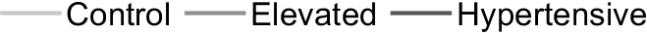
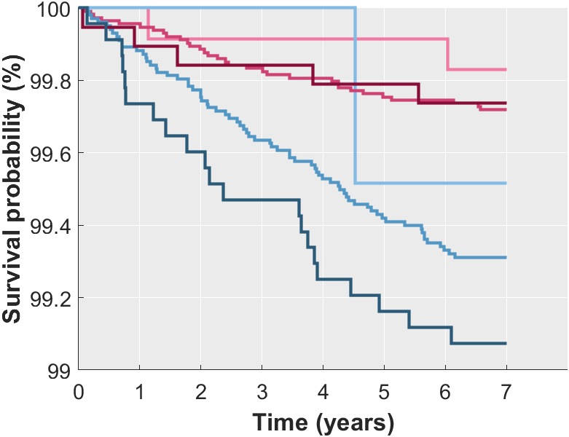
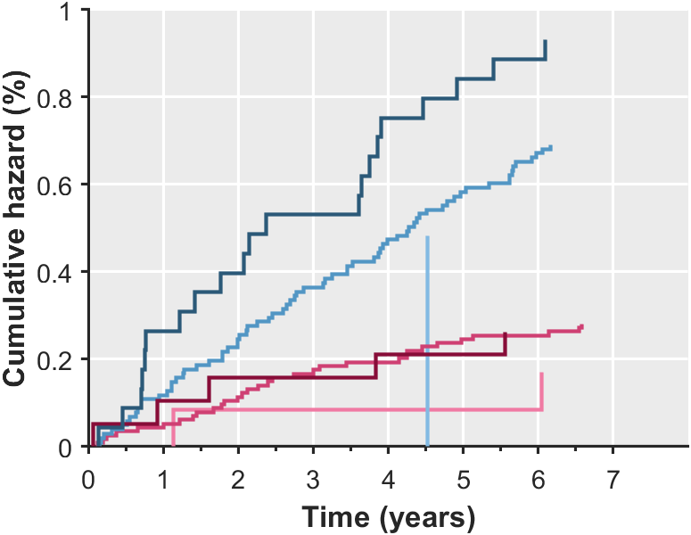
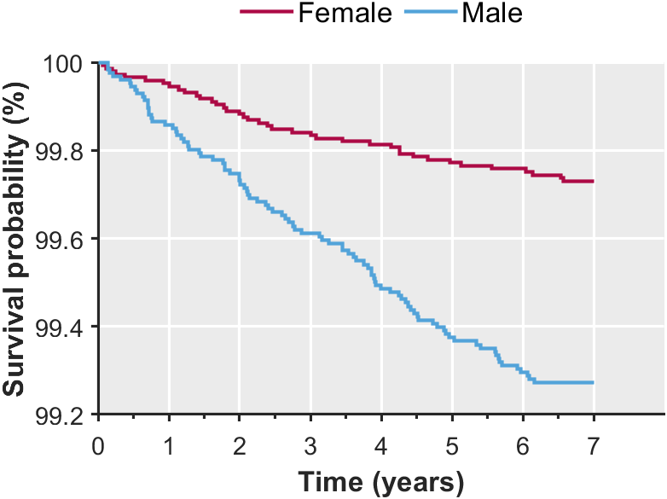
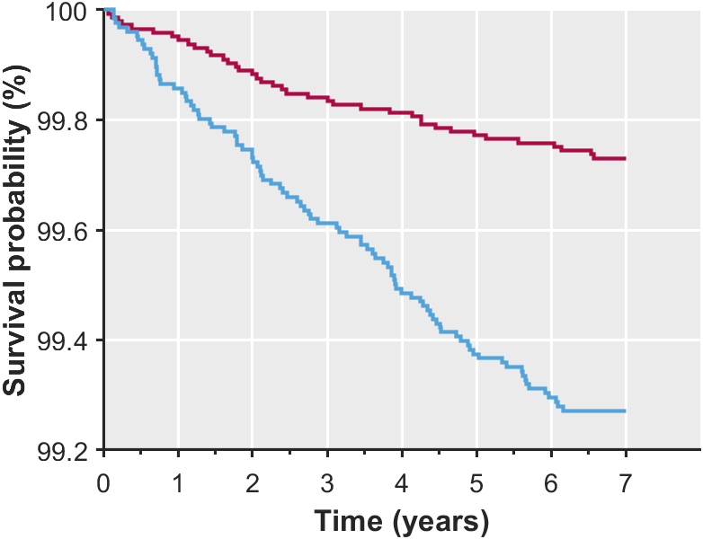
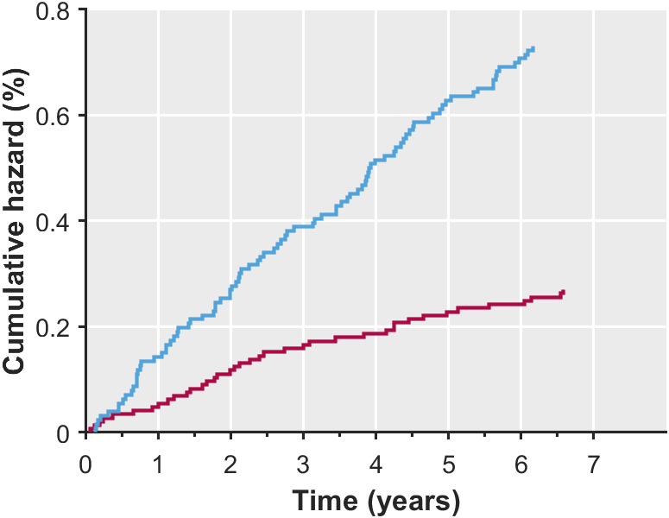
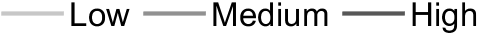
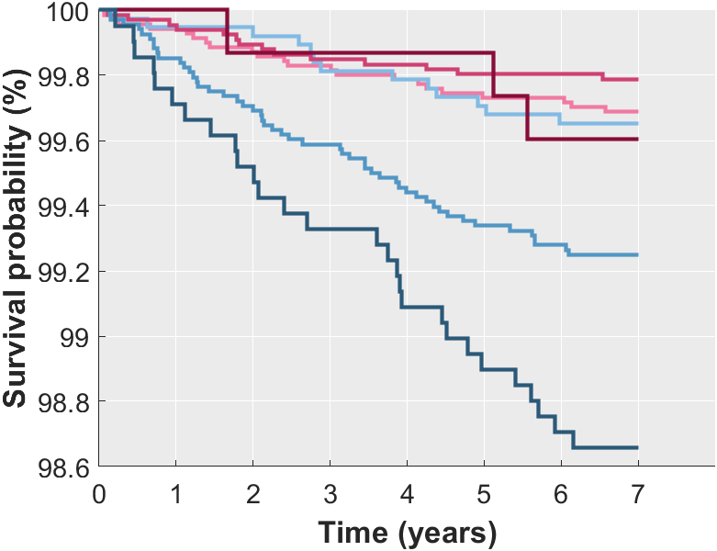
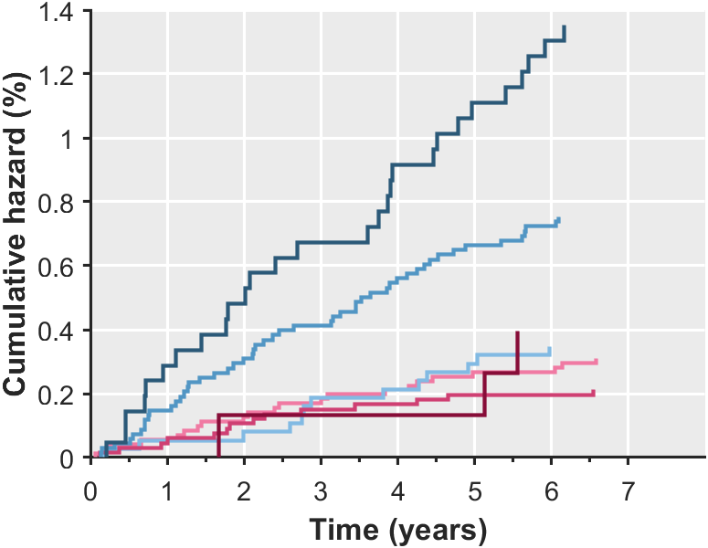
Categorised based on blood pressure
Categorised based on blood pressure
a
b
HR: 2.708
[1.921-3.817]
p: <0.001
Categorised based on hyperscore
Categorised based on hyperscore
Overall p: <0.001, χ²: 29.495
Circulatory diseases deaths + events
a. Survival probability
b. Cumulative hazard

Slide 16
Repeat Imaging Visit Measure vs Hyper Score

Slide 17
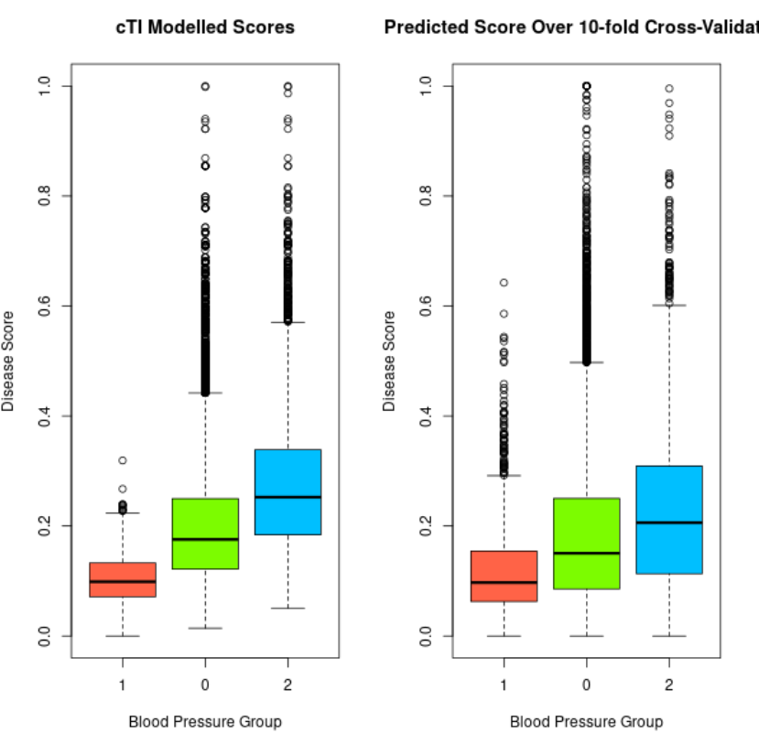
Recap:
Evaluating K-Nearest Neighbour with 10-Fold Cross Validation
(cTI output vs predicted output)

Slide 18
Calculating Instance 3 (2nd Imaging Visit) Hyper Scores
Instance 2 = first imaging visit
Instance 3 = second imaging visit
Find Instance 3 version for all variables (after feature selection) used in cPCA
If variable did not have instances (only 1 recording at instance 0), just re-use what was used previously
Generate the same “feature matrix” as used as the input to cPCA, same order of column, subset of rows from first
New matrix has ~550 columns, ~500 of them were new instance 3 values
New matrix has ~2300 rows as only a portion of patients performed repeat visit
Transform the new matrix into the cPC space (17 components) using eigen matrix computed during cPCA
Use K-Nearest Neighbour (K = 25) to match new cPC (instance 3) with original cPC (instance 2)
Average out the hyper scores (instance 2) of 25 nearest neighbours to get updated hyper score (instance 3)

Slide 19
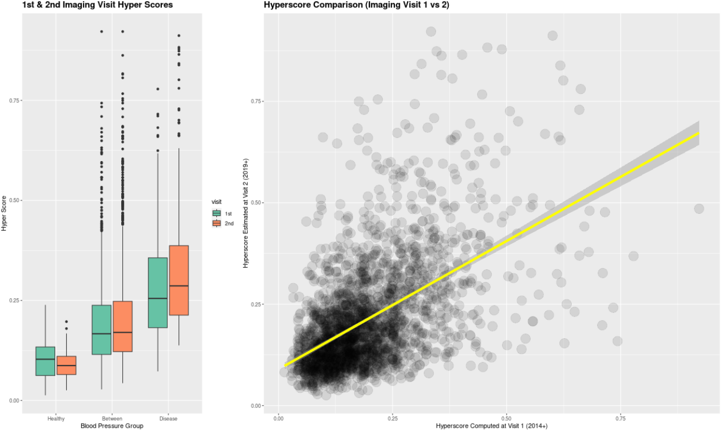

Slide 20
Evaluating Change in Biomarker Value vs Change in Hyper Score
This is not too straight forward as variables change non-linearly at different hyper scores
Fit a loess model using variable and hyper score (imaging visit 1).
Using mean variable value per hyper score interval (0 to 0.1, 0.1 to 0.2 … etc) to get a smooth curve)
Use this model on the new hyper score calculated (imaging visit 2) to predict the biomarker value at imaging visit 2
Compare the predicted biomarker value with the actual reading (imaging visit 2)
This analysis tells us if the biomarker values change in accordance with the changes in hyper score
The relationship is as shown by the fitted loess model, which was already validated
Should this be the other way around? i.e. use actual biomarker value to predict hyper score
Evaluation:
Calculate an error(percentage difference)
Plot correlation of predicted vs real value (at imaging visit 2)
Plot Bland-Altman to compare two distributions (predicted vs real value)

Slide 22
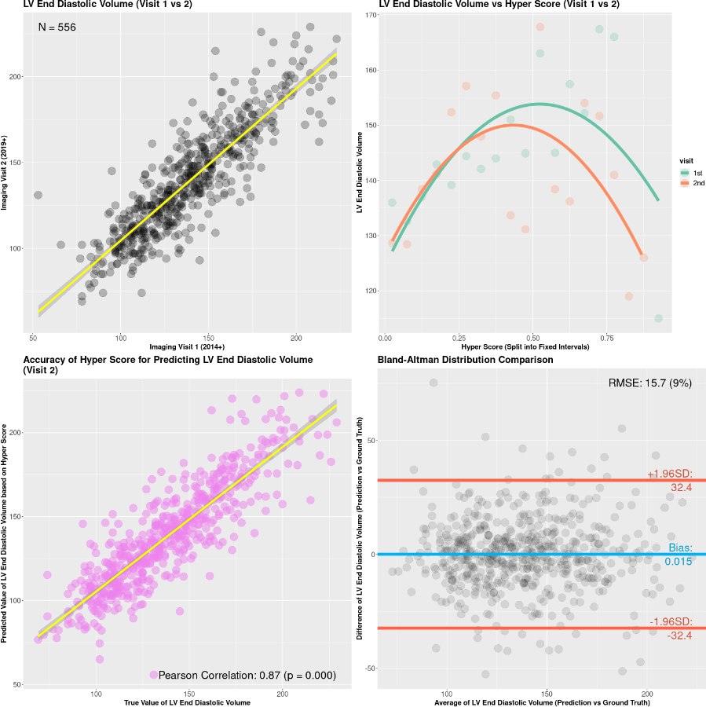

Slide 23
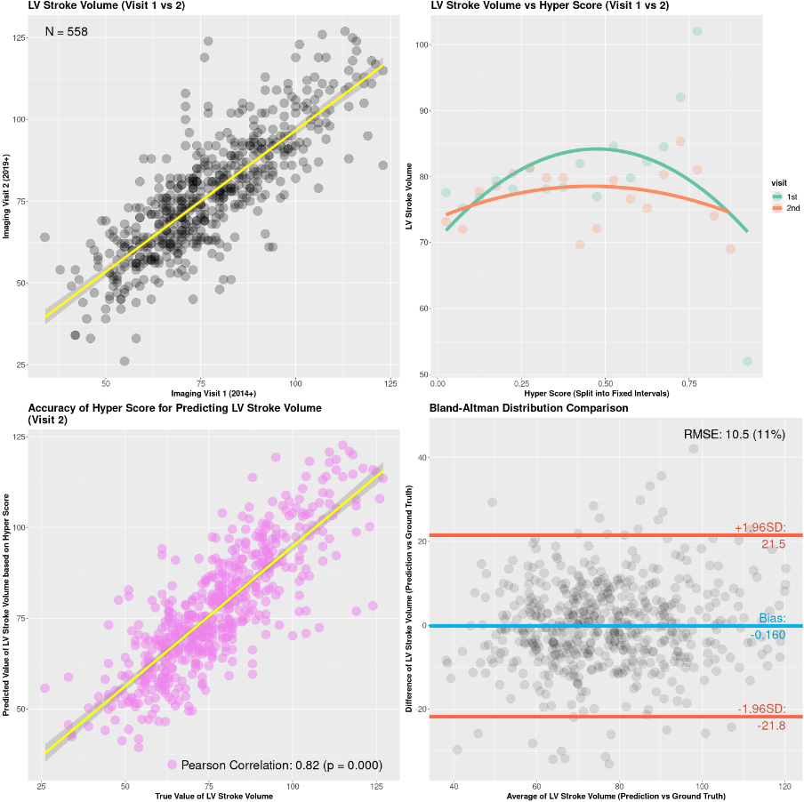

Slide 24
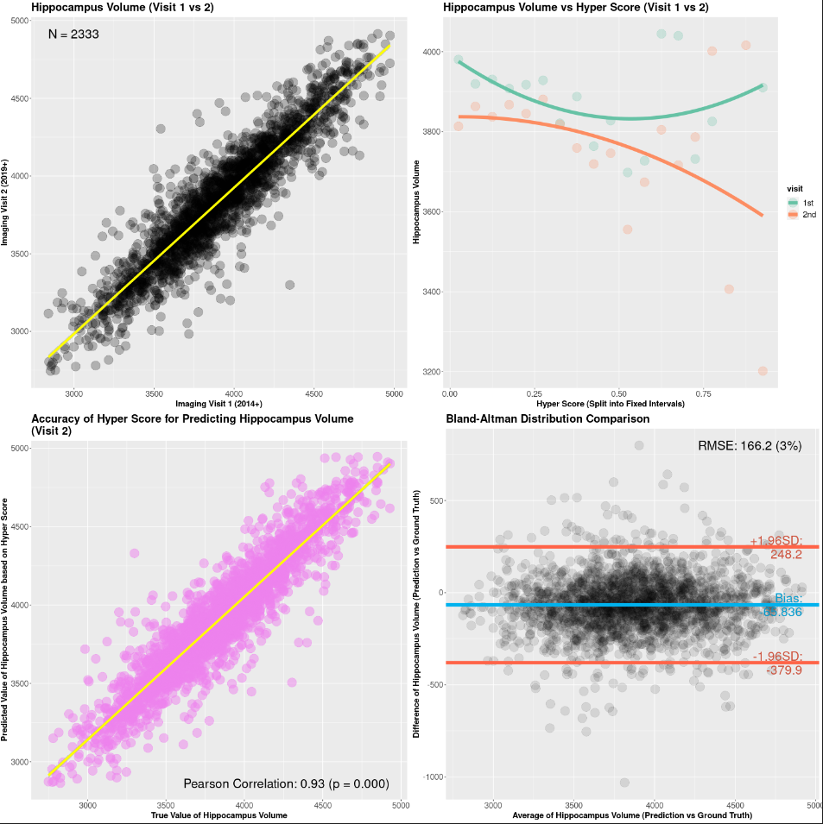

Slide 25
