Slide 1
To Do:
Known variables vs disease score (& trajectories)
Time to outcome/event vs disease score
Disease score (1st visit) vs re-calculated disease score (2nd imaging visit) for known variables

Slide 2
Variable Vs Hyper Score

Slide 3
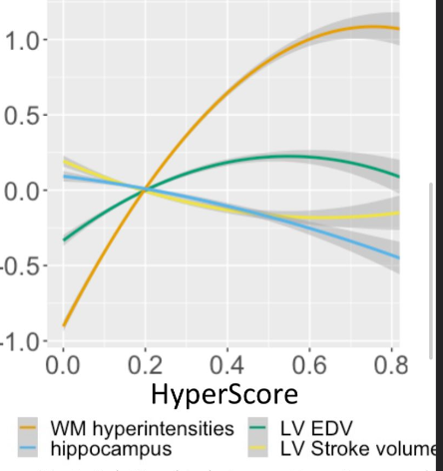
White Matter Hyperintensity:
Increasing then plateau
Hippocampus Volume
Decreasing
LV end diastolic volume
Increasing then decreasing
LV stroke volume
Decreasing then increasing

Slide 4
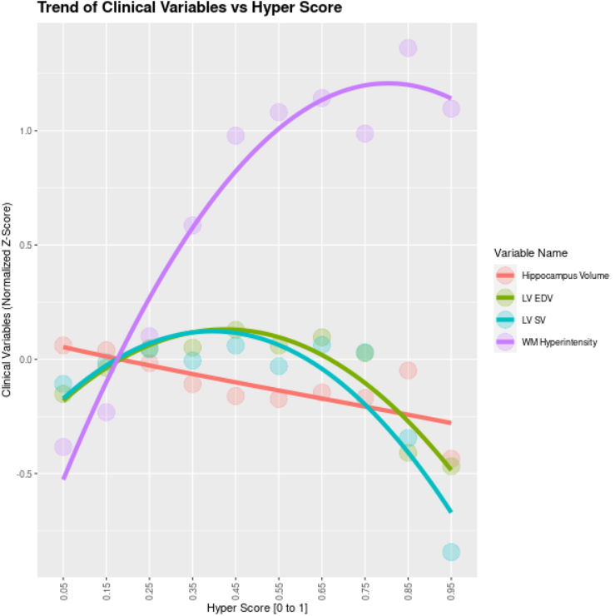
Split Hyper Score into Intervals and Plot Means of Variables per Interval

Slide 5
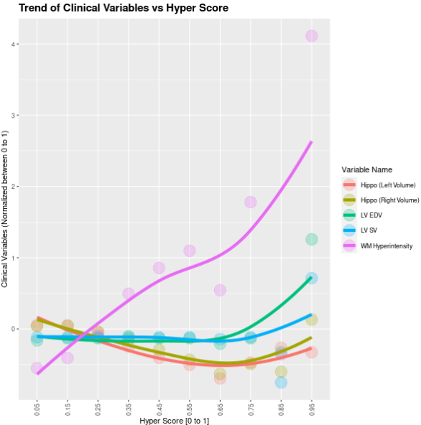
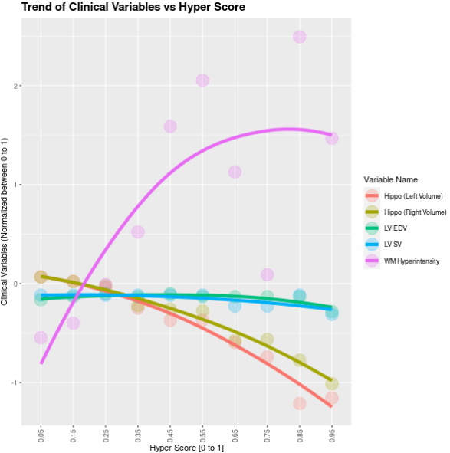
All Variables (No Ft Selection)
Co-Cor Ft Selection Only
(Imbalanced Brain/Body Comp Variables)

Slide 6
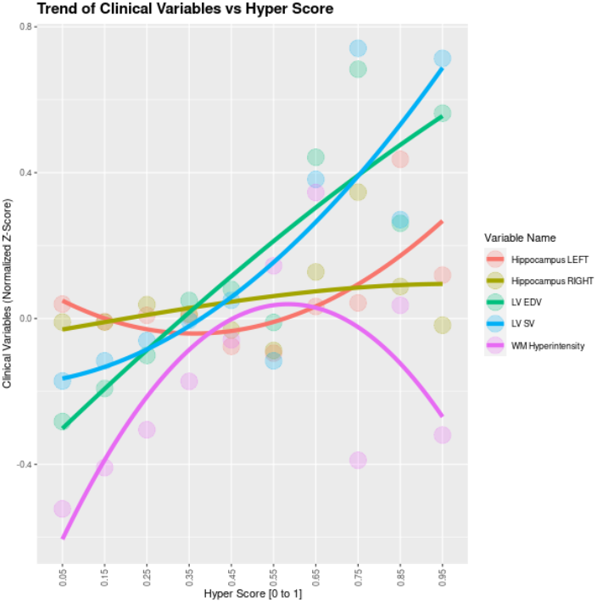
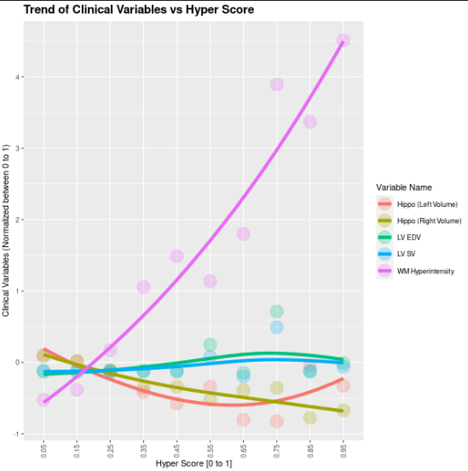
Co-Cor Ft Selection + Brain
Co-Cor Ft Selection + Body Comp

Slide 7
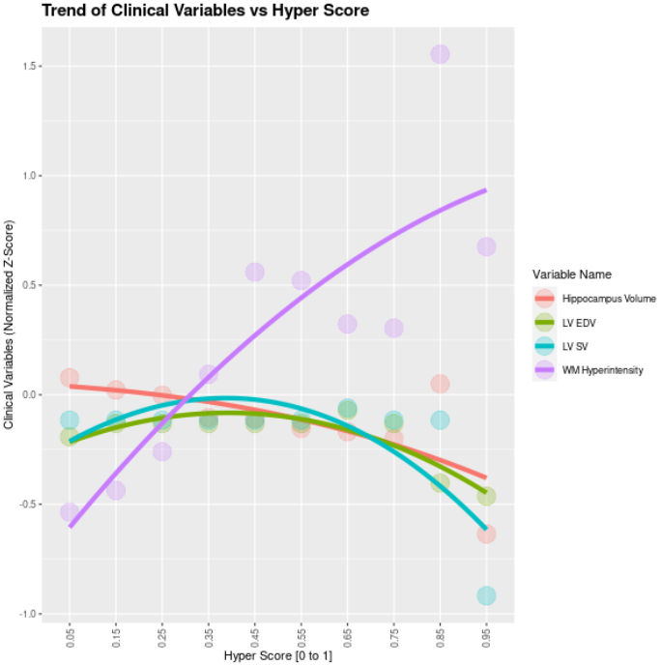
Mean per (10) intervals
Median per (10) intervals

Slide 8
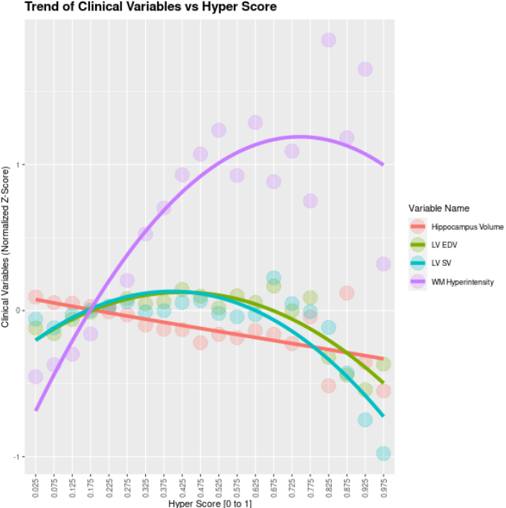
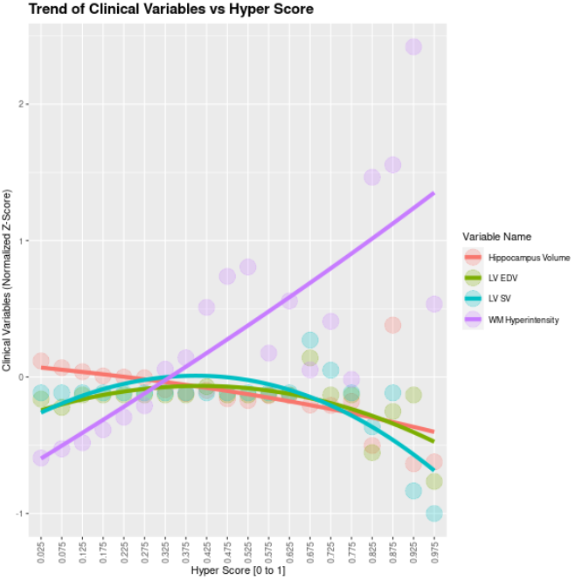
Mean per (20) intervals
Median per (20) intervals

Slide 10
Variable Vs Hyper Score Per Trajectory

Slide 11
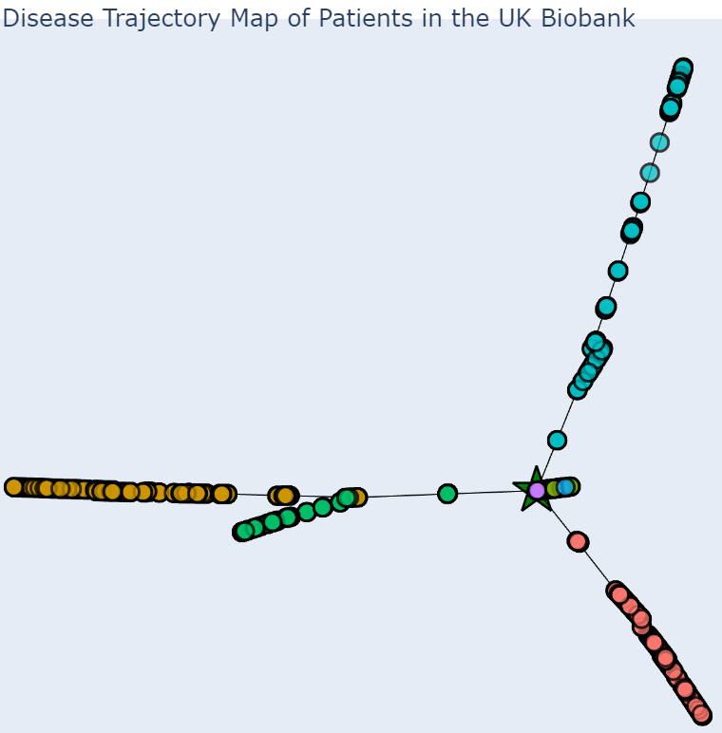
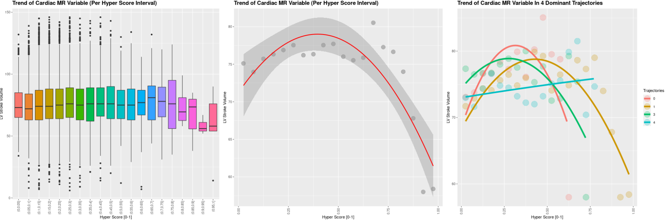
LV Stroke Volume

Slide 12
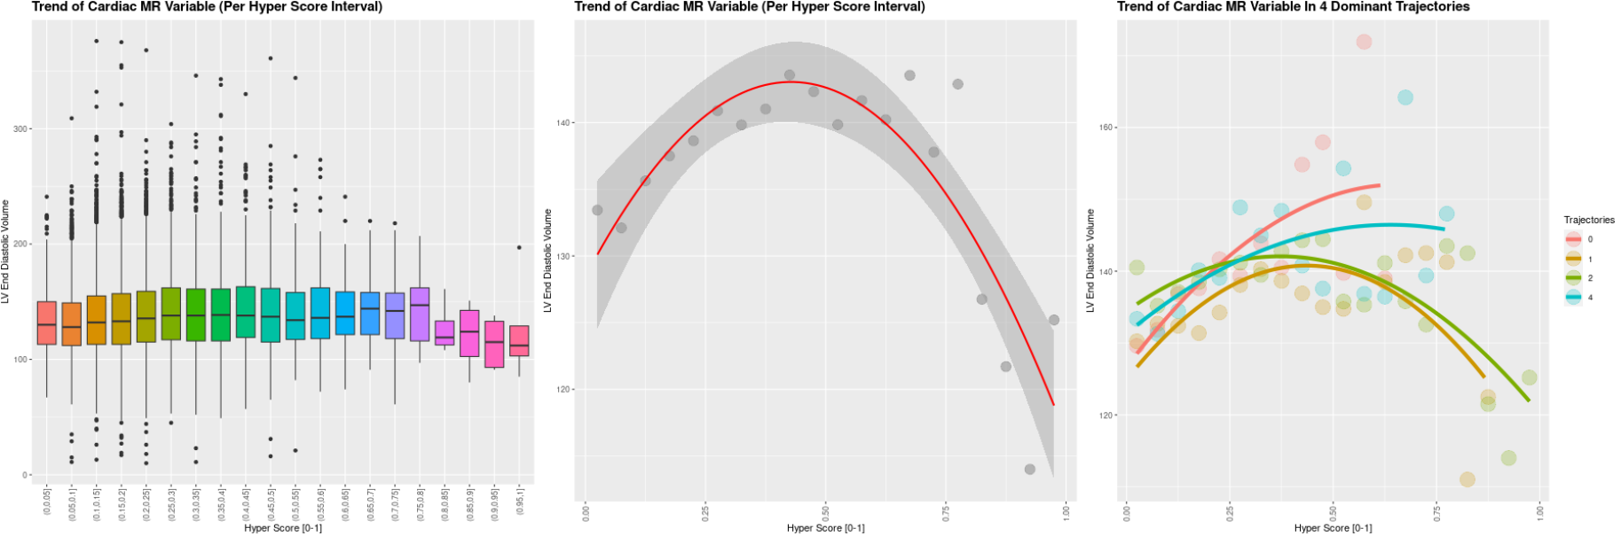
LV End Diastolic Volume

Slide 13
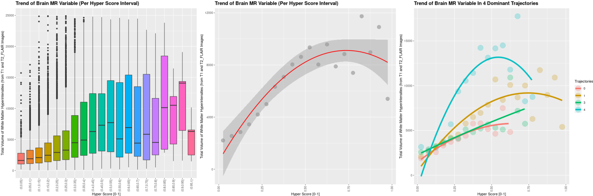
White Matter Hyperintensities

Slide 14
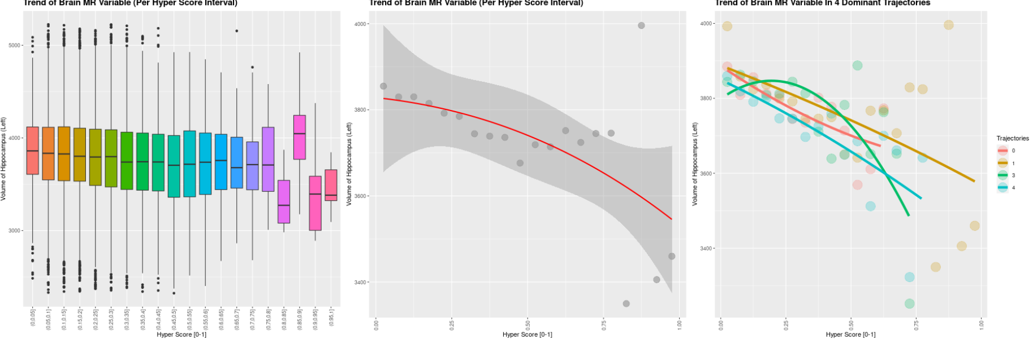
Volume of Hippocampus

Slide 15
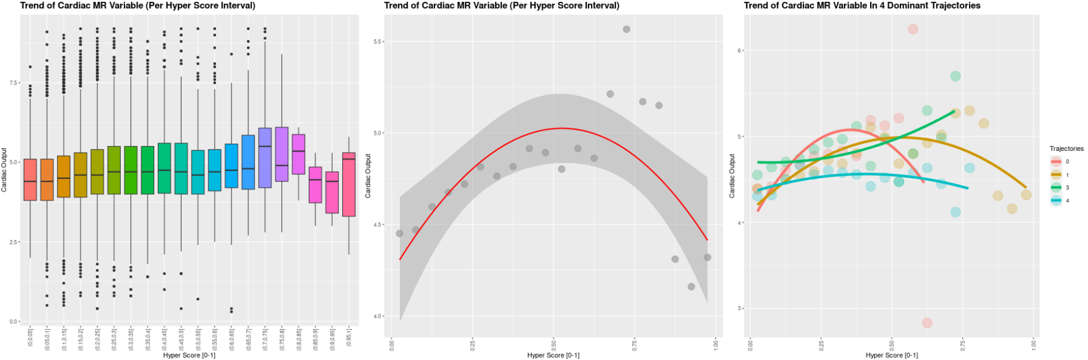
Cardiac Output

Slide 16
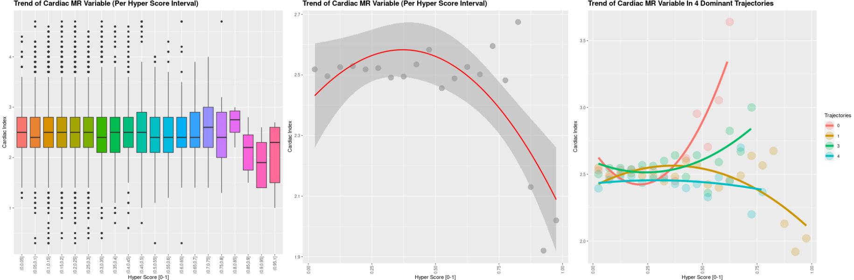
Cardiac Index

Slide 17
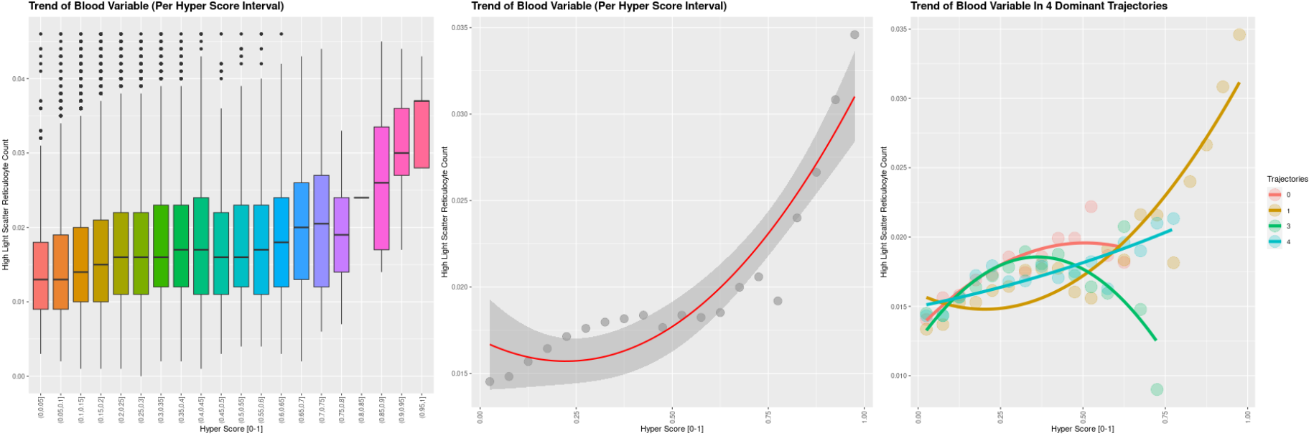
High Light Scatter Reticulocyte

Slide 18
Outcome vs Hyper Score

Slide 21
Repeat Imaging Visit Measure vs Hyper Score

Slide 22
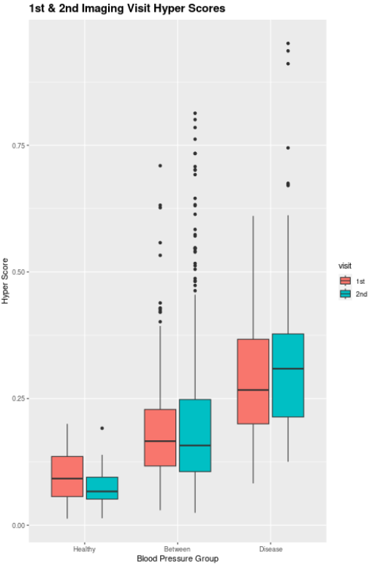
Instance 2 = first imaging visit
Instance 3 = second imaging visit
Find Instance 3 version for all variables (after feature selection) used in cPCA
If variable did not have instances (only 1 recording at instance 0), just re-use what was used previously
Generate the same “feature matrix” as used as the input to cPCA, same column order
New matrix has ~550 columns, ~500 of them were instance 3 values
New matrix has ~2300 rows as only a portion of patients performed repeat visit
Transform the new matrix into the cPC space using eigen matrix computed during cPCA
Use K-Nearest Neighbour (K = 25) to match new cPC (instance 3) with original cPC (instance 2)
Average out the hyper scores (instance 2) of 25 nearest neighbours to get updated hyper score (instance 3)

