Slide 1
To Do:
Known variables vs disease score
Time to outcome/event vs disease score
Repeat imaging variable change (1st/2nd) vs disease score
Variables in different trajectories

Slide 2
Variable Vs Hyper Score

Slide 3
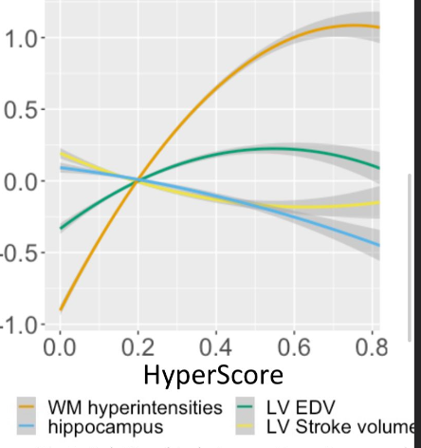
White Matter Hyperintensity:
Increasing then plateau
Hippocampus Volume
Decreasing
LV end diastolic volume
Increasing then decreasing
LV stroke volume
Decreasing then increasing

Slide 4
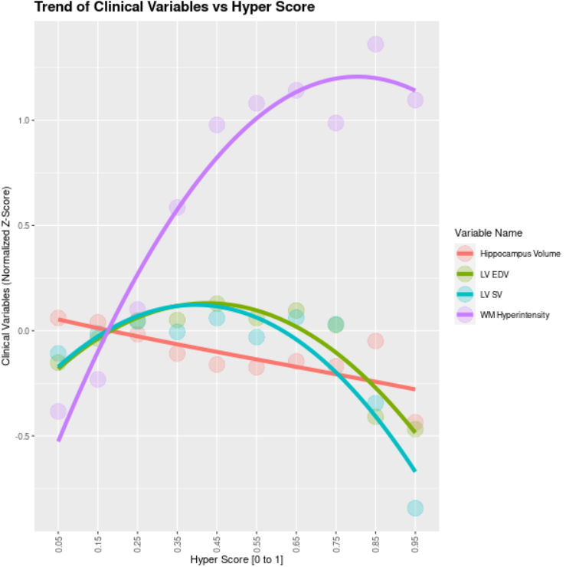
Split Hyper Score into Intervals and Plot Means of Variables per Interval

Slide 5
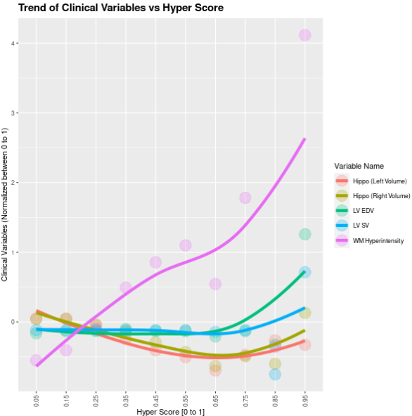
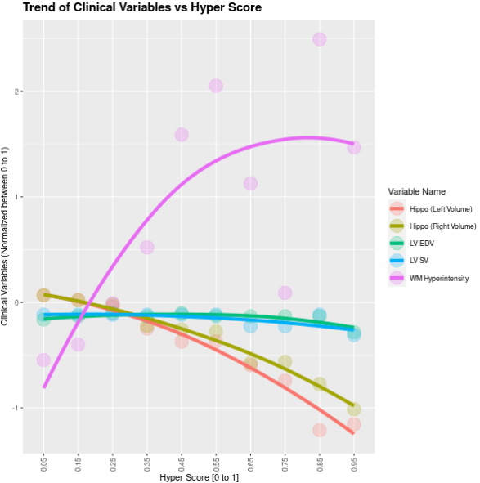
All Variables (No Ft Selection)
Co-Cor Ft Selection Only
(Imbalanced Brain/Body Comp Variables)

Slide 6
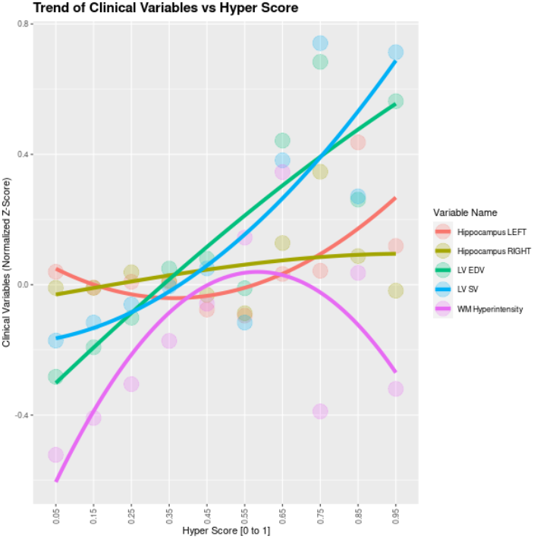
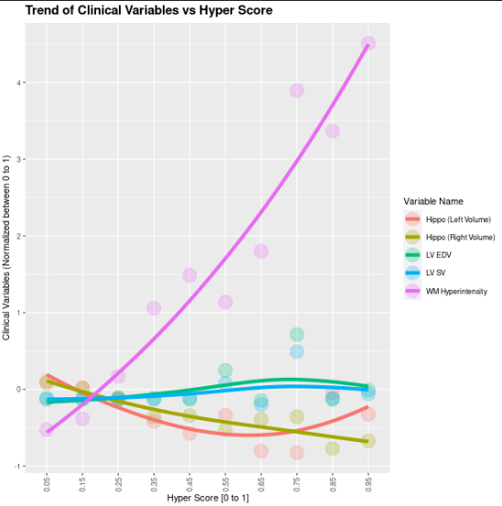
Co-Cor Ft Selection + Brain
Co-Cor Ft Selection + Body Comp

Slide 7
Event vs Hyper Score

Slide 11
Repeat Imaging Visit Measure vs Hyper Score

Slide 15
Variables in Trajectories

