Slide 1
To Do:
Known variables vs disease score (& trajectories)
Time to outcome/event vs disease score
Repeat imaging variable change (1st/2nd) vs disease score

Slide 2
Variable Vs Hyper Score

Slide 3
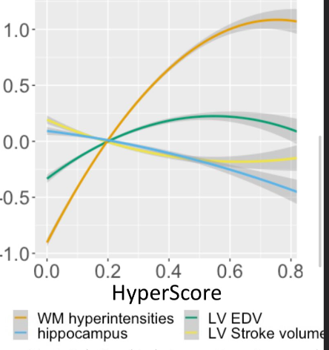
White Matter Hyperintensity:
Increasing then plateau
Hippocampus Volume
Decreasing
LV end diastolic volume
Increasing then decreasing
LV stroke volume
Decreasing then increasing

Slide 4
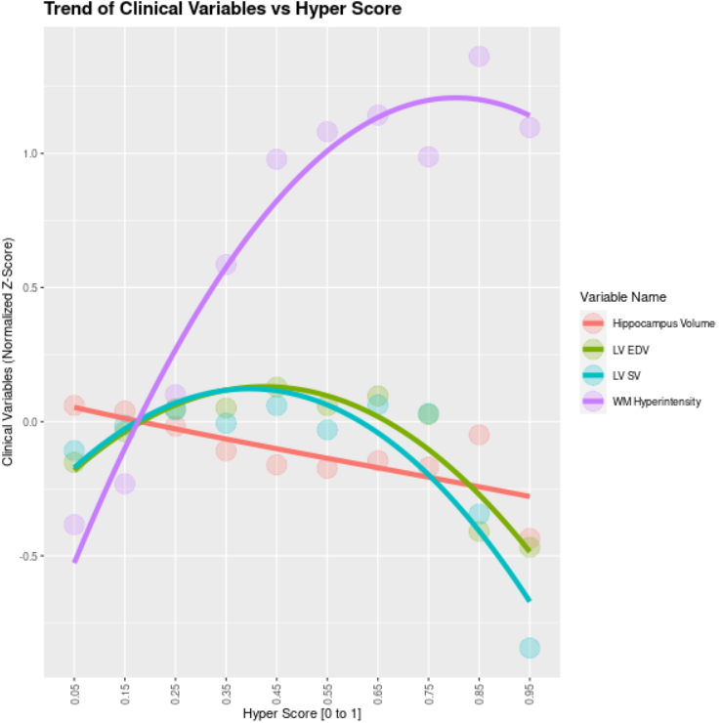
Split Hyper Score into Intervals and Plot Means of Variables per Interval

Slide 5
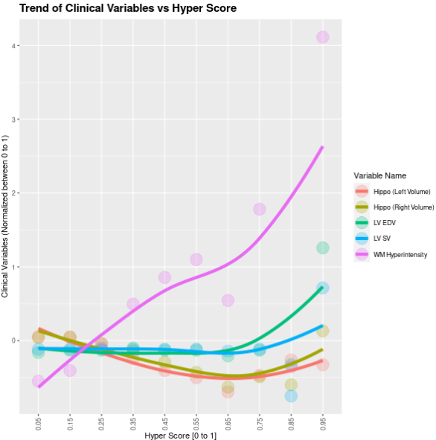
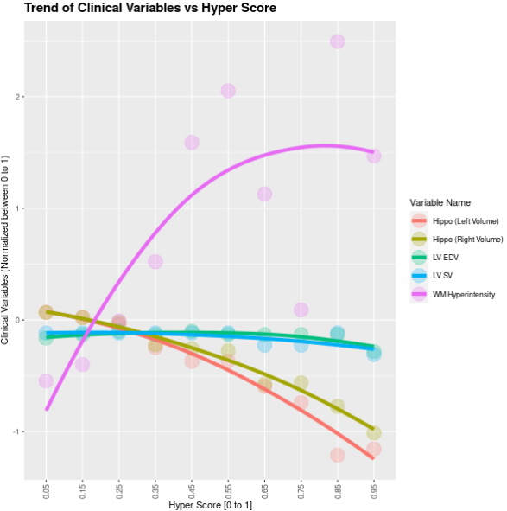
All Variables (No Ft Selection)
Co-Cor Ft Selection Only
(Imbalanced Brain/Body Comp Variables)

Slide 6
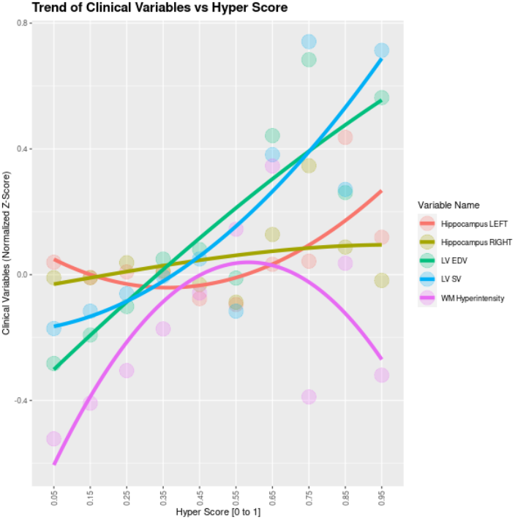
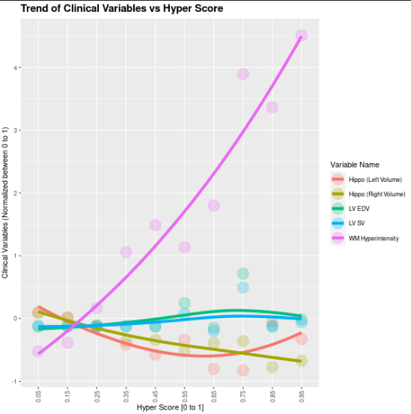
Co-Cor Ft Selection + Brain
Co-Cor Ft Selection + Body Comp

Slide 7
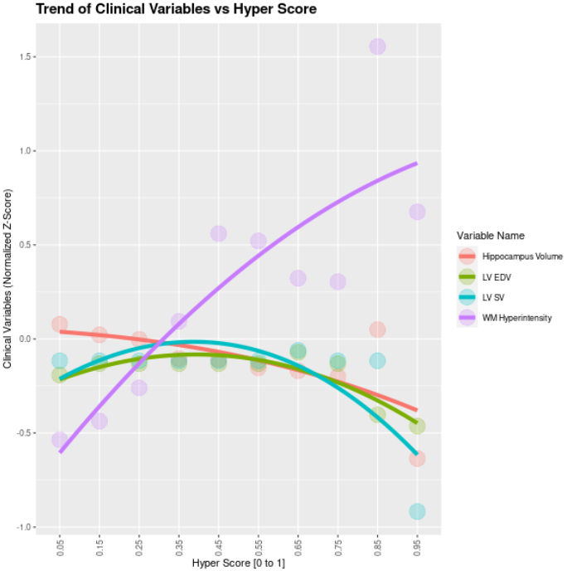
Mean per (10) intervals
Median per (10) intervals

Slide 8
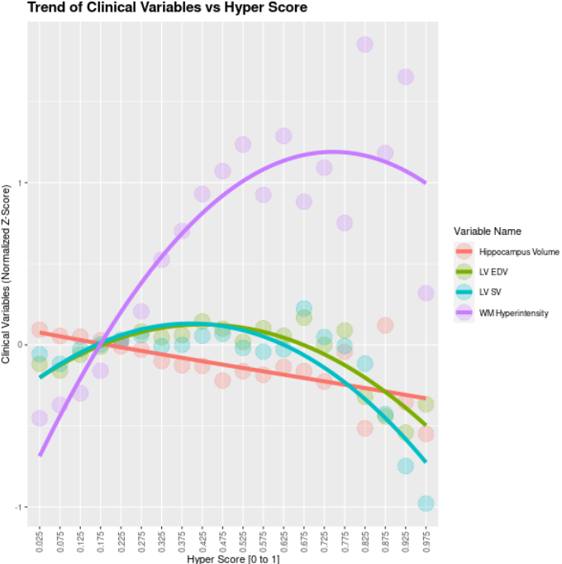
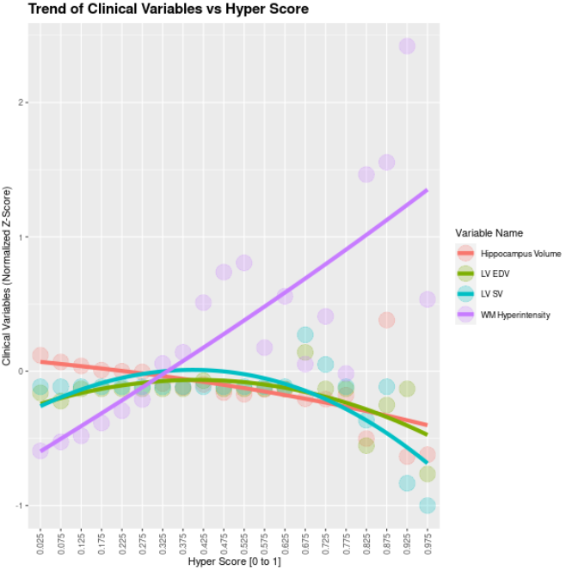
Mean per (20) intervals
Median per (20) intervals

Slide 9
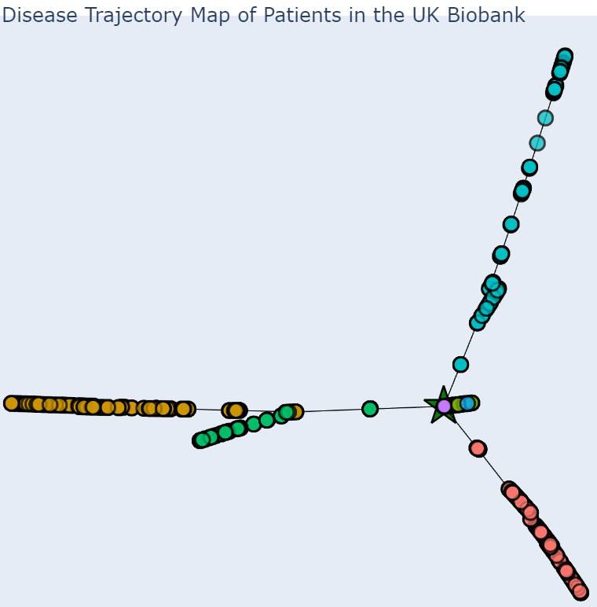
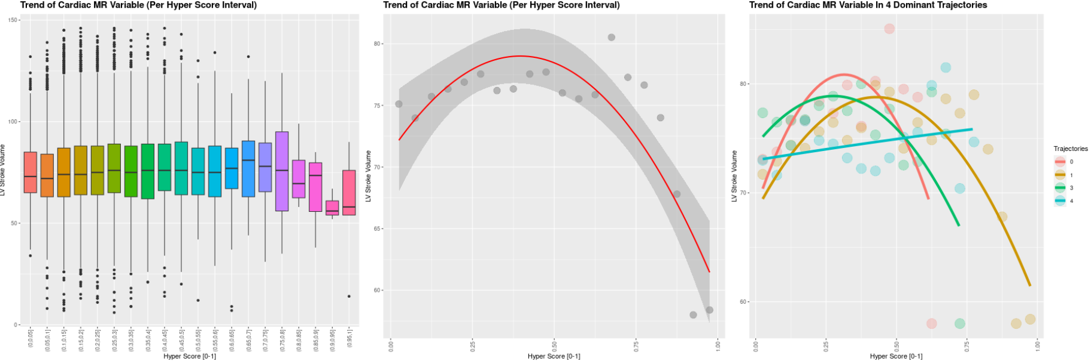
LV Stroke Volume

Slide 10
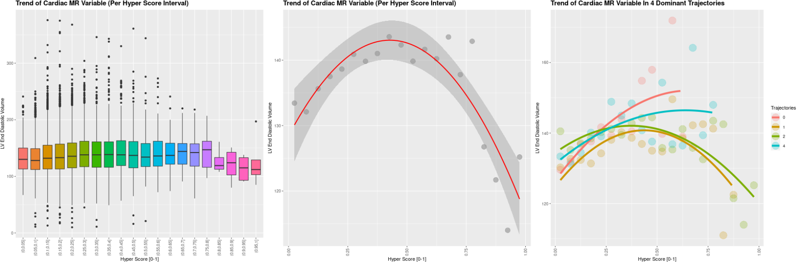
LV End Diastolic Volume

Slide 11
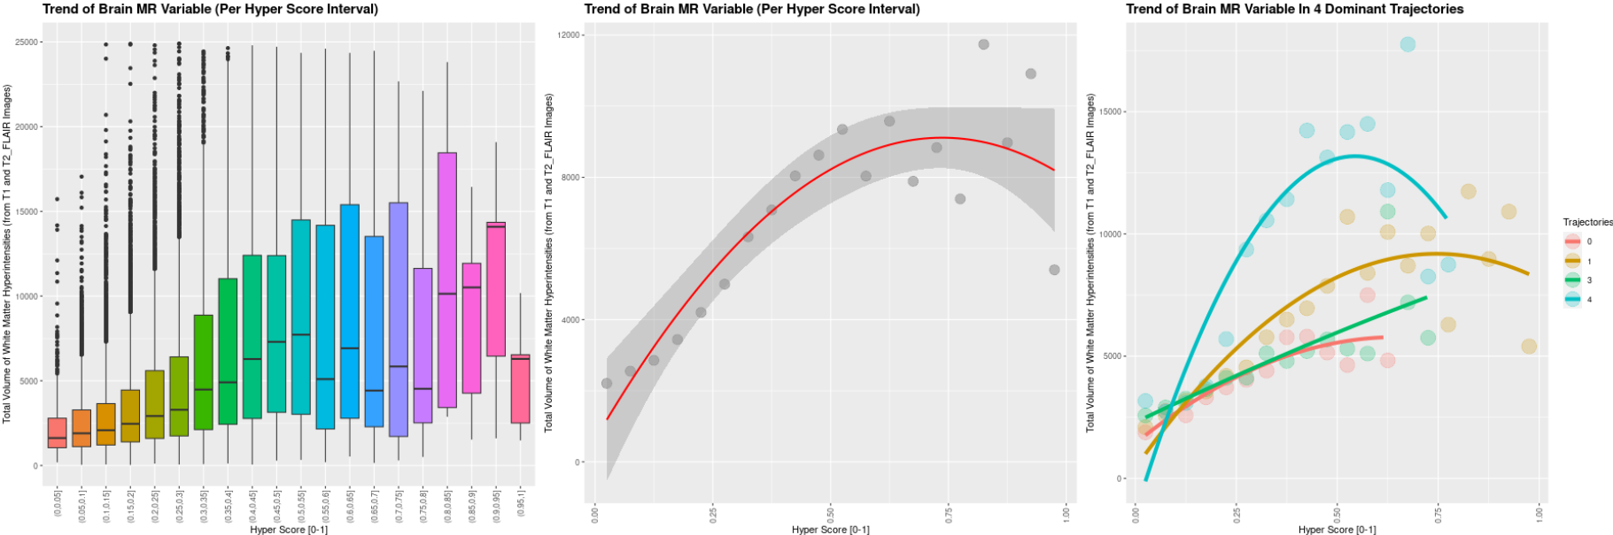
White Matter Hyperintensities

Slide 12
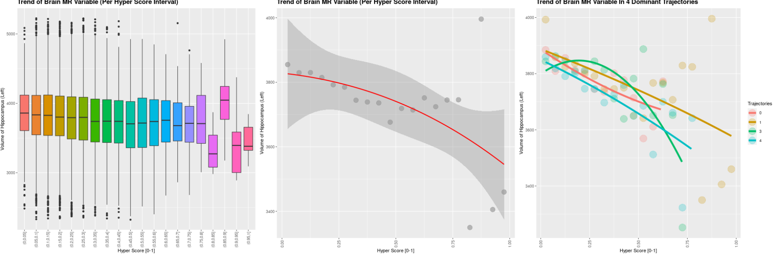
Volume of Hippocampus

Slide 13
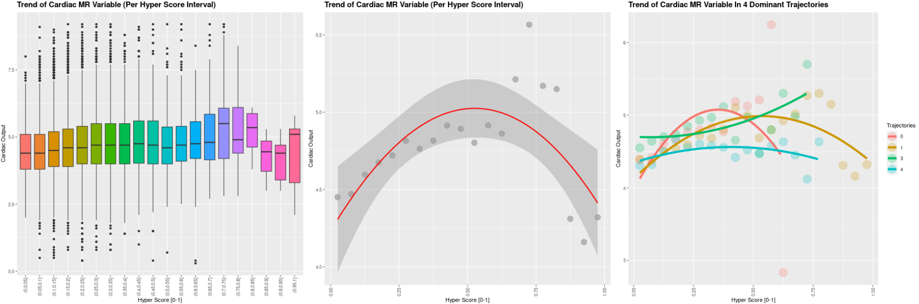
Cardiac Output

Slide 14
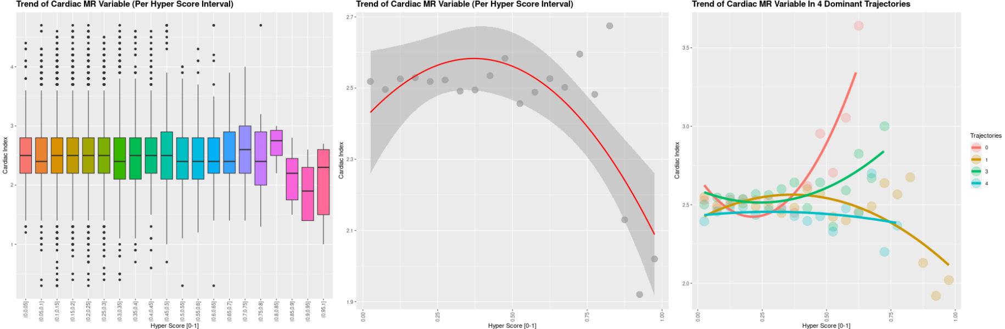
Cardiac Index

Slide 15
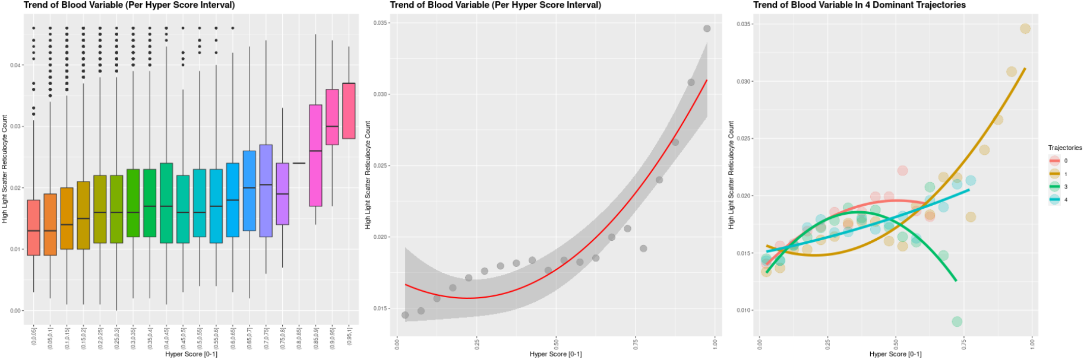
High Light Scatter Reticulocyte

Slide 16
Outcome vs Hyper Score

Slide 19
Repeat Imaging Visit Measure vs Hyper Score

Slide 20
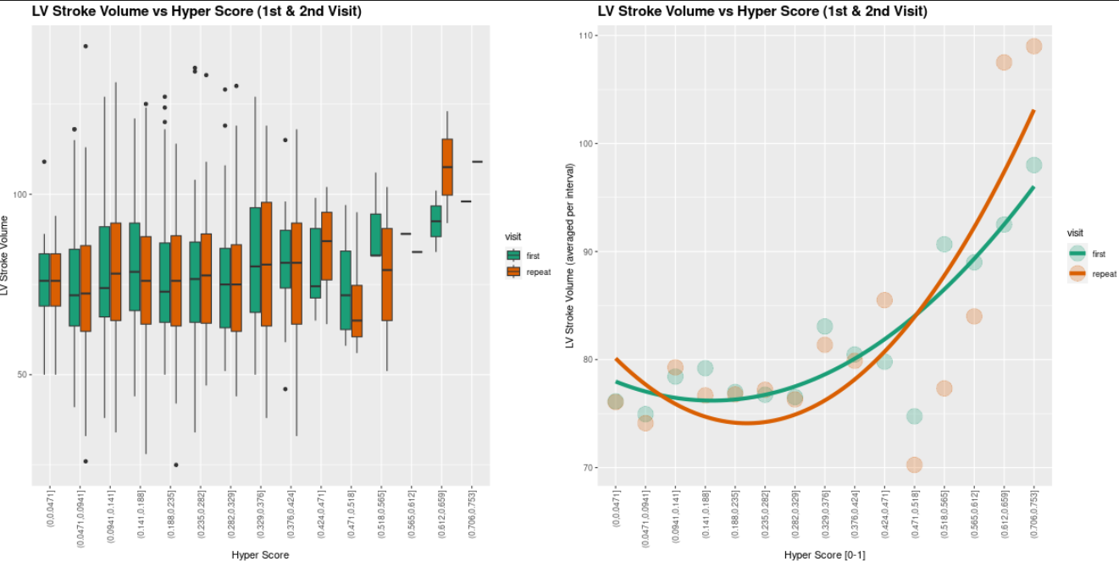
613 measurements

Slide 21
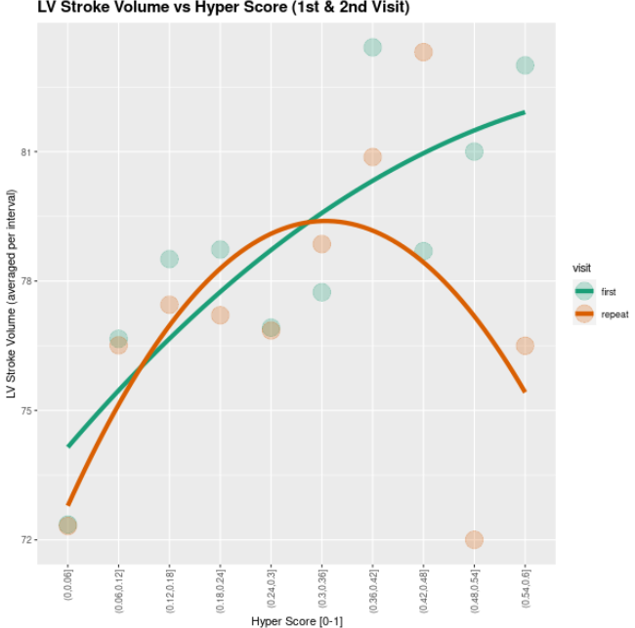
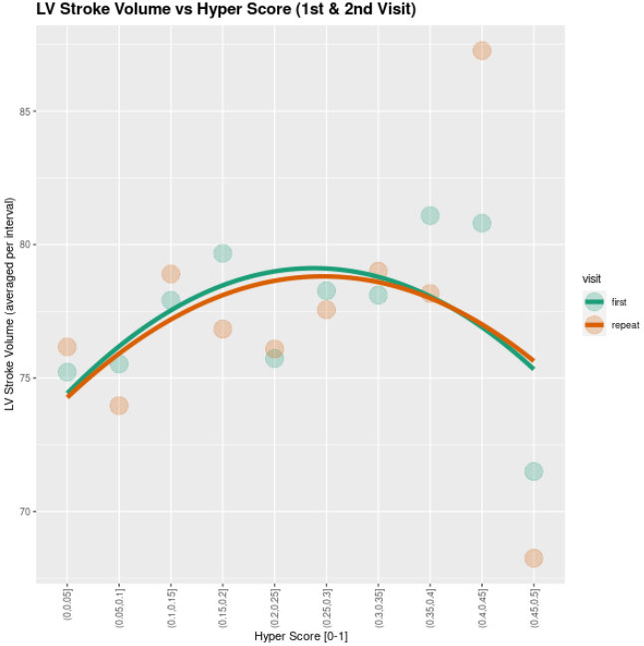
Limit Hyper Score range to 0-0.6
Limit Hyper Score range to 0-0.5

Slide 22
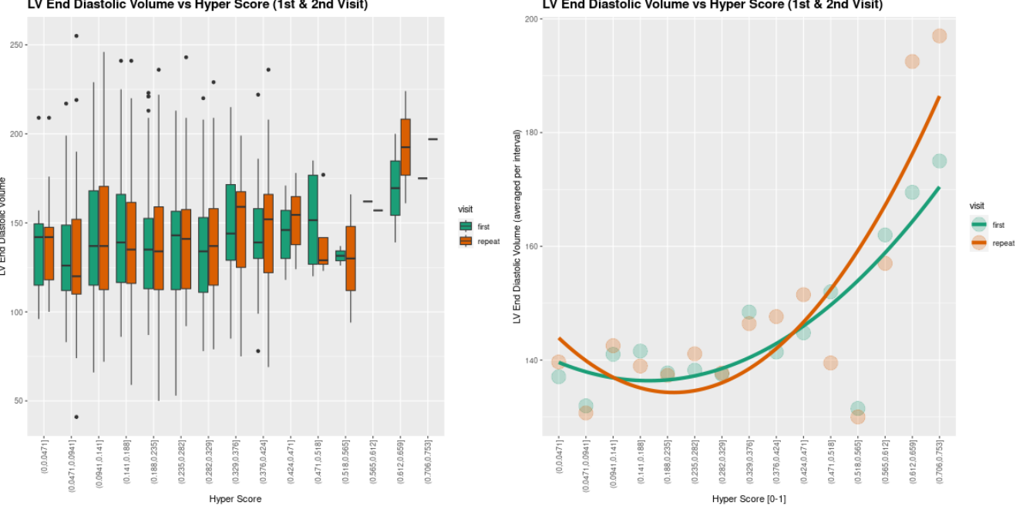
610 measurements

Slide 23
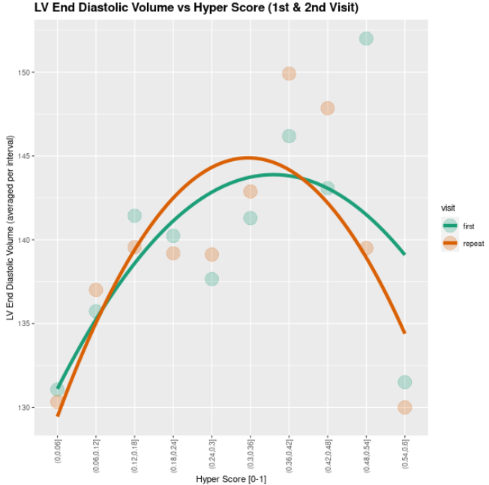
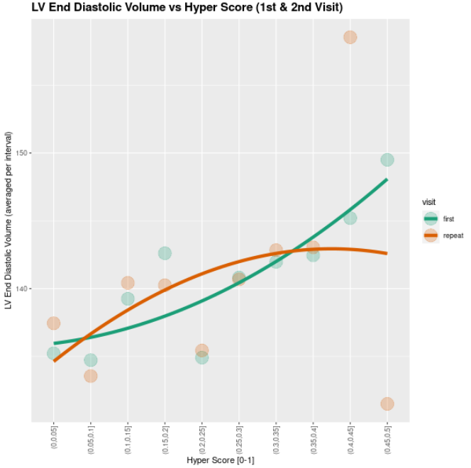
Limit Hyper Score range to 0-0.6
Limit Hyper Score range to 0-0.5

Slide 24
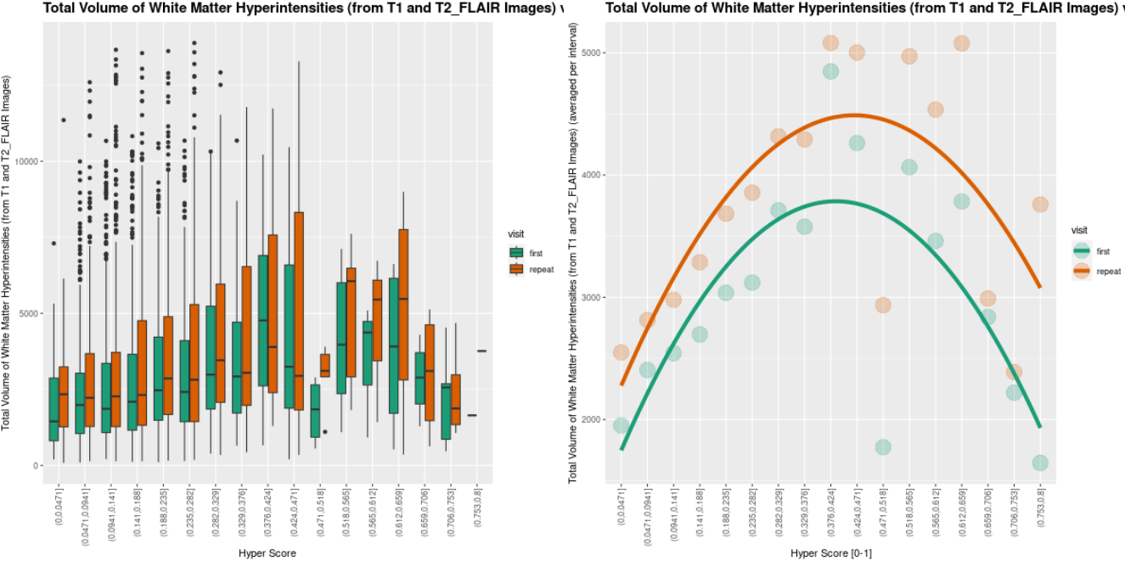
2447 measurements

Slide 25
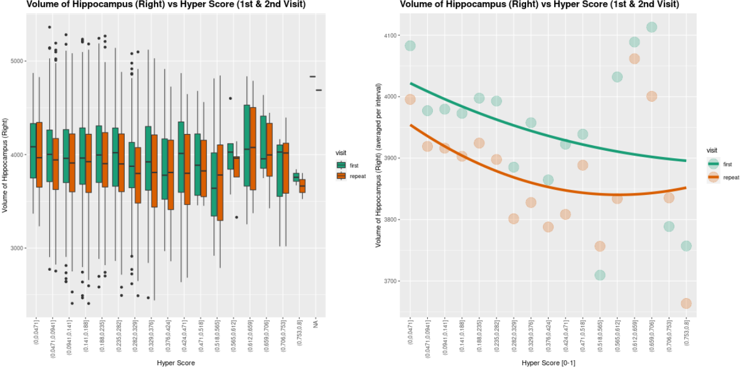
2669 measurements

