Slide 1



























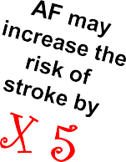





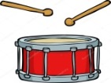


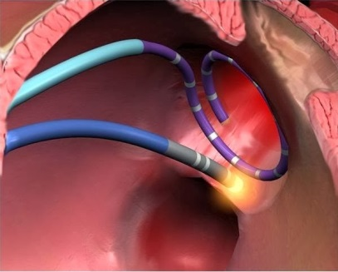






Atrial Electrophysiology Group
Dr. Jichao Zhao
Introduction: Atrial fibrillation (AF) is the most common form of abnormal heart rhythm and prevalence of AF is 2%, impacting more than 33.5 million patients with AF in the world. AF is characterized by rapid and irregular beating of the atria.
AF not only leads to diminished quality of life and morbidity, but also increases risk of stroke, heart failure and overall mortality. Current treatment of AF remains suboptimal and is an increasing economic burden in health care.
My job is to pump blood around the body
I need oxygen and nutrients from the blood
Brain is the control centre for everything you do. To work at its best the brain needs oxygen and nutrients brought to it by the blood. It’s the heart who makes it possible.
The heart consist of four chambers that enables it to pump the oxygenated blood from your head to toe.
Normally the heart beats in a steady rhythm to pump blood around the body. However for some people their heart does not beat to this normal rhythm.
Because you have atrial fibrillation (AF)
Brain, why am I quivering like this?
AF is a medical condition which interferes with normal rhythm #and causes the heart to beat irregularly. Symptoms of AF include palpitations, dizziness, tiredness and chest pain. Having AF means that the heart pumps blood less efficiently and blood may be left in the atria, forming clots. These clots may travel through the bloodstream to brain and cause brain cells to die, known as ischaemic stroke.
Aims and Methods: Our team aims to improve our understanding of AF and to investigate effective strategies for AF treatment by combining novel computational approaches (computer models and machine learning) with high-resolution structural imaging, experimental mapping and clinical studies.
Diagnosis and monitoring of AF: Convolutional neural networks and signal sensors are developed to receive and process ECGs.
Antiarrhythmic drug therapy: Biophysics-based computer models are utilized to pinpoint key ionic channels to target.
Ablation treatment: Signal analysis, panoramic mapping and computer models are used to identify precise locations of AF drivers for “burning”.

