Slide 1
VE281 Data Structures and Algorithms
Linear Time Selection
Learning Objective:
Understand randomized selection algorithm
Understand deterministic selection algorithm
Know how to analyze their runtime complexity

Slide 2
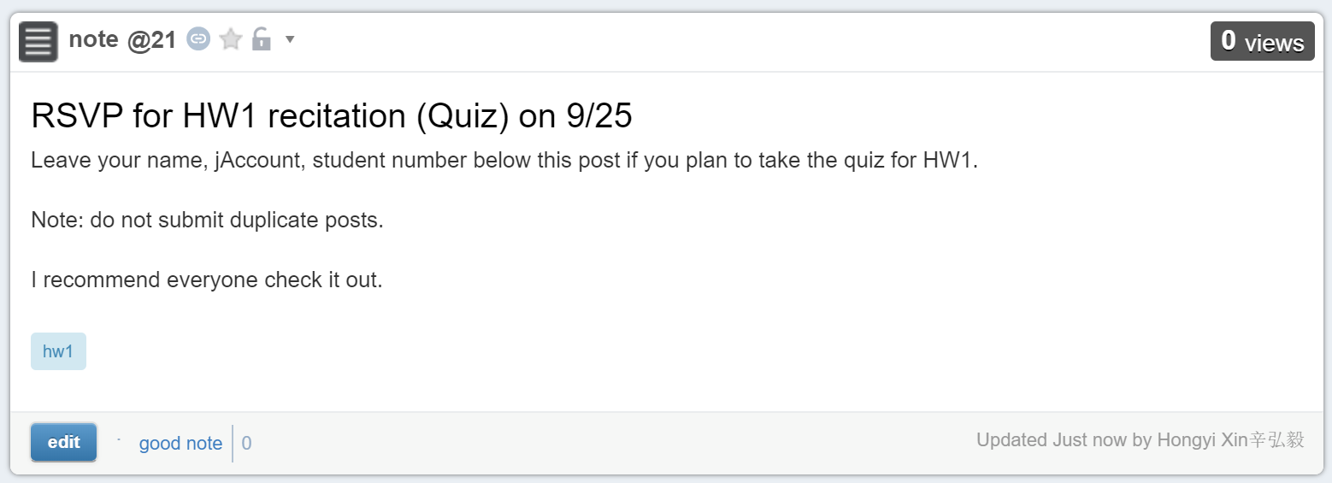
Announcement
RC class this Friday 8-10PM
Post on Piazza if you plan to come to the RC class
Testing VM will be released tomorrow

Slide 3
Recap
What is the complexity of radix sort for decimal numbers?
Max digits: K
Number of elements: N

Slide 4
Recap
What is the worst-case complexity for quicksort?

Slide 5
Outline
Randomized selection algorithm
Deterministic selection algorithm
Notes:
A topic related to sorting

Slide 6
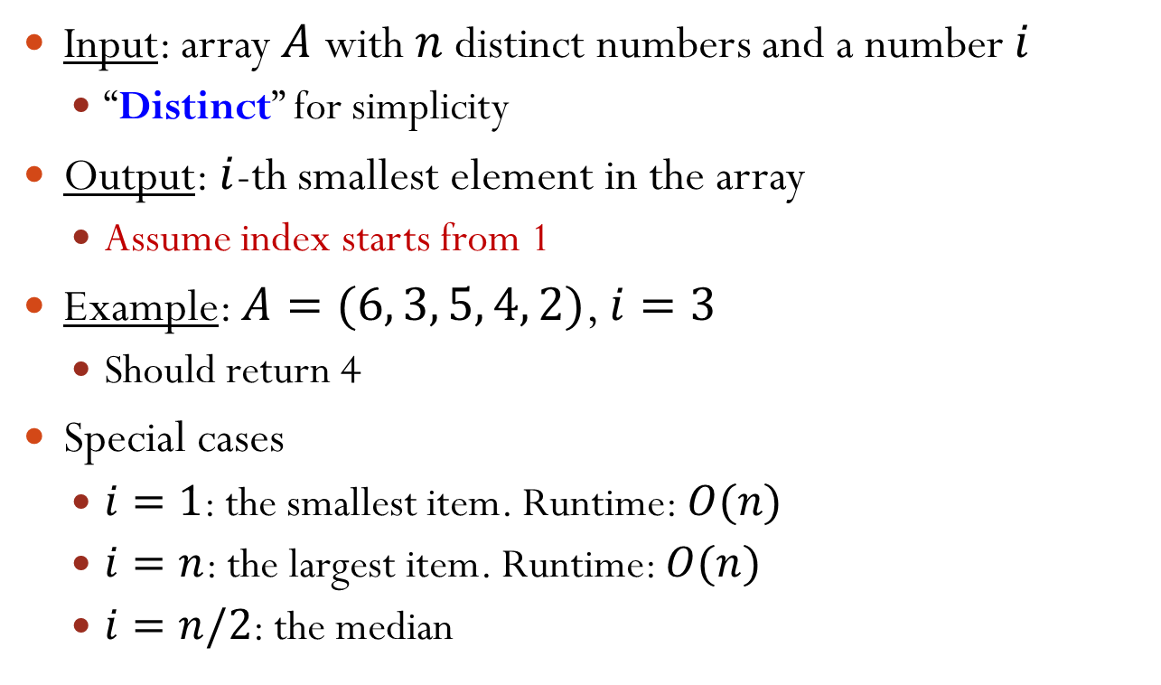
The Selection Problem
Input: array $A$ with $n$ distinct numbers and a number $i$
“Distinct” for simplicity
Output: $i$-th smallest element in the array
Assume index starts from 1
Example: $A=(6, 3, 5, 4, 2)$, $i=3$
Should return 4
Special cases
$i=1$: the smallest item. Runtime: $O(n)$
$i=n$: the largest item. Runtime: $O(n)$
$i=n/2$: the median
Notes:
Index starts from 1.
What’s the runtime of finding the median?

Slide 7
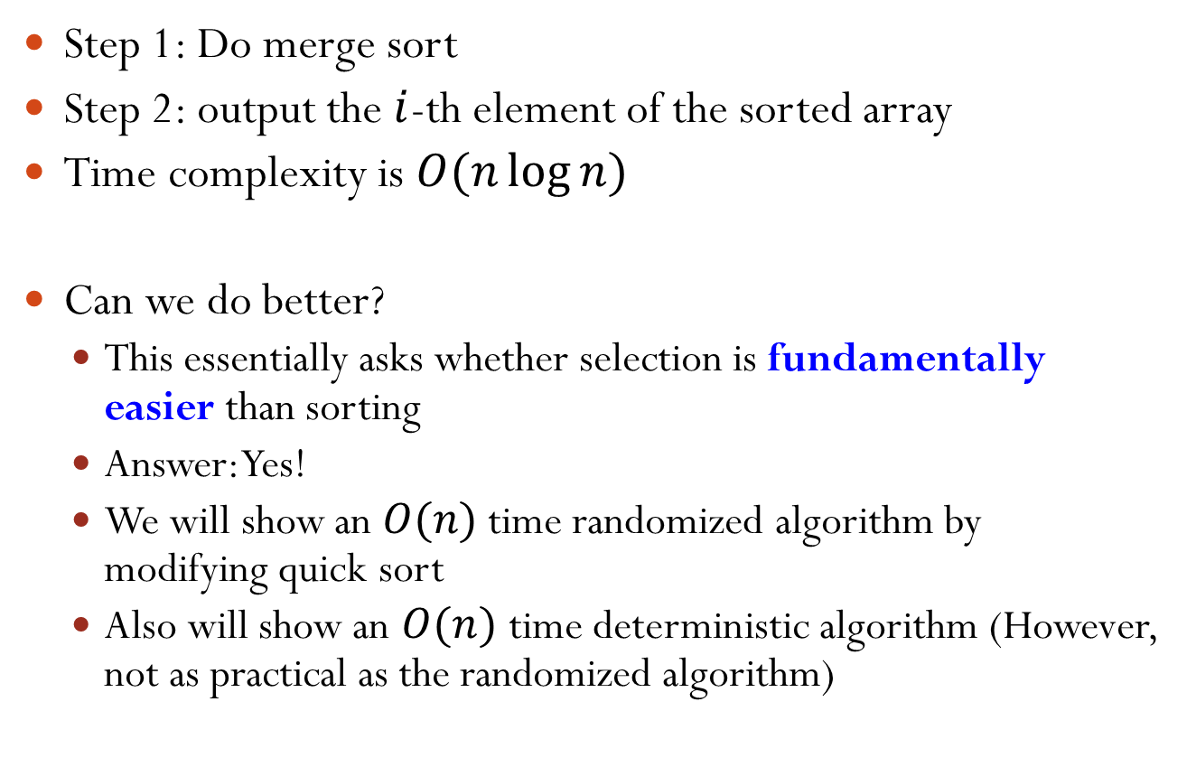
Solution: Reduction to Sorting
Step 1: Do merge sort
Step 2: output the $i$-th element of the sorted array
Time complexity is $O(n\log{n})$
Can we do better?
This essentially asks whether selection is fundamentally easier than sorting
Answer: Yes!
We will show an $O(n)$ time randomized algorithm by modifying quick sort
Also will show an $O(n)$ time deterministic algorithm (However, not as practical as the randomized algorithm)
Notes:
Deterministic algorithm is in the same position as merge sort

Slide 8

Recall: Partitioning in Quick Sort
Pick a pivot
Put all elements $<$ pivot to the left of pivot
Put all elements $≥$ pivot to the right of pivot
Move pivot to its correct place in the array
6
2
8
5
11
10
4
1
9
7
3
pivot
4
2
3
5
1
6
10
11
9
7
8

Slide 9
Basic Idea
Suppose we are looking for 6th smallest item in an array of length 12. We do partition.
Suppose the pivot is at position 4. Then we only need to focus on the sub-array right of the pivot and look for the 2nd item in the array
Suppose the pivot is at position 8. Then we only need to focus on the sub-array left of the pivot and look for the 6th item in the array
In both cases, recurse!

Slide 10
Randomized Selection
Rselect(int A[], int n, int i) { // find i-th smallest item of array A of size n if(n == 1) return A[1]; Choose pivot p from A uniformly at random; Partition A using pivot p; Let j be the index of p; if(j == i) return p; if(j > i) return Rselect(1st part of A, j-1, i); else return Rselect(2nd part of A, n-j, i-j); }
Notes:
Since 1 <= i <= n, if n = 1, i must be 1. Then, we simply return A[1].

Slide 11

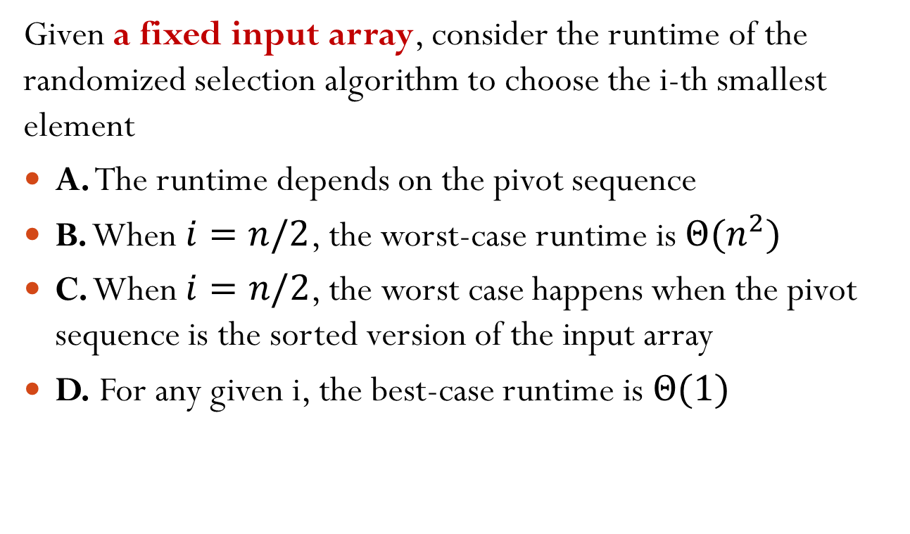
Which Statements Are Correct?
Given a fixed input array, consider the runtime of the randomized selection algorithm to choose the i-th smallest element
A. The runtime depends on the pivot sequence
B. When $i=n/2$, the worst-case runtime is $Θ(n^{2})$
C. When $i=n/2$, the worst case happens when the pivot sequence is the sorted version of the input array
D. For any given i, the best-case runtime is $Θ(1)$

Slide 12
Short Break – 5 min
Question Time!

Slide 13

Average Runtime of Rselect
Theorem: for every input array of length $n$, the average runtime of Rselect is $O(n)$
Holds for every input data (no assumption on data)
“Average” is over random pivot choices made by the algorithm

Slide 14
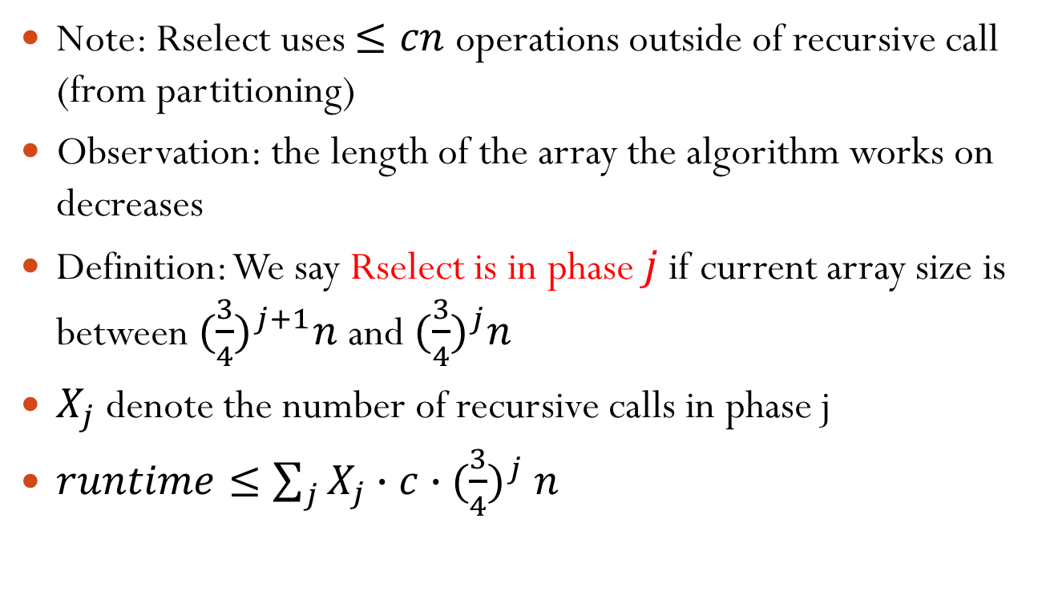


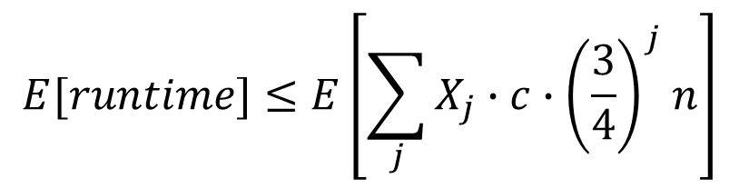
Average Runtime Analysis
Note: Rselect uses $≤cn$ operations outside of recursive call (from partitioning)
Observation: the length of the array the algorithm works on decreases
Definition: We say Rselect is in phase $j$ if current array size is between ${(\frac{3}{4})}^{j+1}n$ and ${(\frac{3}{4})}^{j}n$
$X_{j}$ denote the number of recursive calls in phase j
$runtime≤\sum_{j}{X_{j}∙c{∙(\frac{3}{4})}^{j}n}$
We need to further get $E[X_{j}]$
$$E[runtime]≤E\left[\sum_{j}{X_{j}∙c{∙\left(\frac{3}{4}\right)}^{j}n}\right]$$
$$=cn\sum_{j}{{\left(\frac{3}{4}\right)}^{j}E\left[X_{j}\right]}$$
Notes:
For example, phase 0 is size between [3/4n, n]. Depends on what the pivot you choose, the array may enter a new phase or remain in the current phase
Xj gives a nice upper bound on the runtime. Final phase number is log_{4/3} n

Slide 15
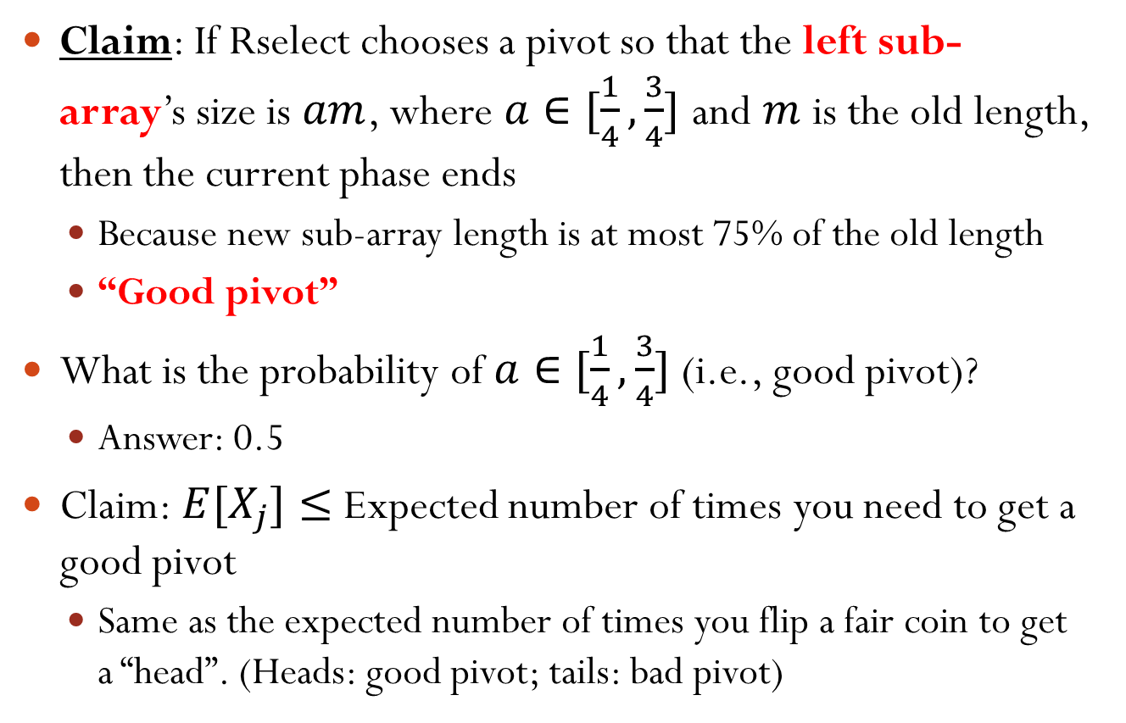
Average Runtime Analysis
Claim: If Rselect chooses a pivot so that the left sub-array’s size is $am$, where $a∈[\frac{1}{4},\frac{3}{4}]$ and $m$ is the old length, then the current phase ends
Because new sub-array length is at most 75% of the old length
“Good pivot”
What is the probability of $a∈[\frac{1}{4},\frac{3}{4}]$ (i.e., good pivot)?
Answer: 0.5
Claim: $E[X_{j}]≤$ Expected number of times you need to get a good pivot
Same as the expected number of times you flip a fair coin to get a “head”. (Heads: good pivot; tails: bad pivot)
Notes:
Now, for the first moment when we enter phase j, we pick pivot. If a is inside [1/4, 3/4], the phase enters into j+1. If a is outside [1/4, 3/4], we may also end the current phase and enter into phase j+1. Thus, E[X_i] is less than the number of times you need to get a good pivot.
To prove the claim, can consider a pivot sequence like BBG (B for bad pivot and G for good pivot).
Why smaller E[X_j]? Because even we don’t get a good pivot, it may also enter into the next phase. For example, a=0.2, we proceed on the left array.

Slide 16


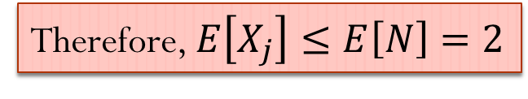
Coin Flipping Analysis
Let $N$ be the number of coin flips until you get heads
$N$ is a geometric random variable: $P\left(N=k\right)=\frac{1}{2^{k}}$, $k=1,2,…$
$E\left[N\right]=\frac{1}{2}∙1+\frac{1}{2}∙(1+E[N])$
#flips when 1st is head
#flips when 1st is tail
$$⇒E\left[N\right]=2$$
Prob. 1st flip is head
Therefore, $E\left[X_{j}\right]≤E\left[N\right]=2$
Prob. 1st flip is tail

Slide 17
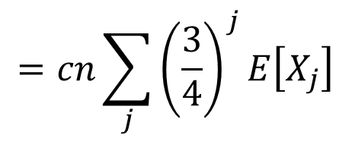
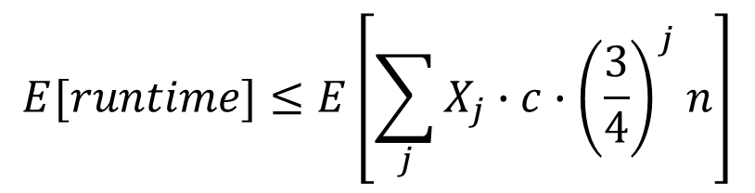

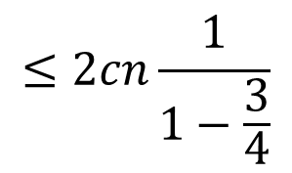
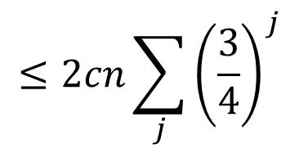
Average Runtime Analysis
$$E[runtime]≤E\left[\sum_{j}{X_{j}∙c{∙\left(\frac{3}{4}\right)}^{j}n}\right]$$
$$=cn\sum_{j}{{\left(\frac{3}{4}\right)}^{j}E\left[X_{j}\right]}$$
$$≤2cn\sum_{j}{{\left(\frac{3}{4}\right)}^{j}}$$
$$≤2cn\frac{1}{1−\frac{3}{4}}$$
$$=8cn=O(n)$$
当选择不是3/4，求和出来依然会是个常数

Slide 18
Outline
Randomized selection algorithm
Deterministic selection algorithm

Slide 19
A Good Pivot
Best pivot: the median
But, this is a circular problem
Goal: find pivot guaranteed to be good enough
Idea: use “median of medians”

Slide 20
A Deterministic ChoosePivot
ChoosePivot(A, n)
A subroutine called by the deterministic selection algorithm
Steps:
Break A into n/5 groups of size 5 each
Sort each group (e.g., use insertion sort)
Copy n/5 medians into new array C
Recursively compute median of C
By calling the deterministic selection algorithm!
Return the median of C as pivot
Notes:
Why in step 4 we don’t call sorting?

Slide 21
Deterministic Selection Algorithm
Dselect(int A[], int n, int i) { // find i-th smallest item of array A of size n if(n == 1) return A[1]; Break A into groups of 5, sort each group; C = n/5 medians; p = Dselect(C, n/5, n/10); Partition A using pivot p; Let j be the index of p; if(j == i) return p; if(j > i) return Dselect(1st part of A, j-1, i); else return Dselect(2nd part of A, n-j, i-j); }
ChoosePivot
Same as Rselect
The function has two recursive calls

Slide 22
Short Break – 5 min
Question Time!

Slide 23
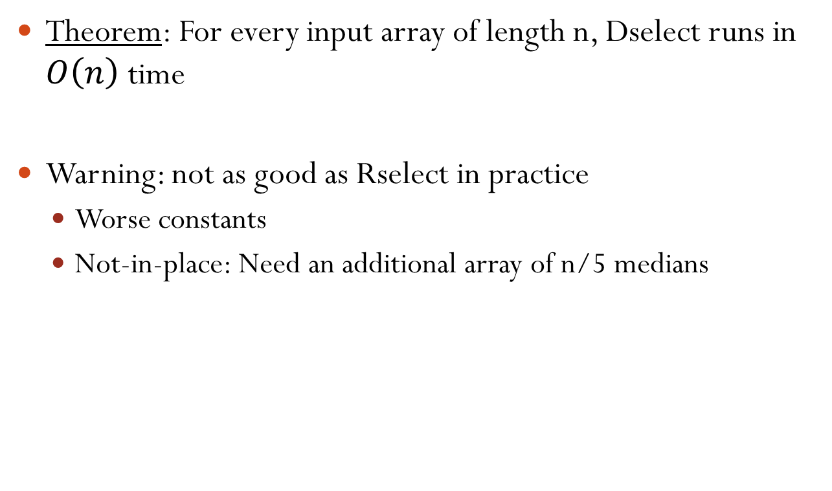
Runtime of Dselect
Theorem: For every input array of length n, Dselect runs in $O\left(n\right)$ time
Warning: not as good as Rselect in practice
Worse constants
Not-in-place: Need an additional array of n/5 medians

Slide 24
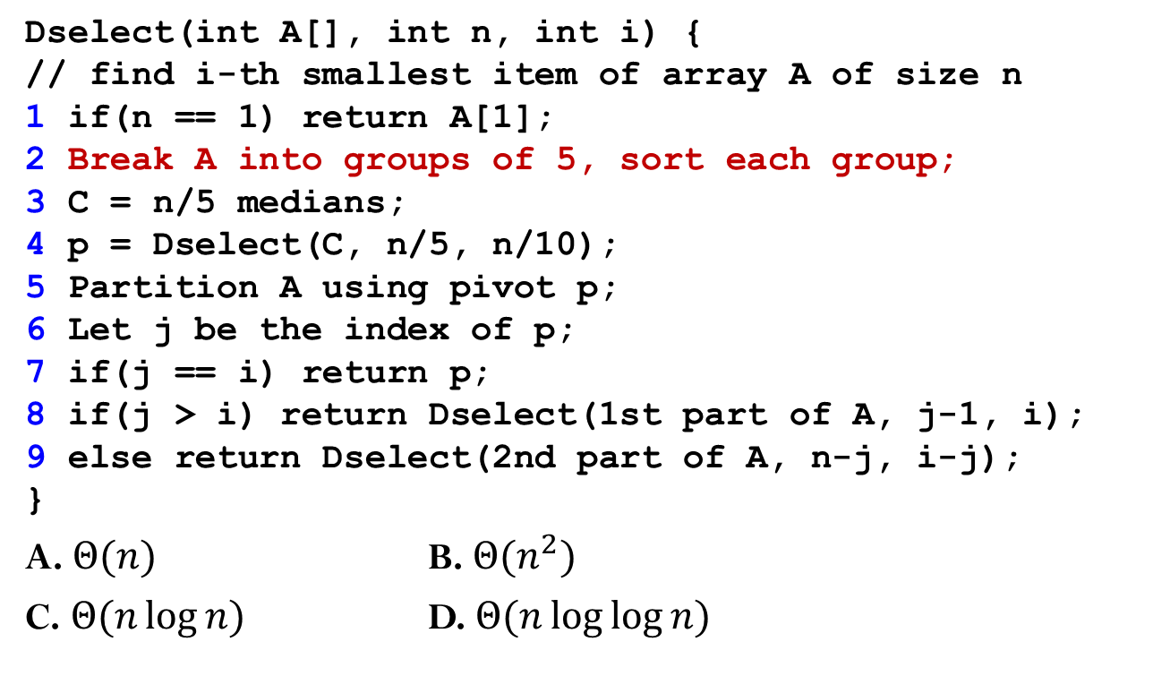
What’s the Runtime of Step 2?
Dselect(int A[], int n, int i) { // find i-th smallest item of array A of size n 1 if(n == 1) return A[1]; 2 Break A into groups of 5, sort each group; 3 C = n/5 medians; 4 p = Dselect(C, n/5, n/10); 5 Partition A using pivot p; 6 Let j be the index of p; 7 if(j == i) return p; 8 if(j > i) return Dselect(1st part of A, j-1, i); 9 else return Dselect(2nd part of A, n-j, i-j); }
A. $Θ(n)$ B. $Θ(n^{2})$
C. $Θ(n\log{n})$ D. $Θ(n\log{\log{n}})$

Slide 25
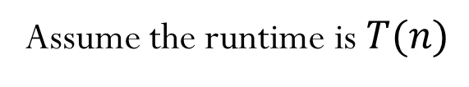





Runtime of Dselect
Assume the runtime is $T(n)$
Dselect(int A[], int n, int i) { // find i-th smallest item of array A of size n 1 if(n == 1) return A[1]; 2 Break A into groups of 5, sort each group; 3 C = n/5 medians; 4 p = Dselect(C, n/5, n/10); 5 Partition A using pivot p; 6 Let j be the index of p; 7 if(j == i) return p; 8 if(j > i) return Dselect(1st part of A, j-1, i); 9 else return Dselect(2nd part of A, n-j, i-j); }
$$Θ(n)$$
$$Θ(n)$$
$$T(n/5)$$
$$Θ(n)$$
$$T(?)$$

Slide 26

Recurrence
There exists a positive constant $c$ such that
$T\left(1\right)≤c$
$T\left(n\right)≤cn+T\left(\frac{n}{5}\right)+T(?)$
The next question is what is the size of the array of the second recursive call

Slide 27
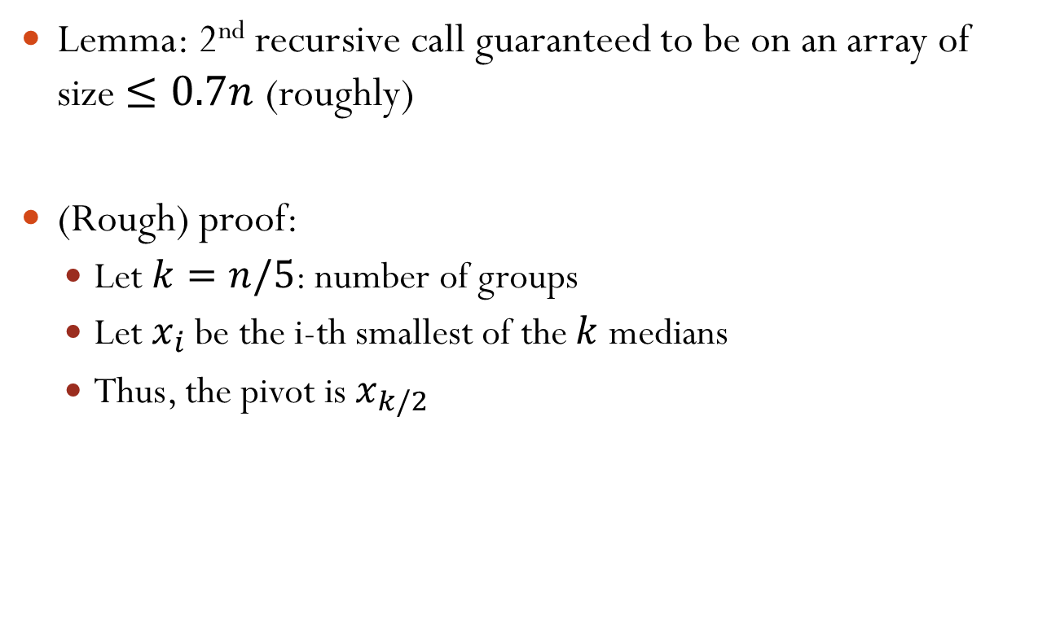
Lemma on Size
Lemma: 2nd recursive call guaranteed to be on an array of size $≤0.7n$ (roughly)
(Rough) proof:
Let $k=n/5$: number of groups
Let $x_{i}$ be the i-th smallest of the $k$ medians
Thus, the pivot is $x_{k/2}$
Notes:
(Optional) Goal: 1) >=30% of input array smaller than $x_{k/2}$; 2) >=30% of input array larger than $x_{k/2}$
>= 30% of input array smaller than x_{k/2} ➔ < 70% of input array larger than x_{k/2}

Slide 28














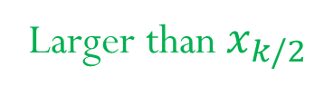





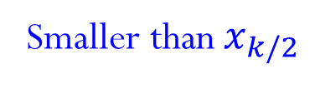
Proof of Lemma
Imagine we layout elements of A in a 2-D grid
At least ~ (3/5)*(1/2) = 30% elements smaller than $x_{k/2}$
At least ~ 30% elements larger than $x_{k/2}$
Result: Number of elements < $x_{k/2}$ is in between 30% and 70%. The same for number of elements > $x_{k/2}$
Larger than $x_{k/2}$
$$…$$
$$…$$
$$\begin{matrix}\begin{matrix}∎ \\ ∎ \\ x_{1}\end{matrix} \\ \begin{matrix}∎ \\ ∎\end{matrix}\end{matrix}$$
$$\begin{matrix}\begin{matrix}∎ \\ ∎ \\ x_{2}\end{matrix} \\ \begin{matrix}∎ \\ ∎\end{matrix}\end{matrix}$$
$$\begin{matrix}\begin{matrix}∎ \\ ∎ \\ x_{k/2−1}\end{matrix} \\ \begin{matrix}∎ \\ ∎\end{matrix}\end{matrix}$$
$$\begin{matrix}\begin{matrix}∎ \\ ∎ \\ x_{k/2}\end{matrix} \\ \begin{matrix}∎ \\ ∎\end{matrix}\end{matrix}$$
$$\begin{matrix}\begin{matrix}∎ \\ ∎ \\ x_{k/2+1}\end{matrix} \\ \begin{matrix}∎ \\ ∎\end{matrix}\end{matrix}$$
$$\begin{matrix}\begin{matrix}∎ \\ ∎ \\ x_{k}\end{matrix} \\ \begin{matrix}∎ \\ ∎\end{matrix}\end{matrix}$$
Increasing
$$…$$
$$…$$
$$<$$
$$<$$
$$…$$
$$<$$
$$<$$
$$<$$
$$<$$
$$…$$
$$<$$
$$…$$
$$…$$
$$…$$
$$…$$
Smaller than $x_{k/2}$

Slide 29
Example
Input:
After sorting each group of 5 elements
7,2,17,12,13,8,20,4,6,3,19,1,9,5,16
2,7,12,13,17, 3,4,6,8,20,1,5,9,16,19
pivot
20 19 17 8 16 13 6 9 12 4 5 7 3 1 2
Increasing
Larger than pivot
Smaller than pivot

Slide 30
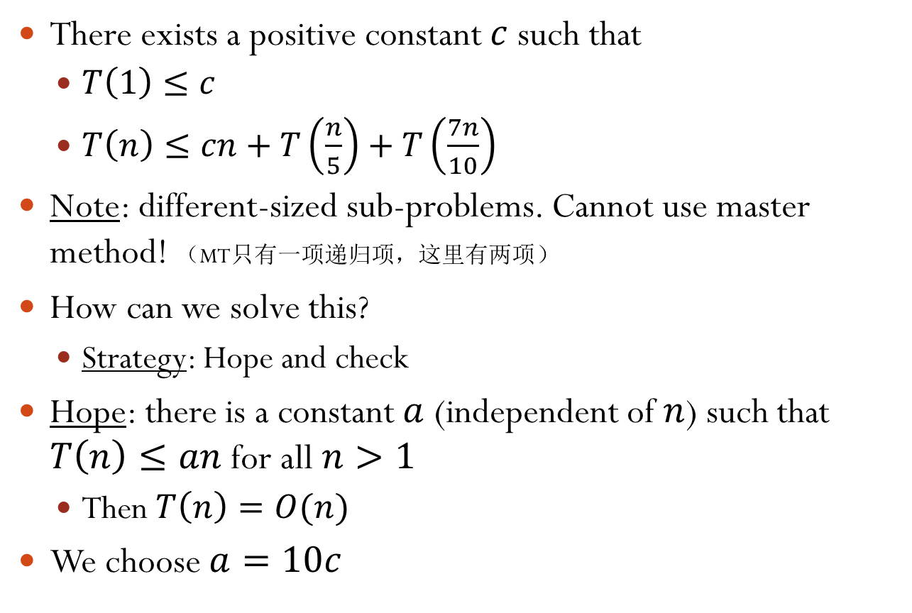
Recurrence
There exists a positive constant $c$ such that
$T\left(1\right)≤c$
$T\left(n\right)≤cn+T\left(\frac{n}{5}\right)+T\left(\frac{7n}{10}\right)$
Note: different-sized sub-problems. Cannot use master method! （MT只有一项递归项，这里有两项）
How can we solve this?
Strategy: Hope and check
Hope: there is a constant $a$ (independent of $n$) such that $T\left(n\right)≤an$ for all $n>1$
Then $T\left(n\right)=O(n)$
We choose $a=10c$

Slide 31
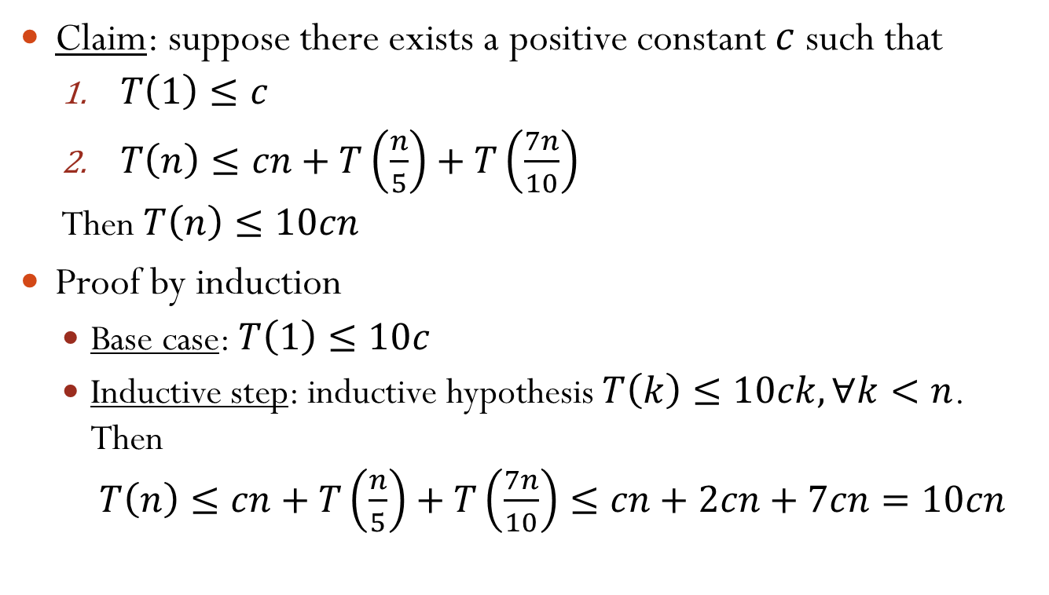

Proof $T\left(n\right)=O(n)$
Claim: suppose there exists a positive constant $c$ such that
$T\left(1\right)≤c$
$T\left(n\right)≤cn+T\left(\frac{n}{5}\right)+T\left(\frac{7n}{10}\right)$
Then $T\left(n\right)≤10cn$
Proof by induction
Base case: $T\left(1\right)≤10c$
Inductive step: inductive hypothesis $T\left(k\right)≤10ck,∀k<n$. Then $T\left(n\right)≤cn+T\left(\frac{n}{5}\right)+T\left(\frac{7n}{10}\right)≤cn+2cn+7cn=10cn$
Dselect runs in linear time

