Slide 1
VE281 Data Structures and Algorithms
Graphs
Learning Objectives:
Know some basics about graph
Know how to represent graphs in computer

Slide 2
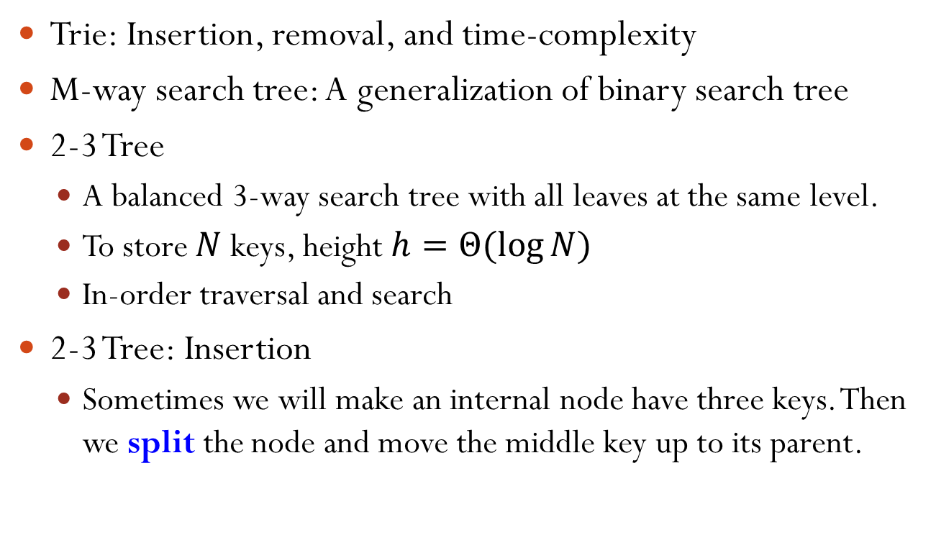
Graphs
A graph is a set of nodes $V=\{v_{1},v_{2},…,v_{n}\}$ and edges $E=\{e_{1},e_{2},…,e_{m}\}$ that connects pairs of nodes.
Nodes also known as vertices.
Edges also known as arcs.
Two nodes are directly connected if there is an edge connecting them, e.g., v₁ and v₂ are directly connected, but not v₁ and v₃.
v₁
v₂
e₂
e₁
e₃
v₃
v₄
e₄

Slide 3
Graphs
Directly connected nodes are adjacent to each other (e.g., v₁ and v₂), and one is the neighbor of the other.
The edge directly connecting two nodes are incident to the nodes, and the nodes incident to the edge.
v₁
v₂
e₂
e₁
e₃
v₃
v₄
e₄

Slide 4
Simple Graphs
Two nodes may be directly connected by more than one parallel edges, e.g., e₁ and e₂.
An edge connecting a node to itself is called a self-loop, e.g., e₄.
A simple graph is a graph without parallel edges and self-loops.
Unless otherwise specified, we will work only with simple graphs in this course.
e₄
e₁
v₁
v₂
e₃
e₂
v₃

Slide 5
Complete Graphs （clique）
A complete graph is a graph where every pair of nodes is directly connected.
How many edges are there in a complete graph of N nodes?

Slide 6
Directed Graphs
Directed graph (digraph): edges are directional.
Nodes incident to an edge form an ordered pair.
e = (v₁, v₂) means there is an edge from v₁ to v₂. However, there is no edge from v₂ to v₁.
Examples: rivers and streams, one-way streets, provider-customer relationships.
v₁
v₂
e₂
e₁
v₃

Slide 7
Undirected Graphs
Undirected graph: all edges have no orientation.
There is no ordering of nodes on edges.
e = (v₁, v₂) means there is an edge between v₁ and v₂.
Examples: friendship and two-way roads.
v₁
v₂
e₂
e₁
v₃

Slide 8
Paths
A path is a series of nodes v₁, …, v_{n} that are connected by edges.
For a directed graph, if v₁, …, v_{n} is a path, then there is an edge from v_{i} to v_{i+1} for each i.
For an undirected graph, if v₁, …, v_{n} is a path, then there is an edge between v_{i} and v_{i+1} for each i.
v₁
v₂
e₂
v₁, v₂, v₃ is a path.
v₃, v₂, v₁ is not a path.
e₁
v₃
v₁
v₂
e₂
v₁, v₂, v₃ is a path.
v₃, v₂, v₁ is also a path.
e₁
v₃

Slide 9
Simple Paths
A simple path is a path with no node appearing twice
e.g., v₁, v₂, v₃ is a simple path; v₁, v₂, v₃, v₄, v₂ is not.
v₁
v₂
e₂
e₁
e₃
v₃
v₄
e₄

Slide 10
Connected Graphs
A connected graph is a graph where a simple path exists between all pairs of nodes.
A directed graph is strongly connected if there is a simple directed path between any pair of nodes.
v₁
e₃
e₁
v₃
v₂
e₂
Notes:
v1 -> v2
v1 -> v3
v2 -> v1
v2 -> v3
v3 -> v1
v3 -> v2

Slide 11
Connected Graphs
A directed graph is weakly connected if there is a simple path between any pair of nodes in the underlying undirected graph.
v₁
v₂
e₂
e₁
The directed graph is weakly connected, but not strongly connected.
e₃
v₃
v₄
e₄

Slide 12
Node Degree
The degree of a node is the number of edges incident to the node, e.g., degree(v₂) = 3, degree(v₃) = 2.
What is the relationship between the sum of degrees of all nodes and the number of edges?
Sum(degrees) = 2 * Number(edges)
v₁
v₂
e₂
e₁
e₃
v₃
v₄
e₄
Notes:
Can be verified with this example

Slide 13
Node Degree for Directed Graphs
For directed graphs, we differentiate between incoming edges and outgoing edges of a node. Thus we differentiate between a node’s in-degree and its out-degree.
in-degree: number of incoming edges of a node
out-degree: number of outgoing edges of a node
Nodes with zero in-degree are source nodes, e.g., v₁.
Nodes with zero out-degree are sink nodes, e.g., v₃.
What is the sum of in-degrees/out-degrees of all nodes?
v₁
v₂
e₂
e₁
in-degree(v₂) = 1 out-degree(v₂) = 2
e₃
v₃
v₄
e₄

Slide 14
Cycles and Directed Acyclic Graphs
A cycle is a path starting and finishing at the same node.
A self-loop is a cycle of length 1.
A simple cycle has no repeated nodes, except the first and the last node, e.g., v₁, v₂, v₃, v₁.
A graph with no cycle is called an acyclic graph.
A directed graph with no cycles is called a directed acyclic graph, or DAG for short.
e₁
v₁
v₂
e₂
e₃
v₃
Notes:
DAG is very useful

Slide 15
Directed Acyclic Graphs (DAG)
Are the following graphs DAGs? 都是
A
B
C
v₁
v₂
D
E
F
v₃
v₄
G
v₅

Slide 16
Weighted Graphs
Weighted graph: edges of a graph may have different costs or weights.
For example, the weights on edges represent the distance between two nodes.
4
6
v₁
v₂
e₂
e₁
7
e₃
v₃
v₄
e₄
8

Slide 17
Graph Size and Complexity
The size of a graph and the complexity of a graph algorithms are usually defined in terms of
number of edges $|E|$
number of vertices $|V|$
or both
Sparse graph: a graph with few edges.
$|E|≪{|V|}^{2}$ or $|E|≈Θ(\left|V\right|)$
Example: tree
Dense graph: a graph with many edges.
$|E|≈Θ({\left|V\right|}^{2})$
Example: complete graph

Slide 18

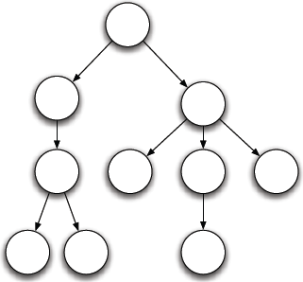
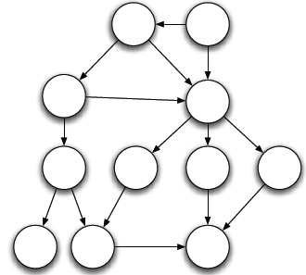
Linked Lists, Trees, and Graphs
Linked List
Tree
Graph

Slide 19
Linked Lists, Trees, and Graphs
Linked List
Graph
Tree

Slide 20
Graph Representation Adjacency Matrix
Adjacency matrix: a $|V|×|V|$ matrix representation of a graph.
$A(i,j)=1$, if $(v_{i},v_{j})$ is an edge; otherwise $A(i,j)=0$.
1 2 3 4 5
v₁
v₂
12345
0 1 1 0 0
1 0 0 1 0
v₃
v₄
1 0 0 1 0
0 1 1 0 1
v₅
0 0 0 1 0

Slide 21
Adjacency Matrix for Weighted Graph
If $(v_{i},v_{j})$ is an edge and its weight is $w_{ij}$, then $A(i,j)=w_{ij}$; otherwise $A(i,j)=∞$.
1 2 3 4 5
4
v₁
v₂
12345
∞ 4 2 ∞ ∞
2
5
∞ ∞ ∞ 5 ∞
v₃
7
v₄
∞ ∞ ∞ ∞ ∞
∞ ∞ 7 ∞ 3
v₅
3
∞ ∞ ∞ ∞ ∞
Question: why not use 0 to represent a missing edge?
Notes:
Note: this is a directed graph, so it is not symmetric.

Slide 22
Adjacency Matrix Properties
Space complexity: ${|V|}^{2}$ units
For an undirected graph, may store only the lower or upper triangle. Thus, $\left(|V|−1\right)|V|/2$ units.
What is the time complexity for finding if node $v_{i}$ is adjacent to node $v_{j}$?
$O(1)$
What is the time complexity for finding all nodes adjacent to a given node $v_{i}$?
$O(|V|)$

Slide 23
Graph Representation Adjacency List
Adjacency list: an array of $|V|$ linked lists.
Each array element represents a node and its linked list represents the node’s neighbors.
v₁
v₂
[1]
2
3
[2]
1
4
v₃
v₄
[3]
1
4
[4]
2
3
5
v₅
[5]
4

Slide 24
Graph Representation Adjacency List
Each edge in an undirected graph is represented twice.
Each edge is treated as bidirectional.
Each edge in a directed graph is represented once.
Weighted graph stores edge weight in linked-list node.
v₁
v₂
[1]
2
3
[2]
1
4
v₃
v₄
[3]
1
4
[4]
2
3
5
v₅
[5]
4

Slide 25

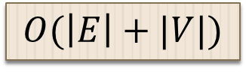
Adjacency List Properties
What is the space complexity? 就算E空也有V个
What is the worst case time complexity for checking if node $v_{i}$ is adjacent to node $v_{j}$?
What is the worst case time complexity for finding all nodes adjacent to a given node $v_{i}$?
v₁
v₂
[1]
2
3
[2]
1
4
v₃
v₄
[3]
1
4
[4]
2
3
5
v₅
[5]
4
$$O(\left|E\right|+|V|)$$
$$O(|V|)$$
$$O(|V|)$$
Notes:
For space complexity, can we write it as O(|E|), since |V| = O(|E|)?
Answer: No. Since the graph could contain far fewer edges than nodes.

Slide 26
Comparison of Graph Representation
Worst case time complexity for two common operations:
Determine whether $v_{i}$ is adjacent to $v_{j}$
Adjacency matrix: $O(1)$; Adjacency list: $O(|V|)$
Determine all the nodes adjacent to $v_{i}$
Both adjacency matrix and adjacency list: $O(|V|)$
Adjacency list often requires less space than adjacency matrix.
Dense graphs are more efficiently represented as adjacency matrices and sparse graphs as adjacency lists.

Slide 27
Sample Graph Problems
Path finding problems
Find if there exists a path between two given nodes.
Find the shortest path between two given nodes.
Connectedness problems
Find if the graph is a connected graph.

