Slide 1
VE281 Data Structures and Algorithms
Topological Sorting
Learning Objectives:
Know what a topological sorting is and why it is useful
Know the topological sorting algorithm and its runtime complexity

Slide 2

Topological Sorting
Topological sorting : an ordering on nodes of a directed graph so that for each edge $(v_{i},v_{j})$ (means: an edge from $v_{i}$ to $v_{j}$) in the graph, $v_{i}$ is before $v_{j}$ in the ordering.
Also known as topological ordering.
A
B
C
D
E
F
G
A topological sorting is: A, G, D, B, E, C, F

Slide 3
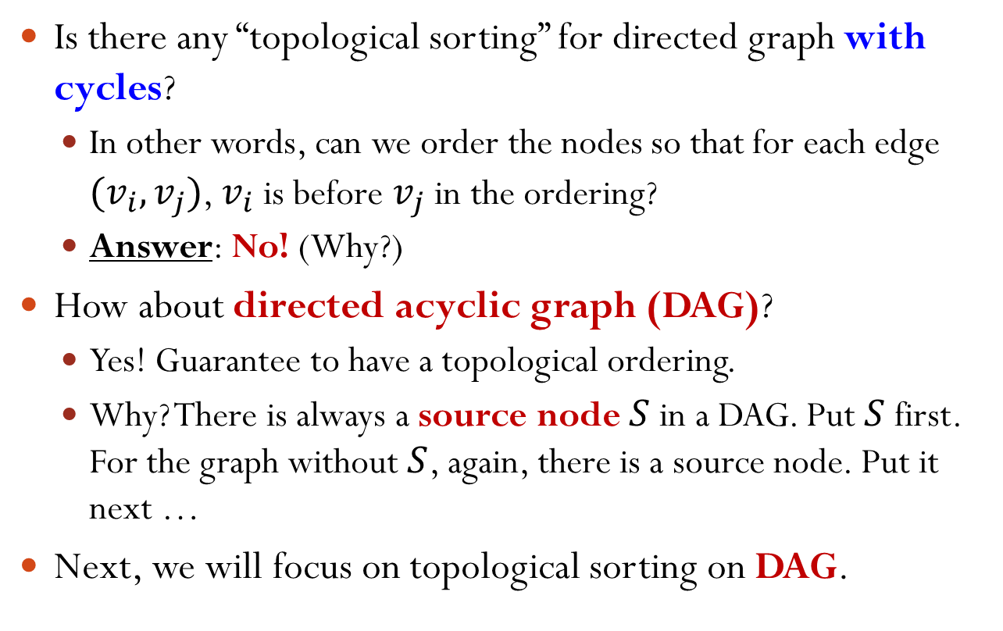
Which Graph Has Topological Sorting?
Is there any “topological sorting” for directed graph with cycles?
In other words, can we order the nodes so that for each edge $(v_{i},v_{j})$, $v_{i}$ is before $v_{j}$ in the ordering?
Answer: No! (Why?)
How about directed acyclic graph (DAG)?
Yes! Guarantee to have a topological ordering.
Why? There is always a source node $S$ in a DAG. Put $S$ first. For the graph without $S$, again, there is a source node. Put it next …
Next, we will focus on topological sorting on DAG.
Notes:
Why no topological sorting for directed graph with cycles? Consider a cycle

Slide 4
Topological Sorting
Topological sorting is not necessarily unique:
A, G, D, B, E, C, F and A, B, G, D, E, F, C are both topological sorting.
Are the following orderings topological sorting?
A, B, E, G, D, C, F
A, G, B, D, E, F, C
A
B
C
D
E
F
G

Slide 5
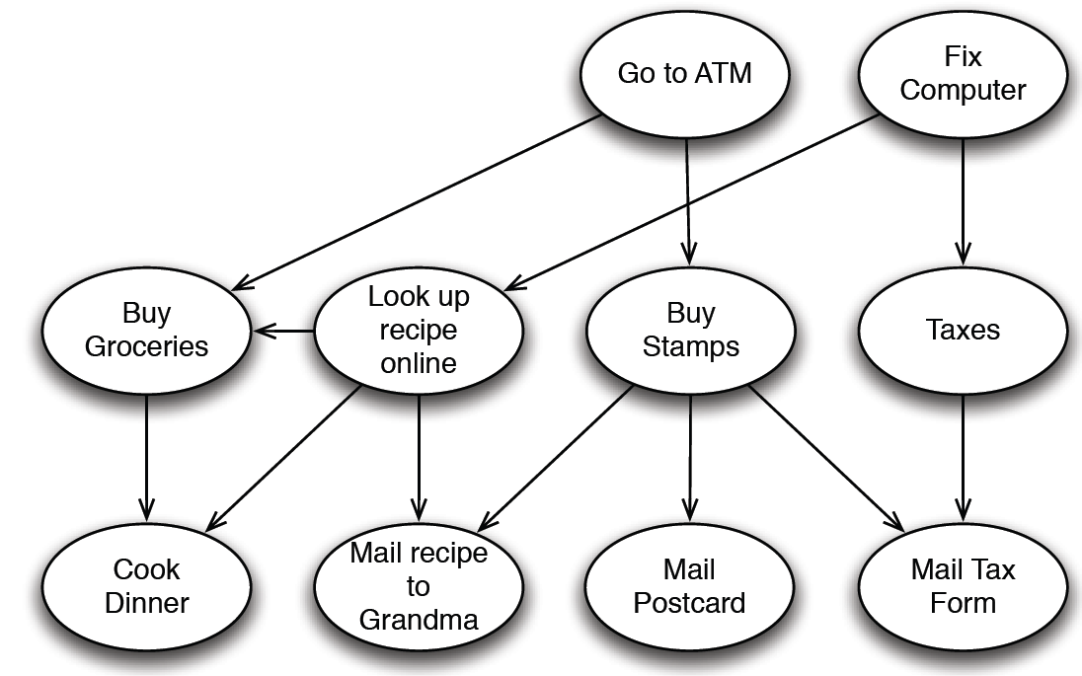
Topological Sorting Applications
Scheduling tasks when some tasks depend on other tasks being completed.
Serialization
Parallel ➔ Serial
Sort out complex dependencies
Notes:
In order to cook dinner, we need to ...

Slide 6
Topological Sorting Applications
Evaluating a combination logic circuit given a set of inputs.
1
1
1
?
0
x₁
A₁
A₃
x₂
x₃
O₁
x₄
A₂
O₂
y

Slide 7
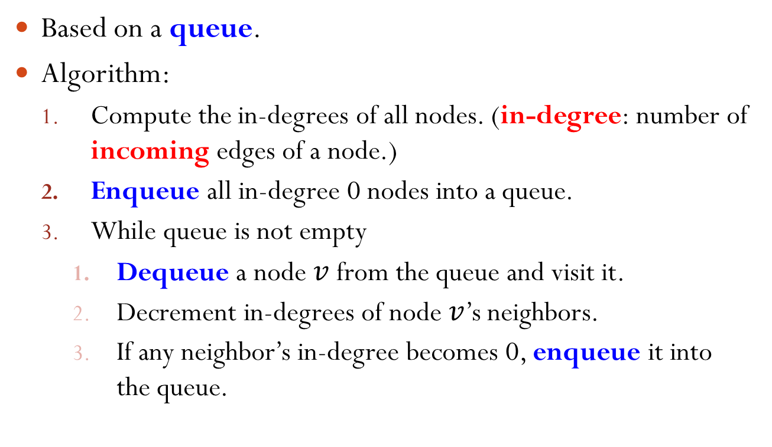
Topological Sorting: Algorithm
Based on a queue.
Algorithm:
Compute the in-degrees of all nodes. (in-degree: number of incoming edges of a node.)
Enqueue all in-degree 0 nodes into a queue.
While queue is not empty
Dequeue a node $v$ from the queue and visit it.
Decrement in-degrees of node $v$’s neighbors.
If any neighbor’s in-degree becomes 0, enqueue it into the queue.

Slide 8
Topological Sorting Algorithm Example
A
B
C
Queue
D
E
F
G
Enqueue A and G
In-degrees
A | B | C | D | E | F | G
0 | 1 | 2 | 2 | 2 | 1 | 0
Order

Slide 9
Topological Sorting Algorithm Example
A
B
C
Queue
A
G
D
E
F
G
Dequeue A, visit A, and decrement in-degrees of A’s neighbors.
In-degrees
A | B | C | D | E | F | G
0 | 1 | 2 | 2 | 2 | 1 | 0
Order

Slide 10
Topological Sorting Algorithm Example
A
B
C
Queue
G
D
E
F
G
Enqueue B
In-degrees
A | B | C | D | E | F | G
0 | 1 0 | 2 | 2 1 | 2 | 1 | 0
Order
A

Slide 11
Topological Sorting Algorithm Example
A
B
C
Queue
G
B
D
E
F
G
Dequeue G, visit G, and decrement in-degrees of G’s neighbors.
In-degrees
A | B | C | D | E | F | G
0 | 0 | 2 | 1 | 2 | 1 | 0
Order
A

Slide 12
Topological Sorting Algorithm Example
A
B
C
Queue
B
D
E
F
G
Enqueue D
In-degrees
A | B | C | D | E | F | G
0 | 0 | 2 | 1 0 | 2 | 1 | 0
Order
A | G

Slide 13
Topological Sorting Algorithm Example
A
B
C
Queue
B
D
D
E
F
G
Dequeue B, visit B, and decrement in-degrees of B’s neighbors.
In-degrees
A | B | C | D | E | F | G
0 | 0 | 2 | 0 | 2 | 1 | 0
Order
A | G

Slide 14
Topological Sorting Algorithm Example
A
B
C
Queue
D
D
E
F
G
Dequeue D, visit D, and decrement in-degrees of D’s neighbors.
In-degrees
A | B | C | D | E | F | G
0 | 0 | 2 1 | 0 | 2 1 | 1 | 0
Order
A | G | B

Slide 15
Topological Sorting Algorithm Example
A
B
C
Queue
D
E
F
G
Enqueue E
In-degrees
A | B | C | D | E | F | G
0 | 0 | 1 | 0 | 1 0 | 1 | 0
Order
A | G | B | D

Slide 16
Topological Sorting Algorithm Example
A
B
C
Queue
E
D
E
F
G
Dequeue E, visit E, and decrement in-degrees of E’s neighbors.
In-degrees
A | B | C | D | E | F | G
0 | 0 | 1 | 0 | 0 | 1 | 0
Order
A | G | B | D

Slide 17
Topological Sorting Algorithm Example
A
B
C
Queue
D
E
F
G
Enqueue C and F
In-degrees
A | B | C | D | E | F | G
0 | 0 | 1 0 | 0 | 0 | 1 0 | 0
Order
A | G | B | D | E

Slide 18
Topological Sorting Algorithm Example
A
B
C
Queue
C
F
D
E
F
G
Dequeue C, visit C, and decrement in-degrees of C’s neighbors.
In-degrees
A | B | C | D | E | F | G
0 | 0 | 0 | 0 | 0 | 0 | 0
Order
A | G | B | D | E

Slide 19
Topological Sorting Algorithm Example
A
B
C
Queue
F
D
E
F
G
Dequeue F, visit F, and decrement in-degrees of F’s neighbors.
In-degrees
A | B | C | D | E | F | G
0 | 0 | 0 | 0 | 0 | 0 | 0
Order
A | G | B | D | E | C

Slide 20
Topological Sorting Algorithm Example
A
B
C
Queue
D
E
F
G
Queue is now empty. Done!
In-degrees
A | B | C | D | E | F | G
0 | 0 | 0 | 0 | 0 | 0 | 0
Order
A | G | B | D | E | C | F

Slide 21
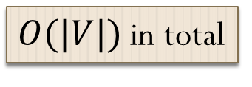
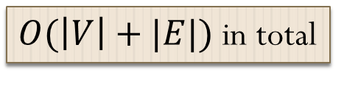
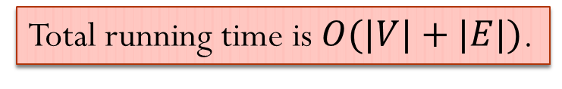


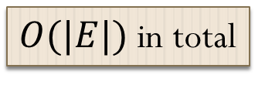
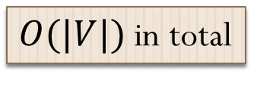
Topological Sorting Algorithm Time Complexity
不会visit一个edge两次，所以不是EV。E为零，每个node也要数一次，所以不是E
Assume adjacency list representation
Compute the in-degrees of all nodes.
Enqueue all in-degree 0 nodes into a queue.
While queue is not empty
Dequeue a node $v$ from the queue and visit it.
Decrement in-degrees of node $v$’s neighbors.
If any neighbor’s in-degree becomes 0 …
… place it in the queue.
$O(\left|V\right|+|E|)$ in total
$O(|V|)$ in total
$O(|V|)$ in total
$O(|E|)$ in total
$O(|V|)$ in total
Total running time is $O(|V|+|E|)$.

