Slide 1
An introduction to APM with Machine Learning
Huichao Zhao

Slide 2
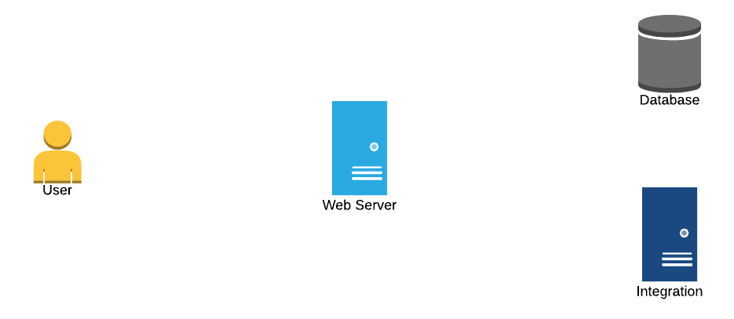
Typical Scenario
Transactional Web Applications
Transactions / second
Query cache usage
Server load
Availability
Request
Response
Requests / second
Errors
Server load
Availability
Response time
Availability
Requests / second
Server load
Availability

Slide 3
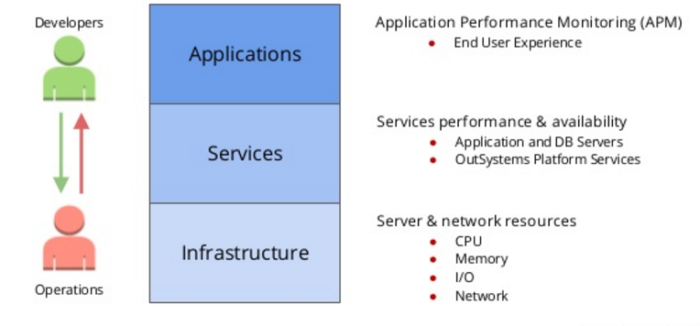
APM
Application Performance Monitoring (APM) is a set of disciplines, part of Performance Management, designed provide accurate information on how business applications are performing.

Slide 4
Iterative Approach
Identify patterns in metrics
Correlate with other data (Platform Analytics, logs)
Smart alert (Automatic baseline, Dynamics threshold, Seasonality analysis)
Apply corrective measures
Automatically recommend most relevant signals
Scaling or reconfiguration of server / services
Application fixes / improvements
Measure
Improve
Analyze

Slide 5
Key Features
Know how your system behaves
(Identify common patterns,
Recognize trends,
Predict issues and scaling needs)
Alerts you when attention is needed
Be warned of potential issues allowing you to react
Reduce MTTD (mean time to detect) and MTTR (mean time to resolve)
Reactive : fast post-mortem root cause analysis
Real-time: smart alerting
Proactive: predicative analysis, anomaly detection, recommendation

Slide 6
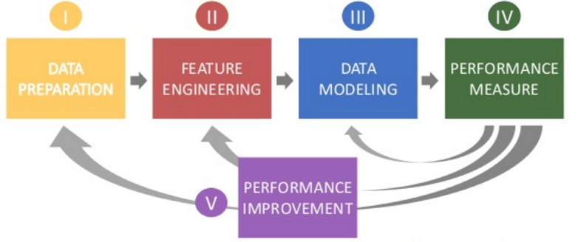
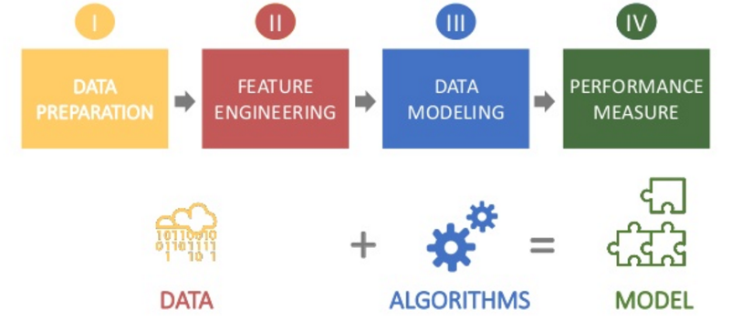
ML-tasks
Data preparation (collect and query, clean, deal with missing data, format)
Feature engineering (feature construction, transformation, dimension reduction)
Data modeling (supervised/unsupervised learning, deep learning, reinforcement learning)
Performance measure (cross-validation, cost/loss function)
Performance improvement (underfitting, overfitting, boosting, more data, com )

Slide 7
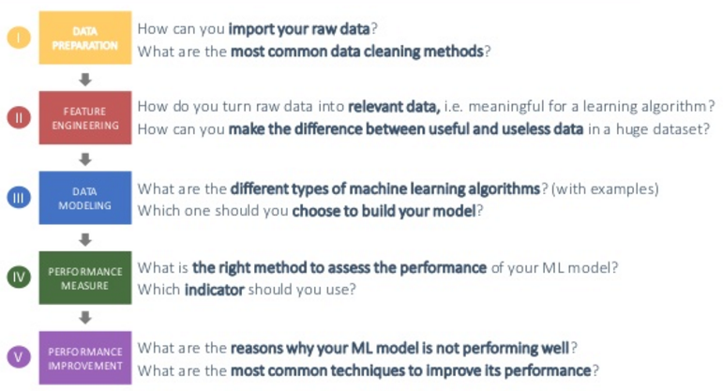

Slide 8
APM-Data preparation
APM data is semi-structured, Different data types require various methods to retrieve, discover and analyze
We have metrics/time series:
CPU usage
Java jvm metrics
Network latency
Daily active user
We have categorical data:
Node name
Service name
Region ID
User IP
We have hierarchical trees:
Modules → nodes → tiers
Aggregated stats → individual level stats
We have graphs:
We have unstructured data:
Logs
Error messages
Stack traces

Slide 9
APM- Feature Engineering
Dimensionality and the size of the data store:
To overcome this challenge of dimensionality, most analytics systems limit the number of comparisons it is possible to make to a few hundred.
Analyzing data of different types
Time series data, which represents the value of performance metrics sampled at regular time, is synchronous in nature. Notification data (e.g. log file messages, traps, events/alerts from management systems) on the other hand, is asynchronous as it reflects events within the system. Both data types must be analyzed to facilitate acclerated troubleshooting.
Analyzing data of different qualities:
Time series data can be of different granularities (e.g. 1s, 15s, 5min intervals). Data can be missing or contain significant gaps. The analytic approach taken must assume uncertainty in order to provide the most accurate results.

Slide 10
APM-Data Modeling
ML frequently applied to APM:
clustering
neural net / deep learning
classification
ranking
recommendation
graph/network analysis
Prediction
APM Applications:
relevant signal recommendation
time series modeling
metric prediction
auto regex inference
unstructured data clustering
anomaly detection
graph optimization

Slide 11
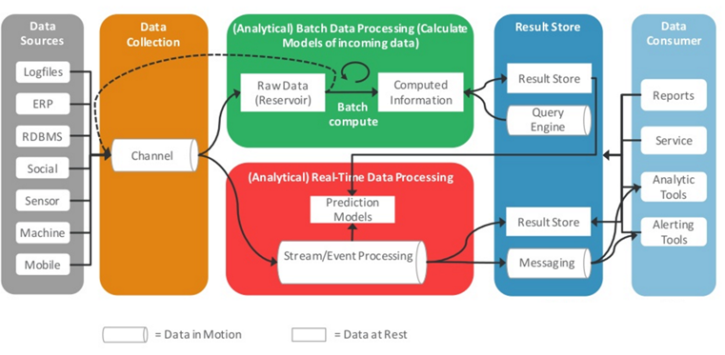
APM– Data Pipeline (Sample -1)

Slide 12
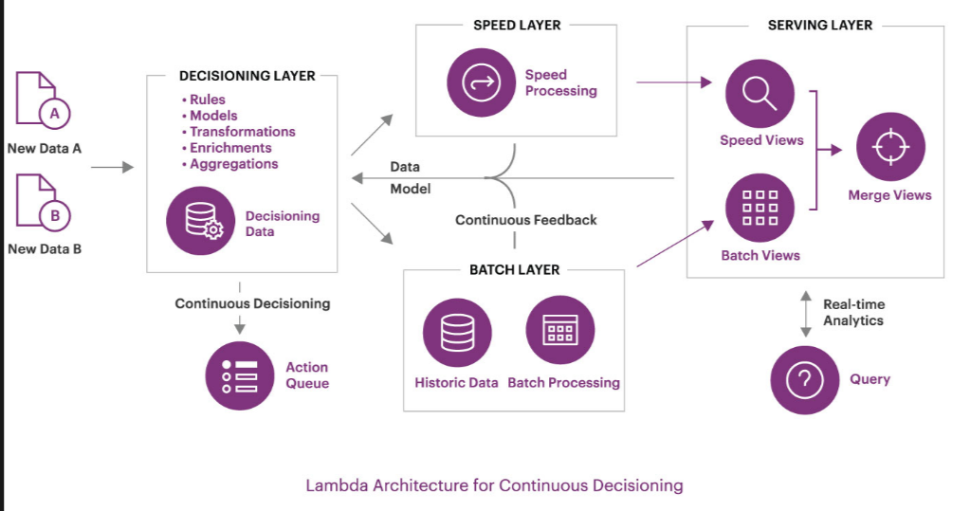
APM– Data Pipeline (Sample -2)

