Slide 1
Python for zhc
Huichao Zhao

Slide 2
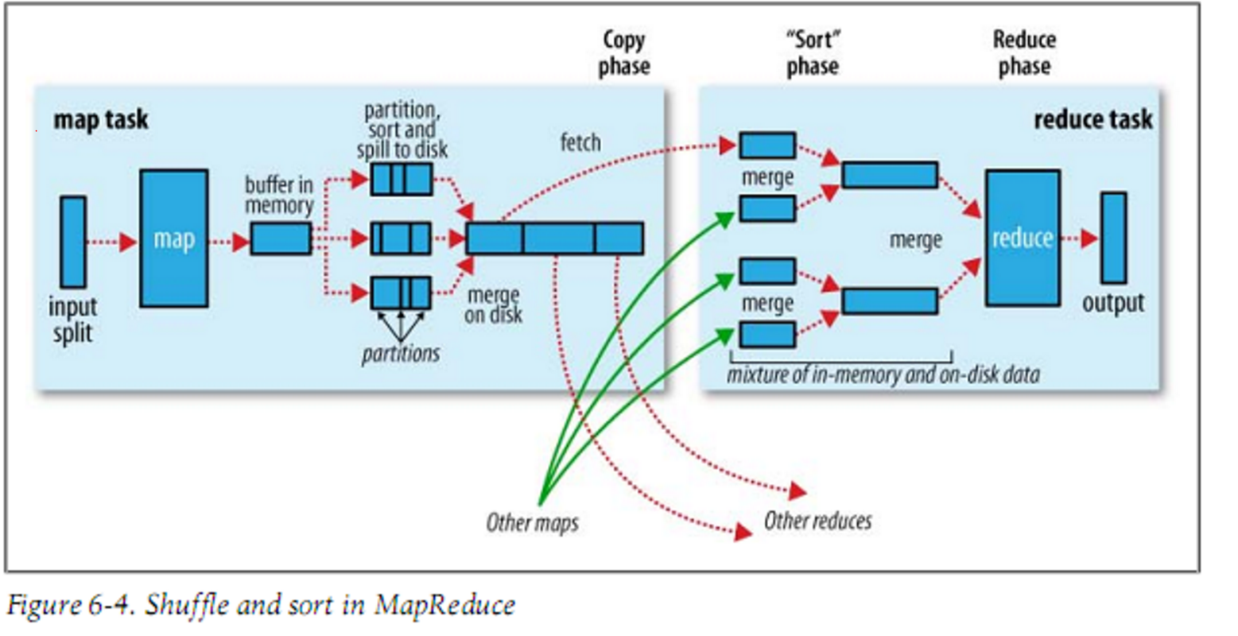
Why Hadoop so slow

Slide 3
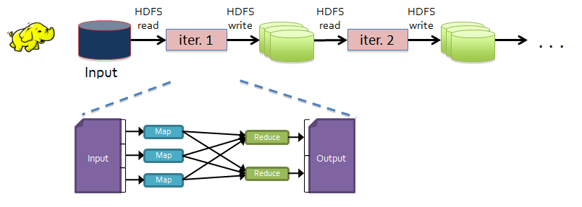
Why Hadoop so slow
Slow due to replication, serialization, and disk IO
Inefficient for:
Iterative algorithms (Machine Learning, Graphs & Network Analysis)
Interactive Data Mining (R, Excel, Ad hoc Reporting, Searching)

Slide 4
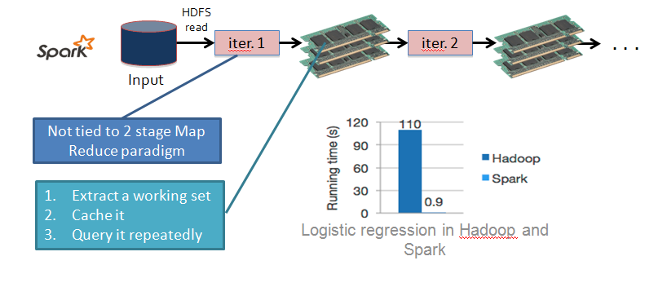
Spark Data Flow
https://www.quora.com/What-is-the-difference-between-Apache-Spark-and-Apache-Hadoop-Map-Reduce

Slide 5
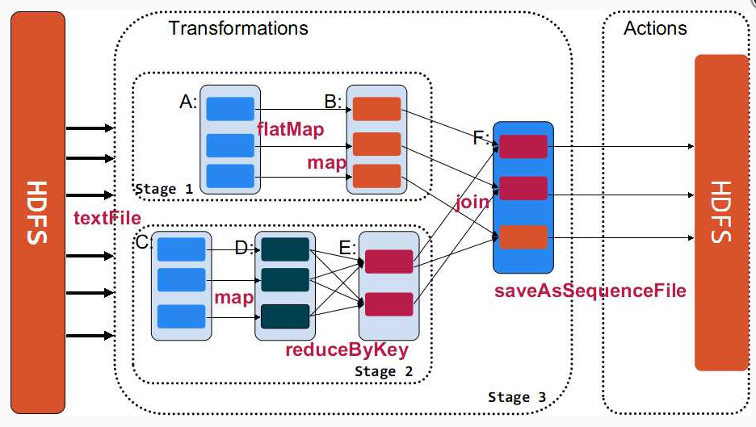

Slide 6

More reasons!

Slide 7
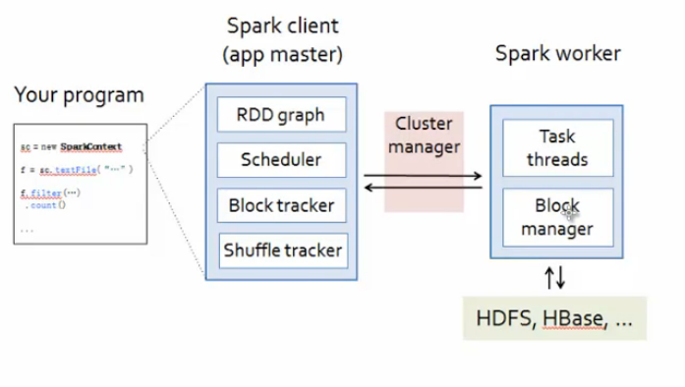

Slide 8
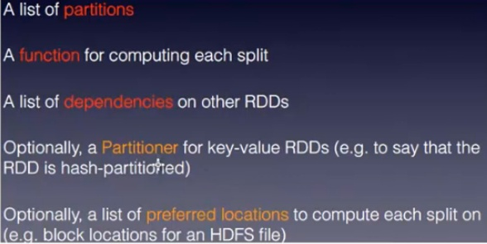
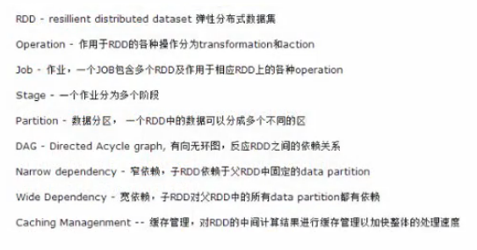
RDD is everythins for dev

Slide 9
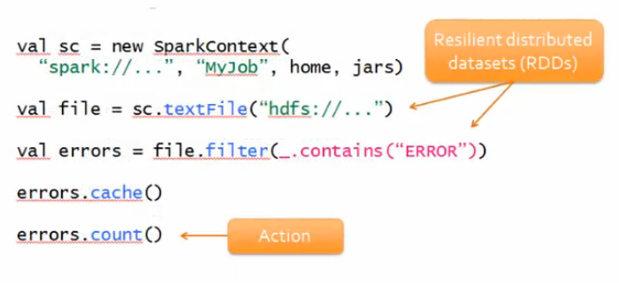

Slide 10
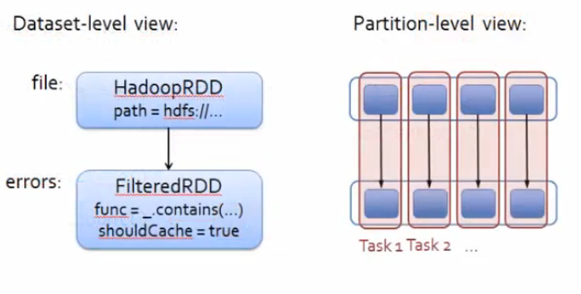

Slide 11
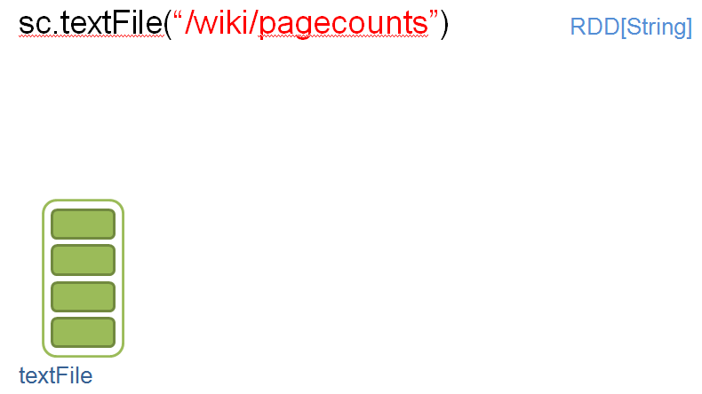
Example

Slide 12
sc.textFile(“/wiki/pagecounts”)
.map(line => line.split(“\t”))
RDD[String]
RDD[List[String]]
textFile
map

Slide 13
sc.textFile(“/wiki/pagecounts”)
.map(line => line.split(“\t”))
.map(R => (R[0], int(R[1])))
RDD[String]
RDD[List[String]]
RDD[(String, Int)]
textFile
map
map

Slide 14
sc.textFile(“/wiki/pagecounts”)
.map(line => line.split(“\t”))
.map(R => (R[0], int(R[1])))
.reduceByKey(_+_)
RDD[String]
RDD[List[String]]
RDD[(String, Int)]
RDD[(String, Int)]
textFile
map
map
reduceByKey

Slide 15
sc.textFile(“/wiki/pagecounts”)
.map(line => line.split(“\t”))
.map(R => (R[0], int(R[1])))
.reduceByKey(_+_, 3)
.collect()
RDD[String]
RDD[List[String]]
RDD[(String, Int)]
RDD[(String, Int)]
Array[(String, Int)]
collect
reduceByKey

Slide 16
Stage 1
Stage 2
collect
reduceByKey
textFile
map
map
Stages are sequences of RDDs, that don’t have a Shuffle in between

Slide 17
Stage 1
Stage 2
collect
reduceByKey
textFile
map
map
Read HDFS split
Apply both the maps
Start Partial reduce
Write shuffle data
Read shuffle data
Final reduce
Send result to driver program
Stage 1
Stage 2

Slide 18
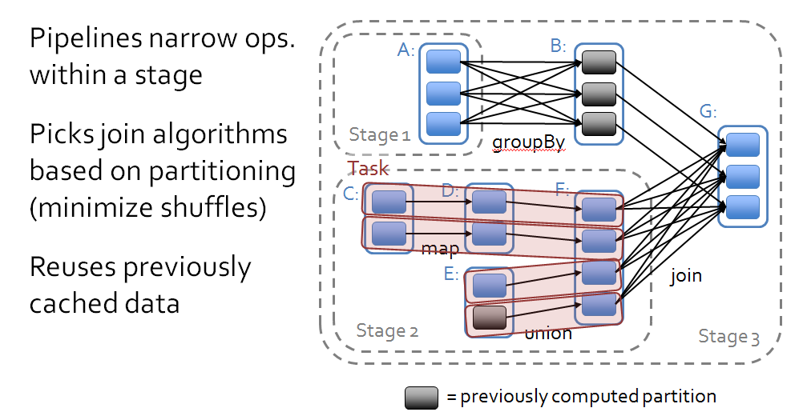
Scheduler Optimizations

Slide 19
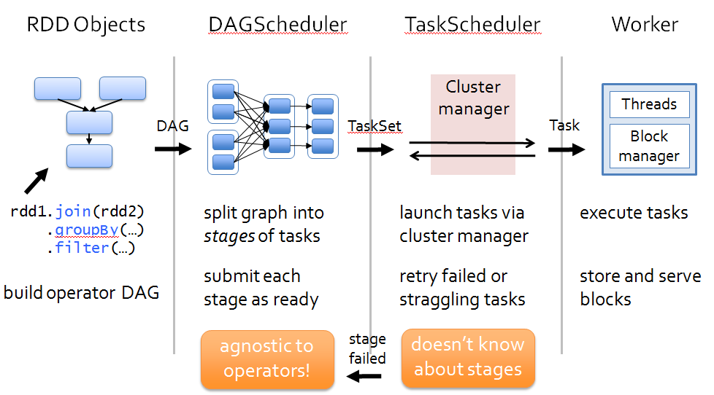
Scheduling Process
Task : The fundamental unit of execution in Spark
Stage : Set of Tasks that run parallel
DAG : Logical Graph of RDD operations
RDD : Parallel dataset with partitions

Slide 20
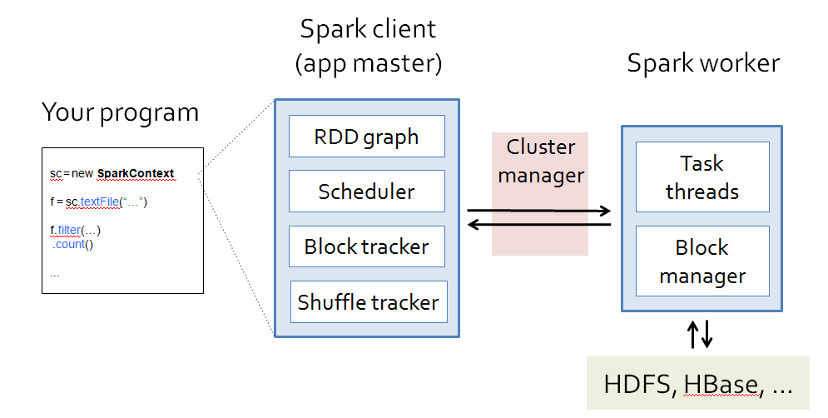
Summary of Components

Slide 21
Summary of Components

Slide 22
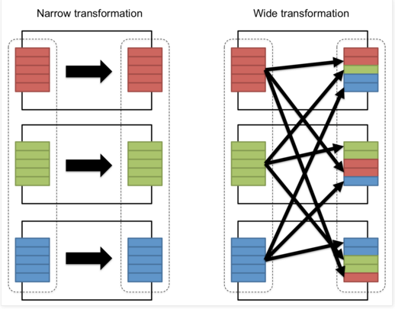

Slide 23
